Slide 1
LOGIC GAME PROJECT
Team Runtime error

Slide 2




CONTENTS
01
02
03
TEAM MEMBERS
TOPIC
STAGES OF REALIZATION
04
USED TECHNOLOGY

Slide 3
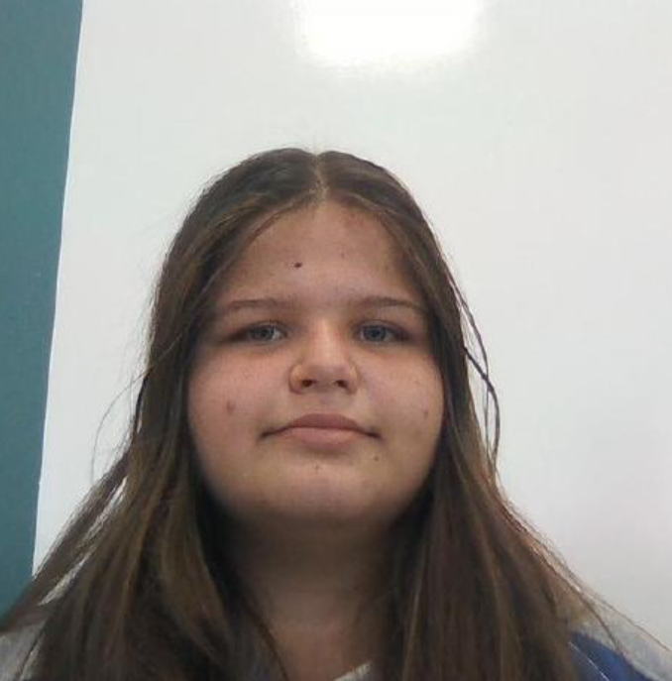
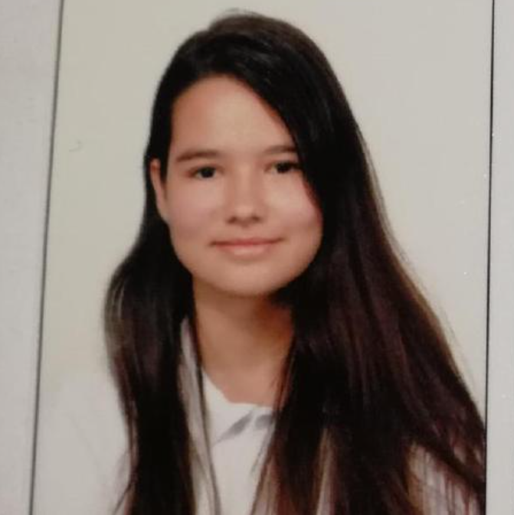
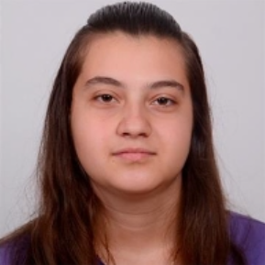
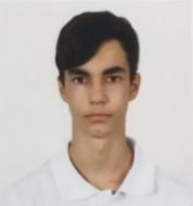
TEAM MEMBERS
Petya Stoyanova – Scrum Trainer
Class – 9G
Galya Ivanova – Backend Developer
Class – 9G
Zhasmina Mihaleva – Backend Developer
Class – 9G
Viktor Kozhedub – QA engineer
Class – 9G

Slide 4




TOPIC
The topic of the project was to make a prototype of the game "boole0". We had a month to do the following activities: form our teams, discuss the topic and realize it.

Slide 5
STAGES OF REALIZATION
IDEA
ORGANIZATION
REALIZATION
PRESENT

Slide 6








USED TECHNOLOGY

Slide 7
LET’S MOVE ON TO OUR PROJECT!

Slide 8

THANKS FOR YOUR ATTENTION

