Slide 1
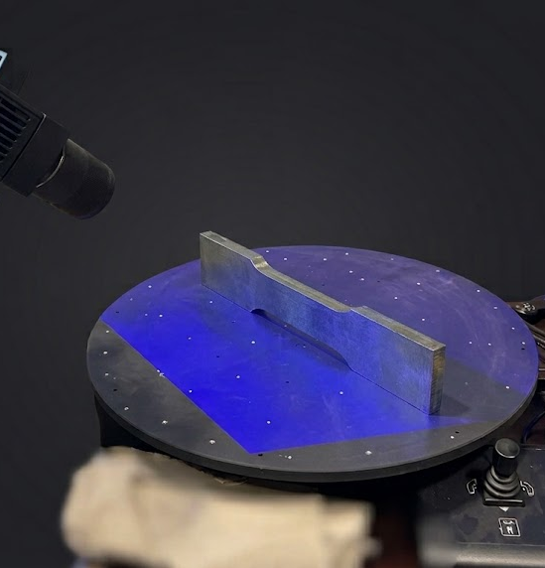
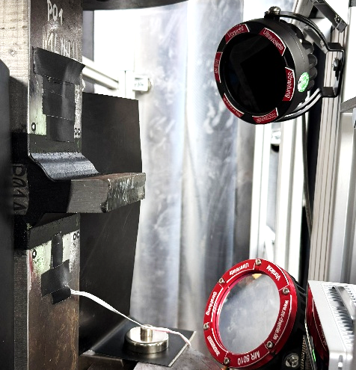
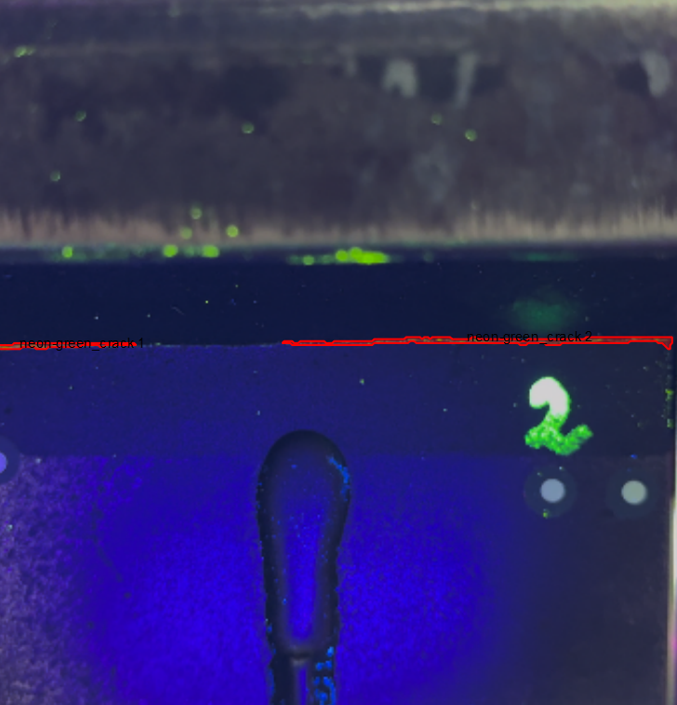
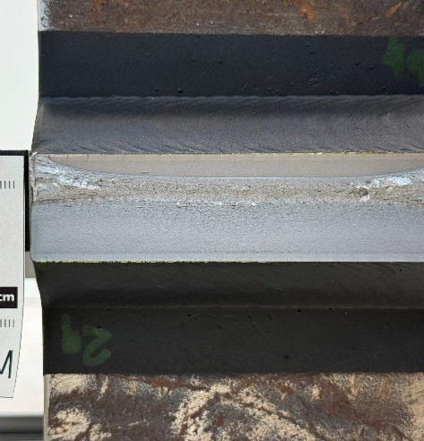
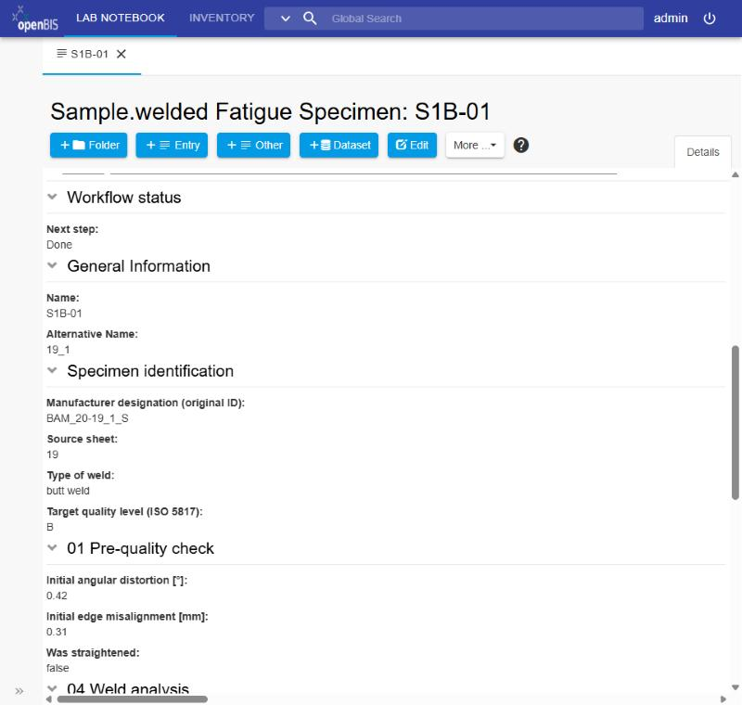
AI agents turn our fatigue tests into a lean openBIS data structure
[Authors] · BAM, 7.2 Buildings and Structures
Idea Describe the experiment once, in domain language. AI agents check it against the BAM data standard and the live BAM Data Store, design a flat structure and create only what is really missing. Humans approve every decision.
1 The tests: S-N curves of welded joints
2 The agent approach: check first
Butt and cruciform joints, randomised load levels – scatter starts before the test, so every specimen must be traceable.
Workflow
12 steps,
domain language
BAM standard
bam-masterdata,
141 object types
BAM Data Store
what exists?
read-only
AI agents + scripts
understand · design · compare – every element gets one verdict
3D scan
test rig
crack monitoring
fracture surface
20
2
41
40
01–02
03–06
07–11
12
REUSE
EXTEND
CREATE
LIVE-ONLY
Preparation
Characterisation
Test rig
Post-test
use as is
add terms
define new
migrate
quality check,
grinding
3D scan, weld
rating, geometry
gauges, cyclic
test, evaluation
fracture
surface
Humans approve twice (design, gap report). Only missing types are created; new types go to the BAM standard as a pull request.
Per specimen: 34 data items · 10 instruments · 17 file kinds
3 Seven steps: scripts count, agents decide, humans approve
1
2
3
4
5
6
7
Catalog the
standard
Inventory the
instance
Read the
workflow
Design a flat
structure
Gap analysis
(4 verdicts)
Python classes,
import-tested
Apply to openBIS,
dry run first
■ AI agent ■ deterministic script
✔ human approval
✔ human approval
4 Result: one specimen, three steps, one level
5 Connected across departments
Specimen “Next step” on top · sections 01 · 02 · 04 · 05 · 06
FB 9.3
welding +
process docs
Specimen
one object,
one place
FB 7.2
12-step
test workflow
SCAN
steps 03–04
TEST
steps 07–11
FRACTURE
step 12
Welding and test data meet at the same specimen.
Instruments and datasets are linked once – and found from both sides.
Instruments & consumables: created once in the inventory, linked as parents
2
6+2
0
1
new object
types
vocabularies
new + extended
new dataset
types
link
depth
openBIS: specimen with “Next step”
Take-home
Check, don’t just generate
deterministic catalog, real import test, dry run
Humans decide
design & gap report approved; domain calls stay with experts
Reusable pattern
any department: describe → agents check → approve

