Slide 1
S-N Fatigue Tests on Welded Joints
log Δσ
Structured Research Data in openBIS with AI Agents
BAM · FB 7.2 Structural Engineering · BAM Data Store · [Date]
schematic
log N
Notes:
Timing: ~0:20
Welcome. Two parts: first our experiments – S-N (Wöhler) fatigue tests on welded joints in FB 7.2; then how AI agents helped us turn that workflow into a clean, structured data model in openBIS (BAM Data Store).
Before the talk: apply the BAM slide template and insert the BAM logo – the top-right corner is kept free on every slide for it (no logo is included in this file). Fill in the date on this slide. The S-N curve on the right is a schematic sketch without measured data.

Slide 2
We determine S-N curves of welded butt and cruciform joints – every specimen counts, and scatter starts before the test
PART A · WHY FATIGUE TESTS ON WELDED JOINTS
1
Specimens
Butt and cruciform joints from a known source sheet
Quality level ISO 5817: target B / C / D;
Annex C rating: C63 / B90 / B125
PLACEHOLDER
Insert photo: specimen / test rig
replace this frame with your own photo
2
Test series
Several load levels: high / medium / low
Randomised test order – avoids bias from sheet or sequence
3
Result per specimen
Number of cycles + termination reason:
total fracture / crack detected / run-out / manual stop
Notes:
Timing: ~1:00
We test welded butt and cruciform joints under cyclic load and determine S-N (Wöhler) curves. Each specimen comes from a known source sheet and is rated by weld quality according to ISO 5817 – target quality level B, C or D, and the Annex C rating C63, B90 or B125.
A series covers several load levels (high / medium / low); the test order is randomised. The result per specimen is the number of cycles plus the termination reason: total fracture, crack detected, run-out (cycle limit reached) or manual stop.
Key point: scatter starts before the test. Source sheet and randomisation are there to avoid bias – which is exactly why this assignment has to be documented for every specimen.
TODO: insert your own photo of a specimen / the test rig into the placeholder frame on the right.

Slide 3
Twelve steps in four phases – each phase produces data and files
PART A · THE WORKFLOW IN 12 STEPS
Workflow
01
02
03
04
05
06
07
08
09
10
11
12
 | Preparation | Characterisation | Test rig | Post-test analysis
Steps | 01 Pre-quality check 02 Chamfering / grinding | 03 3D scan 04 Weld analysis (GOM) 05 Series assignment 06 Geometry | 07 Strain gauge application 08 Measuring chain 09 Installation stress 10 Cyclic fatigue test 11 Evaluation | 12 Fracture surface
Equipment / material | – | ZEISS GOM ATOS 5, caliper | HBM strain gauges, X60 adhesive, crack luminescence, Luxonis camera, IMC, servo-hydraulic machine | Macro camera, digital microscope
Data & files | Angular distortion, edge misalignment (before / after straightening), photos, report | Scan raw data, quality rating, load level, thickness / width ×3 | Distances, sampling rate, preload force, load programme, IMC raw data, cycles | Photos, crack origin, beach marks
Notes:
Timing: ~1:15
Twelve steps in four phases.
Preparation (01–02): pre-quality check of the weld – angular distortion and edge misalignment, before and after straightening, gross weld defects – then chamfering / grinding.
Characterisation (03–06): 3D scan with the ZEISS GOM ATOS 5, weld analysis giving the ISO 5817 Annex C rating, randomised series assignment (load level, test order, source sheet), and geometry before installation with a caliper – thickness and width at three positions each.
Test rig (07–11): strain gauge application (HBM LY11-6/120, HBM X60 adhesive, crack luminescence set, Luxonis OAK-4D-Pro camera), measuring chain with the IMC amplifier and the servo-hydraulic machine, installation stress (preload force), the cyclic fatigue test itself, and evaluation (gross / net cycles).
Post-test analysis (12): fracture surface with macro camera and digital microscope – crack origin, beach marks.
This table is exactly the content of our workflow requirements document (PRD v2, section 3) – that is all the department has to write.

Slide 4
Data items, instruments and files for every specimen – each needs exactly one place
PART A · WHAT HAS TO BE CAPTURED
Data items
Instruments & consumables
Files – 17 kinds
ID manufacturer ID, internal and series designation, source sheet, weld geometry, target quality level
01 angular distortion, edge misalignment (initial / after straightening), weld defects
04–06 Annex C rating, load level, test order, thickness and width ×3
07–11 strain gauge positions, sampling rate, recording mode, preload, termination reason, cycles
ZEISS GOM ATOS 5 (3D scan)
Caliper
HBM LY11-6/120 strain gauges
HBM X60 adhesive
Crack luminescence set (MR Chemie)
Luxonis OAK-4D-Pro camera
IMC measuring amplifier
Servo-hydraulic testing machine
Macro camera, digital microscope
01–02 photos, post-processing report
03–05 3D scan raw data, GOM export, randomisation script
07–10 gauge drawing, setup photo, bending moment raw, load programme, IMC raw, monitoring images
11 cleaned data, plots, conversion script
12 macro photos, microscope images, beach-mark evaluation
Requirement: every value, device and file has exactly one place – and each specimen shows where it is in the workflow and what comes next.
Notes:
Timing: ~0:50
What has to be captured per specimen: identification and weld data, distortion and misalignment, the Annex C rating, the series assignment, the geometry, and on the test rig strain gauge positions, amplifier settings, preload, termination reason and cycles.
Around ten instruments and consumables are involved, and the workflow produces 17 kinds of files – from specimen photos to IMC raw data and beach-mark evaluations.
The requirements from our PRD: every measured value and every file needs exactly one, unambiguous place; per test series it must be visible at a glance which specimen is at which step and what comes next; and the data must be machine-evaluable later – the S-N curve straight from the series table, a parser for the IMC raw data.

Slide 5
AI agents check our workflow against the BAM standard and the live instance – and create only what is really missing
PART B · THE AGENT APPROACH
Workflow PRD
steps + principles P1–P8 (flat, reuse-first), in domain language
REUSE
20
EXTEND
2
AI agents + scripts
understand · design · compare
in the standard – use as is
in the standard – add terms
Every element is checked against both sources
bam-masterdata
BAM standard, 141 object types
CREATE
41
LIVE-ONLY
40
missing – define new
on the instance, not in the standard → migrate
Humans approve twice:
Approve design
Four verdicts (counts from the gap report)
Live openBIS instance
What already exists? (read-only)
openBIS: create only what is missing
bam-masterdata
new types proposed via PR
Approve gap report
1 input · 2 sources
Notes:
Timing: ~1:00
The idea: the input is a requirements document (PRD) written in domain language – the workflow plus principles P1–P8 such as 'flat structure' and 'reuse-first'. It says what we want to document, not which openBIS types exist.
Agents and deterministic scripts check every element against two sources: bam-masterdata, the BAM standard data model (141 object types), and the live openBIS instance (what already exists – read-only).
Each element gets one of four verdicts: REUSE (exists in the standard and fits), EXTEND (exists, needs a few extra terms), CREATE (genuinely missing), LIVE-ONLY (types found on the instance but not in the standard – these are migrated to standard types rather than built upon). For our workflow: 20 REUSE, 2 EXTEND, 41 CREATE, 40 LIVE-ONLY.
Only what is missing gets created on openBIS; new types are proposed to the shared standard via pull request. Humans approve at two points: the structure design and the gap report.

Slide 6
Seven steps – each done by a specialised agent or a verifiable script
PART B · THE PIPELINE
Script
count, verify
1 Catalog of the standard
2 Live inventory (read-only)
7 Apply to openBIS (dry run, idempotent)
Agent
understand, decide
3 Extract requirements
4 Design flat structure
5 Gap analysis
6 Python classes (import-tested)
Human
approve
Approve design
Approve gap report
Counting is done by a script (deterministic), deciding by an agent, approving by a human.
Notes:
Timing: ~1:00
The pipeline in seven steps:
1 Catalog – a script indexes everything the bam-masterdata standard contains.
2 Live inventory – a read-only query of what exists on the openBIS instance.
3 Extract requirements – an agent transcribes the PRD: steps, data items, equipment, files, decisions.
4 Design flat structure – an agent maps every value, device and file to exactly one place. Human checkpoint: approve the design.
5 Gap analysis – REUSE / EXTEND / CREATE / LIVE-ONLY against both sources. Human checkpoint: approve the gap report.
6 Python classes – declarative bam-masterdata classes for the CREATE items only, verified by a real import test.
7 Apply to openBIS – a script with dry run first; idempotent, so a re-run creates nothing twice.
Rule of thumb: counting is done by a script (deterministic), deciding by an agent, approving by a human.

Slide 7
Nine single-purpose agents – one job and one hard guardrail each
PART B · AGENT ROLES
Agent | Role | Guardrail
bam-masterdata-explorer | Catalogs the standard by running the AST script | Never hand-writes the catalog; identical re-runs
prd-requirements-extractor | Transcribes the PRD: steps, data items, equipment, files | Never invents types; never classifies
structure-designer | Gives every item one place in a flat structure | Depth 1, no step→step links, nothing unplaced
gap-analyzer | Classifies against standard and instance: 4 verdicts | Every REUSE / EXTEND cites file:line
masterdata-extender | Writes Python classes for CREATE items only | No code for REUSE / EXTEND; must pass import test
openbis-notebook-generator | Builds the one-time setup notebook | No hard-coded credentials; only valid pyBIS calls
openbis-parser-generator | Scaffolds the per-run ingestion parser | Parser never calls the database directly
skill-reviewer | Meta: scores a run, logs failures with stable IDs | Evidence mandatory for every failure
prompt-surgeon | Meta: proposes a minimal patch to an agent | Never edits frozen sections; cites failure IDs
+ 4 deterministic scripts (catalog, live inventory, spec export, apply) · every agent runs with an explicit tool allowlist (least privilege)
Notes:
Timing: ~1:00
Nine agents, each with a single responsibility. Seven production agents: the explorer builds the catalog of the standard by running a script (never by hand); the extractor transcribes the PRD and never invents types; the structure designer gives every value, device and file exactly one place in a flat structure; the gap analyzer issues the four verdicts and cites file and line for every REUSE/EXTEND; the masterdata extender writes classes only for CREATE items and must pass a real import test; the notebook and parser generators produce the one-time setup notebook and the per-run ingestion parser.
Two meta agents improve the others from evidence: the reviewer scores a captured run, the prompt surgeon proposes minimal, evidence-cited patches and never touches the frozen sections of an agent definition.
In addition there are four deterministic scripts (catalog, live inventory, spec export, apply). Every agent declares an explicit tool allowlist – least privilege.

Slide 8
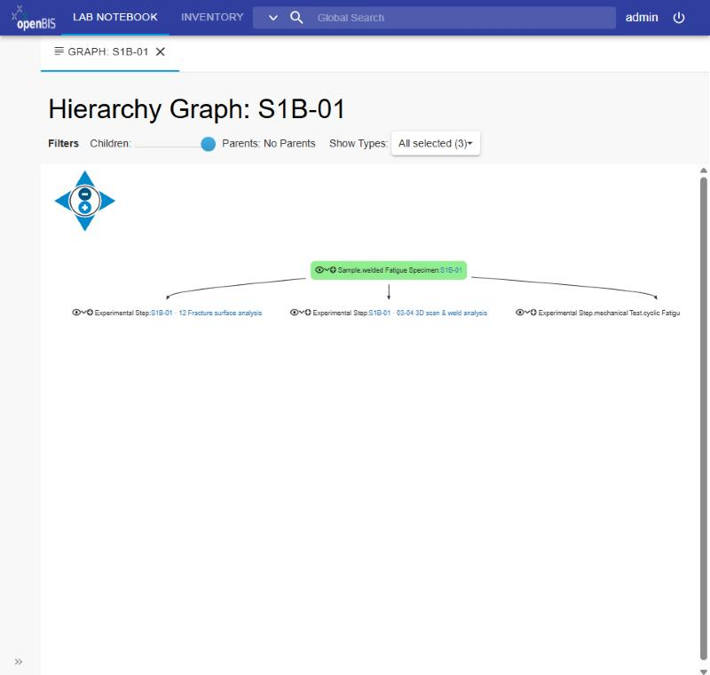
One specimen, three step objects, one level – the workflow stays visible
PART B · RESULTING STRUCTURE IN openBIS
Collection SERIES_1_BUTT_WELD = one test series
S1B-01 · SAMPLE.WELDED_FATIGUE_SPECIMEN
Field “Next step” at the top · numbered sections 01 · 02 · 04 · 05 · 06
children (depth 1)
S1B-01-SCAN
steps 03–04
S1B-01-TEST
steps 07–11 (one section each)
S1B-01-FRACTURE
step 12
parents (inventory)
ZEISS GOM ATOS 5
Strain gauge, adhesive, crack set, camera, IMC, machine
Macro camera, digital microscope
openBIS hierarchy graph: specimen S1B-01 with its three child steps (fracture surface, 3D scan & weld analysis, cyclic fatigue test)
2
new object types
6
new vocabularies (+2 extended)
0
new dataset types
1
link depth
4
objects per specimen
Notes:
Timing: ~1:15
The resulting structure. A test series is a collection – e.g. Series 1, butt weld. Each specimen is one object of the new type WELDED_FATIGUE_SPECIMEN: the field 'Next step' sits at the top, and the steps done on the specimen itself (01, 02, 04, 05, 06) are numbered sections in its form.
Only where an instrument, a time span and files belong together is there a separate step object: SCAN for steps 03–04, TEST for steps 07–11 (one section per step), FRACTURE for step 12. They are direct children of the specimen – exactly one level, no step-to-step chains – and they live in the same series collection. Instruments and consumables are created once in the inventory and linked as parents. Files go to standard dataset types.
Key figures of the design: 2 new object types, 6 new vocabularies plus 2 extended ones, 0 new dataset types, link depth 1, 4 objects per specimen. The screenshot on the right is the hierarchy graph of specimen S1B-01 in openBIS.

Slide 9
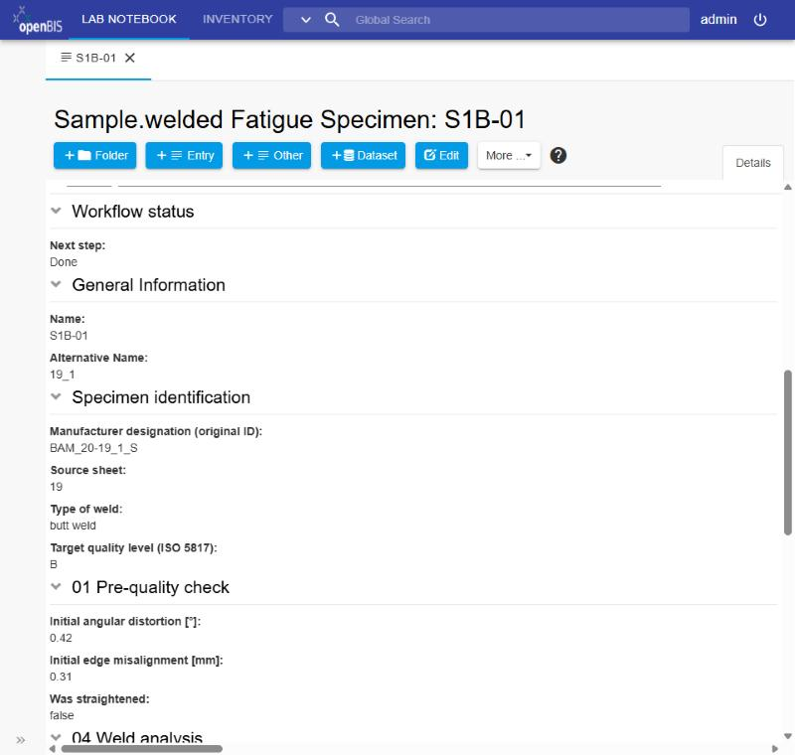
Every specimen shows its next step – the series table is the test matrix
PART B · DAILY USE: “WHAT COMES NEXT?”
Specimen | Load level | Order | Annex C | Next step | Cycles (net) | Termination
S1B-01 | high | 3 | B90 | done | 231,900 | Total fracture
S1B-02 | low | 1 | B90 | done | 10,000,000 | Run-out
S1B-03 | medium | 2 | B125 | 12 Fracture surface | 1,052,000 | Crack
S1B-04 | high | 4 | B90 | 10 Test running | – | –
S1B-05 | medium | 5 | C63 | 07 Strain gauges | – | –
S1B-06 | – | – | – | 03 3D scan | – | –
DEMO – fictitious values
openBIS form of specimen S1B-01: “Next step” on top, then identification and the numbered sections (01 Pre-quality check, 04 Weld analysis, …)
Notebook · once
Set up the structure and register the specimens of a series
Parser · after every test run
Reads the IMC results and fills the TEST step (cycles, termination reason)
Next step = ordered list 01–12 + done
Notes:
Timing: ~1:00
Daily use. On the right is the form of specimen S1B-01 in openBIS: 'Next step' is at the very top, followed by identification and the numbered sections. 'Next step' is an ordered list – steps 01 to 12 plus 'done'.
The table shows the series as a test matrix: load level, randomised test order, Annex C rating, next step, net cycles and termination reason. One glance tells you which specimen goes onto the machine next. The values in this table are DEMO values – fictitious.
Two ways the data gets in: a notebook, run once, sets up the structure and registers the specimens; a parser runs after every test and reads the IMC results into the TEST step – cycles and termination reason.

Slide 10
The value lies in checking, not in generating
PART B · SAFEGUARDS & NEXT STEPS
1
Deterministic catalog
The standard is indexed by a script, not by the model – re-runs are byte-identical
Next steps
PR to bam-masterdata: 2 object types, 6 vocabularies, 2 extensions
Sync the openBIS instance with the standard
Upstream issue: skip mandatory-field check when updating existing objects
Transfer the pattern: other departments write a workflow PRD and run the pipeline
2
Real import test
Generated classes must import against the actual bam-masterdata package
3
Dry run + idempotent apply
Changes are previewed first; re-runs create nothing twice; conflicts are reported
4
Instance behind the standard
Fields the instance cannot hold yet are skipped and reported – not guessed
5
Mandatory fields checked up front
Creation is transactional – nothing is left half-created
Limits
Domain decisions stay with humans – e.g. quality levels, joint type vs. weld type
6
Human review checkpoints
Design and gap report are approved before anything is generated or applied
Notes:
Timing: ~1:15
What makes the approach trustworthy is the checking, not the generating. Six safeguards:
1 The standard is catalogued by a deterministic script (AST-based), not by the language model – reproducible, byte-identical re-runs.
2 Generated Python classes must pass a real import test against the actual bam-masterdata package – a syntax check is not enough.
3 Applying to openBIS always starts with a dry run; the apply is idempotent and reports conflicts instead of overwriting.
4 Where the instance is out of sync with the standard (e.g. missing BAM location vocabularies), affected fields are skipped and reported rather than guessed.
5 Mandatory fields of the instance are checked before creating objects; creation is transactional, so nothing is left half-created.
6 Humans approve the design and the gap report before anything is generated or applied.
Next steps: a pull request to bam-masterdata (2 object types, 6 vocabularies, 2 vocabulary extensions); syncing the openBIS instance with the standard (admin task); an upstream issue for bam-masterdata – today it requires mandatory fields even when only updating existing objects, so the parser has an option not to update the specimen; and transferring the pattern: any department can write a workflow PRD and run the pipeline – agents and scripts are in the repository.
Limits: domain decisions – for example quality levels, or whether butt/cruciform is a joint type or a weld type – stay with humans.
Transition to questions.

Slide 11
All figures as of 6 Oct 2026, checked against the openBIS instance dev1 and bam-masterdata @ d7a871b
BACKUP · SOURCES
Statement | Source (repository)
12-step workflow, equipment, files, principles P1–P8 | BAM_PRD_Workflow_FB72_v2.md
141 object types in the standard | generated/CATALOG.md (script tools/build_catalog.py)
Structure, sections, vocabularies, series table, file mapping; 2 types, 6 + 2 vocabularies, depth 1, 4 objects per specimen | generated/welded_fatigue_v2/design.md
20 REUSE · 2 EXTEND · 41 CREATE · 40 LIVE-ONLY | generated/welded_fatigue_v2/gap-report.md
Agent roles and guardrails | presentation/02_Agent_Roles.md, .claude/agents/
Safeguards and next steps | presentation/06_Befunde_und_Entscheidungen.md
Screenshots (openBIS dev1, 6 Oct 2026); demo series values are fictitious | presentation/screenshots/
Notes:
Timing: backup – show only on request (0:00)
Backup slide (not presented): sources for all figures and images in the talk. All paths are relative to the repository root.

