Slide 1
MAGNITO · COMPUTATIONAL SCREENING
Fe / Co
Fe-rich Heavy-Rare-Earth
Magnet Search
↑
↑
↑
↑
Gd / Tb / Dy / Ho / Er / Tm
↓
Search criteria, database landscape, the ferro- vs ferrimagnetic test, and an active-learning path forward
4f moment antiparallel
→ ferrimagnet, not ferromagnet
Target: μ₀Ms > 2 T · Tc > 550 K · uniaxial anisotropy · RE-lean
706 paired DFT calculations staged · 352 compounds · 5 databases screened
Notes:
Framing: the program wants >2 T. The physics obstacle is that heavy-RE 4f moments couple antiparallel to Fe, so the default outcome is a ferrimagnet with a reduced net moment.

Slide 2
WHY THIS SEARCH IS HARD
The target, and the rule that fights it
What a viable permanent magnet needs
The Campbell rule
1
μ₀Ms > 2 T
In metallic RE-TM intermetallics the 4f spin couples to Fe through a fixed chain:
dense Fe/Co sublattice, little dilution
4f spin ↔ own 5d (parallel, on-site)
5d ↔ Fe 3d (ANTIparallel, between sites)
2
Tᴄ > 550 K
strong TM-TM exchange
Heavy RE (Gd–Tm): J = L + S, so the total moment follows the spin → antiparallel to Fe → ferrimagnet
3
Uniaxial anisotropy
needs the RE 4f crystal field
Light RE (Nd, Sm, Pr): J = L − S, so the total moment opposes the spin → parallel to Fe → ferromagnet
4
RE-lean, no critical elements
cost and supply
Consequence: a genuinely ferromagnetic Fe-HREE phase is the exception, not the target to assume. The screen must test it, not presume it.
Notes:
Campbell rule: 4f-5d-3d chain fixes the sign. Heavy RE gives ferrimagnetism; light RE gives net-parallel alignment. This is why every database 'FM' label on a Gd-Fe compound deserves suspicion.

Slide 3
SCREEN DEFINITION
Search criteria
1
Fe or Co ≥ 60 at.%
2
Contains one heavy RE
a dense 3d sublattice is the only route to >2 T; dilute phases cannot reach it
Gd, Tb, Dy, Ho, Er, Tm — the 4f source of anisotropy
3
Ternary compositions
4
E above hull ≤ 0.2 eV/atom
keeps the phase space synthesisable and the DFT tractable
on, below, or metastably above — many real magnets are metastable
5
Magnetic, or unknown
6
Ordering decided by us
moment > 0.3 μᴮ/atom; 'no data' is kept, not discarded
no database can answer FM vs ferri — that is the calculation
Criteria 5 and 6 are deliberately permissive: an unlabelled compound is a candidate, not a rejection.

Slide 4
WHERE WE LOOKED
What each database can and cannot answer
Database | Hits | Filters natively | Key limitation
GNoME | 749 | composition, stability | no magnetic data at all; on-hull set only
Materials Project | 178 | ordering label, hull, moment | FM-initialised label; 4f frozen in core
OQMD | 283 | hull, composition | moments not exposed; structures via slow API
Alexandria | 73 | elements, nelements | moments response-only; server outages
AFLOW | 29 | spin per atom, species | no hull distance; thin RE-TM ternary coverage
The limitation they share
Every large database runs ONE spin-polarised calculation per structure, initialised ferromagnetically, with heavy-RE 4f frozen in the PAW core. So a “FM” label means “the Fe sublattice kept its moments” — never that the RE couples parallel. Nine FM-labelled Fe/Co-HREE candidates were found across all five databases; all nine contained Gd, the one heavy RE these codes treat explicitly.
Notes:
The nine FM-labelled hits being all-Gd is a tell: it is an artefact of which element is treated with explicit 4f, not a physical discovery.

Slide 5
THE SCARCE COMMODITY
Datasets that actually contain anisotropy
Source | What it uniquely has | Role in this campaign
Novamag | DFT K₁/MAE, exchange, Tc for RE-lean magnets | train + validate the MAE surrogate; calibrate A₂⁰
MAGNDATA | ~2,000 EXPERIMENTAL magnetic structures | ground truth for the fm/ferri coupling sign
C2DB | systematic MAE + exchange (2D materials) | benchmark an MAE model before trusting it in 3D
Heusler set (Sanvito) | ~236k compositions, moments + est. Tc | Tc training data; funnel-reporting template
Nelson–Sanvito Tc | ~2,500 experimental Curie temperatures | screen Tc before computing exchange constants
NIMS MatNavi / MDR | curated Nd-Fe-B and 1-12 experiment | validation targets (registration required)
Why these are worth more per entry
Not open — do not plan around
The five large databases we screened carry composition, stability and a moment. None carries MAE, exchange constants or Tc at scale — the quantities a permanent magnet is actually judged on. Novamag is the only open source of systematic anisotropy, which is what makes an MAE surrogate trainable at all.
MPDS / Pauling File and Springer Materials hold the deepest experimental magnet record, but neither is openly accessible.
Notes:
Novamag: CC-BY-4.0, auto-fetched from Zenodo record 3241267 (160 MB). MAGNDATA is the strongest available test of the coupling-sign protocol - every experimental RE-TM entry is a check.

Slide 6
FROM DATABASES TO CALCULATIONS
Screening funnel
554,055
GNoME stable entries scanned
1,152
unique candidate formulas across 5 databases
756
with retrievable crystal structures
352
compounds staged for DFT (24 native Gd + 328 Gd surrogates)
726 parent compounds
collapse into 328
surrogate calculations
706
paired fm / ferri VASP calculations
Deduplicated on (substituted formula, space group); coupling transfers back to each parent by de Gennes scaling.

Slide 7
THE DECIDING CALCULATION
Two configurations, one energy difference
1
2
3
Pair every structure
→
Read the sign of ΔE
→
Transfer across the series
Two collinear spin-polarised PBE+U runs, identical except the SIGN of the initial Gd moment: fm (+7 μᴮ) and ferri (−7 μᴮ).
ΔE = E(ferri) − E(fm). Negative → ferrimagnetic ground state. Positive → genuine FM RE-TM coupling.
Tb–Tm ship as f-in-core potentials whose 4f cannot flip, so Gd is substituted onto every RE site and the result is carried back by de Gennes scaling, (gᴊ − 1)J.
Settings and controls
PBE+U Gd 4f U = 6.7 / J = 0.7 eV (U_eff = 6) · no U on metallic Fe · LASPH, LMAXMIX = 6 · ENCUT 520 · 8000 k-points·atom
Guards statics on a common geometry so ΔE isolates exchange · every run checked for SCF drift into the other spin state · light RE pinned to f-in-core so only Gd carries a flippable 4f · GdFe₂ (a known ferrimagnet) run as a protocol control

Slide 8
PILOT — 16 RUNS, 8 COMPOUNDS
The protocol validates, and the database labels fall
Compound | Prototype | ΔE per Gd (meV) | Ground state | Net moment, ferri (μᴮ)
GdFe₂ (control) | Laves C15 | −352 | ferrimagnetic | −6.98
GdAlFe₄ | CaCu₅ RT₄X | −277 | ferrimagnetic | −0.03
GdGaFe₄ | CaCu₅ RT₄X | −284 | ferrimagnetic | 0.24
GdCo₄Si | CaCu₅ RT₄X | −155 | ferrimagnetic | −3.14
GdFe₄B | CaCu₅ RT₄X | −521 | ferrimagnetic | 1.08
GdCo₄B | CaCu₅ RT₄X | −263 | ferrimagnetic | −6.78
Gd₂Fe₃Co | Laves C14 | −329 | ferrimagnetic | −7.53
Gd₂Fe₁₂Ga₅C₂ | new, C2/m | −107 | ferrimagnetic | 8.53
Control passed
Database FM labels were artefacts
GdFe₂ is experimentally a ferrimagnet and the protocol reproduces that by 352 meV/Gd — which is what licenses trusting the rest.
GdAlFe₄ and GdGaFe₄ (Alexandria) and GdCo₄Si (MP) were all FM-labelled. All three are ferrimagnetic by 155–284 meV/Gd — and the two RT₄X phases are almost fully compensated, so their true net moment is ≈ 0, not the ≈1.9 T the FM-initialised numbers implied.
Notes:
8 of 8 pairs ferrimagnetic. 280 meV is far too large to be a convergence artefact. The compensation in RT4X is the practical kill: Fe sublattice ~14 muB cancels against Gd 7 muB x2 sites.

Slide 9
SCALING THE SCREEN
Why the fm/ferri energies had to be forced apart before they could be trusted
The problem: a plain SCF doesn't stay where you put it
The funnel this actually produced
Each compound needs two static calculations - one initialised ferromagnetic, one ferrimagnetic - and the energy difference between them is the answer. At 353-compound scale, a plain unconstrained SCF too often drifts out of the state it was initialised in: LDA+U has several self-consistent solutions, and a simple collinear starting guess is not a strong enough anchor to hold either configuration in place through convergence.
353
compounds analysed
static fm/ferri pair, Gd surrogate
The fix: lock the total moment, then release it
95
apparent ferromagnets
NUPDOWN fixes the total spin-up minus spin-down electron count, forcing the SCF to converge inside the intended basin. The target is derived from each element's own measured moment (not textbook values), never from a run already suspected of drifting.
naive, unconstrained SCF result - taken at face value, most are not real
4
survive NUPDOWN hardening
1
Stage A - locked
measured-moment-derived locked rerun, released to a final unconstrained static
NUPDOWN set to the intended fm/ferri moment; hardened mixing (NELM, EDIFF, AMIX); CHGCAR-only restart (WAVECAR skipped - it once cost 700 GB and failed ~60 runs on disk pressure alone)
2
Stage B - released
1
survives every remaining check
NUPDOWN removed; one final unconstrained static from Stage A's charge density - the energy actually compared, since a locked run only proves a state exists, not that VASP would choose it freely
3 of those 4 carried implausible multi-eV exchange energies - an LDA+U multi-minima artefact, not real coupling
Notes:
The 95->4 collapse on first hardening attempt actually went to ZERO credible - that first pass derived NUPDOWN from the same runs it was trying to fix (circular). Fixed by requiring a freely-converged reference or falling back to measured nominal per-element moments, split by high-spin/low-spin branch.

Slide 10
CAMPAIGN RESULTS
One candidate survives every validity check
353 compounds analysed -> 1 credible ferromagnet
Co16Gd2Mn · new-R3m
1
Implausible exchange energy
Co-rich 2-17-like lattice, Mn on one Co site
3-5.5 eV/Gd, 10-15x any real value - LDA+U landing in a different state, not physical coupling
dE (ferri - fm)
+114.5 meV/Gd
2
Untracked sublattice collapse
ground state
ferromagnetic
a spectator element (Os, Y, Lu, Ru, Ce...) shifting between fm/ferri, invisible if only Fe/Co are watched
u0Ms
1.95 T
3
TM sublattice itself collapsed
Mn couples ferromagnetically to Gd while Co keeps its usual antiparallel preference - flipping the net RE-TM sign for the compound.
the Fe or Co moment changed between runs - the failure the constrained rerun was built to fix
Validated: stable Co sublattice, stable Mn magnitude, normal exchange-energy scale, clean EDIFF convergence on both configs (47 / 29 SCF steps of 400).
Projected magnetisation for the real target compositions
Three of five heavy-RE analogues clear the 2 T program target.
Parent compound | Heavy RE | Projected u0Ms
Co16Dy2Mn | Dy | 2.26 T
Co16Ho2Mn | Ho | 2.26 T
Co16MnTb2 | Tb | 2.17 T
Co16Er2Mn | Er | 2.17 T
Co16MnTm2 | Tm | 1.98 T

Slide 11
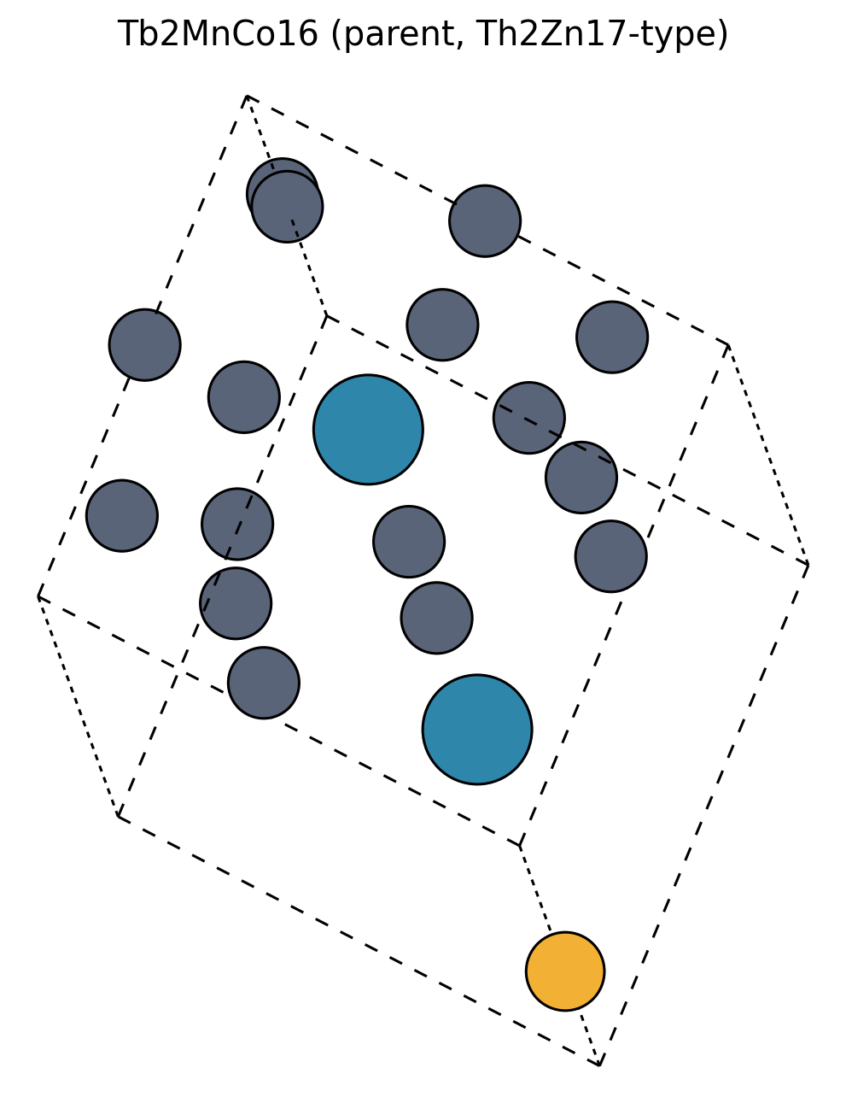
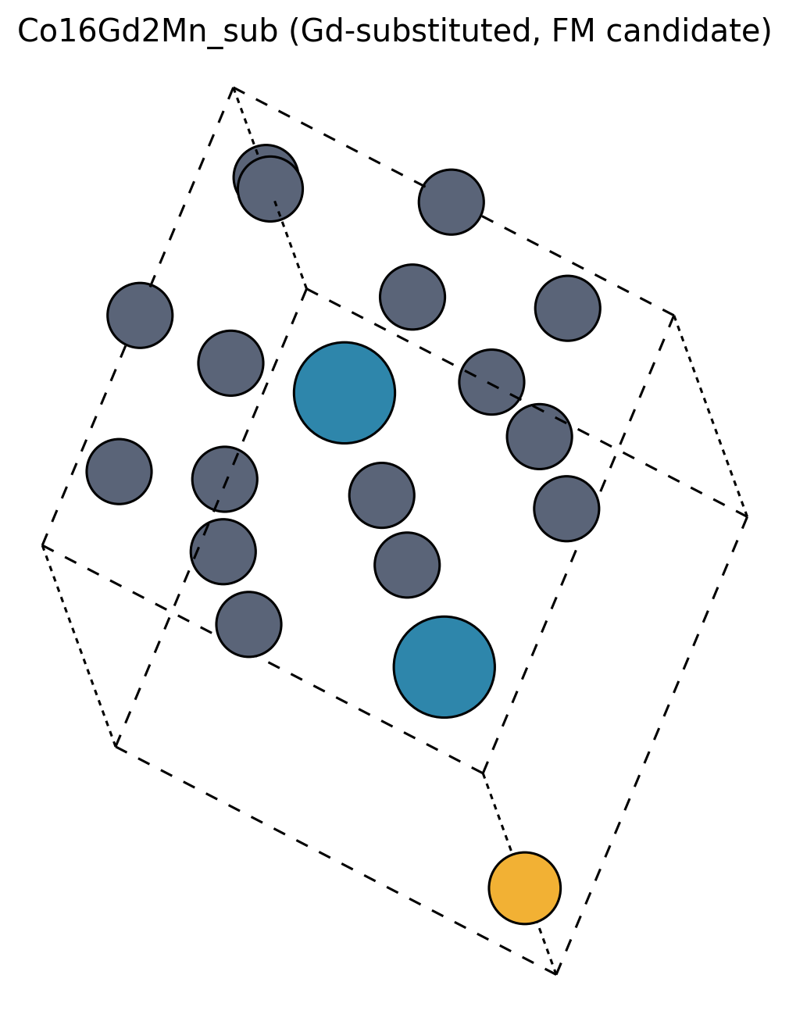
STRUCTURAL LINEAGE
A one-atom variant of a magnet already on the market
The real magnet this descends from
1
Sm2Co17
commercial 2:17 SmCo permanent magnet - one of only two SmCo classes ever commercialised (with SmCo5, the 1:5 type)
2
RE2Co17
the general Th2Zn17-type family - Y, Ce, Pr, Nd, Sm, Gd, Tb... all form this same rhombohedral structure
3
RE2MnCo16
Tb2MnCo16 - parent (GNoME)
Co16Gd2Mn_sub - FM candidate
one of the 17 transition-metal sites replaced by Mn - the single change this campaign is built around
Th2Zn17 prototype, R-3m (#166) - independently DFT-relaxed by GNoME, Tb in the RE site, one of 17 TM sites occupied by Mn.
Identical lattice - Gd stands in for Tb (explicit 4f, S-state surrogate). Same Mn-for-Co site. Only the RE identity changes.
Every candidate in this campaign is a controlled chemical edit of an already-magnetic parent - swap the light RE for a heavy one, then perturb one transition-metal site. Co16Gd2Mn_sub is the one edit, out of 353, where that perturbation flips the whole compound's magnetic order rather than just its Curie temperature or anisotropy.

Slide 12
WHY MN, AND WHAT'S BEING VERIFIED
A one-atom coupling lever, now being checked without the Gd stand-in
Why a magnetic Mn site flips the sign
Tier-2: checking the mechanism without the Gd stand-in
1
Heavy-RE-TM magnets are ferrimagnetic by default: the 4f moment polarises the RE's own 5d shell parallel (intra-atomic), and that 5d hybridises antiparallel with neighbouring Fe/Co 3d (Campbell's rule). Net result: RE and TM sublattices oppose.
Everything above used Gd as a computational surrogate for Tb/Dy/Ho/Er/Tm (explicit 4f, S-state, tractable). potpaw_PBE.64 ships an explicit-4f potential for all five real heavy REs too, so the natural next check is direct: relax each real RE on its own native lattice, no surrogate, no de Gennes projection.
2
Mn is the known exception to that rule. Its 3d filling differs enough from Fe/Co that RE-Mn coupling is frequently parallel (ferromagnetic) rather than antiparallel, in contrast to the near-universal RE-Co antiparallel preference.
Compound | fm | ferri | Status
Co16Tb2Mn | not converged | clean | in progress
Co16Dy2Mn | clean | symmetry-broken | in progress
Co16Ho2Mn | killed (walltime) | symmetry-broken | in progress
Co16Er2Mn | collapsed to ferri-like | inhomogeneous | in progress
Co16Tm2Mn | killed (walltime) | killed (walltime) | in progress
3
Every DFT run in this campaign confirms it directly: in Co16Gd2Mn_sub and every native-RE compound checked so far, the Mn site's own moment aligns WITH the RE 4f moment, while all 16 Co sites align against it - a completely consistent sign pattern, not a coincidence.
4
One Mn atom against sixteen Co atoms cannot flip the lattice by weight of numbers - but it only has to tip the net energy balance, not the head count. That single competing bond is apparently enough: fm sits 114.5 meV/Gd below ferri for this compound.
No compound yet has both configs converged to a coherent, symmetric state - no fm-vs-ferri energy is trustworthy yet. Unconstrained relaxation let the two equivalent RE sites break symmetry, and Mn's moment collapsed when they did. Next: rerun with the total moment locked, then release to an unconstrained static.
The only validated, promising result to date remains Co16Gd2Mn_sub (Gd surrogate, Tb's native lattice): dE = +114.5 meV/Gd, ferromagnetic ground state, u0Ms = 1.95 T. Tier-2 exists to confirm this holds for the real heavy REs - it has not yet confirmed or refuted it.

Slide 13
PER-ATOM MOMENTS, DIRECTLY MEASURED
Mn always sides with Gd - never with Co - in both configurations
FM - all three sublattices aligned
FERRI - Gd and Mn flip together, Co doesn't
Gd (sites 1, 2)
Gd (sites 1, 2)
+6.74, +6.75 uB
-7.06, -7.04 uB
Mn (site 3)
Mn (site 3)
+3.13 uB
-3.38 uB
Co (16 sites, +1.49 to +1.59 uB)
Co (16 sites, +1.37 to +1.53 uB)
avg +1.53 uB
avg +1.47 uB
total moment
total moment
41.1 uB
6.15 uB
Mn's moment matches Gd's sign in every configuration checked - fm or ferri, this compound or any native-RE compound in the Tier-2 batch. Co never once follows it. That is the direct measurement behind the Campbell's-rule exception this campaign is built on.
Notes:
Source: OUTCAR_04 for Co16Gd2Mn_sub (runs/ternary/Tb/new-R3m/Co16Gd2Mn_sub), the validated release-stage static - the same result behind dE=114.5 meV/Gd. Per-site magnetization(x) table, LORBIT=11 atomic-sphere projection.

Slide 14
EXTENDING THE GD DATASET
Using Campbell's rule to predict the rest of the series
What the Gd calculation gives you
1
Rank by uncompensated moment, not by FM
For every Gd result, evaluate M_TM − n_RE·g_J·J across the series. High Fe:RE ratios (2-17, 1-12) leave a large residual; RT₄X compensates to ≈ 0. This reprioritises the whole candidate list at zero DFT cost.
ΔE from the fm/ferri pair is the RE-TM exchange energy itself. Because the sign is fixed by the 4f-5d-3d chain and only the 4f spin magnitude changes down the series, one Gd pair predicts all six heavy rare earths.
2
Hunt where the 5d-3d chain breaks
coupling strength
The antiparallel sign is mediated by RE 5d. Screen for phases where that channel weakens: semiconducting or semimetallic X, long RE-Fe distances, RE coordinated only by anions, dilute RE. These are the only plausible FM exceptions.
J(RE–TM) ∝ (g_J − 1) J
Tc contribution — de Gennes factor
G = (g_J − 1)² J(J + 1)
3
Use the induced 5d moment as a free diagnostic
Gd 15.75 · Tb 10.5 · Dy 7.08 · Ho 4.5 · Er 2.55 · Tm 1.17
Every Gd run already reports the RE 5d moment. Where its sign or magnitude deviates from the usual antiparallel pattern, the mechanism is weakening — a cheap flag for which compounds deserve explicit Tb–Tm treatment.
net moment
M_net = M_TM − n_RE × g_J·J
The Fe sublattice moment carries over unchanged; only the RE terms rescale — so both Tc and net moment are predictable for Tb–Tm without new calculations.
4
Escalate only the outliers
Explicit 4f Tb–Tm with occupation-matrix control is expensive and fragile. Reserve it for de Gennes outliers and predicted FM exceptions, then add Tᴄ via exchange constants for survivors.
Notes:
Key reframing: the Gd campaign is not just a yes/no on ferromagnetism. It is a measurement of the RE-TM exchange that propagates to the whole heavy series analytically.

Slide 15
AFTER THE COUPLING QUESTION
How much Gd must be replaced to make a magnet
The gap the campaign leaves
1
Inputs
Gd is a 4f⁷ S-state ion: L = 0, spherical charge cloud, no single-ion anisotropy by construction. That is exactly why it is a clean surrogate for exchange — and exactly why it can never be the final composition.
|ΔE| per Gd from the campaign sets the exchange field; Stevens α_J and ⟨r²⟩ are tabulated. Only A₂⁰, the crystal-field parameter at the RE site, must be computed separately.
κ = √( K₁ / μ₀Ms² ) ≥ 1
2
Model
K₁(x,T) from the 2nd-order crystal field with the Callen–Callen l = 2 law (K₁ ∝ m_RE³); Ms(x) from the TM sublattice and the RE moments, signed by the coupling.
μ₀Ms | K₁ for κ = 1 | K₁ for κ = 1.54
1.5 T | 1.8 MJ/m³ | 4.2 MJ/m³
2.0 T | 3.2 MJ/m³ | 7.5 MJ/m³
3
Solve
smallest x clearing κ ≥ 1 at operating temperature. Example: A₂⁰ = +300 K/a₀², 450 K → Tb at x = 0.77 gives K₁ = 5.7 MJ/m³, μ₀Ms = 2.67 T, κ = 1.0.
Higher Ms demands MORE anisotropy, not less — which is why a 2 T target forces a non-spherical 4f ion. (κ = 1.54 is Nd₂Fe₁₄B.)
4
Keep Gd for Tc
Gd has the largest de Gennes factor of the series (15.75 vs Tb 10.5, Dy 7.08), so it contributes most to Tc. Target the MINIMUM x that clears the bar.
Two traps the solver enforces: only ONE Stevens sign family is easy-axis for a given A₂⁰ (Tb/Dy/Ho have α_J < 0, Er/Tm α_J > 0 — mixing them cancels), and K₁ < 0 is easy-plane, which is not a magnet at any magnitude.
Notes:
A20 sign convention must be calibrated against a known compound first. Novamag is the natural calibration source.

Slide 16
BEYOND WHAT THE DATABASES HOLD
Generating candidates: decoration, then symmetry
Prototype decoration — run this
Wyckoff generation — second priority
Substitute the X site of each named magnet prototype through a magnet-relevant palette (Al, Si, Ga, Ge, B, C, N, P, Sn, Sb, Ti, V, Cr, Zr, Nb, Mo, W, Hf, Ta), plus an Fe↔Co swap. Chemically conservative, and historically how most real magnets were found.
Place the stoichiometry on the symmetry orbits of a target space group. Reaches genuinely new frameworks rather than re-decorating known ones — but the structures come out unrelaxed, the hit rate is low, and the volume (10⁴–10⁵) only makes sense behind a machine-learned potential.
CaCu₅-RT₄X
61
ThMn₁₂-stabilized
21
Neither generator produces a hull distance — which is the whole point of the ≤ 0.2 eV/atom criterion.
Th₂Zn₁₇-interstitial
21
LaCo₉Si₄
21
MLIP-relax (MACE / CHGNet) → E_hull against MP + Alexandria → keep ≤ 0.2 eV/atom → only then DFT.
Nd₂Fe₁₄B
20
RT₃ / Th₂Zn₁₇
2
146 new candidates — including GdFe₁₁Si / GdAlFe₁₁ / GdFe₁₁N, the real 1-12 magnet chemistry
Generated ≠ stable
Database candidates arrive with a hull distance; generated ones do not. For 146 decorations the MLIP filter costs minutes — for a Wyckoff sweep it is the only thing that makes DFT affordable at all.

Slide 17
CLOSING THE LOOP
Steering the next DFT batch with active learning
706 labelled
fm / ferri pairs
Surrogate model
Acquisition
+ batch select
Generative proposal
Next DFT batch
→
→
→
→
ΔE, site moments,
hull distance
GNN or GP on structure
→ ΔE, Mₙₑₜ, Eₕᵤₗₗ
q-EI / UCB on Mₙₑₜ,
diversity-penalised
diffusion model conditioned
on high Mₙₑₜ, low Eₕᵤₗₗ
~60 packed nodes,
one job, ~6 h
results re-train the surrogate each round
Bayesian optimisation
Reinforcement learning
Diffusion / generative
MLIP pre-filter
Cheapest to stand up. Fits the problem: a scalar objective (net moment, or ΔE > 0) over a fixed 1,152-compound pool, batched to match one packed Perlmutter job.
Treats substitution as sequential decisions — which site, which element. Useful once the pool is exhausted and the search must generate rather than select.
MatterGen-style, conditioned on high uncompensated moment. Proposes new decorations of the 2-17 and 1-12 frameworks instead of re-ranking known ones.
Fine-tune MACE on this campaign's spin-polarised data, then relax and pre-rank thousands of proposals before any DFT is spent.
The 706 runs are the seed dataset: the first systematically computed RE-TM exchange labels for this chemistry.
Notes:
The point of the loop: each DFT batch is expensive and queue-bound, so batch composition matters more than per-run speed. BO with a diversity penalty matches the packed-job batch size.

