Slide 1
MAGNITO · COMPUTATIONAL SCREENING
Fe / Co
Fe-rich Heavy-Rare-Earth
Magnet Search
↑
↑
↑
↑
Gd / Tb / Dy / Ho / Er / Tm
↓
Search criteria, database landscape, the ferro- vs ferrimagnetic test, and an active-learning path forward
4f moment antiparallel
→ ferrimagnet, not ferromagnet
Target: μ₀Ms > 2 T · Tc > 550 K · uniaxial anisotropy · RE-lean
706 paired DFT calculations staged · 352 compounds · 5 databases screened
Notes:
Framing: the program wants >2 T. The physics obstacle is that heavy-RE 4f moments couple antiparallel to Fe, so the default outcome is a ferrimagnet with a reduced net moment.

Slide 2
WHY THIS SEARCH IS HARD
The target, and the rule that fights it
What a viable permanent magnet needs
The Campbell rule
1
μ₀Ms > 2 T
In metallic RE-TM intermetallics the 4f spin couples to Fe through a fixed chain:
dense Fe/Co sublattice, little dilution
4f spin ↔ own 5d (parallel, on-site)
5d ↔ Fe 3d (ANTIparallel, between sites)
2
Tᴄ > 550 K
strong TM-TM exchange
Heavy RE (Gd–Tm): J = L + S, so the total moment follows the spin → antiparallel to Fe → ferrimagnet
3
Uniaxial anisotropy
needs the RE 4f crystal field
Light RE (Nd, Sm, Pr): J = L − S, so the total moment opposes the spin → parallel to Fe → ferromagnet
4
RE-lean, no critical elements
cost and supply
Consequence: a genuinely ferromagnetic Fe-HREE phase is the exception, not the target to assume. The screen must test it, not presume it.
Notes:
Campbell rule: 4f-5d-3d chain fixes the sign. Heavy RE gives ferrimagnetism; light RE gives net-parallel alignment. This is why every database 'FM' label on a Gd-Fe compound deserves suspicion.

Slide 3
SCREEN DEFINITION
Search criteria
1
Fe or Co ≥ 60 at.%
2
Contains one heavy RE
a dense 3d sublattice is the only route to >2 T; dilute phases cannot reach it
Gd, Tb, Dy, Ho, Er, Tm — the 4f source of anisotropy
3
Ternary compositions
4
E above hull ≤ 0.2 eV/atom
keeps the phase space synthesisable and the DFT tractable
on, below, or metastably above — many real magnets are metastable
5
Magnetic, or unknown
6
Ordering decided by us
moment > 0.3 μᴮ/atom; 'no data' is kept, not discarded
no database can answer FM vs ferri — that is the calculation
Criteria 5 and 6 are deliberately permissive: an unlabelled compound is a candidate, not a rejection.

Slide 4
WHERE WE LOOKED
What each database can and cannot answer
Database | Hits | Filters natively | Key limitation
GNoME | 749 | composition, stability | no magnetic data at all; on-hull set only
Materials Project | 178 | ordering label, hull, moment | FM-initialised label; 4f frozen in core
OQMD | 283 | hull, composition | moments not exposed; structures via slow API
Alexandria | 73 | elements, nelements | moments response-only; server outages
AFLOW | 29 | spin per atom, species | no hull distance; thin RE-TM ternary coverage
The limitation they share
Every large database runs ONE spin-polarised calculation per structure, initialised ferromagnetically, with heavy-RE 4f frozen in the PAW core. So a “FM” label means “the Fe sublattice kept its moments” — never that the RE couples parallel. Nine FM-labelled Fe/Co-HREE candidates were found across all five databases; all nine contained Gd, the one heavy RE these codes treat explicitly.
Notes:
The nine FM-labelled hits being all-Gd is a tell: it is an artefact of which element is treated with explicit 4f, not a physical discovery.

Slide 5
THE SCARCE COMMODITY
Datasets that actually contain anisotropy
Source | What it uniquely has | Role in this campaign
Novamag | DFT K₁/MAE, exchange, Tc for RE-lean magnets | train + validate the MAE surrogate; calibrate A₂⁰
MAGNDATA | ~2,000 EXPERIMENTAL magnetic structures | ground truth for the fm/ferri coupling sign
C2DB | systematic MAE + exchange (2D materials) | benchmark an MAE model before trusting it in 3D
Heusler set (Sanvito) | ~236k compositions, moments + est. Tc | Tc training data; funnel-reporting template
Nelson–Sanvito Tc | ~2,500 experimental Curie temperatures | screen Tc before computing exchange constants
NIMS MatNavi / MDR | curated Nd-Fe-B and 1-12 experiment | validation targets (registration required)
Why these are worth more per entry
Not open — do not plan around
The five large databases we screened carry composition, stability and a moment. None carries MAE, exchange constants or Tc at scale — the quantities a permanent magnet is actually judged on. Novamag is the only open source of systematic anisotropy, which is what makes an MAE surrogate trainable at all.
MPDS / Pauling File and Springer Materials hold the deepest experimental magnet record, but neither is openly accessible.
Notes:
Novamag: CC-BY-4.0, auto-fetched from Zenodo record 3241267 (160 MB). MAGNDATA is the strongest available test of the coupling-sign protocol - every experimental RE-TM entry is a check.

Slide 6
FROM DATABASES TO CALCULATIONS
Screening funnel
554,055
GNoME stable entries scanned
1,152
unique candidate formulas across 5 databases
756
with retrievable crystal structures
352
compounds staged for DFT (24 native Gd + 328 Gd surrogates)
726 parent compounds
collapse into 328
surrogate calculations
706
paired fm / ferri VASP calculations
Deduplicated on (substituted formula, space group); coupling transfers back to each parent by de Gennes scaling.

Slide 7
THE DECIDING CALCULATION
Two configurations, one energy difference
1
2
3
Pair every structure
→
Read the sign of ΔE
→
Transfer across the series
Two collinear spin-polarised PBE+U runs, identical except the SIGN of the initial Gd moment: fm (+7 μᴮ) and ferri (−7 μᴮ).
ΔE = E(ferri) − E(fm). Negative → ferrimagnetic ground state. Positive → genuine FM RE-TM coupling.
Tb–Tm ship as f-in-core potentials whose 4f cannot flip, so Gd is substituted onto every RE site and the result is carried back by de Gennes scaling, (gᴊ − 1)J.
Settings and controls
PBE+U Gd 4f U = 6.7 / J = 0.7 eV (U_eff = 6) · no U on metallic Fe · LASPH, LMAXMIX = 6 · ENCUT 520 · 8000 k-points·atom
Guards statics on a common geometry so ΔE isolates exchange · every run checked for SCF drift into the other spin state · light RE pinned to f-in-core so only Gd carries a flippable 4f · GdFe₂ (a known ferrimagnet) run as a protocol control

Slide 8
PILOT — 16 RUNS, 8 COMPOUNDS
The protocol validates, and the database labels fall
Compound | Prototype | ΔE per Gd (meV) | Ground state | Net moment, ferri (μᴮ)
GdFe₂ (control) | Laves C15 | −352 | ferrimagnetic | −6.98
GdAlFe₄ | CaCu₅ RT₄X | −277 | ferrimagnetic | −0.03
GdGaFe₄ | CaCu₅ RT₄X | −284 | ferrimagnetic | 0.24
GdCo₄Si | CaCu₅ RT₄X | −155 | ferrimagnetic | −3.14
GdFe₄B | CaCu₅ RT₄X | −521 | ferrimagnetic | 1.08
GdCo₄B | CaCu₅ RT₄X | −263 | ferrimagnetic | −6.78
Gd₂Fe₃Co | Laves C14 | −329 | ferrimagnetic | −7.53
Gd₂Fe₁₂Ga₅C₂ | new, C2/m | −107 | ferrimagnetic | 8.53
Control passed
Database FM labels were artefacts
GdFe₂ is experimentally a ferrimagnet and the protocol reproduces that by 352 meV/Gd — which is what licenses trusting the rest.
GdAlFe₄ and GdGaFe₄ (Alexandria) and GdCo₄Si (MP) were all FM-labelled. All three are ferrimagnetic by 155–284 meV/Gd — and the two RT₄X phases are almost fully compensated, so their true net moment is ≈ 0, not the ≈1.9 T the FM-initialised numbers implied.
Candidates turned out to be all Ferrimagnetic !!! [had to change convergence protocol, by staging it!! ]
Notes:
8 of 8 pairs ferrimagnetic. 280 meV is far too large to be a convergence artefact. The compensation in RT4X is the practical kill: Fe sublattice ~14 muB cancels against Gd 7 muB x2 sites.

Slide 9
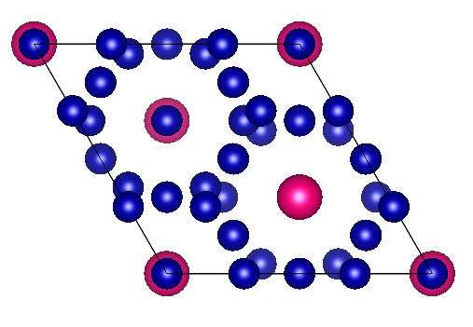
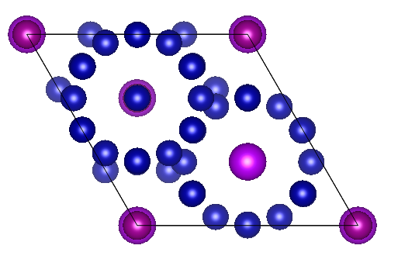
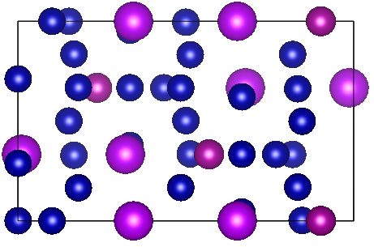
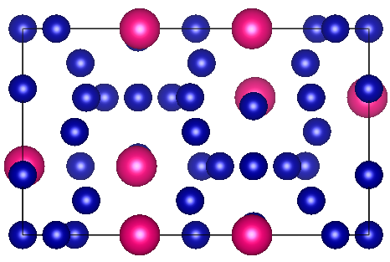
STRUCTURAL LINEAGE
Start with a known stoichiometry → modify Co to Mn so it can ferromagnetically couple with RE, due to its lower filling
The real magnet this descends from
1
Sm2Co17
commercial 2:17 SmCo permanent magnet - one of only two SmCo classes ever commercialised (with SmCo5, the 1:5 type)
2
RE2Co17
the general Th2Zn17-type family - Y, Ce, Pr, Nd, Sm, Gd, Tb... all form this same rhombohedral structure
3
RE2MnCo16
Sm2Co17 - parent
Co16Gd2Mn_sub - FM candidate
one of the 17 transition-metal sites replaced by Mn - the single change this campaign is built around
Soft-magnet
Identical lattice - Gd stands in for Sm, with one Co-site replaced by Mn (explicit 4f, S-state surrogate). Same Mn-for-Co site. This should be FM even with heavy - RE identity changes.
Every candidate in this campaign is a controlled chemical edit of an already-magnetic parent - swap the light RE for a heavy one, then perturb one transition-metal site. Co16Gd2Mn_sub is the one edit, out of 353, where that perturbation flips the whole compound's magnetic order rather than just its Curie temperature or anisotropy.
This idea might be applicable to the other motifs as well (e.g. 1:12 etc.); There could be disorder in the TM lattice, but that should not affect the magnetization;

Slide 10
CAMPAIGN RESULTS
One candidate survives every validity check
353 compounds analysed -> 1 credible ferromagnet
Co16Gd2Mn · new-R3m
1
Implausible exchange energy
Co-rich 2-17-like lattice, Mn on one Co site
3-5.5 eV/Gd, 10-15x any real value - LDA+U landing in a different state, not physical coupling
dE (ferri - fm)
+114.5 meV/Gd
2
Untracked sublattice collapse
ground state
ferromagnetic
a spectator element (Os, Y, Lu, Ru, Ce...) shifting between fm/ferri, invisible if only Fe/Co are watched
u0Ms
1.95 T
3
TM sublattice itself collapsed
Mn couples ferromagnetically to Gd while Co keeps its usual antiparallel preference - flipping the net RE-TM sign for the compound.
the Fe or Co moment changed between runs - the failure the constrained rerun was built to fix
Validated: stable Co sublattice, stable Mn magnitude, normal exchange-energy scale, clean EDIFF convergence on both configs (47 / 29 SCF steps of 400).
Projected magnetisation for the real target compositions
Three of five heavy-RE analogues clear the 2 T program target.
Parent compound | Heavy RE | Projected u0Ms
Co16Dy2Mn | Dy | 2.26 T
Co16Ho2Mn | Ho | 2.26 T
Co16MnTb2 | Tb | 2.17 T
Co16Er2Mn | Er | 2.17 T
Co16MnTm2 | Tm | 1.98 T

Slide 11
PER-ATOM MOMENTS, DIRECTLY MEASURED
Mn always sides with Gd - never with Co - in both configurations
FM - all three sublattices aligned
FERRI - Gd and Mn flip together, Co doesn't
Gd (sites 1, 2)
Gd (sites 1, 2)
+6.74, +6.75 uB
-7.06, -7.04 uB
Mn (site 3)
Mn (site 3)
+3.13 uB
-3.38 uB
Co (16 sites, +1.49 to +1.59 uB)
Co (16 sites, +1.37 to +1.53 uB)
avg +1.53 uB
avg +1.47 uB
total moment
total moment
41.1 uB
6.15 uB
Mn's moment matches Gd's sign in every configuration checked - fm or ferri, this compound or any native-RE compound in the Tier-2 batch. Co never once follows it. That is the direct measurement behind the Campbell's-rule exception this campaign is built on.
Notes:
Source: OUTCAR_04 for Co16Gd2Mn_sub (runs/ternary/Tb/new-R3m/Co16Gd2Mn_sub), the validated release-stage static - the same result behind dE=114.5 meV/Gd. Per-site magnetization(x) table, LORBIT=11 atomic-sphere projection.

Slide 12

The Full Loop: Where DFT, MLIP, and Causal ML Sit
Two loops: an operational loop that proposes and tests new alloys, and an understanding loop that explains the results and feeds back in.
GP surrogate
mean = causal rules
→
Acquisition
+ resolves ENCO gaps
→
Generative
DOSMatGen: new alloys
→
MLIP filter
relax + stability check
→
DFT+Experiment
ground truth
↑ disambiguation target
↓ DFT results
↑ sets mean function
Causal / interpretable pipeline
RF → SOM → EBM → SymReg → LogReg → ENCO
↻ retrains the surrogate every round
navy = operational loop red = DFT (ground truth) teal = causal / interpretable pipeline (Loop 2)

