Slide 1
Dla kursanta
Przed rozpoczęciem obrony prześlij wypełnioną prezentację do trenera.
Dostarcz wszystkie wytworzone artefakty (testy, kod) np. w postaci PDF lub adresu na Githubie/Gitlabie.
Zapewnij dostępy do narzędzi z których korzystałeś (np. Test Rail lub JIRA), tak aby trener mógł zweryfikować twoją pracę i ją ocenić.
Materiały dostarcz przynajmniej 24h przed rozpoczęciem obrony na adres mailowy trenera (trener skontaktuje się z Tobą indywidualnie).

Slide 2
Final Project
Paweł Garstka
ZDtestPol116
Guru99 Bank

Slide 3
Brief overview of the project
The Guru99 Bank project aims to provide net banking facility to its customers. The Guru99 Bank will have 2 roles: Manager, Customer with list of different features.
I have tested the web application based on provided requirements
Performed tasks:
  Test cases and test runs executed in Test Rail
  Bugs reported in JIRA
  Scenarios written in BDD
  Exploratory session
  Product and project risks analysis

Slide 4
Specification
1. New customer can be created
2. Empty New customer form cannot be submitted
3. Password can be changed
4. Reset form

Slide 5
Project and product risks
Product risks:
Insecure data storage - threats include the possibility of malware gaining access to the user account
Insufficient transport layer protection - this refers to the lack of data encryption for data transfer over public network
Poor authorization and authentication - refers to cybersecurity and avoiding vulnerabilities and cyberattacks
High response time for critical functions
User experience of the product does not meet customer expectations
Project risks:
Delays in delivery and task completion
Inaccurate estimates and poor requirements
Resource skillset issues
Resources availability
Team skills

Slide 6
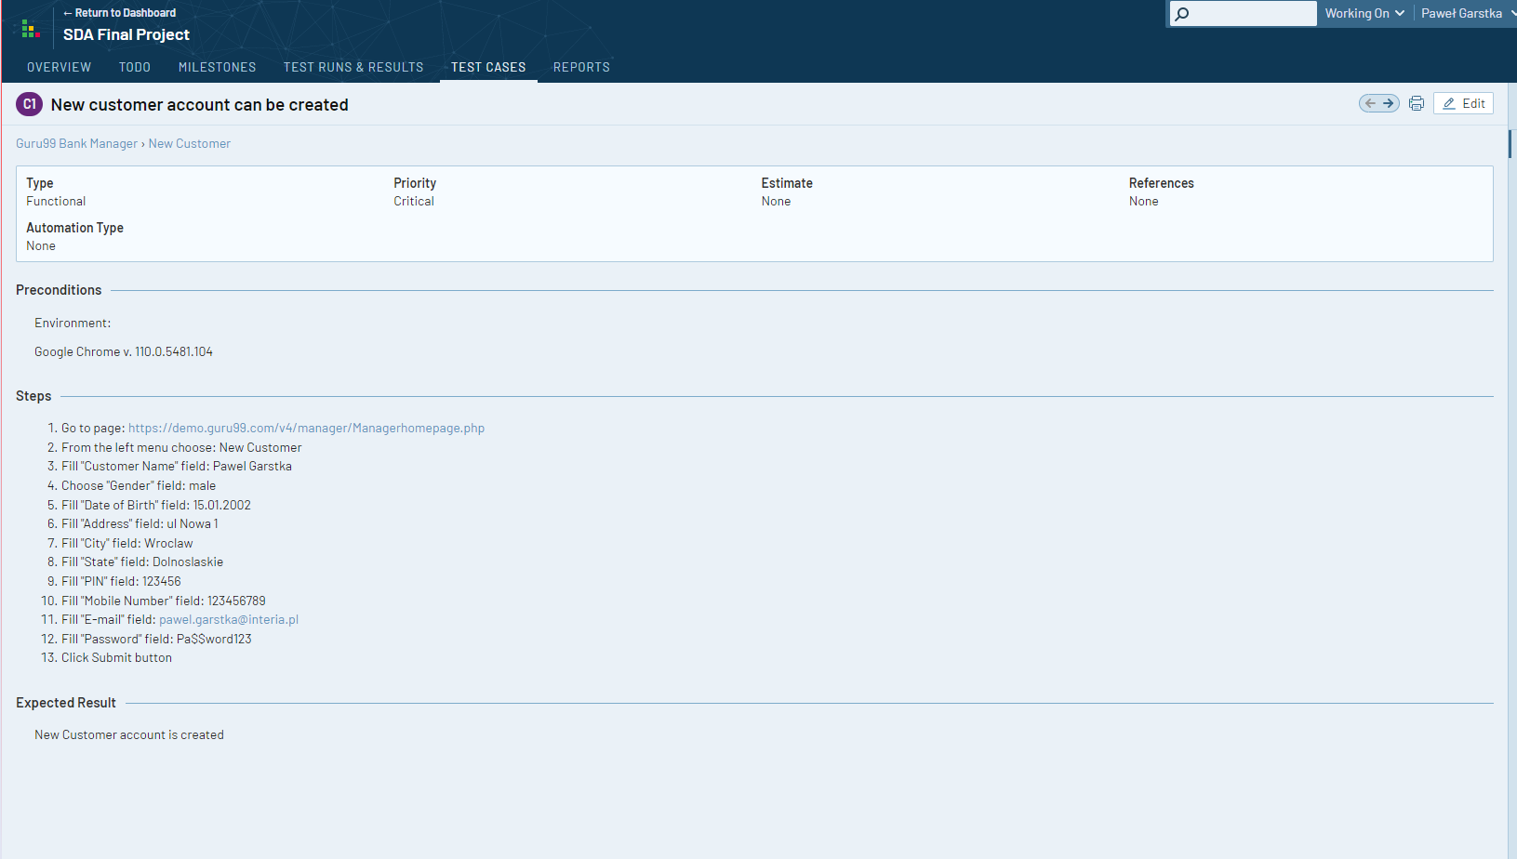
Test cases from TestRail

Slide 7
Exploratory Session
Session ID: SFP1
Tester Start time | Paweł Garstka 12:00 | Date Finish time | 19.02.2023 13:00
Purpose | exploration of the functionality of the page
Found bugs | customer account cannot be created, password cannot be changed
Further analyze | esting other subpages related to account (new account, edit account, delete account) and money transfering (deposit, withdraw, fund transfer)

Slide 8
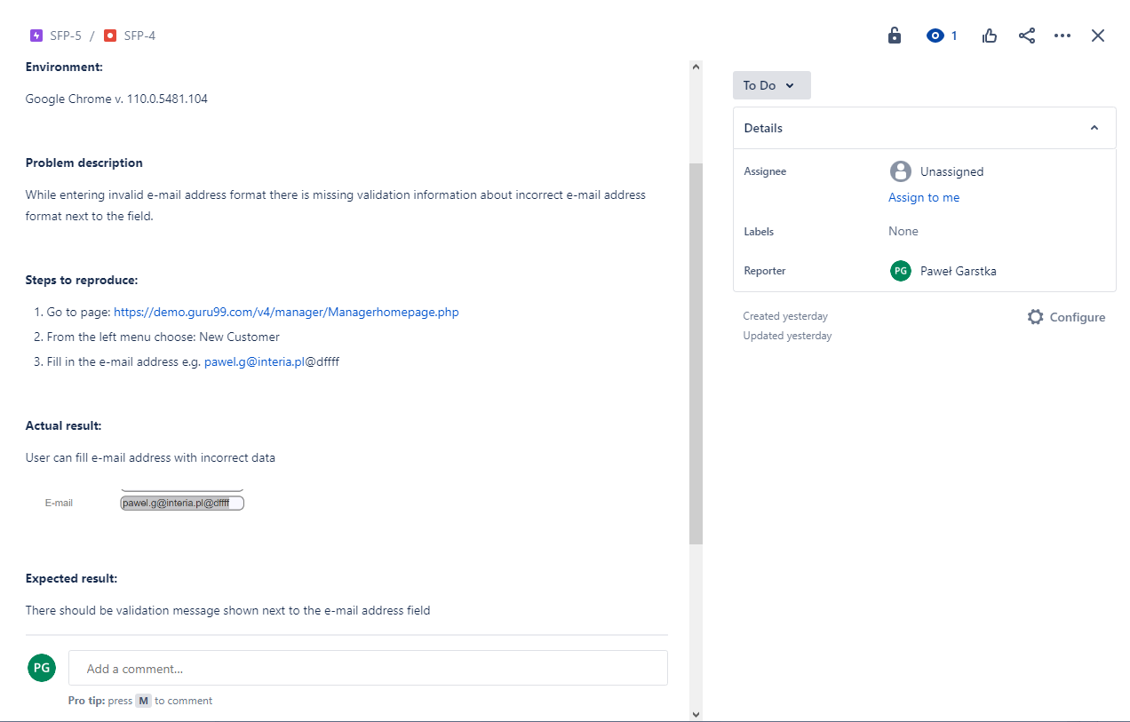
Reporting bugs in JIRA

Slide 9
Additional elements
Sending requests with Postman (GET, POST, PUT, DELETE)
https://gpawel.atlassian.net/wiki/spaces/SFP/pages/10289275/API+testing
Writing test cases with BDD
https://gpawel.atlassian.net/wiki/spaces/SFP/pages/10322031/BDD

