Slide 1
Uber Assignment
By -> Piyush Gaur

Slide 2
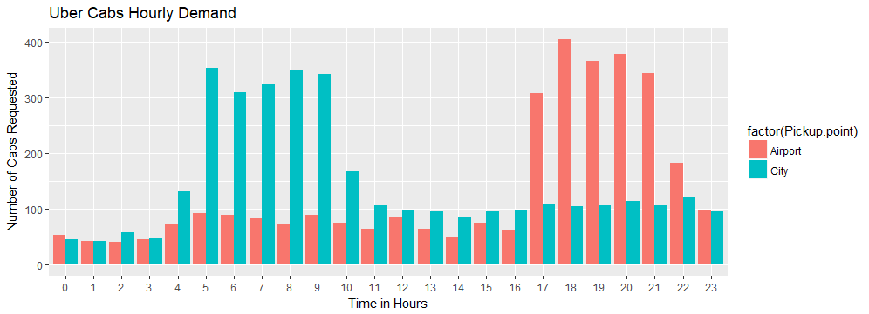
Data Preparation
Bar Chart depicting hour wise trip request made at city and airport respectively.

Slide 3
Data Cleaning Dividing the Request time in to 5 time slots based on below assumption
Pre-Morning Time Slot - > When Request Hour <= 3 hours
Morning_Rush Time Slot - > When Request Hour >= 4 and <= 9
Day_Time Time Slot -> When Request Hour >=10 and <= 16.
Evening_Rush Time Slot -> When Request Hour > =17 and <= 21
Late_Night Time Slot When Request Hour is other than defined above is considered as late night

Slide 4
Data Cleaning Count of number of trips made during different time slot derived previously.
Count of trips made at Pre-Morning Time Slot - > 136
Count of trips made at Morning_Rush Time Slot - > 932
Count of trips made at Day_Time Time Slot -> 722
Count of trips made at Evening_Rush Time Slot -> 784
Count of trips made at Late_Night Time Slot -> 257

Slide 5
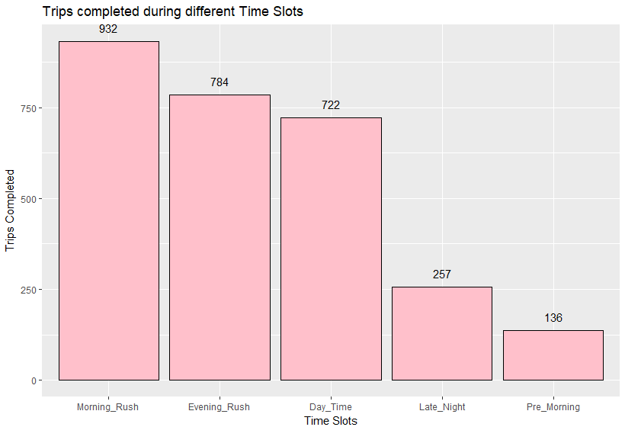
Bar Chart for number of trips made during different time slots

Slide 6
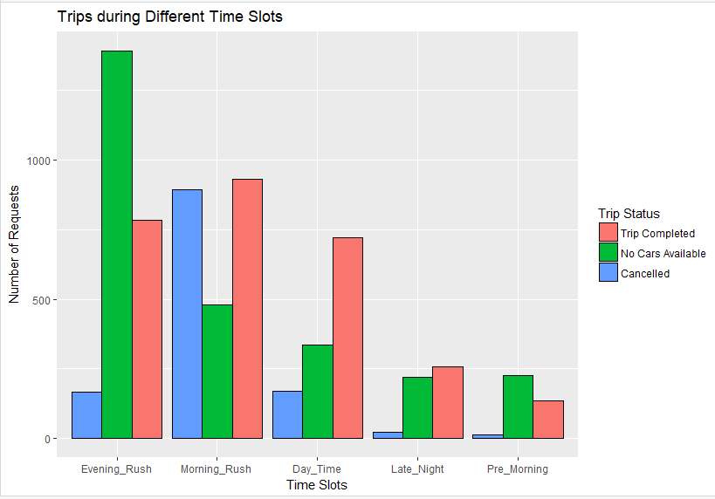
Problem Identification
A Dodged bar chart here representing portion of bars as completed, cancelled and no cars available requests out of total requests made.
Problem 1 :
A large number of trips got cancelled during the Morning_Rush time slot
Problem 2:
Cabs were not available for a large number of requests during Evening_Rush time slot

Slide 7
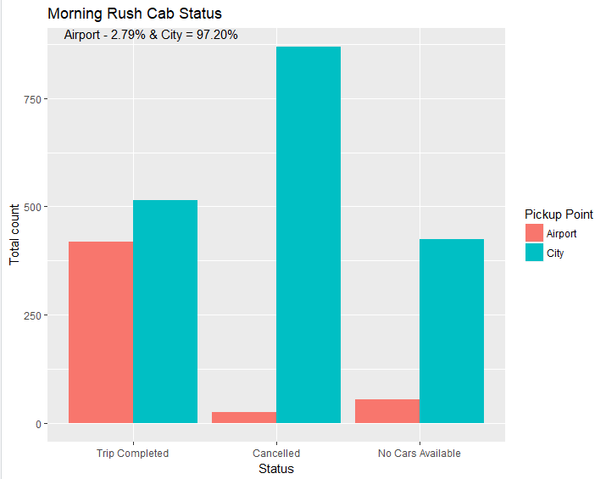
Problem 1 A large number of trips got cancelled during the Morning_Rush time slot .
Plotting a dodges bar chart to find out if the problem is more sever for pickup requests made at the airport or the city.
Percentage break up for the total number of issues in the time slot based on pick-up point.
Percentage of total issues based on pick up point at the following :
Airport - 2.79 %
City - 97.20 %

Slide 8
Problem 1 Gap Between Supply and demand (Morning_Rush time slot )
Finding Out Gap Between Supply and demand (Morning_Rush time slot )
For Morning_Rush time slot demand is the number of requests made at the city and Supply is the number of requests completed from city to airport
No of trips requests made in city during Morning_Rush - 1808
No of trips completed in city during Morning_Rush – 514
Reason for supply –demand gap during Morning_Rush Slot.
A large number of flights leave the airport during Morning rush time slot. There are very less incoming flights in the morning rush. A driver who reaches airport during the that time has to spend idle time to pick up a customer back to the city. The driver could utilize the idle time for other trips if he chooses not to go to the airport. Due to large number of service requests were cancelled in morning rush resulting in huge supply demand gap

Slide 9
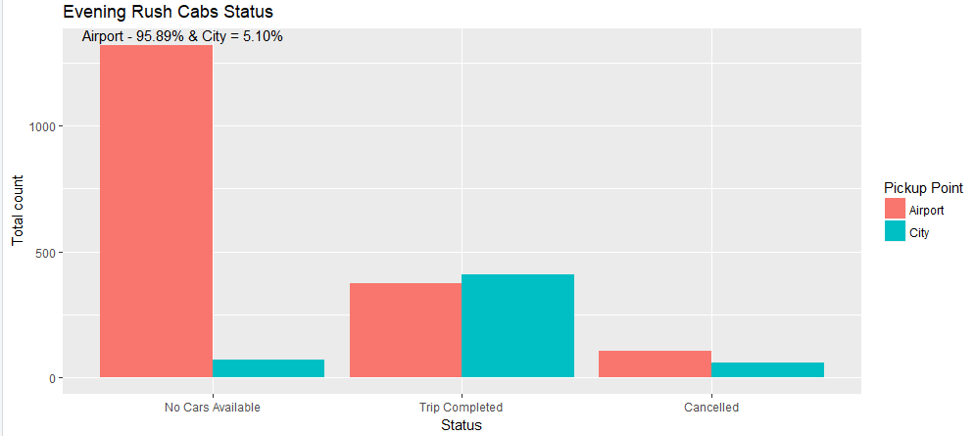
Problem 2 Cabs were not available for a large number of requests during Evening_Rush time slot
Plotting a dodges bar chart to find out if the problem is more sever for pickup requests made at the airport or the city.
Percentage break up for the total number of issues in the time slot based on pick-up point.
Percentage of total issues based on pick up point at the following :
Airport - 95.89 %
City - 5.10 %

Slide 10
Problem 2 Gap Between Supply and demand (Evening_Rush time slot )
Finding Out Gap Between Supply and demand (Evening_Rush time slot )
For Evening_Rush time slot demand is the number of requests made at the airport and Supply is the number of requests completed from airport to city
No of trips requests made at airport during Evening_Rush - 1800
No of trips completed from airport to city during Evening_Rush – 373
Reason for supply –demand gap during Evening_Rush Slot.
At the airport incoming flights are more and outgoing flights are less during evening rush slot. As the out going flights are less , the cabs coming to the airport are also very less during that time. This is reducing the availability of cabs at airport in the evening time slot. As the incoming flights are more , the passengers are also more in the evening. These passengers are not getting sufficient cabs to leave the airport in the evening. This is creating supply - demand gap at the airport in evening rush time slot

Slide 11
Recommendation Some ways to resolve the supply-demand gap.
Recommendation for morning rush slot from city
Reducing the money charged from cab drivers for utilizing Uber services for making a trip to airport
Charging More Money from Customers to the airport during morning rush time slot
Recommendation for evening rush slot from airport
Reducing the money charged from cab drivers for utilizing Uber services for making a trip to city
Charging More Money from Customers to trip from airport to city during evening rush time slot

