Slide 1
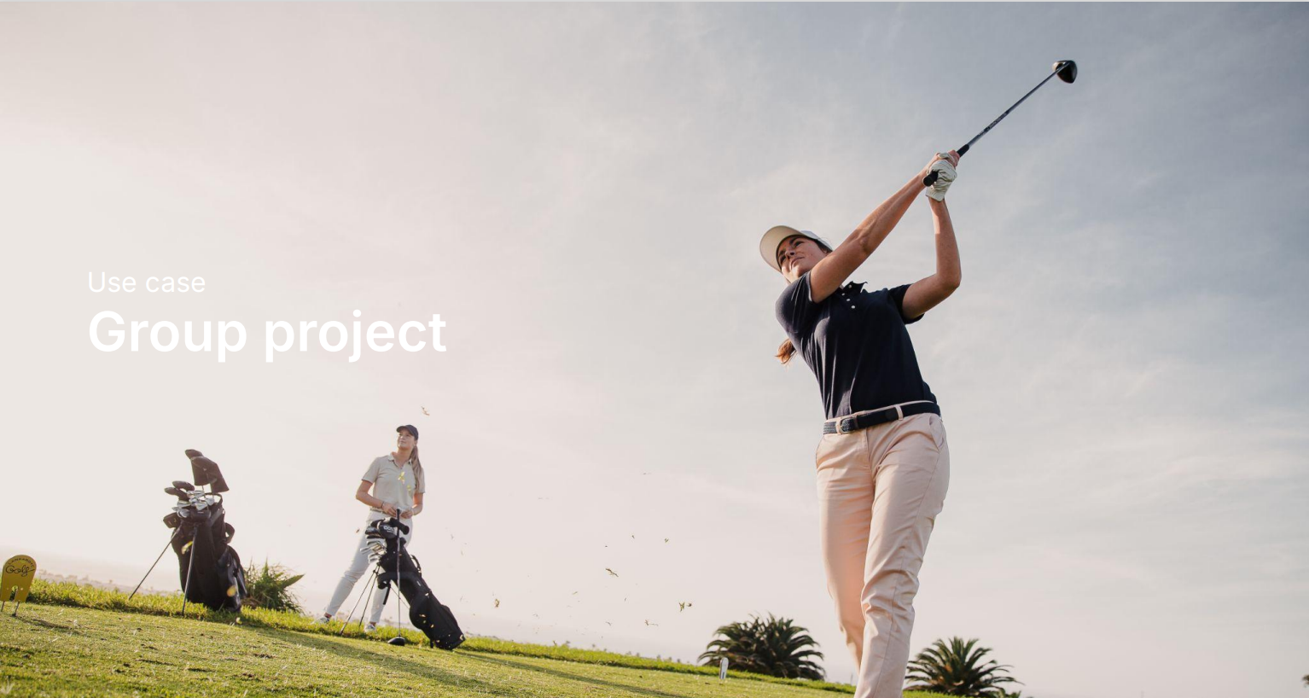

Slide 2
Introduction: Context and objectives
Decathlon Cardio Fitness brand, partnered with Sissy Mua, a fitness influencer, in an influencer campaign.
The main objective was to recruit new Gen Z customers from social networks.
Did the campaign rejuvenate their Gen Z Customers and was it profitable?

Slide 3
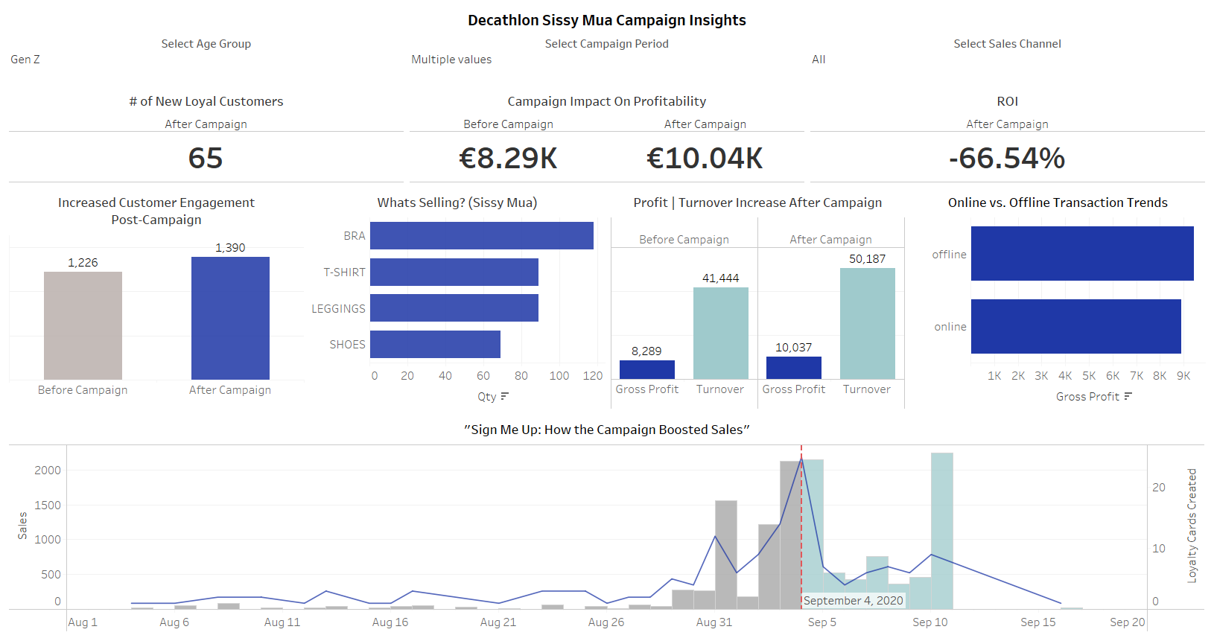

Slide 4
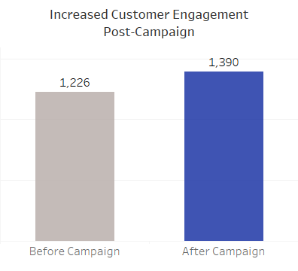
Gen Z Rejuvenated?
Gen Z customer activity increased post-campaign
65 new Loyal Gen Z customers attracted

Slide 5
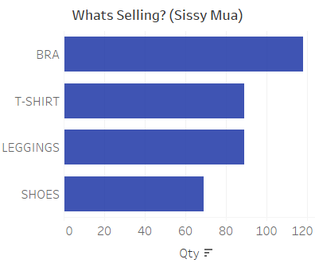
Which Sissy Mua Items are Selling?
Gen Z are buying Bras, T-shirts and Leggings

Slide 6
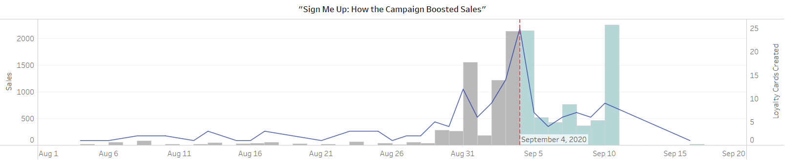
Sign Me Up: How the Campaign Boosted Sales
There is a noticeable spike in both sales and loyalty card signups on the campaign day

Slide 7
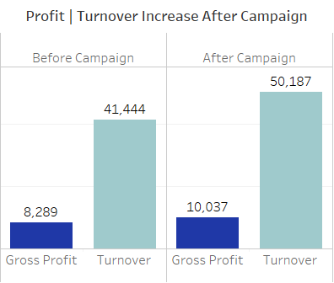
Campaign Impact on Profitability
Both profit and turnover increased for Gen Z customer's post-campaign

Slide 8
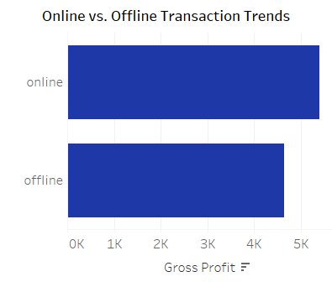
Online vs. Offline: Transaction Channels
More profit was realized from Gen Z through online channels

Slide 9

Return on investment
Negative ROI for Gen Z but …

Slide 10
Summary: Campaign performance vs objectives
Rejuvenating the Target Audience: The campaign successfully engaged Gen Z, as reflected in their increased customer activity and new loyalty card signups.
Profitability: While profit increased post-campaign, the negative ROI for Gen Z customers highlights a need for better cost control and more targeted strategies for future campaigns.

Slide 11

THANK YOU
Brita Tamm
502-555-0152
brita@firstupconsultants.com
www.firstupconsultants.com

