Slide 1

Efficient doctor patient management portal
Group 4

Slide 2

Group Members
Bharapaneedi Navya Sree
Harshitha . N
Gavireddy Sireesha
Lasya Pandeti
Gopika . P
This Photo by Unknown Author is licensed under CC BY-NC

Slide 3
Project Time Line
SRS Release
07/12/2022
Code
Implementation
08/12/2922
Integration testing
Planning and implementation
11/12/2022
Design
08/12/2022
Unit testing
Planning andImplementation
11/12/2022

Slide 4
Table Of contents
Understanding the problem statement
Coding and execution
Coding and Testing
Challenges Faced

Slide 5
1.
Understanding the
Problem statement

Slide 6
Introduction to problem statement
Registration of doctor and patient and organ Donor into the portal
Database to store the information given by the user
Query system to list all appointments carried out by a doctor
Allocating slots to the patients
Allowing doctor to record the medical history of a patient on the website
Allowing Admin to add, modify or delete the patient data

Slide 7
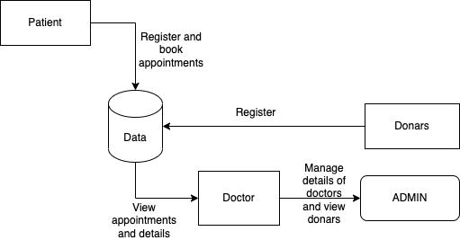
DFD Level 0 Diagram for patient

Slide 8
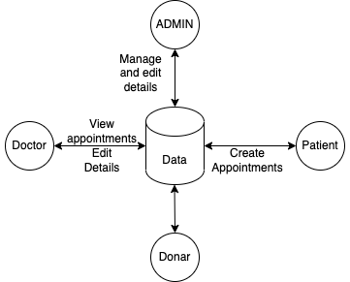
DfD Level 1 Diagram for doctor

Slide 9
Menu Based System
start
Main menu
Admin
Doctor
Patient
Organ donation
1.Add,edit,delete doctor details
2.Modify and delete
Patient details
1.Register
2.Enter slots
3.Recording patient history
4.Changing his basic information
1.Register
2.Selecting doctor with specialization he/she want
3.Selecting slot
1.Register for organ donation
2.Can search for available organs

Slide 10
Function description
doctor_registration() : doctor has to register in the portal with is basic details and mci licence number
view_bookings() : used to see the bookings that are made by the patient
record_patient_history() : patient history will be recorded for future refernce
edit_patient_data() : admin and doctor can be able to edit patient data
view_patient_data : doctor and patient can be able to see patient data

Slide 11
Function description
patient_corner(): to maintain patient registration and login steps
isalpha_validation1(char *str): to validate name of doctor/patient/admin
isdigit_validation1(char *str) : to validate mobile number, Mci licence numer, Adhar number
book_appointment(): to book appointment of the patient
patient_list_to_file(): adding the patient list into file so doctor can be able to see the patient history

Slide 12
2.
Coding And Execution
2

Slide 13
System Architecture
DOCTOR:
Register/login into the portal,
Can see the appointments,
Can see patients medical
history
Patient-
Register/login to portal
Booking appointment
Doctor patient management portal
Admin:
Can add,delete or modify doctors
And patient details
Organ Donor-
Registering for
donating organ
Or to get organ

Slide 14
Portal functions
Regestering doctor, fixing slots,allocating patients to doctors, storing patients history
Regestering patient,selecting doctor,
selecting slots for appointment
Modifying,adding,
deleting doctor details
Adding and deleting patient details
registering for organ donation and selecting for
required organs

Slide 15
3.
Coding and Testing

Slide 17
INTEGRATED TESTING

Slide 18
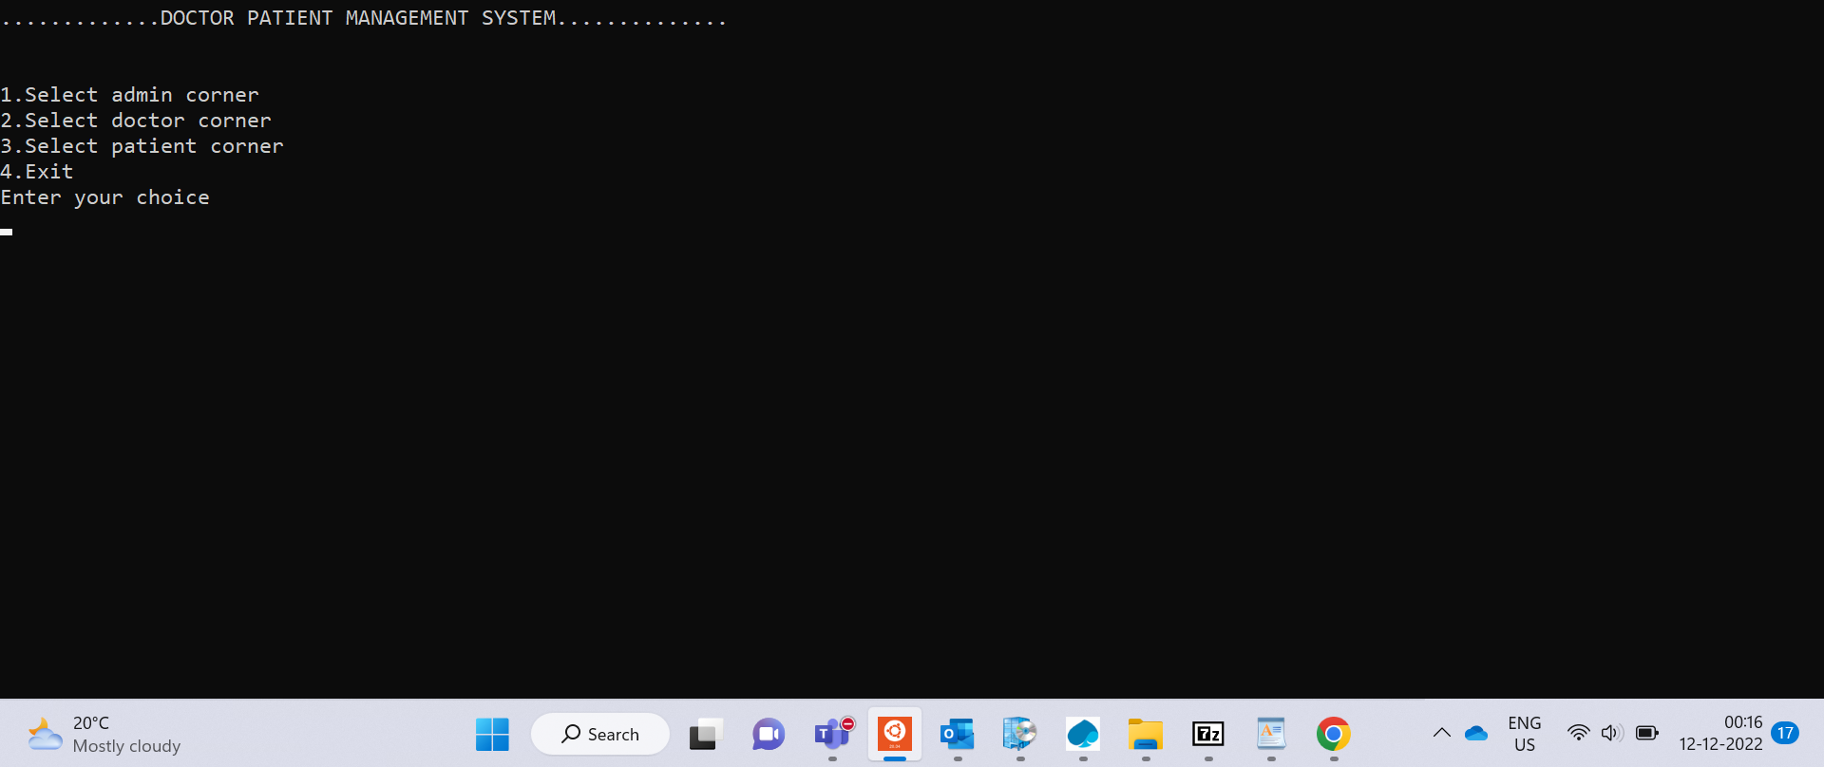

Slide 19
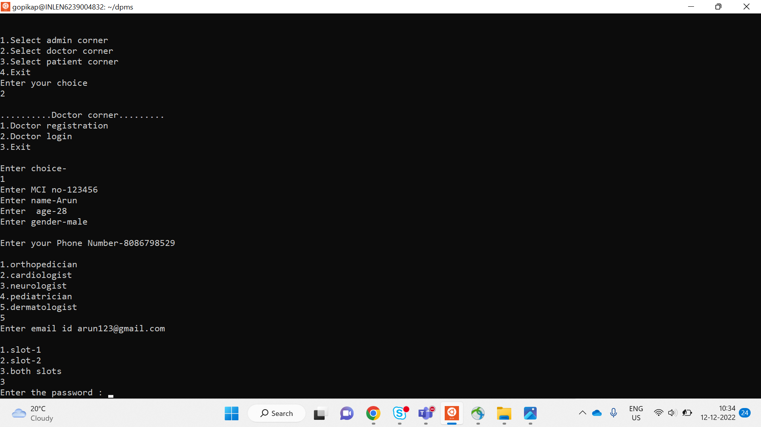

Slide 20
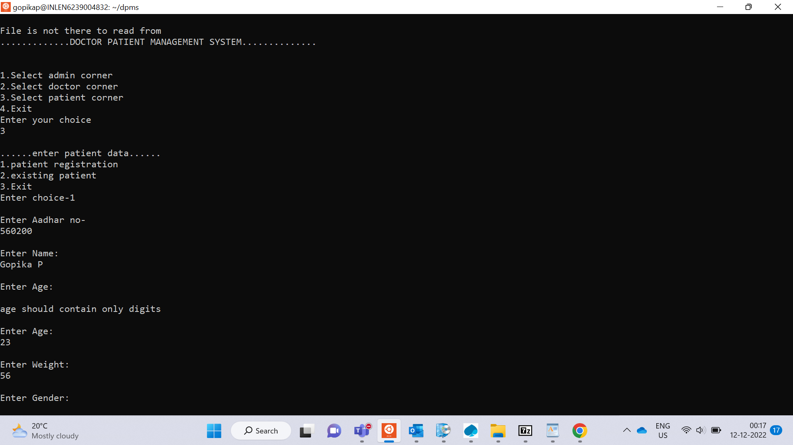

Slide 21
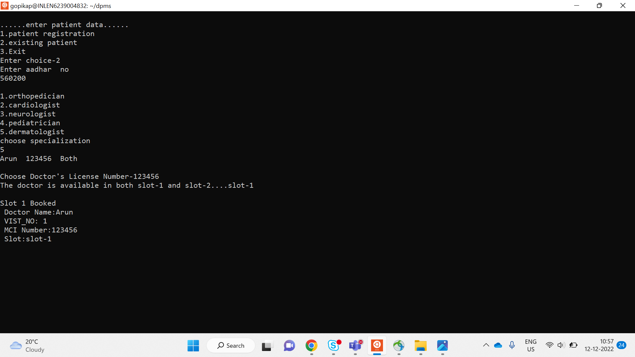

Slide 22
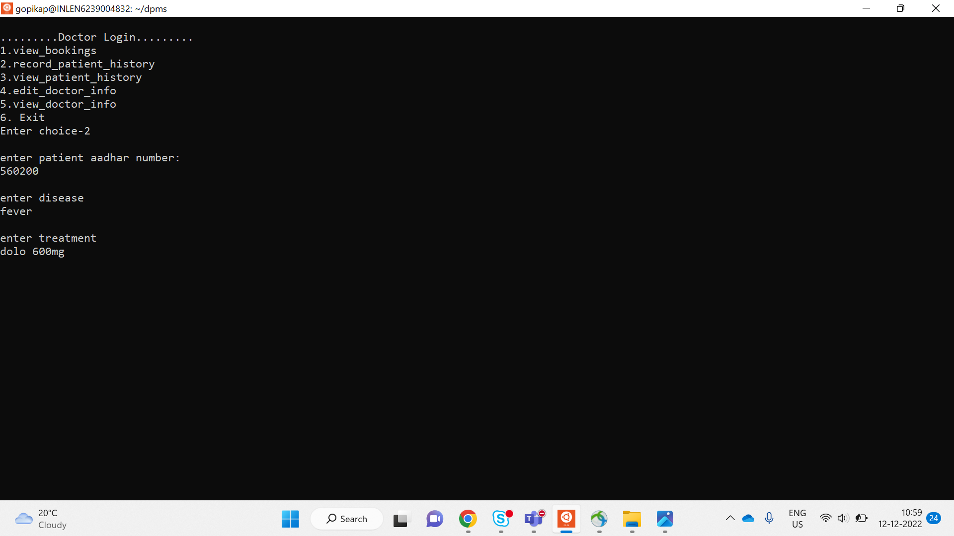

Slide 23
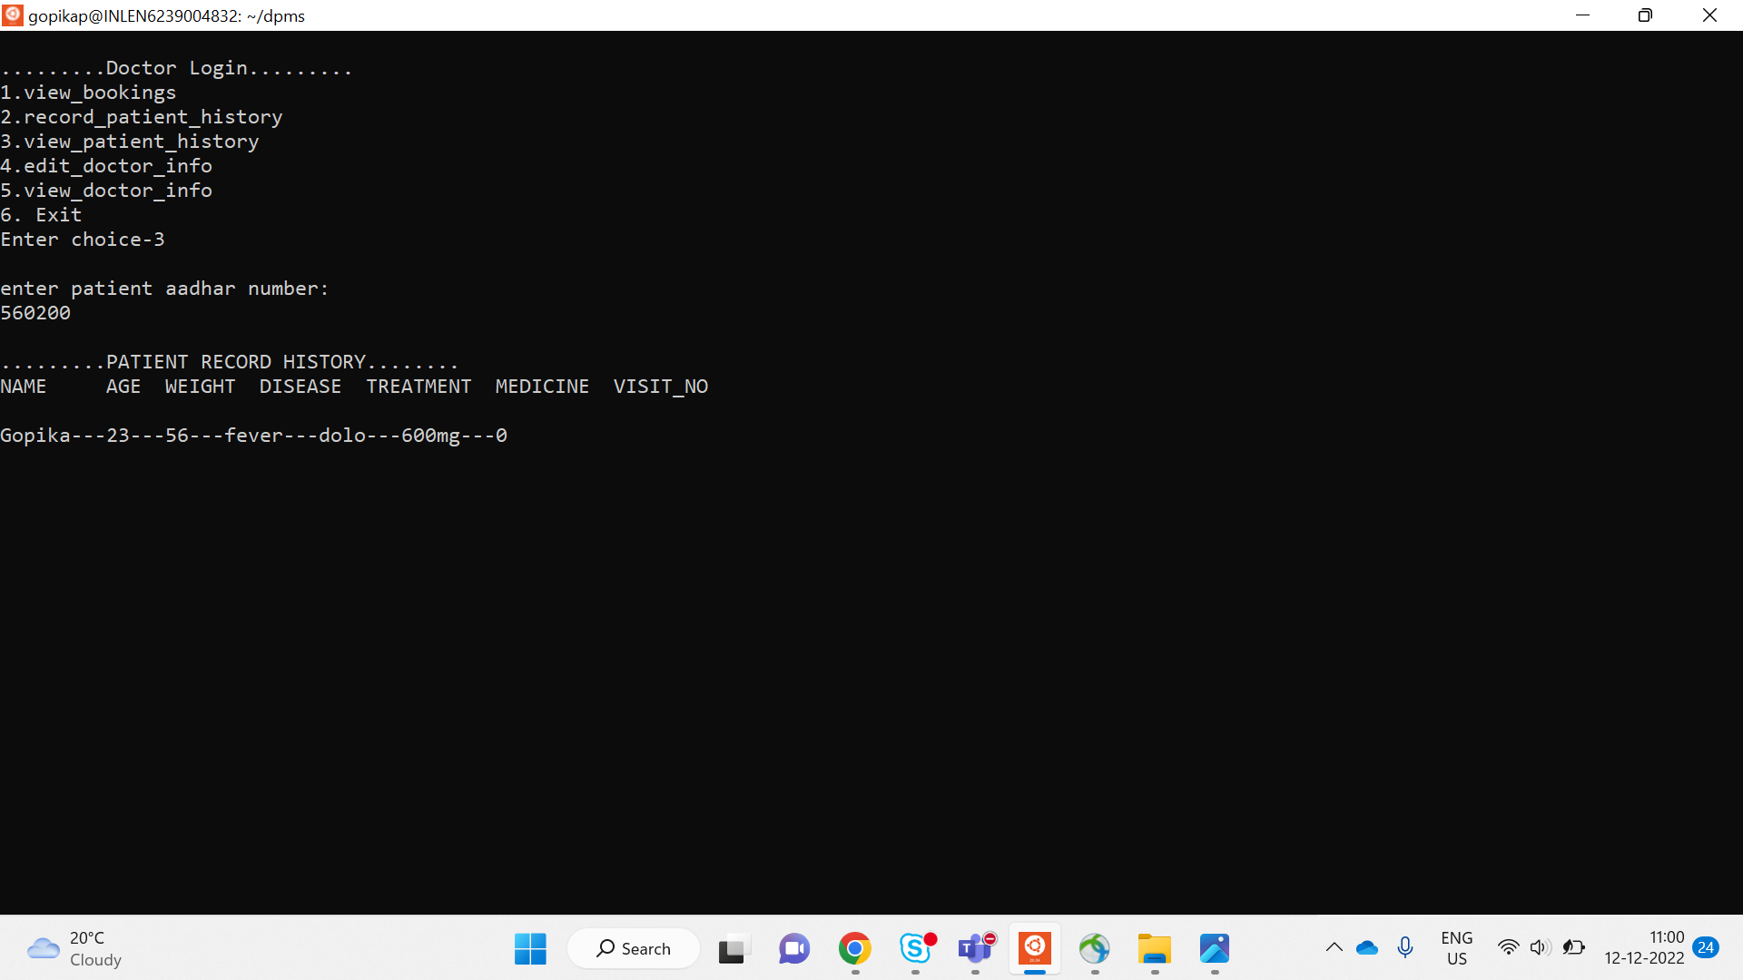

Slide 24
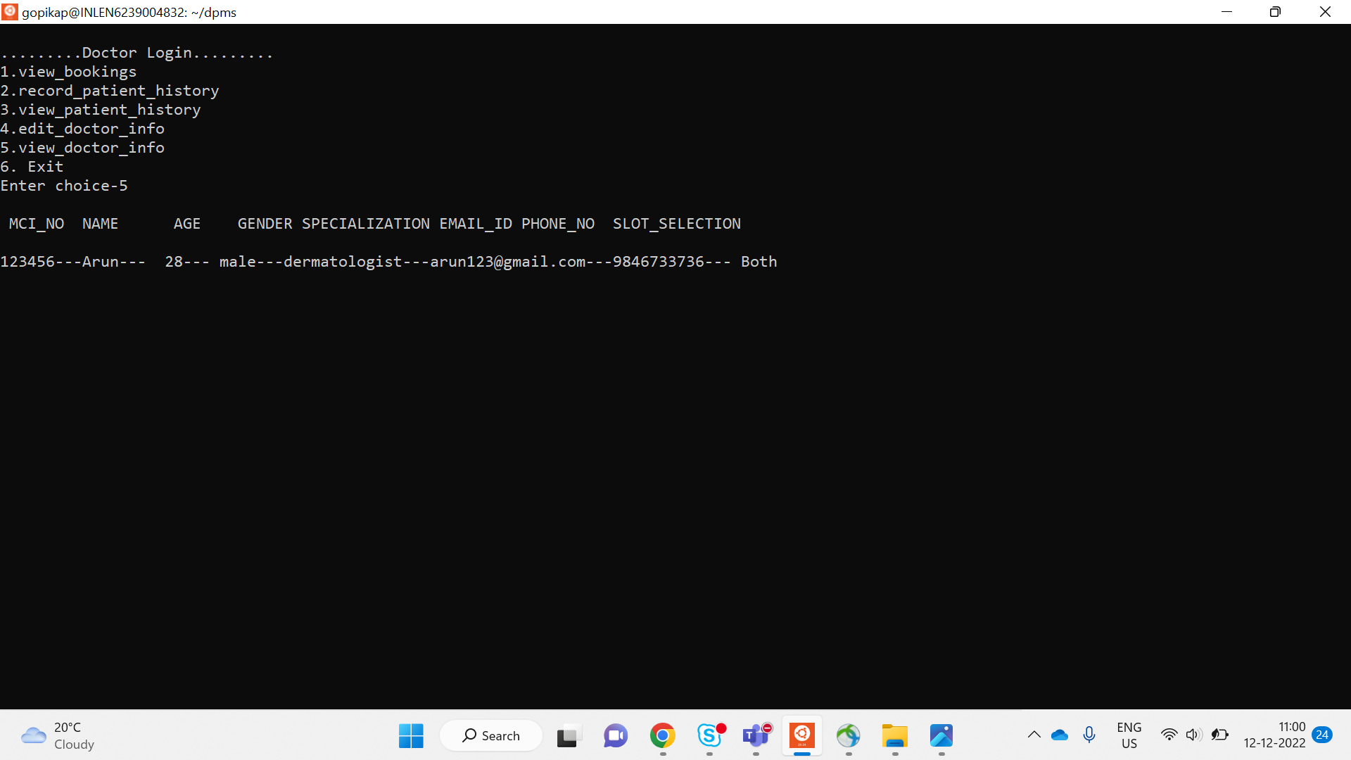

Slide 25
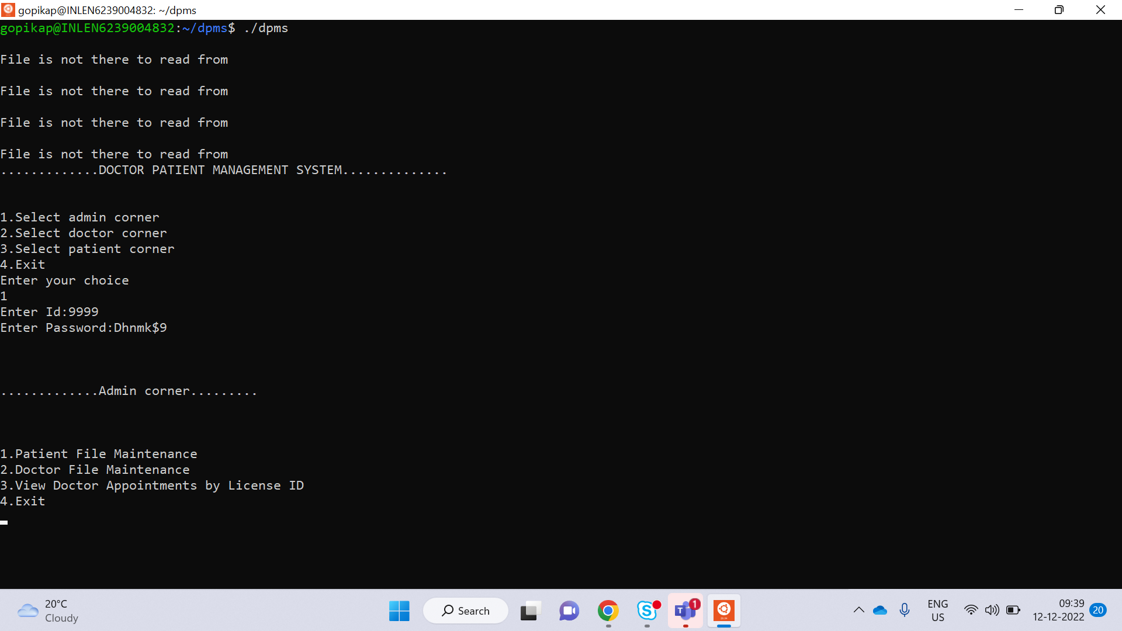

Slide 26
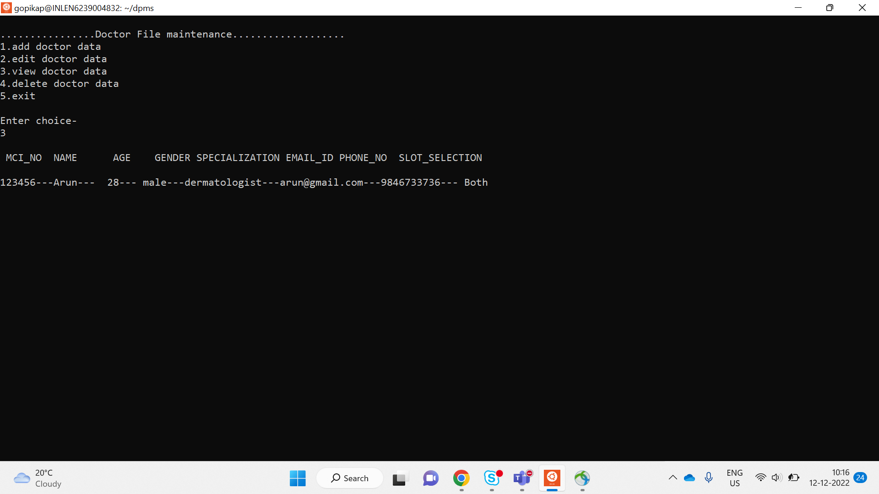

Slide 27
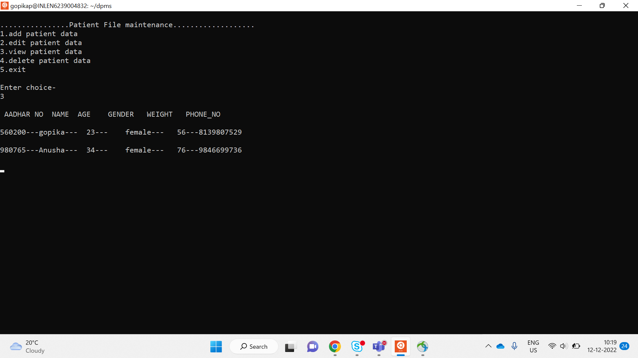

Slide 28
Valgrind report

Slide 29
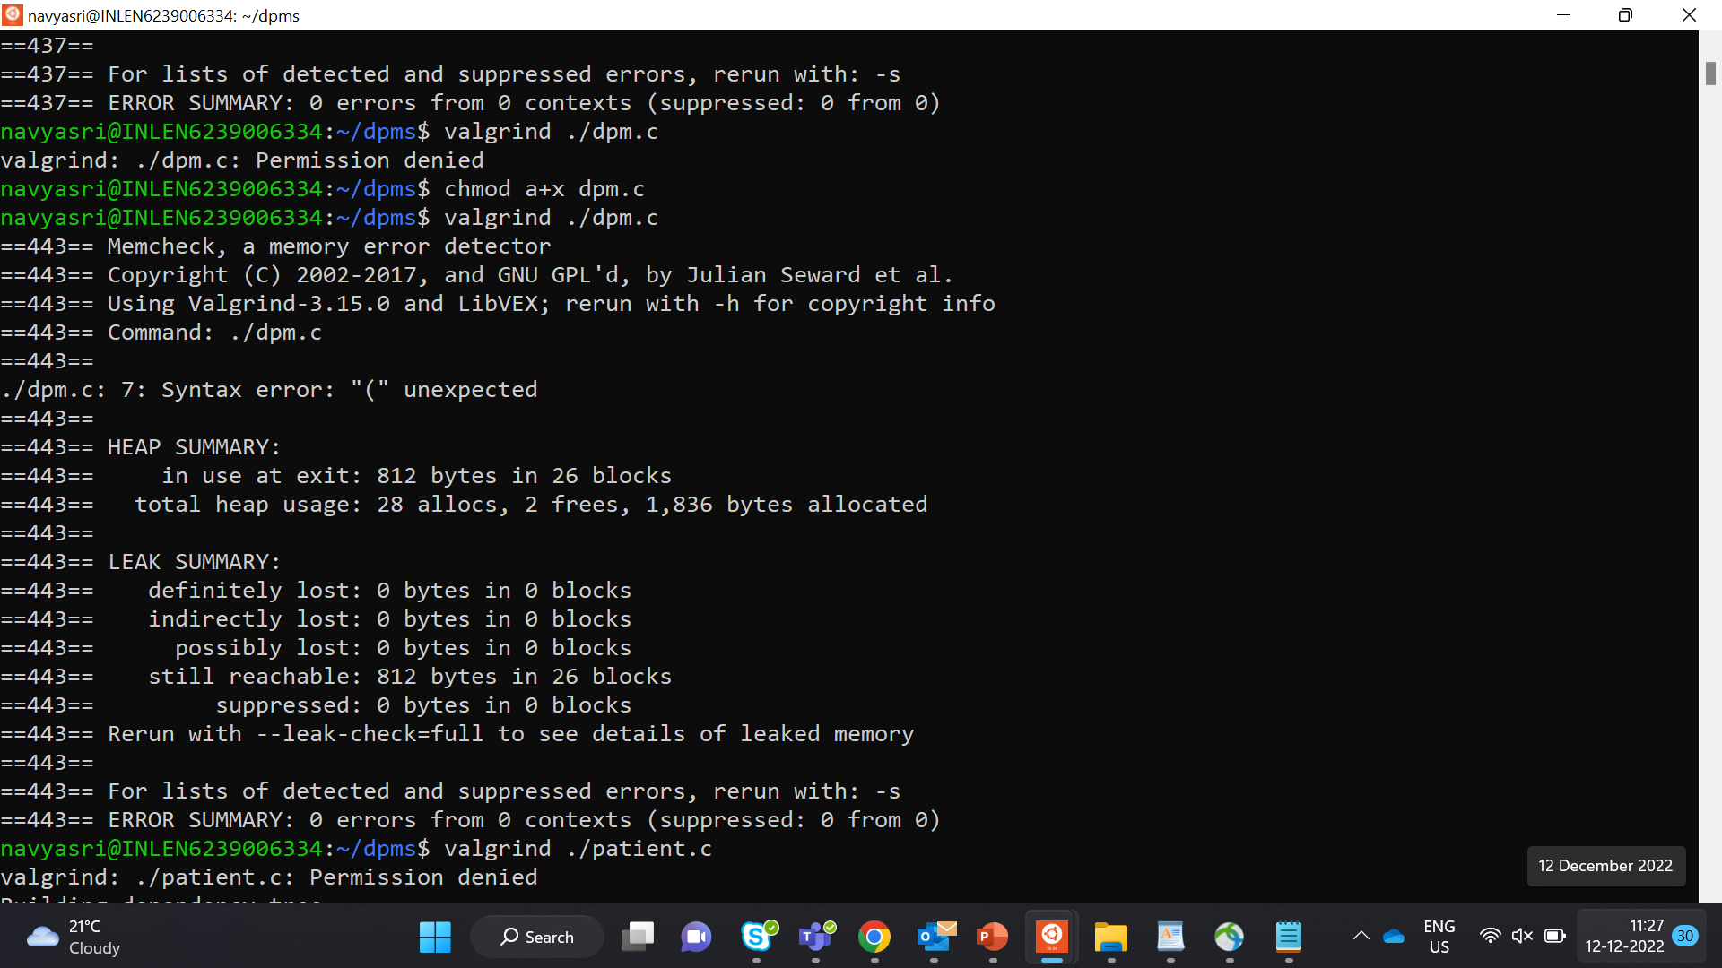

Slide 30
4.obstacles

Slide 31
Challenges faced
To decide which data structure would be best for our project
Setting and making login portal for Doctor and patient
Using three separate database is maintained, Cunit testing was challenging.

Slide 32
conclusion
Successfully completed the coding and testing phases as per the given problem statement.
Got the expected results for the efficient doctor patient management portal

Slide 33


