Slide 1
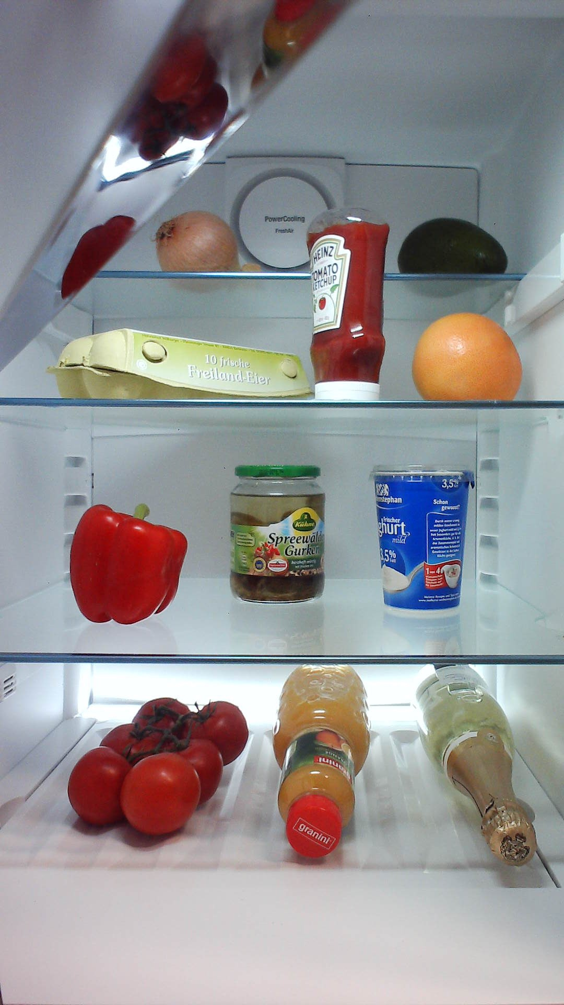
Proposals
Class 1
ConvNet
Feature map
Classifier
Class 2
Ex. VGG16, ZF
Class 3

