Slide 1

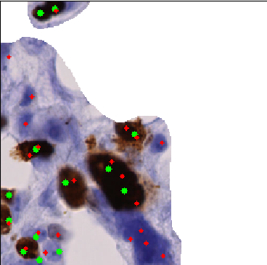
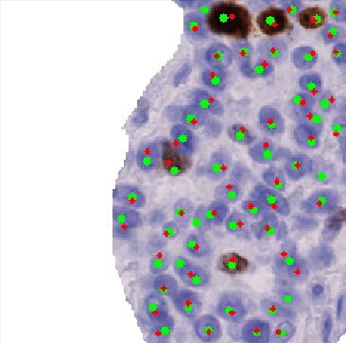
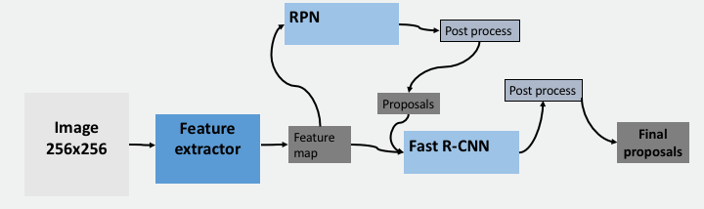
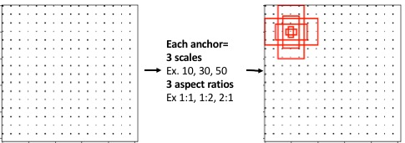

Efficient nuclei detection and classification with deep learning
Peter Grønborg, Mathematical Modelling and Computing, Technical University of Denmark
By applying state-of-the-art deep learning method for object detection, Faster R-CNN, to histopathology images it is possible to detect and classify with high accuracy. With an mAP at 0.841 and recall 0.832 this network outperforms current methods for detecting nuclei and with a speed at 0.2s per 256x256 image.
Introduction
In 2015 Denmark had 64,718 people diagnosed with breast cancer while above 1140 people died, primarily women. When determine how quick the cancerous growth is the Ki-67 antigen can give a proliferation index which is a ratio between positive nuclei and the total number of nuclei.
Current state-of-the-art and applied methods in Visopharm all relies on various segmentations methods like HoG, DoG and simple threshold by pixel intensity.
With modern day deep learning object detection pushes the boundaries for accuracy and speed which is broken almost every year since 2012.
Results
When evaluating the images it can be seen that some of the nuclei detected but do not have a ground truth, even though they actually seems like nuclei, which have not been annotated properly. The mAP for all the test images for after optimizing the final post-processing is 0.841 and recall is 0.832.
Methods
Pre-processing – when the whole slides are digitalized, region of interest(RoI) within the sampled area is extracted. Everything outside of these RoI is removed/deleted.
Faster R-CNN – is a unified deep learning network with a detection layer(RPN) and a classification layer which both relies on a shared feature map from a feature extractor network. The unique about this method is that it can be trained E2E.
Feature extractor – is where the image is fed into the network. The feature extractor in this network is a pre-trained network which extracts high hierarchy features. The output is a feature map. In this case a pre-trained VGG16 network is applied.
RPN – takes the feature map from the feature extractor and runs it through a 3x3 conv. layer. Each output from this conv. layer is then sent parallelly through two 1x1 conv. layers. Where one handles object score and the other box regression for 9 different anchors in each anchor center.
Hereafter a cleaning of the proposals is performed(NMS, threshold etc.) to keep the best scoring proposals.
Fast R-CNN – handles the classification part. It takes all the proposals from the RPN and for each proposal extracts a RoI of a fixed size from the feature map. Each RoI is then sent to a couple of fully connected layers before it is sent through a softmax classification layer and a box regression layer to fit the proposal better. At the end a final NMS and threshold can be performed.
Figure 3: Worst and best scoring mAP images Left image is the worst scoring image with a mAP at 0.455 while the right is the highest scoring image with a mAP at around 0.982. Only centers is included. Green is ground truth while red is predicted
Figure 1: The unified Faster R-CNN This unified network consist of three main parts. The feature extractor which output a feature map. Here a pre-trained network can be applied. The RPN which extracts proposals with objects and their boundary boxes from different anchors. At the end the Fast R-CNN takes the proposals and classify the object within them.
Figure 4: Precision vs. Recall A diagram of 1,000 nuclei images where precision and recall is calculated in each. This is for the optimized network.
Conclusions and future work
From the work carried out it have been demonstrated that the deep learning method, Faster R-CNN, is capable of detecting objects correctly and at some cases better then what pathologist can perform.
It is now shown that it is possible to detect nuclei but segmenting the nuclei would be a task that can even improve the detection.
Anchors – are fixed sized boxes which is spread throughout the entire image in its original scale. These is applied in the RPN where they keep their fixed sizes with boundary box notation, x_{center}, y_{center}, h, w. Each anchor center correspond to a feature map node.
References
[1] Engholm, G.(2018) Statistik om brystkræft, https://www.cancer.dk/brystkraeft-mammacancer/statistik-brystkraeft/

