Slide 1
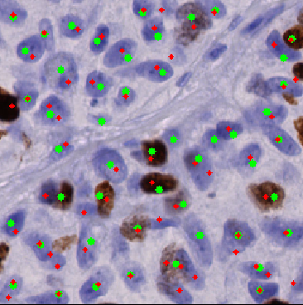
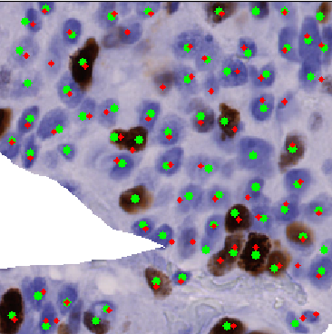


Efficient nuclei detection and classification with deep learning
Real-time speed
High accuracy

