Slide 1
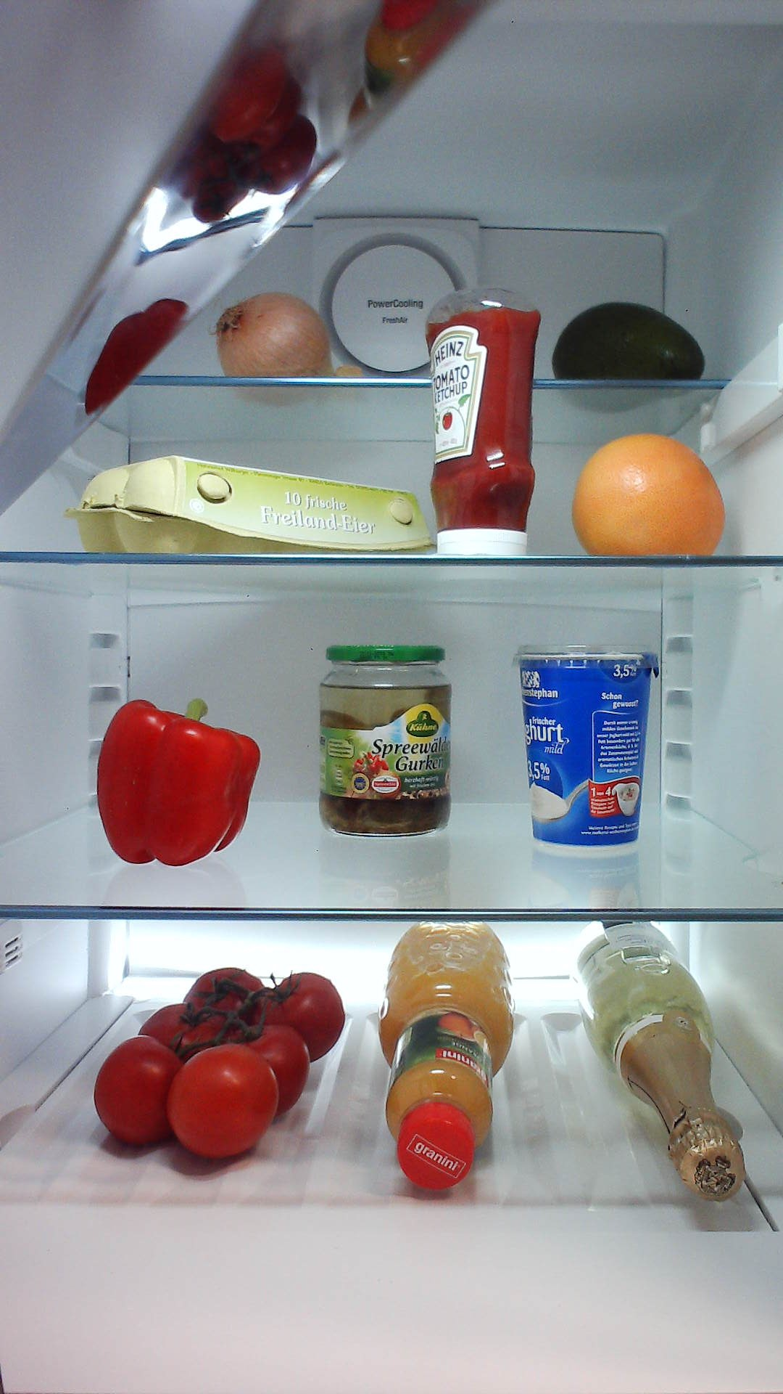
Proposals
Class 1
ConvNet
Feature map
Classifier
Class 2
Ex. VGG16, ZF
Class 3

Slide 2
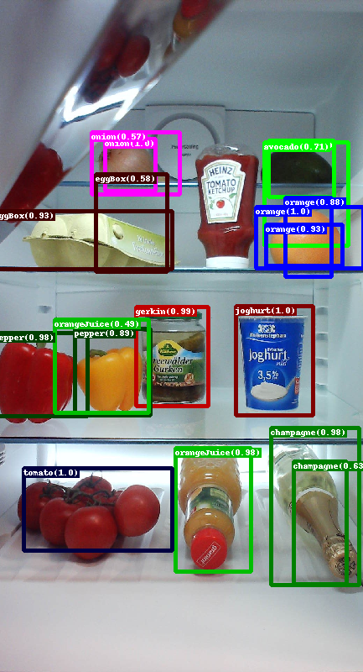
RPN
1x1 conv
Obj. det.
Post processing
3x3 conv.
1x1 conv
Box reg.
Transform boxes
Post processing
Proposals
Feature extractor
Feature map
Fast R-CNN
Roipooling
FC
Softmax
FC
Transform boxes
Box reg.

Slide 3
RPN
Post process
Post process
Image
256x256
Proposals
Feature extractor
Feature map
Final
proposals
Fast R-CNN

Slide 4
16x16 feature output
Relu5_3
512x16x16
Output stride = 16
Image
256x256
Feature extractor
VGG16
Last conv layer/
feature map

Slide 5
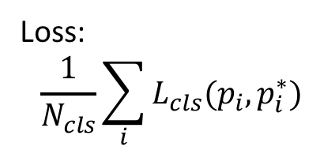
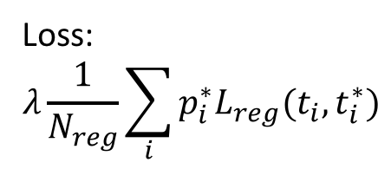
Loss:
$$\frac{1}{N_{cls}}\sum_{i}{L_{cls}(p_{i},p_{i}^{∗})}$$
3x3 slidingwindow
1x1conv
Object
512x3x3 feature map
3x3 conv
Output 9x2
16x16x9
proposals
Output 9x4
1x1conv
Regre.
Proposal:
Objectscore
Boundary box coord
Output 512
Loss:
$$λ\frac{1}{N_{reg}}\sum_{i}{{p_{i}^{∗}L}_{reg}(t_{i},t_{i}^{∗})}$$

Slide 6
Anchor centers in image
Anchors in image for 1 center
Each anchor=
3 scales
Ex. 10, 30, 50
3 aspect ratios
Ex 1:1, 1:2, 2:1

Slide 7
Through all proposals
by objectscore
Threshold objectscore
Threshold objectscore
16x16x9
proposals
Sort proposals by objectscore
Threshold
Keep top 6000
NMS
Remove IoU>0.7
Threshold
Keep top 300
>300
proposals
Training = top 2000
Each output:
x, y, w, h

Slide 8
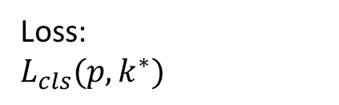
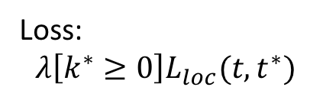
Loss:
$$L_{cls}(p,k^{∗})$$
Relu5_3
512x16x16
fc6
4096
fc7
4096
Last conv layer/
feature map
FC
Softmax
RoI pooling
FC
FC
Flatten
>300
proposals
Output:
25088
>300
proposals
FC
Regre.
Output:
512x7x7
x, y, w, h
Loss:
$$λ\left[k^{∗}≥0\right]L_{loc}(t,t^{∗})$$

Slide 9
>300
proposals
Remove background
NMS for class k
Remove IoU>0.7
Threshold
class
Final
proposals
Not added in Faster R-CNN
x_{min}, x_{max}, y_{min}, y_{max}, Class, prob.

Slide 10
Output stride = 2
Output
stride = 4
Output
stride = 8
Output
stride = 16
Output
stride = 32
Pool4
Pool5
fc6 – drop6
fc8
Pool2
Conv3_3
Prop
Conv2_1
Pool3
Conv4_3
Conv5_3
Data
Conv2_2
Conv1_1
Conv1_2
Pool1
Conv3_1
Conv3_2
Conv4_1
Conv4_2
Conv5_1
Conv5_2
fc7 – drop7
Feature extractor network

Slide 11
IoU = 0.1429
IoU = 0.6203
IoU = 0.2500

