Slide 1
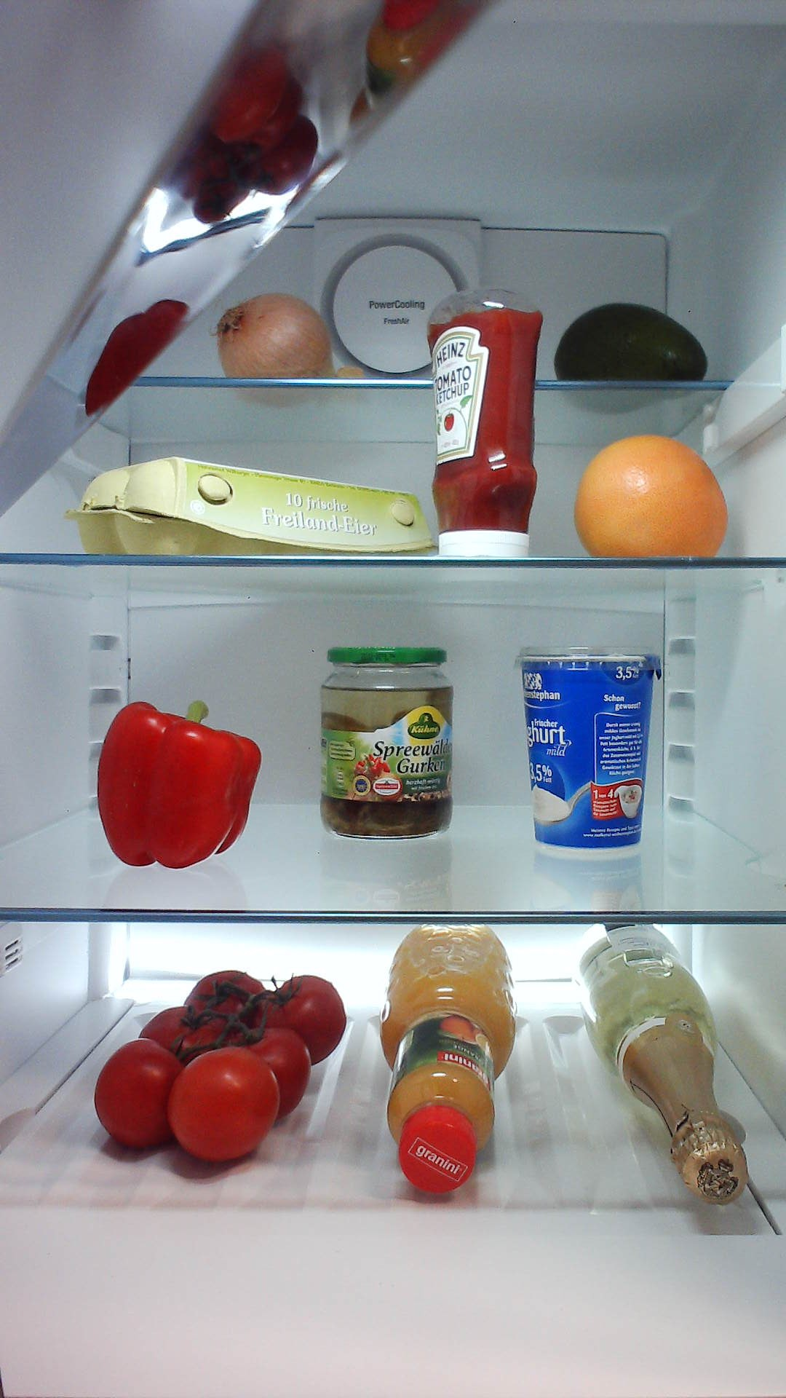
Proposals
Class 1
ConvNet
Feature map
Classifier
Class 2
Ex. VGG16, ZF
Class 3

Slide 2
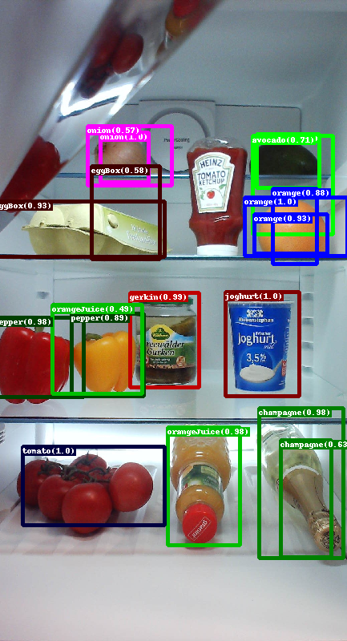
RPN
1x1 conv
Obj. det.
NMS/
threshold
3x3 conv.
1x1 conv
Box reg.
Transform boxes
NMS/
threshold
Proposals
ConvNet
Feature map
Fast R-CNN
Roipooling
FC
Ex. VGG16, ZF
Softmax
FC
Transform boxes
Box reg.

Slide 3
Stride = 2
Stride = 4
Stride = 8
Stride = 16
Stride = 32
Pool4
Pool5
fc6 – drop6
fc8
Pool2
Conv3_3
Prop
Conv2_1
Pool3
Conv4_3
Conv5_3
Data
Conv2_2
Conv1_1
Conv1_2
Pool1
Conv3_1
Conv3_2
Conv4_1
Conv4_2
Conv5_1
Conv5_2
fc7 – drop7
Feature extractor network

