Slide 1
Implementaion of Floyd warshall algorithm in java
End Semester Project
TOPIC – ROUTE MAP NAVIGATION USING FLOYD WARSHALL ALGORITHM

Slide 2
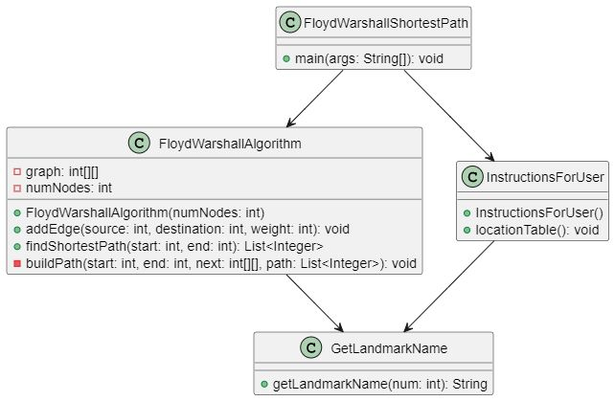
UML DIAGRAM

Slide 3
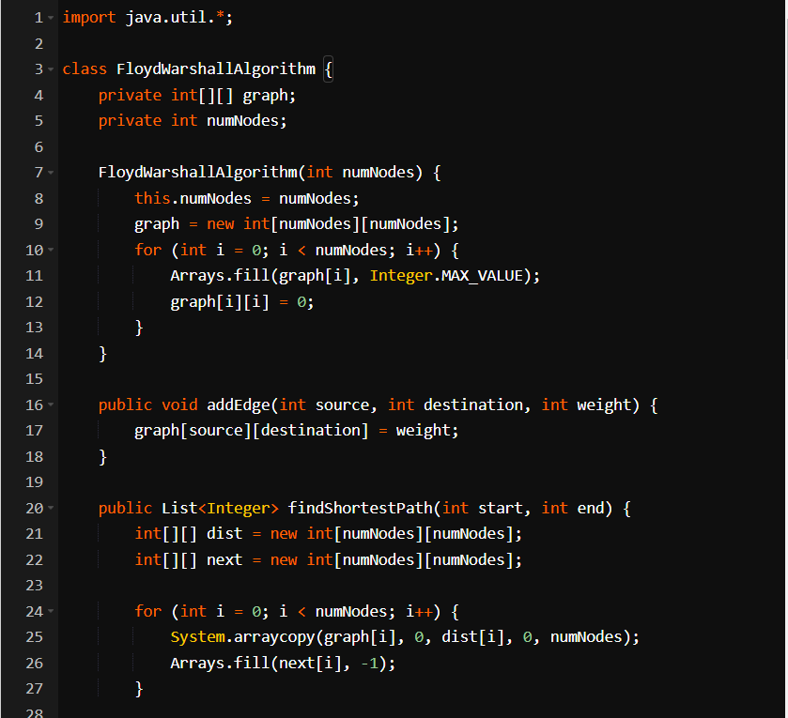
CODE

Slide 4
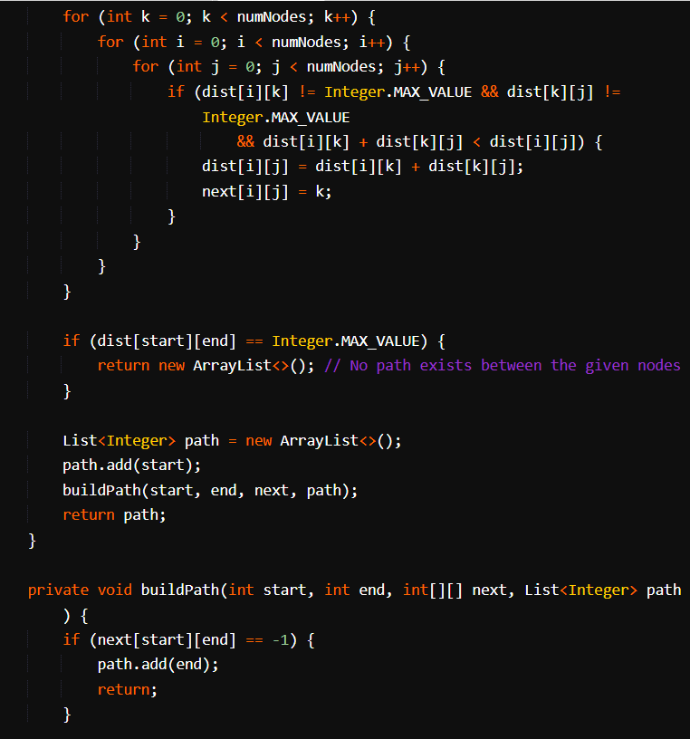
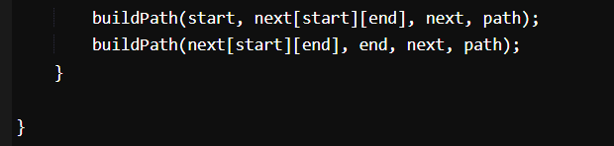

Slide 5
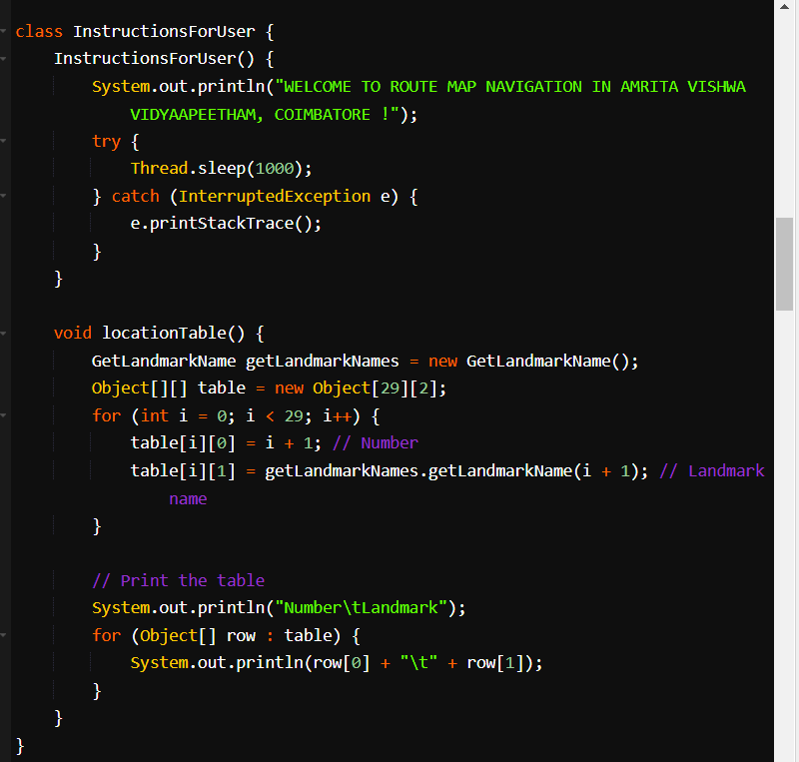
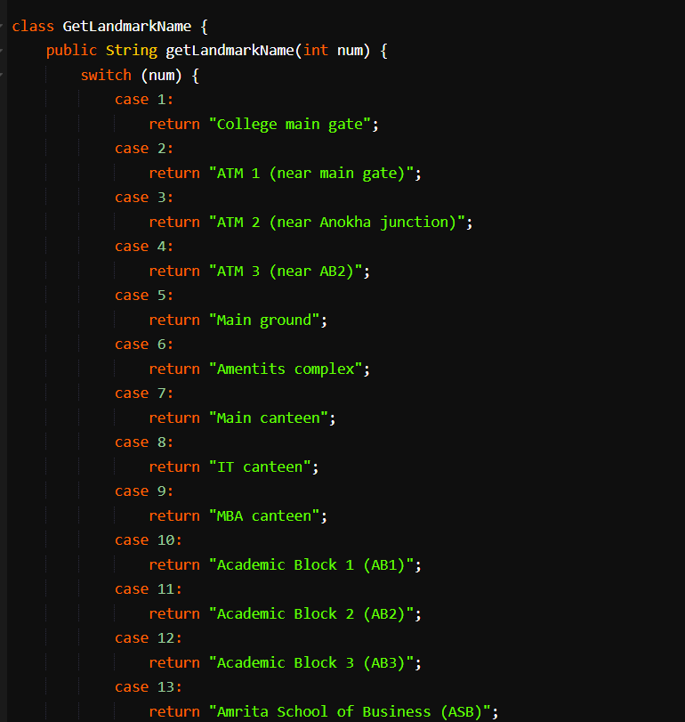

Slide 6
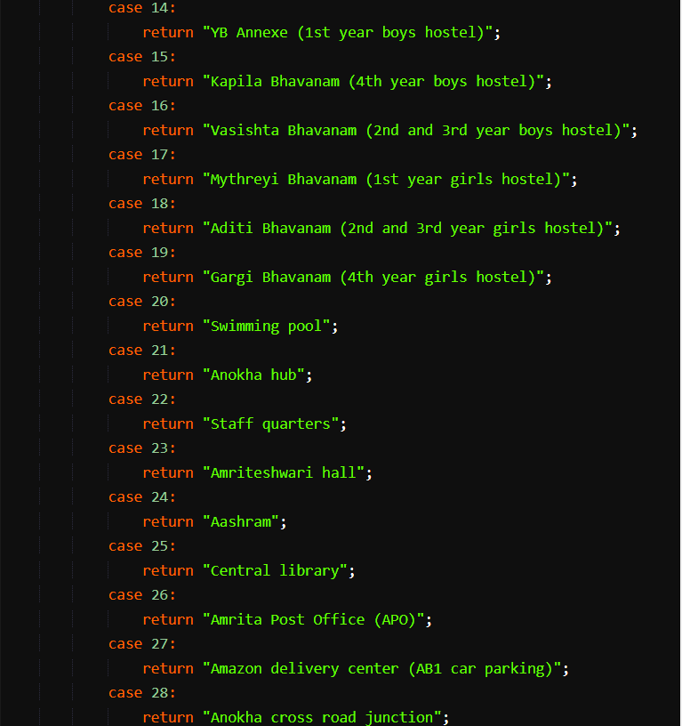
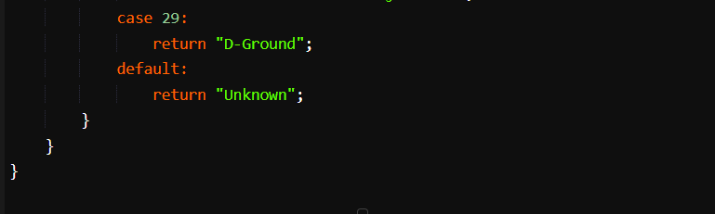

Slide 7
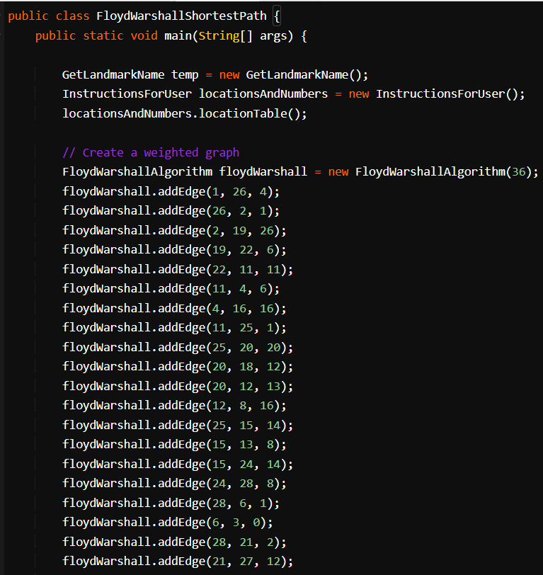
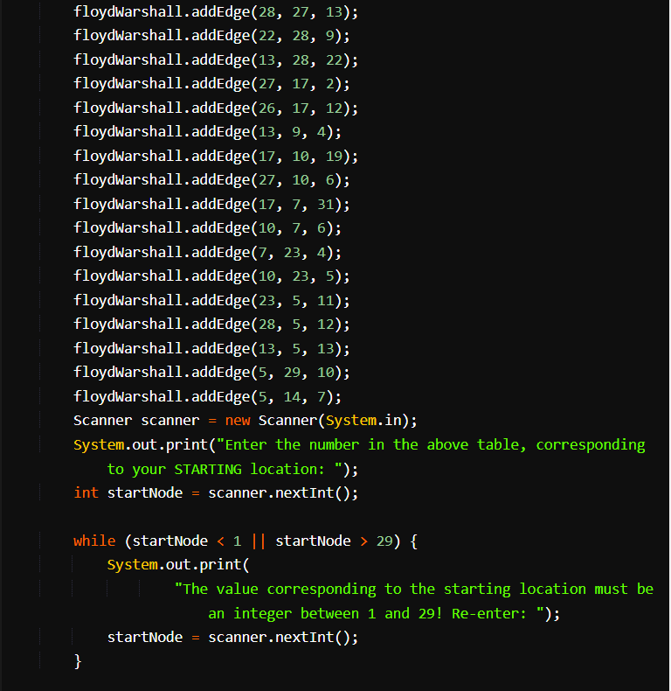

Slide 8
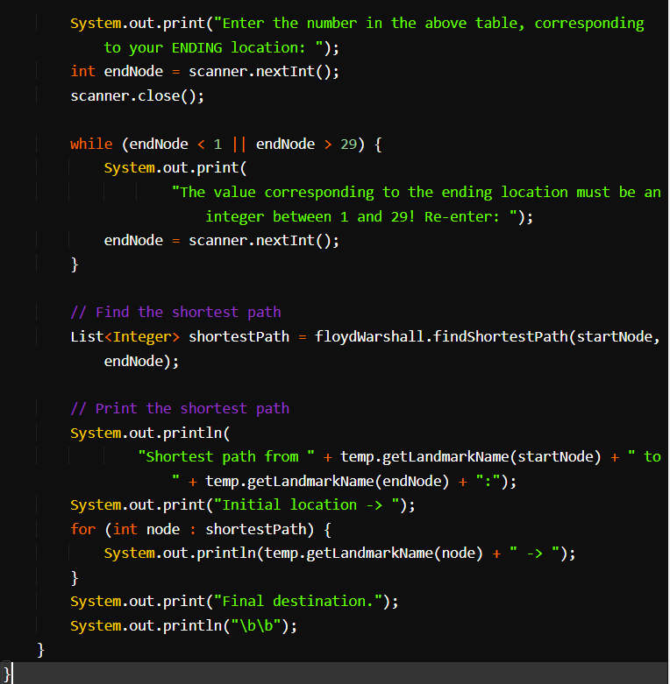

Slide 9
CODE EXPLANATION
The above code implements the Floyd-Warshall algorithm for finding the shortest path between two nodes in a weighted graph. Here's a step-by-step explanation of the code:
The code begins with the definition of the FloydWarshallAlgorithm class, which represents the algorithm implementation. It initializes the graph and provides methods for adding edges and finding the shortest path.
The InstructionsForUser class is defined to provide some introductory instructions for the user.
The GetLandmarkName class contains a method getLandmarkName that returns the name of a landmark given its corresponding number.
The main method in the FloydWarshallShortestPath class is the entry point of the program.
An instance of the GetLandmarkName class is created, and the InstructionsForUser class is instantiated to display the location table.
An instance of the FloydWarshallAlgorithm class is created with a parameter 36, which represents the total number of nodes in the graph.
Edges are added to the graph using the addEdge method of the FloydWarshallAlgorithm class. Each edge is defined by its source node, destination node, and weight.

Slide 10
The user is prompted to enter the starting and ending location numbers. The findShortestPath method of the FloydWarshallAlgorithm class is called with the start and end node numbers to find the shortest path between them. If a valid path is found, it is stored in the shortestPath list. The shortest path is printed, starting from the initial location and ending at the final destination. The Floyd-Warshall algorithm itself works as follows: A 2D array dist is created to store the distances between each pair of nodes. Initially, it is filled with the weight values of the graph's edges. Another 2D array next is created to store the next node in the shortest path. The algorithm iterates over all nodes to find the shortest path between any two nodes by considering intermediate nodes.

Slide 11
For each pair of nodes (i, j) and for each intermediate node k, it checks if the path from i to k and then from k to j is shorter than the current shortest path from i to j. If so, it updates the distance and next node accordingly. After the algorithm completes, if the distance from the start node to the end node is still Integer.MAX_VALUE, it means there is no path between them. Otherwise, the shortest path is built by recursively backtracking through the next array. Finally, the shortest path is returned as a list of node numbers. Note: The code assumes that the location table has 29 entries, numbered from 1 to 29. The table maps the location numbers to their corresponding names, and it is used to display the names of the start and end locations, as well as the intermediate nodes in the shortest path.

Slide 12
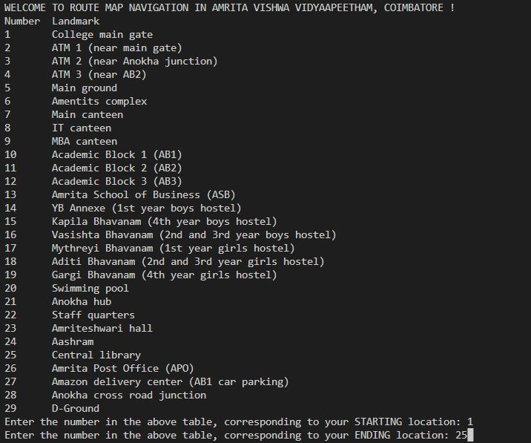
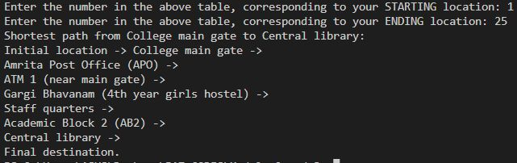
OUTPUT

Slide 13
THANK YOU

