Slide 1
ROUTE MAP NAVIGATION IN JAVA USING DIJKSTRA’S ALGORITHM
OBJECT ORIENTED PROGRAMING IN JAVA
END SEMESTER PROJECT, MODULE 1
Presented by : P.GUNA VARDHAN [CB.EN.U4AIE22145],
On behalf of Project Group 17, AIE-B

Slide 2
Introduction
What / Why / How
ARE WE GOING TO DO?

Slide 3
01
Dijkstra algorithm definition and logic

Slide 4
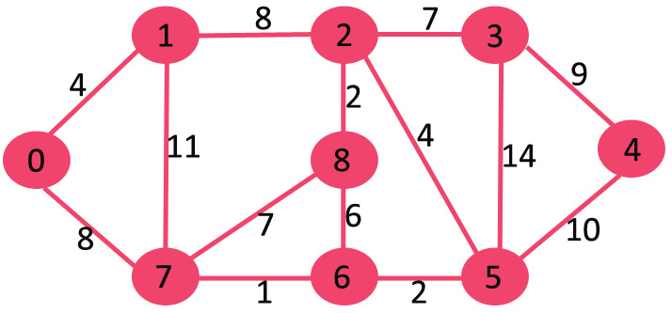
How to we calculate the shortest between two nodes in such trees?

Slide 5
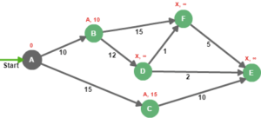
EXAMPLE
Now that we have our graph initialized, we pick the node with the lowest distance from the unsettled set, then we evaluate all adjacent nodes that are not in settled nodes: The idea is to add the edge weight to the evaluation node distance, then compare it to the destination's distance. e.g. for node B, 0+10 is lower than INFINITY, so the new distance for node B is 10, and the new predecessor is A, the same applies to node C.
Node A is then moved from the unsettled nodes set to the settled nodes.

Slide 6
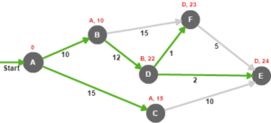
EXAMPLE
Nodes B and C are added to the unsettled nodes because they can be reached, but they need to be evaluated.
Now that we have two nodes in the unsettled set, we choose the one with the lowest distance (node B), then we reiterate until we settle all nodes in the graph:

Slide 7
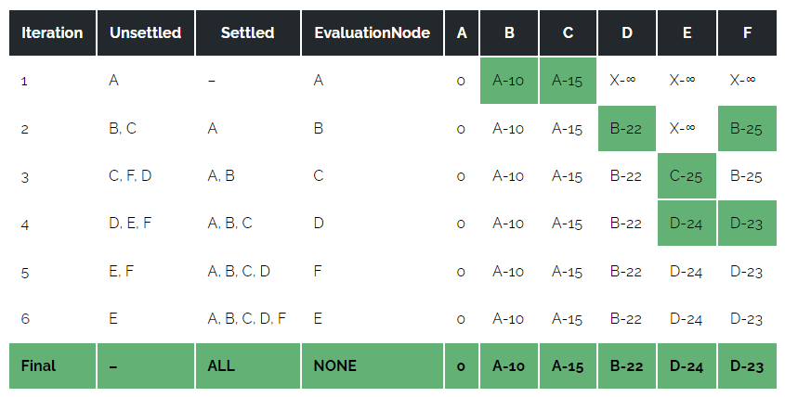
EXAMPLE

Slide 8
Final answer for this example
Finally, we can calculate the shortest paths from node A are as follows:
Node B : A –> B (total distance = 10)
Node C : A –> C (total distance = 15)
Node D : A –> B –> D (total distance = 22)
Node E : A –> B –> D –> E (total distance = 24)
Node F : A –> B –> D –> F (total distance = 23)

Slide 9
Implementation in JAVA.

Slide 10
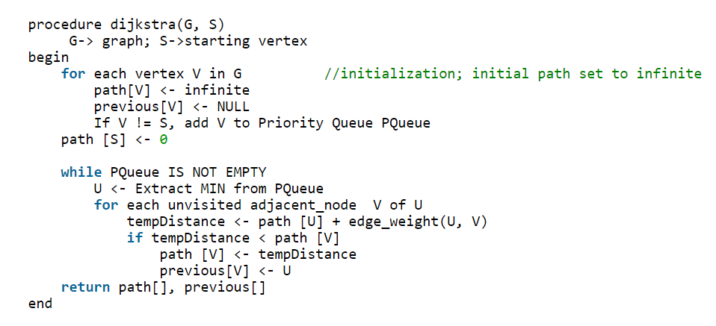
Pseudo Code

Slide 11
PROGRAM
We wrote to implement it in JAVA

Slide 12
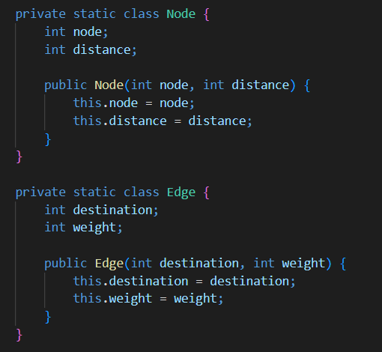
“DijkstraAlgorithm” class

Slide 13
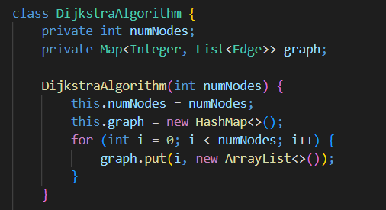
“DijkstraAlgorithm” class

Slide 14
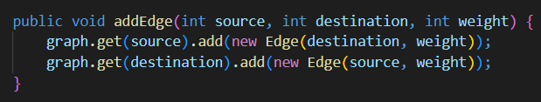
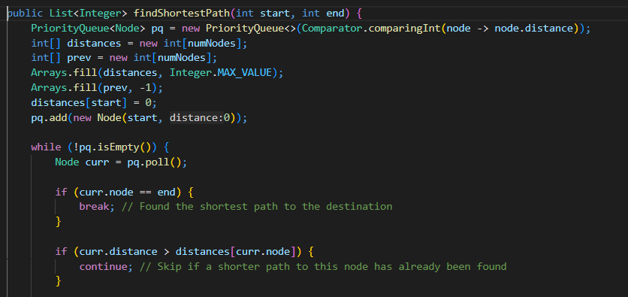
“DijkstraAlgorithm” class

Slide 15
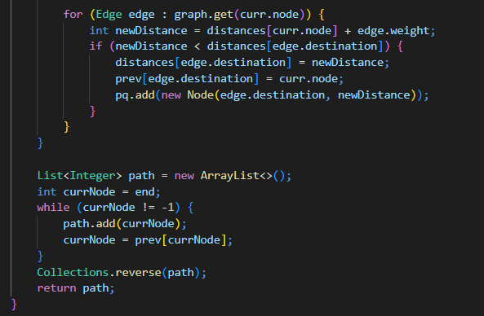
“DijkstraAlgorithm” class

Slide 16
02
Classification and Relevance of remaining classes

Slide 17
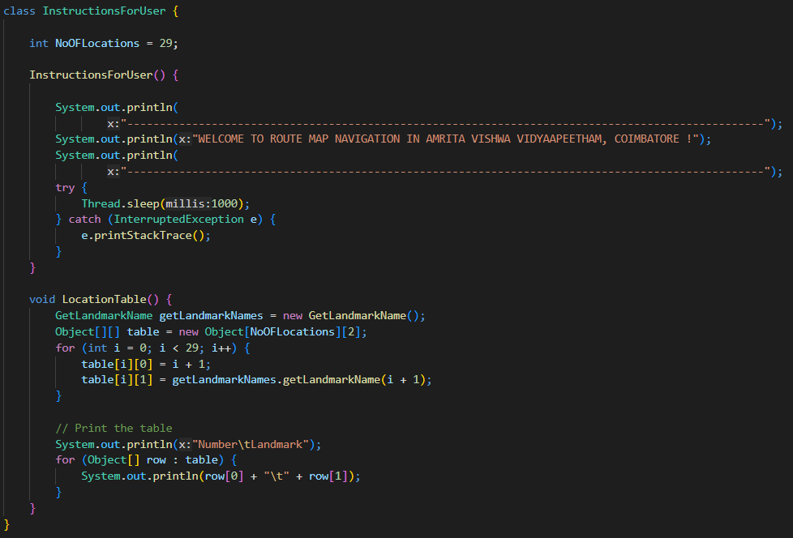
“InstructionsForUser” class

Slide 18
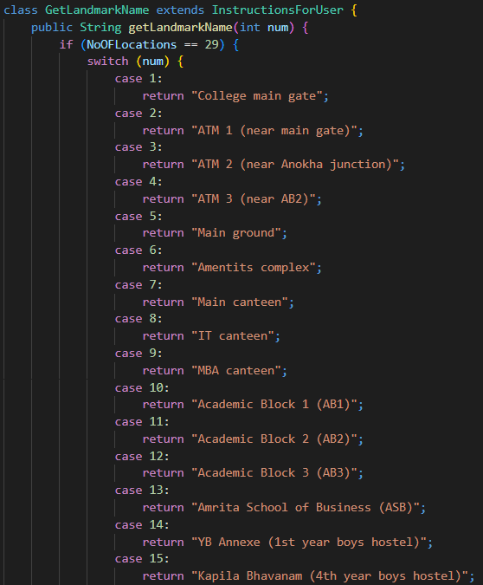
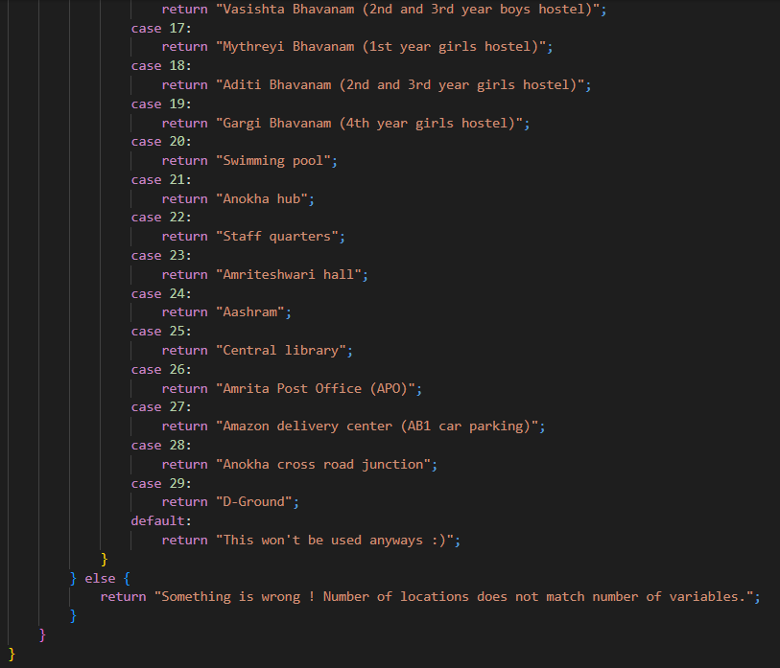
“GetLandMarkName” class

Slide 19
03
Main class and LOGIC

Slide 20
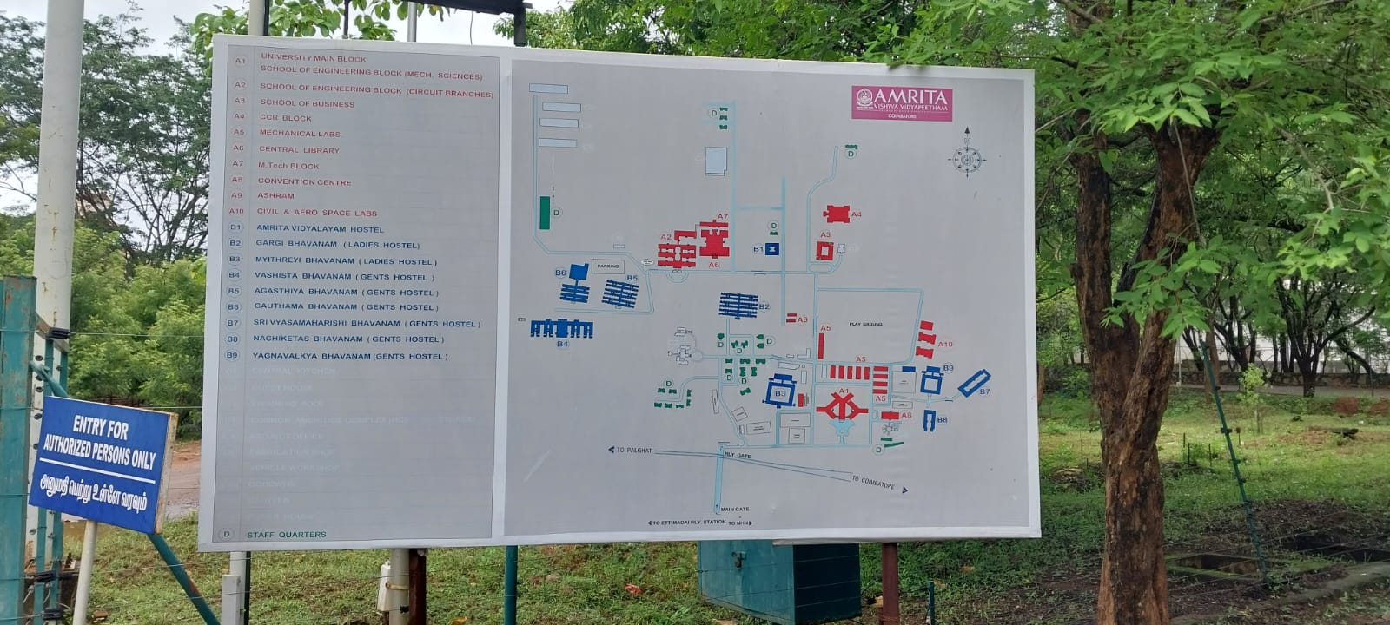
What did we do?

Slide 21
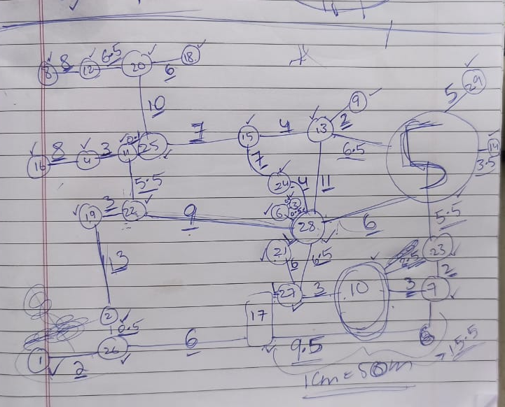
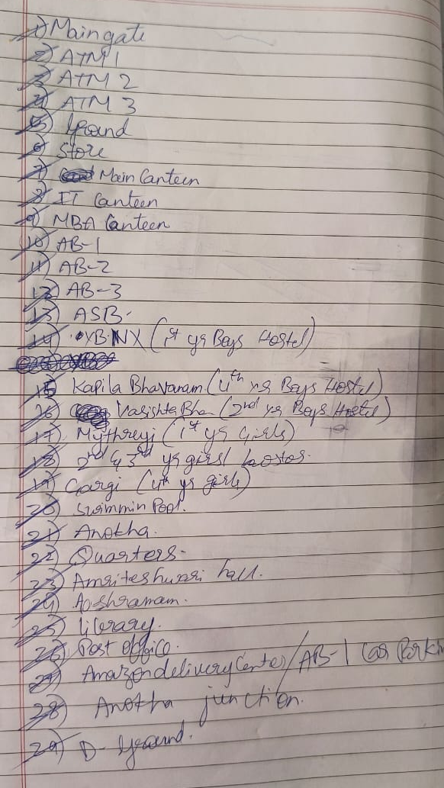
What did we do?

Slide 22
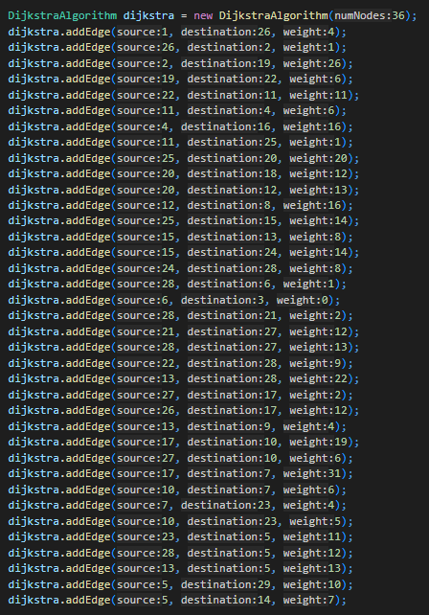
Creating tree in java using the map we have drawn

Slide 23
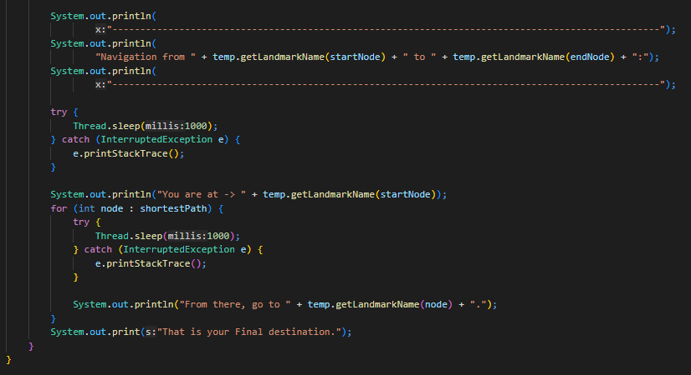
Printing the output

Slide 24
Usage of Object Oriented Programing
Classes
Objects
Constructors
Access modifies
“This”
Inheritance
Exception Handling

Slide 25
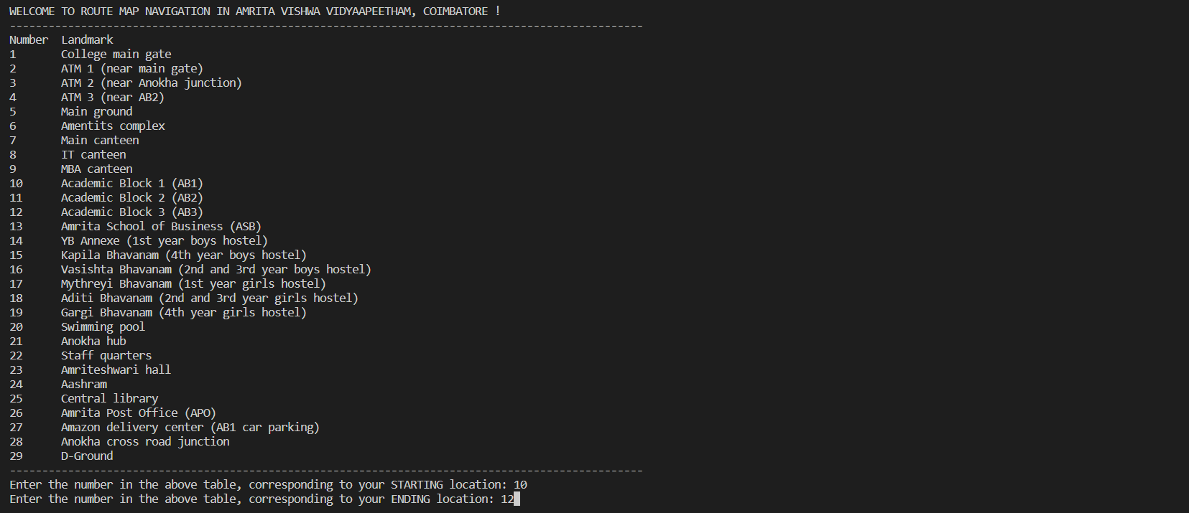
OUTPUT VERIFICATION

Slide 26
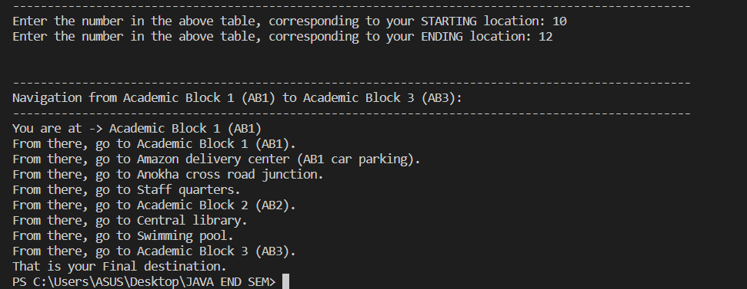
OUTPUT VERIFICATION

Slide 27

THANK YOU

