Slide 1
EOC II SEM 2 PROJECT
ELEMENTS OF COMPUTING SYSTEMS
PRESENTED BY : TEAM NUMBER 17

Slide 2
A
PART
Implementation of HACK computer in HDL

Slide 3
Basic Concept
The Nand2Tetris course is a comprehensive exploration of computer engineering and electronics design. It guides students through the process of building a fully functional general-purpose computer called the Hack computer. The course, developed by Noam Nisan and Simon Schocken, covers the assembly of logic gates, combinational chips, and the arithmetic logic unit (ALU) using the fundamental NAND gate.
One of the key components used in the construction of sequential logic circuits, which are vital for the memory in the Hack computer, is the Data Flip Flop (DFF). Students learn to implement various essential elements such as Bits, Registers, RAM chips, and a Programme Counter. This hands-on approach allows them to gain a deep understanding of how hardware chips function.
The course also enables participants to create an operating system capable of executing complex programs like Tetris. By leveraging the fundamental NAND logic gate and combining it with the constructed hardware, students gain practical experience in designing and building a fully operational computer system.

Slide 4
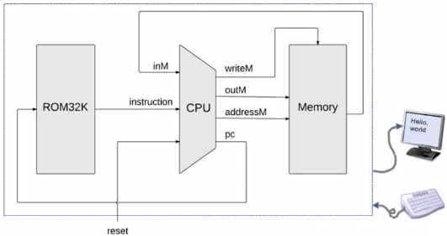
Hack Computer

Slide 5
HACK Computer (HDL code)
CHIP Computer {
IN reset;
PARTS:
// Put your code here:
ROM32K(address=pc, out=instruction);
CPU(inM=memOut, instruction=instruction, reset=reset, outM=outM,
writeM=writeM, addressM=addressM, pc=pc);
Memory(in=outM, load=writeM, address=addressM, out=memOut);
}
We use several other pre existing files for out operation

Slide 6
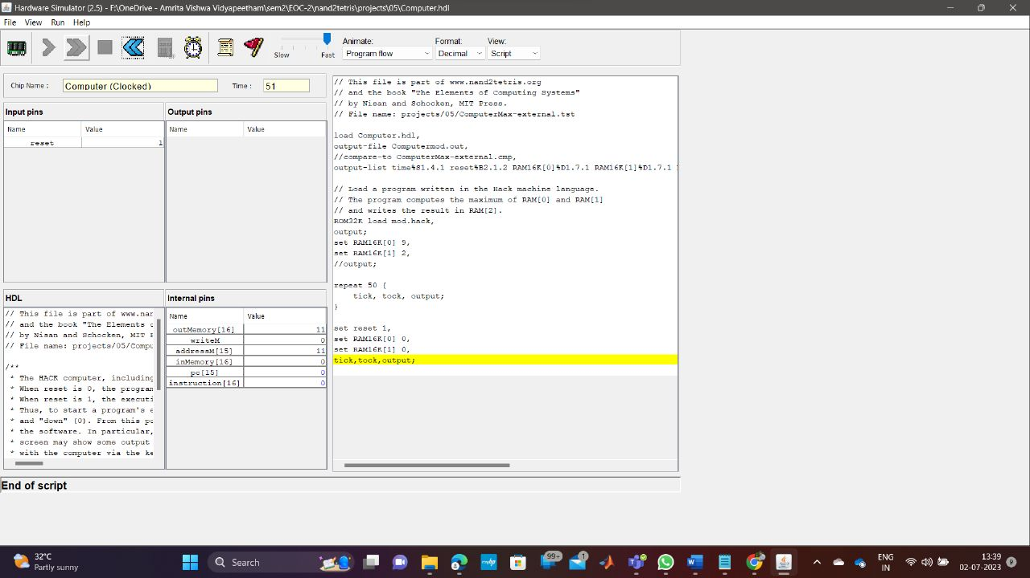
Output Verification

Slide 7
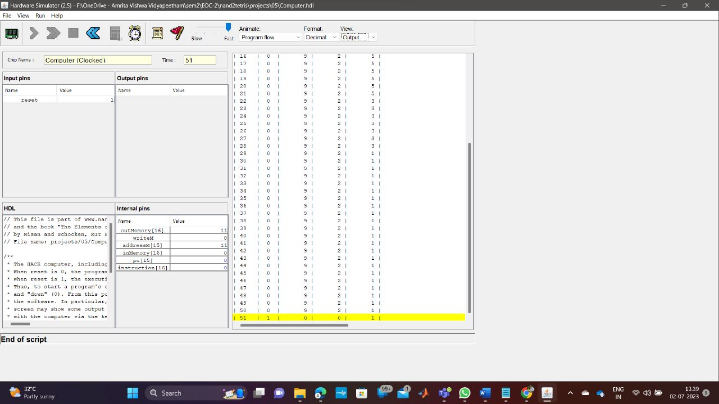
Output Verification

Slide 8
B
PART
Implementation of PONG game in jack.

Slide 9
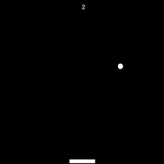
What is PONG GAME ?
A single-player Pong game is a classic arcade game that simulates a virtual table tennis match. In this version, the player controls a paddle on one side of the screen, while the computer controls the opposing paddle on the other side. The objective is to hit the ball back and forth, trying to prevent it from passing the player's paddle and scoring points. The game typically features simple graphics, with a ball, paddles, and a basic playing field.

Slide 10
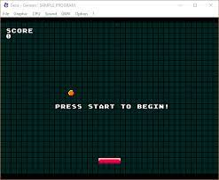
What is PONG GAME ?
The player's paddle is usually controlled using either the keyboard or mouse, allowing them to move up and down to intercept the incoming ball. The computer-controlled paddle is programmed to follow the ball's movement and attempt to return it. As the game progresses, the ball's speed increases, making it more challenging for the player to react in time. The player earns points for successfully hitting the ball and loses points or lives when they miss it. The goal is to achieve the highest possible score by keeping the ball in play for as long as possible.

Slide 11
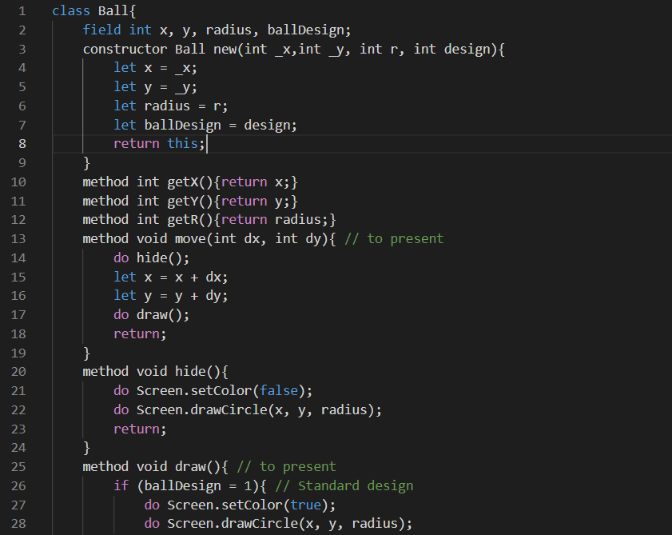
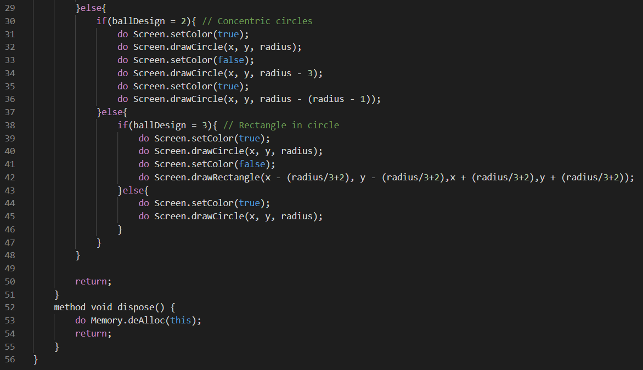
Implementation in JACK (‘Ball’ file)

Slide 12
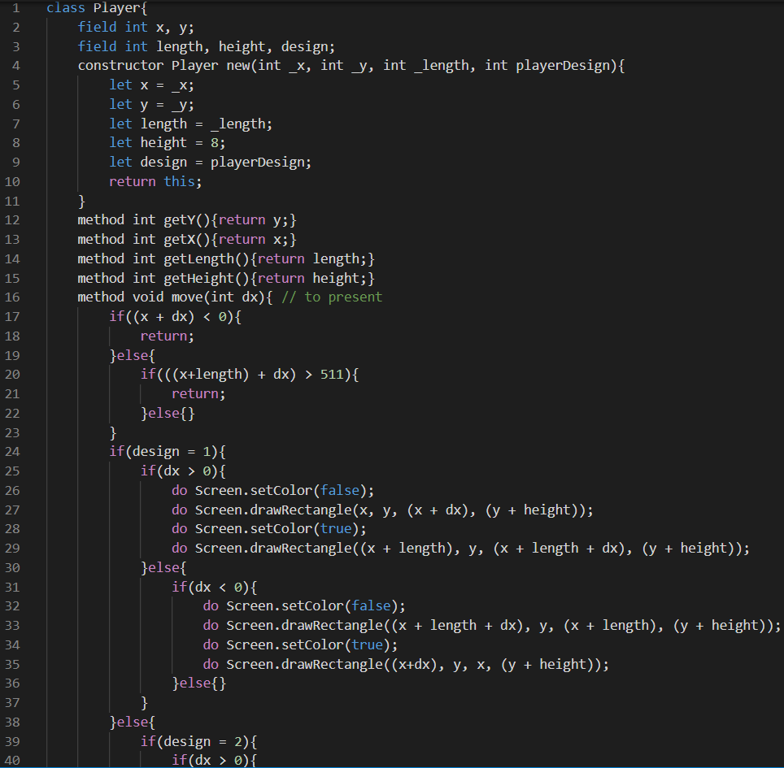
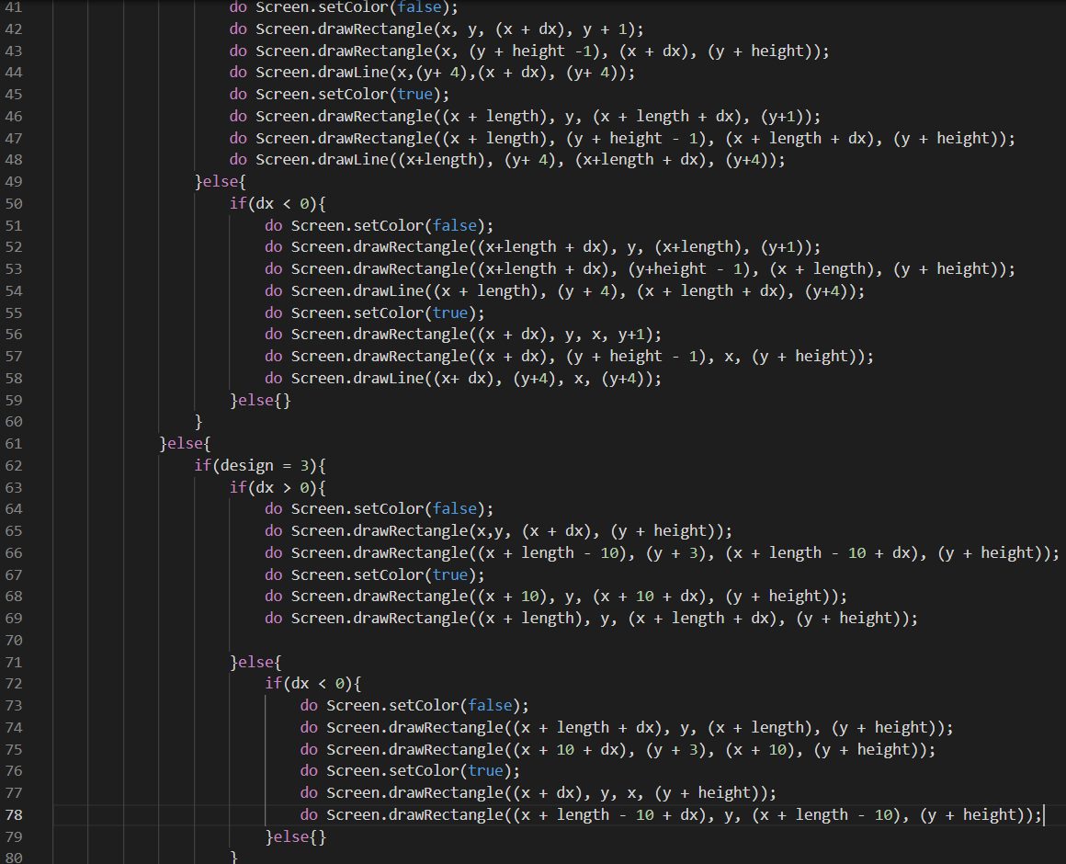
Implementation in JACK (‘Player’ file)

Slide 13
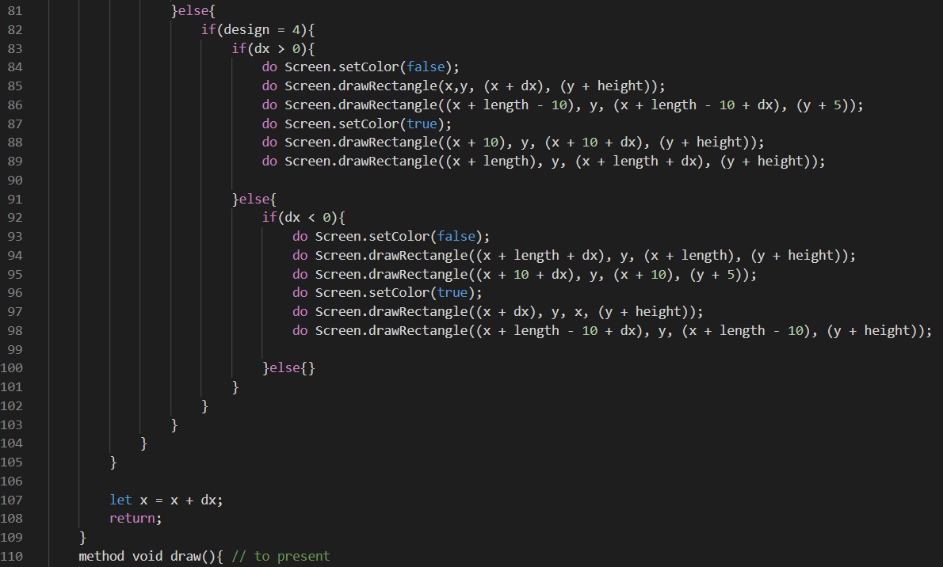
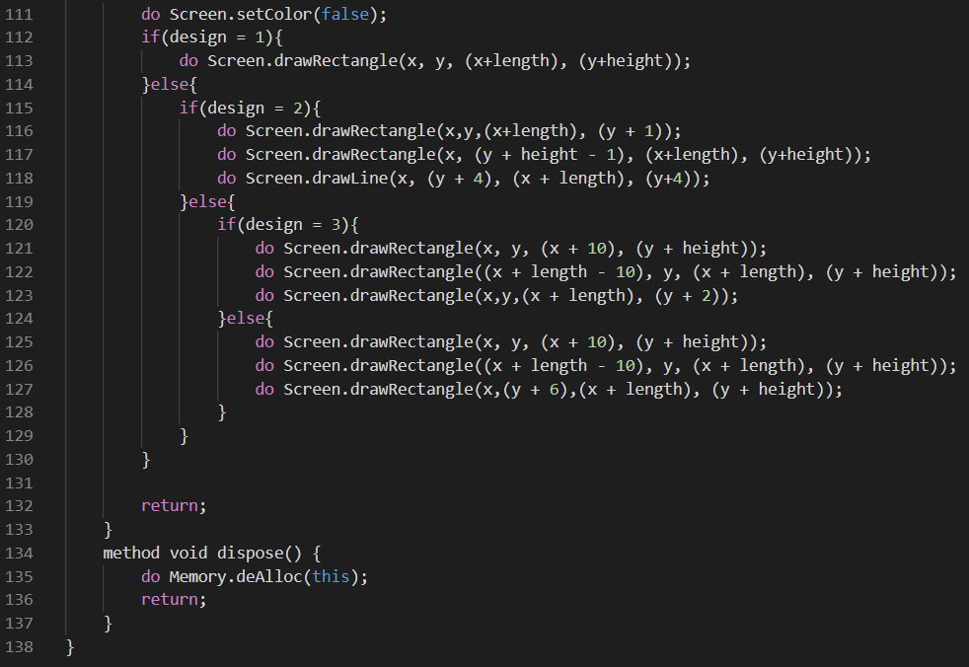
Implementation in JACK (‘Player’ file)

Slide 14
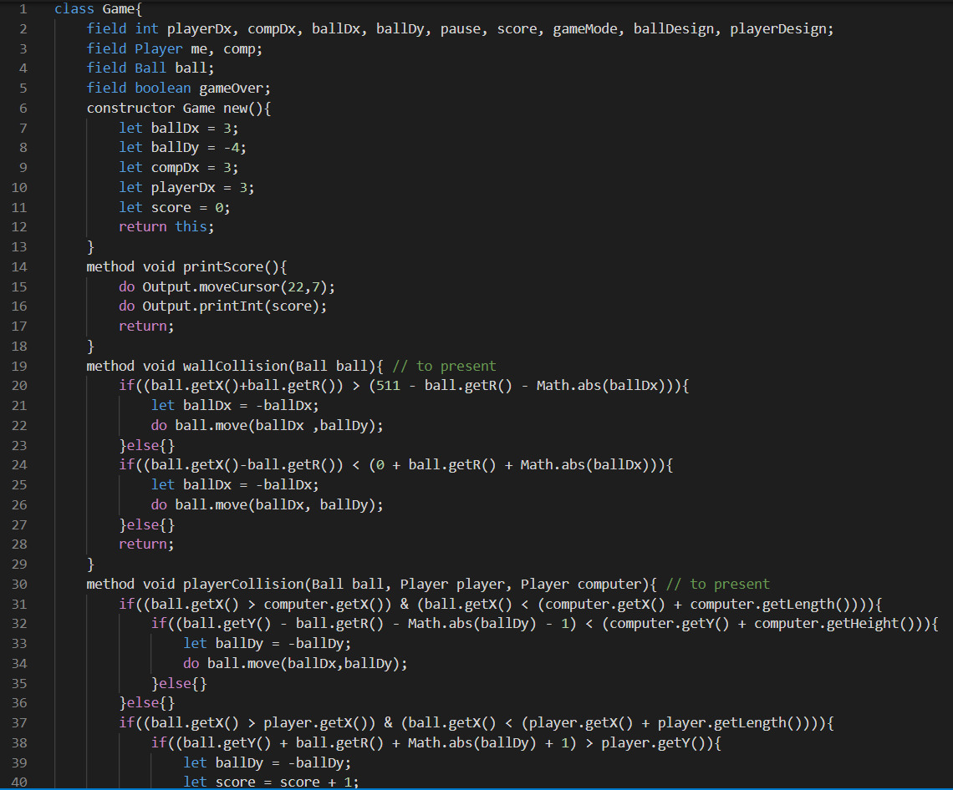
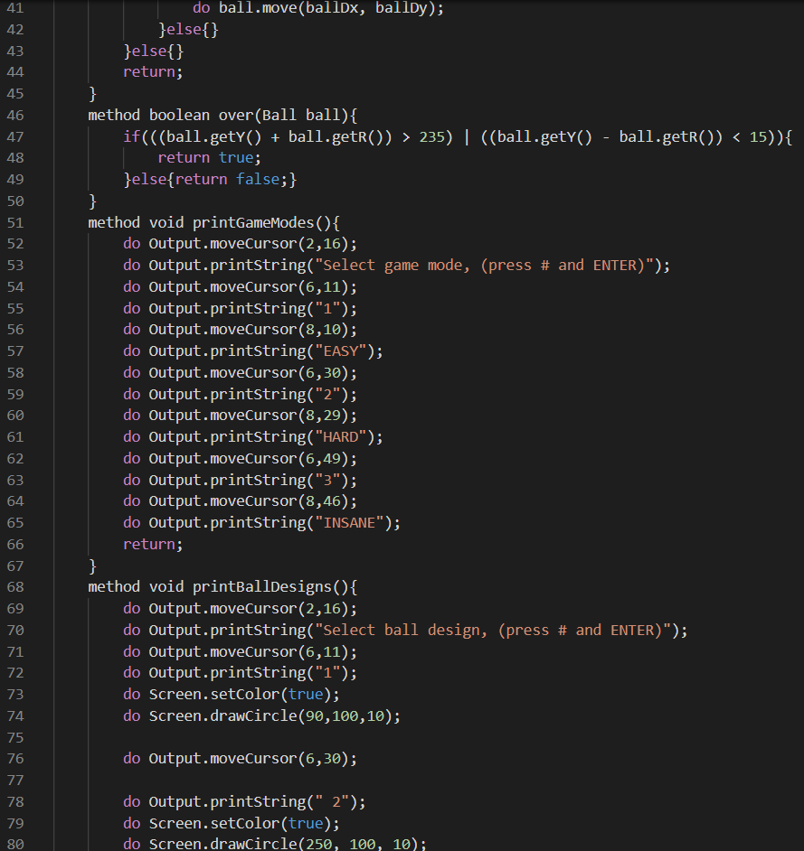
Implementation in JACK (‘Game’ file)

Slide 15
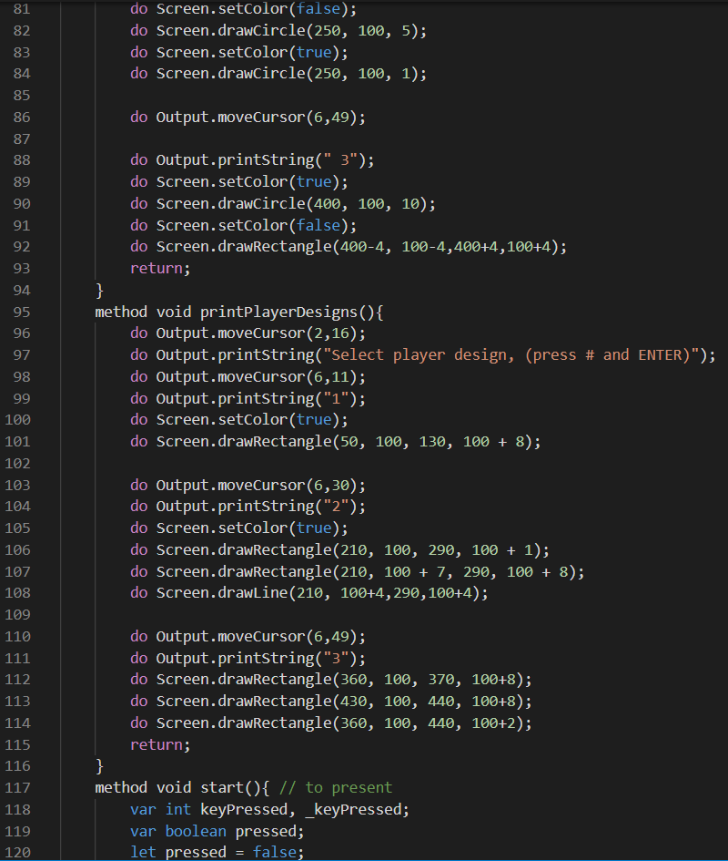
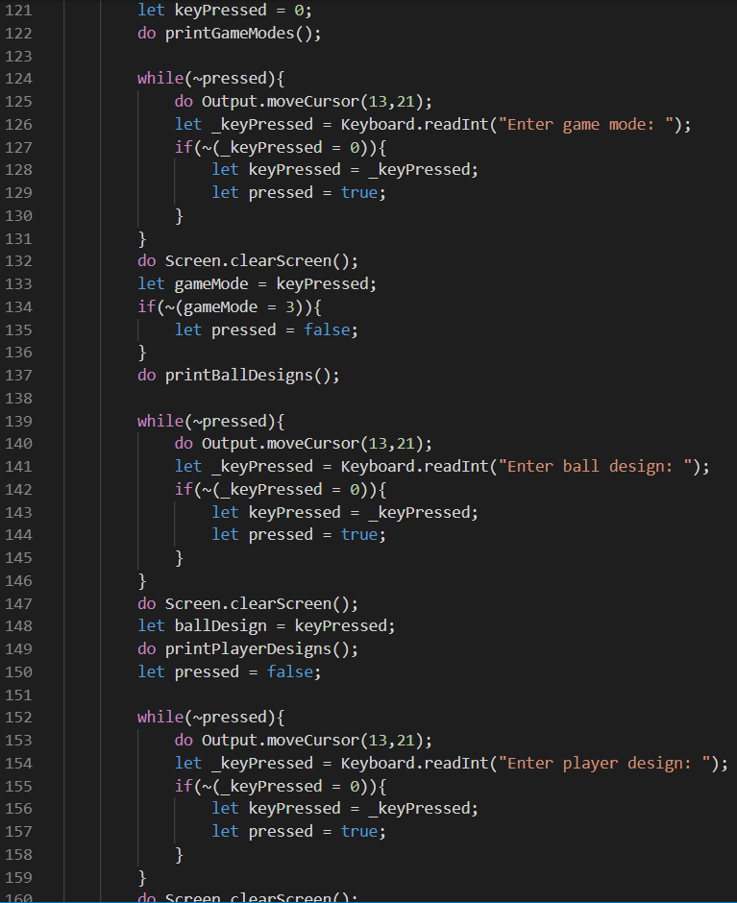
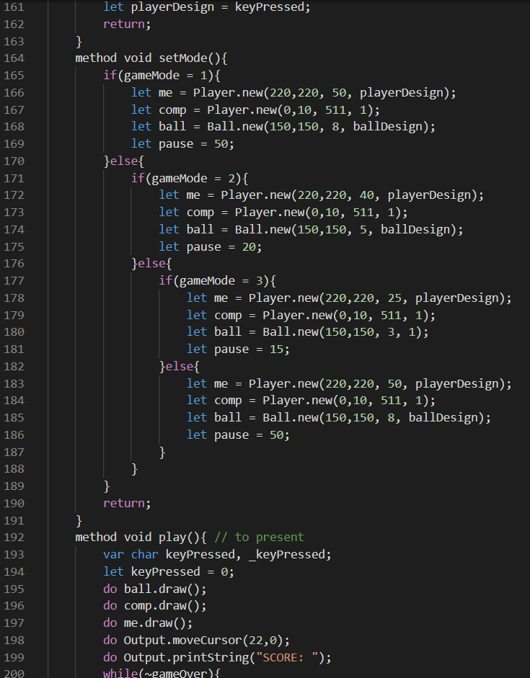
Implementation in JACK (‘Game’ file)

Slide 16
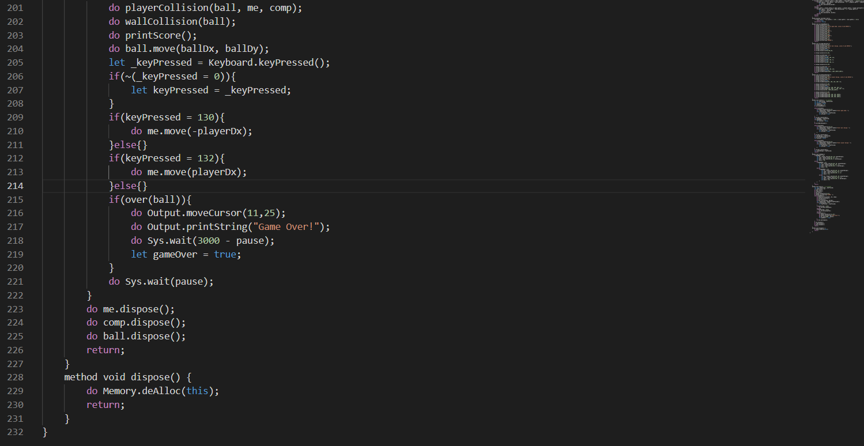
Implementation in JACK (‘Game’ file)

Slide 17
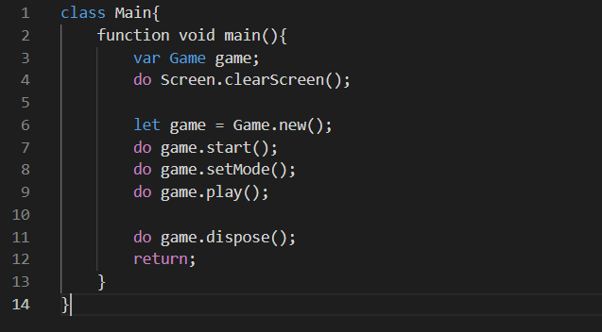
Implementation in JACK (‘Main’ file)

Slide 18
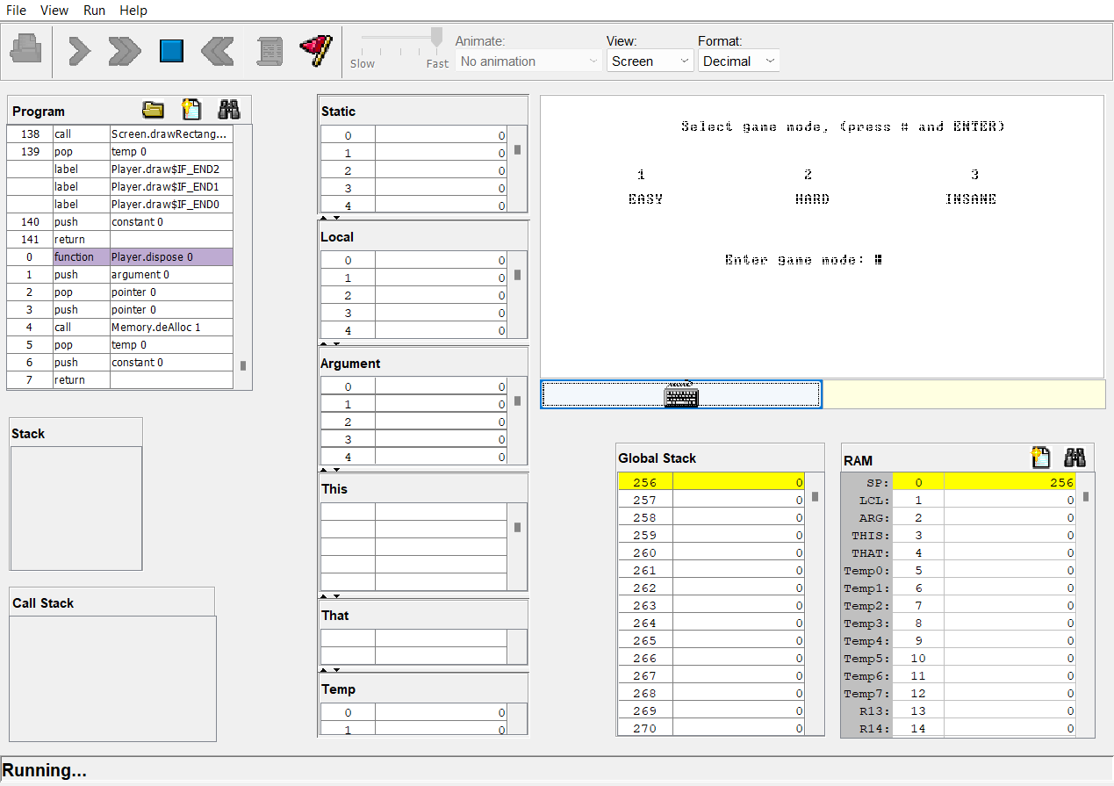
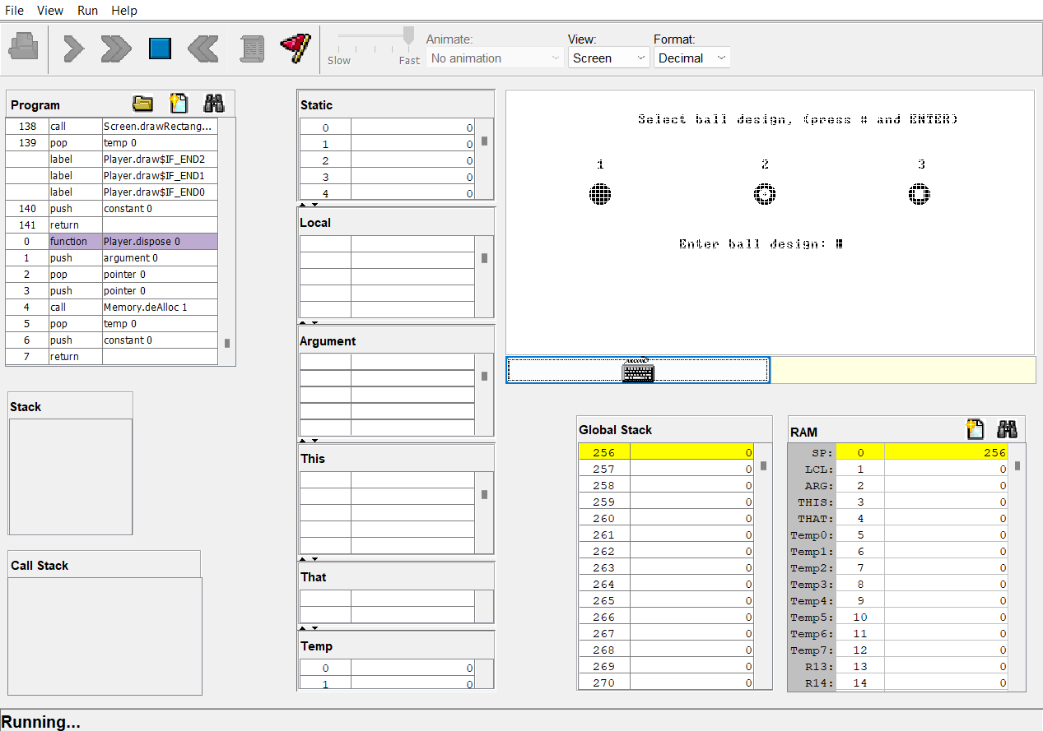
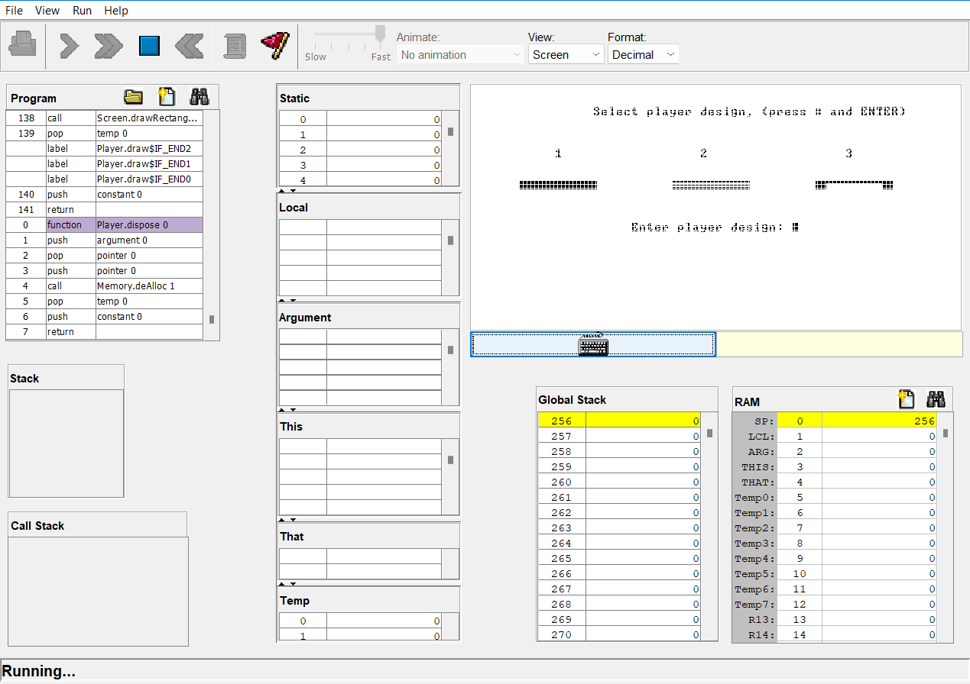
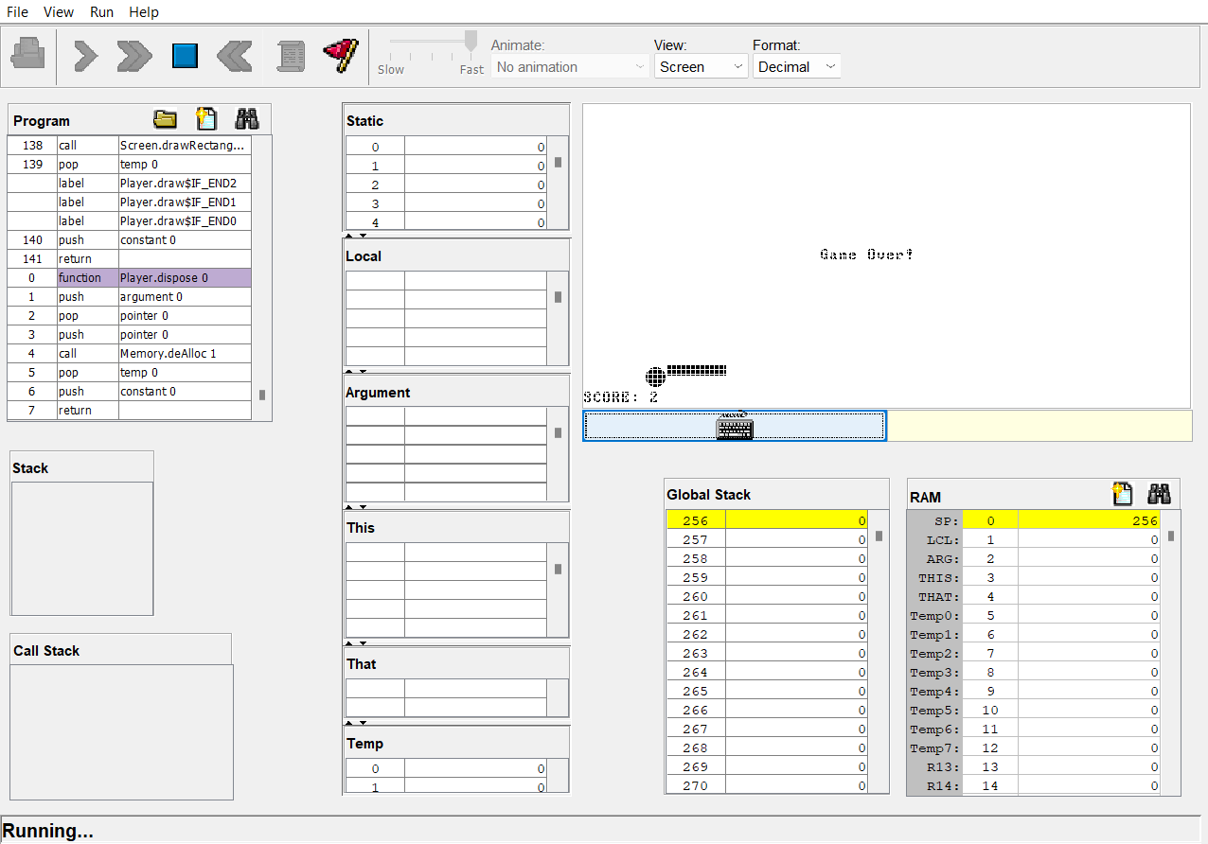
Output Verification

Slide 19

Thank You

