Slide 1
Damage Detection of Bearings
Done by
Guru Prasaath Pushparaj
Matri.no : 1702033
guru.pushparaj@student.uni-siegen.de
Data set used: ws2324_9
Password: WS2324_951419
Condition Monitoring
(Vibration Based methods)
Structural Health Monitoring

Slide 2
Project objective and Steps involved:
Objective:
Analyzing the signals given in the data set obtained from the bearing using sensor by various signal processing techniques taught in the lecture and exercise class.
Identifying the type of damage occurred in the bearing by the above techniques used.
Steps:
Analyzing the signals in both Time and Frequency domain
Statistical Features like mean, variance, standard deviation, kurtosis, skewness, probability density function, Cumulative density function, quantiles, etc. were found and plotted in the graphs.
In Frequency domain the signals are Fourier transformed and their respective amplitude spectrum, welch curve and power spectral density were calculated and plotted.
The method of windowing using various windows were applied and the signals are plotted.
The Envelope spectrum of the signals were constructed using Hilbert transform and the PSD of the envelope was compared with the harmonics of the damaged frequencies to identify the type of damage occurred in the bearing.

Slide 3
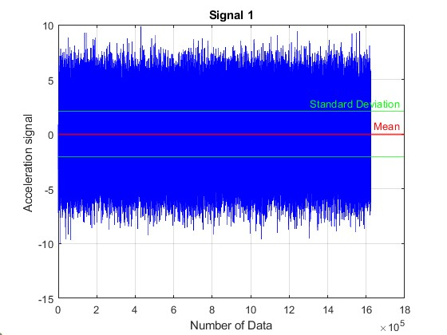
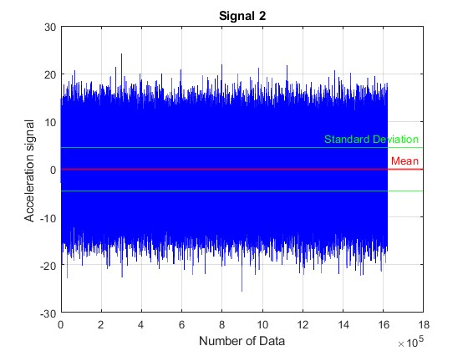
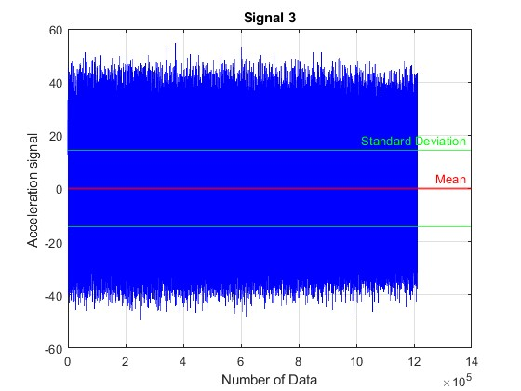
Statistical Feature Analysis in Time domain:
Features | Value | Features | Value
Mean | -0.026 | Skew | -0.0025
RMS | 2.0661 | crest | 4.866
Var | 4.268 | kurtosis | 2.9767
STD | 2.066 | Quantile | -0.0271
Features | Value | Features | Value
Mean | -0.036 | Skew | -0.0334
RMS | 4.5611 | crest | 5.6266
Var | 20.802 | kurtosis | 3.111
STD | 4.5610 | Quantile | -0.0151
Features | Value | Features | Value
Mean | -0.024 | Skew | 0.048
RMS | 14.401 | crest | 3.7878
Var | 207.40 | kurtosis | 2.4084
STD | 14.401 | Quantile | -0.2171

Slide 4
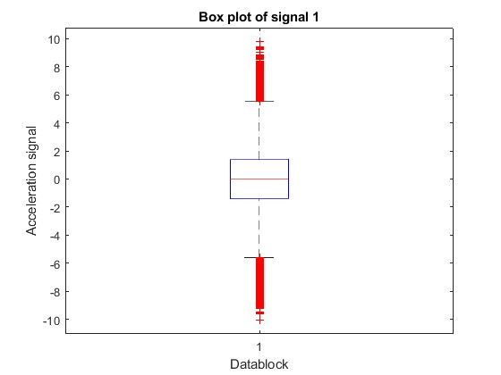
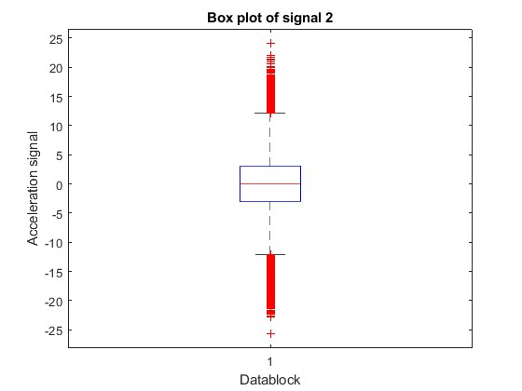
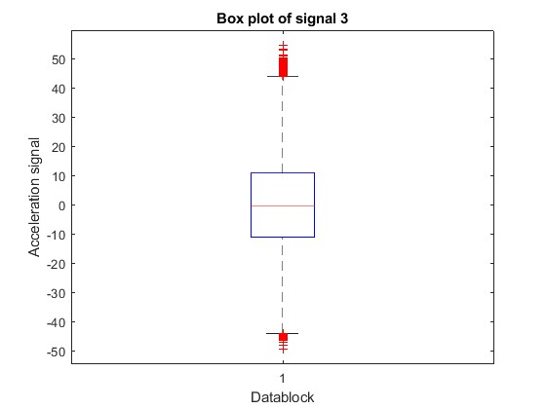
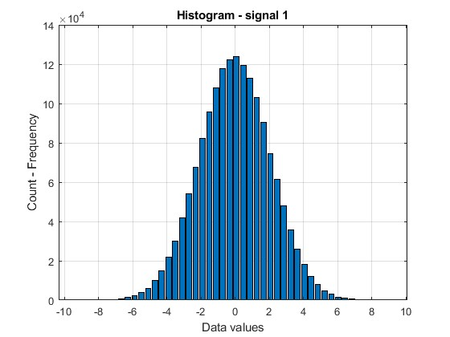
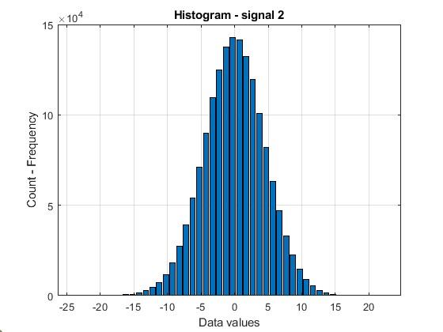
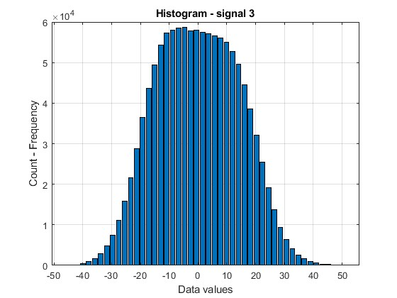
Statistical Feature Analysis in Time domain:

Slide 5
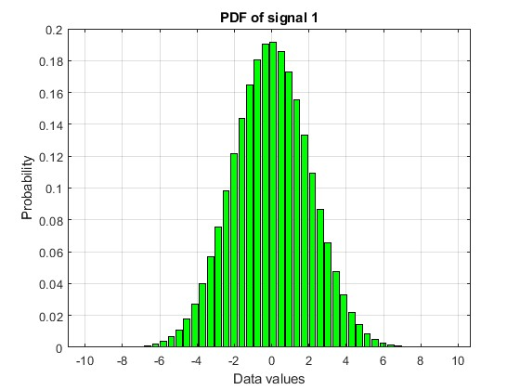
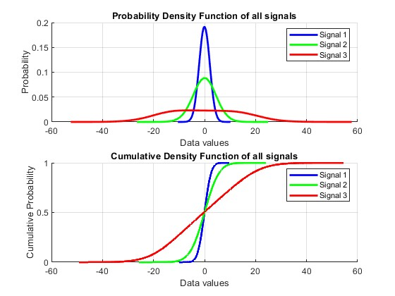
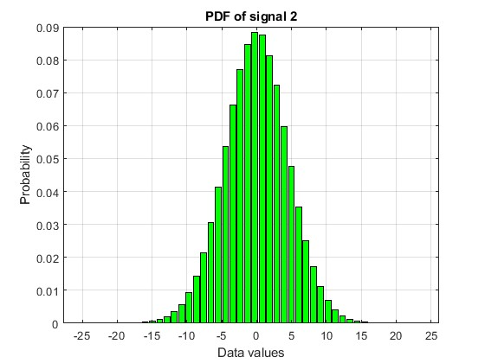
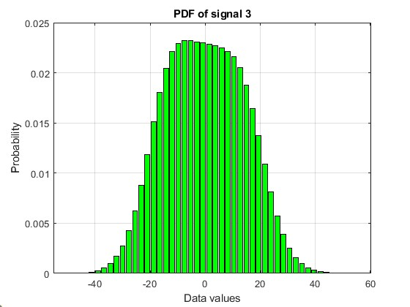
Statistical Feature Analysis in Time domain:

Slide 6
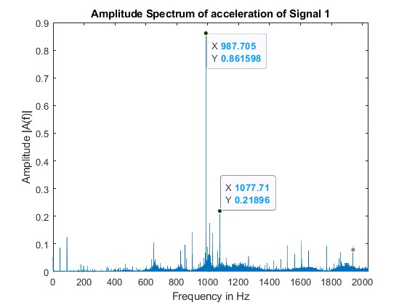
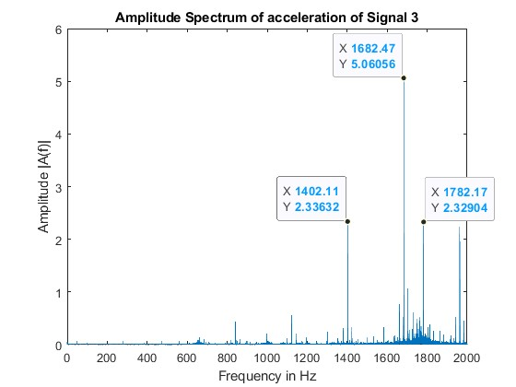
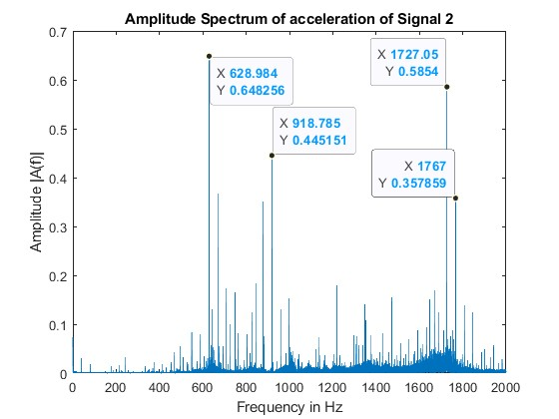
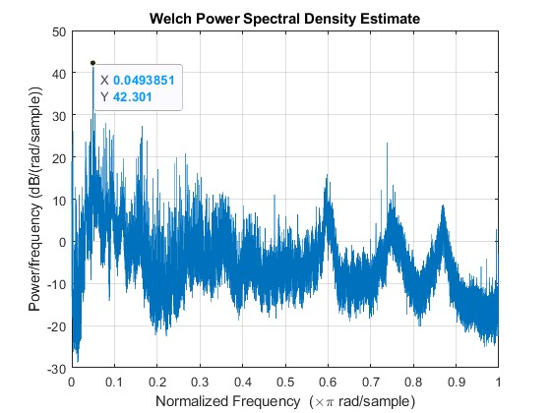
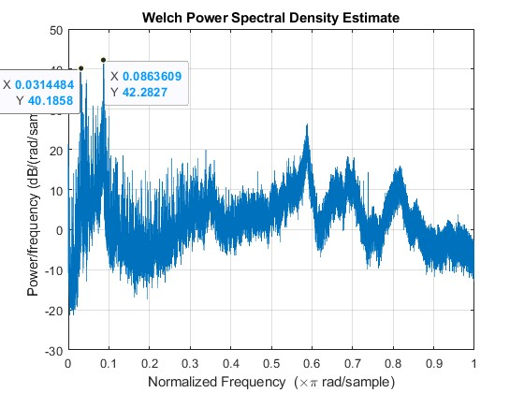
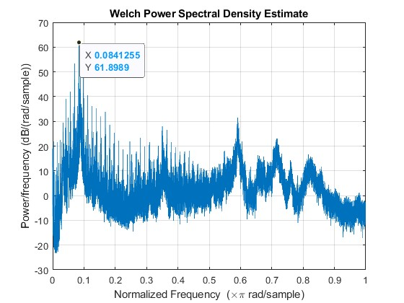
Frequency Domain – Amplitude spectrum and Welch spectrum:

Slide 7
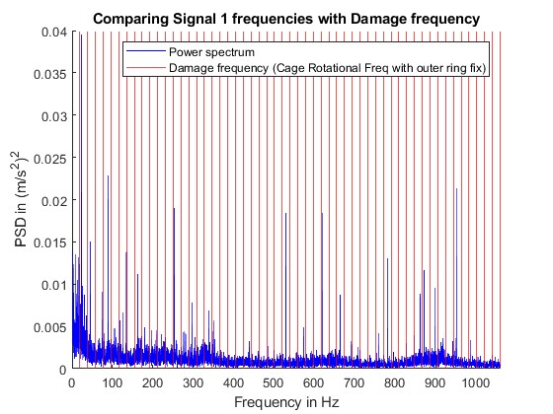
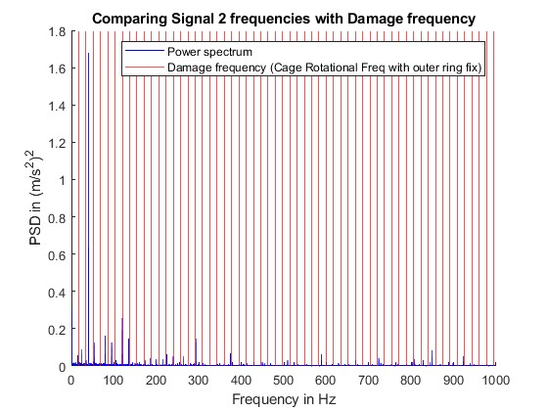
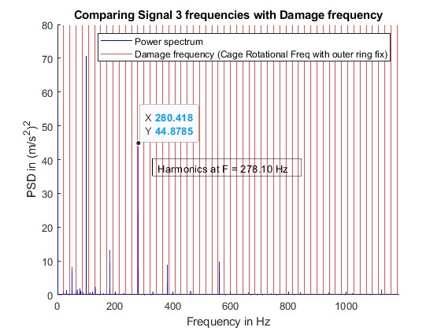
Comparing Envelope PSD spectrum with Harmonics of Damage frequency:
Cage rotational frequency with outer ring fixed
In Signal 3 the amplitude of frequency 280.4 Hz aligns with the Harmonics of Cage rotational Frequency at 278.10 Hz when the outer ring is fixed. Hence there occurred a damage in signal 3.

Slide 8
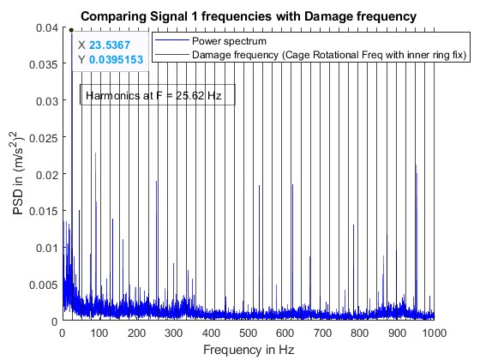
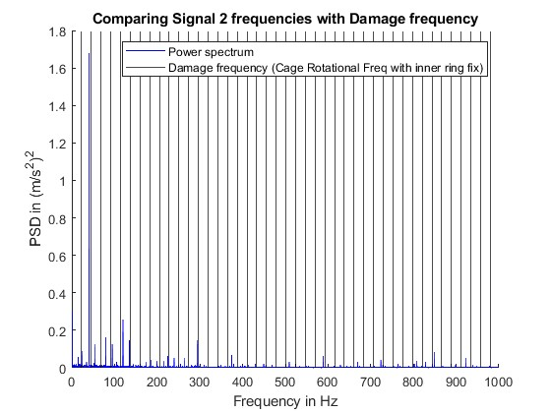
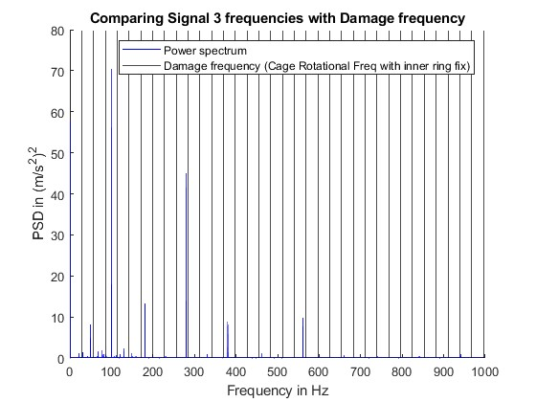
Comparing Envelope PSD spectrum with Harmonics of Damage frequency:
Cage rotational frequency with inner ring fixed
In Signal 1 the amplitude of frequency 23.53 Hz aligns with the Harmonics of Cage rotational Frequency at 25.62 Hz when the inner ring is fixed. Hence there occurred a damage in signal 1.

Slide 9
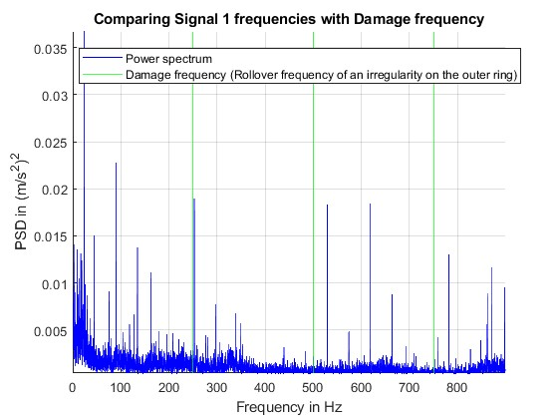
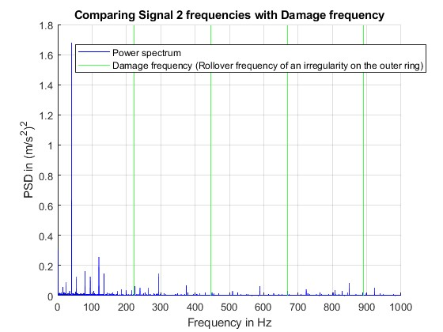
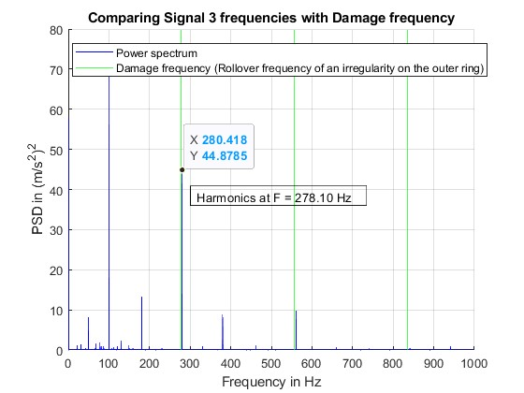
Comparing Envelope PSD spectrum with Harmonics of Damage frequency:
Rollover frequency of an irregularity on the outer ring
In Signal 3 the amplitude of frequency 280.42 Hz aligns with the Harmonics of rollover frequency of an irregularity on the outer ring at 278.10 Hz. Hence there occurred a damage in signal 3.

Slide 10
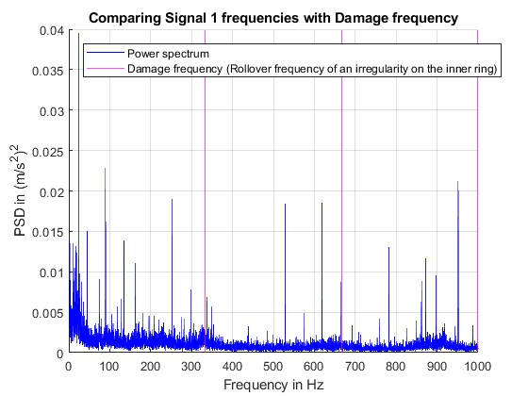
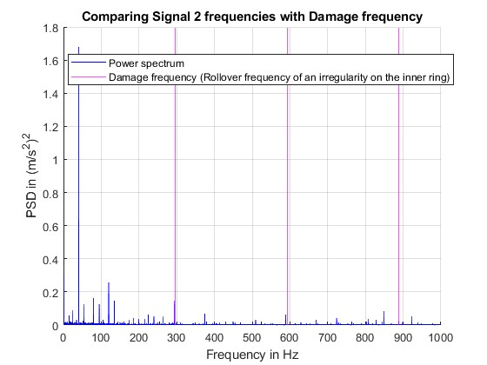
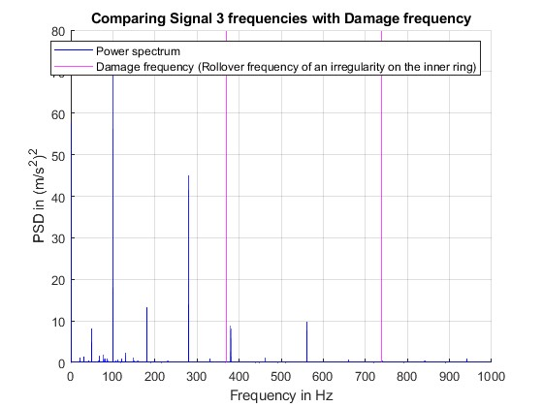
Comparing Envelope PSD spectrum with Harmonics of Damage frequency:
Rollover frequency of an irregularity on the inner ring
Here no higher energy amplitude of frequencies matches with any of the harmonics of roll over frequency of an irregularity on inner ring. Hence no damage occurred in all the three signals.

Slide 11
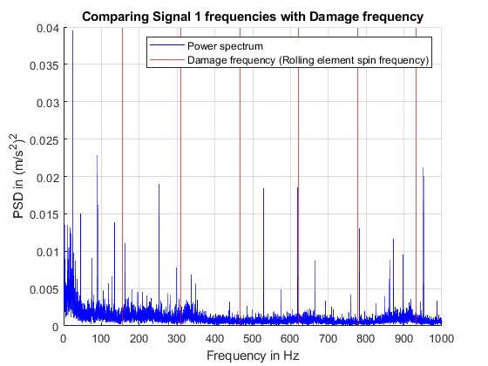
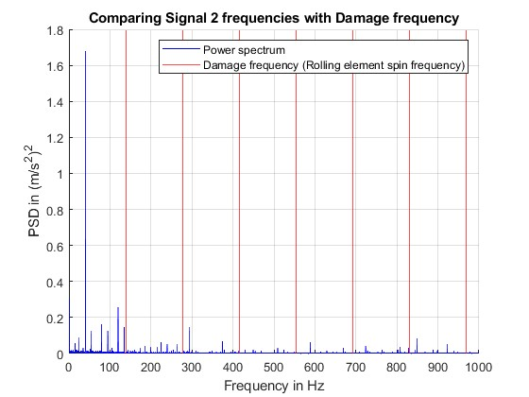
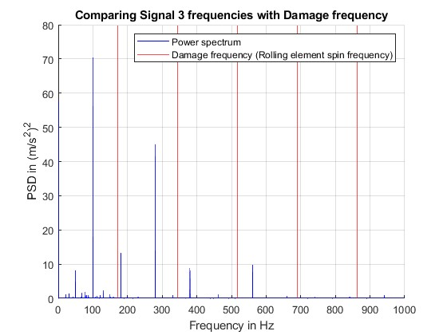
Comparing Envelope PSD spectrum with Harmonics of Damage frequency:
Rolling element spin frequency
Here no higher energy amplitude of frequencies matches with any of the harmonics of rolling element spin frequency. Hence no damage occurred in all the three signals.

Slide 12
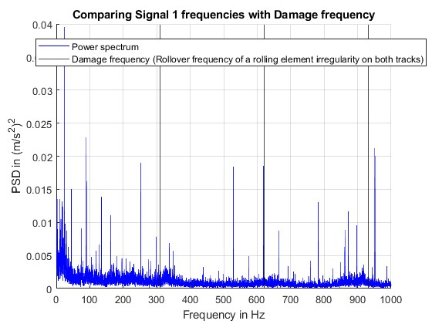
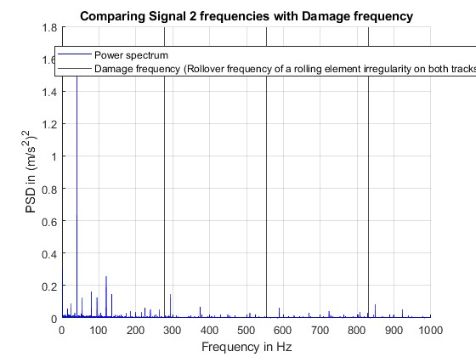
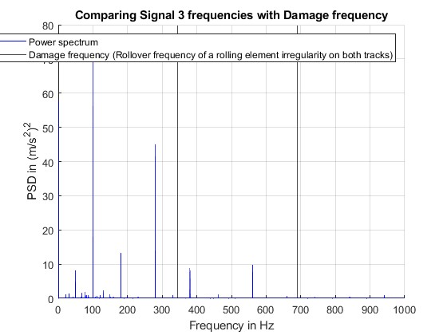
Comparing Envelope PSD spectrum with Harmonics of Damage frequency:
Rollover frequency of a rolling element irregularity on both tracks
Here no higher energy amplitude of frequencies matches with any of the harmonics of roll over frequency of a rolling element irregularities. Hence no damage occurred in all the three signals.

Slide 13
Vielen Danke.....

