Slide 1



Slide 2


Slide 3
Challenges
1
Lack of trained teachers, dedicated spaces and audio visual aids for effective dissemination of knowledge
2
Fragmentation of knowledge as in existing subjects like Science and Physical Education.
3
Failure to standardize curriculum (Content, methodology, Teacher Training)
4
Overemphasis on academic results than outcomes
5
Deep-rooted-Taboos (sexual health, mental health, and menstruation)
6
Comfortability of teacher (Refraining from speaking specific health topics due to personal limitations/lack of training)
Notes:
f

Slide 4
Vision
To educate and enlighten students to help them make the best choices in near future.
To incorporate health education into existing educational infrastructure so that students can access interactive content (Short form videos, Animations, Quizzes, Games, Simulation) whilst teachers have the access to deck(Lesson plans, Activity plans, Worksheets) . Bringing different domains of health education under one roof.
To design a user-friendly portal which provides personalized learning experience to the students.
To create a community forum where the students get to ask any sort of doubt anonymously to the panel of teachers and subject experts.
100% No exam policy. We are here to enlighten children, not test them.
To deliver content in multi-lingual format.
Provide short form videos where the experts themselves record a video on a topic (usually of duration 2-3min each) . Specific health related topics(taboos) are directly taught to the students keeping age appropriation in mind.
To prevent students from prey to quacks(Disinformation).
To Implement a hybrid model where,
=> Teachers who teach Science (in offline mode) will be trained and given suitable resources.
=> Provide curated content on the portal(online mode)
10. To deploy AI-ML models in near future, which can make the content even more interactive.

Slide 5







Competition

Slide 6

Solution(Website)
Home page:

Slide 7
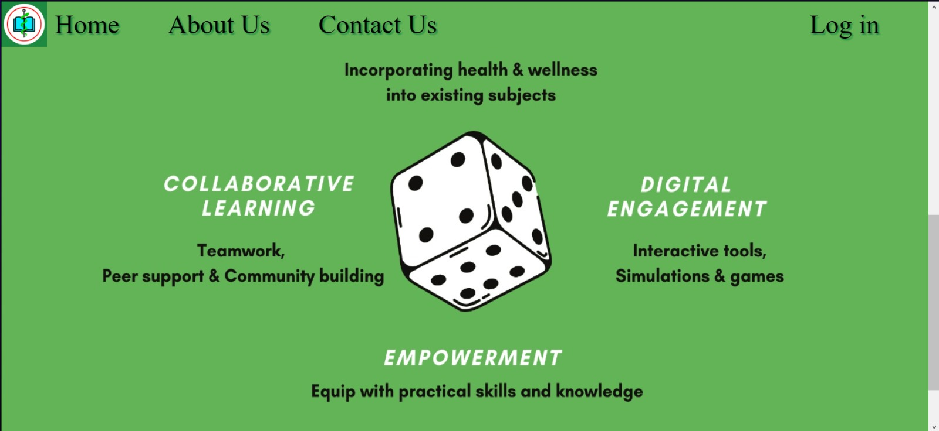

Slide 8
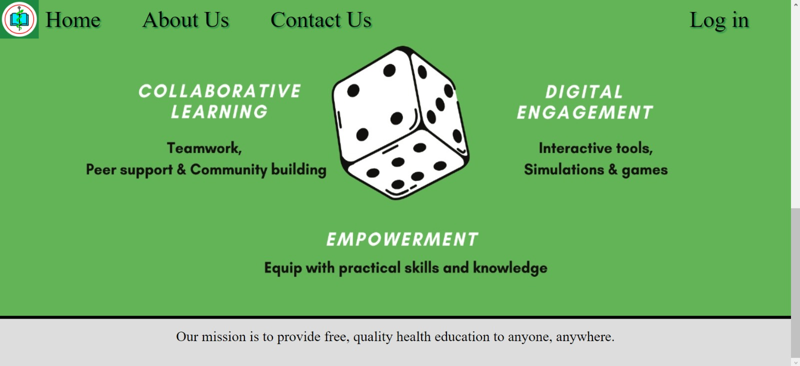

Slide 9

About Us:

Slide 10

Main Login:

Slide 11

Student Login:

Slide 12
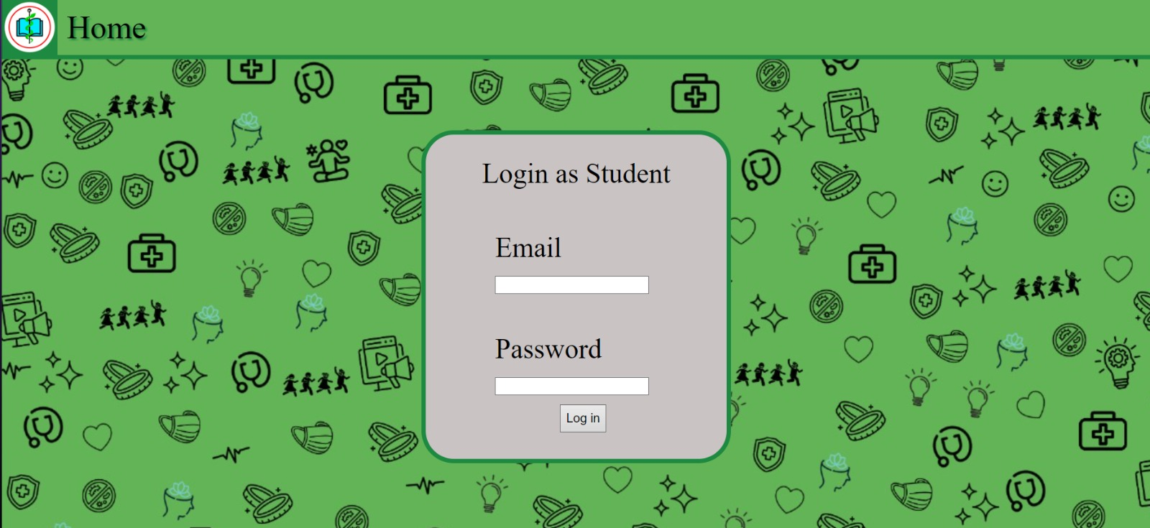
Existing Student Login:

Slide 13

New Student Registration:

Slide 14

Teacher Login:

Slide 15
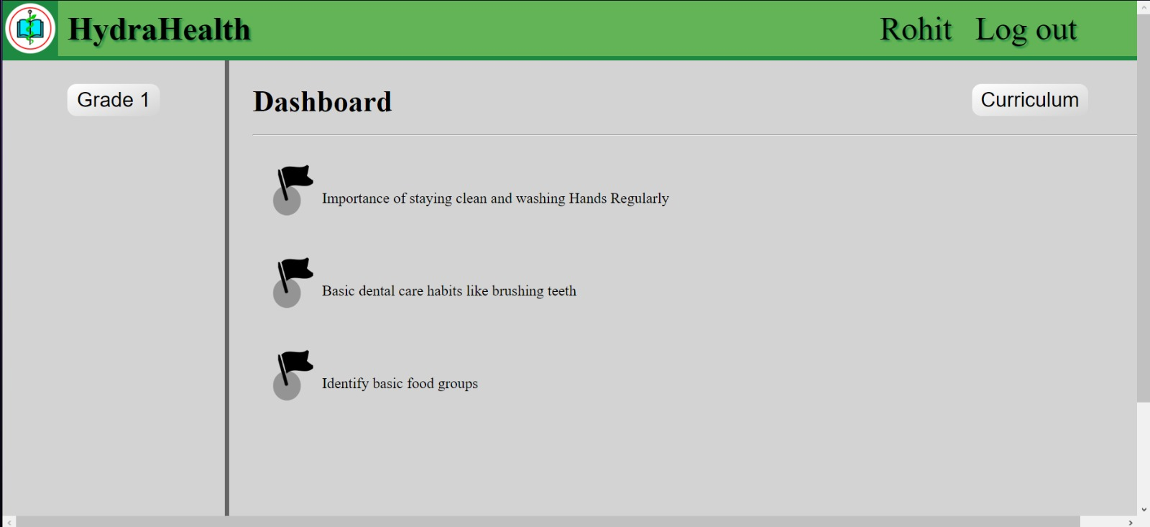
Grade 1 course Dashboard:

Slide 16
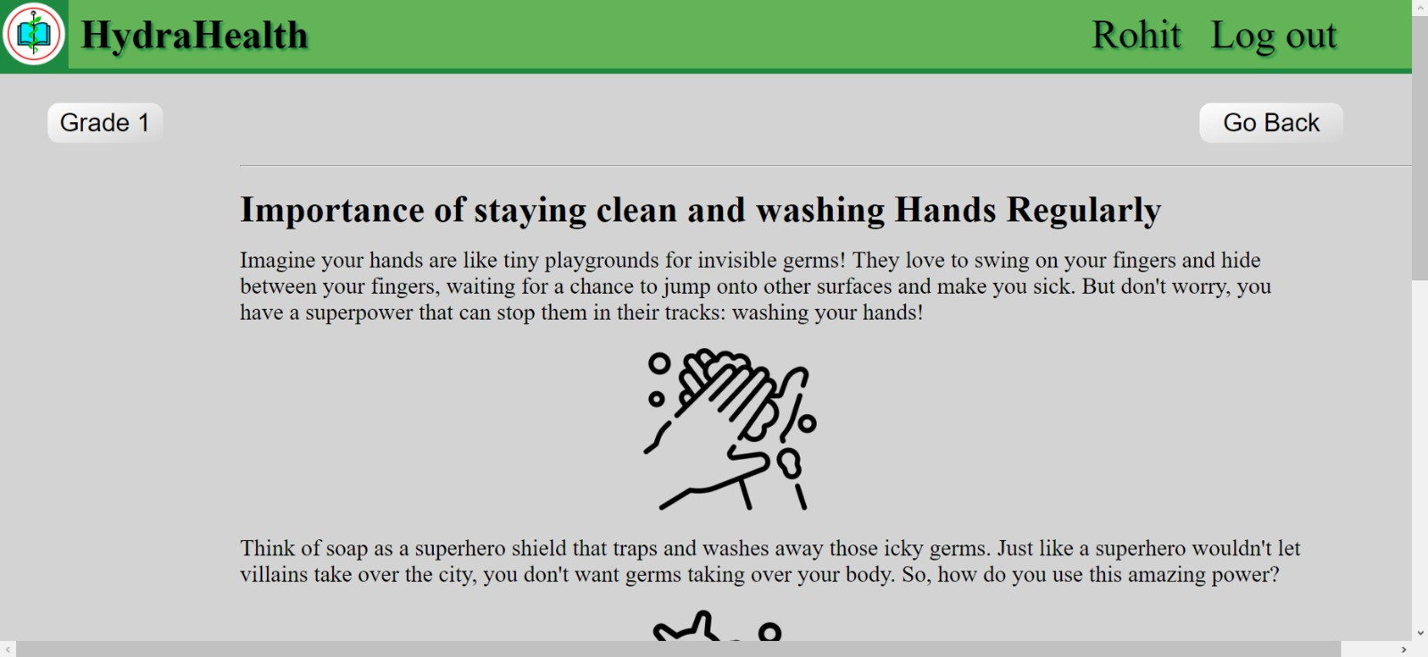
Module-1 :

Slide 17
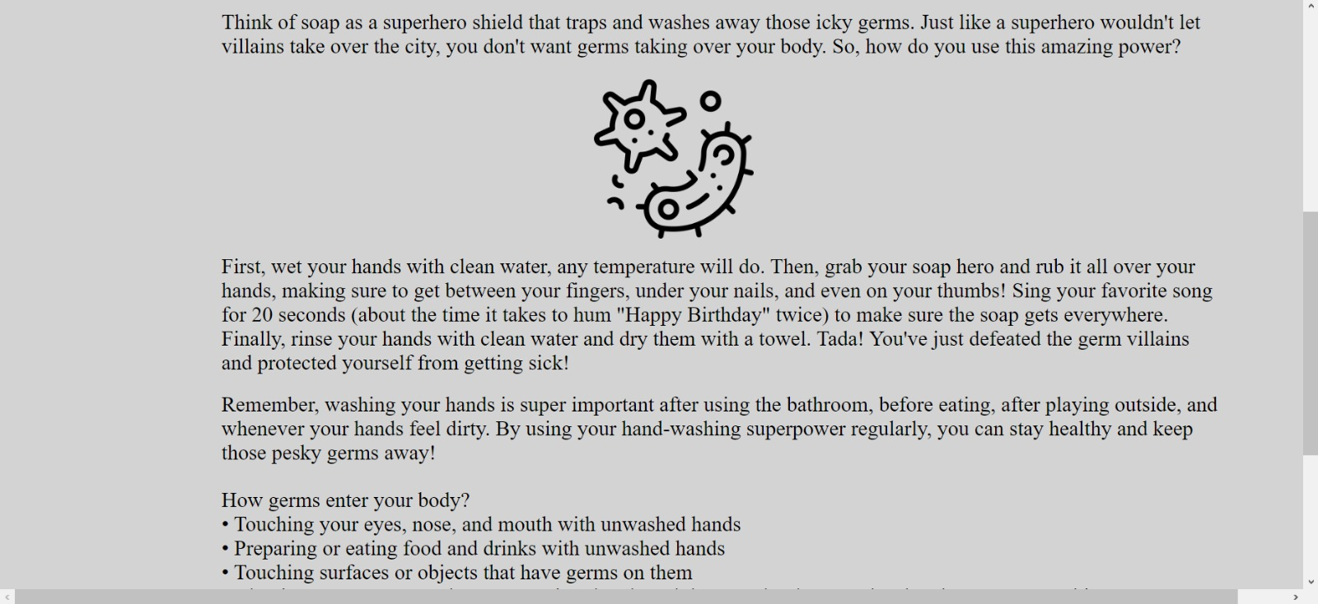

Slide 18
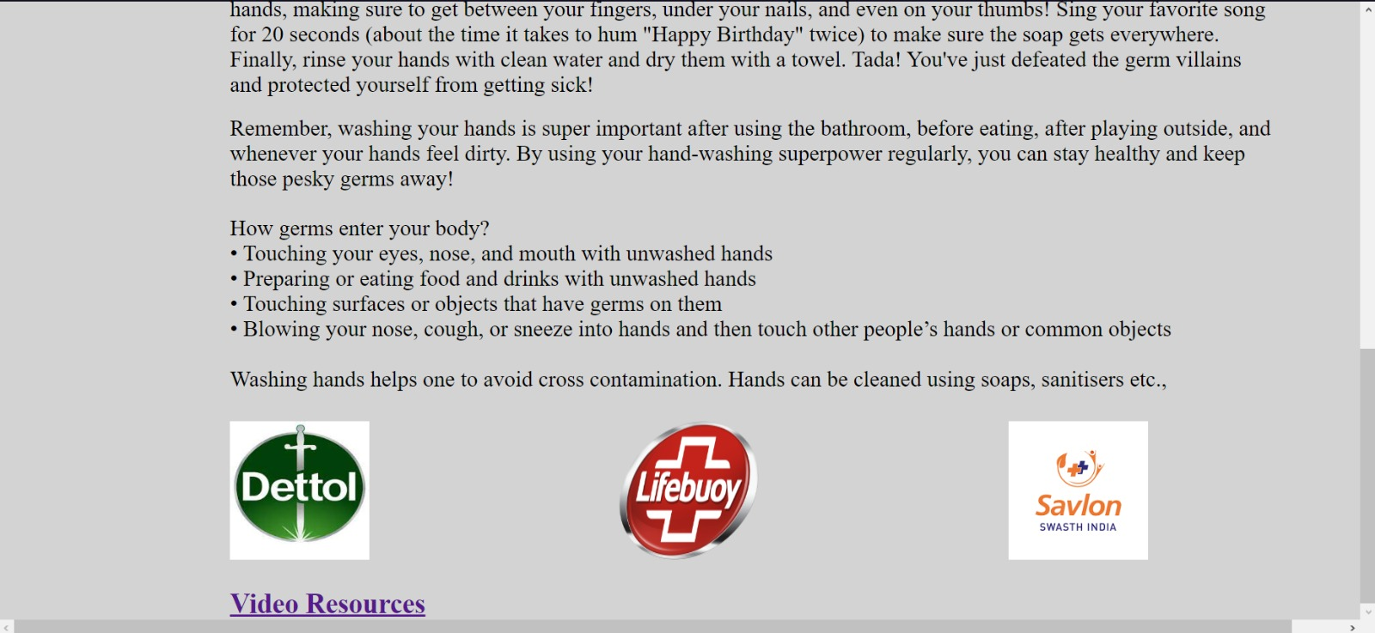

Slide 19
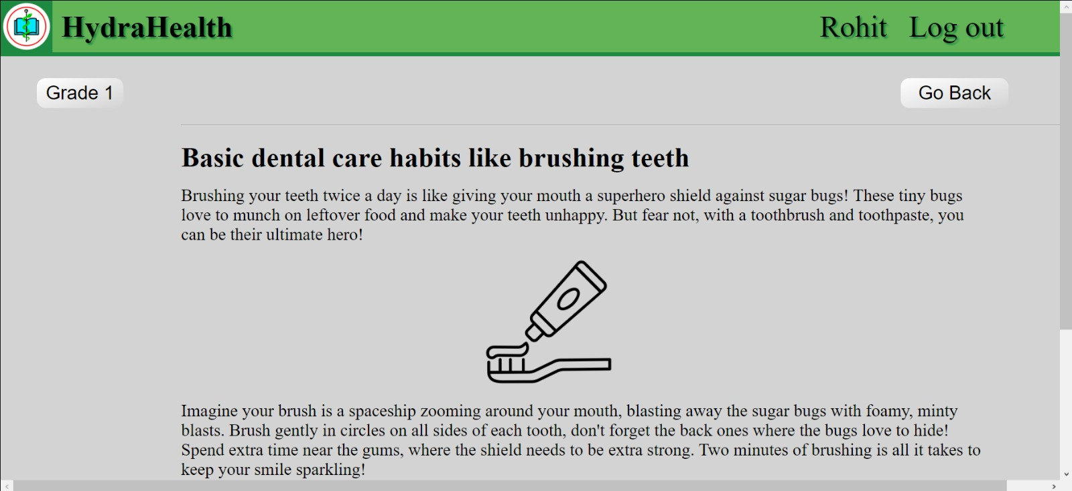
Module-2 :

Slide 20
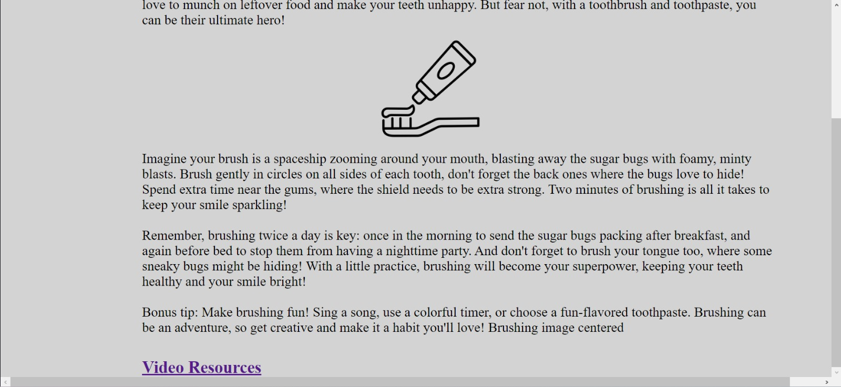

Slide 21
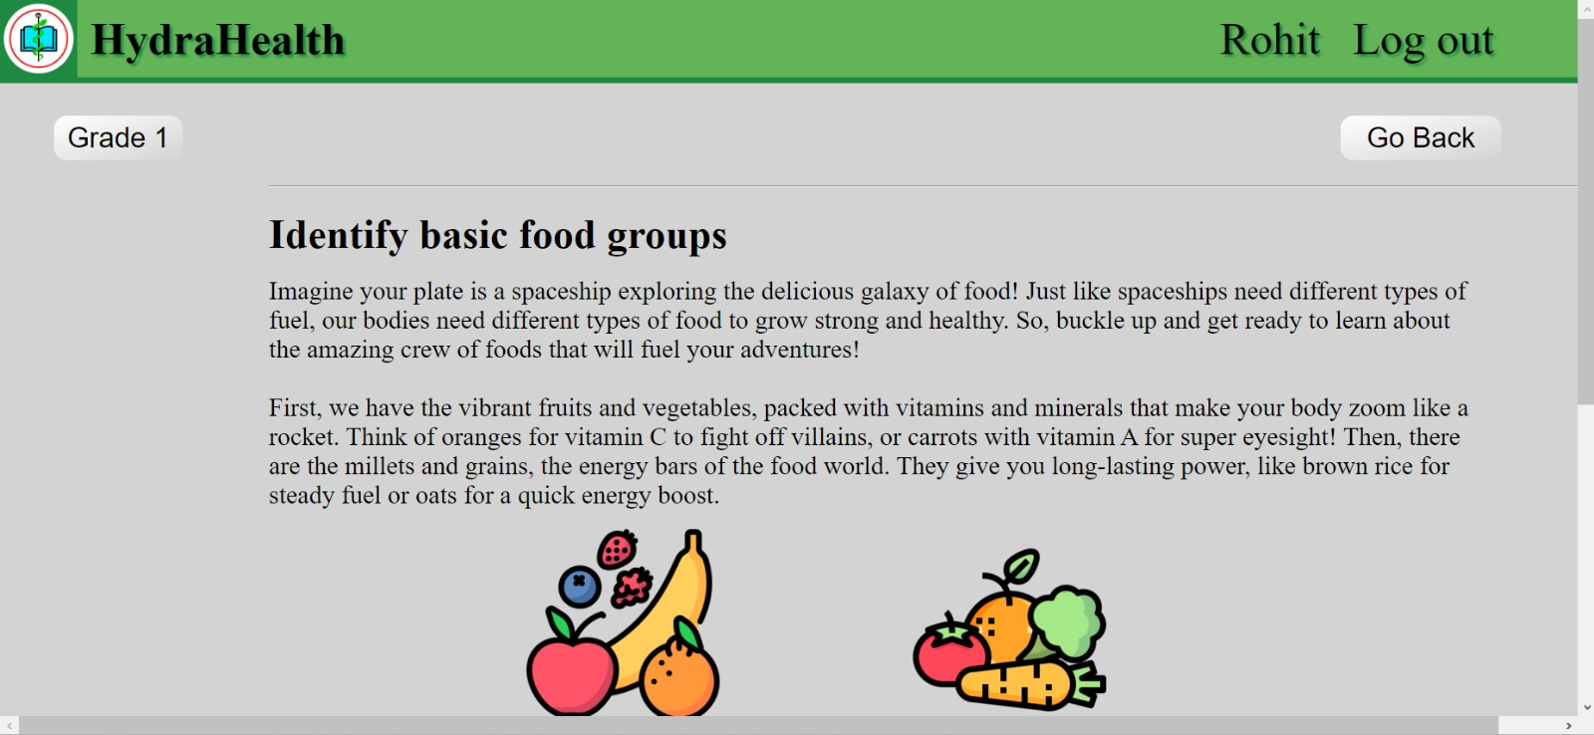
Module-3 :

Slide 22
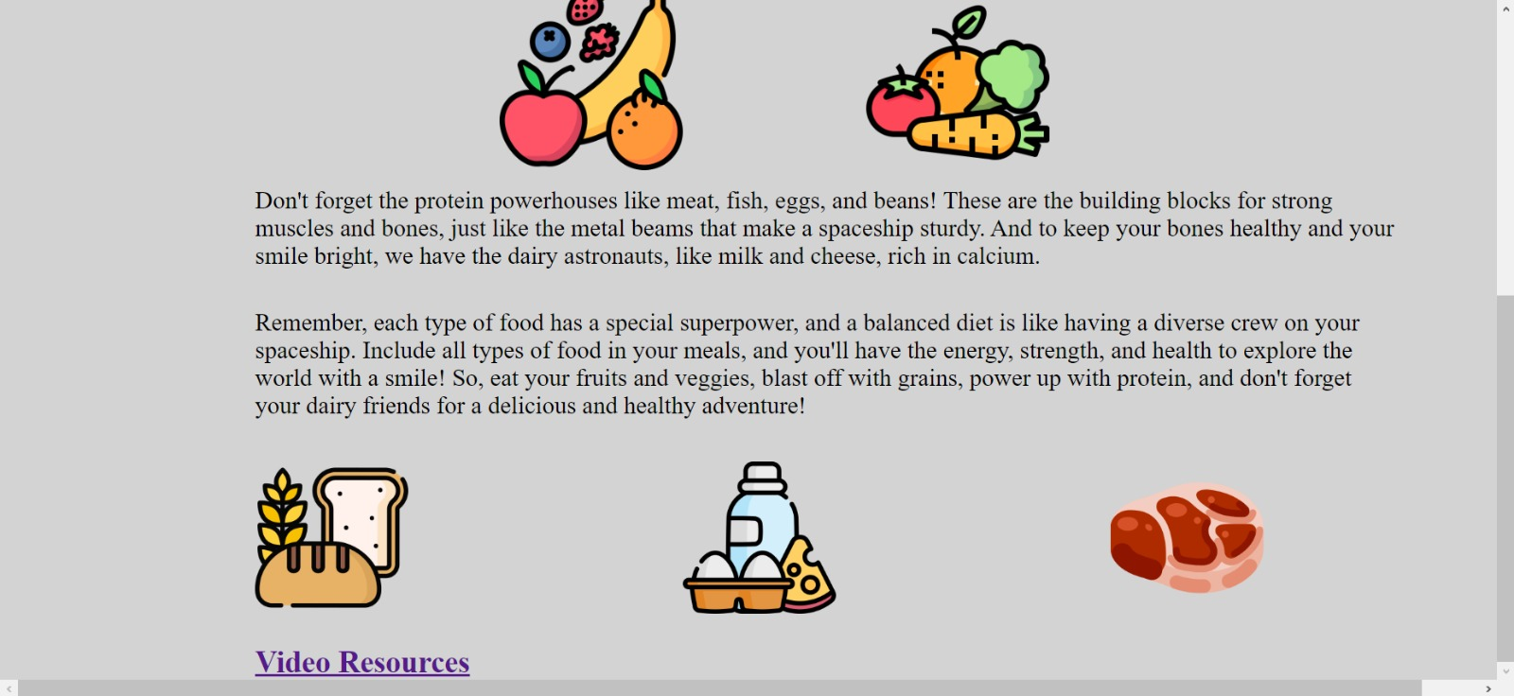

Slide 23



Tech Stack Used
HTML/CSS
python Django
sqlite3

Slide 24
Curriculum at a Glance
Teach personal hygiene
Promote mental health
Information on diseases and emergency preparedness
Inculcate good habits and discipline early on
Educate on internet safety
Warn about substance abuse
Encourage physical activities
Foster choices
Educate on sexual health and gender studies
Practice safety
Promote looking and feeling better

Slide 25

Curriculum
Grade 1
Discuss the importance of staying clean and washing hands regularly
Introduce basic dental care habits like brushing teeth twice a day and the brushing technique
Identify basic food groups (e.g., fruits, vegetables, grains)
Grade 2
Explore healthy snack and meal options
Discuss the importance of drinking water for hydration
Discuss the benefits of physical activity for health and growth
Introduce simple exercises and games to promote physical activity
Teach basic road safety rules (e.g., looking both ways before crossing the street)
Introduce fire safety rules (e.g., stop, drop, and roll)

Slide 26
Grade 3
Importance of eating breakfast for energy and focus
Discuss portion sizes and balanced meals
Different types of physical activities (e.g., running, jumping, stretching)
Discuss the importance of outdoor play for physical and mental health
Personal safety rules (e.g., not talking to strangers)
Introduce basic first aid skills (e.g., applying a bandage)
Grade 4
Benefits of eating fruits and vegetables.
Concept of "eating the rainbow" for a variety of nutrients.
Sportsmanship and teamwork in physical activities.
Stretching before exercise to prevent injuries
Safety rules (e.g., home, school, playground).
Teach basic emergency preparedness (e.g., knowing emergency phone numbers).

Slide 27
Grade 5
Discuss the importance of reading food labels for making healthy choices
Explore the concept of moderation when eating treats and sweets
Discuss the importance of regular physical activity for overall health and well-being
Review safety rules for different situations (e.g., biking, swimming)
Teach on choke rescue techniques
Grade 6
Mental Health and Stress Management
Explore common stress factors for middle school students
Introduce coping strategies for managing stress (e.g., deep breathing, mindfulness)
Mewing and looksmaxxing techniques
Knowledge of various common diseases, vectors and ways to avoid them
Explore internet safety and cyberbullying awareness
Review basic first aid skills and emergency response procedures

Slide 28
Grade 7
Discuss the importance of seeking help for mental health concerns
Introduce resources for mental health support (e.g., school counsellors, hotlines)
Explore the risks and consequences of substance abuse
Teach refusal skills and strategies for resisting peer pressure
Review safety practices for various settings, including home, school, and community environments
Discuss strategies for preventing accidents and injuries, including first aid skills and emergency response procedures
Grade 8
Discuss the characteristics of healthy relationships (e.g., mutual respect, communication)
Introduce the concept of consent and setting boundaries in relationships. Review physical and emotional changes during puberty
Discuss reproductive health topics in more depth, including menstruation, contraception methods, and sexual health.

Slide 29
Grade 9
Explore common mental health disorders among adolescents (e.g., anxiety disorders, mood disorders) and introduce coping strategies for managing mental health challenges, including stress management techniques and relaxation exercises.
Examine the relationship between nutrition and overall health, including the impact of diet on physical and mental well-being. Also, discuss the importance of balanced nutrition, portion control, and making healthy food choices.
Emphasize the benefits of regular physical activity for cardiovascular health, muscular strength, and flexibility. Introduce the principles of fitness training, including aerobic exercise, strength training, and flexibility exercises.
Explore the risks associated with substance use and abuse, including alcohol, tobacco, and other drugs. Also, discuss addiction, withdrawal symptoms, and the impact of substance abuse on physical and mental health.
Discuss topics related to sexual health, including consent, healthy relationships, and contraception. Also, Introduce strategies for making responsible and informed decisions regarding sexual activity

Slide 30
Grade 10
Provide comprehensive sexual health education, including topics such as sexually transmitted infections (STIs), HIV/AIDS, and reproductive rights. Also, discuss strategies for preventing STIs and unintended pregnancies, including the proper use of condoms and other barrier methods.
Raise awareness about mental health issues, including depression, anxiety, and suicide prevention. Also, discuss the importance of reducing stigma surrounding mental illness and advocating for mental health support services.
Explore the relationship between nutrition, physical activity, and weight management. Also, discuss healthy approaches to weight management, including the importance of balanced nutrition, regular physical activity, and positive body image.
Expand on topics related to substance use prevention, including the impact of addiction on individuals and communities. Also, discuss intervention strategies for supporting individuals struggling with substance abuse, including accessing treatment and support services.
Explore the characteristics of healthy relationships, including effective communication, mutual respect, and conflict resolution skills. Also, discuss strategies for building and maintaining healthy relationships with family, friends, and romantic partners.
Review safety practices related to driving, including traffic laws, defensive driving techniques, and the dangers of driving under the influence. Also, discuss strategies for preventing common injuries and accidents, including sports-related injuries, falls, and burns.

Slide 31


By
1. S Nazeer Ahammed(23BEC0205)
2. Arnav Mathur(23BCE0379)
3. Aditya Pai(23BML0049)

