Slide 1
C Sharp
At

Slide 2
Introduction to .Net Framework
List of .Net Framework Features
Components of .Net Framework
Flow of execution for .Net Application
Define an assembly and its features
Types of Assembly
Features of .Net Framework 3.0
Visual Studio 2013 IDEW

Slide 3
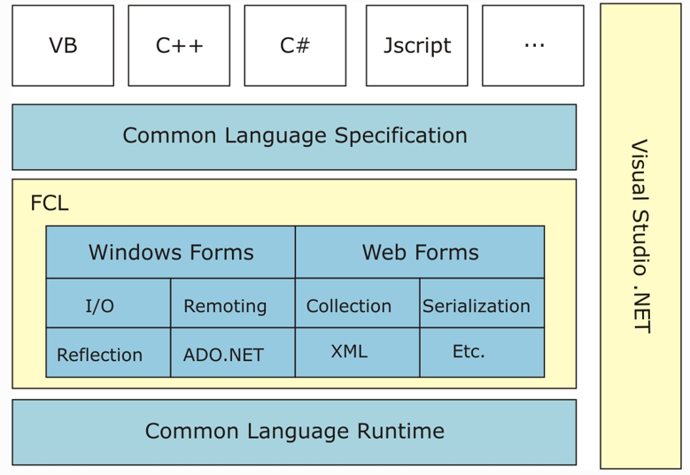
.Net Framework

Slide 4
.Net Languages
Key features of .Net languages
Standardized by ECMA
Component based
Object Oriented
Robust and durable code
.Net Languages
C#, VB.Net, F# etc.

Slide 5
Common Language Specification(CLS)
Ensures source code compiled by .Net compiler interoperates with .Net Framework
CLS describes set of features that different languages have in common
CLS is subset of Common Type of System(CTS)
CTS defines rules concerning data types
Any program which uses CLS-Complient types can interoperate with any .Net program written in any language
.Net languages support both CLS and CTS

Slide 6
Common Type System(CTS)
Enables cross language integration, type safety and high performance code execution
Provides and object oriented model where all types are derived from common class, System.Object
Support two main categories
Value types
Reference types

Slide 7
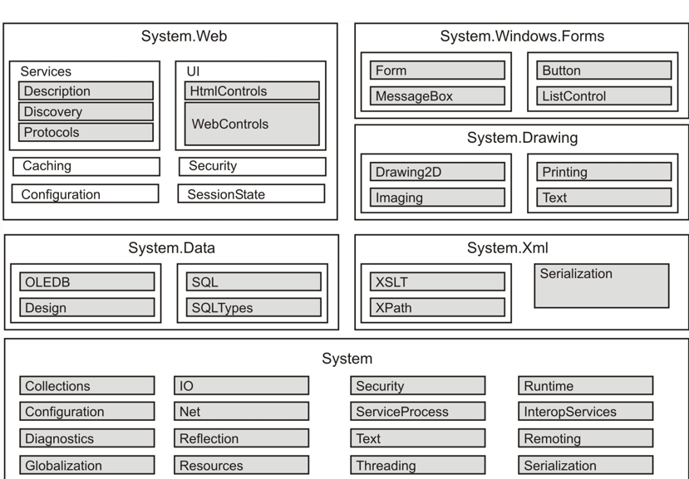
Framework Class Library

Slide 8
Windows Forms
Framework for building rich clients
Rich set of controls
Extensible controls
Data-aware
ActiveX Support
Printing Support
Advance Graphics(GDI+)

Slide 9
Web Forms
Built with ASP.Net
Logical evolution of Active Server Pages
Similar development model
Less code
New Programming model:
Even-driven/server-side controls
Rich Controls(e.g. DataGrid, Validation)

Slide 10
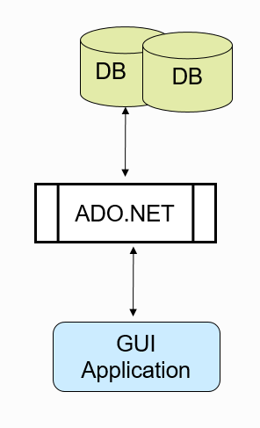
ADO.Net
An Object Model for accessing data.
Two architectures:
Connected
DisConnected
Rich DataBinding support
Can view and process data relationally
Tables or Hierarchically XML

Slide 11
Common Language Runtime
Execution engine for managed code – MSIL
CLR Services
Secure execution of code
Automatic memory management
Interoperability
Exception handling

Slide 12
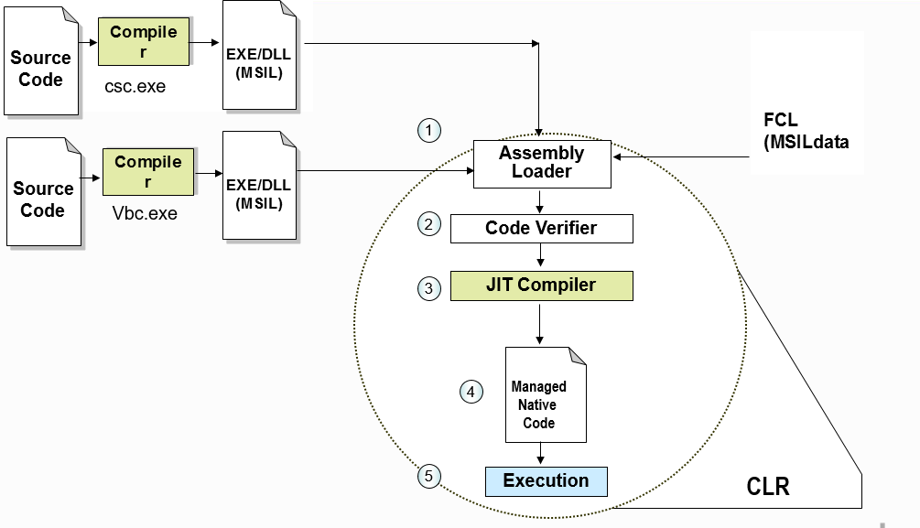
Dot Net Application Execution

Slide 13
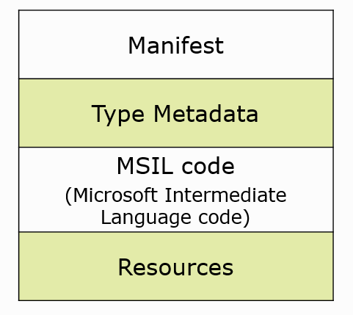
Assembly
Logical unit of deployment
Single deployable unit
Components of Assembly

Slide 14
Types of Assemblies:
Private Assembly
Shared Assembly

Slide 15
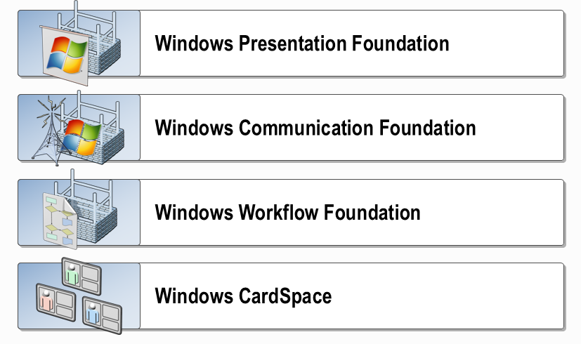
Dot Net Framework 3.0 Technologies

Slide 16
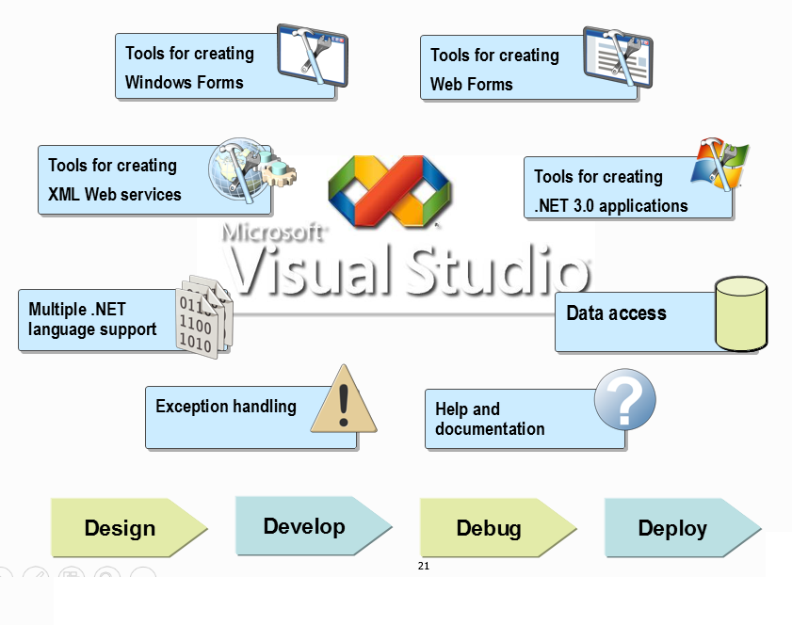
Visual Studio .Net 2015

Slide 17
Recap….

