Slide 1
C Sharp Language Constructs

Slide 2
Objective
Writing C# program
Use types
Value Types and Reference Types
Implementing Boxing and UnBoxing
Working with Methods
User ref, out and params keywords
User defined data type like enum and struct
Working with Arrays

Slide 3
C# Language
C++ Heritage
Interoperability
Interacting with COM and other languages
Productivity
Short learning curve
Type Safe
Object Oriented Language
Case Sensitive

Slide 4
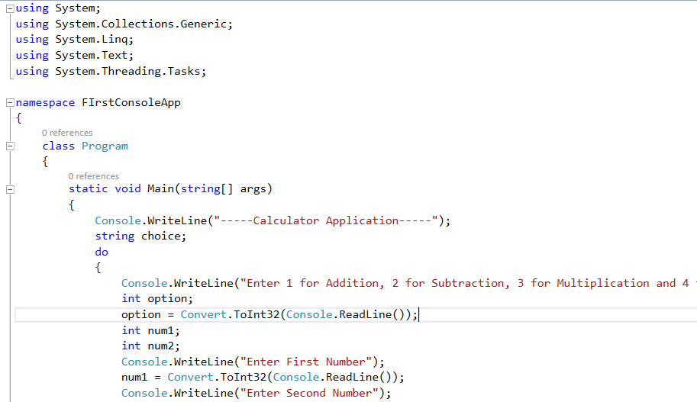
Structure of simple C# program

Slide 5
Types
A C# program is a collection of types.
Class, Struct, Delegate, Enum, Interface
C# provides predefined types:
Eg. Int, String, Double, Bool, Object …
Custom Types can be created
All data and code is defined within a type
No global variables and global functions

Slide 6
Types continued..
Types can be instantiated and used by
Calling methods, Get and Set properties
Can convert from one type to another(Type casting)
Types are organized into namespaces, files and assemblies
Types are arranged in hierarchy
There are two categories of types:
Value Types and Reference Types

Slide 7
Type
Value Type:
Directly store data on stack
Reference Type:
Contain reference to the actual object on managed heap

Slide 8
Types
Value Types:
Primitives : int width, float speed;
Enum : enum AccountType {Saving, Current}
Struct : struct DictionaryEntry{object key, object value}
Reference Types:
Root : object
String : string
Classes : class Employee
Arrays : string[] strStates = new string[10];
Interfaces : interface IEnumerable
Delegates :

