Slide 1
Multithreading

Slide 2
Objective
Define multitasking and multithreading
List different thread state in the life cycle of a thread
Write a simple multithreaded application
Assign priorities to the thread
Use synchronization to access a resource by multiple thread
Implement synchronization technique like automatic, synchronized code regions and manual synchronization
Use Mutex class to synchronize threads across inter process boundaries
Use Timer class to execute a method at specific intervals
Use ThreadPool to increase efficiency of an application

Slide 3
Multitasking
Ability to have more than one program working at the same time
The objective is to utilize the idle time of the CPU
Multitasking can be done in two ways:
Non Pre-emptive
Pre-emptive

Slide 4
Multithreading
Multithreading is the ability of an operating system to execute different parts of a program simultaneously
When to use multithreading
Performing operation that take a large amount of time
Prioritization of the task
Application has to wait for some event to occur

Slide 5
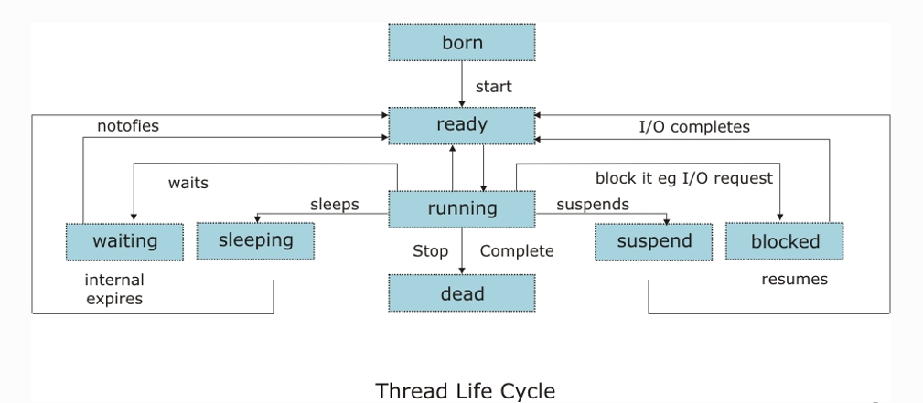
Thread
Thread is a path of Executing in a running application

Slide 6
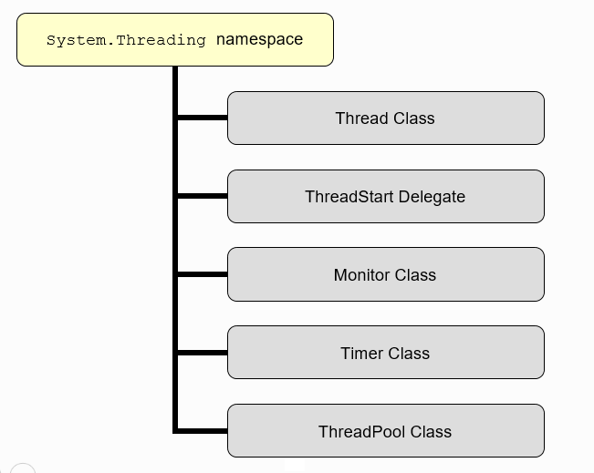
System.Threading namespace
Provides a number of classes and other types to support multithreading

Slide 7
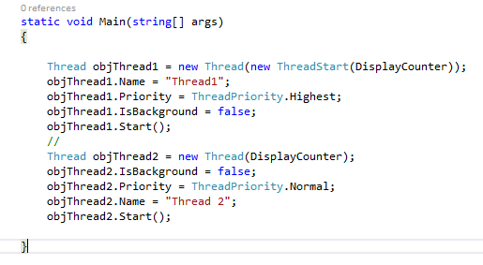
Thread Class

Slide 8
Thread Scheduling
Threads are schedule for execution using priority
Thread properties are defined as ThreadPriority enumeration
Highest
AboveNormal
Normal
BelowNormal
Lowest

Slide 9
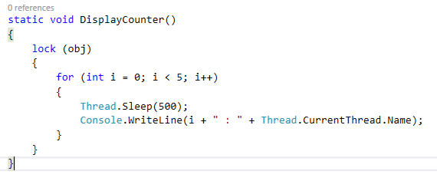
Thread Synchronization
Controlled access to resources needs to be given
Provided by lock on the object to prevent second thread modifying it

Slide 10
Thread Synchronization
Common problems of multithreading
Deadlocks:
Avoided by managing timeouts using threading classes like monitor class
Race Condition:
Avoided by implementing InterLocked class
Different strategies to synchronize access to instance and static methods and instance fields
Synchronized contexts
Synchronized code regions
Manual synchronization

Slide 11
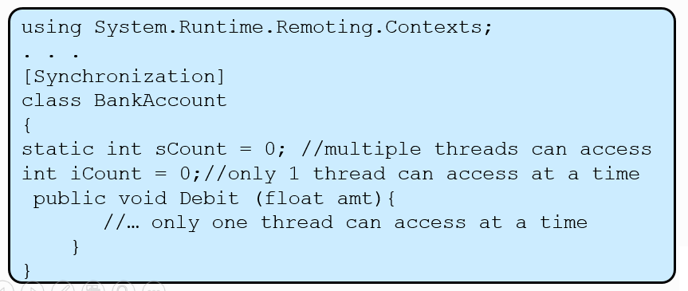
Synchronization Context
[Synchronization] enables simple, automatic synchronization for instance of the class
Static fields and methods are not protected from concurrent access by multiple threads

Slide 12
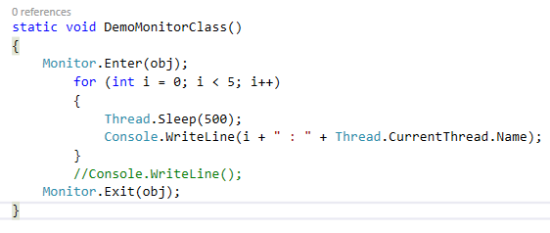
Synchronized code regions
Restricted access to a block of code, commonly called a critical section is required
Monitor class
Control access to these objects by granting a lock on an object to a single thread
Exposes methods like Enter(), Exit(), Wait() etc.

Slide 13
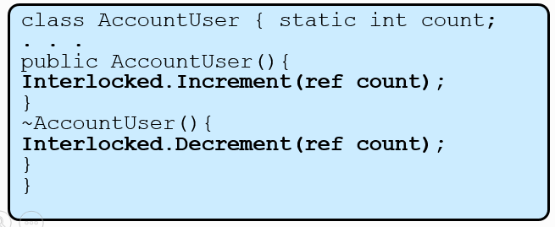
Manual Synchronization
Access to a variable shared by multiple threads is synchronized manually using InterLocked class
InterLocked class exposes methods like Add(), Increment(), Decrement() etc. to perform automatic operations on such variables

Slide 14
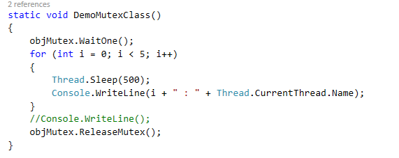
Inter Process Synchronization
Use Mutex class
To synchronize between threads cross process
Use ReaderWriterLock
In scenarios with a single “writer” and multiple “readers”

Slide 15
Timer Class
Used to periodically execute a method

Slide 16
Thread Pool
Provides a pool of threads that can be used to post work items, process asynchronous I/O, wait on behalf of other threads, and process timers.
Used to improve efficiency
Thread pool should not be used when:
Need a task to have a particular priority
Have a task that might run for a long time
Need to place threads into a single threaded apartment
Need a stable identity to be associated with the thread

Slide 17
Think before Multithreading
Keeping track of and switching between threads consumes memory resources and CPU time
Programming with multiple threads can be complex
Shared resources utilization problem

Slide 18
Recap…

