Slide 1
Reflection And Custom Attributes

Slide 2
Objective
Define Reflection
Dynamically Load Assembly
Use different classes in System.Reflection namespace
Implementing Late Binding
Create Custom Attributes and apply them on types

Slide 3
Reflection
Reflection is the ability to examine the metadata in the assembly manifiest at runtime
Reflection is useful in the following situations
Need to access Attributes in programs metadata
To examine and instantiate types in an assembly
To build new types at runtime using classes in System.Reflection.Emit
To perform late binding, accessing methods on types created at runtime

Slide 4
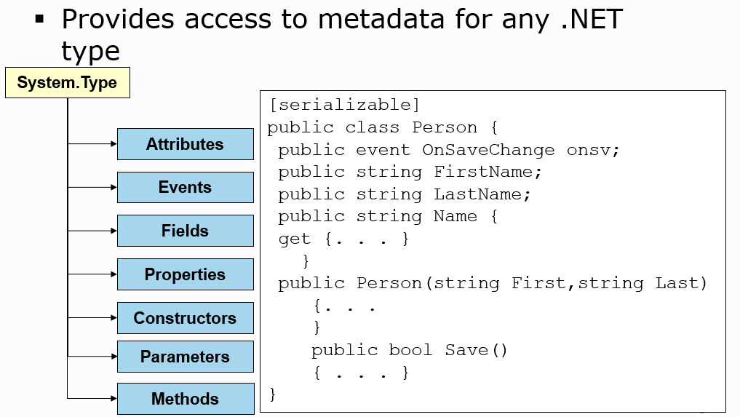
System.Type Class

Slide 5
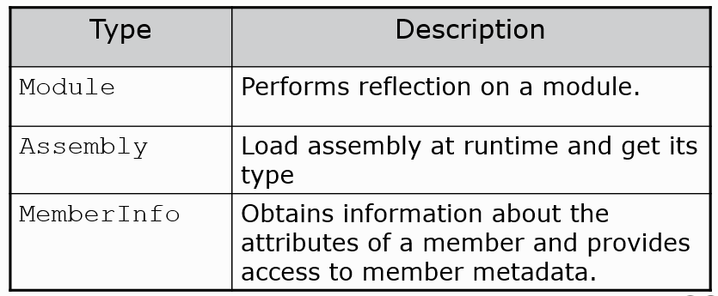
System.Reflection namespace
Contains classes and interfaces that provides a managed view of loaded types, methods and fields
These types provide ability to dynamically create and invoke types

Slide 6
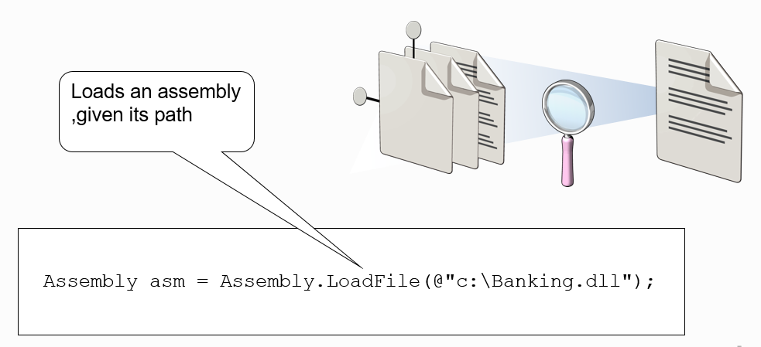
Assembly Class
Helps to access the metadata of assemblies during runtime

Slide 7
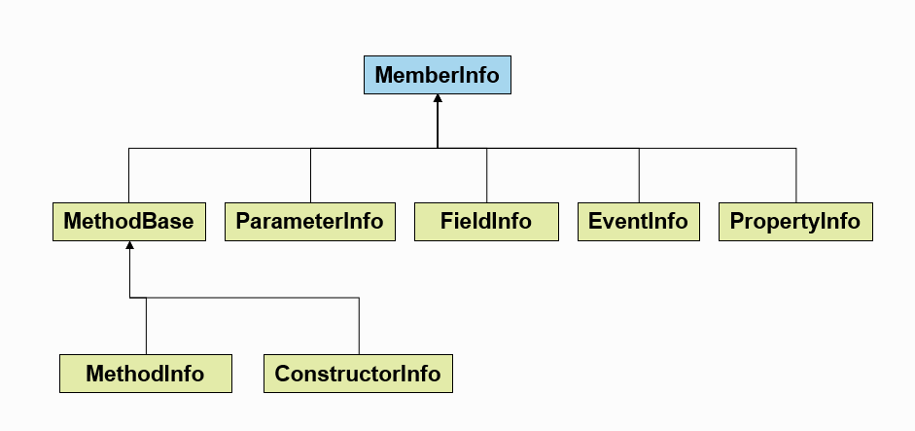
MemberInfo class
Base class for all members of a class

Slide 8
Binding
The process of associating function call to the function definition
Two types:
Compile time binding
Late/Runtime binding

Slide 9
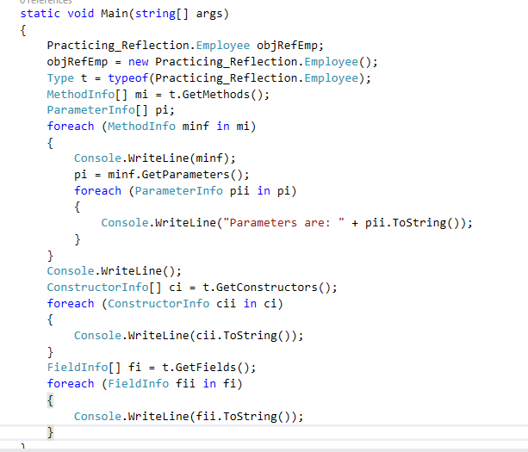
Late Binding

Slide 10
Attributes
Declarative tags that convey information to the runtime
Stored with the metadata of the element
.Net Framework provides predefined attributes
The runtime contains code to examine values of attributes and to act on them
Types of Attributes:
Standard Attributes
Custom Attributes

Slide 11
Standard Attributes
.Net Framework provides various predefined attributes
General attributes
COM interoperability attributes
Transaction handling attributes
Visual designer component-building attributes

Slide 12
Custom Attributes
User defined class which can be applied as an attribute on any .Net compatible types like:
Class
Constructor
Event
Field
Method
Property
Parameter
Return Value
Delegate
Enum
Struct
Event

Slide 13
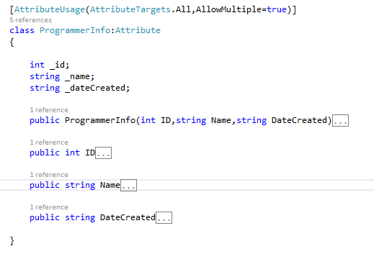
Attribute Usage
Step 1: Apply AttributeUsageAttribute
Step 2: Designing Attribute class
Step 3: Defining Members

Slide 14
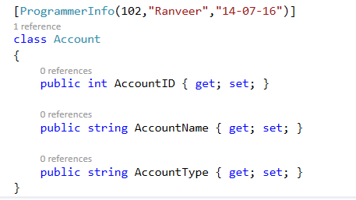
Applying Custom Attributes
Custom attribute is applied in the following way:

Slide 15
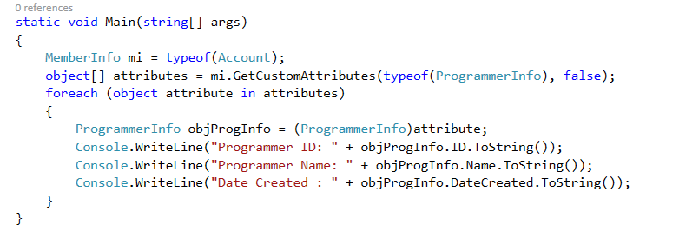
Retrieving custom attribute
Retrieving custom attribute:

Slide 16
Recap…

