Slide 1
T-DEV-810
Zoidberg

Slide 2
Artificial Intelligence
Very wide / unprecise definition
“The computational part of the ability to achieve goals in the world.“ (McCarthy)
“The ability to solve hard problems” (Marvin Minsky)
Human-like tasks
Problems without clear algorithms
Or too complex (NP) to be solved for large data
AI can find an APPROXIMATE solution, statistically correct

Slide 3
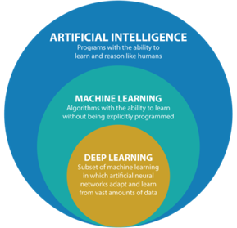
Many technologies
Expert systems rule inference (forest of« if »), knowledge base deduction from facts
Heuristic added to algorithms
Machine learning (ML) no predefined rules / knowledge Computer “learn” from examples or experience kNN, SVM, Bayes
Deep Learning One technology of ML among other (Deep) neural network

Slide 4
AI winter(s)
AI as an academic discipline : mid 50s
Perceptron (1st neural network) : invented 1943, implementation 1958
Neural network mostly abandoned in early 70s
Recent changes : far more complex NN (“deep”) explosion of available data for training

Slide 5
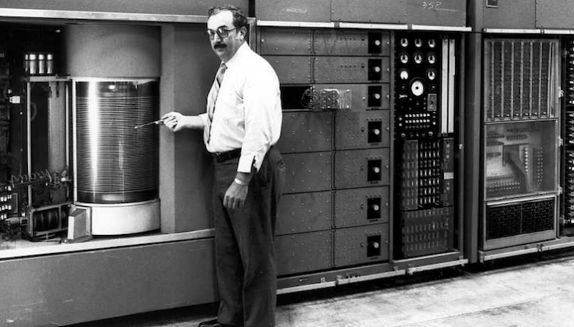
AI winter(s)
1954 : Georgetown U / IBM demo of automatic translator
On IBM 701 high end machine (RAM = 2K x 36 bits…), 2000 multiplication/s
PPT - The Georgetown-IBM experiment demonstrated in January 1954 PowerPoint Presentation - ID:3967861 (slideserve.com)
Researcher states that usable translator could be developed within 5 years
Massive funding
ALPAC
1964-66 : Congress committee evaluates (lack of) progress ; Very negative conclusions
any resemblance to self-driving cars that will be available in 5 years is pure coincidence

Slide 6
Machine learning
Supervised learning
You learned to distinguish cats and dogs because your parents told you this is a dog/cat
Unsupervised learning
You should be able to sort a card game in
Reinforcement learning
How a dog learn a trick (rewards when expected behaviour)

Slide 7
Supervised Learning
Labelled data
Not always available
Costly to produce
Dataset quality
Ex: MS Chat Bot that became racist
Dataset size
Always reserve part of dataset to evaluate mode
Model should be evaluated on “new” data

Slide 8
Classification
Input = features
Output = class (or probability)
Images - each pixel is a feature - or complex pré-processing (features = texture element)
Most models : list of features (order is not related to image structure)
Some model take 2D aspect into account

Slide 9
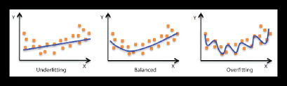
Classification
Model gives approximation of reality
Is this approximation correct ?

Slide 10
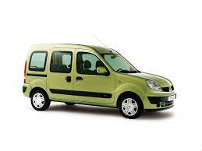
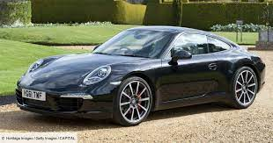
T-DEV-810
Experiment several techniques (preprocessing, models, etc...)
Compare them
Need metrics to compare
Which metrics are meaningful ??
vs

Slide 11
Explainable AI
How does your AI “takes decision” ?
Can you explain it ?
Which features are important ?

Slide 12
Large Data
Are all elements of data relevant ? (preprocessing)
Not all methods are equal, some consume more resources
NN are not always the best option
In many cases, training is resource intensive
Which features are important ?
Not all data can be processed at the same time (batch)

Slide 13
Back to the project
Research spirit
Jupyter notebooks
VS Code handle them nicely
With texts, graphs, etc….
Many resources on image classification
Cite your sources
Experiment several models
not only NN
And several options, pre-processing, etc…
Graphical representation is always better
Results MUST be analysed

Slide 14
Any Questions ?

