Slide 1
Owl M-A Material Design Android App
Team Members
-Logendar G(715522104030)
-Murali Mohan K (715522104035)
-PSSG Dhaaran (715522104056)
-Tamil Selvan K (715522104307)

Slide 2
DESCRIPTION
The "Owl M A" app is a modern, user-friendly application built around Material Design principles to offer an intuitive and efficient user experience. This app emphasizes ease of navigation, real-time updates, and interactive features for users looking to manage information seamlessly.
Centralized Dashboard: The app’s dashboard provides a clear and organized view of essential metrics and updates, allowing users to quickly access and manage important information.
Profile Customization: Users can manage and personalize their profile settings, ensuring a tailored experience that meets individual needs and preferences.
Real-Time Data and Analytics: The app offers dynamic, auto-updated reports and statistics, empowering users to make informed, data-driven decisions with ease.
Mobile Accessibility: Optimized for mobile use, "Owl M A" ensures a consistent and responsive experience across devices, allowing users to interact with the app anytime, anywhere.

Slide 3
Main Activity.java:
package com.example.owlapplication
import android.content.Context
import android.content.Intent
import android.os.Bundle
import androidx.activity.ComponentActivity
import androidx.activity.compose.setContent
import androidx.compose.foundation.Image
import androidx.compose.foundation.background
import androidx.compose.foundation.clickable
import androidx.compose.foundation.layout.*
import androidx.compose.foundation.rememberScrollState
import androidx.compose.foundation.shape.RoundedCornerShape
import androidx.compose.foundation.verticalScroll
import androidx.compose.material.Card
import androidx.compose.material.Text
import androidx.compose.runtime.Composable
import androidx.compose.ui.Alignment
import androidx.compose.ui.Modifier

Slide 4
import androidx.compose.ui.draw.clip
import androidx.compose.ui.draw.scale
import androidx.compose.ui.graphics.Color
import androidx.compose.ui.res.painterResource
import androidx.compose.ui.res.stringResource
import androidx.compose.ui.text.font.Font
import androidx.compose.ui.text.font.FontWeight
import androidx.compose.ui.text.style.TextAlign
import androidx.compose.ui.unit.dp
import androidx.compose.ui.unit.sp
val primaryColor = Color(0xFF2196F3)
val secondaryColor = Color(0x9DD9FAFF)
val accentColor = Color(0xFFE91E63)
class MainActivity : ComponentActivity() {
override fun onCreate(savedInstanceState: Bundle?) {
super.onCreate(savedInstanceState)
setContent {
StudyApp(this)
}
}
}

Slide 5
@Composable
fun StudyApp(context: Context) {
Column(
modifier = Modifier
.padding(20.dp)
.fillMaxSize()
.background(secondaryColor)
.verticalScroll(rememberScrollState())
) {
Text(
text = "Study Material",
fontSize = 36.sp,
fontWeight = FontWeight.Bold,
color = primaryColor, // Vibrant blue
modifier = Modifier.align(Alignment.CenterHorizontally))
Spacer(modifier = Modifier.height(20.dp))
val cardData = listOf(
CardData(
imageId = R.drawable.img_1,
courseTitle = stringResource(id = R.string.course1),
topicTitle = stringResource(id = R.string.topic1),
targetActivity = MainActivity2::class.java
),

Slide 6
CardData(
imageId = R.drawable.img_2,
courseTitle = stringResource(id = R.string.course2),
topicTitle = stringResource(id = R.string.topic2),
targetActivity = MainActivity3::class.java
),
CardData(
imageId = R.drawable.img_3,
courseTitle = stringResource(id = R.string.course3),
topicTitle = stringResource(id = R.string.topic3),
targetActivity = MainActivity4::class.java
),
CardData(
imageId = R.drawable.img_4,
courseTitle = stringResource(id = R.string.course4),
topicTitle = stringResource(id = R.string.topic4),
targetActivity = MainActivity5::class.java
)
) cardData.forEach { card ->
Card(
modifier = Modifier
.fillMaxWidth()
.height(250.dp)

Slide 7
.clickable {
context.startActivity(Intent(context, card.targetActivity))
}
.clip(RoundedCornerShape(16.dp)), // Rounded corners
elevation = 8.dp,
backgroundColor = secondaryColor // White card background
)
{
Column(
horizontalAlignment = Alignment.CenterHorizontally,
modifier = Modifier.background(secondaryColor)
) {
Image(
painterResource(id = card.imageId),
contentDescription = "",
modifier = Modifier
.height(150.dp)
.scale(scaleX = 1.2F, scaleY = 1F)
)
Text(
text = card.courseTitle,
color = primaryColor, // Vibrant blue
fontSize = 16.sp,)

Slide 8
Text(
text = card.topicTitle,
fontWeight = FontWeight.Bold,
fontSize = 20.sp,
textAlign = TextAlign.Center,
// Use a custom font if desired (replace with your font file)
// font = Font(resource = "your_font_file.ttf")
)
}
}
Spacer(modifier = Modifier.height(20.dp))
}
}
}
data class CardData(
val imageId: Int,
val courseTitle: String,
val topicTitle: String,
val targetActivity: Class<out ComponentActivity>
)

Slide 9
AndroidManifest.xml
<manifest
xmlns:android="http://schemas.android.com/apk/res/android"
xmlns:tools="http://schemas.android.com/tools">
<application android:allowBackup="true"
android:dataExtractionRules="@xml/data_extraction_rules“
android:fullBackupContent="@xml/backup_rules“
android:icon="@mipmap/ic_launcher"
android:label="@string/app_name"
android:supportsRtl="true"
android:theme="@style/Theme.OwlApplication" tools:targetApi="31">
<activity android:name=".RegisterActivity"
android:exported="false"
android:label="@string/title_activity_register"
android:theme="@style/Theme.OwlApplication"/>
<activity android:name=".MainActivity"
android:exported="false“
android:label="MainActivity"
android:theme="@style/Theme.OwlApplication"/>
<activity android:name=".MainActivity5"

Slide 10
android:exported="false"
android:label="@string/title_activity_main5"
android:theme="@style/Theme.OwlApplication"/>
<activity android:name=".MainActivity4"
android:exported="false"
android:label="@string/title_activity_main4" android:theme="@style/Theme.OwlApplication"/>
<activity android:name=".MainActivity3"
android:exported="false"
android:label="@string/title_activity_main3"
android:theme="@style/Theme.OwlApplication"/>
<activity android:name=".MainActivity2"
android:exported="false"
android:label="@string/title_activity_main2"
android:theme="@style/Theme.OwlApplication"/>
<activity android:name=".LoginActivity"
android:exported="true"
android:label="@string/app_name" android:theme="@style/Theme.OwlApplication">
<intent-filter>
<action android:name="android.intent.action.MAIN"/>
<category android:name="android.intent.category.LAUNCHER"/></intent-filter>
</activity></application></manifest>

Slide 11
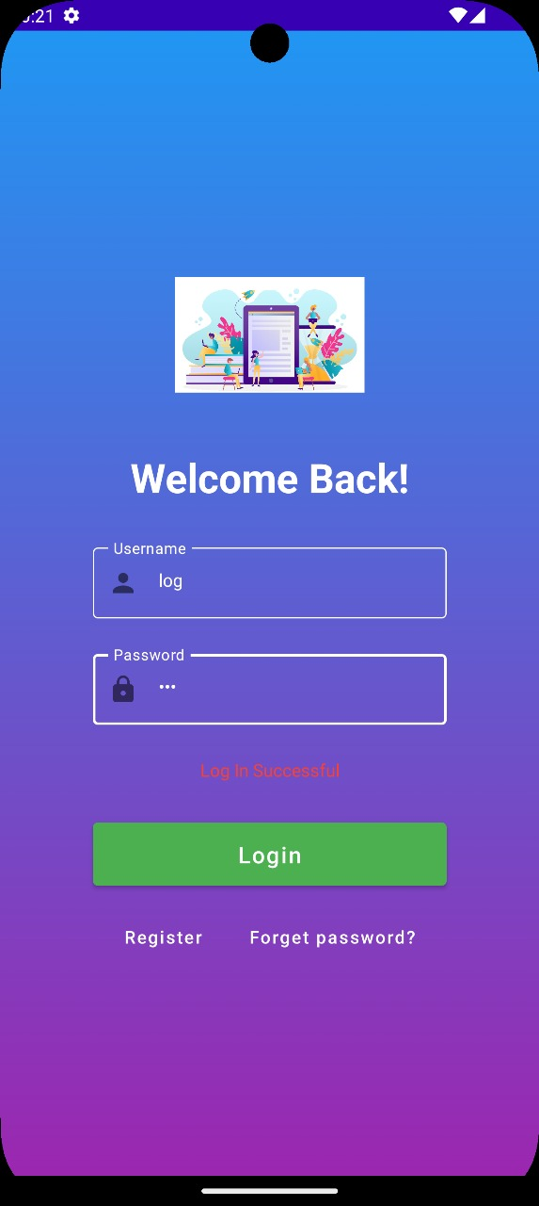
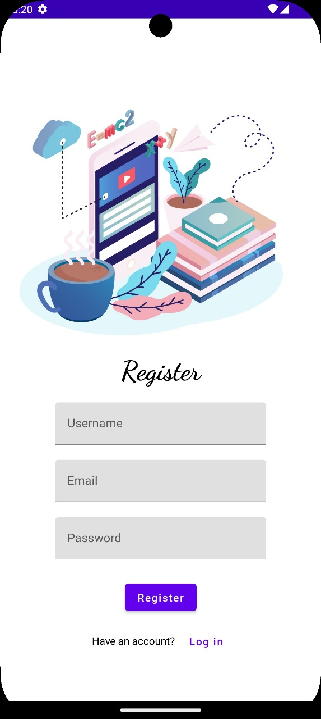
Output:

Slide 12
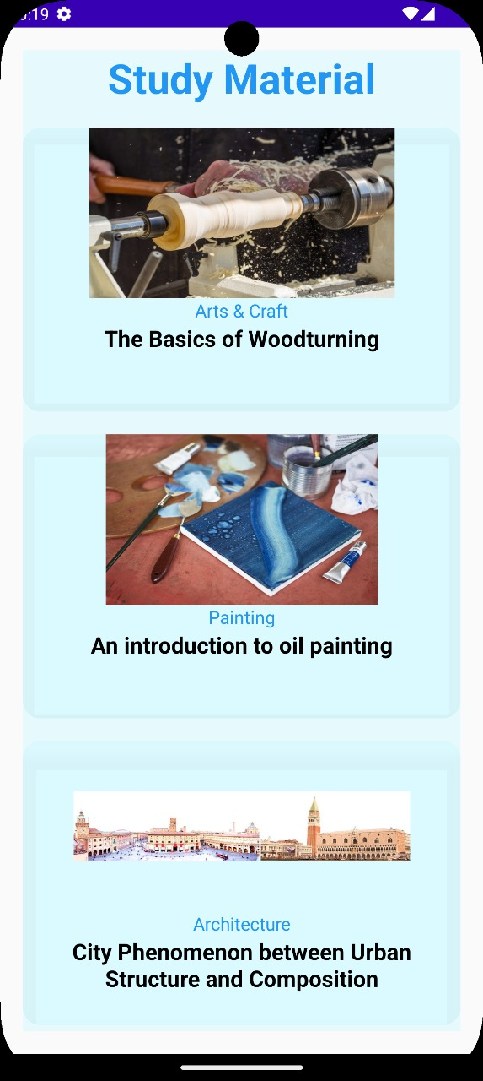
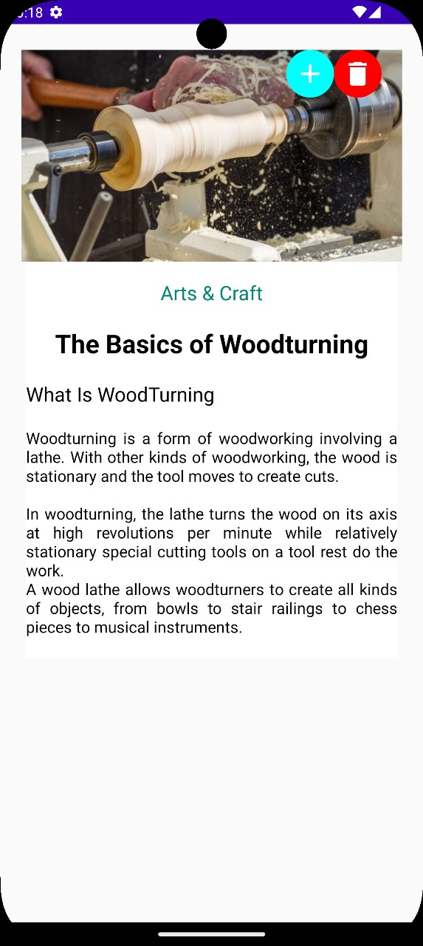

Slide 13
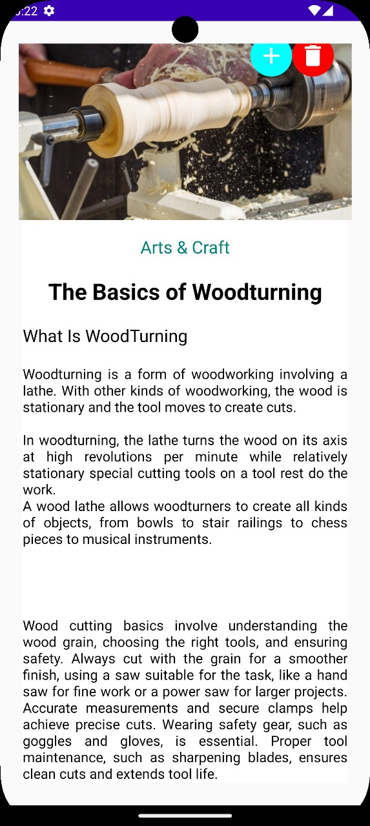
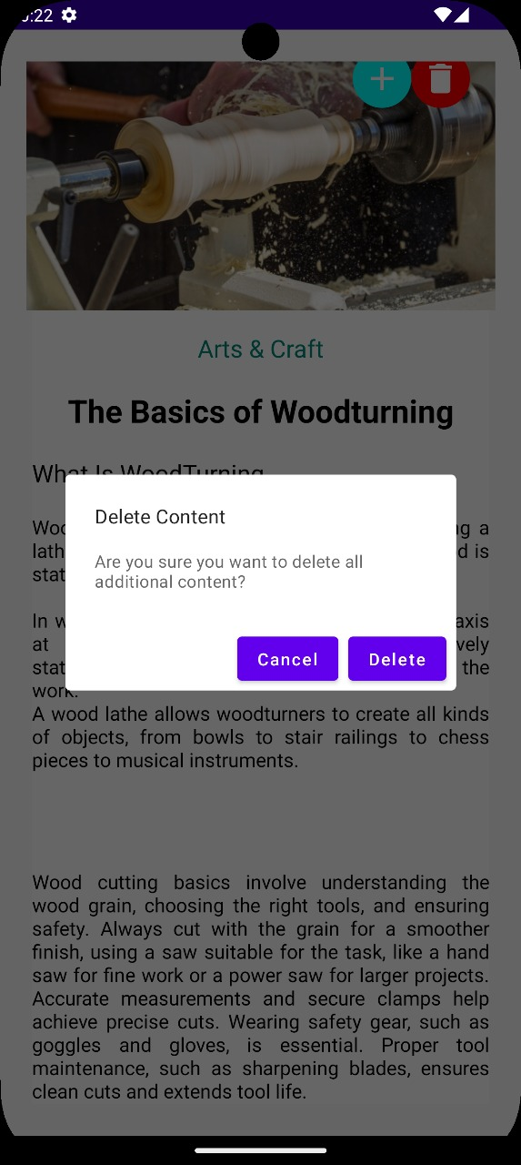

Slide 14
THANK YOU !

