Slide 1

Web development
Department GIC I4
By Toch & Vichea

Slide 2
Content
I. Id and class
II. HTML audio
III. HTML video
IV. HTML form
V. Input (text, radio, checkbox, submit, button )

Slide 3
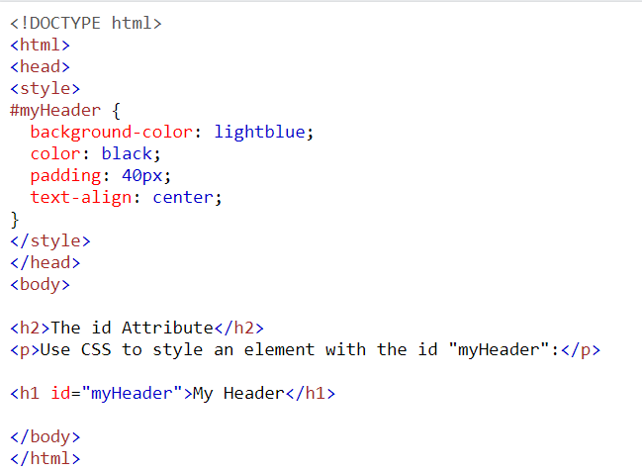
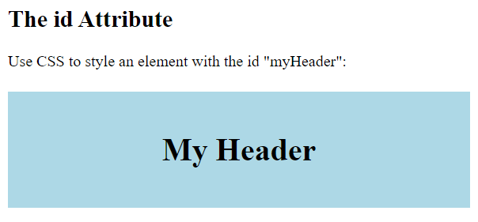

I. Id and Class
Id : It is a attribute that use to specify a unique id for a HTML element, and we can have more than one element with the same id in an HTML document.
. The id attribute is used to point to specific style declaration in a style sheet.
Example:

Slide 4
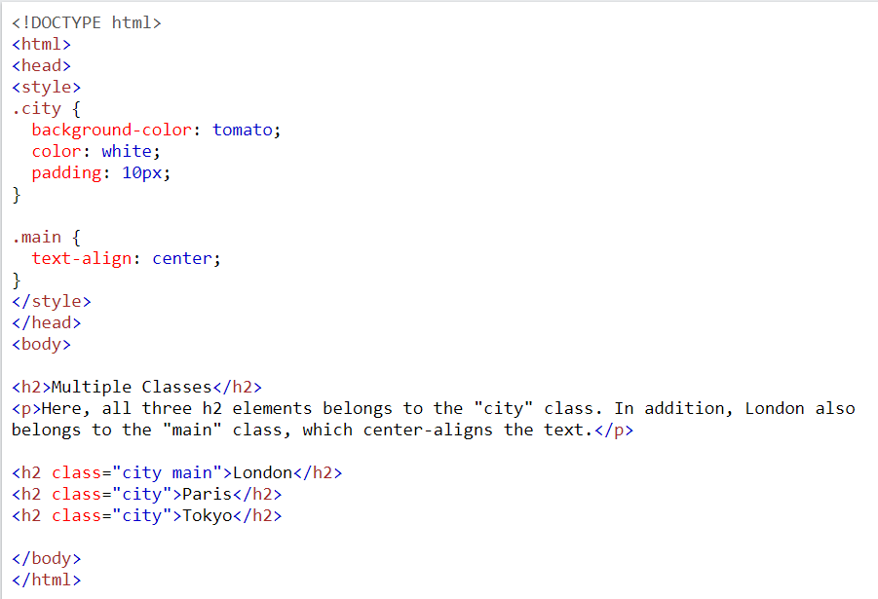
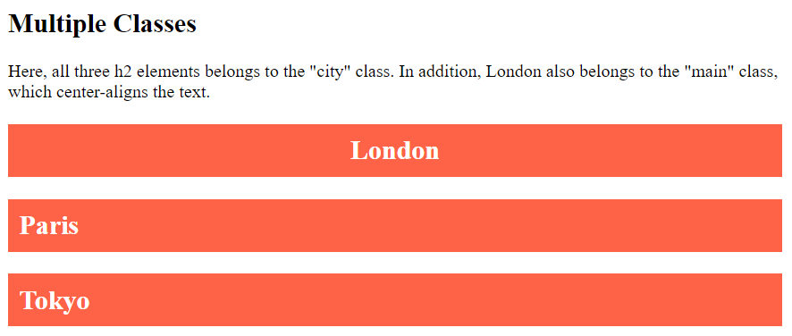
Class : attribute is used to specify a class for an HTML element. Multiple HTML elements can share the same class.
The class attribute is often used to point to a class name in a style sheet. It can also be used by a JavaScript to access and manipulate elements with the specific class name.
Example:

Slide 5


II. Audio
<audio>: element is used to play an audio file on a web page.
Control : attribute adds audio controls, like play, pause, and volume.
<source>: element allows you to specify alternative audio files which the browser may choose from. The browser will use the first recognized format.
Syntax:
Example

Slide 6

III. Video
<video> element is used to show a video on a web page.
controls : attribute adds video controls, like play, pause, and volume.
mute : attribute use to mute the video.
autoplay : attribute use to auto paly the video.
poster : attribute use to embed the poster to the video
Syntax
Example:

Slide 8

Thank you
someone@example.com

