Slide 1
Web-development
Department GIC
By Toch & Vichea

Slide 2
Introduction about website
Website : is a collection of web pages and related content that is identified by a common domain name and published on at least one web server.
Examples: wikipedia.org, google.com, and amazon.com.
.What is Front End and Back End development ?
+ Front End : It is refers to “client-side” development, where focus is on what users
visually see first in their browser or application. Front end developers are responsible
for the look and feel of a side. (HTML, CSS, JS, JQUERY ).
+ Back End : It is refer to “sever-side” of an application. The back end usually consists of three parts such as a server, an application, and a database, User can’t see the
the backend work. But this code is what communication the database information to
the browser. ( JAVA, PHP, PYTHON, MY SQL … ).

Slide 3
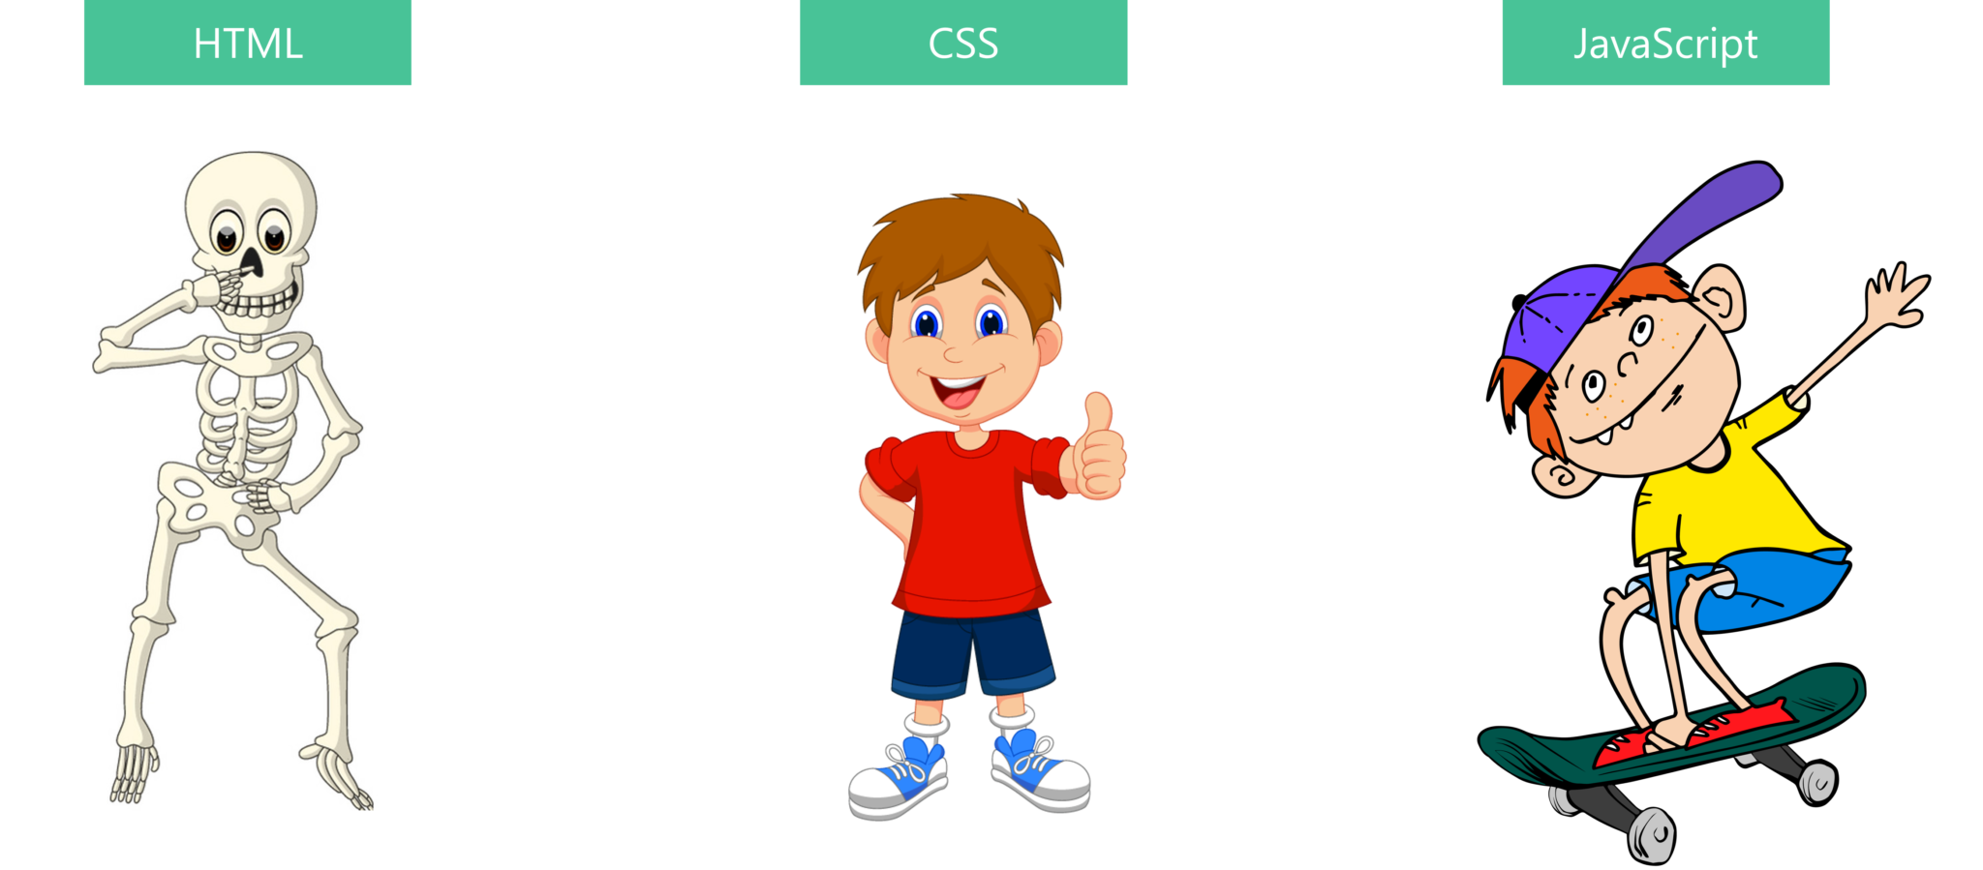
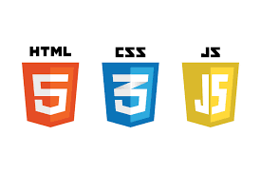
What is HTML, CSS and JS ?
HTML (Hyper Text Markup Language ): is the standard markup language for create web pages.
and describes the structure of a Web page, consists of a series of elements.
CSS (Cascading Style Sheets) : is the language we use to style a Web page or is a language of style rules that we use to apply styling to our HTML elements, for example setting background colors and fonts, and laying out our content in multiple columns.
JS (Java Script ) : it is a high level language that can allow us use to make web pag interactive and adds behavior to web page.

Slide 4
content
I. Introduction about HTML
II. HTML elements
III. Heading
IV. Paragraphs
V. Style

Slide 5
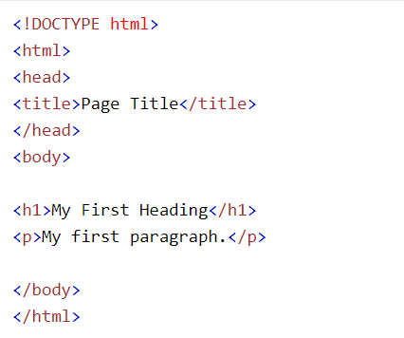
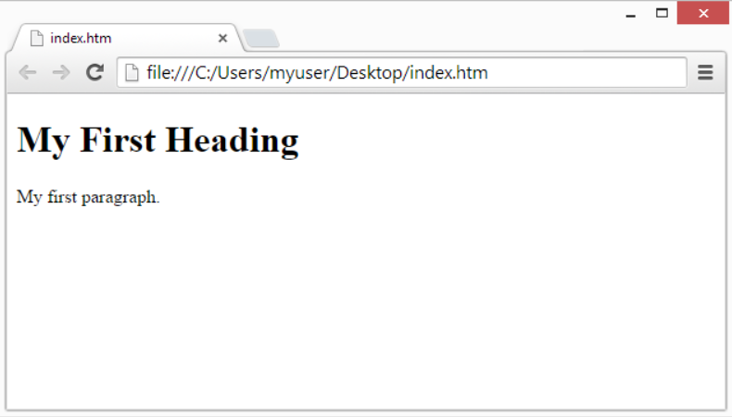

I. What is HTML ?
HTML (Hyper Text Markup Language ) is the standard markup language for create web pages.
and describes the structure of a Web page.
Example:

Slide 6
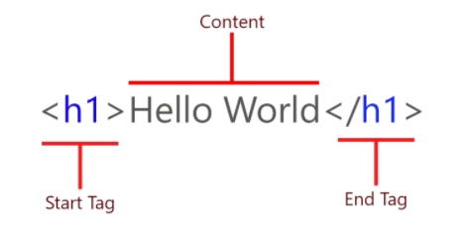
II.HTML elements
HTML elements is everything from the start tag, some content, and an end tag.
Syntax
<tagname>Content goes here...</tagname>
Start Tag: This consists of the name
element, wrapped in opening and closing
angle brackets. <html>
Content: This is content of the element
End Tag: This is the same as the opening
Tag, except that includes a forward slash
Before the element name. </html>

Slide 7
What is Tag?
. Tag : look like this <name_tag> that it have opening tag and close tag.
example:
.<html> : element is the root element and it defines the whole HTML document.
.<body> : element defines the document's body.
.<h1> : element defines a heading.
.<P> : element defines a paragraphs.

Slide 8
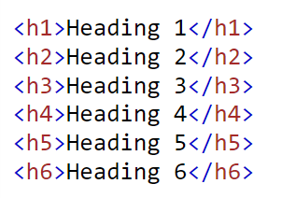
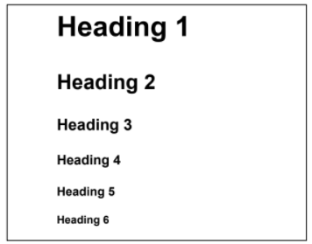

III. What is heading?
Heading: are titles or subtitles that you want to display on a webpage.
heading defines have 6 level <h1> to <h6> there are:
example:

Slide 9

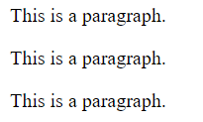
IV. Paragraphs
Paragraph: is element defines a paragraph <p>….</P>.
Example
*NOTE: we use <br> if you want a line break (new line ) without start a new paragraph.

Slide 10
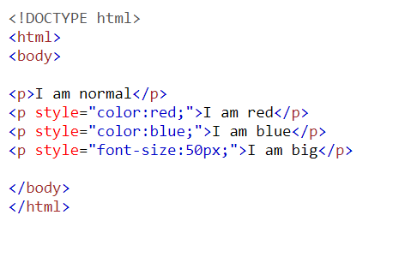
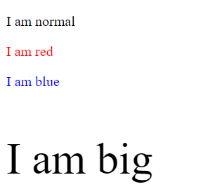
V. Style
HTML style: is used to add styles to an element, such as color, font, size, and more.
syntax
<tagname style="property:value;">
example:

Slide 11
Reference
W3school: https://www.w3schools.com/html/default.asp)
Mozilla Web doc : https://developer.mozilla.org/en-US/docs/Learn)
Write HTML in online tool: https://codepen.io/

