Slide 1

Web development
Department GIC
Week 2
By Toch & Vichea

Slide 2
Content
I. Text format
II. Attribute
III. HTML links, images,
IV. HTML list
V. HTML comment

Slide 3
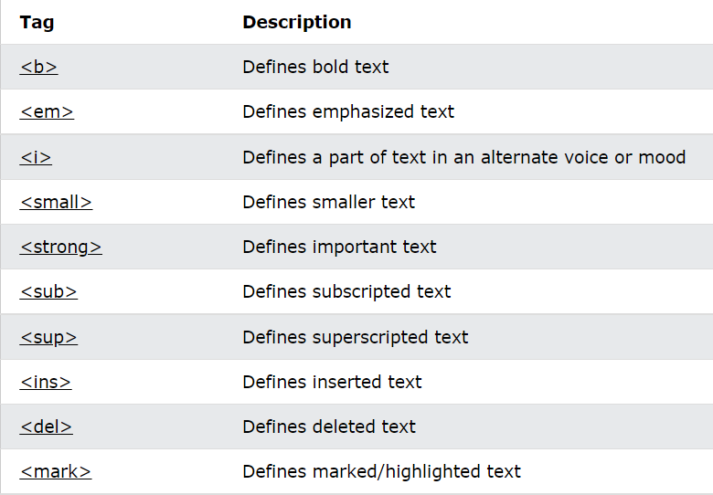
I. Text format
Text format : contains several elements for defining text with a special meaning.
Formatting elements where designed to display special types of text.
. <b> : Blod text
. <strong> : Important text
. <i> : Italic text
. <em> : Emphasized text
. <mark> : Marked text
. <small> : smaller text
. <del> : Deleted text
. <ins> : Inserted text
. <sub> : Subscript text
. <sup> : Superscript text

Slide 4
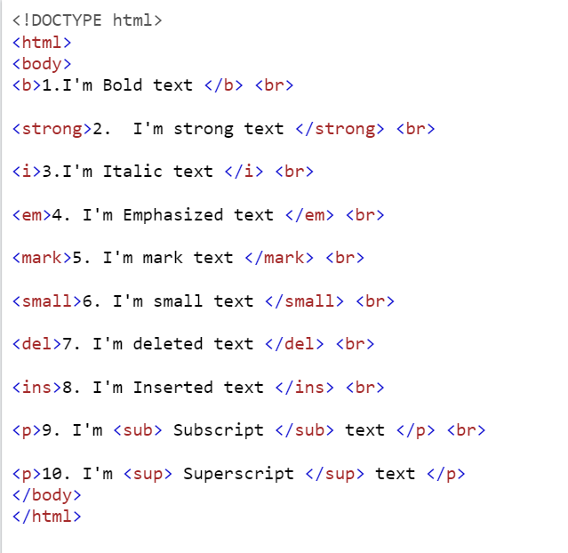
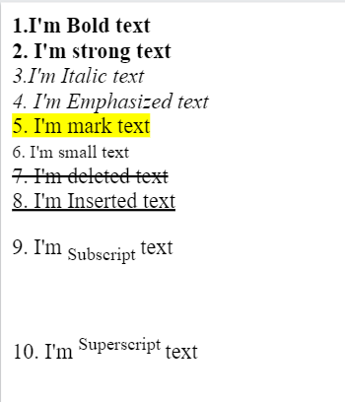

Example:

Slide 5
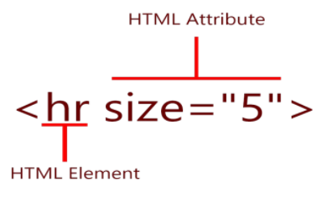
II. Attribute
Attribute : provide additional information about HTML elements
HTML Attributes
.All HTML elements can have attributes
.Attributes provide additional information about elements
.Attributes are always specified in the start tag
.Attributes usually come in name/value pairs like: name="value“.
example:
HTML attribute

Slide 6

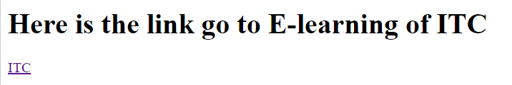
III. HTML links and Images
3.1 Links
HTML links syntax :
.<a></a> : is a tag that have both starting tag and closing tag and is a tag defines a hyperlink.
. herf : is an attribute that defined the URL of a linked resource.
Example:

Slide 7

3.2 Images
HTML images syntax:
. <img > : tag is used to embed an image in an HTML page.
. src : attribute specifies the path to the image to be displayed.
example:

Slide 8
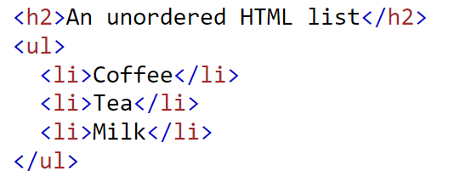
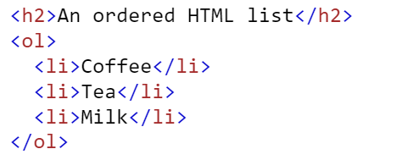
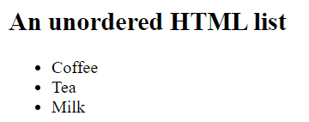
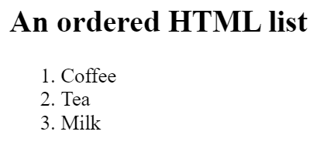
IV. HTML list
HTML list : allow web developers to group a set of related items in lists.
In HTML have 2 types of list there are:
1.unorder html list 2.order html list

Slide 9
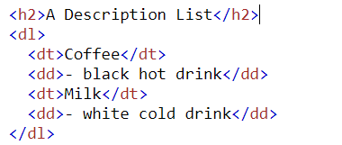
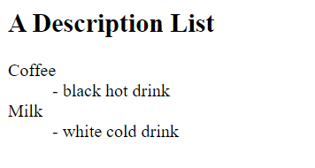
Other list in HTML
HTML also supports description lists.
A description list is a list of terms, with a description of each term.
. <dl>: element to define a description list.
. <dt>: element to define the description term.
. <dd>: element to describe the term in a description list.
Example:

Slide 10

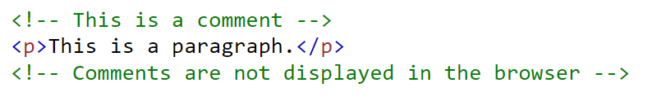

V. HTML comments
HTML comments : is comments are not displayed in the browser, but they can help document your HTML source code.
syntax:
Example:
Note: comment are not displayed in the browser

Slide 11

Thank you
Write HTML in online tool: https://codepen.io/

