Slide 1

WEB Development
Department GIC I4
Week 2 day 1
By Toch & Vichea

Slide 2
Content
I. Block and inline
II. HTML table
III. Iframe

Slide 3
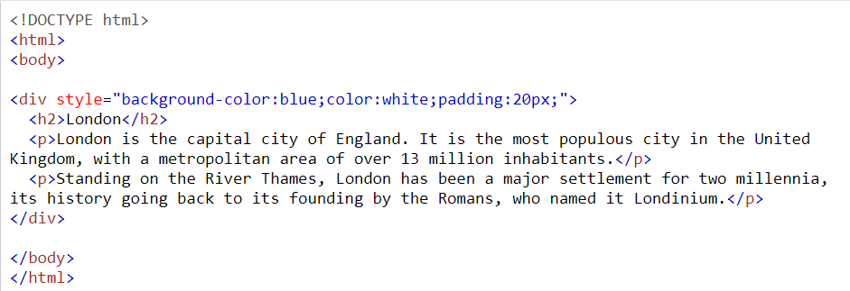
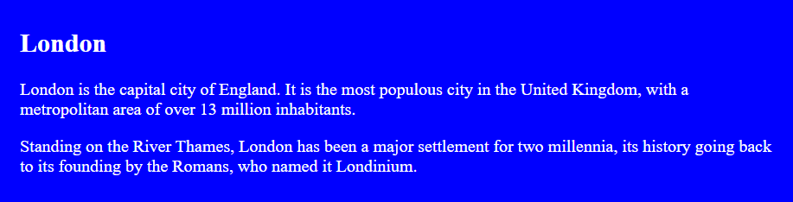

I. Block and inline
1.1 Block elements
block-level element always starts on a new line and takes up the full width available.
<div> : This element is often used as a container for other HTML elements and it is
element has no required attributes, but style, class and id are common.
Example:

Slide 4
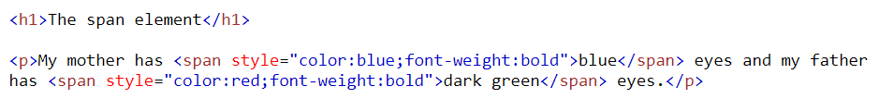

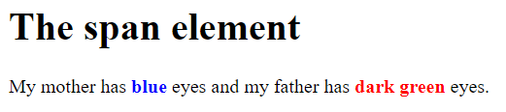
1.2 Inline
Inline : element does not start on a new line and inline element only takes up as much width as necessary this is a <span> element inside a paragraph.
<span> : element is an inline container used to mark up a part of a text, or a part of a document and element has no required attributes, but style, class and id are common.
Example :

Slide 5
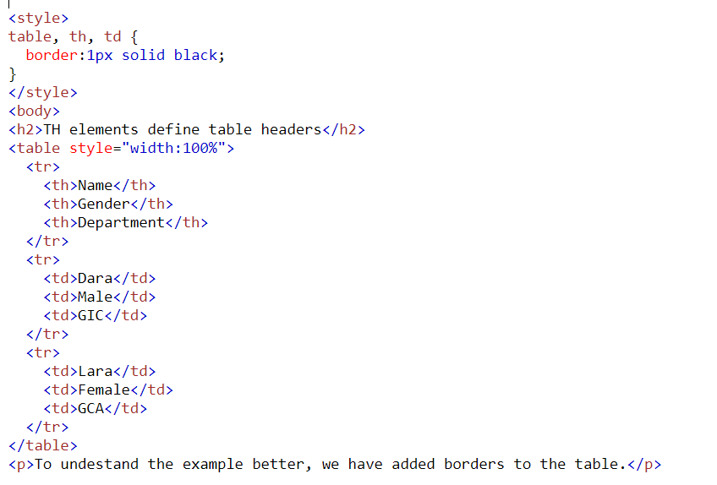
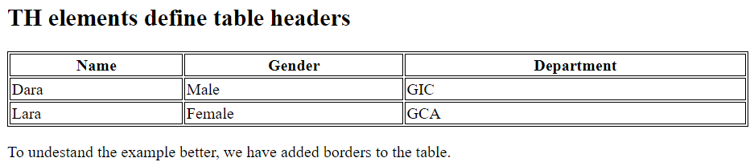
III. HTML table
HTML table : allow web developers to arrange data into rows and columns.
<table> tag for starting the table.
td : stands for table data.
tr : stands for table row.
th : stans for table header.
Example:

Slide 6
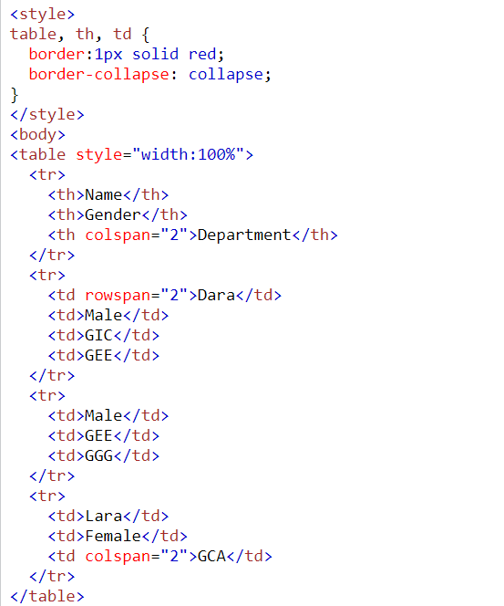
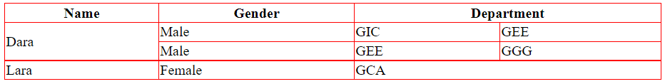
NOTE: rowspan : attribute represents the number of rows to span. colspan : attribute represents the number of columns to span.
Example:

Slide 7
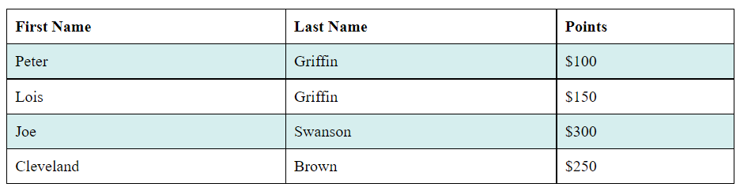
+ HTML Table - Zebra Stripes
If you add a background color on every other table row, you will get a nice zebra stripes effect.
To style every other table row element, use the:
1 :nth-child(even) : for all even row
2 :nth-child(odd) : for all odd row
Example: use nth-child(even)

Slide 8
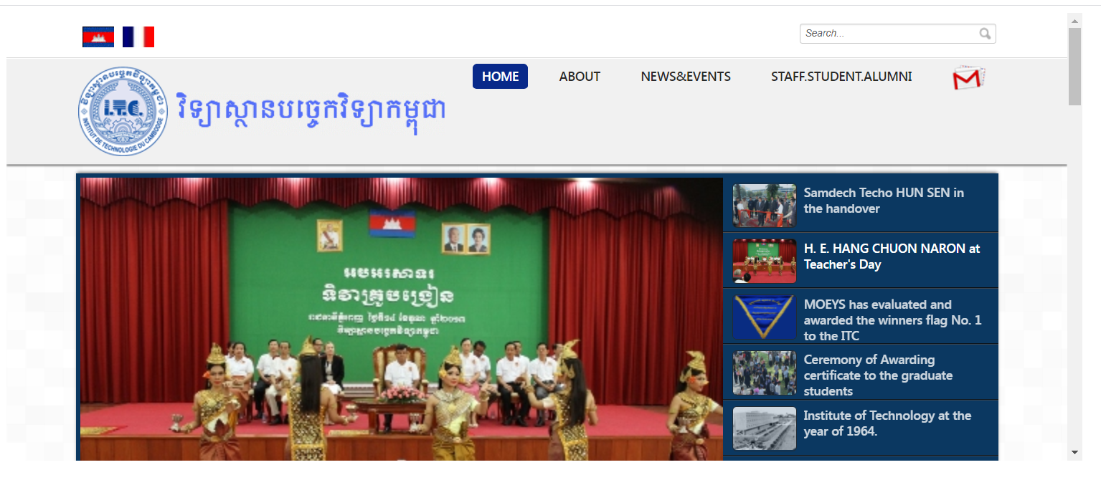
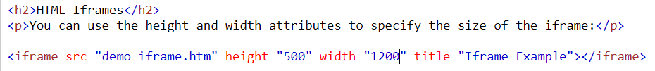
III.Iframe
HTML Iframe : is used to display a web page within a web page.
Syntax :
<iframe> tag specifies an inline frame.
Example :

Slide 9

Thank you
someone@example.com

