Slide 1
TP-03
JavaScript
(Local storage, Cookie, and session)
https://javascript.info/

Slide 2
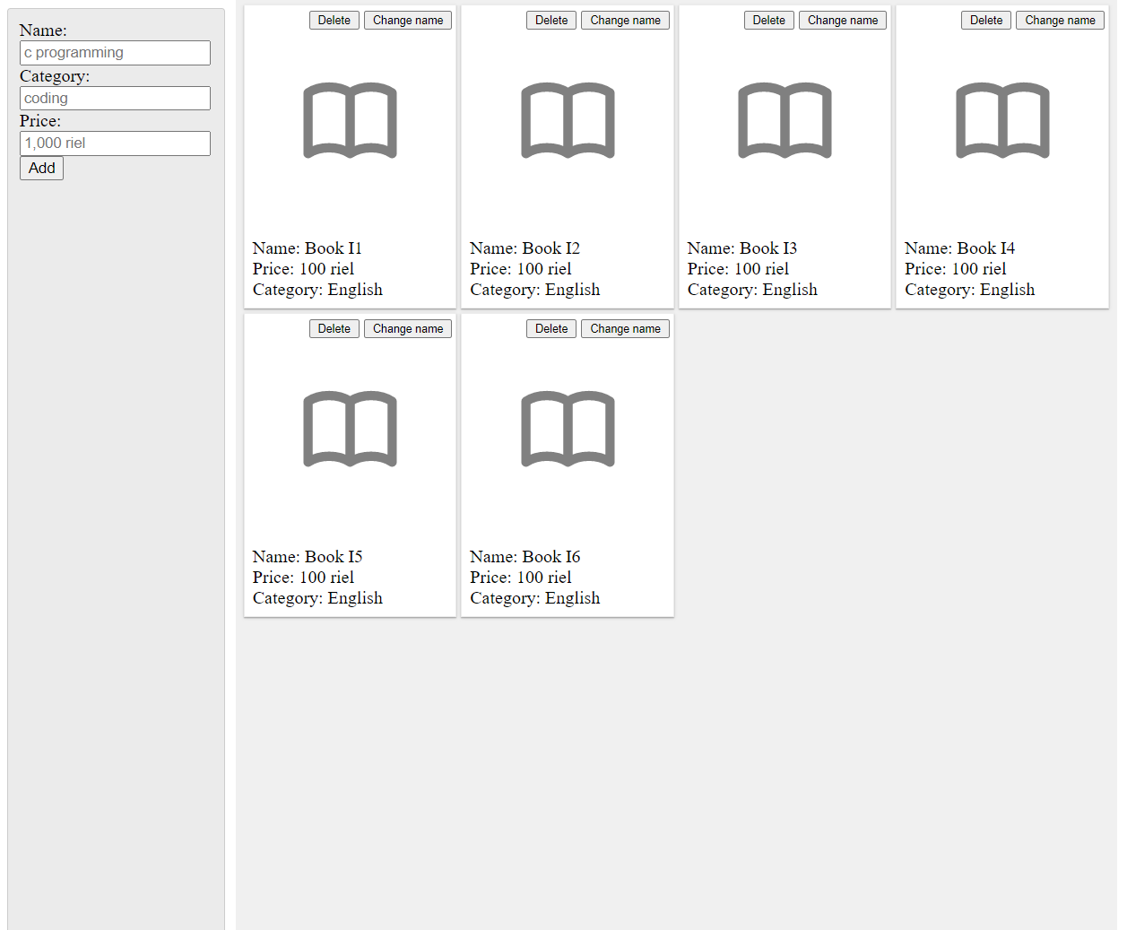
CRUD
EX1: Book shop CRUD with Local storage
Grid view of book collection
Add new book
Delete book
Update new name
👉 You can use both JavaScript or jQuery

Slide 3
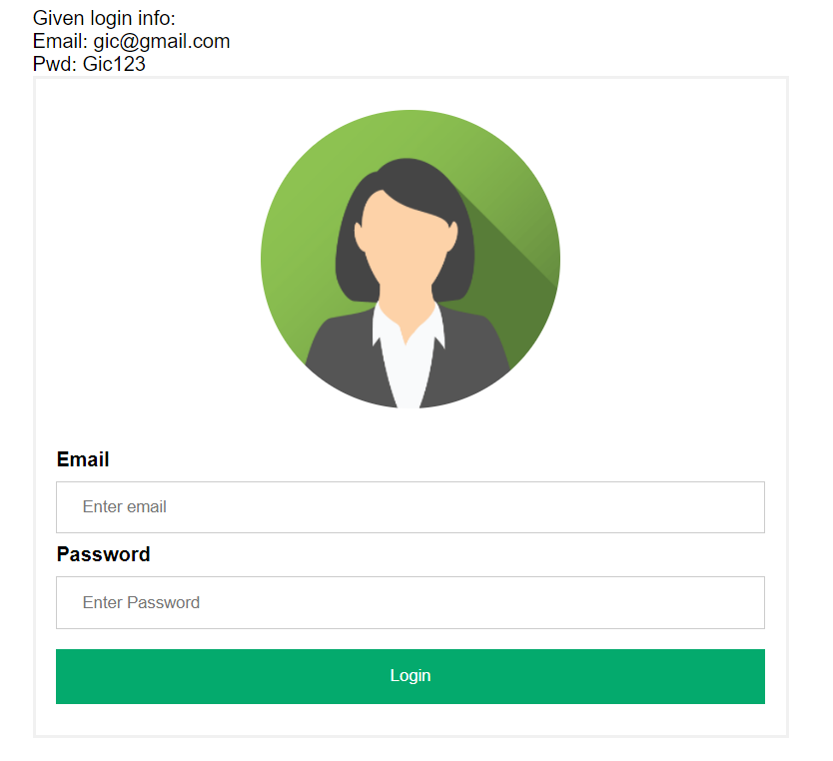
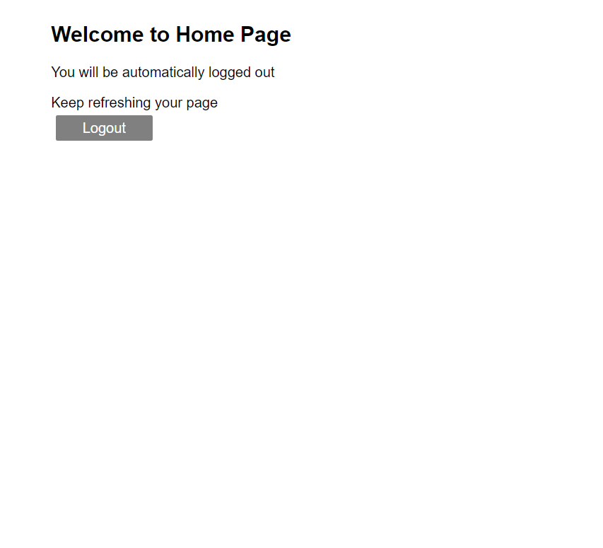
Login Form
EX2: Login Form with Cookie
Note: Google Chrome isn’t working with local

Slide 4
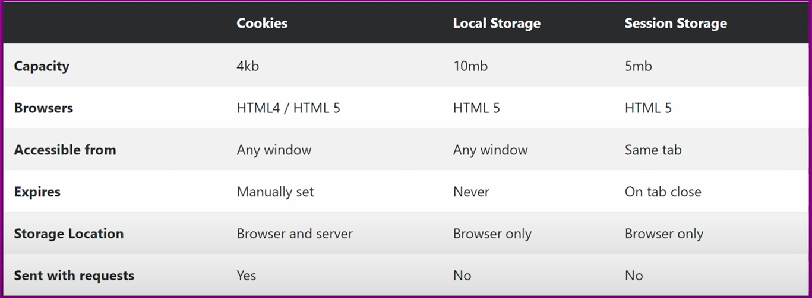
Local storage, Cookie and Session storage

Slide 5



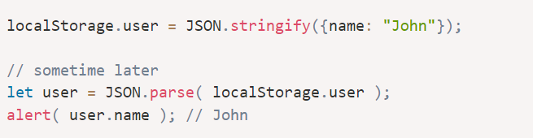
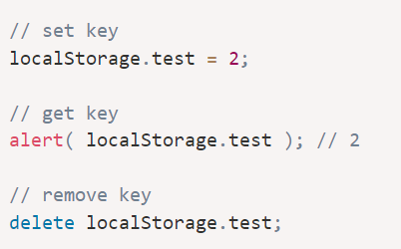


Local storage & Session storage
localStorage
Strings only
Object-like access
Session Storage

Slide 6

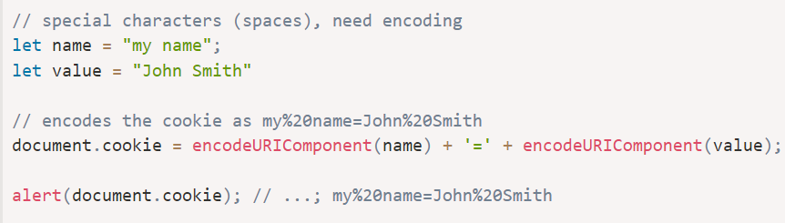
Cookie
Reading from document.cookie
Writing to document.cookie
Cookie options: path=/; domain=site.com; expires; secure; samesite
Note: Check w3school for supporting functions

Slide 7


Bonus
https://d3js.org/
https://observablehq.com/@d3/gallery
https://www.d3indepth.com/
https://sbcode.net/threejs/introduction/
https://fhtr.org/BasicsOfThreeJS/#27
https://threejs.org/

Slide 8

https://www.dunebook.com/top-15-javascript-animation-libraries/
https://github.com/tweenjs/tween.js/

Slide 9
Good luck 👌

