Slide 1

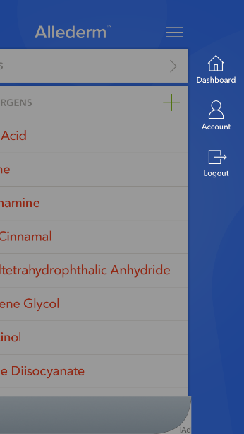
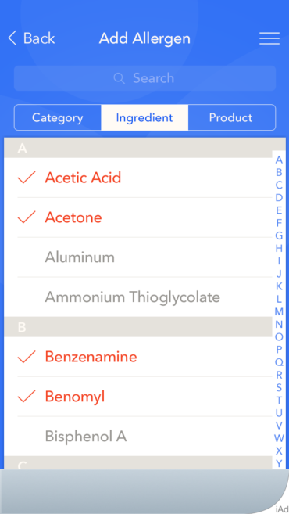
Features
A user will have the ability to create a new account with a username (email address) and password or by selecting an existing account that shares token-based authentication (Facebook, Google).
Log-in screen
Dashboard screen: Edit profile information, manage allergens.

Slide 2
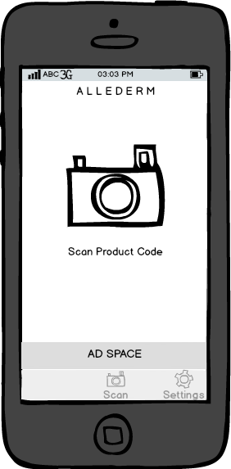
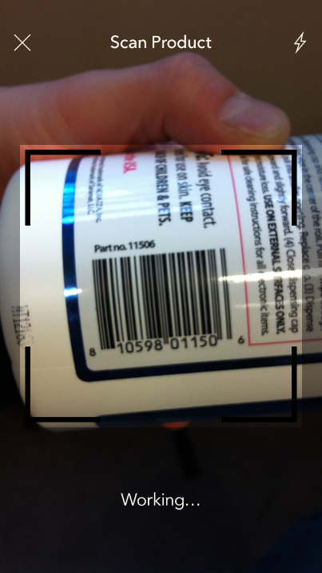
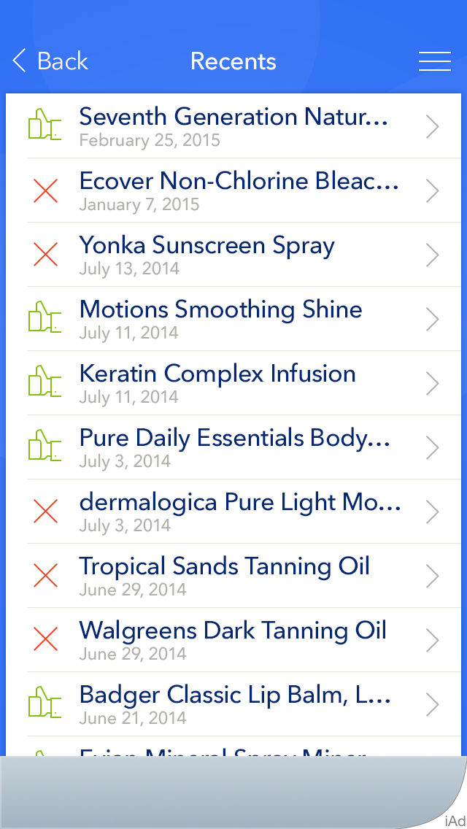
Features
User Friendly- The main landing screen of the application will allow the user to quickly enter into scan mode, where an EAN/UPC can be scanned. Once in scanning mode, the user can use the camera to automatically scan and read a barcode with some guidance from the user interface.

Slide 3
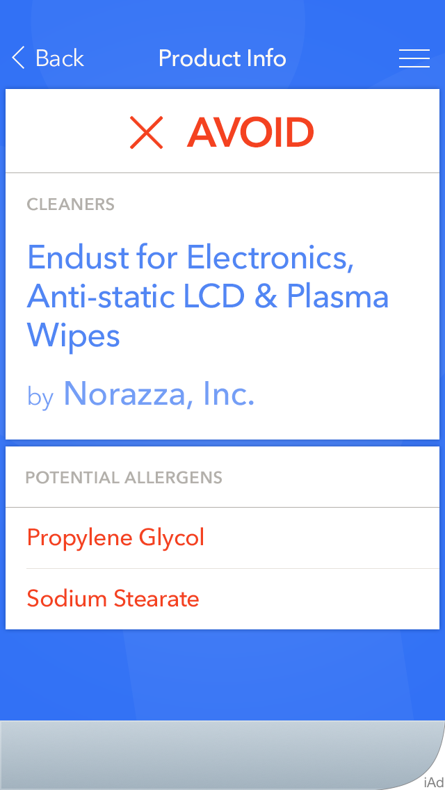
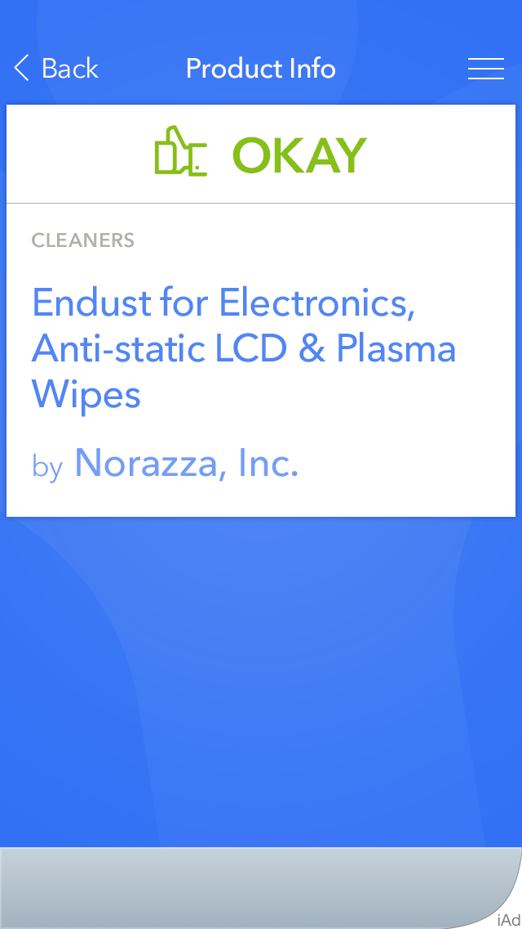
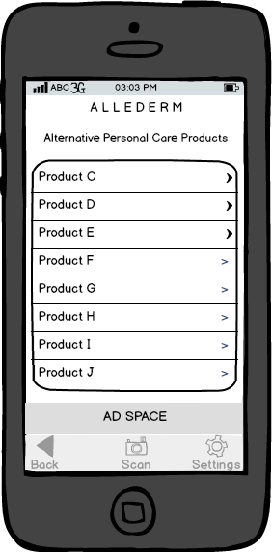
Features
Clean and Simple- Once the barcode is scanned and a product is identified, the system will display the product and a clear indicator if the product contains any allergens listed, as indicated by the user’s profile. If there are allergens, they will be listed for the user to see. In either case, a list of recommended alternate products will be available by touching the available control or swiping to the next screen. This list will be generated by identifying similar products in the Allergen database that do not contain any of the user-specified allergens.

Slide 4
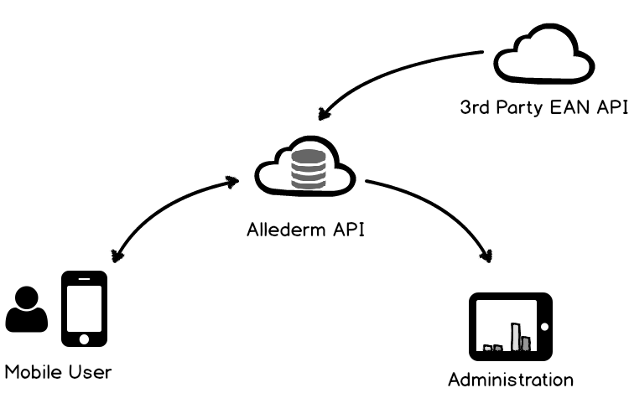
Communication Model
Database

