Slide 1
Introduction
Programming at the Hardware/Software Interface

Slide 2
This work is licensed under a Creative Commons Attribution 4.0 International License. This work is ©2018-21 Christopher A. Bohn, bohn@unl.edu.
You are free to:
Share — copy and redistribute the material in any medium or format
Adapt — remix, transform, and build upon the material for any purpose, even commercially
Under the following terms:
Attribution — You must give appropriate credit, provide a link to the license, and indicate if changes were made. You may do so in any reasonable manner, but not in any way that suggests the licensor endorses you or your use.
No additional restrictions — You may not apply legal terms or technological measures that legally restrict others from doing anything the license permits.
Slide by Bohn
These lecture slides are meant to enhance your use of the Programming at the Hardware/Software Interface textbook. If you have not adopted this publication for your course, please consider doing so.

Slide 3
Course Structure, Syllabus Review
Slide by Bohn

Slide 4
COVID-19 Notes
This course does not have an approved requirement for mandatory face coverings
If your circumstances necessitate mandatory face coverings (family member who cannot be vaccinated or with health condition that makes vaccines less effective), contact me ASAP
I will accommodate students who cannot attend class due to health issues
Slide by Bohn

Slide 5
Why are you taking this course?
required to take
“Computer science is no more about computers than astronomy is about telescopes.” – Edsger Dijkstra
In another course, you’ll program Turing Machines.
In the real world, you’ll program computers.
The overwhelming majority of computer science & software engineering courses rely upon “leaky abstractions.” (term coined by Joel Spolsky)
Slide by Bohn

Slide 6
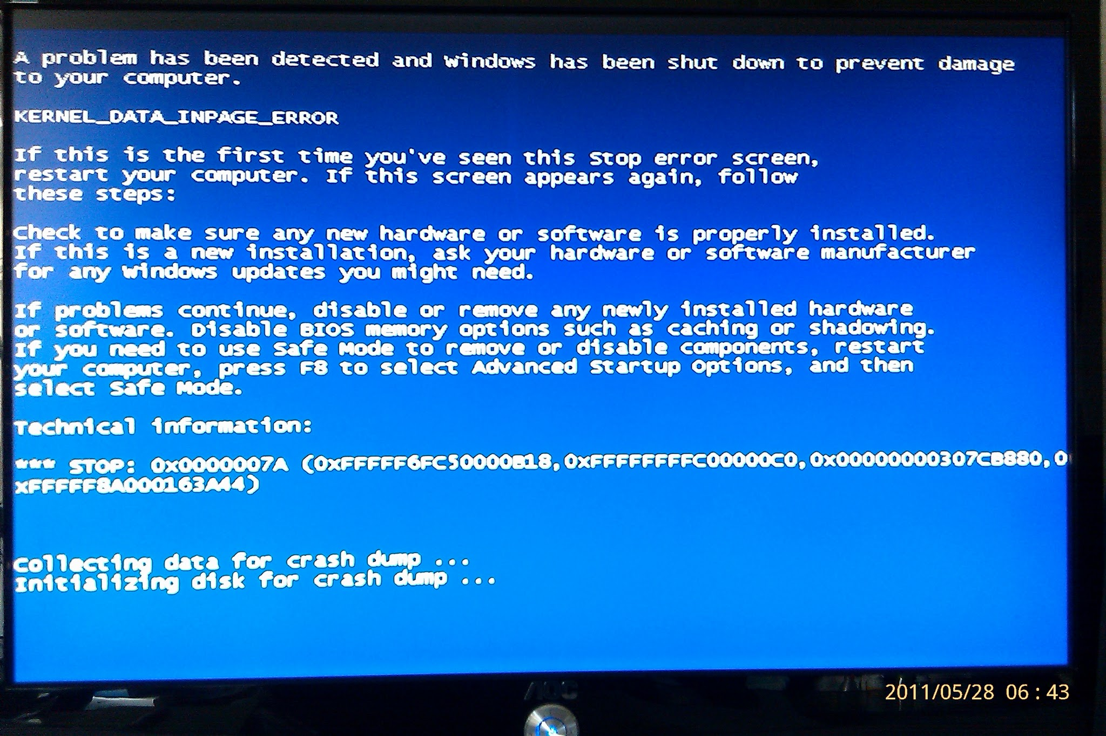
When reality leaks through the abstraction…
Best case: software performs slowly
Frustrating
Moderate case: the hardware and/or operating system prevent an unsafe condition
Embarrassing
Blue Screen of Death photo by Bohn
Slide by Bohn

Slide 7
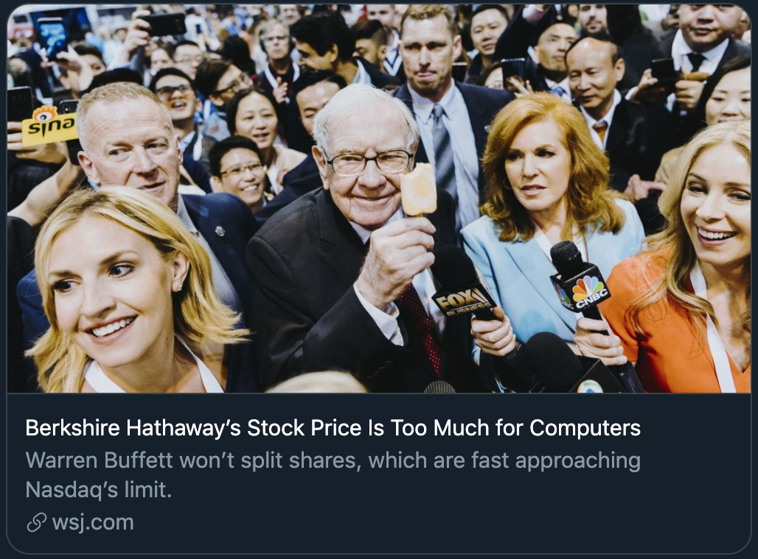
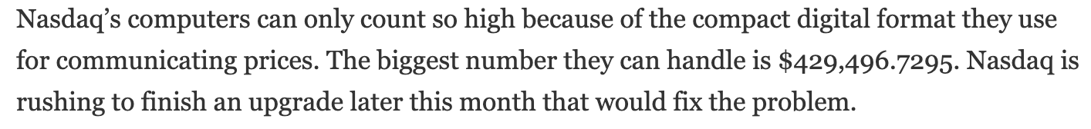
When reality leaks through the abstraction…
Worst case: the hardware and/or operating system don’t or can’t prevent unsafe conditions
Morris Worm (November 1988)
ComAir Christmas Disaster (December 2004)
Berkshire Hathaway’s Stock Price (May 2021)
Slide by Bohn
https://www.wsj.com/articles/berkshire-hathaways-stock-price-is-too-much-for-computers-11620168548
Screenshot of Wall Street Journal story

Slide 8
Languages used in this course
C
Assembly (x86, ARM)
Why?
Slide by Bohn

Slide 9
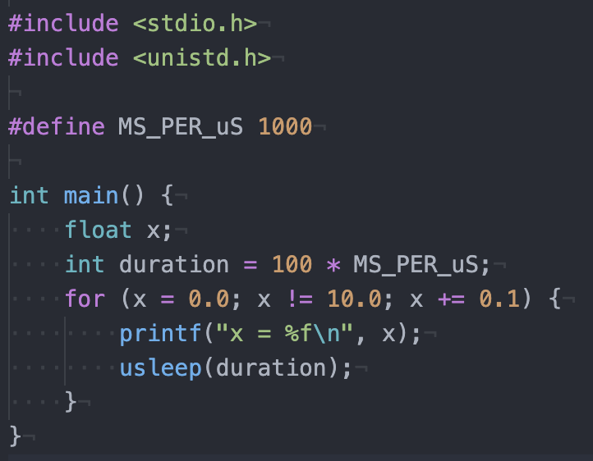
Planned lessons
Why isn’t x’s final value 10.0?
Data representation & arithmetic
Why?
Slide by Bohn
https://www.wsj.com/articles/berkshire-hathaways-stock-price-is-too-much-for-computers-11620168548
Screenshot of code with a “float” loop index

Slide 10
Planned lessons
Data representation & arithmetic
Assembly language
ALGOL, BASIC, COBOL, FORTRAN, Pascal, and PL/I count 1,2,3… (or allow arbitrary array ranges)
Why does C count 0,1,2…?
Why do C strings end in \0 ?
Why does C have an increment operator (i++)?
Why does C have the ternary operator? (x = x<y ? x : y)
Slide by Bohn

Slide 11
Planned lessons
Data representation & arithmetic
Assembly language
Processor architecture
Why is clock speed a poor measure of processor performance?
Slide by Bohn

Slide 12
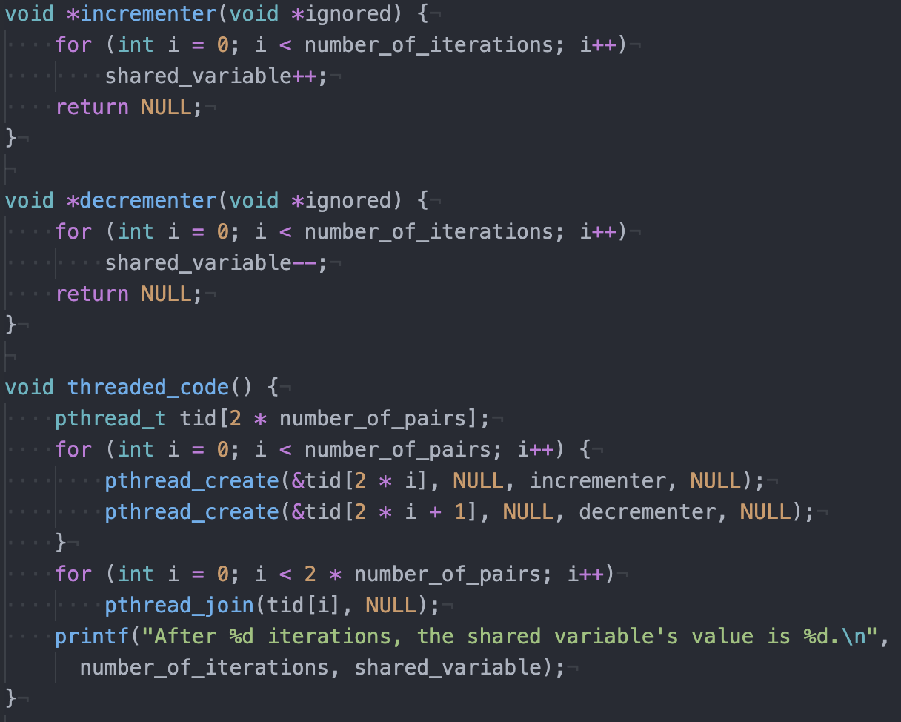
Planned lessons
What is the value of shared_variable when finished?
Data representation & arithmetic
Assembly language
Processor architecture
Concurrency
Slide by Bohn
Screenshot of code with concurrent variable updates

Slide 13
Planned lessons
Data representation & arithmetic
Assembly language
Processor architecture
Concurrency
Exception control flow
Abrupt change in control flow due to change in processor state
(not same as application-level exceptions)
Interrupts, traps, faults, aborts
How do you handle these exceptions and return control to the application?
Slide by Bohn

Slide 14
Planned lessons
Data representation & arithmetic
Assembly language
Processor architecture
Concurrency
Exception control flow
System level I/O
Computers do more than just compute
Keyboard, mouse
Monitor, printer
Disk, tape, punch card
Network
Arbitrary data source/sink
Slide by Bohn

Slide 15
Planned lessons
Data representation & arithmetic
Assembly language
Processor architecture
Concurrency
Exception control flow
System level I/O
Memory
Why is one of these slower than the other?
for( i=0 ; i<RANGE ; i++ )
for( j=0 ; j<RANGE ; j++ ) {
dest[i][j] = src1[i][j];
printf("Row Major indexing : %d,%d\n",i,j);
}
for( j=0 ; j<RANGE ; j++ )
for( i=0 ; i<RANGE ; i++ ) {
dest[i][j] = src2[i][j];
printf("Column Major indexing : %d,%d\n",i,j);
}
Slide by Bohn

Slide 16
Planned lessons
Data representation & arithmetic
Assembly language
Processor architecture
Concurrency
Exception control flow
System level I/O
Memory
Program optimization
More to performance than “Big-O” complexity
How do you use what you’ll learn in this course to make your programs run faster?
without violating good software engineering practices
Slide by Bohn

Slide 17
Course Components
Lectures
Higher level concepts
Recitations
Applied concepts, important tools and skills for labs, clarification of lectures, exam coverage
Labs
The heart of the course
1-2 weeks each
Provide in-depth understanding of an aspect of systems programming and debugging
Homework and Exams
Test your understanding of concepts & key principles
Two midterms and one final
Slide by Bohn
Notes:
Your course might be structured differently.

Slide 18
Let’s get started!
For some of you, this might be the only course where you study low-level behavior
For others, this course might spark an interest in systems programming
Either way, you’ll be a more-effective programmer for knowing how & why computers behave the way they do
Slide by Bohn

