Slide 1
Simple Processor Architecture
Programming at the Hardware/Software Interface

Slide 2
This work is licensed under a Creative Commons Attribution 4.0 International License. This work is ©2018-21 Christopher A. Bohn, bohn@unl.edu.
You are free to:
Share — copy and redistribute the material in any medium or format
Adapt — remix, transform, and build upon the material for any purpose, even commercially
Under the following terms:
Attribution — You must give appropriate credit, provide a link to the license, and indicate if changes were made. You may do so in any reasonable manner, but not in any way that suggests the licensor endorses you or your use.
No additional restrictions — You may not apply legal terms or technological measures that legally restrict others from doing anything the license permits.
Slide by Bohn
These lecture slides are meant to enhance your use of the Programming at the Hardware/Software Interface textbook. If you have not adopted this publication for your course, please consider doing so.

Slide 3
A brief discussion on logic circuits

Slide 4
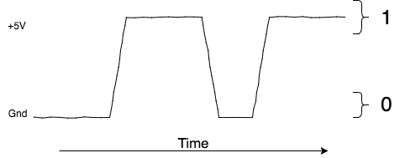
Digital Signals
Really continuous signals
Use voltage thresholds to assign discrete values
Use transistors designed to transition quickly between “high” voltage and “low” voltage (typically ground)
Minimize time transitioning through indeterminate-value range
Transitions from 0 to 1 and from 1 to 0 are not instantaneous!
Slide by Bohn

Slide 5
Combinatorial & Sequential Logic
Combinatorial Logic – outputs depend only on its current inputs
Sequential Logic – outputs depend on sequence of inputs
Slide by Bohn

Slide 6







Logic Gates
a
a
a
a
out
out
out
out
b
b
b
out = ~a
out = a & b
out = a | b
out = a ^ b
a
a
a
out
out
out
b
b
b
out = ~(a & b)
out = ~(a | b)
out = ~(a ^ b)
Slide by Bohn
Respond continuously, with propagation delay
In combinatorial circuit, delays accumulate

Slide 7
Example Propagation Delay: AND gate
Transistor Technology | Parameter | Typical | Maximum
Baseline (7408) | t_{PLH} | 17.5ns | 27ns
 | t_{PHL} | 12ns | 19ns
Schottky (74S08) | t_{PLH} | 4.5ns | 7ns
 | t_{PHL} | 5ns | 7.5ns
Low-Power Schottky (74LS08) | t_{PLH} | 8ns | 15ns
 | t_{PHL} | 10ns | 20ns
Slide by Bohn
Source: Texas Instruments 74x08 datasheet

Slide 8
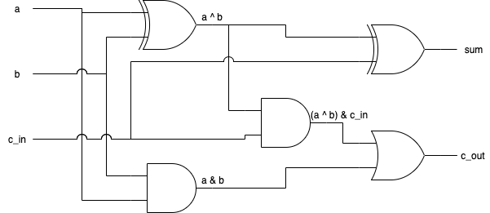
Example Cumulative Delay: Full Adder
45ns from input values being set until all output values are ready (in this hypothetical case)
Outputs take on other, incorrect values before stabilizing
Key reason computers have clocks: give circuits time to stabilize before reading their results
a
b
Slide by Bohn
c_in
a^b
(a^b)&c_in
a&b
sum
c_out

Slide 9
Every Combinatorial Circuit Implements Some Boolean Expression
a | b | c_{in} | sum | c_{out}
0 | 0 | 0 | 0 | 0
0 | 0 | 1 | 1 | 0
0 | 1 | 0 | 1 | 0
0 | 1 | 1 | 0 | 1
1 | 0 | 0 | 1 | 0
1 | 0 | 1 | 0 | 1
1 | 1 | 0 | 0 | 1
1 | 1 | 1 | 1 | 1
DNF Expressions (sum-of-products):
Slide by Bohn

Slide 10
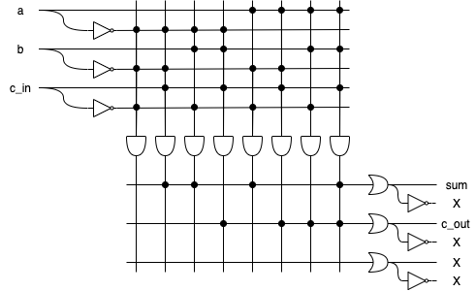
Full Adder Implemented in a Programmable Logic Array
DNF Expressions (sum-of-products):
Slide by Bohn

Slide 11
Multiplexor
0
1
2
3
.
.
.
n
inputs
output
.
.
.
A multiplexor (“mux”) is an electronic switch
One input is selected to pass through to output
output = inputs[select]
0
1
2
3
.
.
.
n
inputs
output
.
.
.
Slide by Bohn
select
select

Slide 12
Combinatorial & Sequential Logic
Combinatorial Logic – outputs depend only on its current inputs
Sequential Logic – outputs depend on sequence of inputs
Feedback sequential circuit – ordinary gates and feedback loops
Clocked synchronous state machine – uses combinatorial logic and feedback sequential circuits to generate outputs that change with respect to a controlling clock signal
(others also exist)
Slide by Bohn

Slide 13
Set-Reset Latches
S-R Latch
S-R Latch
_ _
S | R | Q | /Q
0 | 0 | last Q | last /Q
0 | 1 | 0 | 1
1 | 0 | 1 | 0
1 | 1 | 0 | 0
/S | /R | /Q | Q
1 | 1 | last /Q | last Q
1 | 0 | 1 | 0
0 | 1 | 0 | 1
0 | 0 | 1 | 1
Slide by Bohn
S sets Q to 1
R resets Q to 0
Notes:
/S-/R latches more common (use NAND instead of NOR)
I mention S-R latches only because it’s easier to see the semantics

Slide 14
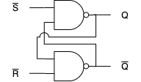
S-R Latch
__ __
/S | /R | /Q | Q
1 | 1 | last /Q | last Q
1 | 0 | 1 | 0
0 | 1 | 0 | 1
0 | 0 | 1 | 1
_
S
_
Slide by Bohn
R
Q
_
Q
Notes:
/S = 1, /R = 0: /Q becomes 1, then Q becomes 0, and they stay that way.
/S=1, /R=1: no change
/S=0, /R=1: Q becomes 1, then /Q becomes 0, and then they stay that way.
/S=1, /R=1: no change

Slide 15
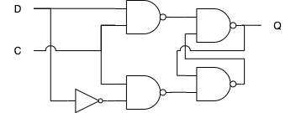
D Latch (“Transparent Latch”)
C | D | Q
0 | 0 | last Q
0 | 1 | last Q
1 | 0 | 0
1 | 1 | 1
D
Slide by Bohn
C
Q
???
D Q
C
Notes:
While clock is low, no change to output
When clock goes high, output follows D
When clock goes low, no change to output
When clock goes high, output follows D
If D transitions too close to clock transition, output can be unpredictable – if D went high early enough, output will have transitioned far enough for feedback to carry it high; if D went high too low, output won’t have transitioned very far and will fall low again – need to keep D stable during “t_setup” before clock transition and “t_hold” after clock transition

Slide 16
Edge-Triggered D Flip-Flop
D
D Q
C
D Q
C
Q
CLK | D | Q
0 | X | last Q
1 | X | last Q
 | 0 | 0
 | 1 | 1
M
CLK
D
Slide by Bohn
CLK
M
Q
D Q
CLK
Notes:
When CLK is low, /CLK is high, and M follows D. Q remains unchanged because CLK is low.
When CLK goes high, /CLK is low, and M keeps its value. Q follows M, which was the last value held before CLK went high.
D’s value is latched into the flip-flop
As CLK remains high, M still holds its value, and Q still follows the unchanging M.
When CLK goes low, M once again follows D. Q remains unchanged.
When CLK goes high, M keeps its value, and Q follows M.
D’s value is latched into the flip-flop

Slide 17
Register
clk
in₇
D Q
CLK
out₇
in₆
D Q
CLK
out₆
in₅
D Q
CLK
out₅
Latches word of data on rising clock edge
in₄
D Q
CLK
out₄
in₃
D Q
CLK
out₃
Slide by Bohn
in₂
D Q
CLK
out₂
in₁
D Q
CLK
out₁
in₀
D Q
CLK
out₀

Slide 18
Register
M
L
I
J
K
N
M
M
L
J
I
L
I
K
J
N
K
input
N
output
Slide by Bohn
Saves data
Holds output steady while combinatorial circuit generating input stabilizes

Slide 19
Processor building blocks

Slide 20
Register File
WriteReg
D Q
CLK
D Q
CLK
D Q
CLK
D Q
CLK
D Q
CLK
D Q
CLK
D Q
CLK
D Q
CLK
D Q
CLK
D Q
CLK
D Q
CLK
Source 1
Read Data 1
D Q
CLK
D Q
CLK
D Q
CLK
D Q
CLK
D Q
CLK
D Q
CLK
D Q
CLK
D Q
CLK
D Q
CLK
D Q
CLK
D Q
CLK
D Q
CLK
D Q
CLK
D Q
CLK
D Q
CLK
D Q
CLK
D Q
CLK
D Q
CLK
D Q
CLK
D Q
CLK
D Q
CLK
D Q
CLK
D Q
CLK
D Q
CLK
D Q
CLK
D Q
CLK
D Q
CLK
D Q
CLK
D Q
CLK
D Q
CLK
D Q
CLK
D Q
CLK
D Q
CLK
D Q
CLK
D Q
CLK
D Q
CLK
Source 2
Read Data 2
D Q
CLK
D Q
CLK
D Q
CLK
D Q
CLK
D Q
CLK
D Q
CLK
D Q
CLK
D Q
CLK
D Q
CLK
D Q
CLK
D Q
CLK
D Q
CLK
D Q
CLK
D Q
CLK
D Q
CLK
D Q
CLK
D Q
CLK
D Q
CLK
D Q
CLK
D Q
CLK
Slide by Bohn
D Q
CLK
D Q
CLK
D Q
CLK
D Q
CLK
D Q
CLK
D Q
CLK
D Q
CLK
D Q
CLK
D Q
CLK
Destination
Write Data
D Q
CLK
D Q
CLK
D Q
CLK
D Q
CLK
Notes:
Combine 16 or 32 general-purpose registers (or some other number) and call this the ”register file”
Source 1, Source 2 – identify which registers have values (or address) that we’re interested in
Read Data 1, Read Data 2 – the values retrieved from those registers
Destination – identify which register we’re going to write a value to
WriteReg signal – do we want to write to a register? If not, do NOT write random bits on WriteData to random register on Destination
Write Data -- the value that’s being written to that register

Slide 21
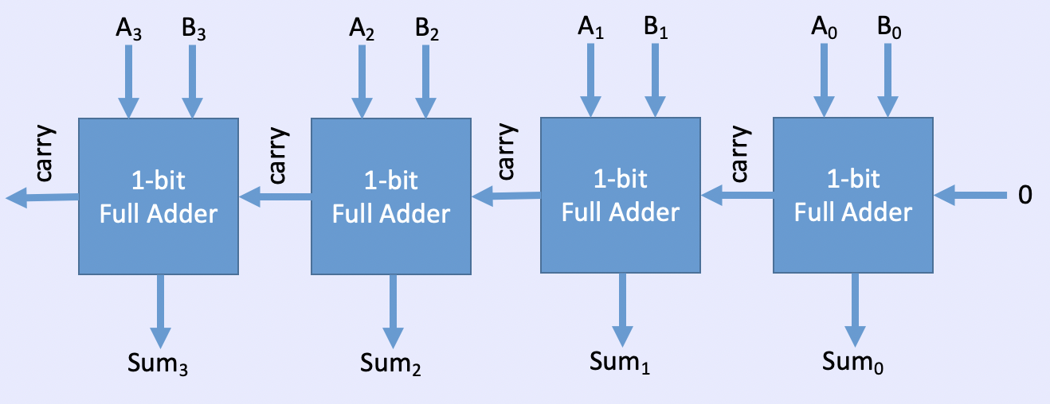
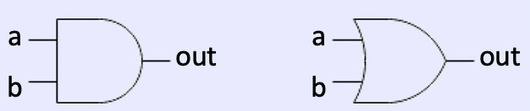
Arithmetic Logic Unit (ALU)
ALU Operation
Operand 1
Status Flags
Result
Slide by Bohn
Operand 2
Notes:
Adder, Multiplier, Divider, Bitwise Operator gates, Bitshift tracings, etc
ALU Operation identifies which operation should be performed (addition, subtraction, bitwise AND, etc)
Operand 1, Operand 2 are the inputs to the selected function
Result is the result of the operation, and Status Flags are the condition codes or flags set by the operation (Zero, Negative, Overflow, etc)

Slide 22
Memory Interface
WriteMem
ReadMem
WriteMem
ReadMem
Address
Address
Read Instruction
Read Data
Slide by Bohn
Write Instruction
Write Data
Notes:
We’ll discuss memory design later, but for now we’ll look at it from the processor’s point of view
Place memory address on the memory bus
If this is a store instruction then we’ll place the data to be written to the address on the memory bus and use the WriteMem signal to specify that the value should be written to memory
If this is a load instruction then we’ll use the ReadMem signal to specify that memory should send the value at the address should be sent back to the processor Note that for instructions that don’t access memory, neither of these signals will be set – from a functionality perspective, there’s no harm in defaulting to “read” but it will increase power consummption and (as we’ll see in Chapter 10) it can have a performance impact.
Note also that for “instruction memory” we’ll never write, and we’ll read every clock cycle, so…
…we can eliminate the “Write Instruction” port and…
…hard-wire its “ReadMem” signal
Also, the address is held by the program counter (PC). The next next instruction will always by PC + 4 bytes, or the target of a branch/jump.

Slide 23
Putting the Building Blocks Together
WriteReg
ALU Operation
Operand 1
WriteMem
ReadMem
PC
Source 1
Read Data 1
Status Flags
Address
DECODE
INSTRUCTION
Address
Read Instruction
Source 2
Read Data 2
Result
Slide by Bohn
Operand 2
Read Data
Destination
Write Data
Write Data

Slide 24
1-cycle-per-instruction processor

Slide 25
ARM Instruction Encoding
Register-Register
Opcode
Source2
Opcode
Source1
Destination
20 16
9 5
4 0
add x2, x0, x1
Slide by Bohn

Slide 26
ARM Instruction Encoding
Register-Register
Opcode
Source2
Opcode
Source1
Destination
20 16
9 5
4 0
Register-Immediate
Opcode
Source2
Source1
Destination
21 10
9 5
4 0
add x2, x0, 12
Slide by Bohn

Slide 27
ARM Instruction Encoding
Register-Register
Opcode
Source2
Opcode
Source1
Destination
20 16
9 5
4 0
Register-Immediate
Opcode
Source2
Source1
Destination
21 10
9 5
4 0
Memory Access
Opcode
Offset
Base Address
Data
20 12
9 5
4 0
Slide by Bohn
str x2, [x1, 24]

Slide 28
ARM Instruction Encoding
Register-Register
Opcode
Source2
Opcode
Source1
Destination
20 16
9 5
4 0
Register-Immediate
Opcode
Source2
Source1
Destination
21 10
9 5
4 0
Memory Access
Opcode
Offset
Base Address
Data
20 12
9 5
4 0
Slide by Bohn
Branch
Opcode
PC Offset
Condition
23 4
3 0
beq .L3

Slide 29
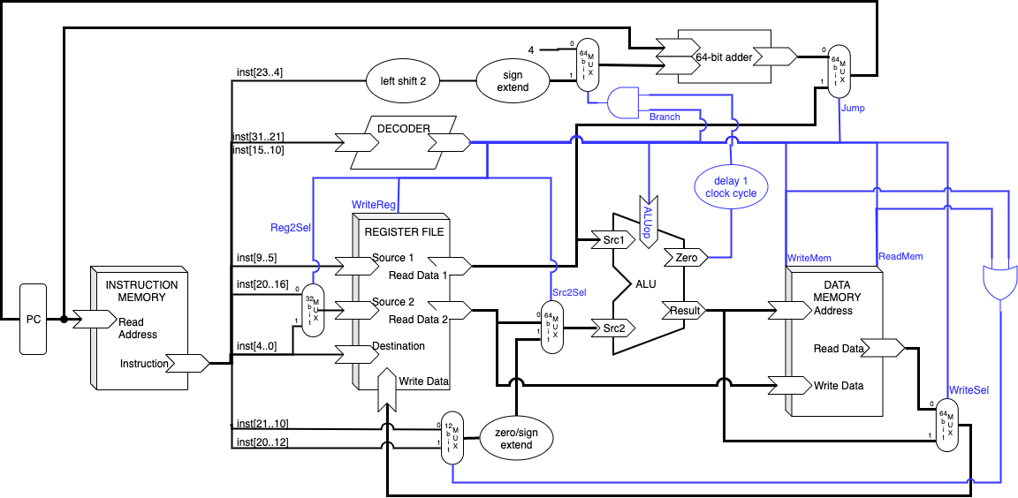
ARM Simple Datapath
WriteReg
ALU Operation
Operand 1
WriteMem
ReadMem
PC
Source 1
Read Data 1
Status Flags
Address
DECODE
INSTRUCTION
Address
Read Instruction
Source 2
Read Data 2
Result
Slide by Bohn
Operand 2
Read Data
Destination
Write Data
Write Data

Slide 30
Observations about this simple design
Stored Program Architecture
Program counter keeps track of which instruction is being processed
Each instruction read from the memory, decoded, and executed
Different types of instructions cause different components to be selected
Separate memories for instructions and data
Harvard memory model
Or possibly “modified Harvard” (single address space but partially-distinct instruction & data memories)
Slide by Bohn
Notes:
We could say the whole thing is a Harvard architecture, but von Neumann is (rightly or wrongly) given credit for the stored program model
Harvard model allows simultaneous access to instructions and data
Modern workstation & server processors tend to be modified Harvard by having separate instruction & data caches but unified main memory. Microcontrollers had been “pure” Harvard (ROM/EPROM/EEPROM instruction, SRAM data) but introduction of flash memory made it possible to put data in instruction memory – I wouldn’t recommend that you do this except for data that’s accessed only occasionally and (almost) never changes, but you can do it.

Slide 31
Single-Cycle Design
Each instruction takes the same amount of time as every other instruction
Clock period determined by instruction requiring the most time
No reuse of functional units
Can be used to identify opportunities for hardware reuse (multi-cycle design)
Can be used to identify opportunities for pipelining
Slide by Bohn

Slide 32
Processor Stages
Fetch instruction from memory (all instructions)
Decode instruction (all instructions)
Read registers (most instructions)
Often treated as part of Decode or as part of Execute
Execute instruction (most instructions)
Different instructions use ALU in different ways
Access Memory (only load and store instructions)
Write back to register file (register-register, register-immediate, and load instructions)
Slide by Bohn

Slide 33
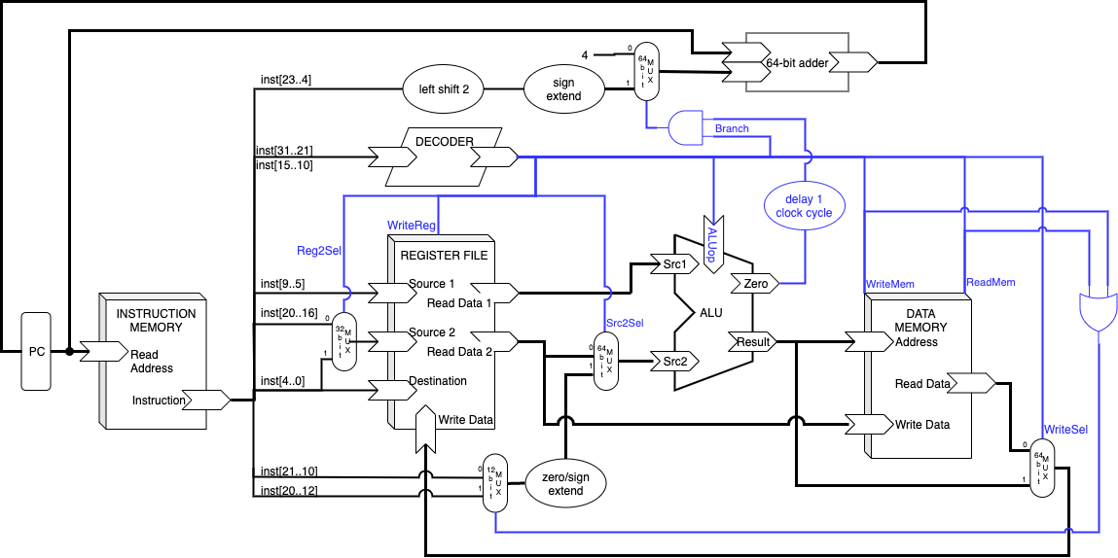
Full Datapath
Slide by Bohn

Slide 34
Fetch
Slide by Bohn

Slide 35
Decode
Slide by Bohn

Slide 36
Execute
Slide by Bohn

Slide 37
Memory Access
Slide by Bohn

Slide 38
Writeback
Slide by Bohn

Slide 39
MIPS Control Logic
Not included in logic diagram
Separate adder used for PC
 |  | R-format | addi | lw | sw | beq
Inputs | Op5 | 0 | 0 | 1 | 1 | 0
 | Op4 | 0 | 0 | 0 | 0 | 0
 | Op3 | 0 | 1 | 0 | 1 | 0
 | Op2 | 0 | 0 | 0 | 0 | 1
 | Op1 | 0 | 0 | 1 | 1 | 0
 | Op0 | 0 | 0 | 1 | 1 | 0
Outputs | RegDst | 1 | 0 | 0 | x | x
 | ALUSrc | 0 | 1 | 1 | 1 | 0
 | MemtoReg | 0 | 0 | 1 | x | x
 | RegWrite | 1 | 1 | 1 | 0 | 0
 | MemRead | 0 | 0 | 1 | 0 | 0
 | MemWrite | 0 | 0 | 0 | 1 | 0
 | Branch | 0 | 0 | 0 | 0 | 1
 | ALUOp1 | 1 | 0 | 0 | 0 | 0
 | ALUOp0 | 0 | 0 | 0 | 0 | 1
Instruction[31]
Instruction[30]
Instruction[29]
Instruction[28]
Instruction[27]
Instruction[26]
Slide by Bohn
Diagram by Patterson & Hennessey

Slide 40
ARM Instruction Encoding
Register-Register
Opcode
Source2
Opcode
Source1
Destination
20 16
9 5
4 0
Register-Immediate
Opcode
Source2
Source1
Destination
21 10
9 5
4 0
Memory Access
Opcode
Offset
Base Address
Data
20 12
9 5
4 0
Slide by Bohn
Branch
Opcode
PC Offset
Condition
23 4
3 0

Slide 41
Register-Register Instruction
Opcode
Source2
Opcode
Source1
Destination
20 16
9 5
4 0
SIGNAL | VAL
Reg2Sel
Src2Sel
ALUop
WriteMem
ReadMem
WriteSel
WriteReg
Branch
0
0
op
0
0
1
1
Slide by Bohn
0

Slide 42
Register-Register Instruction add x3, x6, x9
Opcode
Source2
Opcode
Source1
Destination
20 16
9 5
4 0
SIGNAL | VAL
Reg2Sel | 0
Src2Sel | 0
ALUop | add
WriteMem | 0
ReadMem | 0
WriteSel | 1
WriteReg | 1
Branch | 0
Slide by Bohn
REGISTER | USE
X3
X6
X9
Next PC
Destination
Source 1
Source 2
PC+4

Slide 43
Register-Immediate Instruction add x5, x2, 125
Opcode
Source2
Source1
Destination
21 10
9 5
4 0
SIGNAL | VAL
Reg2Sel
Src2Sel
ALUop
WriteMem
ReadMem
WriteSel
WriteReg
Branch
Slide by Bohn
REGISTER | USE
X5
X2
125
Next PC

Slide 44
Memory Access Instruction ldr x9, [x7, 8]
Opcode
Offset
Base Address
Data
20 12
9 5
4 0
SIGNAL | VAL
Reg2Sel
Src2Sel
ALUop
WriteMem
ReadMem
WriteSel
WriteReg
Branch
Slide by Bohn
REGISTER | USE
X9
X7
8
Next PC

Slide 45
Memory Access Instruction str x1, [x10, 16]
Opcode
Offset
Base Address
Data
20 12
9 5
4 0
SIGNAL | VAL
Reg2Sel
Src2Sel
ALUop
WriteMem
ReadMem
WriteSel
WriteReg
Branch
Slide by Bohn
REGISTER | USE
X1
X10
16
Next PC

Slide 46
Compare Instruction cmp x3, x15
Opcode
Source2
Opcode
Source1
Destination
20 16
9 5
4 0
SIGNAL | VAL
Reg2Sel
Src2Sel
ALUop
WriteMem
ReadMem
WriteSel
WriteReg
Branch
Slide by Bohn
REGISTER | USE
X3
X15
Next PC

Slide 47
Branch Instruction beq .L4
Opcode
PC Offset
23 4
3 0
previous instruction compared two unequal values
Offset field = 0x12
SIGNAL | VAL
Reg2Sel
Src2Sel
ALUop
WriteMem
ReadMem
WriteSel
WriteReg
Branch
Slide by Bohn
REGISTER | USE
Next PC

Slide 48
Branch Instruction beq .L4
Opcode
PC Offset
23 4
3 0
previous instruction compared two equal values
Offset field = 0x12
SIGNAL | VAL
Reg2Sel
Src2Sel
ALUop
WriteMem
ReadMem
WriteSel
WriteReg
Branch
Slide by Bohn
REGISTER | USE
Next PC

Slide 49
Decoder Logic: Partial Truth Table
i₃₁ | i₃₀ | i₂₉ | i₂₈ | i₂₇ | i₂₆ | i₂₅ | i₂₄ | i₂₃ | i₂₂ | i₂₁ |  | Reg2Sel | Src2Sel | ALUop | WriteMem | ReadMem | WriteSel | WriteReg | Branch
0/1 | - | 0/1 | - | 1 | 0 | 1 | - | - | - | - | Reg-Reg | 0 | 0 |  | 0 | 0 | 1 | 1 | 0
0/1 | 0 | 0/1 | 0 | 1 | 0 | 1 | 1 | 0 | 0 | 1 | add(r) |  |  | add |  |  |  |  | 0
0/1 | 1 | 0/1 | 0 | 1 | 0 | 1 | 1 | 0 | 0 | 1 | sub(r) |  |  | sub |  |  |  |  | 0
Slide by Bohn
Notes:
It would be helpful to have the block diagram on a second projector.
i31 indicates 32-bit or 64-bit
R-R & R-I: i29 indicates whether flags should be set
R-I: i22 indicates whether immediate value should be left-shifted by 12.
Mem: i30 indicates 32-bit or 64-bit (this is a curious inconsistency with R-R and R-I)
Reg-Reg, or as the ARM Architecture Reference Manual calls it, Data Processing-Register
Add and subtract differ by one bit; this goes straight into the adder’s carry-in

Slide 50
Decoder Logic: Partial Truth Table
i₃₁ | i₃₀ | i₂₉ | i₂₈ | i₂₇ | i₂₆ | i₂₅ | i₂₄ | i₂₃ | i₂₂ | i₂₁ |  | Reg2Sel | Src2Sel | ALUop | WriteMem | ReadMem | WriteSel | WriteReg | Branch
0/1 | - | 0/1 | - | 1 | 0 | 1 | - | - | - | - | Reg-Reg | 0 | 0 |  | 0 | 0 | 1 | 1 | 0
0/1 | 0 | 0/1 | 0 | 1 | 0 | 1 | 1 | 0 | 0 | 1 | add(r) |  |  | add |  |  |  |  | 0
0/1 | 1 | 0/1 | 0 | 1 | 0 | 1 | 1 | 0 | 0 | 1 | sub(r) |  |  | sub |  |  |  |  | 0
0/1 | - | 0/1 | 1 | 0 | 0 | - | - | - | - | X | Reg-Imm | 0 | 1 |  | 0 | 0 | 1 | 1 | 0
0/1 | 0 | 0/1 | 1 | 0 | 0 | 0 | 1 | 0 | 0/1 | X | add(i) |  |  | add |  |  |  |  | 0
Slide by Bohn
Notes:
It would be helpful to have the block diagram on a second projector.
i31 indicates 32-bit or 64-bit
R-R & R-I: i29 indicates whether flags should be set
R-I: i22 indicates whether immediate value should be left-shifted by 12.
Mem: i30 indicates 32-bit or 64-bit (this is a curious inconsistency with R-R and R-I)
Reg-Reg, or as the ARM Architecture Reference Manual calls it, Data Processing-Register
Add and subtract differ by one bit; this goes straight into the adder’s carry-in
Reg-Imm, or as the ARM Architecture Reference Manual calls it, Data Processing-Immediate (i30 specified add/sub, just like with R-R)
Look for the similarities between add(i) and add(r) – these suggest the ALUop “add”

Slide 51
Decoder Logic: Partial Truth Table
i₃₁ | i₃₀ | i₂₉ | i₂₈ | i₂₇ | i₂₆ | i₂₅ | i₂₄ | i₂₃ | i₂₂ | i₂₁ |  | Reg2Sel | Src2Sel | ALUop | WriteMem | ReadMem | WriteSel | WriteReg | Branch
0/1 | - | 0/1 | - | 1 | 0 | 1 | - | - | - | - | Reg-Reg | 0 | 0 |  | 0 | 0 | 1 | 1 | 0
0/1 | 0 | 0/1 | 0 | 1 | 0 | 1 | 1 | 0 | 0 | 1 | add(r) |  |  | add |  |  |  |  | 0
0/1 | 1 | 0/1 | 0 | 1 | 0 | 1 | 1 | 0 | 0 | 1 | sub(r) |  |  | sub |  |  |  |  | 0
0/1 | - | 0/1 | 1 | 0 | 0 | - | - | - | - | X | Reg-Imm | 0 | 1 |  | 0 | 0 | 1 | 1 | 0
0/1 | 0 | 0/1 | 1 | 0 | 0 | 0 | 1 | 0 | 0/1 | X | add(i) |  |  | add |  |  |  |  | 0
1 | 0/1 | 1 | 1 | 1 | 0 | 0 | 1 | 0 | 1 | X | ldr | X | 1 | add | 0 | 1 | 0 | 1 | 0
1 | 0/1 | 1 | 1 | 1 | 0 | 0 | 1 | 0 | 0 | X | str | 1 | 1 | add | 1 | 0 | X | 0 | 0
Slide by Bohn
Notes:
It would be helpful to have the block diagram on a second projector.
i31 indicates 32-bit or 64-bit
R-R & R-I: i29 indicates whether flags should be set
R-I: i22 indicates whether immediate value should be left-shifted by 12.
Mem: i30 indicates 32-bit or 64-bit (this is a curious inconsistency with R-R and R-I)
Reg-Reg, or as the ARM Architecture Reference Manual calls it, Data Processing-Register
Add and subtract differ by one bit; this goes straight into the adder’s carry-in
Reg-Imm, or as the ARM Architecture Reference Manual calls it, Data Processing-Immediate (i30 specified add/sub, just like with R-R)
Look for the similarities between add(i) and add(r) – these suggest the ALUop “add”
Look for the similarities between add(i) and ldr/str – these suggest commonality for adding immediate values

Slide 52
Decoder Logic: Partial Truth Table
i₃₁ | i₃₀ | i₂₉ | i₂₈ | i₂₇ | i₂₆ | i₂₅ | i₂₄ | i₂₃ | i₂₂ | i₂₁ |  | Reg2Sel | Src2Sel | ALUop | WriteMem | ReadMem | WriteSel | WriteReg | Branch
0/1 | - | 0/1 | - | 1 | 0 | 1 | - | - | - | - | Reg-Reg | 0 | 0 |  | 0 | 0 | 1 | 1 | 0
0/1 | 0 | 0/1 | 0 | 1 | 0 | 1 | 1 | 0 | 0 | 1 | add(r) |  |  | add |  |  |  |  | 0
0/1 | 1 | 0/1 | 0 | 1 | 0 | 1 | 1 | 0 | 0 | 1 | sub(r) |  |  | sub |  |  |  |  | 0
0/1 | - | 0/1 | 1 | 0 | 0 | - | - | - | - | X | Reg-Imm | 0 | 1 |  | 0 | 0 | 1 | 1 | 0
0/1 | 0 | 0/1 | 1 | 0 | 0 | 0 | 1 | 0 | 0/1 | X | add(i) |  |  | add |  |  |  |  | 0
1 | 0/1 | 1 | 1 | 1 | 0 | 0 | 1 | 0 | 1 | X | ldr | X | 1 | add | 0 | 1 | 0 | 1 | 0
1 | 0/1 | 1 | 1 | 1 | 0 | 0 | 1 | 0 | 0 | X | str | 1 | 1 | add | 1 | 0 | X | 0 | 0
0 | 1 | 0 | 1 | 0 | 1 | 0 | 0 | X | X | X | b.cond | X | X | X | 0 | 0 | X | 0 | 1
0/1 | 0 | 0 | 1 | 0 | 1 | X | X | X | X | X | b/bl | X | X | X | 0 | 0 | X | 0 | 1
1 | 1 | 0 | 1 | 0 | 1 | 1 | 0 | 0 | 0 | 0/1 | br/blr | X | X | X | 0 | 0 | X | 0 | 1
Slide by Bohn
Notes:
It would be helpful to have the block diagram on a second projector.
R-R & R-I: i31 indicates 32-bit or 64-bit
R-R & R-I: i29 indicates whether flags should be set
R-I: i22 indicates whether immediate value should be left-shifted by 12.
Mem: i30 indicates 32-bit or 64-bit (this is a curious inconsistency with R-R and R-I)
Reg-Reg, or as the ARM Architecture Reference Manual calls it, Data Processing-Register
Add and subtract differ by one bit; this goes straight into the adder’s carry-in
Reg-Imm, or as the ARM Architecture Reference Manual calls it, Data Processing-Immediate (i30 specified add/sub, just like with R-R)
Look for the similarities between add(i) and add(r) – these suggest the ALUop “add”
Look for the similarities between add(i) and ldr/str – these suggest commonality for adding immediate values
Conditional branching and unconditional jump (b/bl/br/blr)’s commonality tells us what sets the branch control value

Slide 53
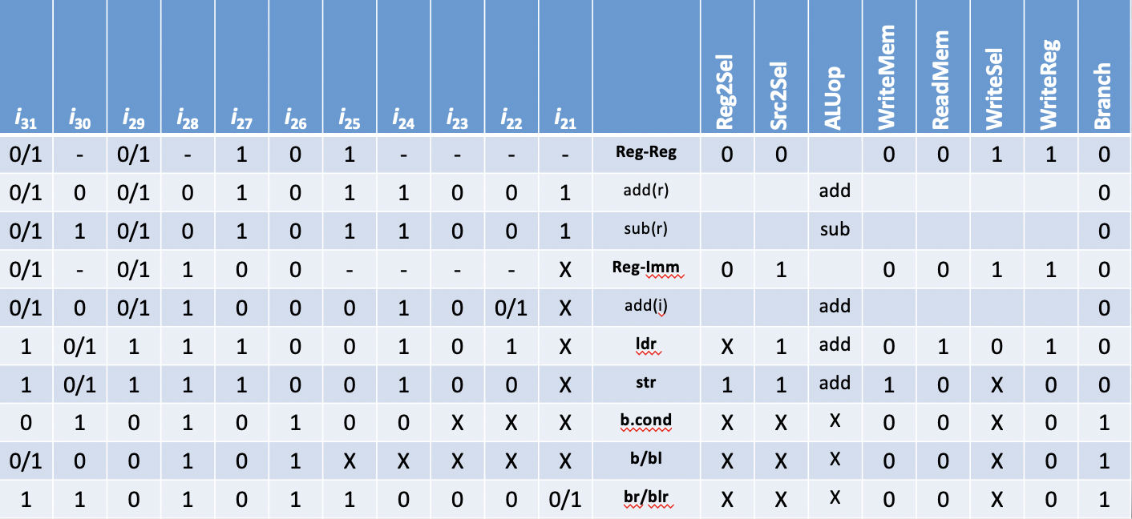
Decoder Logic: DNF Expressions
Slide by Bohn
Notes:
There may be some refinement as more instructions (and more variations on existing instructions) are added to the logic

Slide 54
Performance Issues
Infeasible to vary clock period for different instructions
Could redesign as multiple-cycle-per-instruction processor
Instruction requiring the most time to complete bounds clock period
Load instruction
Instruction memory → register file → ALU → data memory → register file
Memory takes a relatively long time to access
Engineering rule-of-thumb: optimize for the common case
“Make the common case fast”
This design violates that principle
We will improve performance by redesigning as pipelined processor
Slide by Bohn
Notes:
Store instruction doesn’t necessarily take as long, since the processor can continue executing after putting value on memory bus – doesn’t have to wait for result.
Loads are typically about 25% of executed instructions – not uncommon, but the common case is “not load”

Slide 55
Performance Issues
Longest delay determines clock period
Critical path: load instruction
Instruction memory → register file → ALU → data memory → register file
Not feasible to vary period for different instructions
Violates design principle
Making the common case fast
We will improve performance by pipelining
Slide by Srisa-an

Slide 56

Key Ideas
Combinatorial, sequential logic
Boolean expression ⬄ Combinatorial Circuit
Registers latch in values on clock edge, hold values until next clock edge
ARM instructions: fixed-size instruction word, consistent bitfields simplifies decoding
Control signals can be determined by reasoning about what an instruction does
If you know the binary opcodes, you can design Boolean decoder logic
Slide by Bohn

