Slide 1
Pipelined Processor Architecture
Programming at the Hardware/Software Interface

Slide 2
This work is licensed under a Creative Commons Attribution 4.0 International License. This work is ©2018-21 Christopher A. Bohn, bohn@unl.edu.
You are free to:
Share — copy and redistribute the material in any medium or format
Adapt — remix, transform, and build upon the material for any purpose, even commercially
Under the following terms:
Attribution — You must give appropriate credit, provide a link to the license, and indicate if changes were made. You may do so in any reasonable manner, but not in any way that suggests the licensor endorses you or your use.
No additional restrictions — You may not apply legal terms or technological measures that legally restrict others from doing anything the license permits.
Slide by Bohn
These lecture slides are meant to enhance your use of the Programming at the Hardware/Software Interface textbook. If you have not adopted this publication for your course, please consider doing so.

Slide 3
Instruction-Level Parallelism

Slide 4
Multi-Processing / Multi-Threading
Can improve performance
“Parallel programming” if extra processor cores are available
When one thread blocks, other threads can continue (responsiveness)
Must explicitly introduce concurrency
Difficult to reason about
Pernicious bugs
Limited by portion of code that is parallelizable
Slide by Bohn

Slide 5
Instruction-Level Parallelism
Maintains illusion of sequential programming
Pro: As “easy” to reason about as a sequential program (because it is)
Con: If sequential implementation would block, so will ILP
Vector Processing / SIMD
Classic Cray Supercomputers
Intel MMX / SSE / SSE2
Very Long Instruction Word (VLIW)
Intel i860, HP-Intel Itanium
Relies on compiler
Pipelining
All x86 after 80486
Exclusively done in hardware
Slide by Bohn

Slide 6
Pipelining

Slide 7
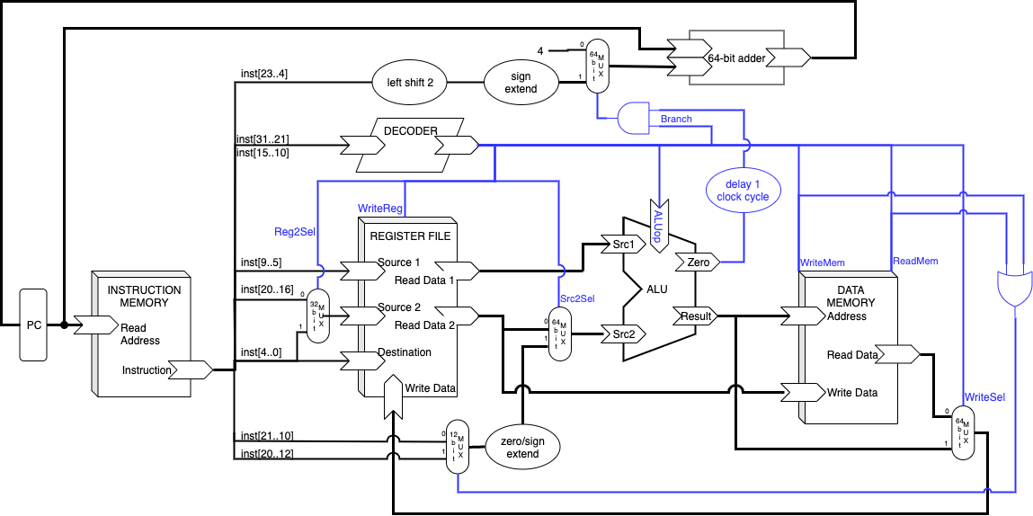
Simple One-Cycle-Per-Instruction Architecture
Clock cycle must be long enough for “load word” instruction:
Fetch instruction
Decode instruction & read from register file
Execute arithmetic (compute address)
Fetch from memory
Slide by Bohn
Write to register file

Slide 8

By way of analogy…
Time to do a load of laundry with all-in-one washer/dryer:
Fetch dirty laundry
Wash load
Dry load
Fold clean laundry
Slide by Bohn
https://unsplash.com/photos/aJN7zURQ1Wg

Slide 9
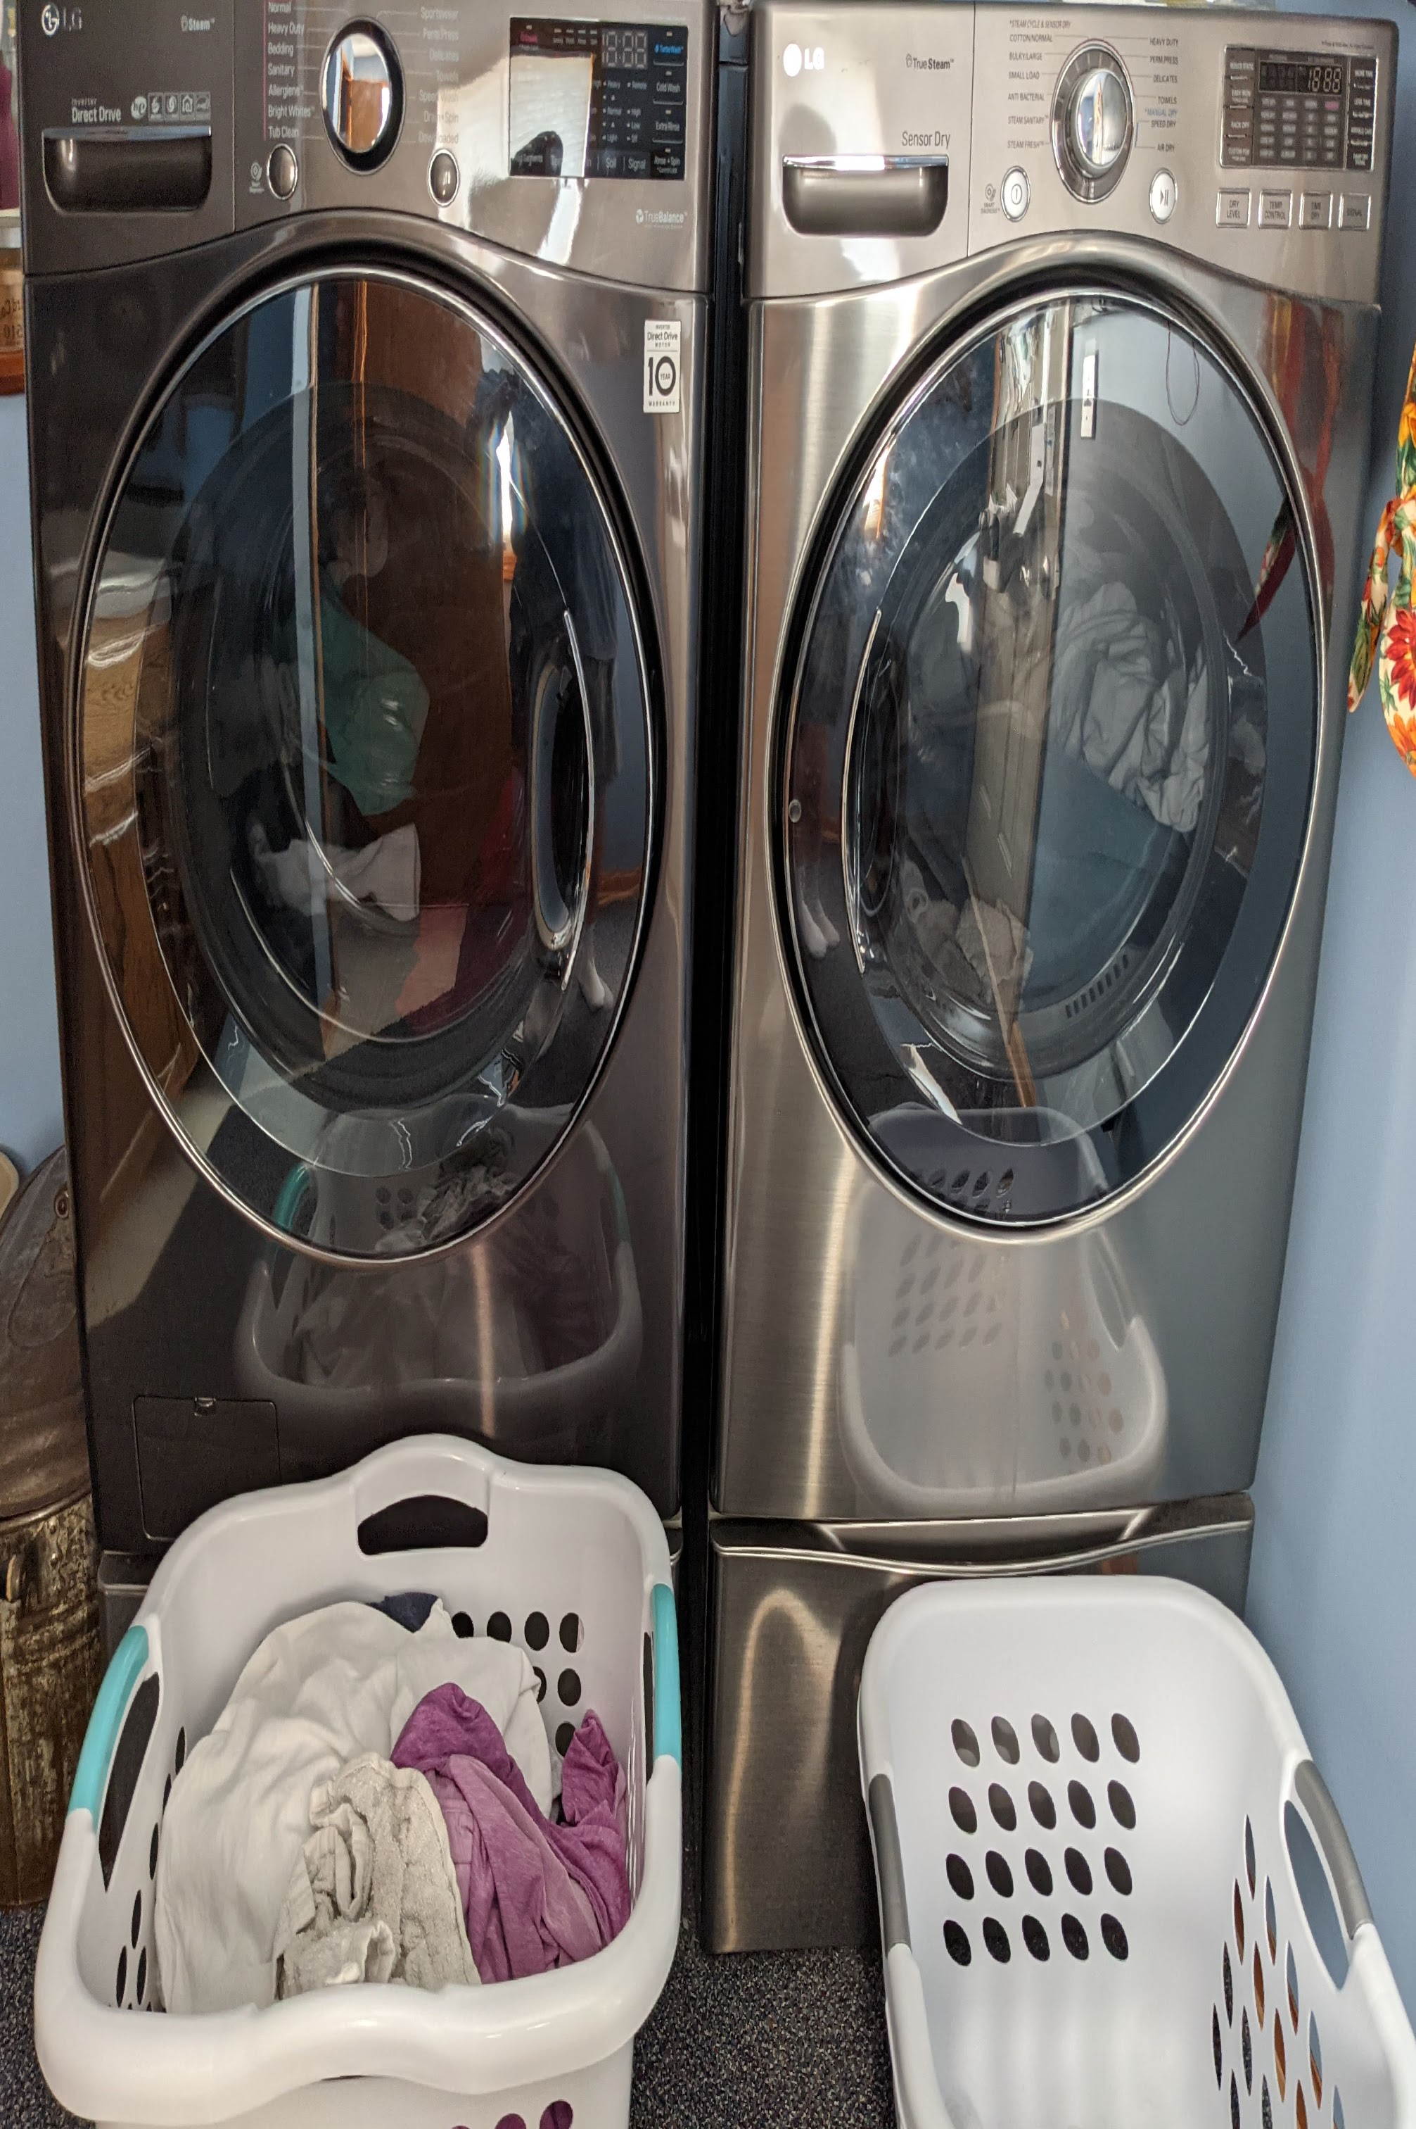
By way of analogy…
Separating the functionality, laundry has independent tasks:
Fetch dirty laundry
Wash load
Dry load
Fold clean laundry
Slide by Bohn
Photo of washer & dryer by Bohn

Slide 10
Pipeline Concept
Processor has independent tasks:
Fetch instruction
Decode instruction & read from register file
Execute arithmetic (compute address)
Fetch from memory
Slide by Bohn
Write to register file

Slide 11
Pipelining
First load
Second load
Divide process into independent stages
Each load of laundry moves through stages in sequence
At any given time, multiple loads of laundry being processed
Third load
Fourth load
Slide by Bohn; screen image by Home Depot
Fifth load
Sixth load

Slide 12
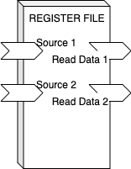
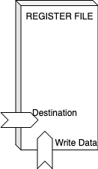
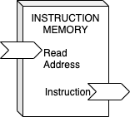
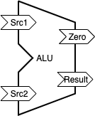
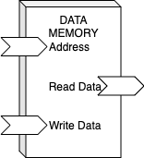
Pipelining
First instruction
Divide process into independent stages
Each instruction moves through stages in sequence
At any given time, multiple instructions being processed
Second instruction
Third instruction
Slide by Bohn
Fourth instruction
Fifth instruction

Slide 13
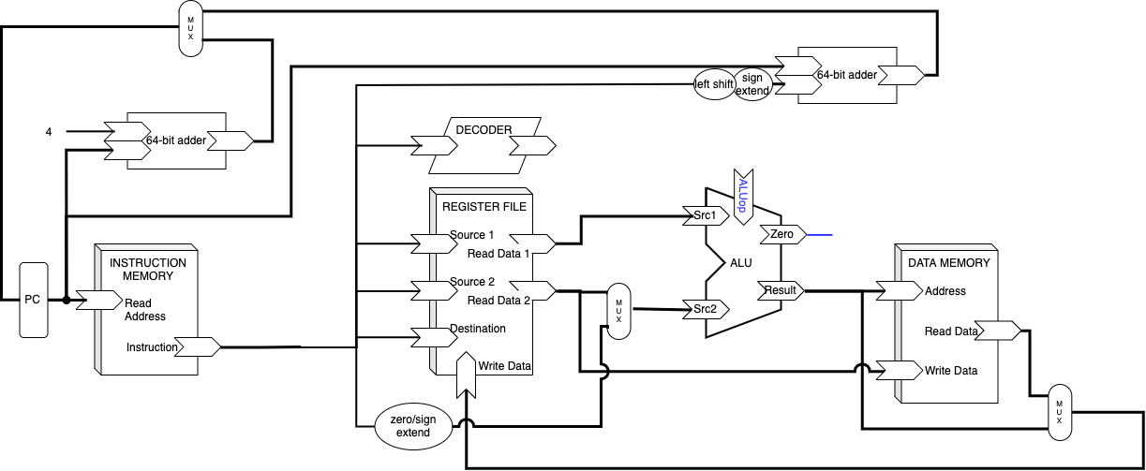
Pipeline Stages
Fetch
Select current PC
Read instruction
Compute incremented PC
Decode
Generate control signals
Read program registers
Execute
Compute result or address
Determine if branch should be taken
Compute new PC if so
Memory
Read or write data memory
Write Back
Update register file
Slide by Bohn

Slide 14
Adding Pipeline Registers
Pipeline registers hold intermediate values from instruction execution
F/D
D/E
E/M
M/W
Slide by Bohn

Slide 15
Fixing Writeback
F/D
D/E
E/M
M/W
Slide by Bohn

Slide 16
Pass Control Signals through Pipeline Registers
F/D
D/E
E/M
M/W
Slide by Bohn

Slide 17
Benefit of Pipelining

Slide 18
Example Baseline: No Pipelining
25ps
320ps
Combinatorial Logic
Slide by Bohn
Computation requires 320ps
Saving result to register require 25ps (t_{setup}+t_{hold})
Clock period must be at least 345ps

Slide 19
Measures of Performance
Latency – time between instruction being issued and result being available
Throughput – number of instructions processed per second
Clock Rate – number of clock cycles per second
Slide by Bohn
Notes:
Latency really only matters for the first instruction. Ideally, every instruction after that will finish one cycle after the previous.
Throughput is a much more useful measure.
Clock rate is a horrible measure of performance … as we’ll see.

Slide 20
Example Baseline: No Pipelining
25ps
320ps
Combinatorial Logic
Slide by Bohn
Computation requires 320ps
Saving result to register require 25ps (t_{setup}+t_{hold})
Clock period must be at least 345ps

Slide 21
Example Baseline: No Pipelining
25ps
320ps
Combinatorial Logic
Slide by Bohn

Slide 22
Instruction n cannot start until Instruction n-1 finishes
Instruction 1
Instruction 2
Instruction 3
Instruction 4
Instruction 5
Slide by Bohn

Slide 23
Example Baseline: Idealized 4-Way Pipeline
25ps
25ps
25ps
25ps
80ps
80ps
80ps
80ps
Stage 1
Stage 2
Stage 3
Stage 4
Slide by Bohn
Ideal case: Divide combinatorial logic evenly; each stage requires 80ps
Saving intermediate results to pipeline registers require 25ps
Clock period must be at least 105ps

Slide 24
Example Baseline: Idealized 4-Way Pipeline
25ps
25ps
25ps
25ps
80ps
80ps
80ps
80ps
Stage 1
Stage 2
Stage 3
Stage 4
Slide by Bohn

Slide 25
Pipelined Instructions have Greater Latency…
Instruction 1
Instruction 2
Instruction 3
Instruction 4
Instruction 5
A
B
C
D
A
B
C
D
A
B
C
D
A
B
C
D
Slide by Bohn
A
B
C
D

Slide 26
Pipelined Instructions have Greater Throughput!
Instruction 1
Instruction 2
Instruction 3
Instruction 4
Instruction 5
A
B
C
D
A
B
C
D
A
B
C
D
A
B
C
D
Slide by Bohn
A
B
C
D
Up to 4 simultaneous instructions

Slide 27
Example Baseline: Idealized 4-Way Pipeline
A
A
B
B
C
C
D
A
B
C
D
D
CLOCK
Instruction 1
Instruction 2
Instruction 3
Instruction 4
Instruction 5
A
B
C
D
Slide by Bohn
A
B
C
D
A
B
C
D
A
B
C
D
A
B
C
D
Notes:
0. We start as Instruction 4 is about to issue, and “Instruction 0” is about to retire
With the rising edge of the clock, the intermediate results are latched in to the pipeline registers
During the clock period, the intermediate results are formed in the combinatorial logic

Slide 28
Non-idealized 4-Way Pipeline
25ps
25ps
25ps
25ps
90ps
60ps
70ps
100ps
Stage 1
Stage 2
Stage 3
Stage 4
Slide by Bohn
Clock rate set by slowest stage
Faster stages idle while waiting for slowest stage to finish

Slide 29
Non-idealized 4-Way Pipeline
25ps
25ps
25ps
25ps
90ps
60ps
70ps
100ps
Stage 1
Stage 2
Stage 3
Stage 4
Slide by Bohn

Slide 30
Limitation to Benefits: Faster Stages Sit Idle While Waiting for Slowest Stage to Finish
Instruction 1
Instruction 2
Instruction 3
Instruction 4
Instruction 5
A
B
C
D
A
B
C
D
A
B
C
D
A
B
C
D
Slide by Bohn
A
B
C
D

Slide 31
Limitation to Benefits: We Can Divide Combinatorial Logic but Not Registers
# stages | t_{clock} | Throughput
1 | 345ps | 2.90 GIPS
2 | 185ps | 5.41 GIPS
4 | 105ps | 9.52 GIPS
8 | 65ps | 15.38 GIPS
16 | 45ps | 22.22 GIPS
25ps
25ps
25ps
25ps
25ps
25ps
25ps
25ps
25ps
25ps
25ps
25ps
25ps
25ps
25ps
25ps
25ps
25ps
25ps
25ps
25ps
25ps
25ps
25ps
25ps
25ps
25ps
25ps
25ps
25ps
25ps
20 ps
320ps
160ps
80ps
40ps
20 ps
40ps
80ps
160ps
20 ps
40ps
80ps
20 ps
40ps
80ps
20 ps
40ps
20 ps
40ps
20 ps
40ps
20 ps
40ps
20 ps
20 ps
20 ps
20 ps
20 ps
20 ps
20 ps
20 ps
Slide by Bohn
Notes:
Increasing pipeline depth increases the clock rate, but the returns diminish even in the ideal case, at the cost of increased circuit complexity. As we’ll see, there are more penalties to be had…

Slide 32
Pipeline Hazards

Slide 33
Data Dependences
// C code; p, q are pointers
q = p + 50;
*q = m + n;
// ARM Assembly Code
add x0, x1, x2
add x1, x0, x3
add x1, x1, x4
Data dependences are not bad
Read After Write (RAW)
Using the result of an earlier calculation
Write After Read (WAR)
Replacing the value previously stored in a location
Write After Write (WAW)
Replacing the value previously stored in a location
// ARM Assembly Code
add x2, x0, 50
add x4, x3, x1
str x4, [x2]
# x86-64 Assembly Code
addq %rax, %rbx
addq %rcx, %rax
addq %rdx, %rax
Slide by Bohn
# x86-64 Assembly Code
movq %rdx, 50(%rbx)
addq %rcx, 50(%rbx)
Notes:
0. Data dependences are good things – what would be the point of computing if no calculation relied on the result of an earlier calculation?
RAW – anytime we’re using a value we previously calculated, it’s a RAW dependence – for ARM, the “read” can be source1 or source2 (or a register used to calculate an address), and the “write” can only be destination (“read” can also be the memory location in a load, and ”write” can also be the memory location in a store) – for x86, the “read” can be source or destination (or a register used to calculate an address), and the “write” can only be destination (the more noteworthy part here is that destination is both a read and a write).
WAR – if we used a value and later overwrite it
WAR – if we write a value and later overwrite it

Slide 34
Data Hazard: Potentially Unsafe Data Dependence
If earlier results are ready to be used, no hazard
Here, the results of the additions are latched into x2 and x4 before the store instruction issues
No hazard
add x2, x0, 50
add x4, x3, x1
str x4, [x2]
Slide by Bohn

Slide 35
Data Hazard: Potentially Unsafe Data Dependence
If earlier results are ready to be used, no hazard
Here, the results of the additions are latched into x2 and x4 before the store instruction issues
No hazard
With instruction-level parallelism, result might not be ready
Could alter computation
x2, x4 are written here
add x2, x0, 50
F
D
E
M
W
add x4, x3, x1
F
D
E
M
W
str x4, [x2]
F
D
E
M
W
Slide by Bohn
x2, x4 are read here

Slide 36
Data Hazard
F/D
D/E
E/M
M/W
initial values:
x0 = 1000 x1 = 200 x2 = 400 x3 = 20 x4 = 30
cycle #
1
2
3
4
5
6
7
cycle 4
add x2, x0, 50
F
D
E
M
W
M
F
D
E
M
W
ALU_Result (x2) = 1050
add x4, x3, x1
E
str x4, [x2]
F
D
E
M
W
ALU_Src1 (x3) = 20
ALU_Src2 (x1) = 200
ALU_Result (x4) = 220
Slide by Bohn
D
ReadData1 (x2) = 400
ReadData2 (x4) = 30
should be 1050
should be 220
Notes:
Here is an example showing that the wrong values will be used in the store instruction.
The problem is that we were issuing the store instruction before the results were ready. Maybe we can delay issuing the store instruction…
(Registers in parentheses indicate the source/destination registers for the intermediate values)

Slide 37
Trying to Fix Data Hazard with a NOP
F/D
D/E
E/M
M/W
initial values:
x0 = 1000 x1 = 200 x2 = 400 x3 = 20 x4 = 30
cycle #
1
2
3
4
5
6
7
cycle 5
add x2, x0, 50
F
D
E
M
W
W
F
D
E
M
W
WriteData(x2) = 1050
add x4, x3, x1
M
nop
F
D
E
M
W
ALU_Result (x4) = 220
Slide by Bohn
F
D
E
M
W
str x4, [x2]
D
ReadData1 (x2) = 400
ReadData2 (x4) = 30
should be 1050
should be 220
Notes:
NOP = “no op” = “no operation” = “do nothing for one clock cycle”
This doesn’t seem to be enough. Obviously, X4 still isn’t ready, and X2 won’t be ready until the end of cycle 5 – but we need the values at the start of cycle 5.

Slide 38
Trying to Fix Data Hazard with 2 NOPs
F/D
D/E
E/M
M/W
initial values:
x0 = 1000 x1 = 200 x2 = 400 x3 = 20 x4 = 30
cycle #
1
2
3
4
5
6
7
cycle 6
add x2, x0, 50
F
D
E
M
W
x2 = 1050
add x4, x3, x1
F
D
E
M
W
W
nop
F
D
E
M
W
WriteData(x4) = 220
Slide by Bohn
F
D
E
M
W
nop
D
str x4, [x2]
F
D
E
M
W
ReadData1 (x2) = 1050
ReadData2 (x4) = 30
should be 220
Notes:
We fixed X2, but we’re still getting the wrong value out of X4

Slide 39
Fixing Data Hazard with 3 NOPs
F/D
D/E
E/M
M/W
initial values:
x0 = 1000 x1 = 200 x2 = 400 x3 = 20 x4 = 30
cycle #
1
2
3
4
5
6
7
cycle 7
add x2, x0, 50
F
D
E
M
W
x2 = 1050
add x4, x3, x1
F
D
E
M
W
x4 = 220
nop
F
D
E
M
W
Slide by Bohn
F
D
E
M
W
nop
D
nop
F
D
E
M
W
ReadData1 (x2) = 1050
ReadData2 (x4) = 220
str x4, [x2]
F
D
E
M
W
Notes:
Finally fixed the problem – we now get the correct outcome
Five simultaneous instructions, but here we turned three instructions into six (it won’t always be that bad) – instead of running 5x as fast, we’re running 1.67x as fast.

Slide 40
Control Dependences: Predicting the PC
Fetch current instruction this clock cycle; fetch next instruction in next clock cycle
If current instruction is conditional branch, cannot determine whether branch is taken until later
If branch/jump target address is saved in a register or memory, cannot determine target address until later
Slide by Bohn

Slide 41
Simple Prediction Strategy If current instruction…
Does not transfer control
ARM: next instruction guaranteed to be at PC+4
x86: next instruction guaranteed to be at %rip+sizeof(current_instr)
Procedure call or unconditional jump to <LABEL>
Next instruction guaranteed to be at <LABEL>
Conditional Branch
Predict next PC to be PC+Offset
Predict “branch taken”
Only correct if branch is taken
Typically right 60% of time
Procedure return or jump to address saved in register
Don’t try to predict
Cannot predict target address
Slide by Bohn

Slide 42
Recovering from Misprediction Recovering from Nonprediction
Conditional Branch
Detect misprediction at end of EXECUTE stage
Procedure Return
x86: get address from stack (MEMORY)
ARM: get address from register (DECODE)
E/M
Slide by Bohn

Slide 43
Unconditional Jump to Address in Register
F/D
D/E
E/M
M/W
initial values:
x30 = 0x3000
cycle #
1
2
3
4
5
6
cycle 2
0x2000: br x30
F
D
E
M
W
D
0x2000: ret
F
D
E
M
W
ReadData1 (x30) = 0x3000
Jump = 1
0x2004: halt
⋮
F
Slide by Bohn
PC = 0x2004
should be 0x3000
0x3000: sub x5, x0, x1
Notes:
“br x30” is equivalent to “ret”

Slide 44
Fixing ARM Nonprediction Control Hazard with 1 NOP
F/D
D/E
E/M
M/W
initial values:
x30 = 0x3000
cycle #
1
2
3
4
5
6
cycle 3
0x2000: br x30
F
D
E
M
W
PC=0x3000
D
F
D
E
M
W
ReadData1 (x30) = 0x3000
Jump = 1
0x2004: nop
0x2008: halt
F
Slide by Bohn
PC = 0x3000
⋮
0x3000: sub x5, x0, x1
F
D
E
M
W
Notes:
ARM, the return address (or target address for br instruction) is in a register – available at the end of decode stage / start of execute stage

Slide 45
Fixing x86 Nonprediction Control Hazard with 3 NOPs
F/D
D/E
E/M
M/W
initial values:
Mem(%rsp) = 0x3000
cycle #
1
2
3
4
5
6
cycle 5
0x2000: ret
F
D
E
M
W
%rip=0x3000
W
F
D
E
M
W
Mem_ReadData1 = 0x3000
Jump = 1
0x2004: nop
0x2008: nop
F
D
E
M
W
F
Slide by Bohn
F
D
E
M
W
PC = 0x3000
0x200C: nop
0x2010: halt
⋮
0x3000: sub %r10, %rax
F
D
E
M
W
Notes:
x86, the return address is on the stack – available at end of memory stage / start of writeback stage

Slide 46
Fixing Conditional Branch
F/D
D/E
E/M
M/W
Fix data hazard (cmp setting flags) and control hazard (setting PC correctly)
cycle #
1
2
3
4
5
6
cycle 4
0x2000: cmp x2, x3
F
D
E
M
W
M
F
D
E
M
W
Zero = 0 or 1
0x2004: nop
D
0x2008: beq 0x3000
F
D
E
M
W
Prev_Zero = 0 or 1
Branch = 1
Slide by Bohn
F
D
E
M
W
0x200C: nop
0x2010: add x5, x0, x1
F
D
E
M
W
⋮
0x3000: sub x5, x0, x1
F
D
E
M
W
Notes:
Zero (or other flag) available at end of Execute / start of Memory – need at least three instructions after cmp before potentially-incorrect instruction.
One of these is beq and the other two are NOPs.
At least one of those NOPs needs to be after beq since we won’t have the branch control signal until end of Decode / start of Execute.

Slide 47
Overcoming Data Hazards: Pipeline Stalls

Slide 48
Our situation…
We introduced pipelining to improve performance by overlapping instructions
Instructions write their results to registers at the end of the pipeline
Instructions that need results must wait so they can execute correctly
Our compiler introduces NOPs to make that happen
Making the compiler aware of the pipeline is no worse than VLIW
The programmer doesn’t need to think about the pipeline
The number of NOPs depends on the instructions and on the pipeline design
Slide by Bohn
and on the pipeline design

Slide 49
Let’s Compile for a Pipeline that Requires 2 NOPs to overcome a Data Hazard
cycle #
1
2
3
4
5
6
7
8
add x2, x0, 50
F
D
E-M
W
add x4, x3, x1
F
D
E-M
W
nop
F
D
E-M
W
Slide by Bohn
F
D
E-M
W
nop
str x4, [x2]
F
D
E-M
W
mul x5, x6, x7
F
D
E-M
W

Slide 50
Compatibility Issues
A program compiled for a processor should run without modification on future backwards-compatible processors
If the future processor requires fewer NOPs, our program is fine
If the future processor requires more NOPs, we have a problem
Example: program compiled for 1-stage processor wouldn’t have enough NOPs for our 5-stage pipeline
Example: program compiled for 4-stage processor wouldn’t have enough NOPs for our 5-stage pipeline
Slide by Bohn

Slide 51
2 NOPs Aren’t Enough When Pipeline Design Needs 3
initial values:
x0 = 1000 x1 = 200 x2 = 400 x3 = 20 x4 = 30
cycle #
1
2
3
4
5
6
7
8
9
cycle 6
add x2, x0, 50
F
D
E
M
W
x2 = 1050
add x4, x3, x1
F
D
E
M
W
W
nop
F
D
E
M
W
WriteData(x4) = 220
Slide by Bohn
F
D
E
M
W
nop
D
str x4, [x2]
F
D
E
M
W
ReadData1 (x2) = 1050
ReadData2 (x4) = 30
should be 220
mul x5, x6, x7
F
D
E
M
W

Slide 52
How Do We Know that Another NOP is Needed?
We know this pipeline needs 3 NOPs to overcome a Data Hazard
The str instruction uses X4
X4 is the destination for an earlier instruction that’s still in the pipeline
The processor can detect this condition!
add x2, x0, 50
F
D
E
M
W
add x4, x3, x1
F
D
E
M
W
nop
F
D
E
M
Slide by Bohn
F
D
E
nop
str x4, [x2]
F
D
mul x5, x6, x7
F

Slide 53
Stalling the Pipeline
cycle #
1
2
3
4
5
6
7
8
9
add x2, x0, 50
F
D
E
M
W
add x4, x3, x1
F
D
E
M
W
X4 will be read by this instruction
nop
F
D
E
M
W
X4 will be written by this instruction
Slide by Bohn
F
D
E
M
W
nop
Processor will inject a “NOP” here
str x4, [x2]
F
D
E
M
W
mul x5, x6, x7
F
D
E
M
W

Slide 54
Stalling the Pipeline
Bubble: hardware-injected NOP
Causes the pipeline to stall behind the bubble
Metaphor: air bubble in water pipe
Bubble stalls water behind it
Bubble moves through the pipe
Water behind the bubble is delayed by the bubble
Slide by Bohn

Slide 55
Without Stalling the Pipeline
0x4000
0x4004
mul
nop
nop
add
str
Slide by Bohn
mul
str
nop #2
nop #1
add

Slide 56
Stalling the Pipeline
0x4000
str
nop
nop
nop
add
Slide by Bohn
nop #2
nop #1
mul
str
bubble
add
bubble
bubble
bubble
Notes:
Instructions ahead of the bubble continue as before
The D-E pipeline register takes on a NOP (bubble) instead of the str instruction
The pipeline registers behind the decode stage do not latch in the intermediate results for one cycle, preventing instructions behind the bubble from moving forward for one cycle

Slide 57
Stalling the Pipeline
cycle #
1
2
3
4
5
6
7
8
9
10
add x2, x0, 50
F
D
E
M
W
add x4, x3, x1
F
D
E
M
W
nop
F
D
E
M
W
bubble injection
Slide by Bohn
F
D
E
M
W
nop
str x4, [x2]
F
D
E
M
W
D
E
M
W
mul x5, x6, x7
pipeline stall
F
F
D
E
M
W

Slide 58
Detecting Stall Condition
Slide by Bohn
E.dest == D.src1 || E.dest == D.src2 || M.dest == D.src1 || M.dest == D.src2
|| W.dest == D.src1 || W.dest == D.src2

Slide 59
Implementing Stall
Stall Detection
stall
bubble
Slide by Bohn

Slide 60
Compiler Can Now Ignore Pipeline Design
Stall condition detected whenever a source in Decode stage is a destination in any later stage
i.e., any earlier instruction still in the pipeline
Stalls 1 cycle if stall condition detected
If stall condition detected in next cycle, will stall another cycle
Slide by Bohn

Slide 61
Overcome Data Hazard with Pipeline Stalls
cycle #
1
2
3
4
5
6
7
8
9
10
add x2, x0, 50
F
D
E
M
add x4, x3, x1
F
D
E
STALL!
D.src1 == M.dest D.src2 == E.dest
str x4, [x2]
F
D
Slide by Bohn
F
mul x5, x6, x7

Slide 62
Overcome Data Hazard with Pipeline Stalls
cycle #
1
2
3
4
5
6
7
8
9
10
add x2, x0, 50
F
D
E
M
W
add x4, x3, x1
F
D
E
M
str x4, [x2]
F
D
E
STALL!
D.src1 == W.dest D.src2 == M.dest
Slide by Bohn
D
mul x5, x6, x7
F
F
Notes:
Decode & Fetch are stalled. A bubble is injected into Execute.

Slide 63
Overcome Data Hazard with Pipeline Stalls
cycle #
1
2
3
4
5
6
7
8
9
10
add x2, x0, 50
F
D
E
M
W
add x4, x3, x1
F
D
E
M
W
str x4, [x2]
F
D
E
M
Slide by Bohn
D
E
STALL!
D.src2 == W.dest
D
mul x5, x6, x7
F
F
F
Notes:
Decode & Fetch are stalled (again). A bubble is injected into Execute (again). The bubble moves down the pipeline.

Slide 64
Overcome Data Hazard with Pipeline Stalls
cycle #
1
2
3
4
5
6
7
8
9
10
add x2, x0, 50
F
D
E
M
W
add x4, x3, x1
F
D
E
M
W
str x4, [x2]
F
D
E
M
W
Slide by Bohn
D
E
M
W
D
E
M
W
D
E
M
W
mul x5, x6, x7
F
F
F
F
D
E
M
W
Notes:
Decode & Fetch are stalled (yet again). A bubble is injected into Execute (yet again). The bubbles move down the pipeline.
No need for further stalls/bubbles.

Slide 65
Overcoming Data Hazards: Data Forwarding

Slide 66
Our situation…
We introduced pipelining to improve performance by overlapping instructions
Instructions write their results to registers at the end of the pipeline
Instructions that need results must wait so they can execute correctly
The pipeline stalls to make that happen
Performance gains are limited by stalls needed for data & control hazards
Is the added complexity worth the performance benefit?
Slide by Bohn

Slide 67
Data Forwarding
The problem
Values written to destination registers at end of Writeback stage
Values needed from source registers before end of Decode stage
Key insight
The values exist in the pipeline!
The values are ready at end of Execute or Memory stage (depending on instruction)
Solution
Pass values directly from later stages to Decode stage when needed
Slide by Bohn

Slide 68
Overcome Data Hazard with Data Forwarding
cycle #
1
2
3
4
5
6
7
add x2, x0, 50
F
D
E
M
add x4, x3, x1
F
D
E
Data Hazard Detected
D.src1 == M.dest D.src2 == E.dest
str x4, [x2]
F
D
Slide by Bohn
F
mul x5, x6, x7

Slide 69
Overcome Data Hazard with Data Forwarding
cycle #
1
2
3
4
5
6
7
add x2, x0, 50
F
D
E
M
W
add x4, x3, x1
F
D
E
M
W
str x4, [x2]
F
D
E
M
W
Slide by Bohn
F
D
E
M
W
mul x5, x6, x7
Notes:
Making visual room to show data forwarding (there is no extra time lapsed here)
Because the values that str needs are already in the pipeline, forward these values to the str instruction rather than waiting for the values to be written to the registers
The values still need to continue down the pipeline so that they are, in fact, written to the registers

Slide 70
Implementing Data Forwarding
Slide by Bohn
Notes:
Here, we’re forwarding from the Writeback stage to Decode to show the idea

Slide 71
Implementing Data Forwarding
Forwarding Logic
Detects hazard
Identifies source for src1, src2
Uses MUX to latch correct value into D/E pipeline register
Slide by Bohn
Notes:
Expand that to include forwarding from Memory and from Execute to Decode.
And it needs to forward to both Sources

Slide 72
Prioritizing Data Forwarding
If more than one stage has a destination that matches the needed source, which stage provides the value?
Preserve non-pipelined semantics
Use the value in the earliest pipeline stage
The instruction closest to the one needing the value
cycle #
1
2
3
4
5
add x2, x0, 50
F
D
E
M
W
mov x2, 100
F
D
E
M
add x3, x2, x1
F
D
E
Slide by Bohn

Slide 73
Pipeline Penalties

Slide 74
Pipeline Stalls are Still Needed
Data Forwarding allows us to use a value as soon as it’s available
Values generated in Execute stage can be forward to instruction immediately behind it
Instructions still must wait for values generated in Memory stage
But not necessarily as long
Slide by Bohn

Slide 75
Load/Use Pair
cycle #
1
2
3
4
5
6
7
ldr x2, [x5]
F
D
E
M
W
add x4, x3, x2
F
D
E
M
W
D
E
M
W
If a value retrieved from memory is used in the very next instruction, the pipeline must stall for 1 cycle
Pipeline-aware compiler may re-order instructions to place an independent instruction between the load and the use
Only if debugging-level behavior does not have to be preserved
Slide by Bohn

Slide 76
Conditional Branch: Correct Prediction
cycle #
1
2
3
4
5
6
7
0x2000: cmp x2, x3
F
D
E
M
W
0x2004: beq 0x3000
F
D
E
M
W
0x3000: sub x5, x0, x1
F
D
E
M
W
Slide by Bohn
Assume branch is taken (60% correct)
Load target instruction from target address

Slide 77
Conditional Branch: Recovering from Misprediction
cycle #
1
2
3
4
5
6
7
8
0x2000: cmp x2, x3
F
D
E
M
W
0x2004: beq 0x3000
F
D
E
M
W
0x3000: sub x5, x0, x1
F
D
E
M
W
0x2008: add x5, x0, x1
F
D
E
M
W
Slide by Bohn
If condition flags indicate branch should not have been taken, we’ll know at the end of the cmp’s Execute stage
Flush the pipeline behind the branch instruction (replace with bubbles)
Load fall-through address into PC

Slide 78
Procedure Return
Must wait until return address is available
ARM
x86
cycle #
1
2
3
4
cycle #
1
2
3
4
5
6
F
D
E
M
F
D
E
M
W
0x2000: ret
0x2000: ret
F
D
E
F
D
E
M
W
Slide by Bohn
0x3000: sub x5, x0, x1
F
D
F
D
E
M
F
D
E
0x3000: subq %rdx, %rax
F
D

Slide 79
Calculating Performance

Slide 80
Cycles Per Instruction, and Throughput
Throughput
Rate at which instructions are processed
Clock rate divided by Cycles per Instruction
Earlier, we assumed an instruction finished each clock cycle
Cycles per Instruction (CPI)
Ideal: an instruction finishes each clock cycle
Reality: most of the time, an instruction finishes each clock cycle
Reality: sometimes a bubble “finishes” instead of an instruction
Slide by Bohn

Slide 81
Calculating CPI
Average penalty for each instruction type: product of
Frequency of instruction occurring in a program
Example: ldr is about 25% of instructions
Fraction of that instruction’s occurrences that result in a penalty
Example: 80% of the time, other instructions exist between the load and the use
Penalty for 20% of ldrs
Number of bubbles injected when the penalty occurs
Example: When load penalty occurs, 1 bubble is injected
Average load penalty: .25*.20*1 = 0.05
Slide by Bohn

Slide 82
Calculating CPI
Average total penalty for each instruction type: product of
Fraction of program’s instructions that are the instruction type
Example: ldr is about 25% of instructions
Fraction of that instruction’s occurrences that result in a penalty
Example: 80% of the time, other instructions exist between the load and the use
Penalty for 20% of ldrs
Number of bubbles injected when the penalty occurs
Example: When load penalty occurs, 1 bubble is injected
Average load penalty: .25*.20*1 = 0.05
Slide by Bohn

Slide 83
Calculating CPI
Average total penalty: sum of penalties for each instruction type
CPI: ideal CPI plus average total penalty
Slide by Bohn

Slide 84
Example CPI Calcuation
Instruction | Instruction Frequency | Condition frequency | Stalls/Bubbles | Product
ldr | 0.25 | 0.20 | 1 | 0.05
bXX | 0.20 | 0.40 | 1 | 0.08
ret | 0.02 | 1.00 | 3 | 0.06
Total Penalty |  |  |  | 0.19
Slide by Bohn

Slide 85
Comparing Designs
Let’s try a different design that reduces the return penalty from 3 to 1 but increases the branch penalty from 1 to 2 – is this an improvement?
Instruction | Instruction Frequency | Condition frequency | Stalls/Bubbles | Product
ldr | 0.25 | 0.20 | 1 | 0.05
bXX | 0.20 | 0.40 | 2 | 0.16
ret | 0.02 | 1.00 | 1 | 0.02
Total Penalty |  |  |  | 0.23
Slide by Bohn

Slide 86
Comparing Branch Prediction Strategies
Instruction | Instruction Frequency | Condition frequency | Stalls/ Bubbles | Product
ldr | 0.25 | 0.20 | 2 | 0.10
bXX | 0.20 | 0.40 | 1 | 0.08
ret | 0.02 | 1.00 | 1 | 0.02
Total Penalty |  |  |  | 0.20
Instruction | Instruction Frequency | Condition frequency | Stalls/ Bubbles | Product
ldr | 0.25 | 0.20 | 2 | 0.10
bXX | 0.20 | 0.35 | 1 | 0.07
ret | 0.02 | 1.00 | 1 | 0.02
Total Penalty |  |  |  | 0.19
Predict Taken
Correct 60% of the time
Predict Backwards Taken, Forward Not Taken (BTFNT)
Correct 65% of the time
Is the performance gain worth the design complexity?
Slide by Bohn
Notes:
Sometimes it’s not a question of which design has better performance, but it’s a tradeoff: better performance vs more complex design or extra power / heat dissipation requirements.
Here we’ll assume a pipeline that has two memory stages to compensate for slower memory, allowing for a faster clock (but a greater load/use penalty).
What is the penalty? What is the CPI?
BTFNT recognizes that loops almost always branch to the target (every iteration except the last one) but more often than not, programmers write if statements expecting the then block to execute so we don’t want to assume that we should branch to the else target.
What is the condition frequency for branches now? If we’re correct 65 of the time, how often are we wrong?
What’s the penalty & CPI?
Is the performance gain worth the extra design complexity? Probably. It’s a small gain, but the cost is only an extra adder, and we’d only be interested in the sign bit after comparing the current PC and the potential target.

Slide 87
Very Advanced Architecture

Slide 88
Out of Order Execution
Compiler can rearrange instructions to prevent stalls
But only if it knows pipeline design: which hazards require stalls, and how many bubbles
Dynamic scheduling: use hardware algorithm to execute/retire instructions when safe to do so
Instructions need not execute in fetch order
Slide by Bohn

Slide 89
Out of Order Execution: Scoreboarding
Introduced in CDC 6600
Uses dependency graph to manage RAW, WAR hazards
Uses DAG to manage WAW hazards
Stall instructions at various stages until dependences are resolved
Other instructions with resolved hazards may proceed while another is stalled
Slide by Bohn

Slide 90
Out of Order Execution: Tomasulo Algorithm
Introduced in IBM 360/Model 91
Renames actual registers in instruction with logical registers
Eliminate false data dependences
Instructions issued to reservation station
Buffer for instructions waiting for dependences to be resolved
Instruction sent to execution unit when dependences are resolved and unit is available
Slide by Bohn

Slide 91
Superscalar Architecture
“Multiple pipelines”
Achieve CPI below 1.0
Issue multiple instructions each clock cycle (like VLIW)
Multiple execution units
Example: ARM Cortex A75 each core has:
3 instructions issued per cycle
2 integer ALUs
2 SIMD/FP units
2 load/store units
1 branch predictor
Slide by Bohn

Slide 92
Branch Prediction
High-Performance Branch Prediction – Critical to Performance
Deeper pipelines → increased ideal throughput
Deeper pipelines → greater misprediction penalty
Use state machine or matrix to track each branch’s taken/not taken history – find patterns
First encounter: use BTFNT
Subsequent encounters: predict based on recent pattern
Branch Target Buffer
Instead of predicting taken/not taken, predict next instruction’s address
Slide by Bohn

Slide 93
Return Stack Buffer
Maintain small stack of return addresses
Accessible immediately, no bubbles required
Mirrors return addresses in program stack / return address register
Typically 4-16 entries – deep enough for most applications
If address from RSB doesn’t match “official copy” then flush pipeline
Slide by Bohn

Slide 94
Return Stack Buffer
RSB
Slide by Bohn

Slide 95

Key Ideas
Pipelining improves performance while preserving sequential semantics
Pipeline registers store intermediate results between pipeline segments
Data dependencies & control dependencies always exist
Dependencies that could cause pipeline to produce incorrect result are hazards
Hazards limit pipeline benefits
Bubbles placed in pipeline due to pipeline stalls & pipeline flushes
Data forwarding eliminates/reduces stalls
Throughput (instructions per second) more meaningful than clock cycle
CPI demonstrates deviation from ideal throughput
Slide by Bohn

