Slide 1
Quantum Darwinism is not enough: Consistency of facts in Wigner’s Friend Scenarios

Slide 2
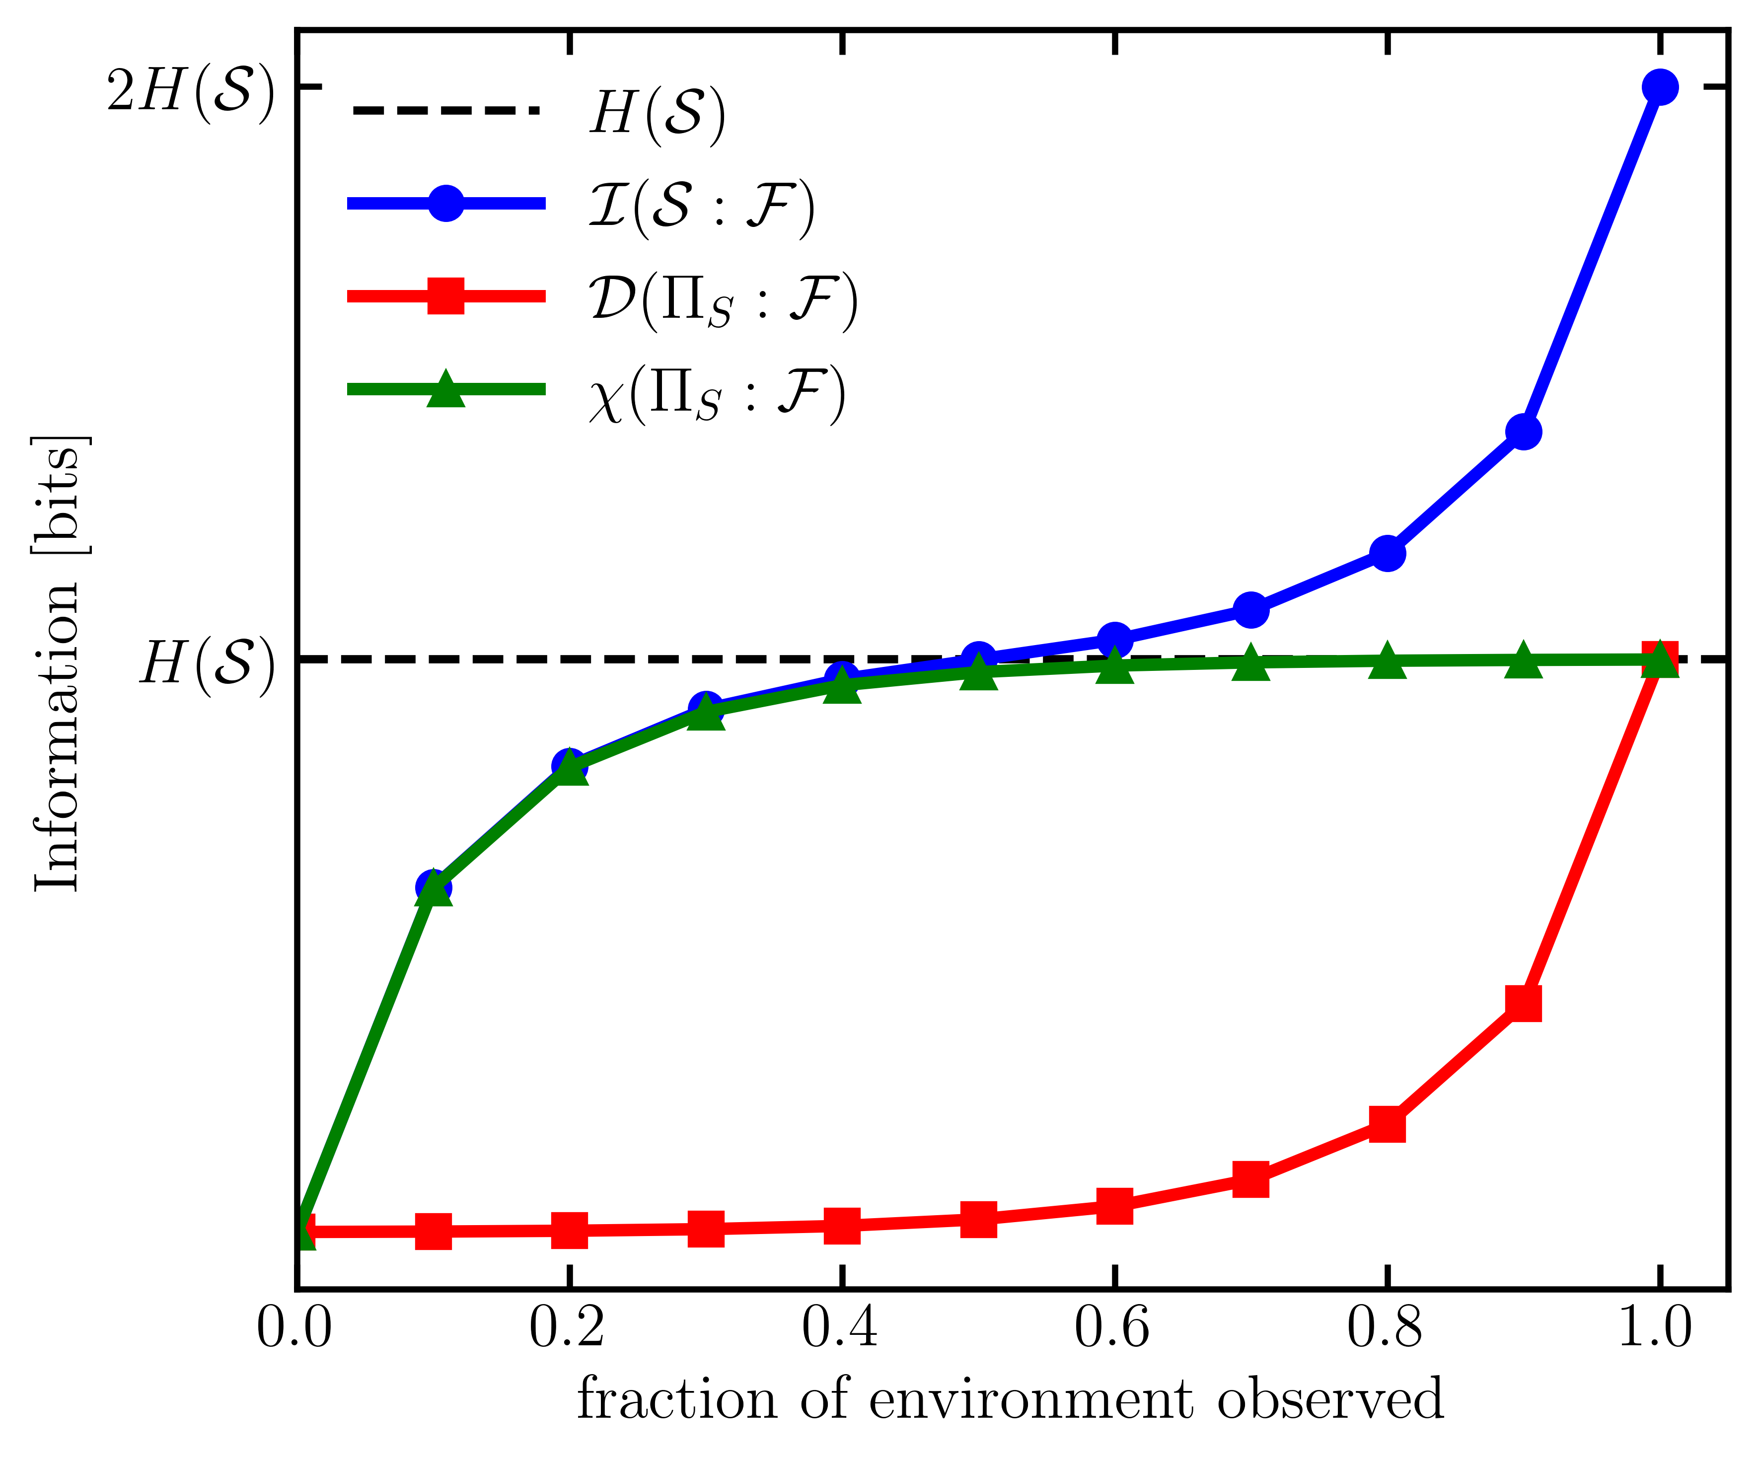
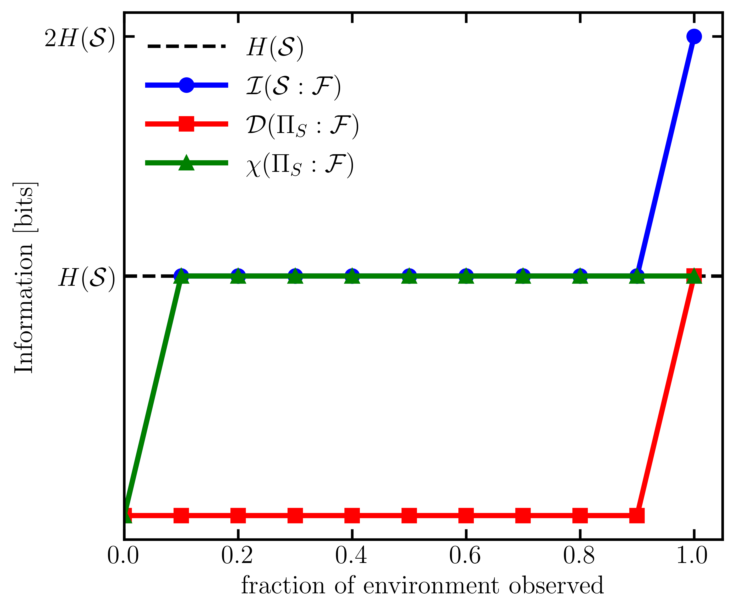
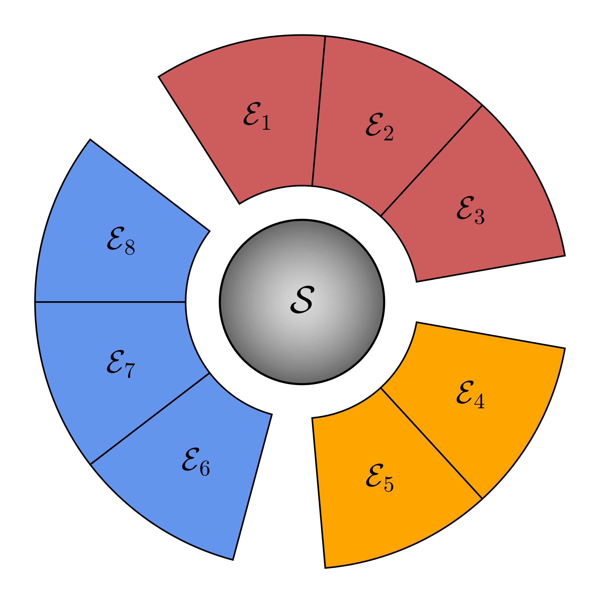
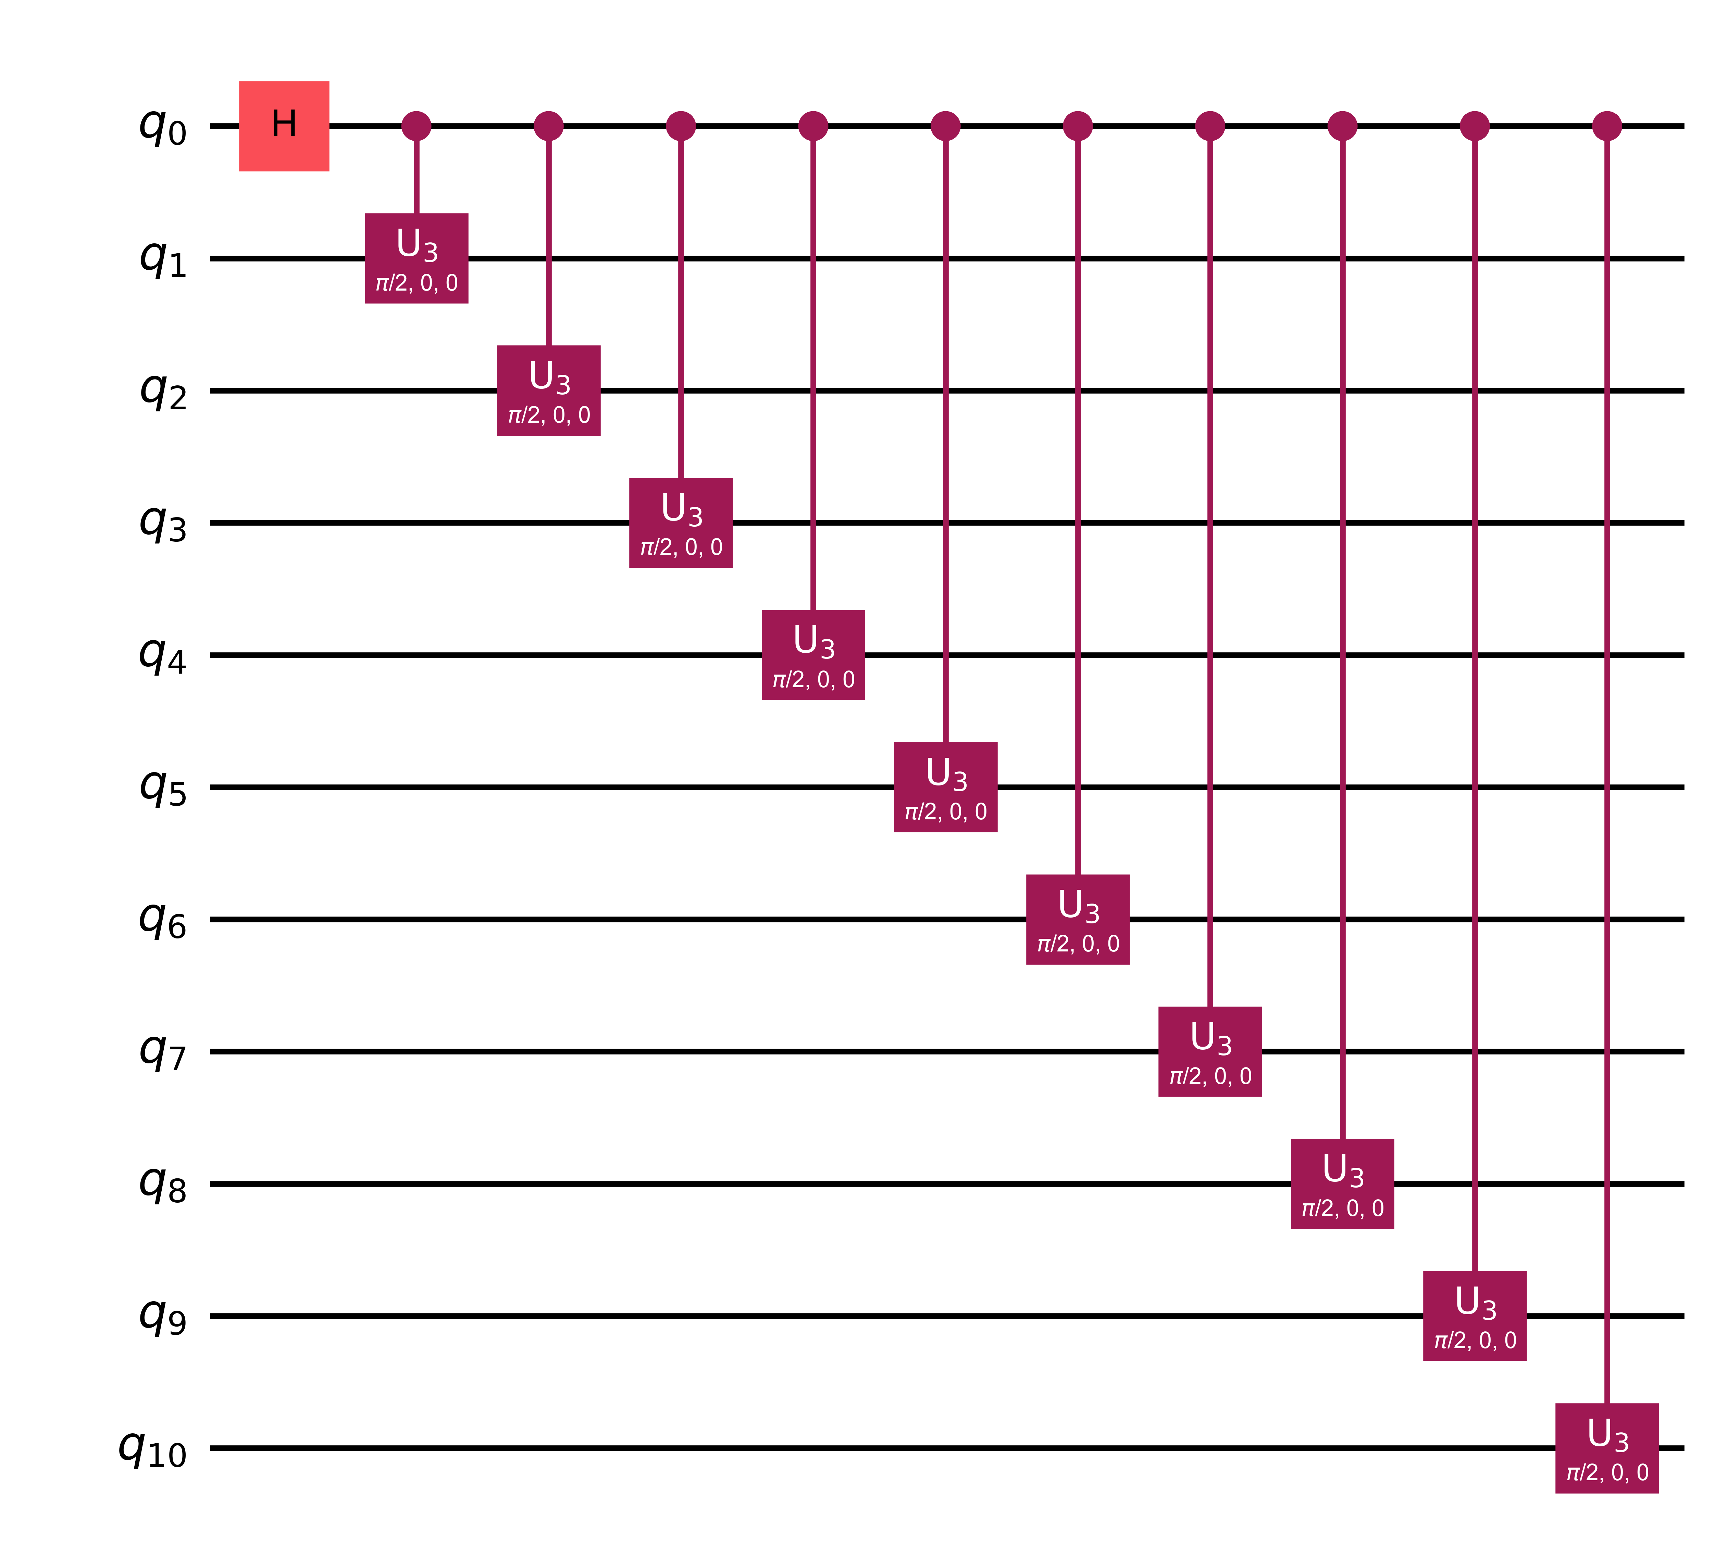
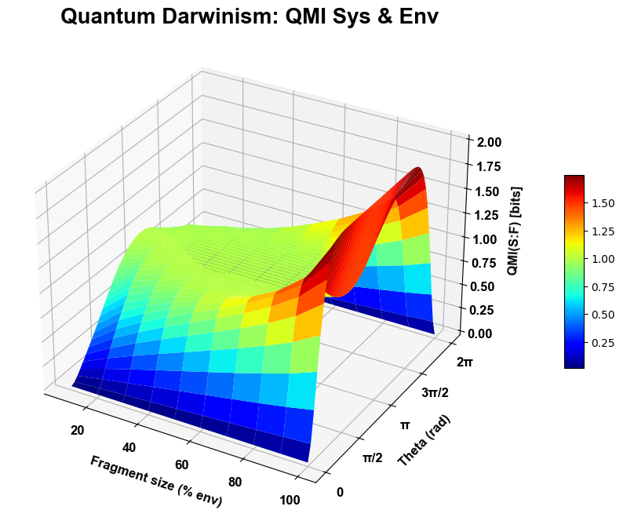
Classic scenario:
Sys + Envir
θ = π/2
θ = π
QMI: Total correlation between S and F
Discord: Quantum correlation
Holevo: Classical correlation
Sys-envir interaction: U3 gate

Slide 3
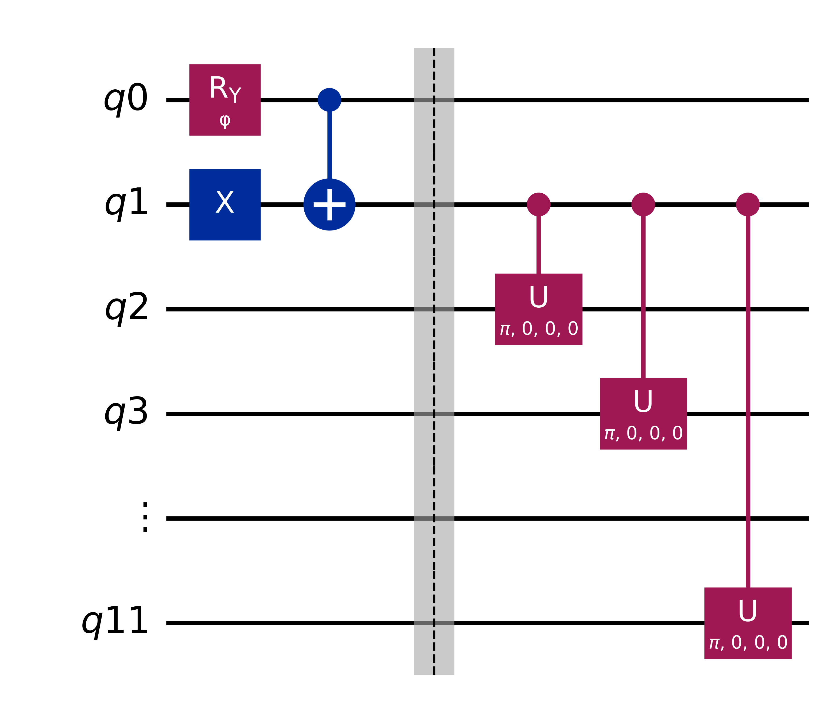
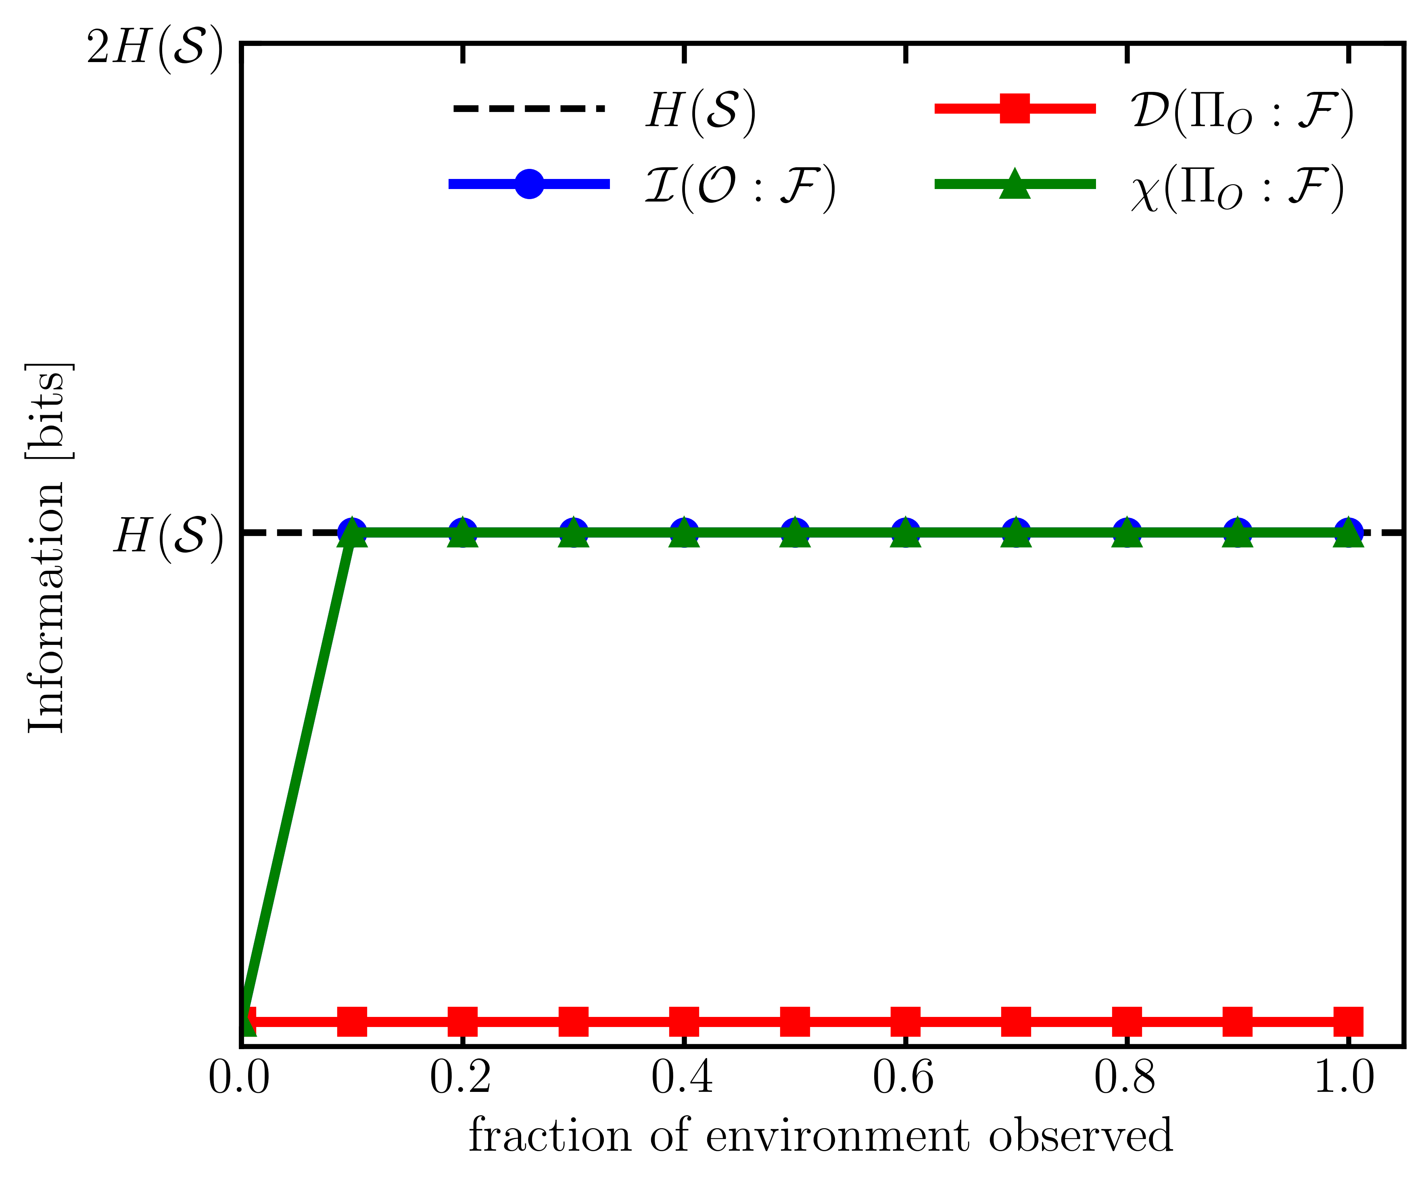
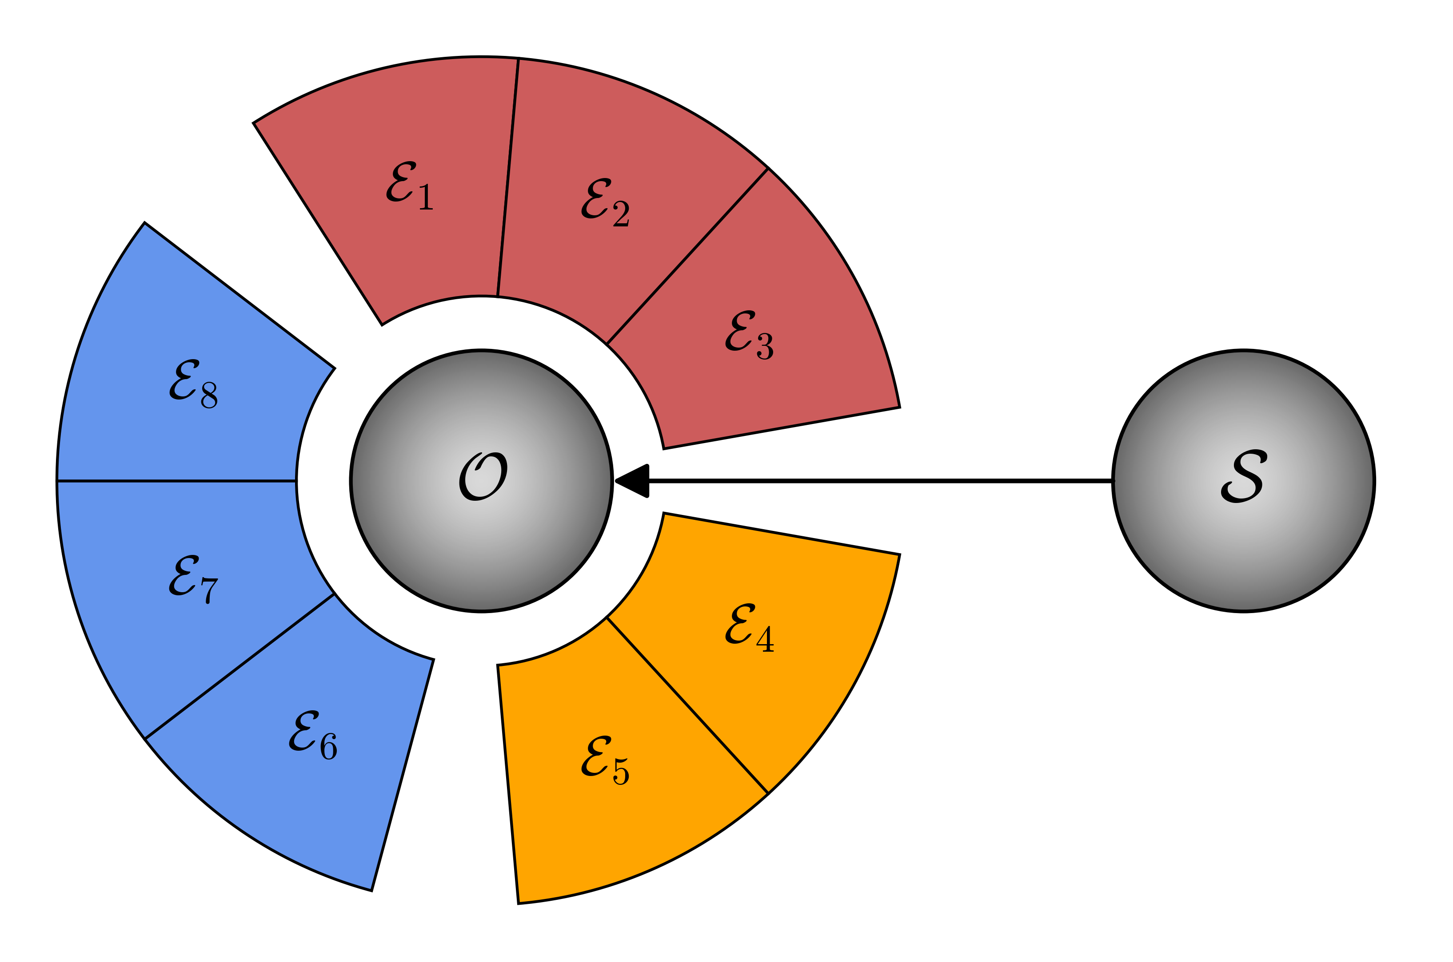
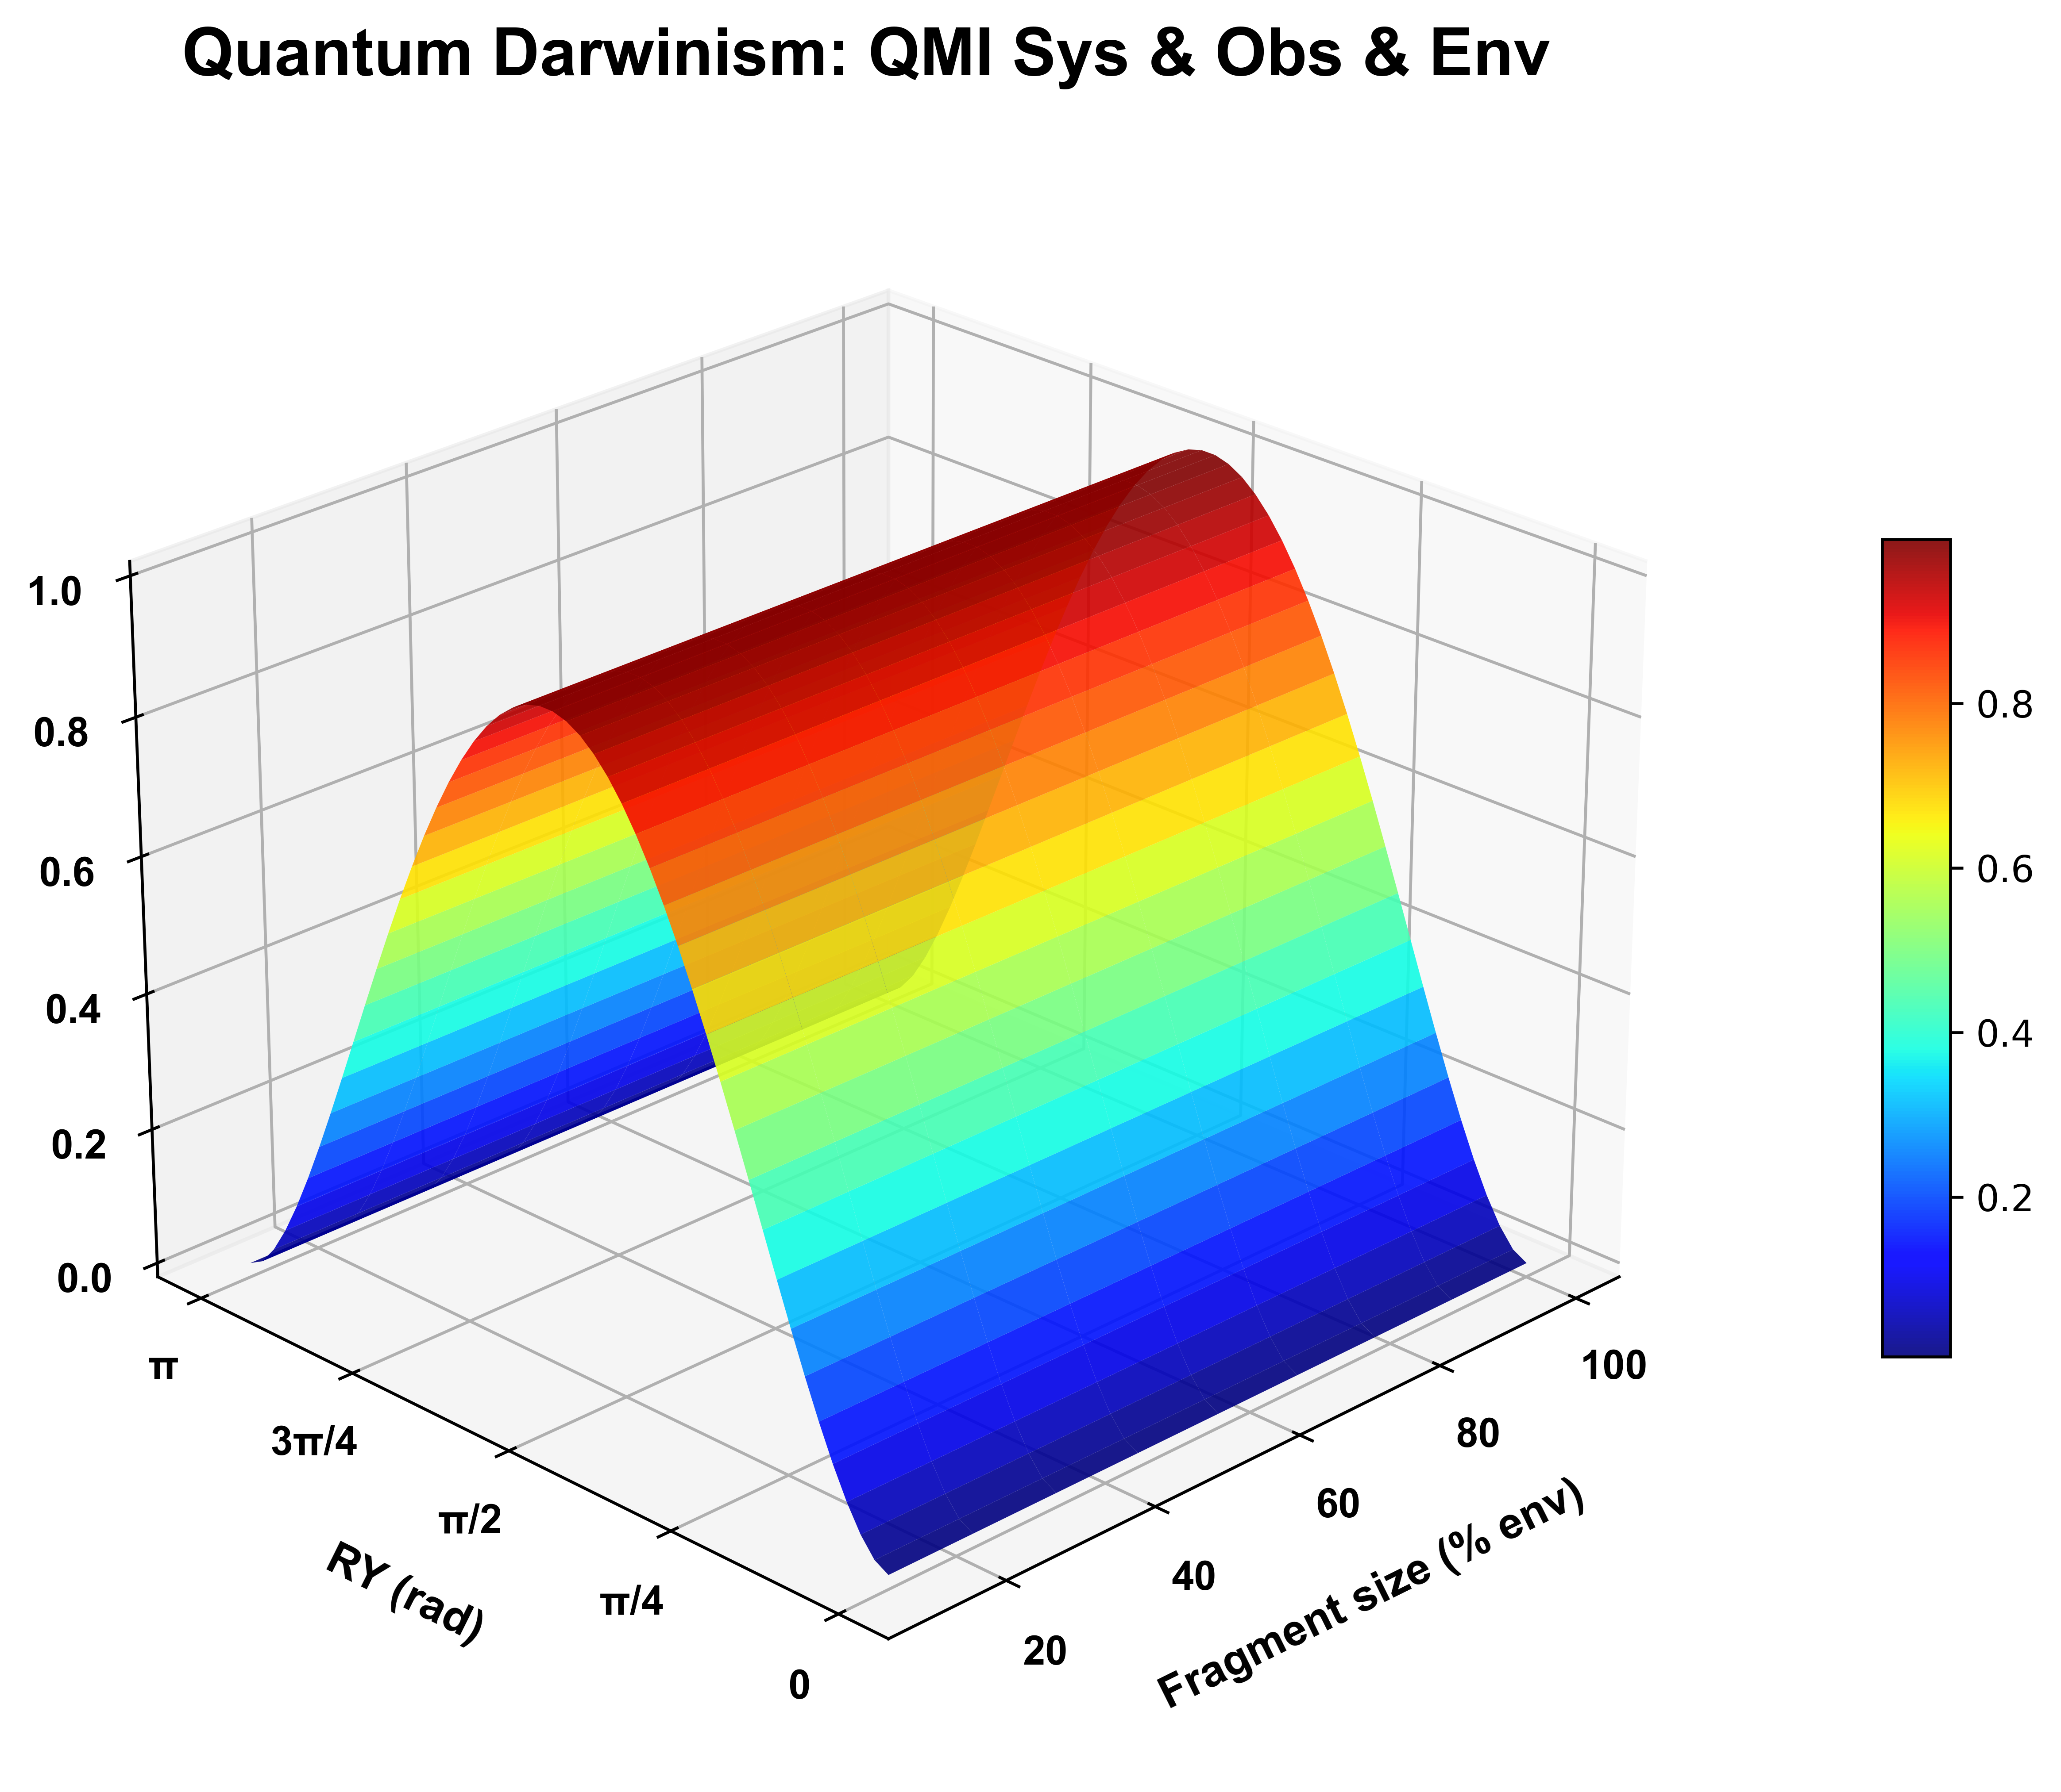
Modified scenario: Sys + Obs + Envir
Sys-obs interaction: CZ gate
Obs-envir interaction: U3 gate
3D simulation: varying θ
RY(phi) = π/2

Slide 4
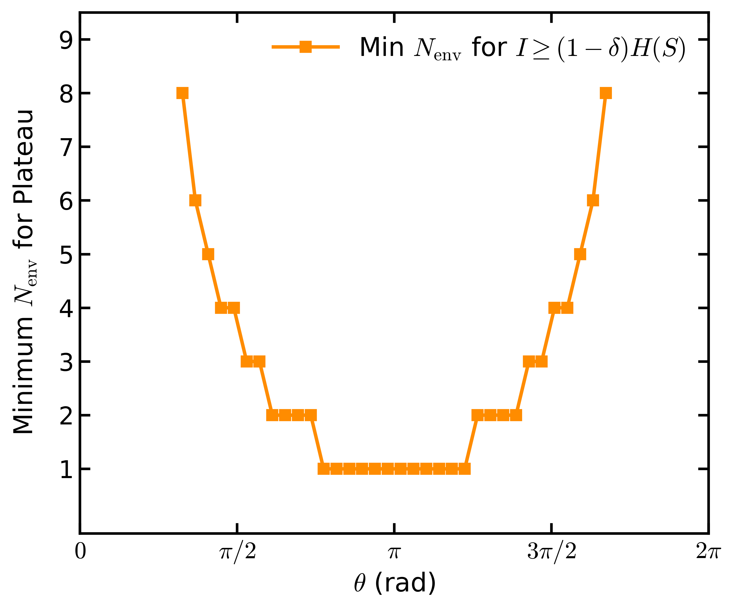
Modified scenario (QMI):
Sys + Obs + Envir

