Slide 1
citiBIke_projectFixDataLInk_skinny
File created on: 2/13/2021 12:37:24 PM

Slide 2
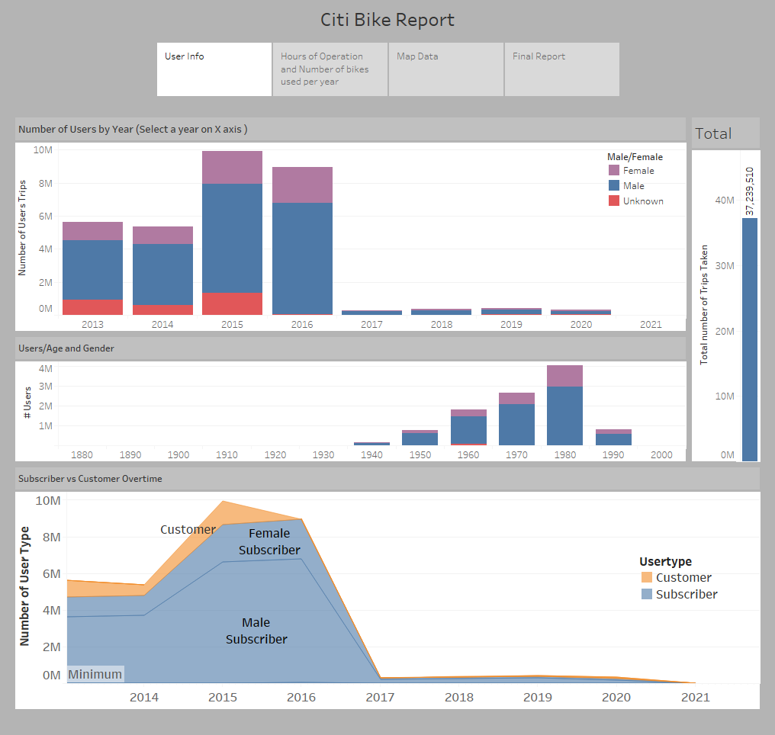

Slide 3
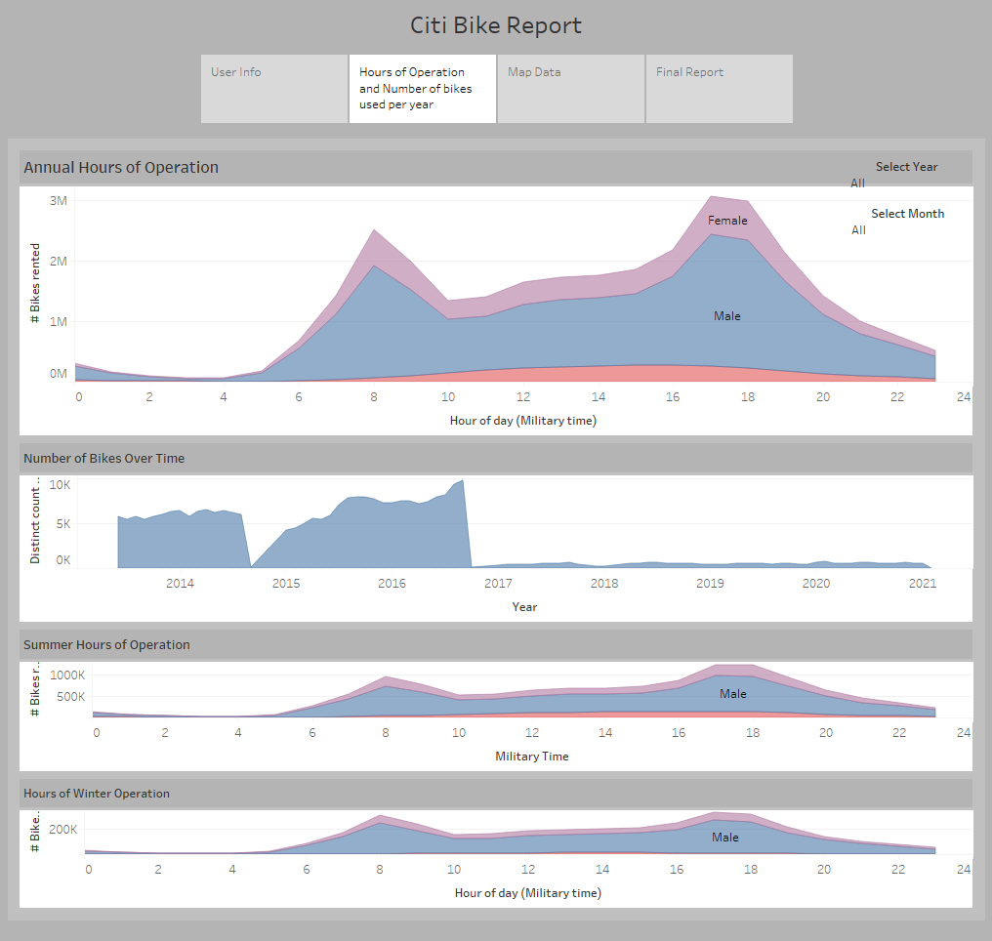

Slide 4
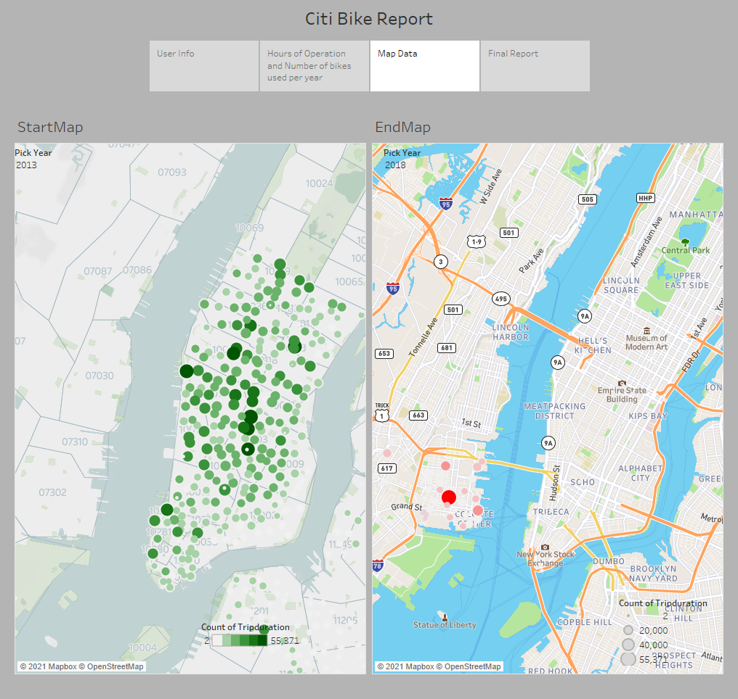

Slide 5
