Slide 1
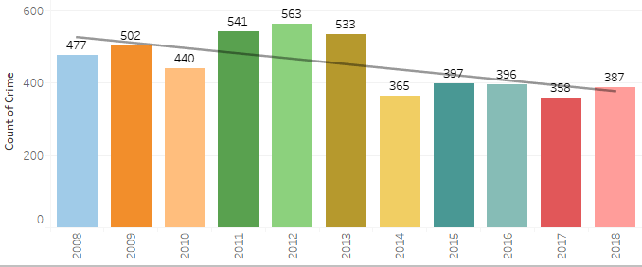
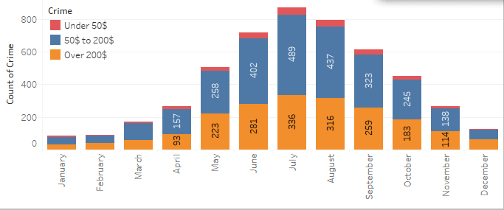
Can Bike theft be predicted?
4,960 Bikes were stolen in Indianapolis between 2018 and 2008 according to public records (fig A). Additional data can be extracted to identify where and when bikes are stolen in Marion county. The months May Through September have a significantly higher rate of theft then colder months. This information coupled with weather data may enable the ability to identify areas of Indianapolis that have a higher
risk for theft.
2018-2008 Bike Theft by year (fig A).
2018-2008 Bike Theft by month (fig B)

Slide 2
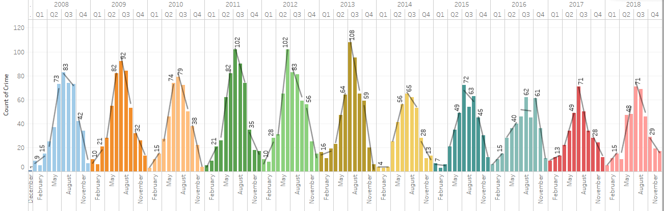
Seasonal Theft trends (2018-2008)
Most bikes are stolen between Q2 and Q3
July and August have the highest historic rates of theft
An almost Gaussian distribution of incidents consistently takes place an annual basis.
A significant decrease in bike theft started in 2014?

Slide 3
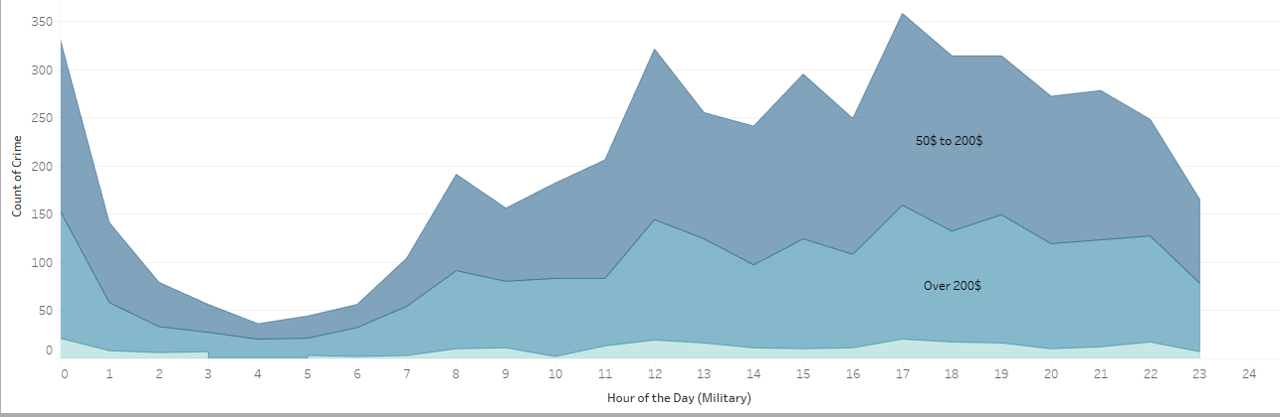
Theft trends by Hour (Data composed from 2018-2008)
Bike theft reported the highest between 12:00 A.M. and 12 P.M
This trend holds up regardless of month
7:00 PM Highest reported time for theft.

Slide 4
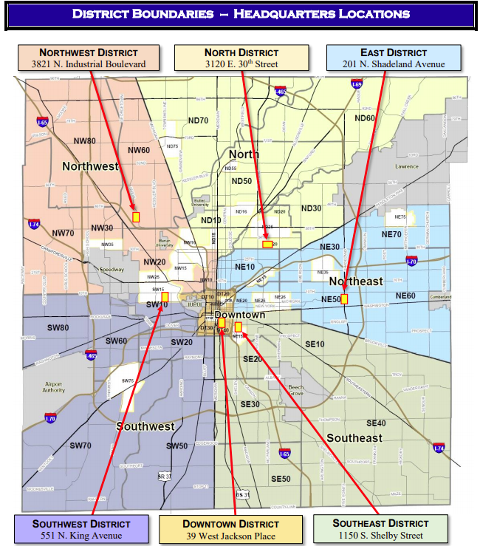
IMPD District Boundaries
Crime is reported by Districts and zones
Date and time data is available
Mapping data for each theft is available. (Coordinates
are in a format not covered in class
Majority of theft reported is in the Downtown District

Slide 5
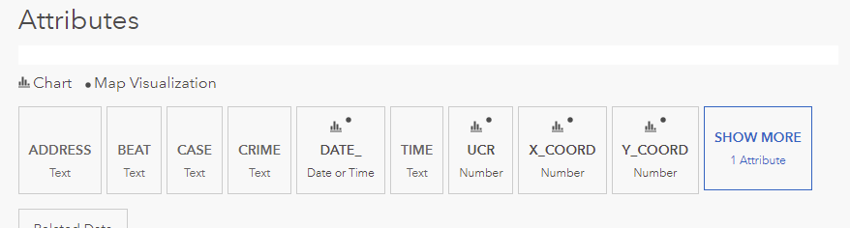
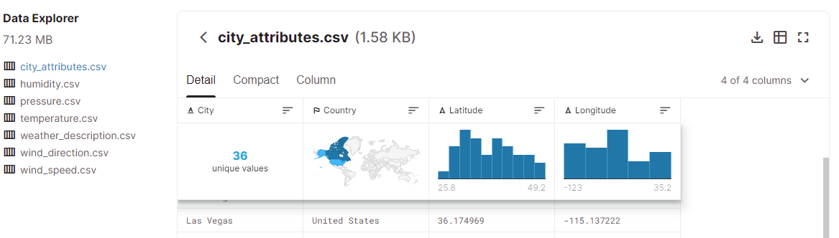
Examples of data available
Open Indy UCR reports 2018-2008
Historical Hourly Weather Data 2012-2017Historical Hourly Weather Data 2012-2017

Slide 6
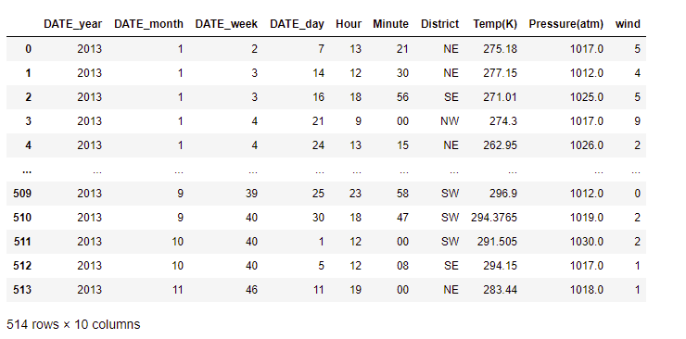
Potential Data set to model from
Data based on 2013

Slide 7
Final proposal
Can a model be built bassed on Dates, Time,
location, weather conditions (Temperature, humidity, wind, etc.)that can predict what districts in Indianapolis have a higher risk of bike theft?

