Slide 1

Open Data Portal
Port Management

Slide 2
Table of contents
01
02
03
04
The Team
Context
Problem
Goals
05
06
07
08
Related Work
Expected Results
Calendar
Communication
Presentation of the team and advisors
Context and introduction of the project
Limitations and necessities that led to the project
Goals expected to achieve with the project
Related projects that share similar goal
Results that expected to be achieved with the project
Project calendar
Tools used for team communication

Slide 3
The Team
01
José Moreira
André Alves
Pedro Rei
Francisco Pinto
Advisor
Architect
DB master
Project Manager
Paulo Pintor
Diogo Costa
Bruno Tavares
Advisor
Product Manager
Devops

Slide 4





02
Context
The need for a single portal for port management data analytics
Open Data Portal
data analytics

Slide 5
03
Problems
Multiple data source
Inconsistency in data points
Missing data
Duplicated data
Depending on who publishes the data the labels can differ, making difficult to gather statistics
E.g in cargo weight it can be in kg, tons or number of containers
In some rows, there are important fields missing
A large-scale database may contain duplicate data that leads to system overload and reduces operational efficiency

Slide 6
04
Goals
1
2
3
4
Use a machine learning algorithm to address data gaps
Perform outliers and inconsistencies detection in the data set
Develop a Data portal for data access
Data analytics for better comprehension of data set

Slide 7

05
Related Work
James Cheney, Laura Chiticariu, and Wang-Chiew Tan. 2009. Provenance in Databases: Why, How, and Where. Found. Trends databases 1, 4 (April 2009), 379–474 - https://doi.org/10.1561/1900000006
Oracle. 2024. Data Deduplication. Retrieved February 20, 2025, from https://www.oracle.com/uk/data-deduplication/
Luc Moreau and Paul Groth. 2013. Provenance: An Introduction to PROV. Morgan & Claypool Publishers. Chapters 2 and 3.

Slide 8
05
Related Work on data provenance
Importance
How?
Why?
Where?
In complex database systems like port operations management, data provenance ensures data integrity and transparency.
Describes the transformations data underwent to reach its current state, providing transparency and supporting process audits.
Identifies which input data contributed to query results, crucial for understanding data sources and their interrelationships.
Traces the exact origin of data within the database, essential for validating data authenticity and accuracy

Slide 9
06
Expected Results
1
Create a well-structured database involves several key steps to ensure efficiency, scalability, and data integrity. With metadata attach to the documents.
2
Development of a website for easier data access, allowing data and metadata downloads.
3
Document analysis via graphs and tables, with the ability to track data provenance of documents, manual entry of data or created the use of a machine learning algorithm.

Slide 10
07
Timeline
Milestone 1
Milestone 2
Milestone 3
Milestone 4
Requirement Gathering, Goals, life cycle objectives, calendar and Roles of Team
Use Cases, Architecture,Functional and Nonfunctional Requirements
Prototype, peer evaluation and mid-term presentation with supervisors
Project presentation, Posters,Video and Final Deployment

Slide 11
07
Calendar
 |  |  | Week
Steps |  |  | 1 | 2 | 3 | 4 | 5 | 6 | 7 | 8
Inception
Definition of technologies to be used
Uses cases
Architecture design
Explore the original database
Creation of the database with metadata
Implementation of the API
Development of the website UI

Slide 12
07
Calendar
 |  |  | Week
Steps |  |  | 9 | 10 | 11 | 12 | 13 | 14 | 15 | 16 | 17
Development of the website UI
Data prediction and outlier detection
Prototype
Metadata visualization
Analysis module
Finalization of the website UI
Deployment
Final Report

Slide 13




08
Communication plan

Slide 14
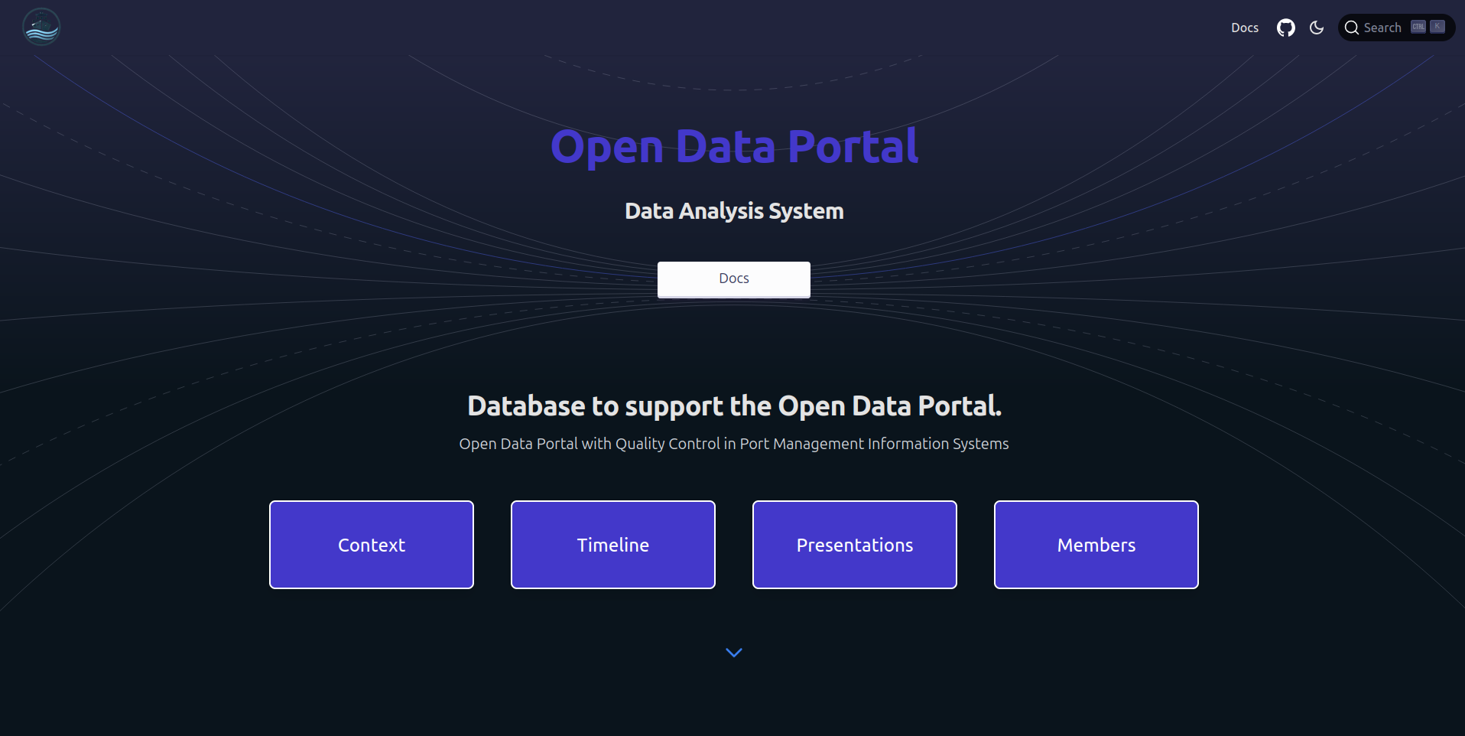

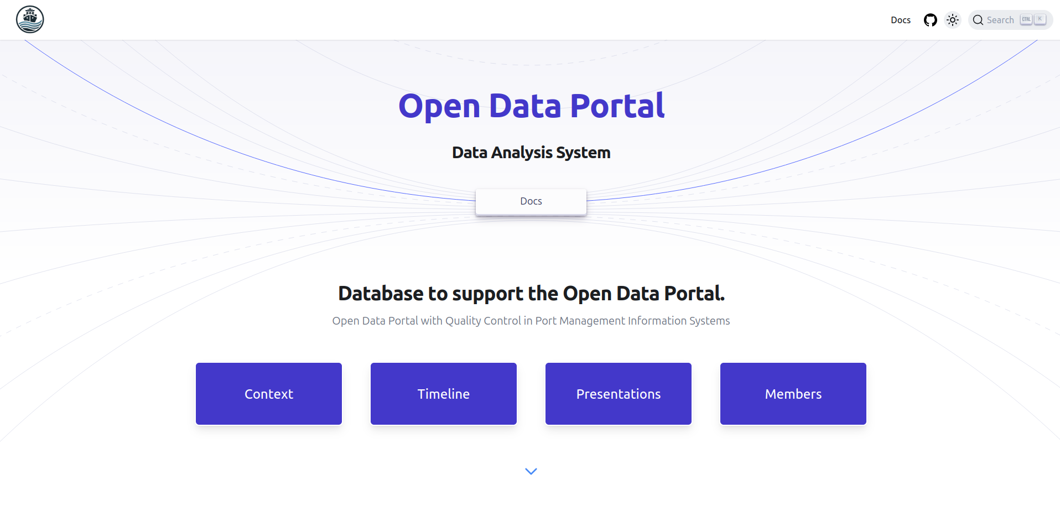
Thanks!
Open Data Portal
Port Management

