Slide 1

Fortgeschrittene Python Programmierung [2023 Edition]

Slide 2
JAN SCHAFFRANEK

Slide 3
Who am I
M.Sc. Applied Computer Science (Machine Learning)
Working as an algorithm engineer at ZF for autonomous driving
Instructor on Udemy since December 2017

Slide 4
Fortgeschrittene Python Programmierung

Slide 5
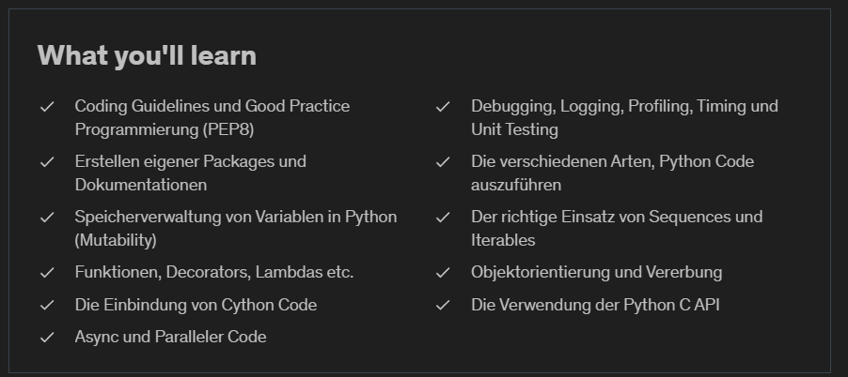
The course

