Slide 1
Development Of An Accommodation Management Platform

Slide 2
Introduction
To develop our project, we decided to take advantage of a project that one of us had, and we created a website for hostel management.
The management of the hostel is related to room reservations, payment dates, check-in/out times and other basic hostel management concerns.

Slide 3
Shape of the website
Our website could be divided in two sub-parts. The back-end and the front-end. The back-end is where all the data bases are created and where all the data related to the management of the hostel can be added and manipulated. On the front-end we have all the “aesthetics” of the website and is where the user can interact with the website.
For the implementation of our website we used two programming languages SQL and PHP.

Slide 4
Programming Languages
SQL (Structured Query Language) is the main programming language for data base development and we find it the easiest to use, and since we are learning it now in the Database discipline we decided to use it.
PHP (PHP: Hypertext Preprocessor or originally Personal Home Page) is a language designed primarily for web development, which has continuously been updated until PHP7, starting to be a OOP (object-oriented programming languages) from PHP3. PHP has a lot of similarities with C/C++ and Java. We decided to use it because it is a really simple and intuitive tool and it has a great connection to severeal database systems such as: Oracle, Sybase, PostgreSQL, InterBase, MySQL, etc..

Slide 5
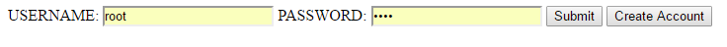

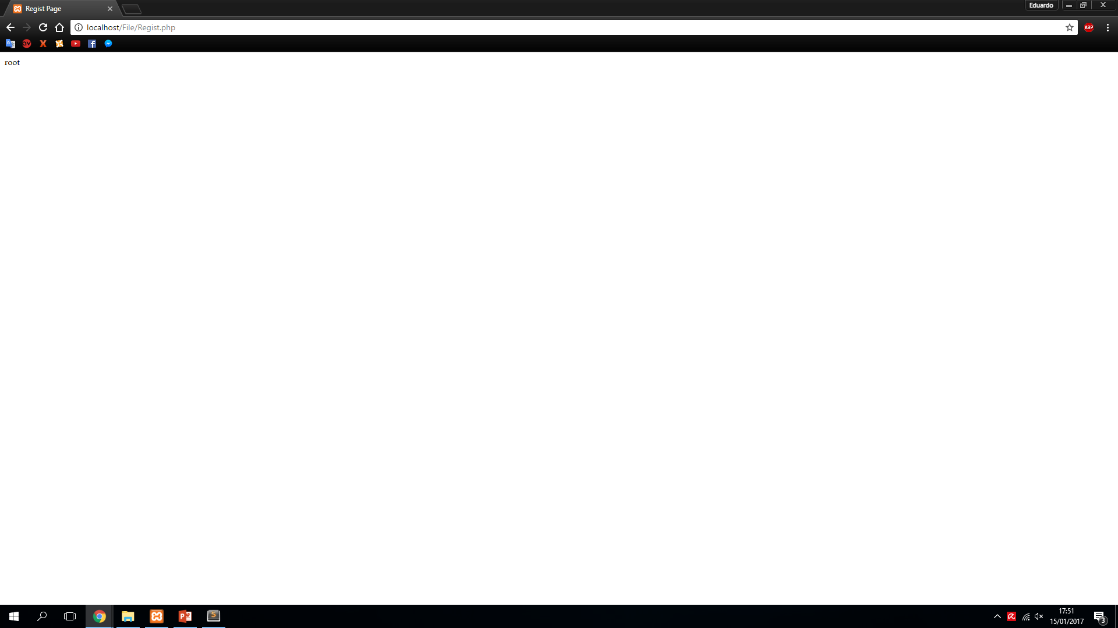

First Steps
In the beginning of our project we started by creating a login page connected to a local database to familiarize us with the languages that we were going to use on the project.
You had the login
The create account
And the end result of your login
or

Slide 6
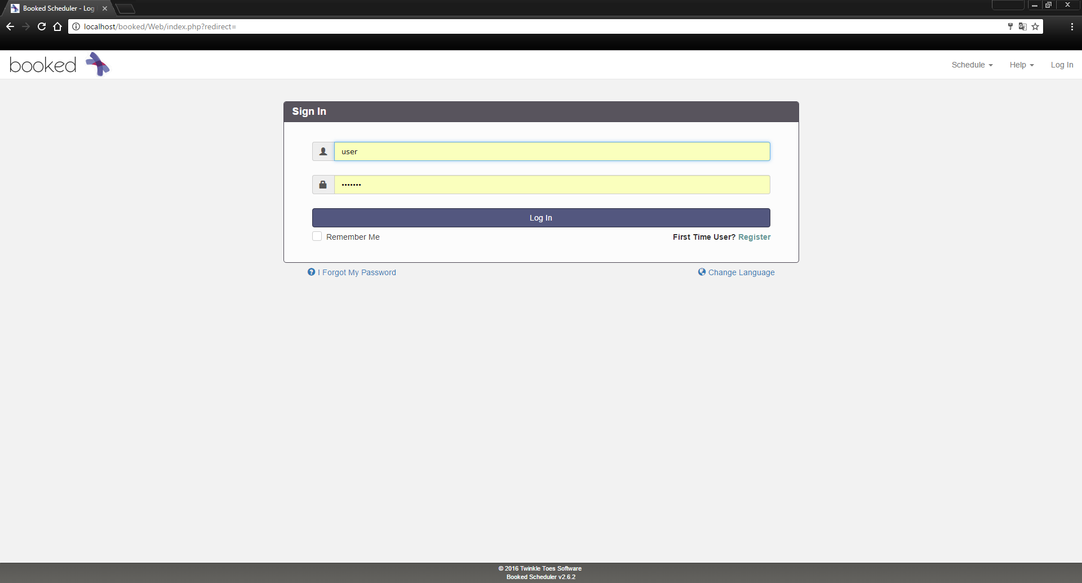
Final Project
Depending on the type of user, you’ll be able to “access” different parts of the platform
This is the initial page where you can create or login to your account

Slide 7
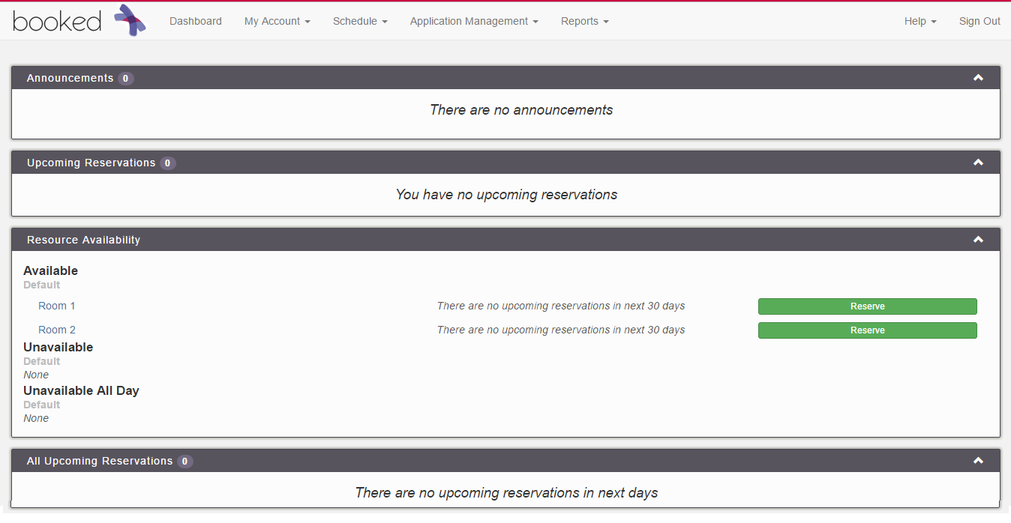
Final Project
This is what an Administrative user will be able to access through their account
On the Dashboard we have a resume of what is on the Schedule.

Slide 8
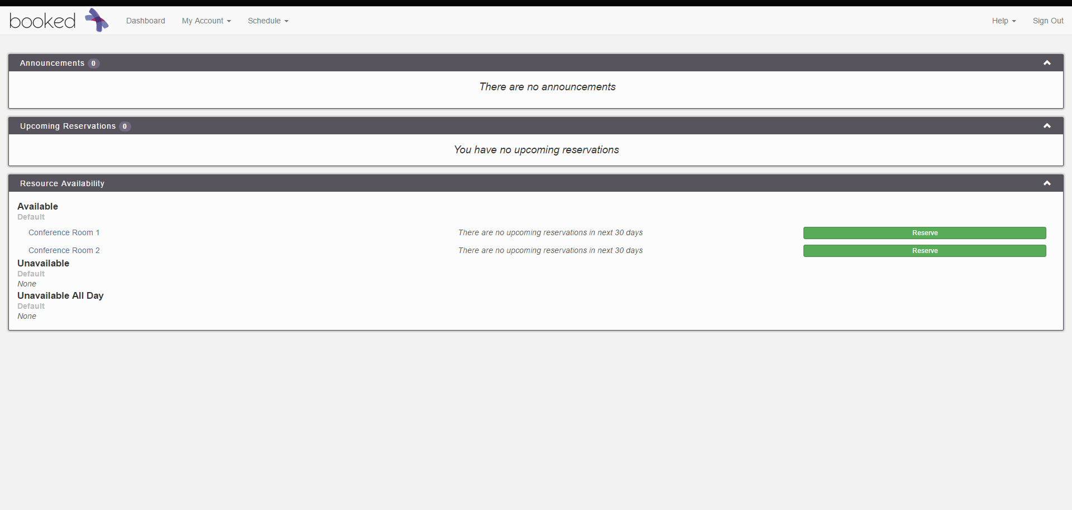
Final Project
This is what a “Normal” user will be able to access through their
Account depending on what he has permission to access
On the Dashboard we have a resume of what is on the Schedule.

Slide 9
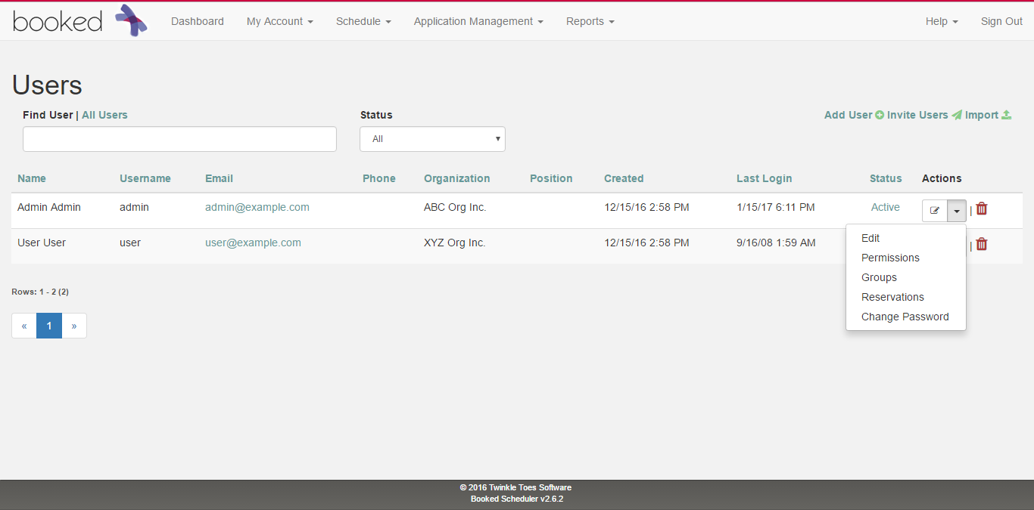
Final Project
Here is where the Administrator is able to edit who has permission to access what and to add/delete people from the platform

Slide 10
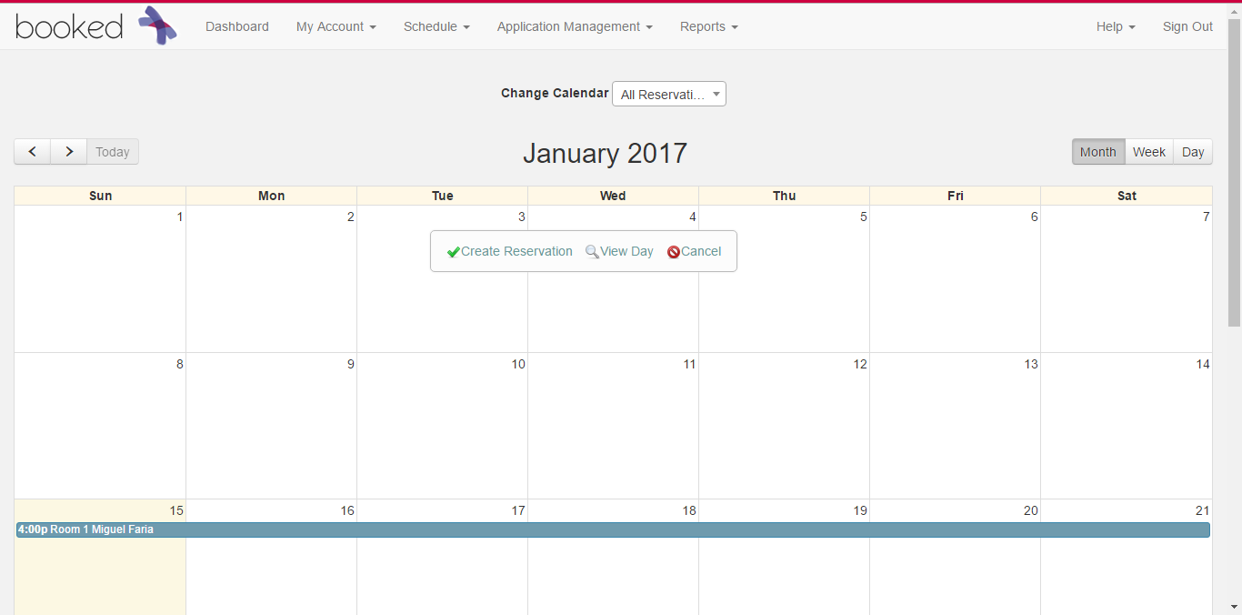
Final Project
In the Schedule section of the platform, you can create the reservations
Which will send you to the following page

Slide 11
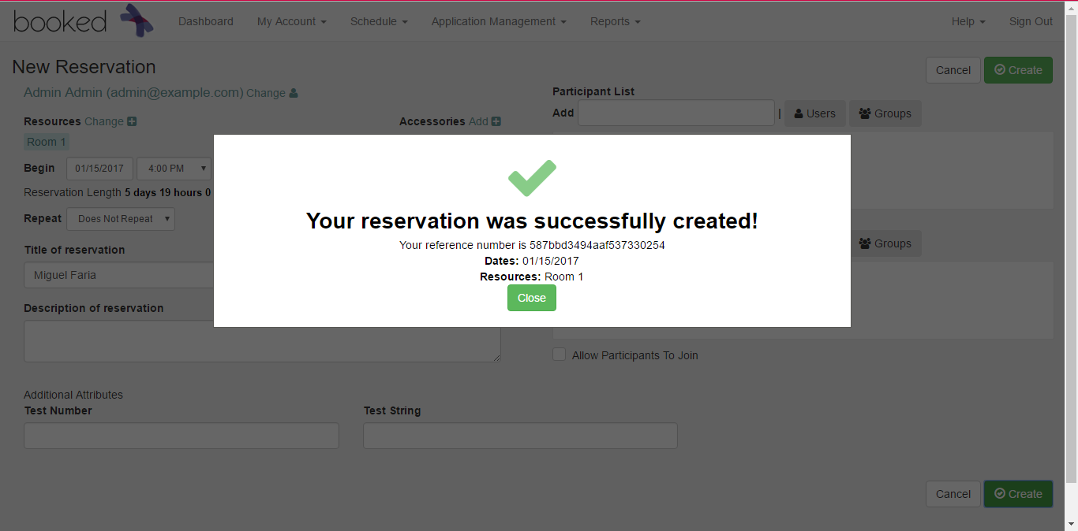
User Interaction
Where you’re able to create the reservation

Slide 12
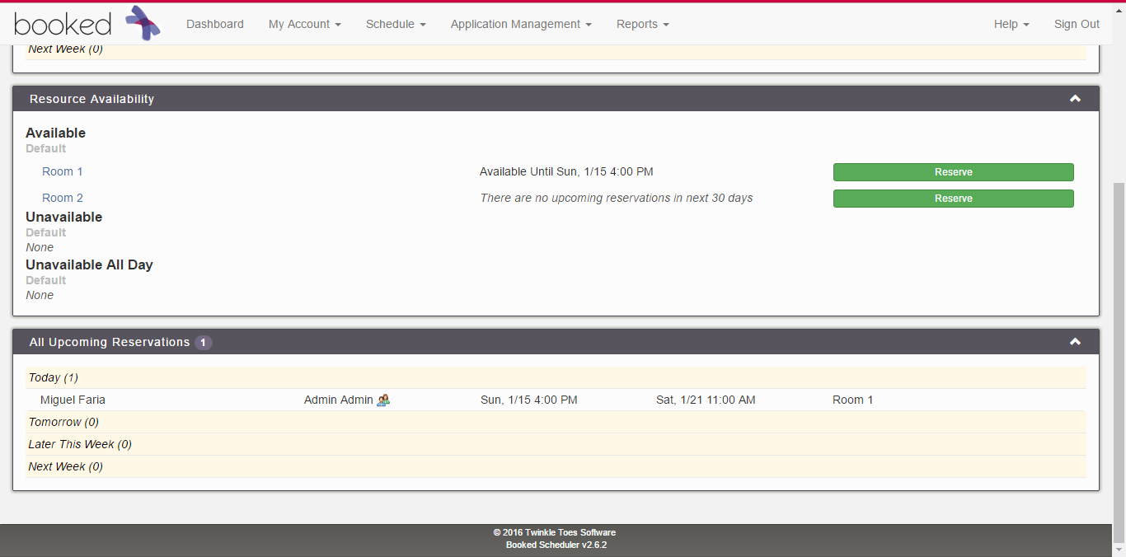
Final Project
The creation of the reservation will appear on the Dashboard

Slide 13
Any questions?

