Slide 1
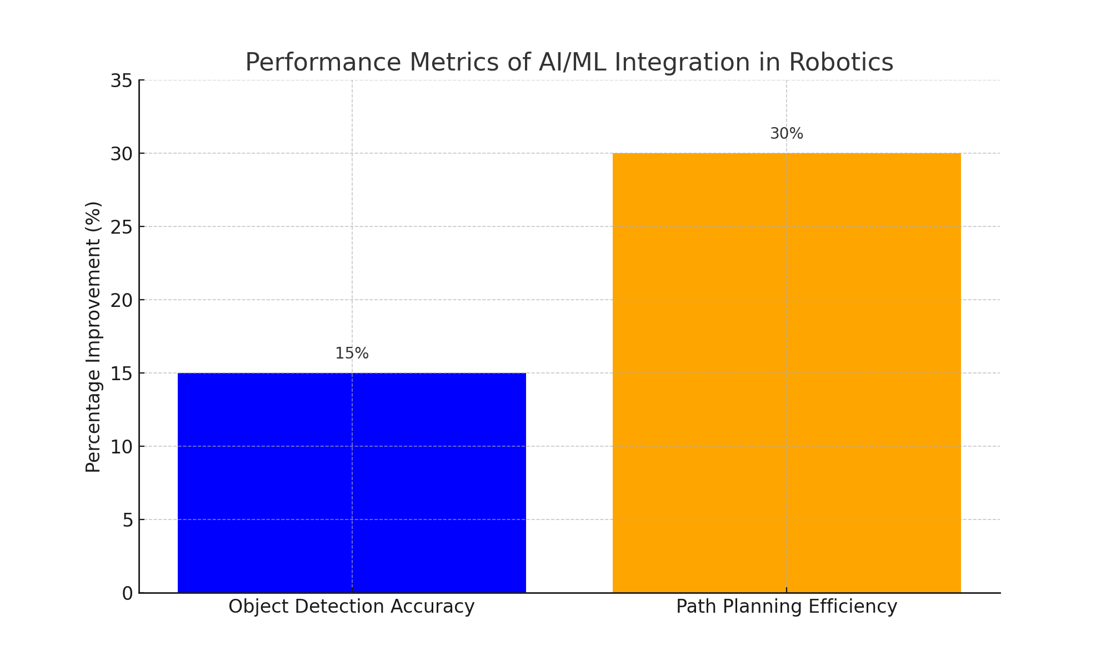
Performance Metrics of AI/ML Integration in Robotics

Slide 2
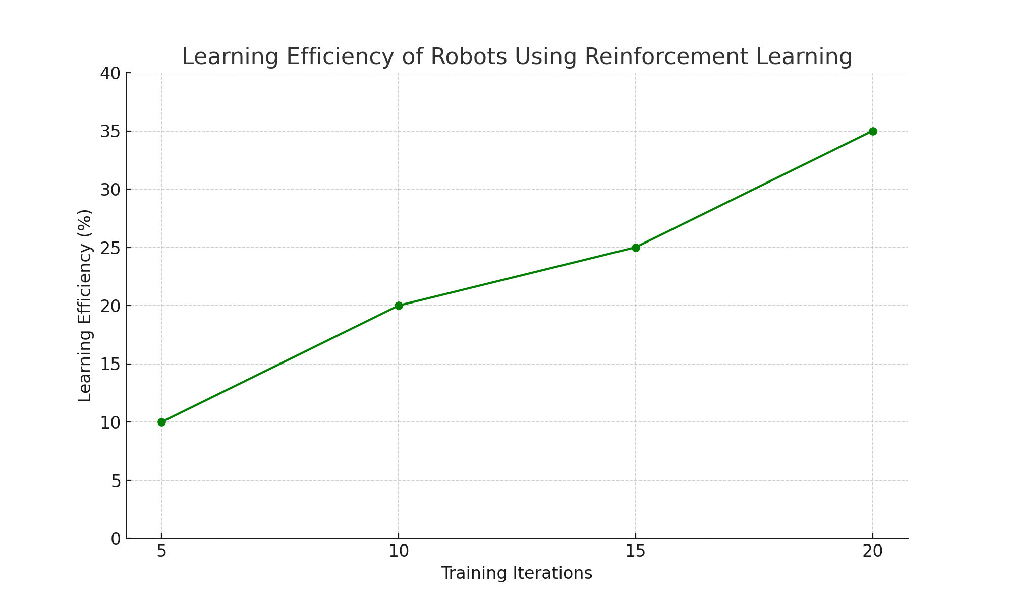
Learning Efficiency of Robots Using Reinforcement Learning

