Slide 1
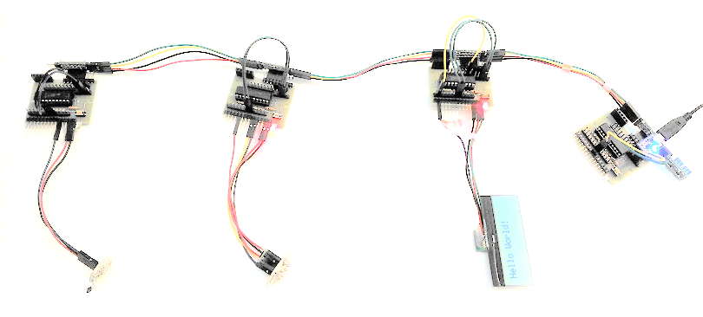
Wired sensor network
Plug&Play protocol over I2C
Plug&Play protocol over UART (CLI)
PC or Smartphone
UART-USB converter
Scheduler
Sensor(Hall sensor)
Sensor(Accelerometer)
Actuator(LCD)
Application
Application
Application
Application
Appl.
Plug&Play protocol
Plug&Play protocol
Plug&Play protocol
Plug&Play protocol
Plug&Play protocol
I2C
I2C
I2C
I2C
UART
USB
Two-wire bus (w/ 5V and GND)
Two-wire via FTDI chip

