Slide 1
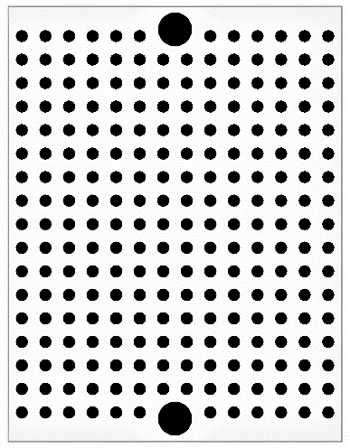
PIC16F1825-I/P
Position detector
October 1st, 2017
hall sensor 3
hall sensor 2
hall sensor 1
hall sensor 0
LED(red)
AN7
AN0
AN1
AN2
A
Pin header
51kΩ
AN7
Pin socket
0.1μF
1kΩ
AN0
AN1
AN2
5V
GND
SCL
SDA

Slide 2
Back
hall sensor 0
hall sensor 1
hall sensor 2
hall sensor 3
AN2
AN1
AN0
AN7
LED(red)
A
51kΩ
AN7
0.1μF
AN0
1kΩ
AN1
AN2
SDA
5V
SCL
GND

Slide 3
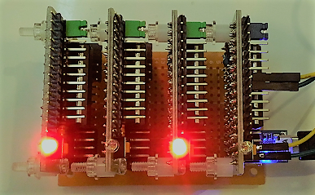
8 pc
A1324LUA-T
Position detector card #1
Position detector card #0
I2C backplane master
:
I2C
Backplane

