Slide 1
Building blocks with 8bit MCU 29th May, 2017

Slide 2
Capability | Module embedded | Circuit pattern | Embedded | Modular jack
Scheduler |  | Scheduler | NA | RJ11 x 2
Temperature & humidity sensor | AE-HDC1000 | HDC-1000 | Y(1), N(1) | RJ11 x 4
3-axis accelerometer | KXR94-2050 | KXR94-2050 | Y | RJ11 x 2
Speed sensor | A1324LUA-T | A1324LUA-T | N | RJ11 x 4
LCD and LED |  | Basic circuit pattern w/ RJ45 modular jack | N | RJ11 x 2 RJ45 x 2

Slide 3
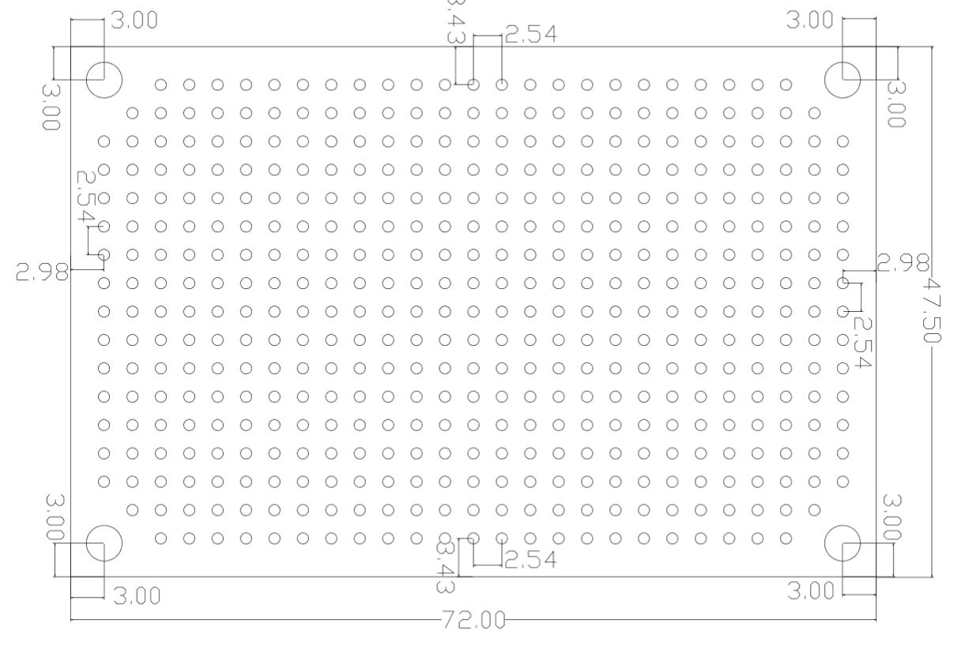
Front
Basic circuit pattern
(w/ LAN modular jack)
51kΩ
0.1μF
A
Vdd
Rx
Vdd
GND
Tx
GND
SDA
SDA
1kΩ
SCL
SCL
Vdd
Vdd
GND
GND
AN7
SCL2
AN3
AN8
SDA2
Tx
Rx

Slide 4
0.1μF
51kΩ
A
Vdd
Rx
Vdd
GND
Tx
GND
SDA
SDA
SCL
1kΩ
SCL
Vdd
GND
Vdd
SCL2
AN7
GND
SDA2
AN8
AN3
Tx
Rx

Slide 5
Front
Scheduler block
51kΩ
0.1μF
A
Vdd
Rx
Vdd
GND
Tx
GND
SDA
SDA
1kΩ
SCL
SCL
Vdd
GND
Tx
Rx

Slide 6
51kΩ
0.1μF
A
Vdd
Rx
Vdd
GND
Tx
GND
SDA
SDA
1kΩ
SCL
SCL
Vdd
GND
Tx
Rx

Slide 7
Front
AE-HDC1000
51kΩ
0.1μF
A
Vdd
Rx
Vdd
GND
Tx
GND
SDA
SDA
1kΩ
SCL
SCL
Vdd
GND
Vdd
SDA2
SCL2
GND
Tx
Rx

Slide 8
0.1μF
51kΩ
A
Vdd
Rx
Vdd
GND
Tx
GND
SDA
SDA
1kΩ
SCL
SCL
Vdd
SDA2
Vdd
GND
GND
SCL2
Tx
Rx

Slide 9
Front
AE-HDC1000
GND
Vdd
SDA2
SCL2
SCL
SDA
Vdd
GND

Slide 10
SDA2
SCL2
Vdd
GND
Vdd
SDA
SCL
GND

Slide 11
Front
KXR94-2050
51kΩ
0.1μF
A
Vdd
Rx
Vdd
GND
Tx
GND
SDA
SDA
1kΩ
SCL
SCL
AN7
AN3
AN8
Z-axis
Vdd
Y-axis
1(Vdd)
8(z)
GND
2(Vdd)
7(y)
Tx
3(GND)
6(x)
Rx
4(unused)
5(GND)
X-axis

Slide 12
0.1μF
51kΩ
A
Vdd
Rx
Vdd
GND
Tx
GND
SDA
SDA
SCL
1kΩ
SCL
AN7
AN8
AN3
Vdd
GND
8(z)
1(Vdd)
Tx
7(y)
2(Vdd)
Rx
6(x)
3(GND)
5(GND)
4(unused)

Slide 13
Front
A1324LUA-T
51kΩ
0.1μF
A
Vdd
Rx
Vdd
GND
Tx
GND
SDA
SDA
1kΩ
SCL
SCL
Vdd
GND
AN8
Vcc
GND
Unused
Vdd
Vout
GND
Tx
Rx
5
2

Slide 14
0.1μF
51kΩ
A
Vdd
Rx
Vdd
GND
Tx
GND
SDA
SDA
SCL
1kΩ
SCL
GND
Vdd
AN8
Vdd
GND
Tx
Rx

Slide 15
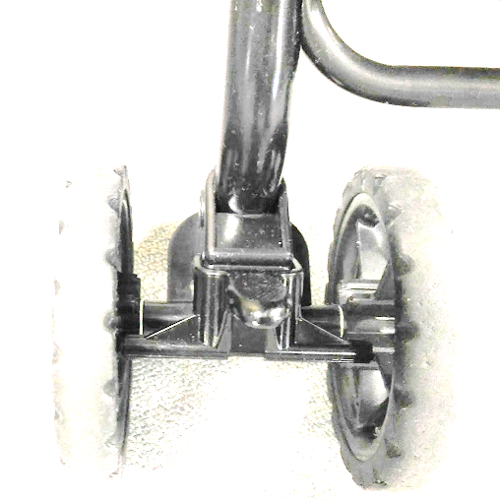
RJ11 modular jack
Magnet
Band
A1324LUA-T
Axis
Magnet
Vcc
Vout
GND

Slide 16
Front
LCD&LED
51kΩ
0.1μF
SCL
A
Vdd
Rx
Vdd
GND
Tx
GND
SDA
SDA
1kΩ
SCL
Vdd
GND
Vdd
Vdd
SDA2
GND
SC7
SCL2
Tx
8
7
6
5
4
3
2
1
Rx

Slide 17
51kΩ
0.1μF
A
Vdd
Rx
Vdd
GND
Tx
GND
SDA
1kΩ
SDA
SCL
SCL
Vdd
SDA2
GND
Vdd
Vdd
SC7
SCL2
GND
Tx
8
7
6
5
4
3
2
1
Rx

Slide 18
Vdd
GND
SDA
SCL
A
1kΩ
RJ45
jack
1
2
3
4
5
6
7
8
LCD

Slide 19
Front
I2C backplane
Vdd
Vdd
GND
GND
SDA
SDA
SCL
SCL

Slide 20
Device initial config
I2C backplane master
SET:1
SAV
I2C backplane slaves
WDA: <I2C address>

