Slide 1

TEAM DEV-HACKERS RENTAL ROOM WORLD
Team members
Sheetal Dadhich
Ishika Tiwari
Rashi Agarwal
Kausar Ahamed

Slide 2
Problem Statement – To make the search for pg's or hostels or even rooms easier and available with a single click, making it easier for the students and working professionals saving time and energy.
Solution - Building and hosting a website, accessible to all for the students to search for all the pg or hostel in the given location, and choose one as per their requirements and also making it accessible for owners to put their pg or hostel information leading to their publicity and also easy data collection for us.

Slide 3
PURPOSE
As we all students have went through a phase where
we spend a lot of time searching for a perfect
hostel/pg for stay. On the other hand room owners
also face problems in search of tenants. Our project
revolves around this idea to create a place where
students can easily find room according to them. As
some might need Wi-Fi, veg/ non-veg mess, and
many other things. Here they can easily find their
room in just some clicks. And room owners need not
search for tenants. It would help students as well as
owners to save their time and energy.

Slide 4
About The Website
The website is designed into two parts, one for the tenants and other for the owners. The students can specify, the particular location, gender, locality and the required food type, and the pg or the room, for which usually the people have to search for days and weeks and much more, which is a complete wastage of time and energy. The website would contain all the details pg along with an image.
The second part, of the website consists of a form where the owners of pg, rooms can fill details including address, type, water facility, rent and other required details which will automatically be attached to the database, which will also make the process of data protection easier.

Slide 5
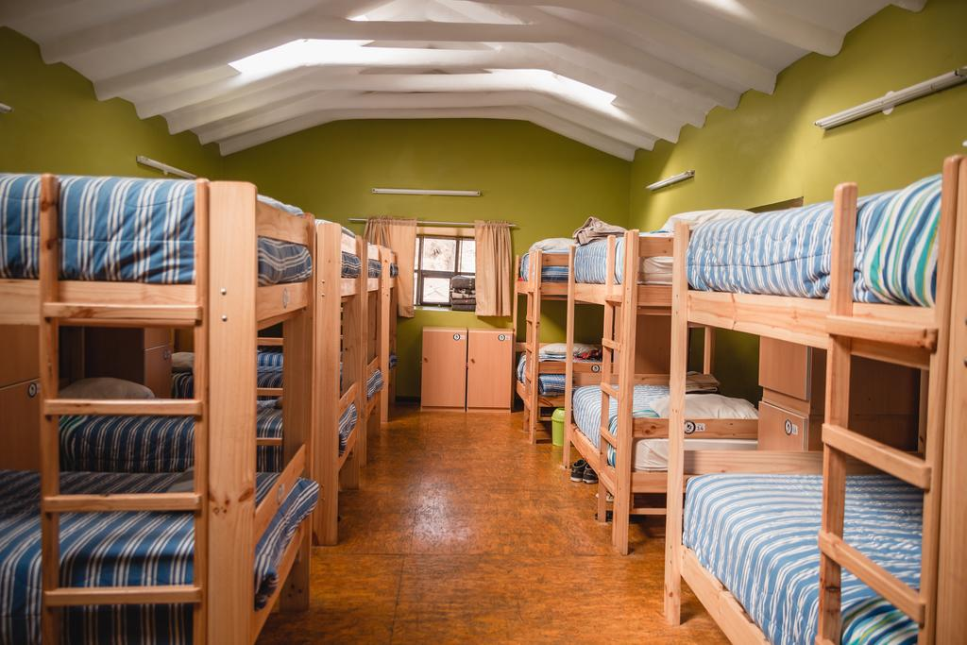
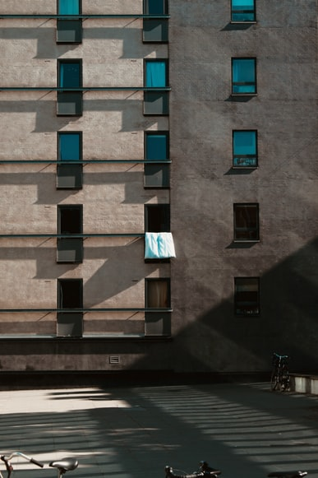

Tenants
Owners
Site for the students to
search for the pg of their choice.
Form for the owners to fill
up their
respective information.

Slide 6
Challenges Faced
Setting Up the Database. It took a lot of time and efforts.
Faced some problems while nested routing.
Hostel and Rooms info are yet to be added.
Even we can make the site very secured by adding malware protection, which were not implemented due to shortage of time.

Slide 7
Text stack -
Font-family: -apple-system, BlinkMacSystemFont, 'Segoe UI', 'Roboto', 'Oxygen', 'Ubuntu', 'Cantarell', 'Fira Sans', 'Droid Sans', 'Helvetica Neue', sans-serif; -webkit-font-smoothing: antialiased; -moz-osx-font-smoothing: grayscale;
Font used in ppt- Palatino, Arial Black
Github repo link - https://github.com/Sheetal575/Dev-Hacker-.git
Youtube link - https://youtu.be/y-f5RSbS5mk

Slide 8
ANY QUESTIONS ??

