Slide 1

August 31,2026

Slide 2
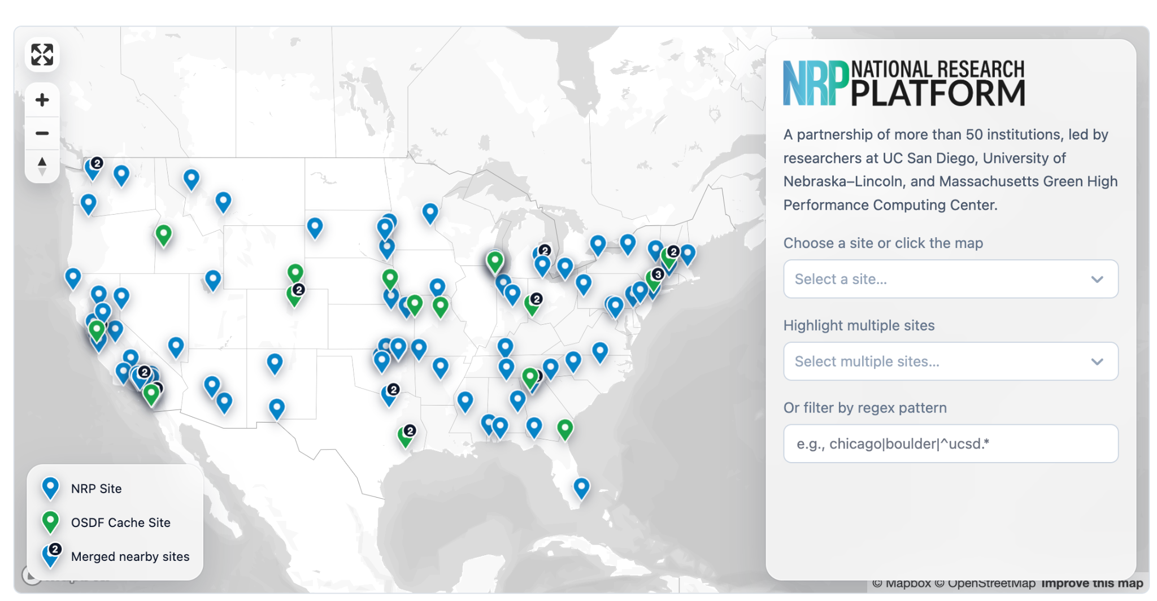
What is The National Research Platform?
The National Research Platform pools GPUs, petabyte-scale storage, and hosted open-weight AI models across more than 70 institutions.
It is free to U.S. nonprofit research and education, funded by the National Science Foundation and governed by the community that contributes to it
NRP operates a primary Kubernetes distribution cluster with hardware spanning across 3 continents, called Nautilus.
https://nrp.ai/

Slide 3
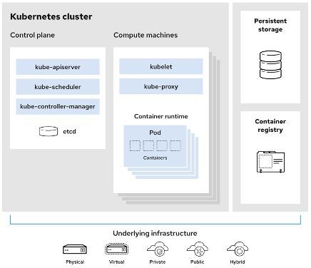
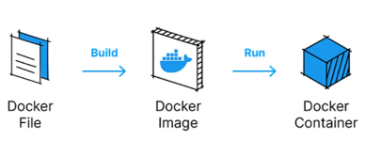
The Nautilius Cluster
Nautilus is a Kubernetes cluster
Control plane: Manages the cluster and the worker nodes
Worker Nodes: Maintain running pods and provide Kubernetes runtime environment
Has been in continuous operation for 6 years.

Slide 4
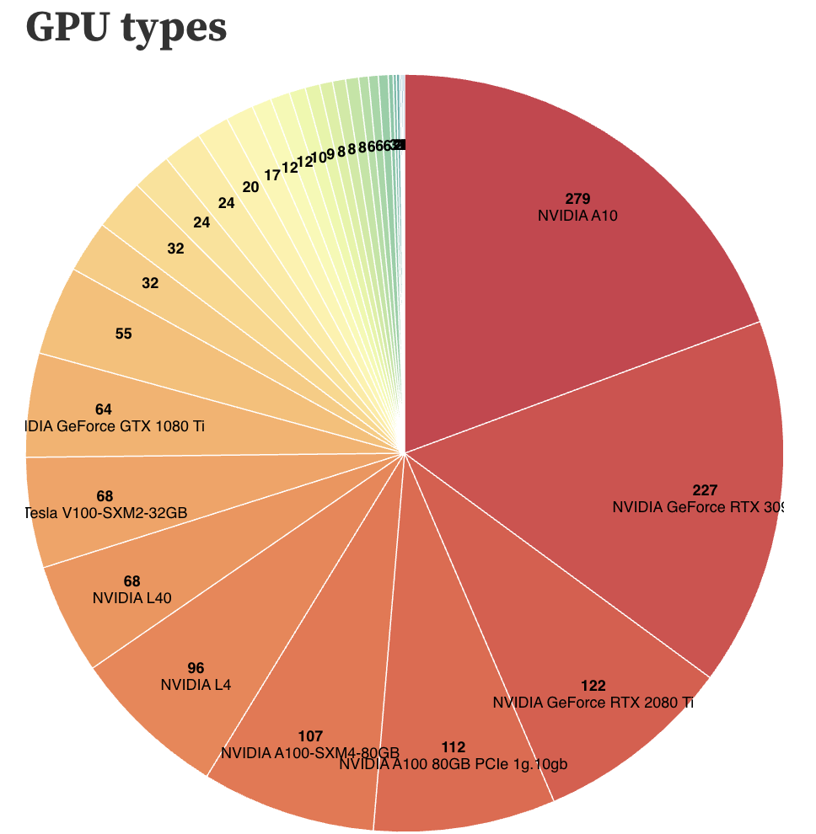
Hardware on Nautilus
The cluster has different types of resources including CPU, GPU, and FPGAs
• CPUs: 16-384 cores/node
• GPUs: max 16 in a node
• FPGAs: max 4 in a node
• Memory (RAM): 16GB – 2.16 TB/node
• Disk Space (local scratch): 77GB – 20TB
/node
https://nrp.ai/viz/resources/

Slide 5
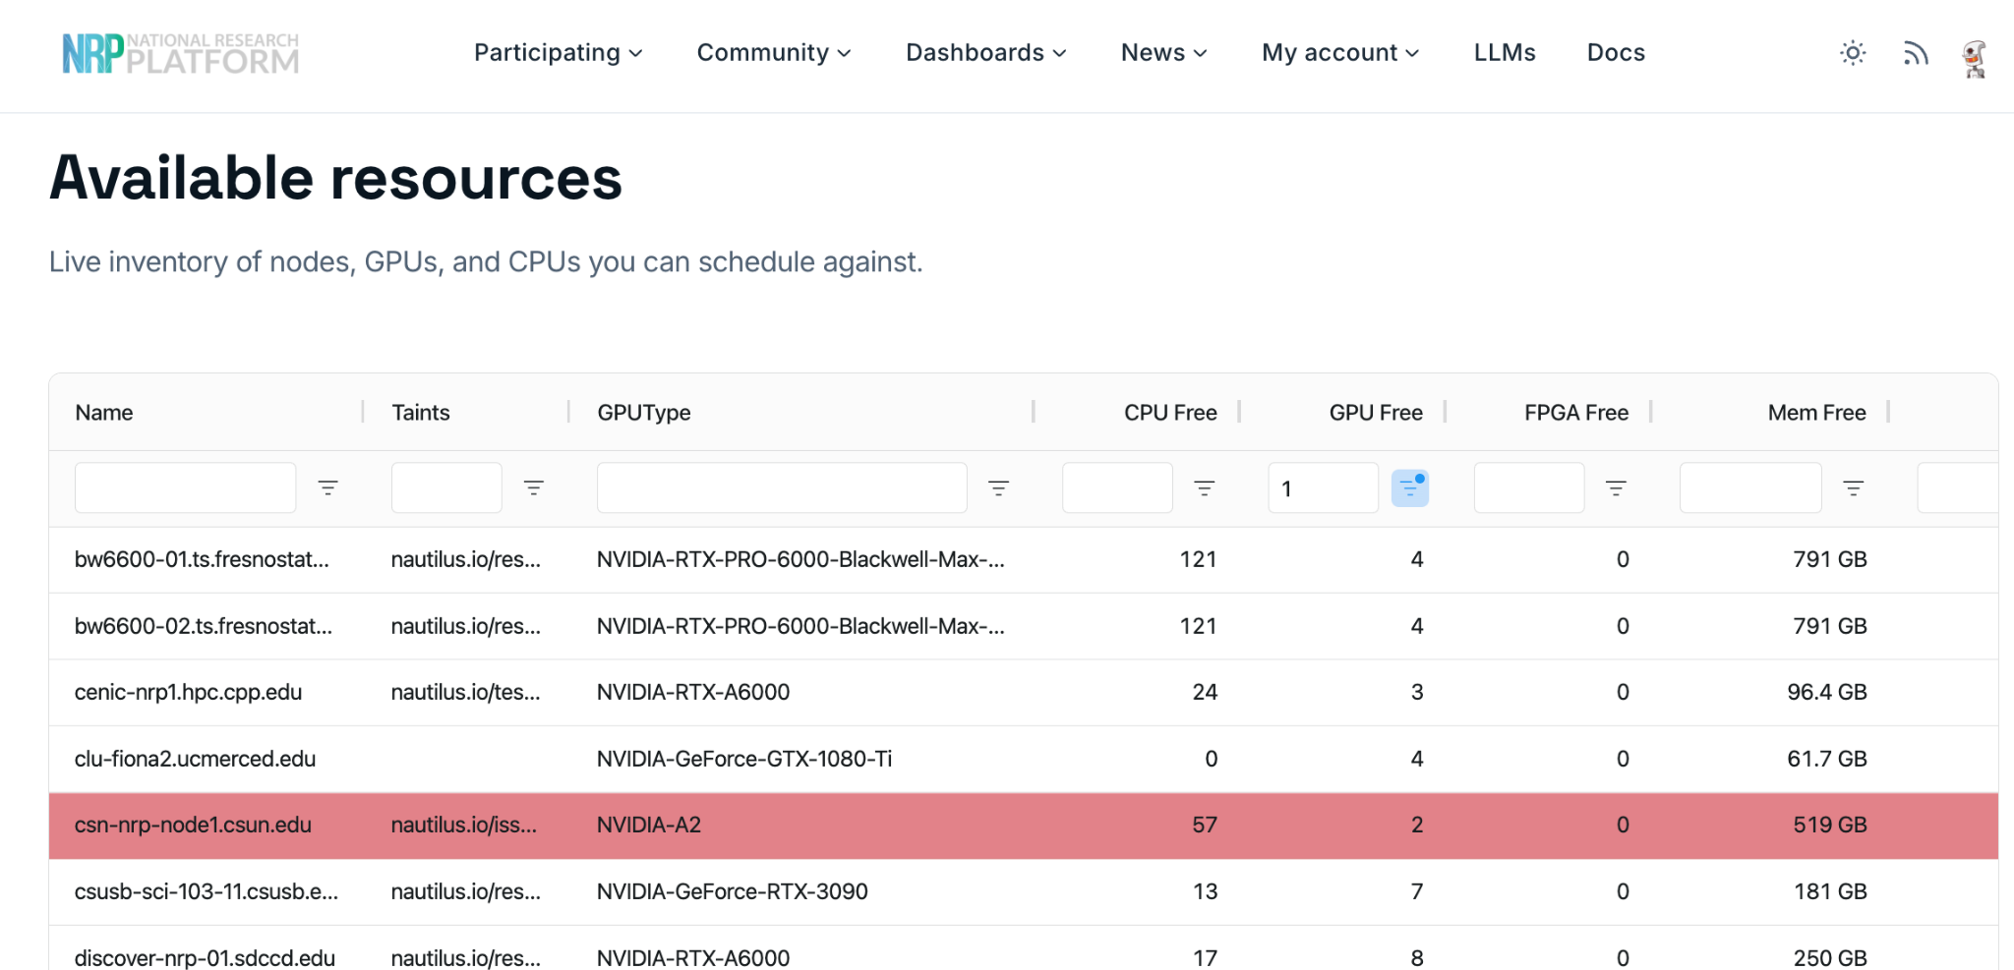
Hardware on Nautilus
https://nrp.ai/viz/resources/

Slide 6
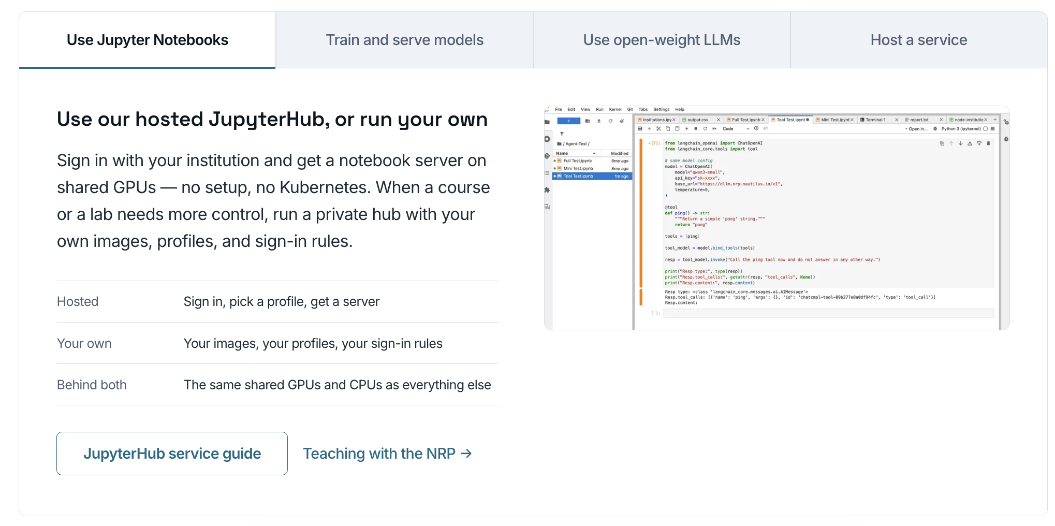
How interact with Nautilius?

Slide 7
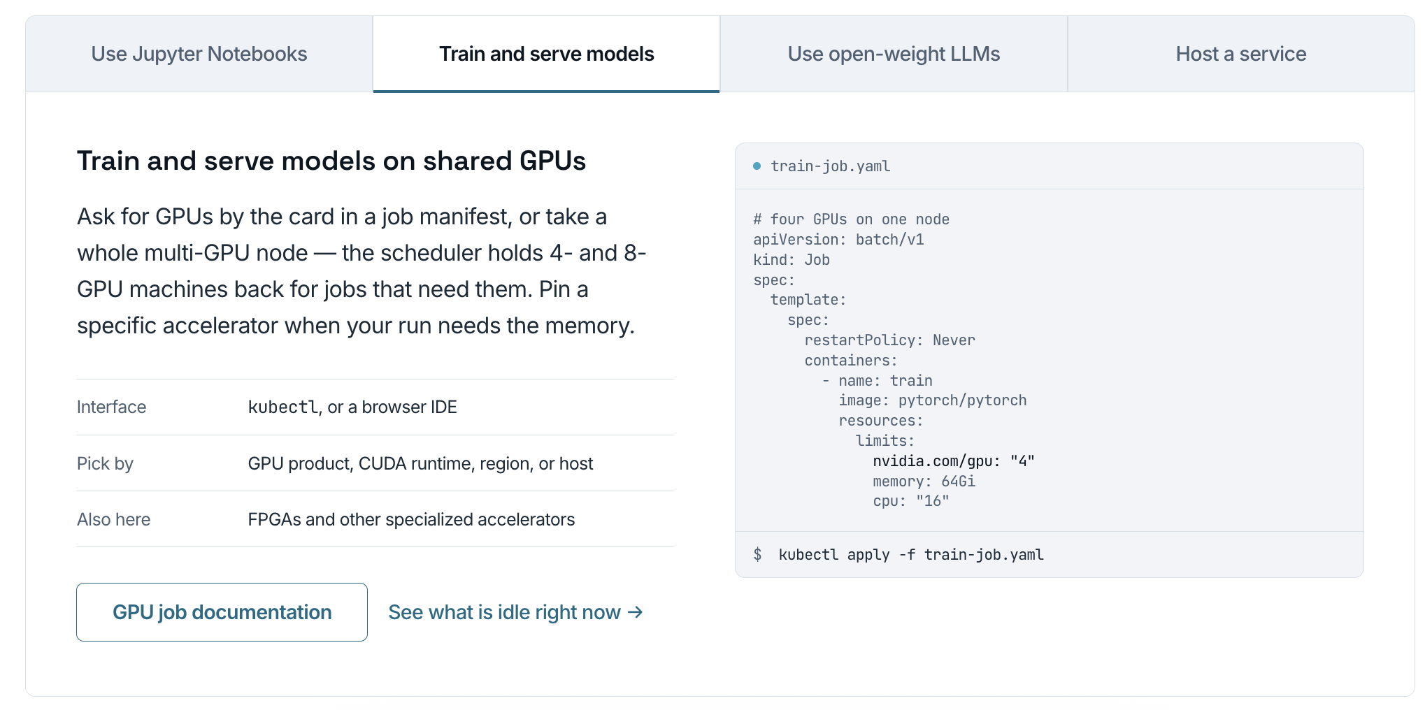
How interact with Nautilius?

Slide 8
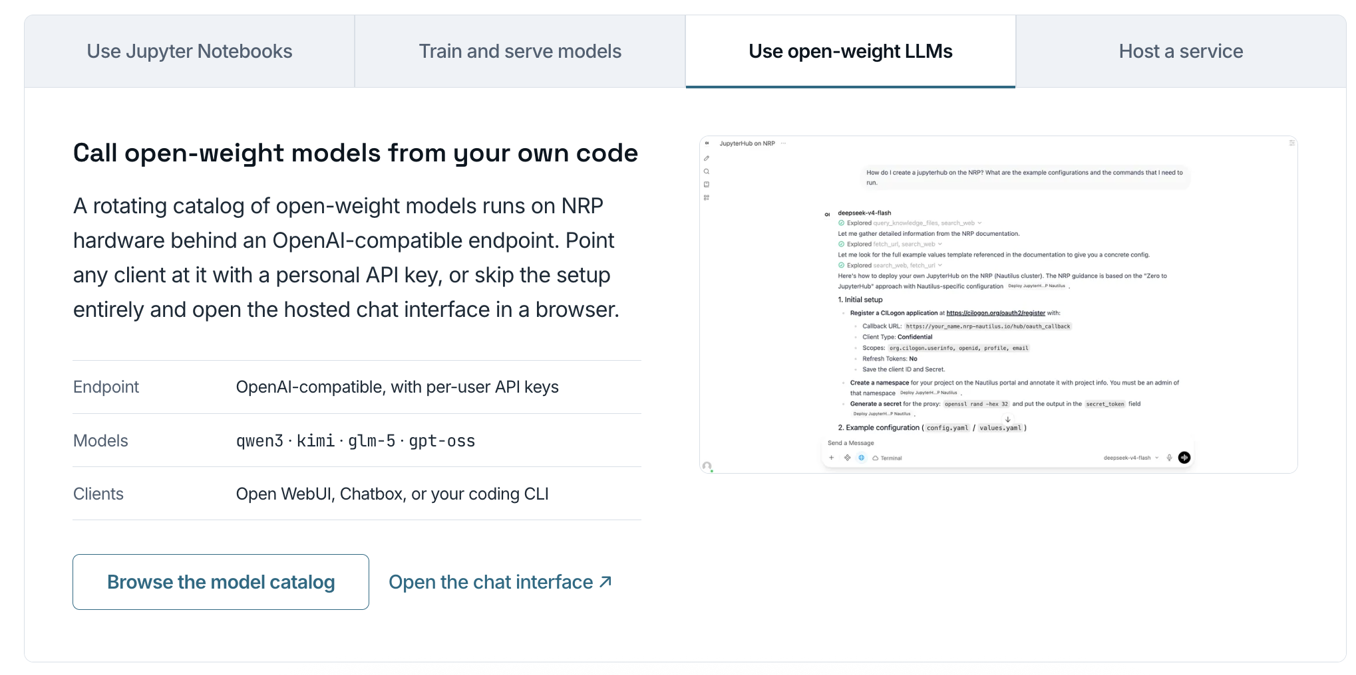
How interact with Nautilius?

Slide 9
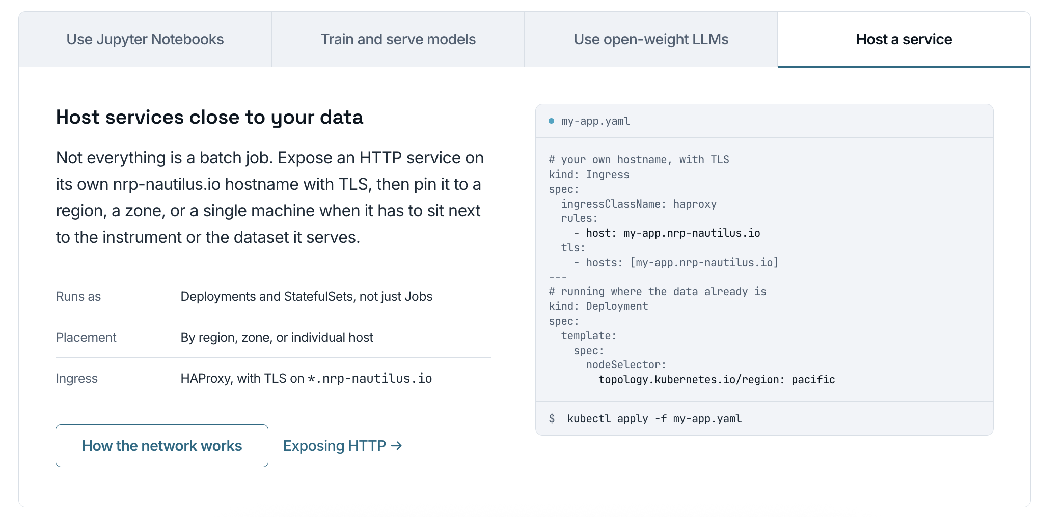
How interact with Nautilius?

Slide 10
How interact with Nautilius?
ML tasks can be run on Nautilus in 3 ways.
Create a pod that stays up for 6 hours. You can request at most 1 GPU. Usually for debugging.
Create a batch-job that execute a list of commands and terminates on finish. No resource limit, but requesting much more than needed or running everrunning command violates policy.
Create a deployment that stays up for 2 weeks. No resource limit, but requesting more than minimal violates policy. Usually not recommended for ML tasks.
Kubectl
kubectl is the official command-line tool for creating / deleting / inspecting above, and more
GUI wrapper of Kubectl
Toolkits like Octant and VSCode Kube plugin provide GUI for kubectl.
Pros: Help understand the cluster better; Remind deletion of resource.

Slide 11
The workflow: four stages
Golden rule: verify your code runs end-to-end locally before using Nautilus. Nautilus is for reproducible, compute-intensive runs — not for finding typos.
A · Local debug
B · Cluster smoke test
C · Full experiment
D · Cleanup
Laptop: imports, paths, data loading,
one forward/backward, checkpoint save+load
1 GPU, small data subset,
a few steps
Scale GPUs / CPU / RAM / data only as far as you can justify
Copy the outputs off,
delete finished and failed jobs
EXIT CRITERION
EXIT CRITERION
EXIT CRITERION
EXIT CRITERION
a small run completes correctly
logs and checkpoints are correct
reproducible and in the tracker
nothing of yours left running

Slide 12
One-time setup
1
Ask for access — Email Prof. Shi (yyshi@ucsd.edu) to add your UCSD email to the lab Group Workspace. This is the only step that waits on a person.
2
Log in to the portal — nrp.ai — sign in with your UCSD identity and confirm you can see the lab workspace.
3
Install the two tools — kubectl talks to the cluster; kubelogin does the UCSD login. kubectl finds the plugin through your PATH.
macOS
Windows: winget install Kubernetes.kubectl and int128.kubelogin
brew install kubectl int128/kubelogin/kubelogin
4
Point kubectl at the lab namespace
kubectl config set-context nautilus --namespace=shi-group-ece-advanced
kubectl get pods # empty list is fine — an error is not
Lab guide §2

Slide 13
Anatomy of a Job YAML
job.yaml
1
kind: Job runs to completion and retries. A Pod would not.
apiVersion: batch/v1
kind: Job
metadata: {name: danielar-effort-smoke}
spec:
backoffLimit: 1
template:
spec:
restartPolicy: Never
containers:
- name: train
image: pytorch/pytorch:2.4.0-cuda12.1
command: ["bash","-lc"]
args: ["python train.py --config exp1.yaml"]
resources:
requests: {cpu: "4", memory: 16Gi,
nvidia.com/gpu: "1"}
limits: {cpu: "4", memory: 16Gi,
nvidia.com/gpu: "1"}
2
name you + the experiment, never “test2”.
3
backoffLimit how many retries before it gives up.
4
image the environment. Pin it — a tag can move under you.
5
command + args the training command lives HERE, in the file.
6
resources what you ask for — see the next slide.
kubectl apply -f job.yaml — that is the whole submission.
Lab guide §3.2

Slide 14
Two blocks decide if it runs
1 · HOW MUCH YOU ASK FOR
2 · WHICH CARD YOU WILL ACCEPT
Keep limits within 1.2× of requests. requests cpu 4 with limits cpu 8 is a 2× ratio — the cluster flags it as a policy violation. Set them equal and you always pass.
You never pick a machine. You name the GPU products that fit, and the scheduler picks one that is free.
affinity:
nodeAffinity:
requiredDuringSchedulingIgnored...:
nodeSelectorTerms:
- matchExpressions:
- key: nvidia.com/gpu.product
operator: In
values: [NVIDIA-A10, NVIDIA-L40]
requests: {cpu: "4", memory: 16Gi, nvidia.com/gpu: "1"}
limits: {cpu: "4", memory: 16Gi, nvidia.com/gpu: "1"}
Start with 1 GPU. Scale only after a smoke test passes.
List several products. One product means queueing for hours.
Ask for what you use. NRP wants GPU utilisation above 40%.

Slide 15
Submit, monitor, stop
WHAT THE STATUS MEANS
the whole loop
kubectl apply -f job.yaml
kubectl get jobs
kubectl get pods
kubectl logs -f <pod-name>
kubectl describe pod <pod-name> # THE
# debug cmd
Pending
the resources you asked for are not schedulable right now
Running
it is on a GPU — kubectl logs -f
OOMKilled
Stop a bad run immediately. A failed Job keeps retrying and keeps holding the GPU until you delete it.
memory limit exceeded: raise memory or shrink the batch
Error / CrashLoop
the command, image, data or environment failed
kubectl delete job <job-name>
Completed
done — copy results off, then delete the Job
Lab guide §4

Slide 16
Command quick reference
Launch
kubectl apply -f job.yaml
List jobs / pods
kubectl get jobs · kubectl get pods
Stream logs
kubectl logs -f <pod-name>
Diagnose scheduling or failure
kubectl describe pod <pod-name>
Copy results out
kubectl cp <pod>:/output ./results
Stop / delete a run
kubectl delete job <job-name>
Refresh a stale login
kubectl oidc-login clean
What GPUs exist
kubectl get nodes -L nvidia.com/gpu.product
Docs nrp.ai/documentation Policies nrp.ai/documentation/userdocs/start/policies
Lab notebook github.com/d2rojas/nautilus-tutorial

