Slide 1
In Search of Reference Points and a Rebuilding Plan For WCNPO Striped Marlin
Jon Brodziak
NOAA Fisheries
Jon.Brodziak@NOAA.GOV
6-Feb-2024

Slide 2
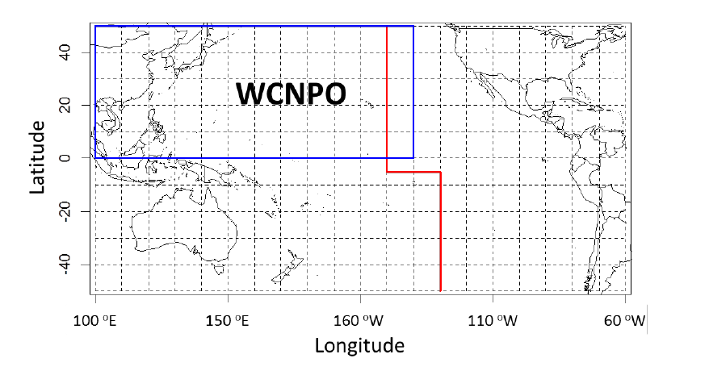
WCNPO Striped Marlin Management Unit for 2022 Benchmark Assessment
Black rectangle is management unit for 2022 assessment, blue rectangle is 2015 management unit, red line is RFMO boundary

Slide 3
2021 Striped Marlin Spawning Biomass

Slide 4
2023 Striped Marlin Spawning Biomass

Slide 5
2021 Striped Marlin Recruitment Time Series

Slide 6
2023 Striped Marlin Recruitment

Slide 7
2023 Striped Marlin Recruitment

Slide 8
2021 Striped Marlin Stock-Recruitment Dynamics

Slide 9
2023 Striped Marlin Stock-Recruitment Dynamics

Slide 13
2021 Striped Marlin Fishing Mortality

Slide 14
2023 Striped Marlin Fishing Mortality

Slide 22
Fishery System Time Series, 1977-2020
Recruitment (rec) and Spawning Stock Biomass (ssb)
Recruits per Spawning Biomass (rssb) and Spawning Potential Ratio (spr)
Population Biomass (popbio) and Catch Biomass (catbio)
Fishing Mortality (fmort) and Fishing Intensity (fspr)
Population Minus Catch Biomass (netbio) and Harvest Rate (hrate)

Slide 23
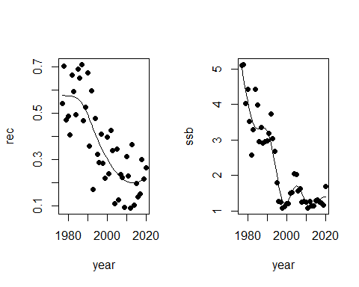

Slide 24
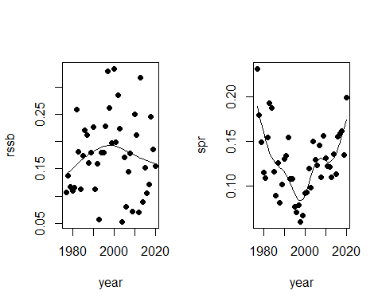

Slide 25
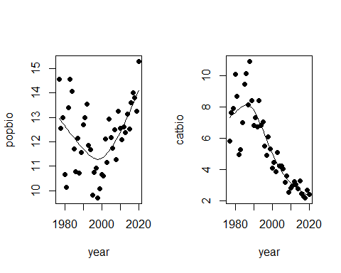

Slide 26
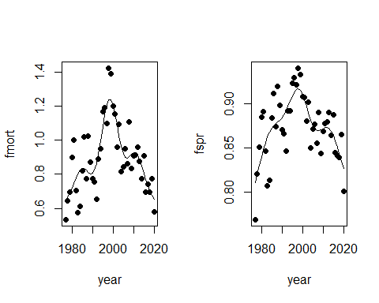

Slide 27
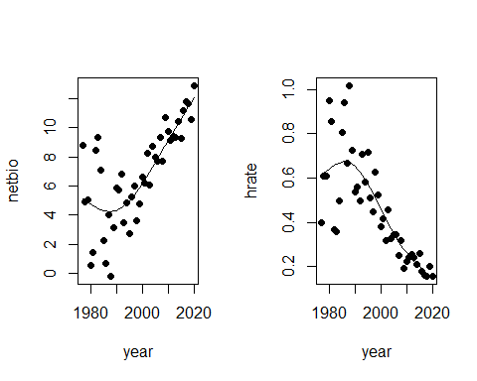

Slide 29



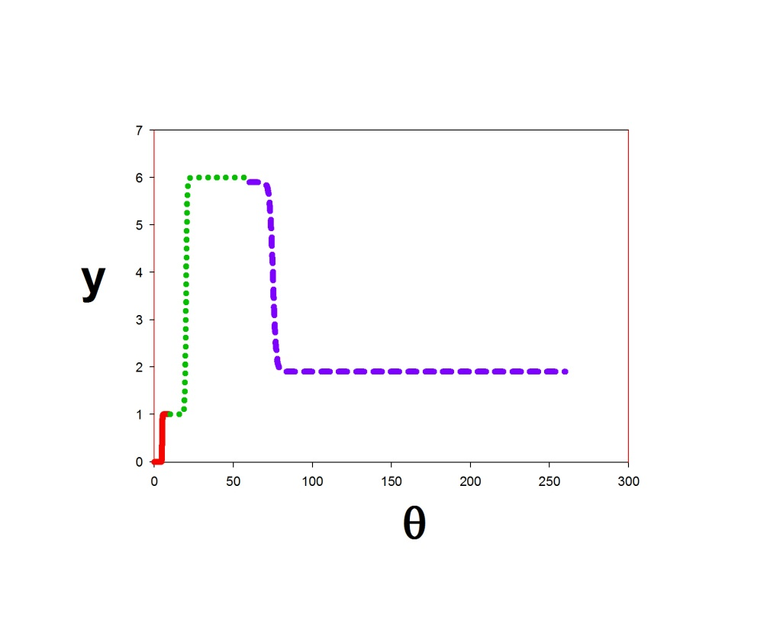

Changepoint Detection Models
Multiple changepoint detection with m changepoints
Changepoint starting and ending positions are
Changepoints are ordered
Changepoint positions are

Slide 30
Changepoint Detection Models
Multiple changepoint detection with m changepoints
Changepoint starting and ending positions are
Changepoints are ordered
Changepoint positions are

Slide 31


Changepoint Detection Models
Single changepoint detection test
Null hypothesis is there is no changepoint (m=0)
Maximum loglikelihood under null hypothesis is
Alternative hypothesis is there is a changepoint (m=1) with maximum loglikelihood under alternative hypothesis for a given

Slide 32
Changepoint Detection Models
Multiple changepoint detection test
Minimize a cost function C() across segments with a penalty function f () for over fitting the number of changepoints
Three minimization algorithms are implemented in the R package changepoint (Killick and Eckley 2013)
BinSeg, or Binary Segmentation (Edwards et al. 1965. Biometrics) – speed is O(n*log(n))
Segment Neighborhoods (Auger et al. 1989. Bull. Math. Biol.) – speed is O(Q*n²)
PELT, or Pruned Exact Linear Time (Killick et al. 2012. JASA) – speed is O(n)

Slide 33
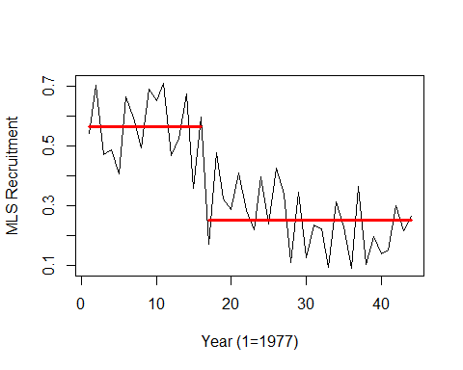

Slide 34
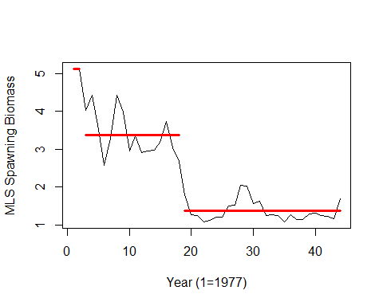

Slide 35
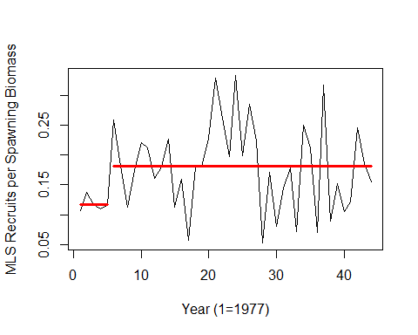

Slide 36
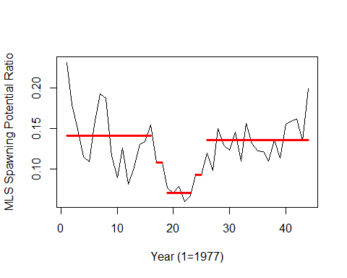

Slide 37
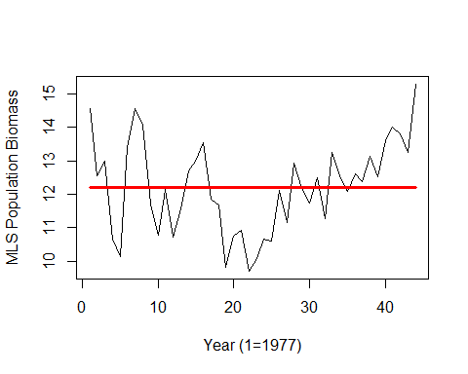

Slide 38
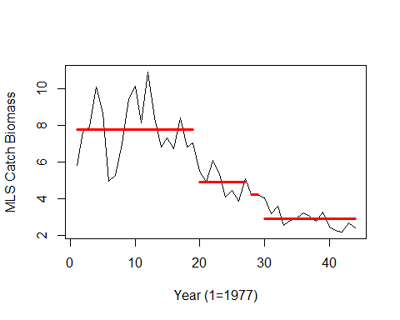

Slide 39
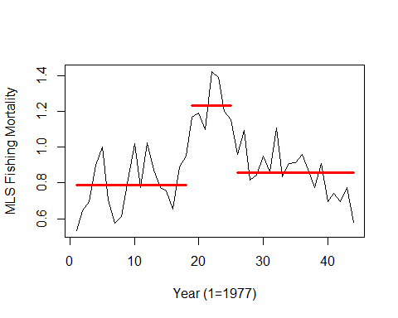

Slide 40
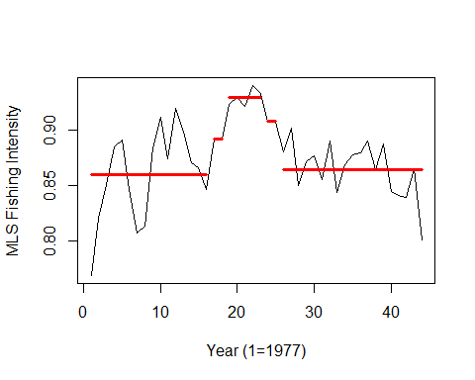

Slide 41
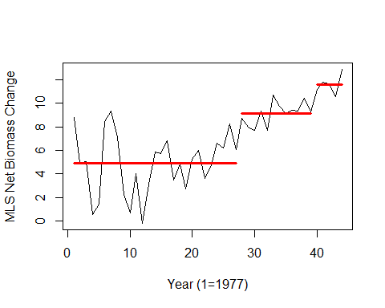

Slide 42
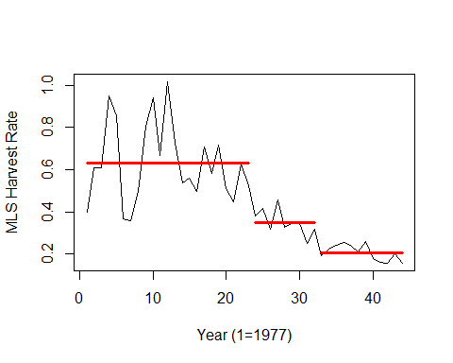

Slide 43
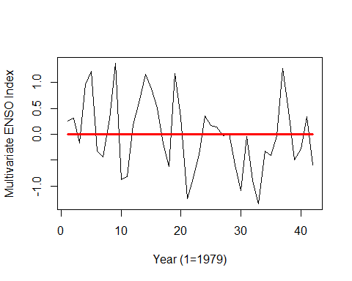

Slide 44
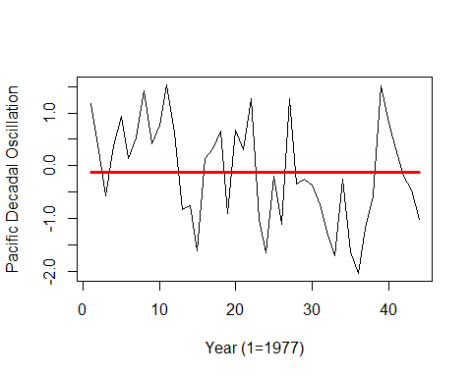

Slide 45
MLS Population and Environmental Time Series Analyses
Empirical Correlation Analyses – Are there obvious associations ?
Autocorrelation Function Analyses – Are time series serially correlated ?
Partial Autocorrelation Function Analyses – Are time series observations correlated after adjustment for dependence on intermediate values ?
Cross-correlation Function Analyses – Are pairs of time series serially correlated ?
Nonstationarity - If ACF decays slowly and PACF has large absolute value at lag-1 the time series is nonstationary and has changing mean or variance or both.

Slide 46
Important Correlations
(Year, Recruitment) with ρ = -0.78
(Year, Spawning Biomass) with ρ = -0.79
(Year, Catch Biomass) with ρ = -0.89
(Year, Net Biomass) with ρ = 0.74
(Year, Harvest Rate) with ρ = -0.83
(ONI, PDO) with ρ = 0.94

Slide 47
Environmental Correlations
(ONI, Spawning Biomass) with ρ = 0.30
(ONI, Population Biomass) with ρ = 0.36
(ONI, Fishing Mortality) with ρ = -0.36
(ONI, SPR) with ρ = 0.27
(MEI, Spawning Biomass) with ρ = 0.38
(MEI, Fishing Mortality) with ρ = -0.32

Slide 48
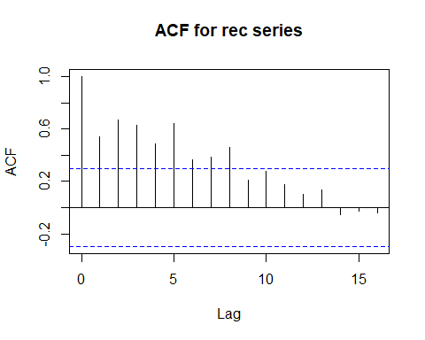

Slide 49
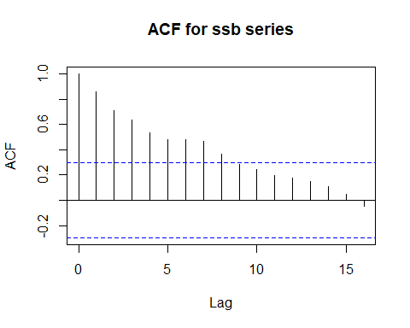

Slide 50
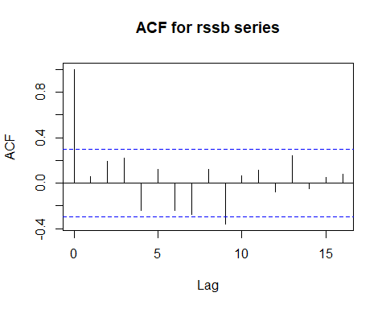

Slide 51
Autocorrelation Function Results
Recruitment: Positive ACF at Lags 1:8 with range 0.36 to 0.67
Spawning Biomass: Positive ACF at Lags 1:8 with range 0.37 to 0.88
Recruits Per Spawner: Negative ACF at Lag 9

Slide 52
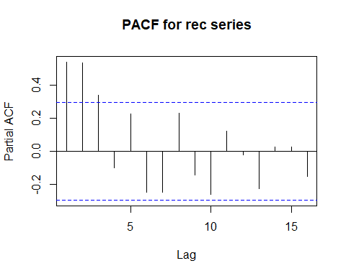

Slide 53
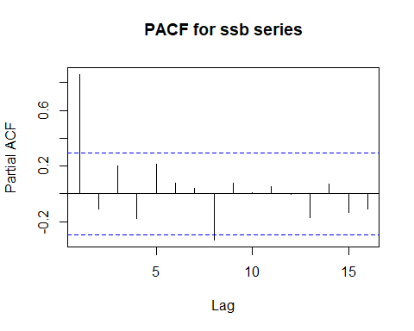

Slide 54
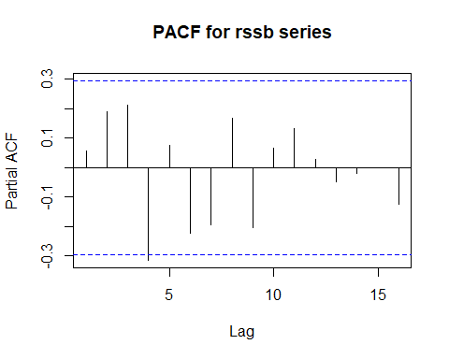

Slide 55
Partial Autocorrelation Function Results
Recruitment: Positive PACF at Lags 1:3 with range 0.34 to 0.54
Spawning Biomass: PACF at Lag 1=0.86, at Lag 8 = -0.33
Recruits Per Spawner: Negative ACF at Lag 4 = -0.31
ONI: Negative PACF at Lag 2 = -0.34
MEI: Negative PACF at Lag 2 = -0.31
PDO: Positive PACF at Lag 1 with α₁ = 0.38

Slide 56
Summarize Time Series Results
Recruitment: Nonstationary with probable AR(1) or MA(1+) processes
Spawning Biomass: Nonstationary with probable AR(1) or MA(1+) processes
Recruits Per Spawner: none
ONI: Nonstationary with probable negative serial correlation at lag 2
MEI: Same as ONI but shorter time series
PDO: Nonstationary with probable AR(1) or MA(1) processes

Slide 57
Summarize Cross Correlation Function Results
Recruitment and Spawning Biomass show positive cross correlations, as expected
Recruitment shows some positive cross correlations with ENSO and PDO
Spawning Biomass shows some positive cross correlations with ENSO and PDO
Recruits Per Spawner lacks strong cross correlations with other series
ENSO has lag (+1) positive correlation with PDO

Slide 58
Some Empirical Results for Setting Time Window for Striped Marlin Under Prevailing Conditions
Recruits Per Spawner (or Survival Ratio) Series for Striped Marlin appears to be approximately stationary over the assessment time horizon
Recruitment and Spawning Biomass Time Series for Striped Marlin appear nonstationary with a substantial decreasing trend over (1977, 2020).
Mean generation time of WCNPO life history is 5 years.
Some short-term environmental forcing was noted for Recruitment & SSB

Slide 59
Some Results for Comparing Projections AGEPRO & SS3
Use constant 20-year average recruitment (LR) or stock-recruitment curve (SR)
Use 100 bootstrapped initial population numbers at age
Use 25-fleets in quarter time step (SS3) or 9-fleets in annual time step (AGEPRO)
Use 2020 fishery data to set selectivities, spawning weights, catch weights at age
4 Scenarios: LR & 2300 catch mt, SR & 2300 mt, LR & F=FMSY, SR & FMSY

Slide 60
Example 4: Fishery selectivity mirroring by fleet for the 2023 WCNPO MLS assessment
Objects are: Fleets (F(.)) and CPUE indices (S(.)) with representative size composition data inside black circles and with flat-topped selectivity in size shaded green and time-varying selectivity in size shaded in orange.
Hyperedges are: Sets of fleets or indices mirrored to one selectivity in yellow shaded figures
Japanese DWLL
Fleet in Area 1 in Quarter 1
Japanese DWLL
Fleet in Area 3 in Quarter 1
F5
Japanese DWLL
Fleet in Area 2 in Quarter 1
Hawaii
Longline Fleet
F1
F9
F4
F14
F23
F6
F16
F22
F2
F20
F18
F8
F25
F24
F10
F17
F12
S2
F3
F11
F19
S1
F15
S3
S6
F13
F7
S5
S4
F21

Slide 61
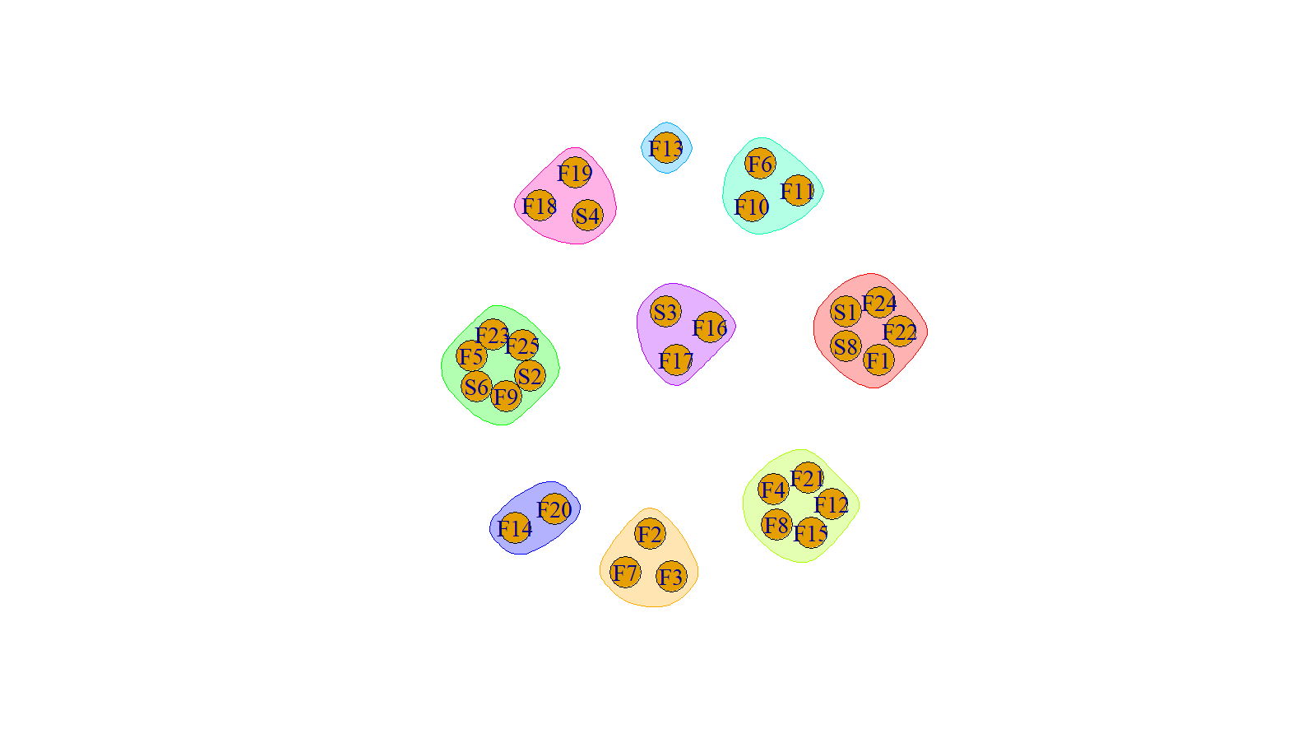
Example 4 continued: Fleets as areas structure used for the 2023 WCNPO MLS assessment
Japanese
Driftnet Fleet
In Quarters 1 & 4
Taiwanese Distant
Water Longline Fleet
Japanese DWLL
Fleet in Area 1 in Quarter 4
Hypergraph visualization
Of the structural patterns
Of fishery selectivities
For 25 fishing fleets
And 6 CPUE indices
With 9 hyperedges
Used in 2023
Japanese DWLL
Fleet in Area 1 in Quarter 1
Japanese DWLL
Fleet in Area 1 in Quarter 3
Hawaii
Longline Fleet
Japanese DWLL
Fleet in Area 3 in Quarter 1
Japanese
Driftnet Fleet
In Quarters 2 & 3
Japanese DWLL
Fleet in Area 2 in Quarter 1

Slide 68
2023 Striped Marlin Rebuilding Analyses

