Slide 1
SWO_SAR_2023
Michelle

Slide 2
Quarto
Quarto enables you to weave together content and executable code into a finished presentation. To learn more about Quarto presentations see https://quarto.org/docs/presentations/.

Slide 3
Bullets
When you click the Render button a document will be generated that includes:
Content authored with markdown
Output from executable code

Slide 4
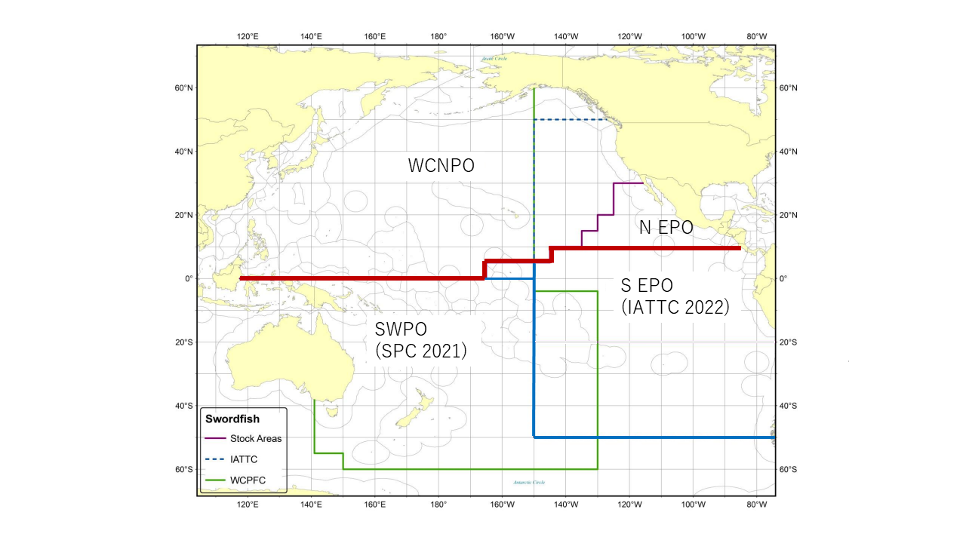
Stock Structure
Figure 1: Western and Central North Pacific Ocean and North Eastern Pacific Ocean swordfish stock boundaries for the 2023 North Pacific swordfish assessment. Spatial structure is treated implicitly using fleets as areas.

Slide 5
Data Available

Slide 6
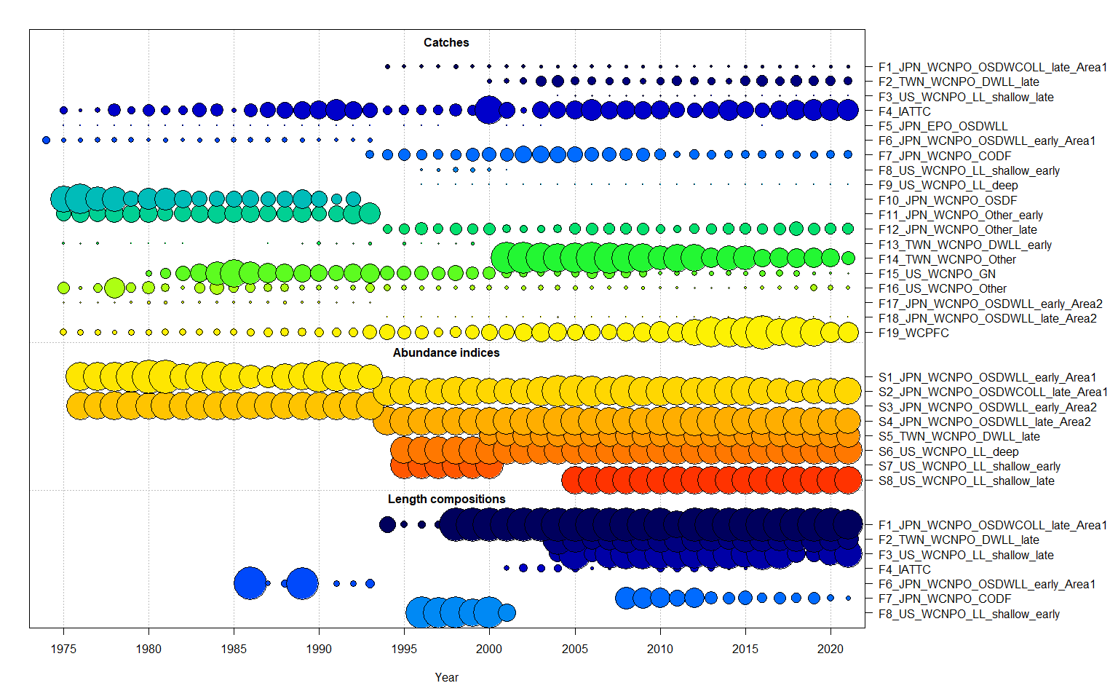
Data available
Figure 2: Catch, CPUE index, and size composition data included in the 2023 NP swordfish stock assessment. The size of the bubble indicates the relative number of observations available.

Slide 7
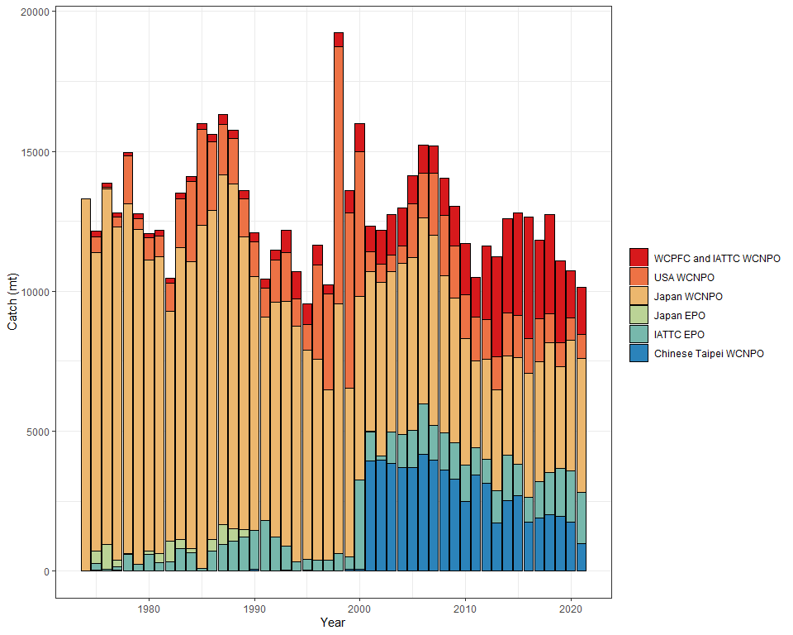
Catch
Figure 3: Total annual catch of the North Pacific swordfish by all fisheries harvesting the stock during 1975-2021. See Table 1 for the reference code for each fishery.

Slide 8
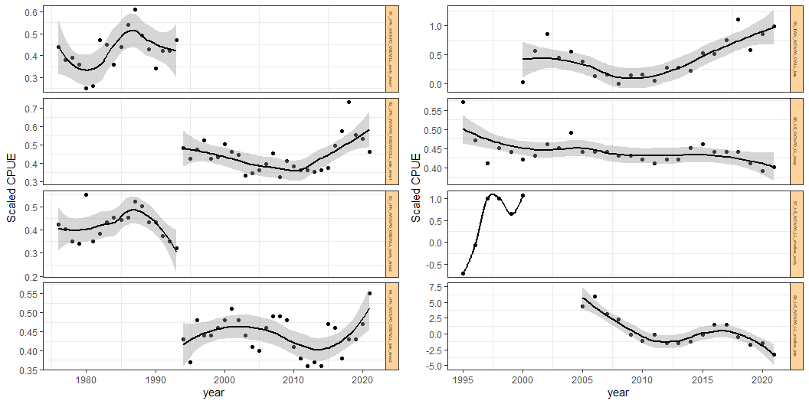
CPUE Indices
Figure 4: Plot of CPUE index by fleet with a simple loess smoother fit to each time series. This provides information on the general trend of the indices considered for inclusion in the model and identifies potential conflict between indices.

Slide 9
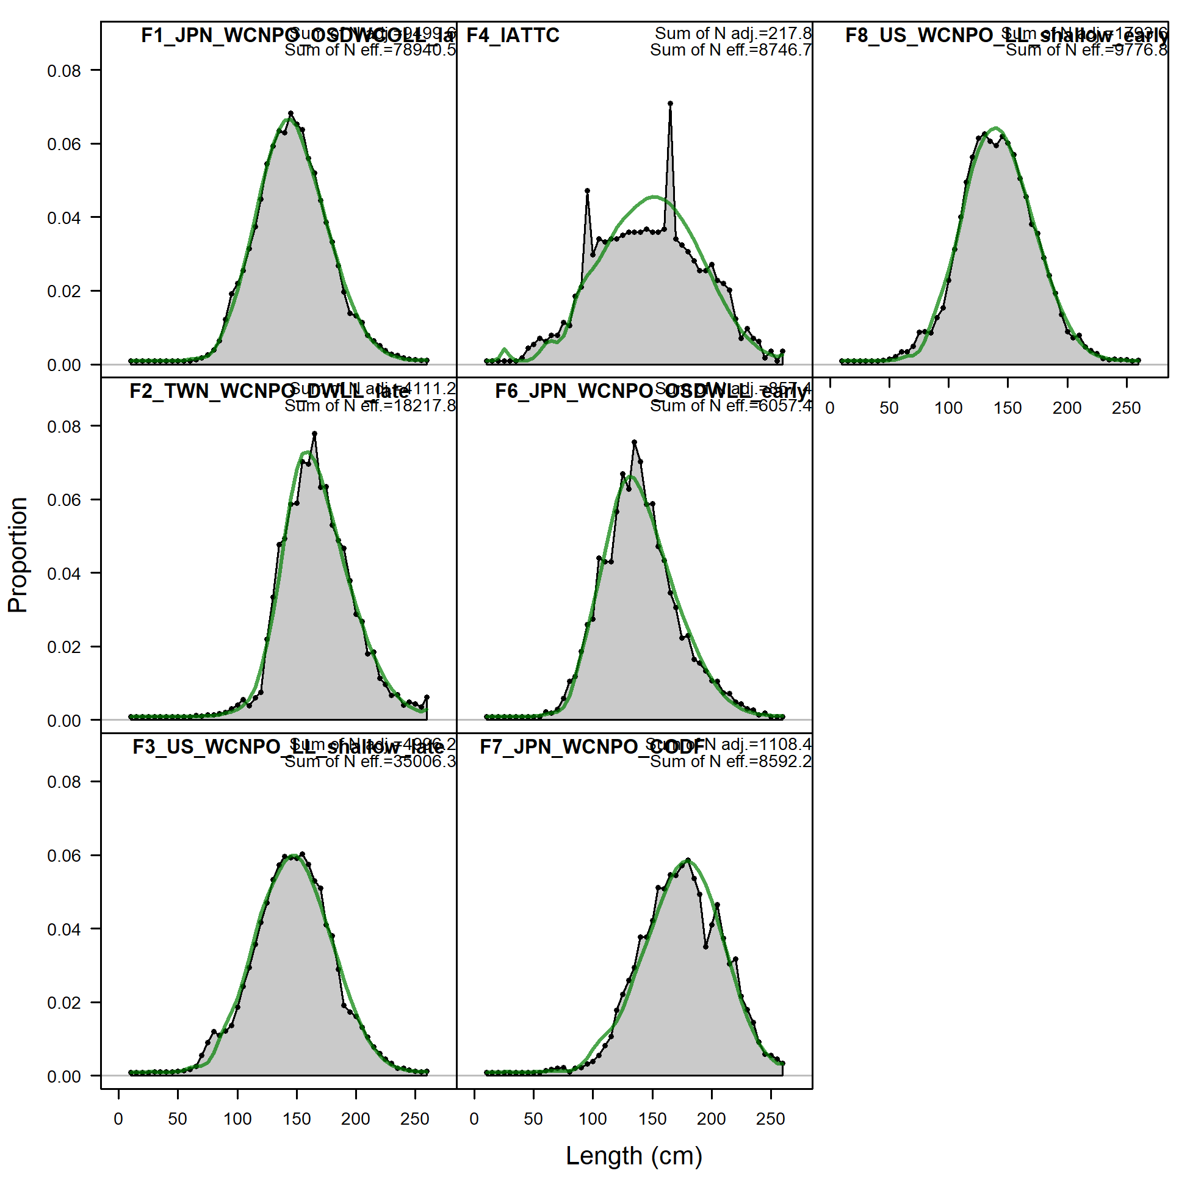
Length Data
Figure 5: Aggregated Size comp data (grey) and model fit (green)

Slide 10
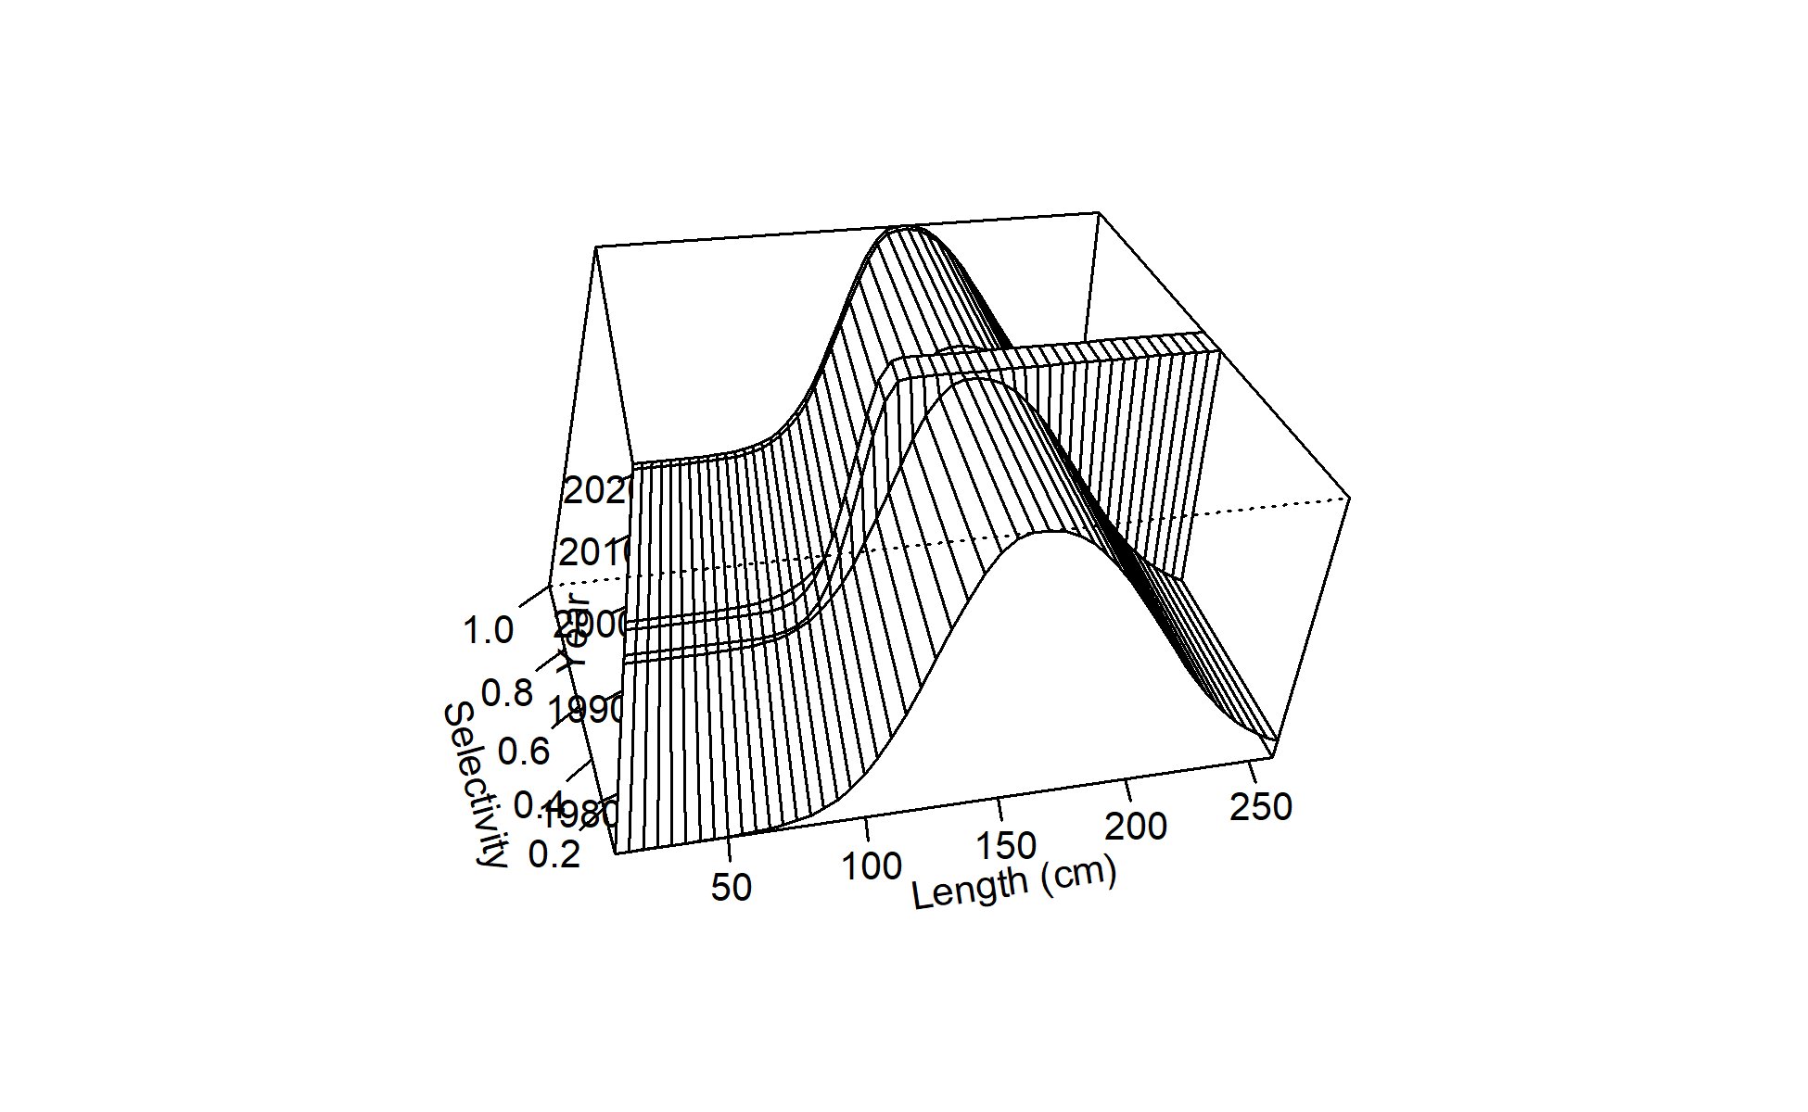
Selectivity
Figure 6: Time-varying selelctivity estimated for F01 Japanese LL Area 1 Late.

Slide 11
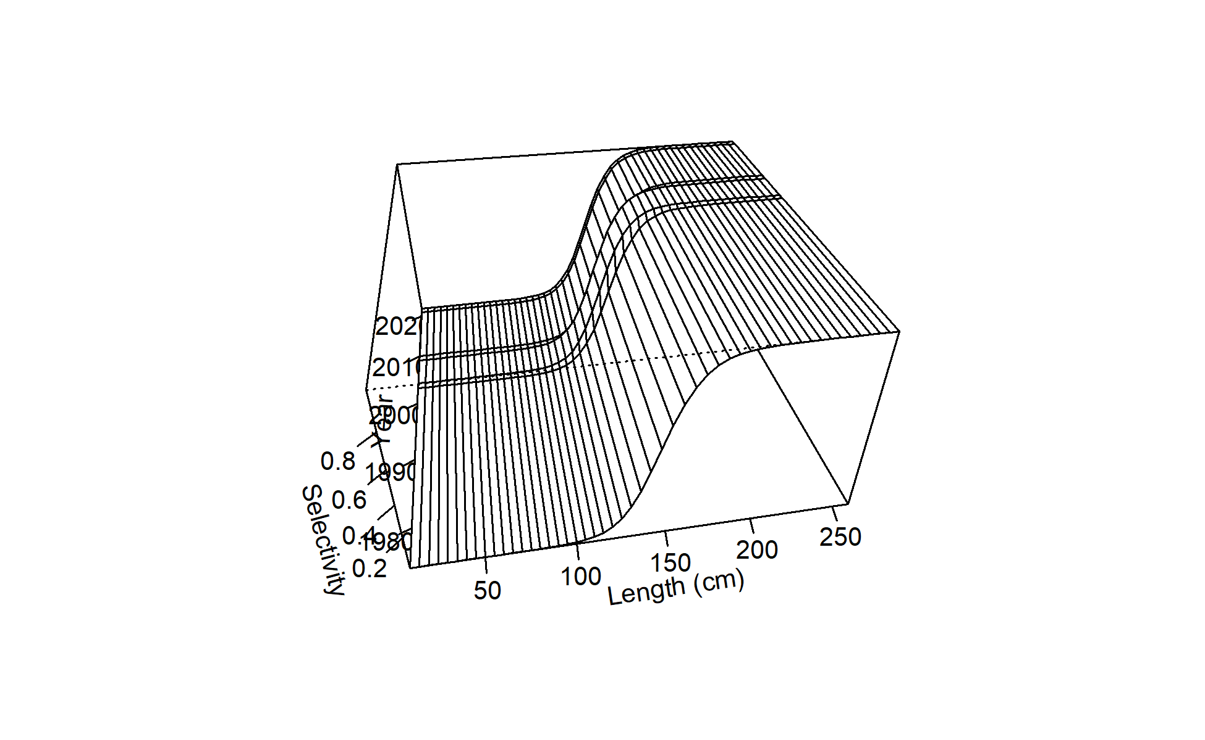
Figure 7: Time-varying selectivity estimated for F02 Chinese Taipei LL late.

Slide 12
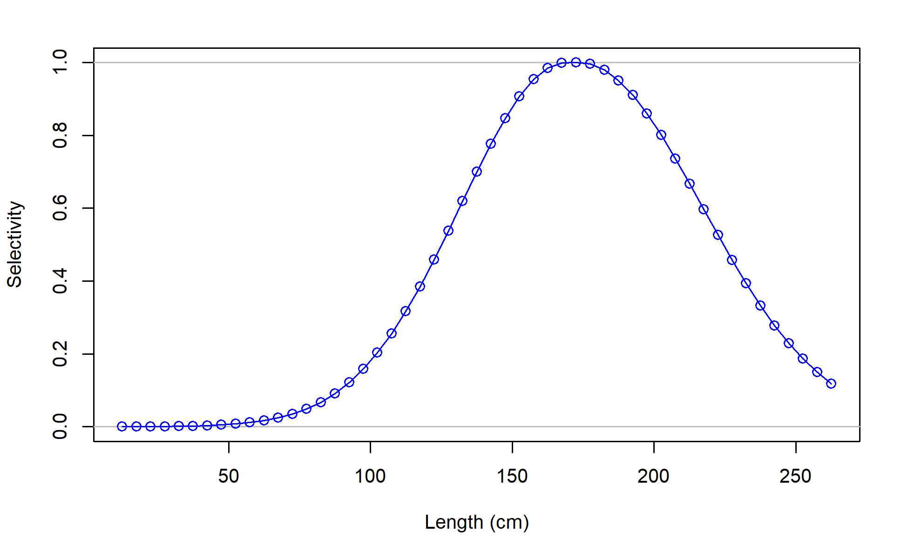
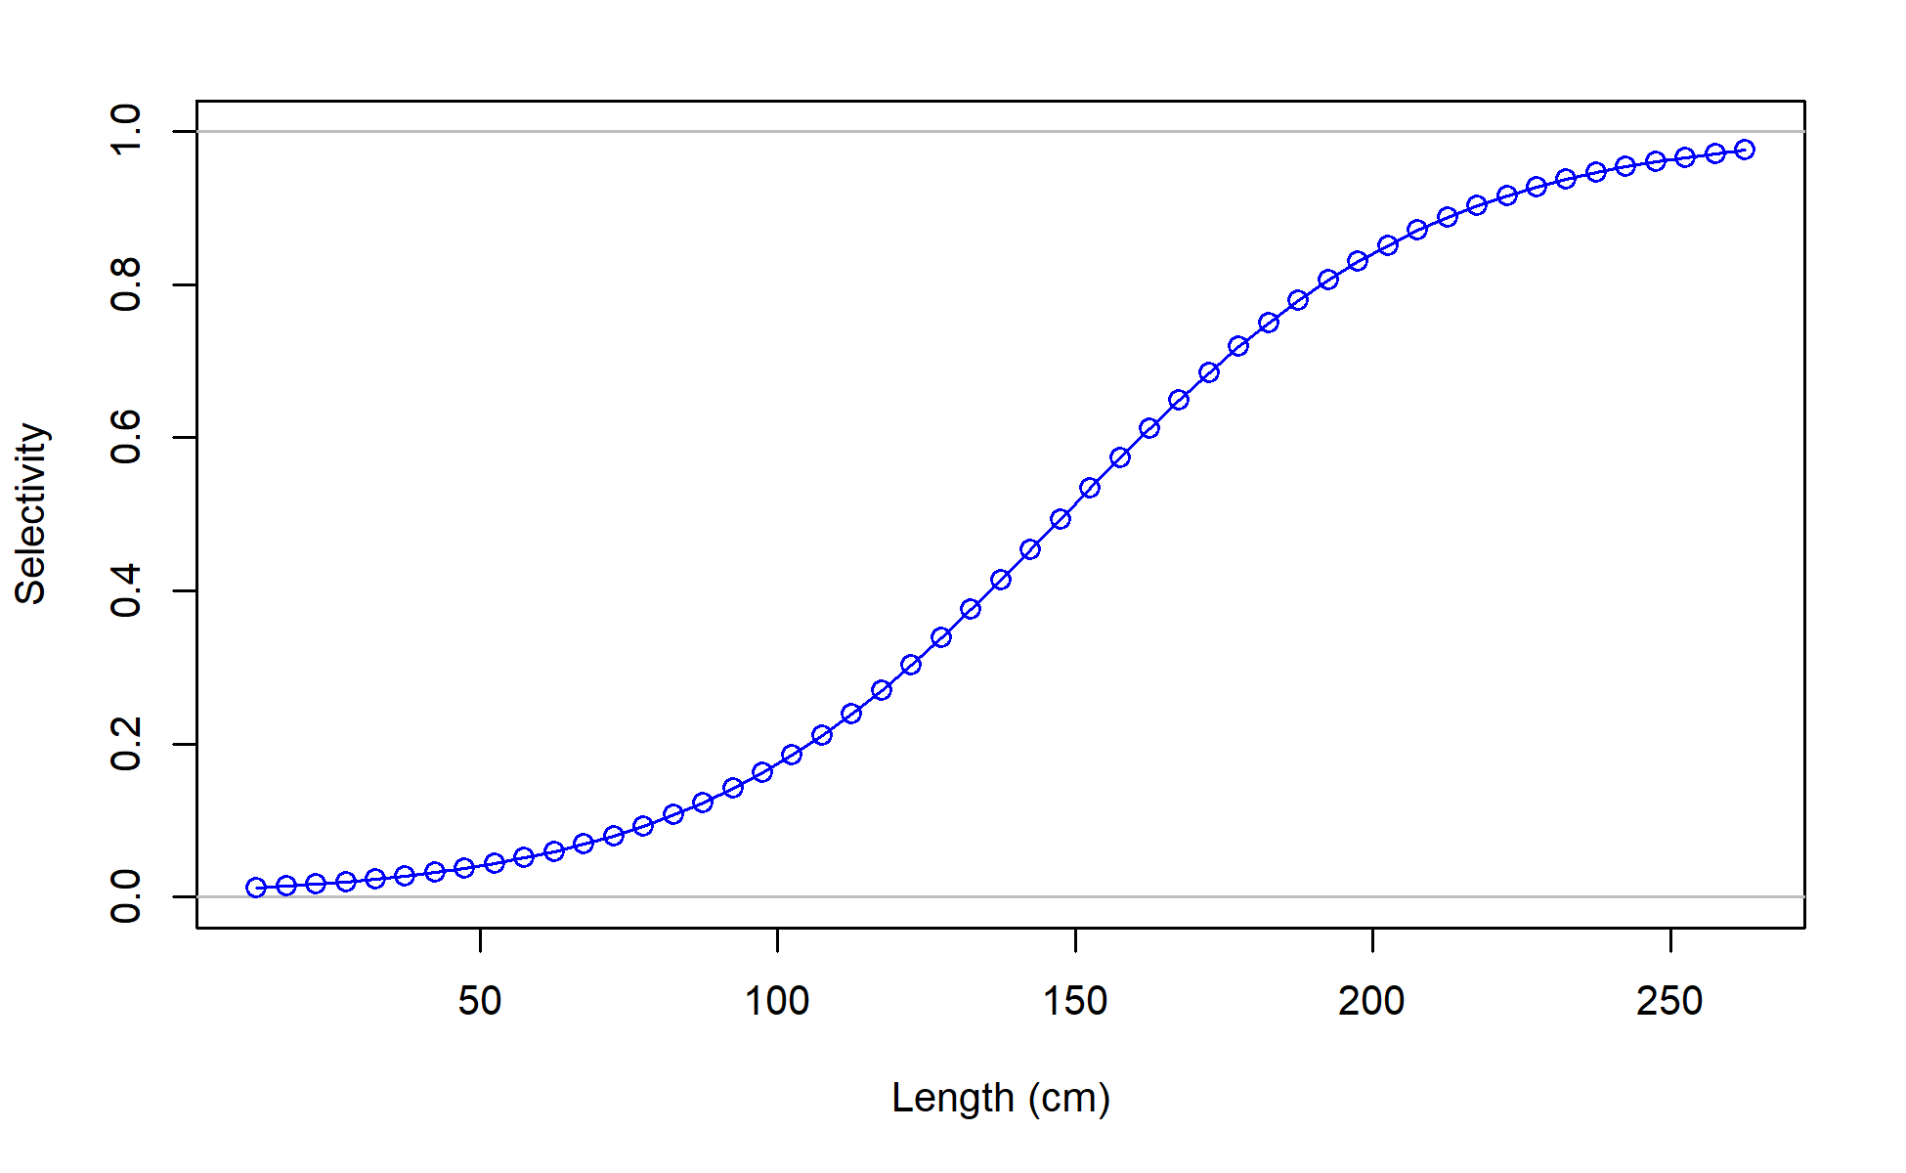
Selectivity
F03_US_WCNPO_LL_shallow_late
F04_IATTC

Slide 13
Model Diagnostics

Slide 14
Jitter Plot

Slide 15
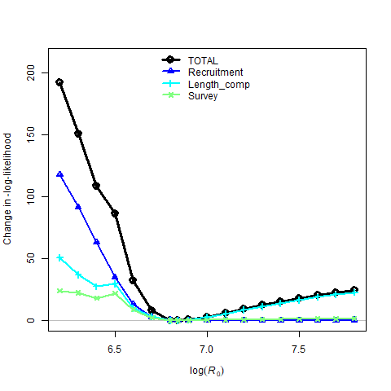
Overall likelihood
Figure 9: Likelihood profile over R0 for the base-case model: total likelihood (black circles), recruitment (blue triangles), length composition data (light blue crosses), and survey/CPUE indices (yellow x).

Slide 16
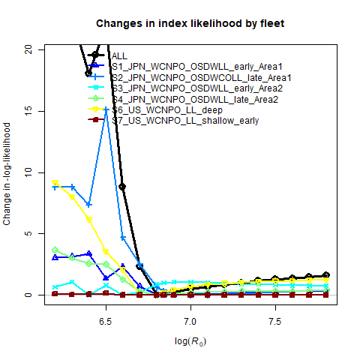
CPUE Diagnostics
Figure 10: Likelihood profile over R0 by CPUE index for the base-case model.

Slide 17
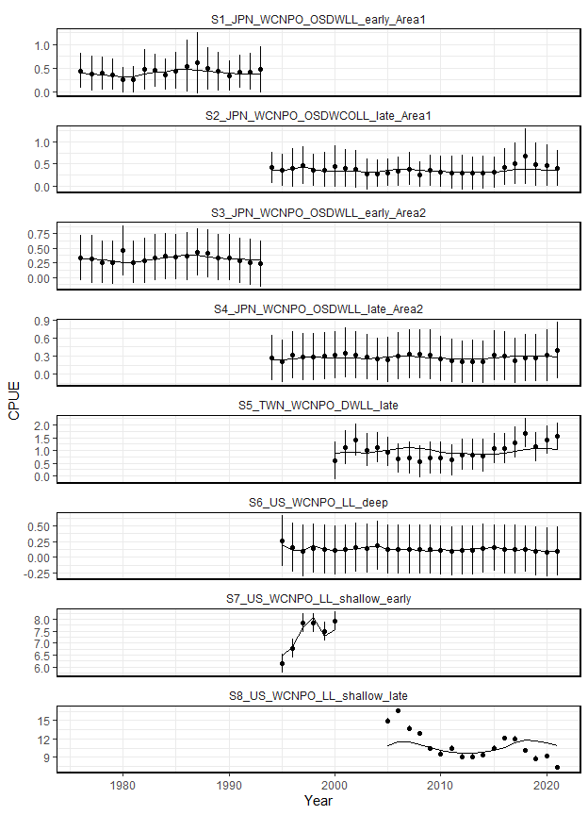
CPUE Diagnostics
Figure 11: Model fits to the standardized catch-per-unit-effort (CPUE) data sets from different fisheries for the base case scenario. The line is the model predicted value and the points are observed (data) values. The vertical lines represent the estimated confidence intervals (± 1.96 standard deviations) around the CPUE values. S5 and S8 were not included in the total likelihood.

Slide 18
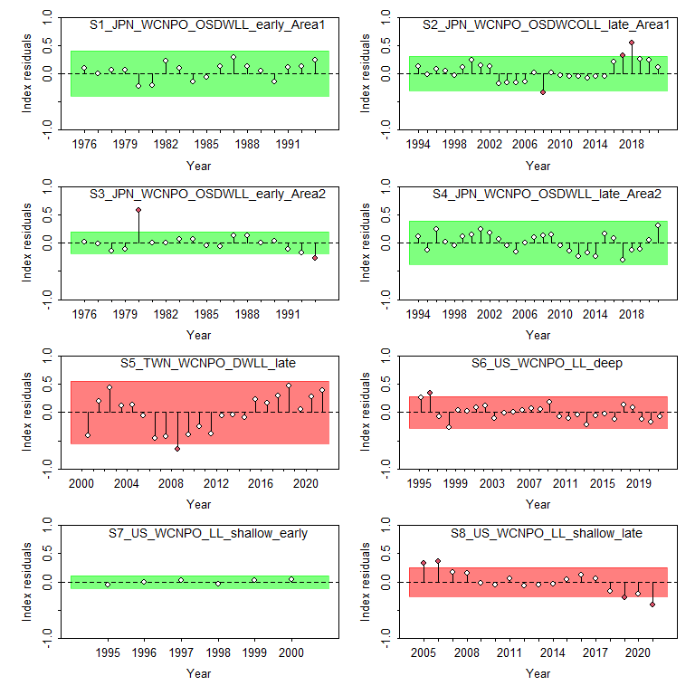
CPUE Runs Test
Figure 12: Results from a runs test for each CPUE index. Red indicates the index failed the test (residuals are not random), green indicates the index passed the test.

Slide 19
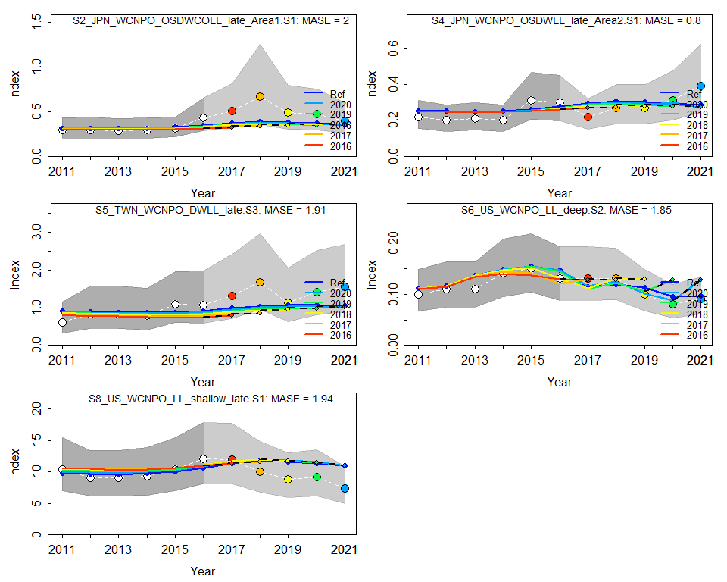
CPUE Hindcast cross-validation
Figure 13: Hind casting cross-validation (HCxval) results for Japanese longline late area 1 (top right), Japanese LL late area 2 (top left), Chinese Taipei deep water longline late (center right), US Hawaii deep-set longline (center left) CPUE, and US Hawaii deep-set longline (bottom left) fits, showing observed (large points with dashed line), fitted (solid lines), and one-year-ahead forecast values (small terminal points) in the old growth model. The observations used for cross-validation are highlighted as color-coded solid circles with associated 95% confidence intervals (light-grey shading). The model reference year refers to the endpoint of each one-year-ahead forecast and the corresponding observation. The mean absolute scaled error (MASE) score associated with each CPUE time series is denoted in each panel.

Slide 20
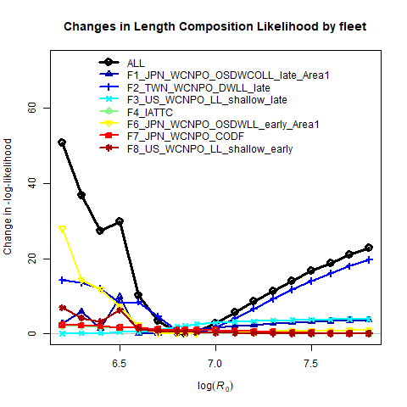
Size likelihood
Figure 14: Likelihood profile over R0 for each length composition time series for the base-case model.

Slide 21
Length fits
Figure 15: Fits to the annual mean length length composition data. The blue line indicates the estimated mean length, open dots indicate input mean length with black bars indicating the distribution of the length data with the added variance.

Slide 22
Size Comp Residuals
Figure 16: Quarterly residual plots the length composition data by fleet. Open circles indicate negative residuals and closed circles indicate positive residuals.

Slide 23
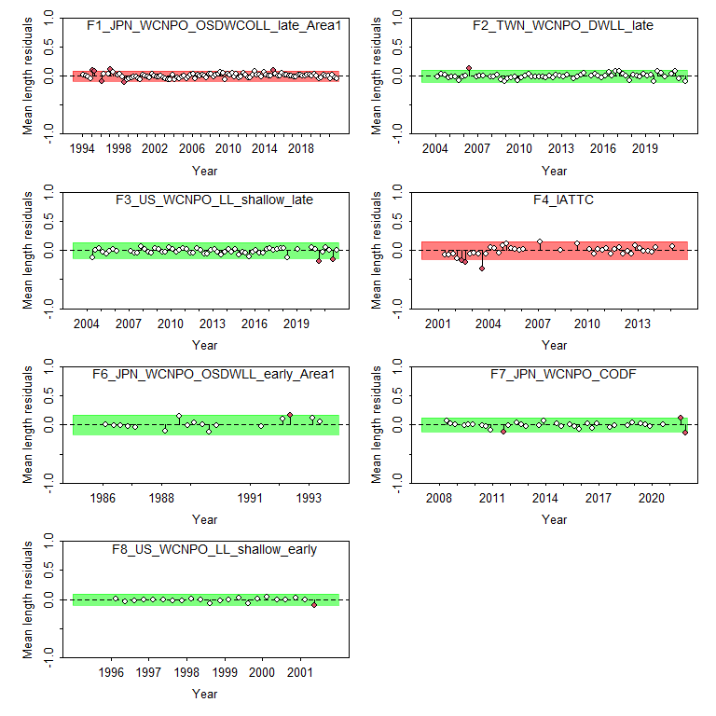
Length Runs Test
Figure 17: Results from a runs test for each size composition time series. Red indicates the time series failed the test (residuals are not random), green indicates the time series passed the test.

Slide 24
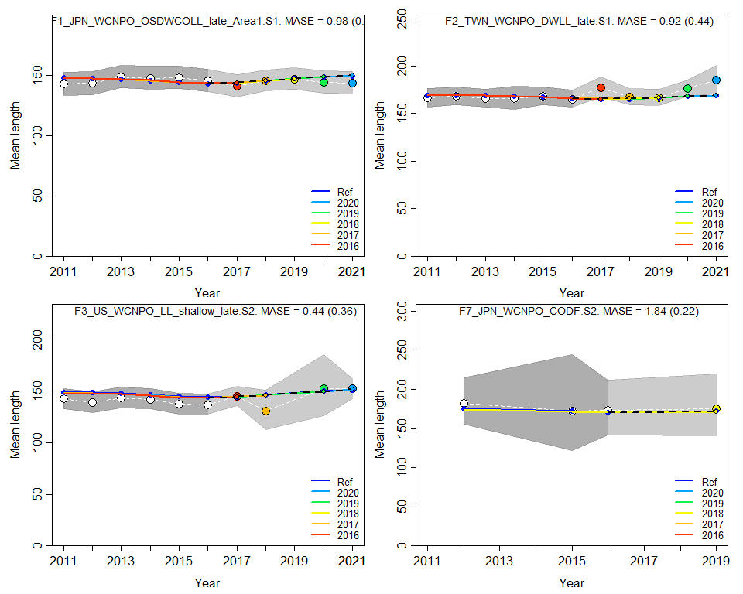
Length Hindcast cross-validation
Warning: combining data from multiple seasons Warning: combining data from multiple seasons Warning: combining data from multiple seasons Warning: combining data from multiple seasons Warning: combining data from multiple seasons Warning: combining data from multiple seasons
Figure 18: Hind casting cross-validation (HCxval) results for size composition mean lengths, showing observed (large points with dashed line), fitted (solid lines), and one-year-ahead forecast values (small terminal points) in the old growth model. The observations used for cross-validation are highlighted as color-coded solid circles with associated 95% confidence intervals (light-grey shading). The model reference year refers to the endpoint of each one-year-ahead forecast and the corresponding observation. The mean absolute scaled error (MASE) score associated with each size composition time series is denoted in each panel.

Slide 25
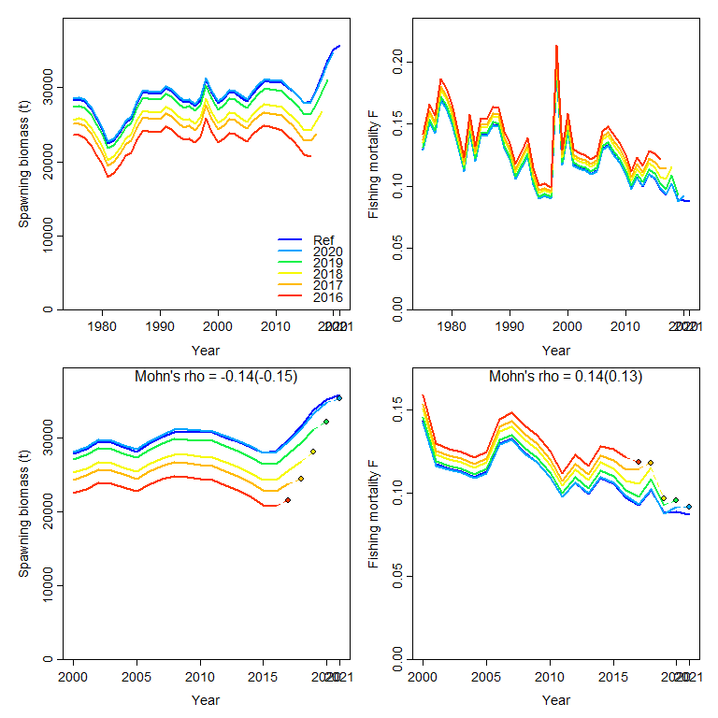
Retrospecitve Analysis
Figure 19: Retrospective analysis of spawning biomass (left) and fishing mortality (right) for the whole time series (top) and the last 20 years (bottom) consisting of 5 reruns of the base case model each fitted with one more year of data removed from the base case model (blue line).

Slide 26
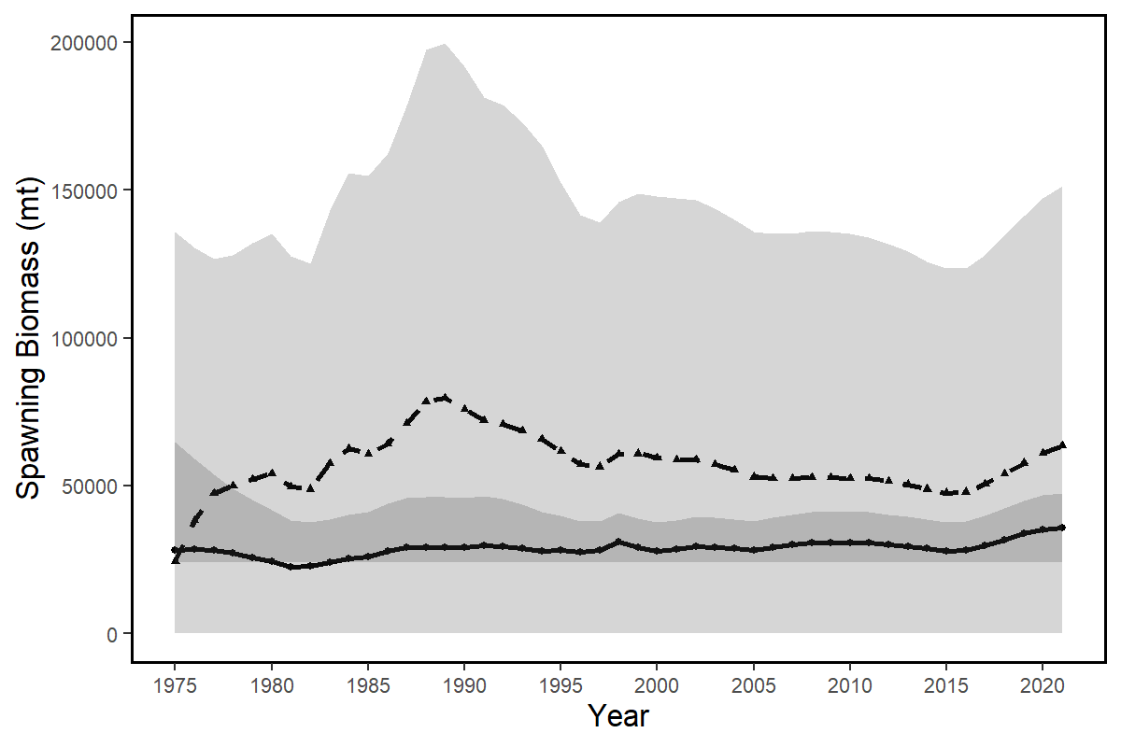
Age Structured Production Model
Figure 20: Spawning stock biomass trend for the ASPM model run (dashed line, triangles) and the base-case model (solid line, circles). Grey shading indicates 95% confidence intervals for each model.

Slide 27
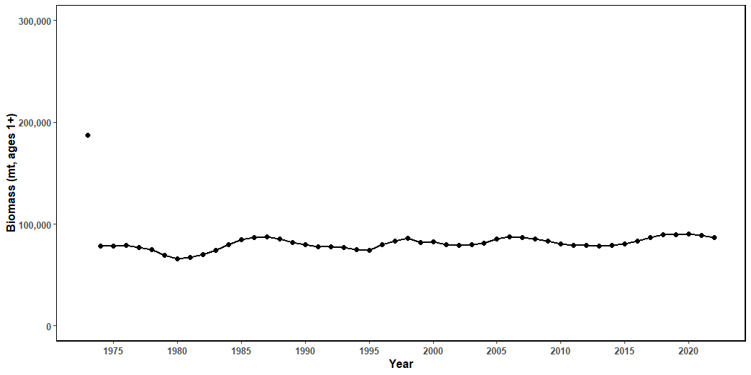
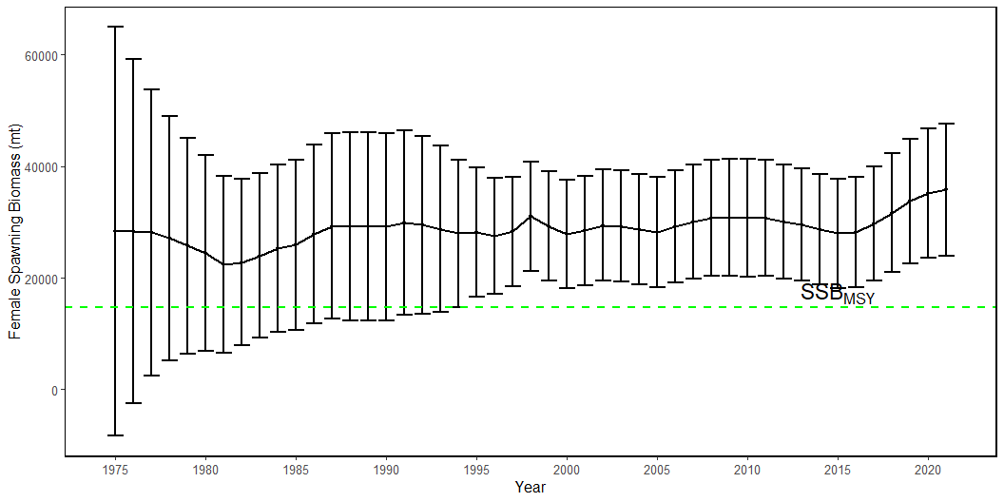
Results
(a)
(b)

Slide 28
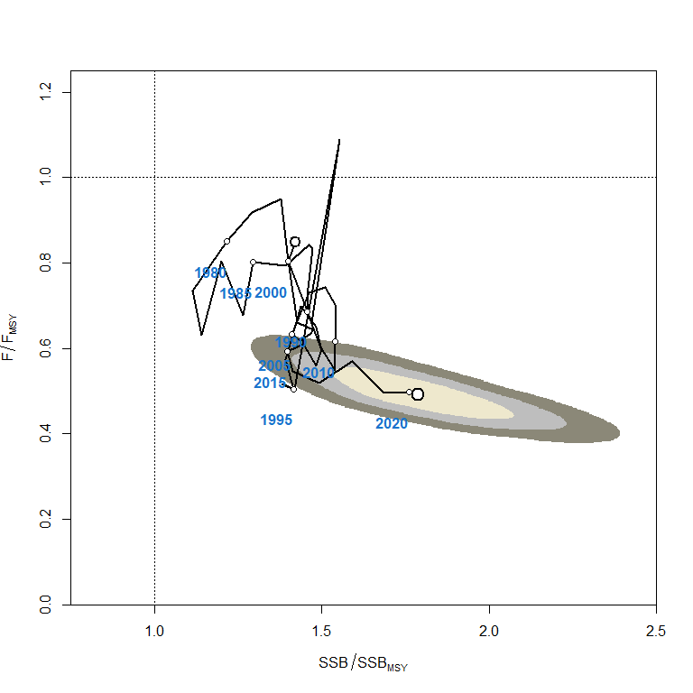
Table results
Quadrant Percent 1 Red 0 2 Orange 0 3 Yellow 0 4 Green 100
Figure 22: Kobe plot of the time series of estimates of relative fishing mortality (average of age 1-10) and relative spawning stock biomass of North Pacific swordish (Xiphias gladius) during 1977-2020. The first white dot indicates 1975, subsequent dots are in 5-year increments. Shading indicates 50%, 80%, and 95% confidence intervals, respectively.

Slide 29
Sensitivty Runs
a b c d e f g h i j k l m n

Slide 30
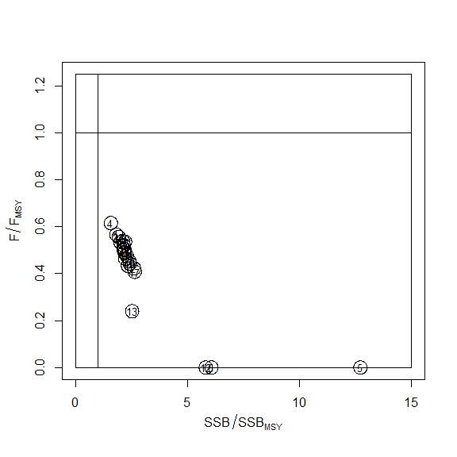
Sensitivity Runs Kobe Plot
Figure 24: Kobe plot showing the terminal-year stock status for the base case model (grey B) and the sensitivity analyses as indicated by the run numbers. For the list of sensitivity runs, please see Table 12.

Slide 31
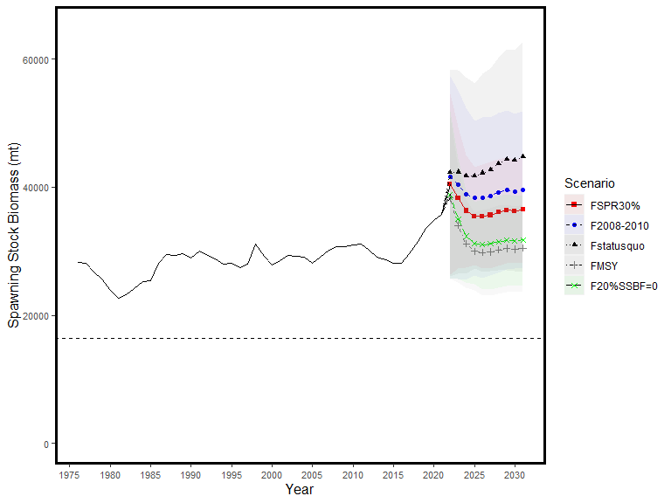
Projections
starter.sso with Bratio: SSB/SSB0 and F: _abs_F
Figure 25: Historical and projected trajectories of spawning biomass from the North Pacific swordfish base case model based upon F scenarios. Dashed line indicates the spawning stock biomass at SSB_{MSY}. The list of projection scenarios can be found in Table XX.

Slide 32
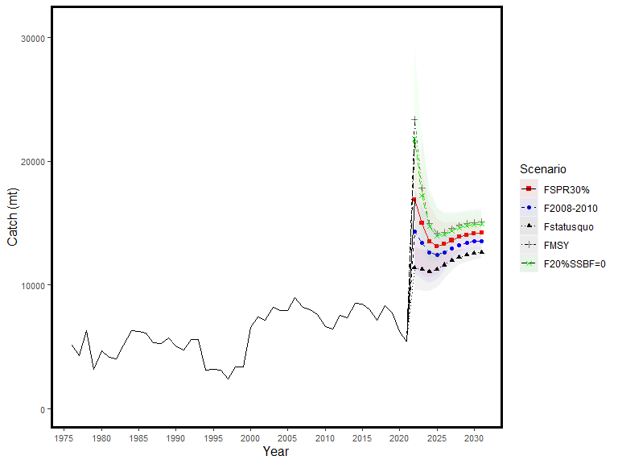
Figure 26: Historical and projected trajectories of catch from the North Pacific swordfish base case model based upon F scenarios. The list of projection scenarios can be found in Table XX.

