Slide 1
A Preliminary Base-case model in SS3.30 for the 2023 North Pacific Swordfish Assessment
Michelle L Sculley, Yi-Jay Chang, Hirotaka Ijima

Slide 2
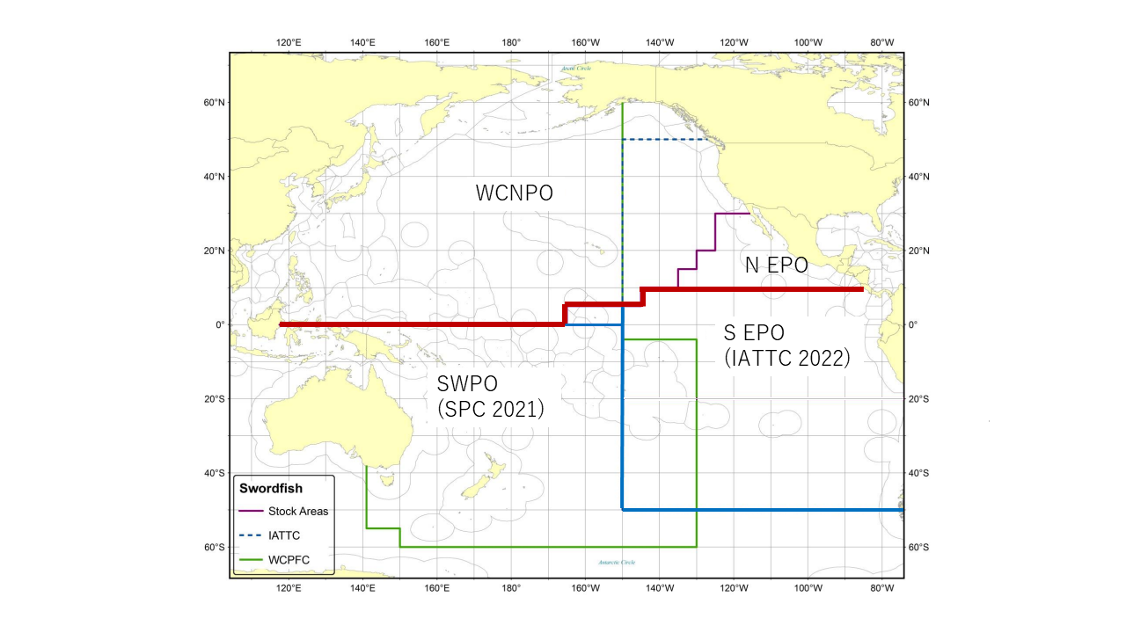
Figure 1: Western and Central North Pacific Ocean and North Eastern Pacific Ocean swordfish stock boundaries for the 2023 North Pacific swordfish assessment. Spatial structure is treated implicitly using fleets as areas.

Slide 3
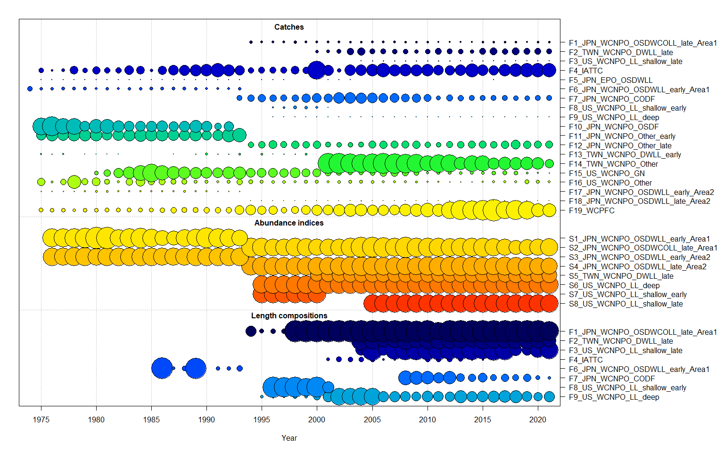
Figure 2: Catch, CPUE index, and size composition data included in the 2023 NP swordfish stock assessment. The size of the bubble indicates the relative number of observations available.

Slide 4
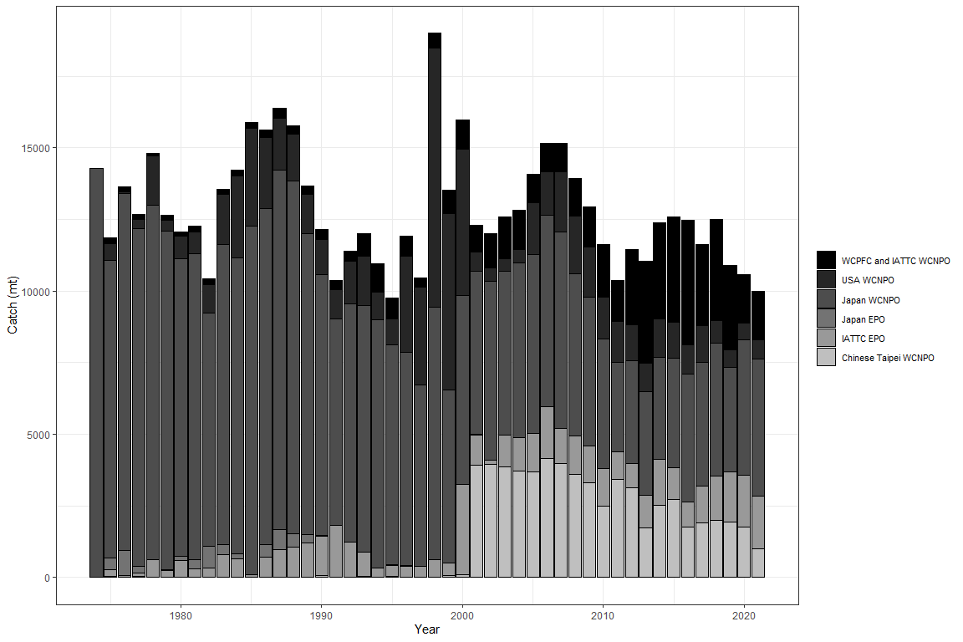
Figure 3: Annual catch of NP swordfish by country or commission and area.

Slide 5
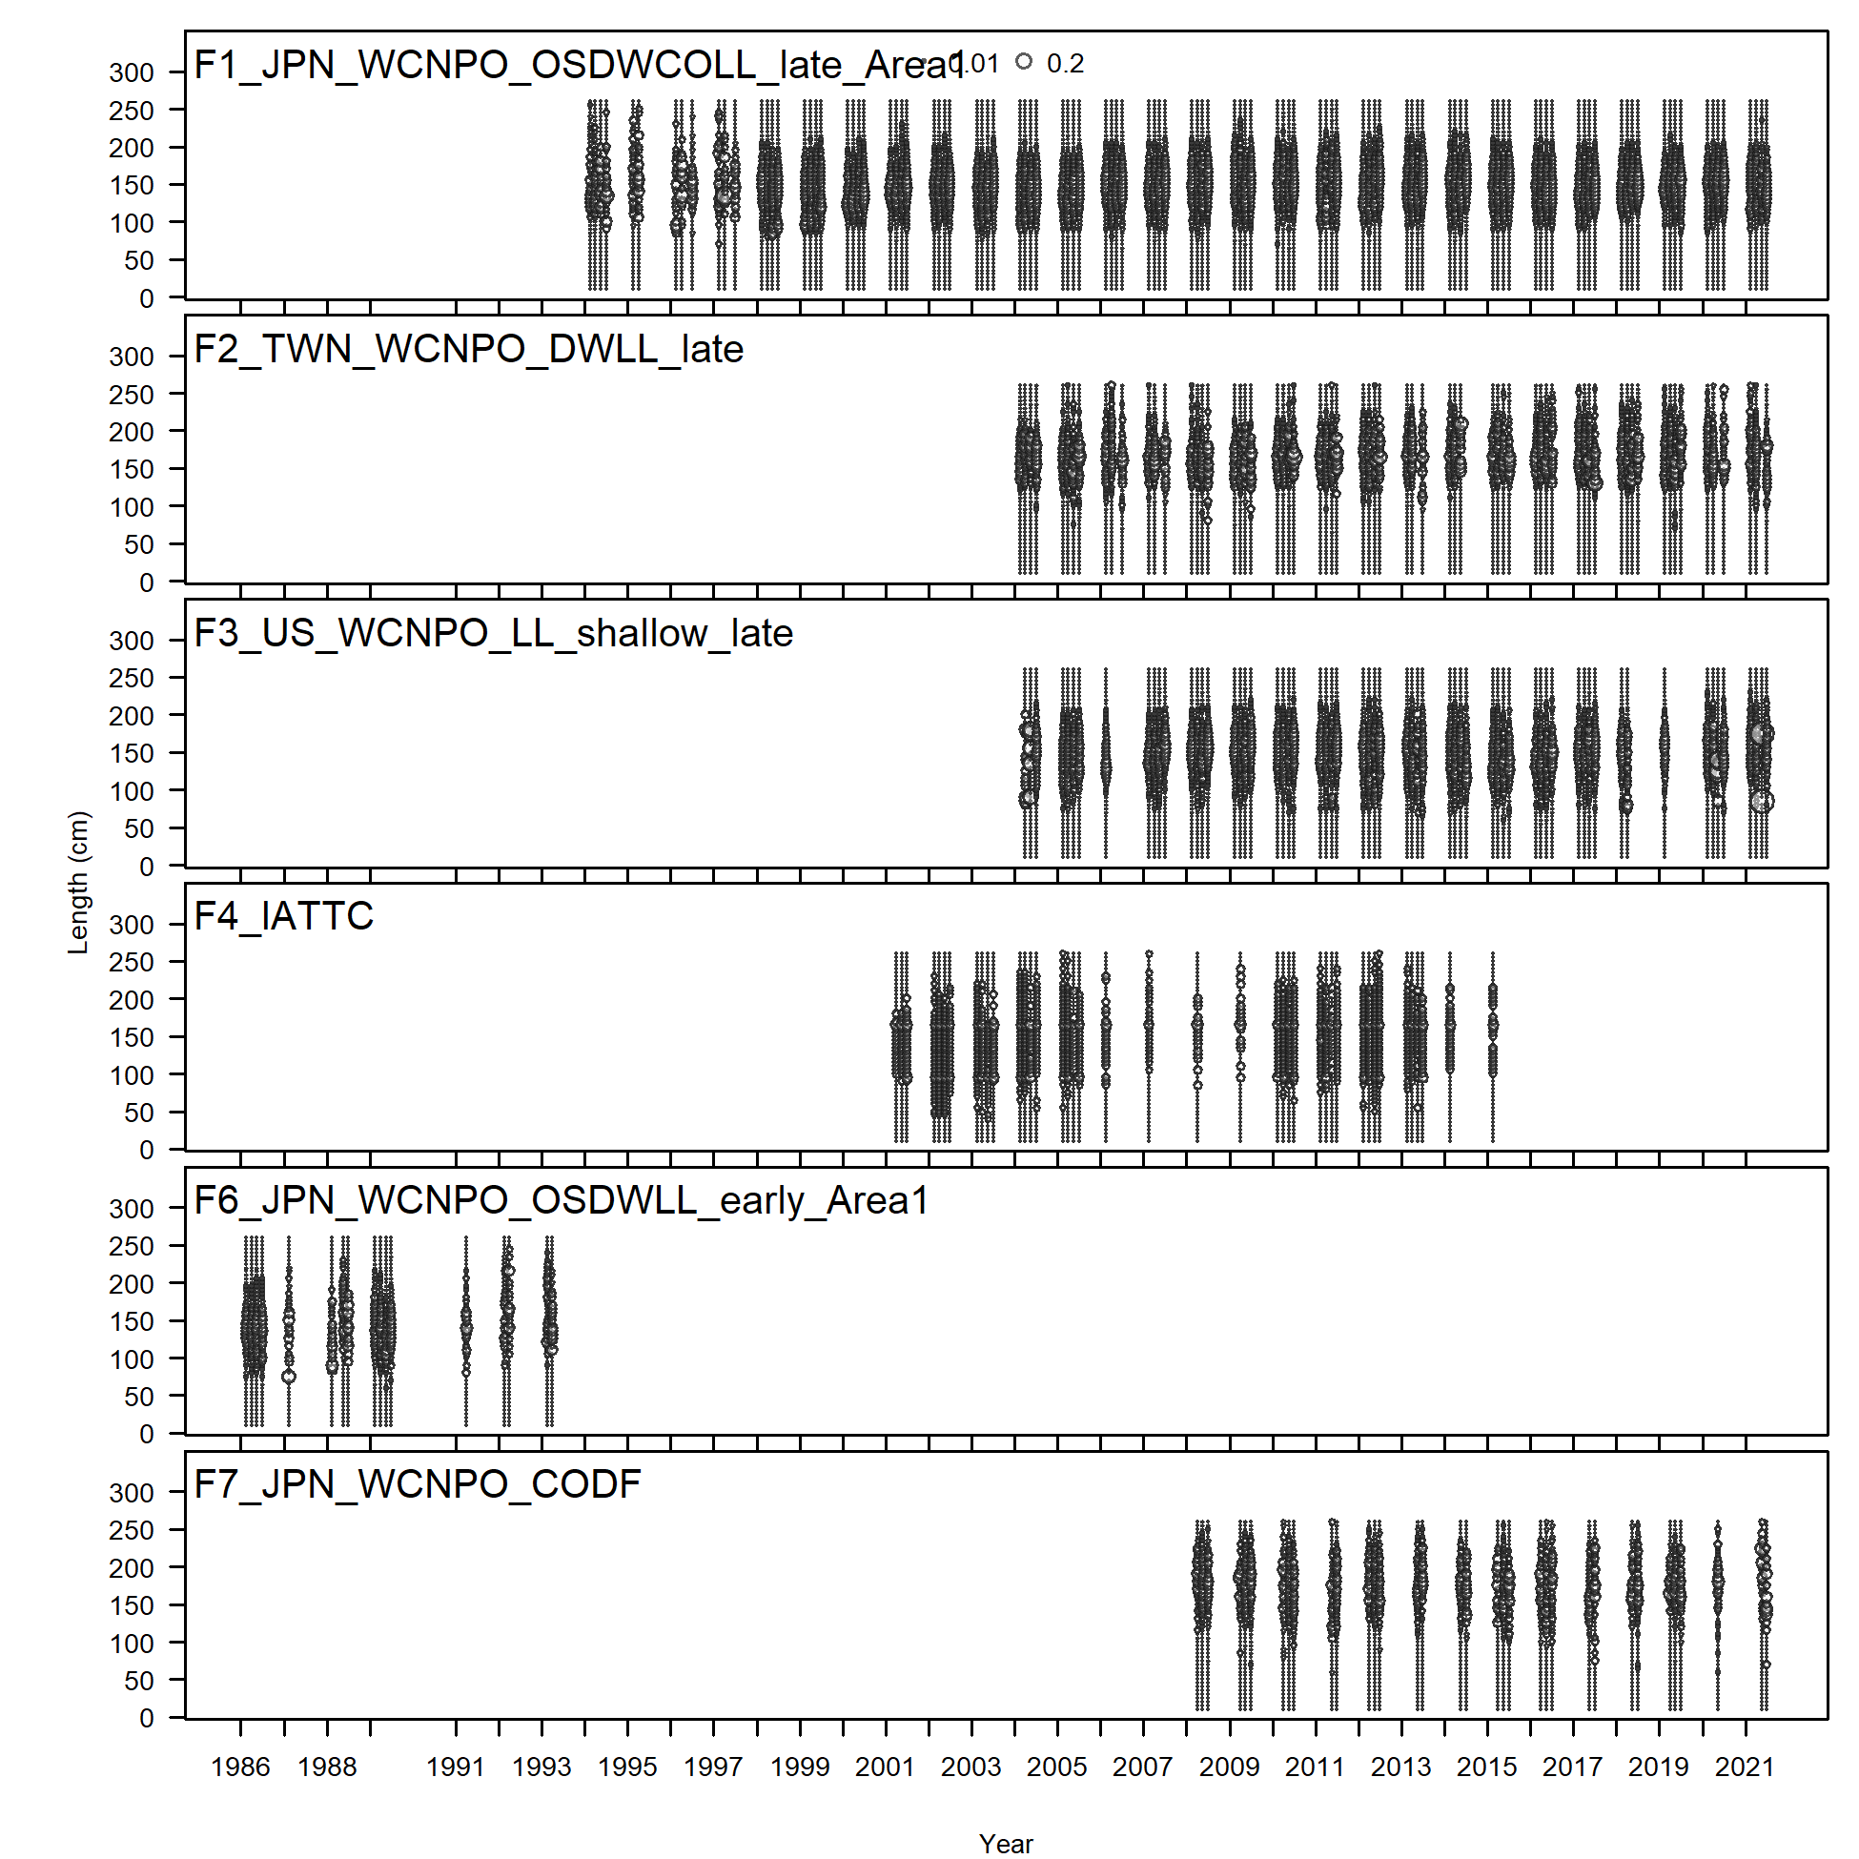
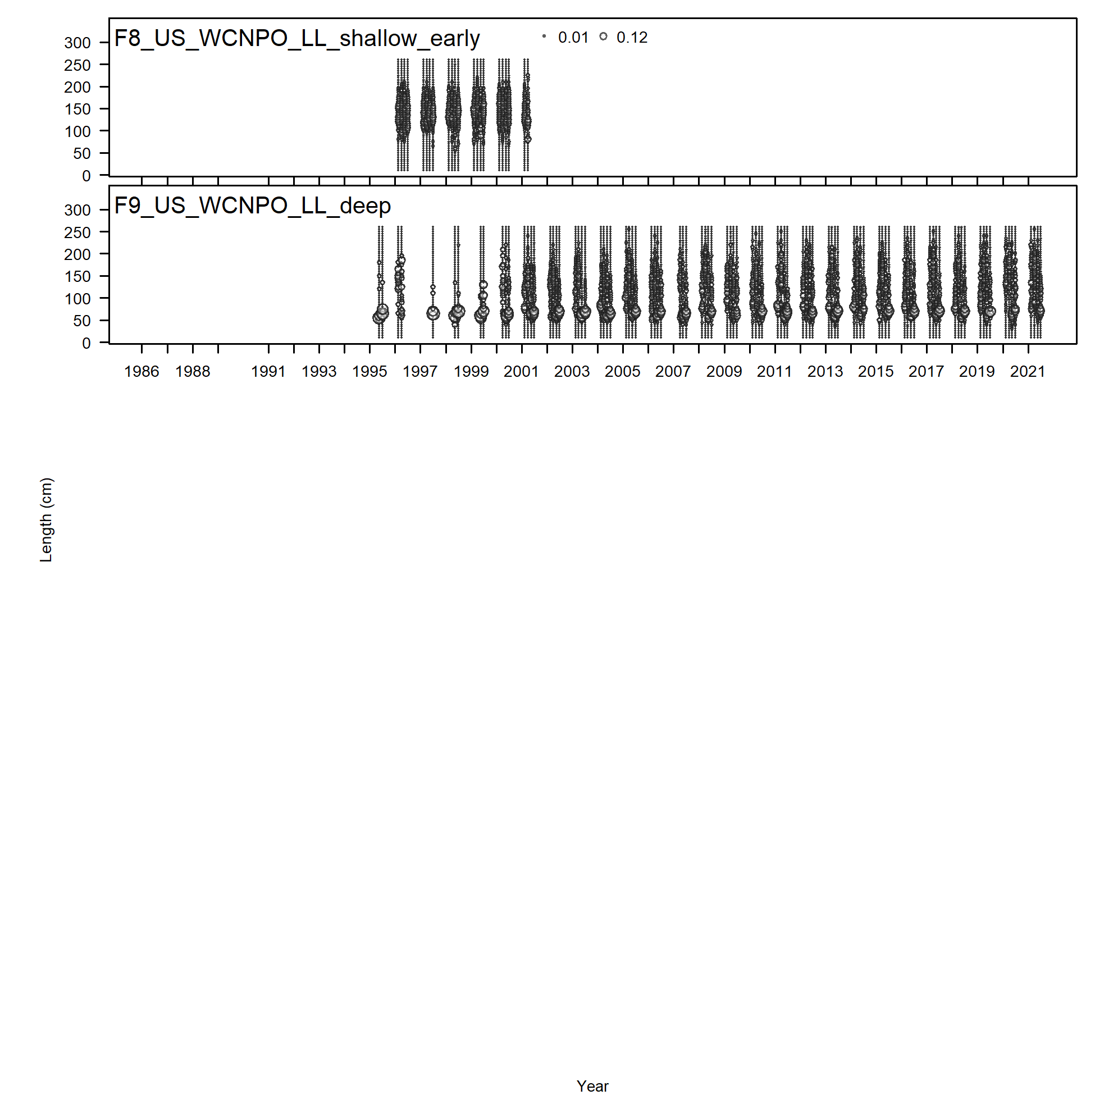

Slide 6
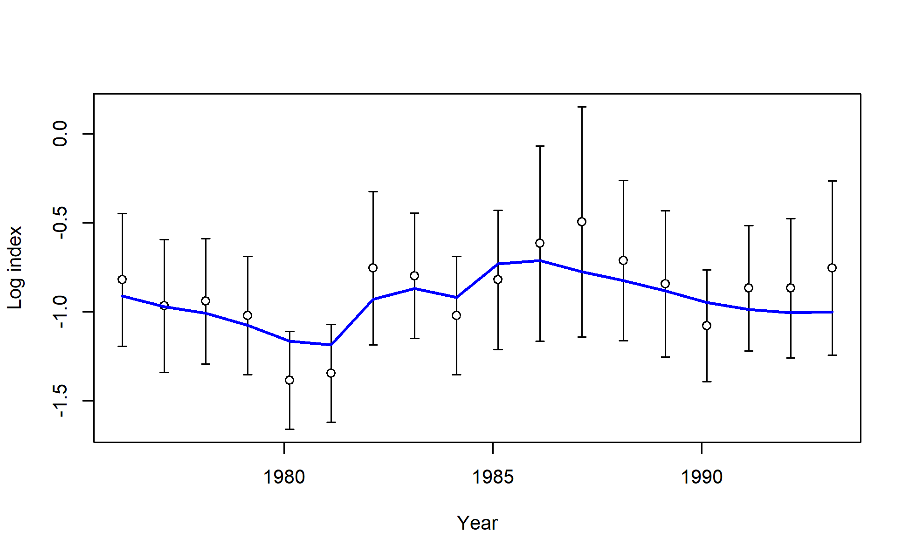
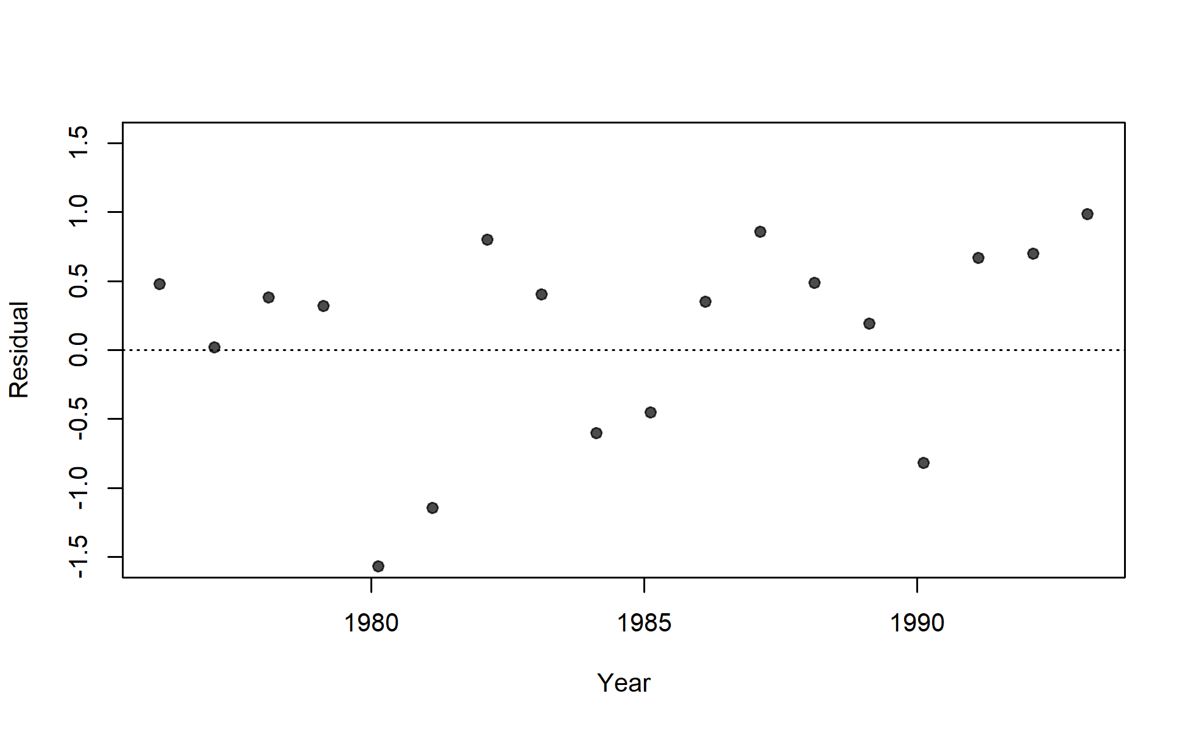
S01_JPN_WCNPO_LL_early_area1

Slide 7
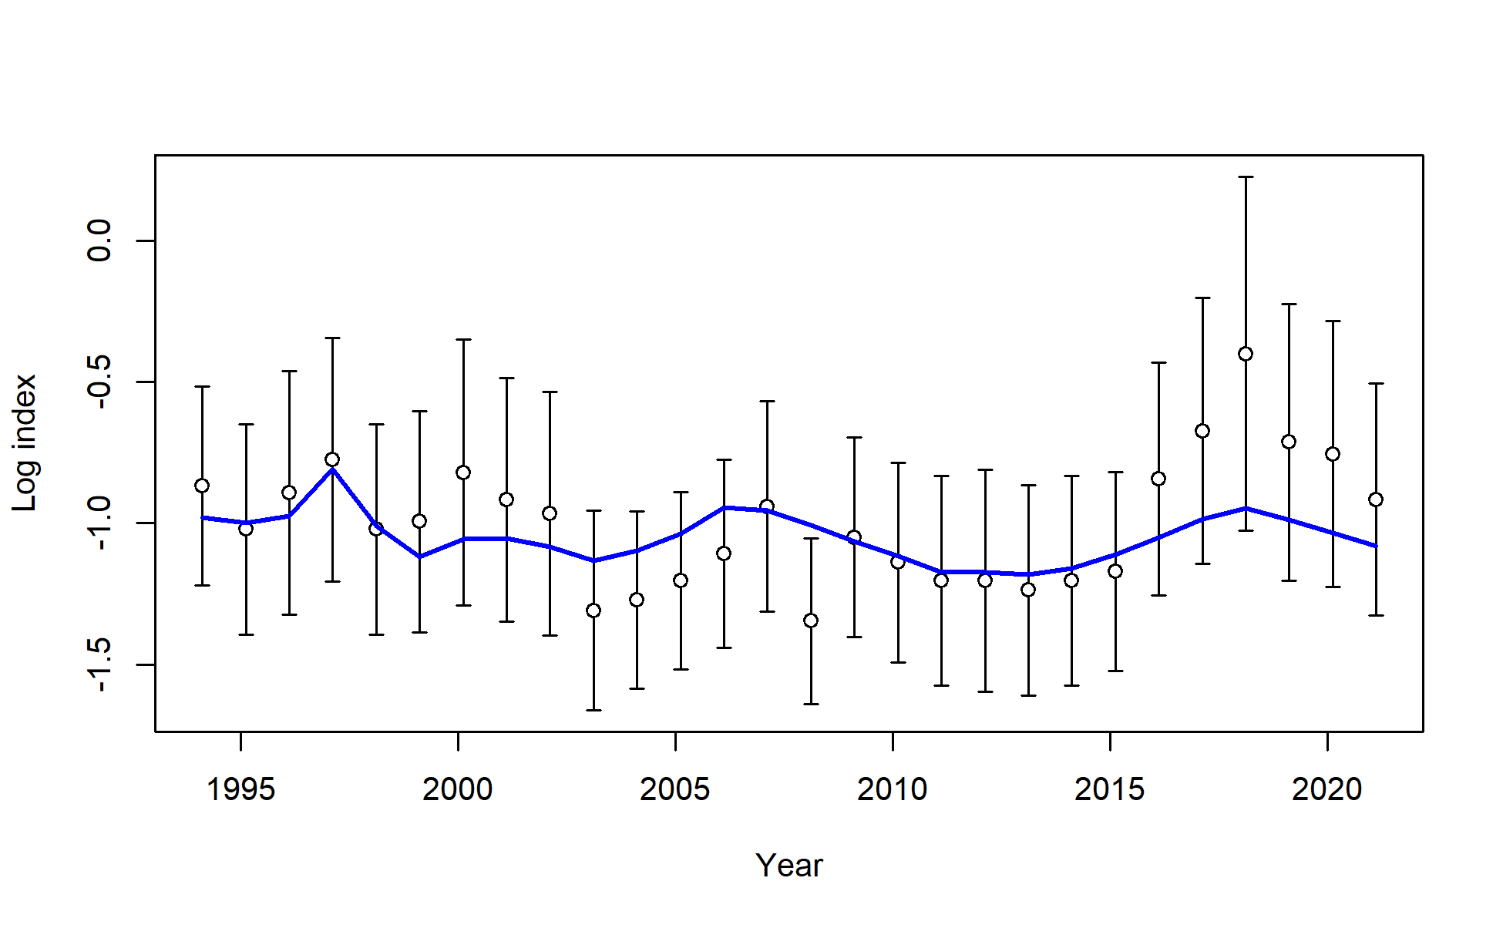
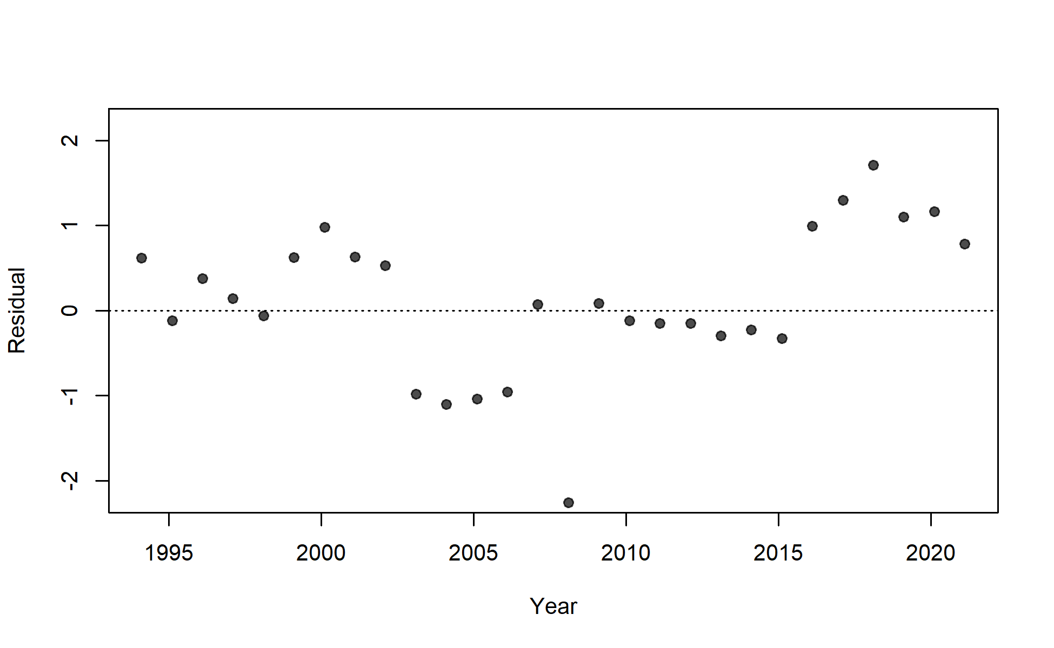
S02_JPN_WCNPO_LL_late_area1

Slide 8
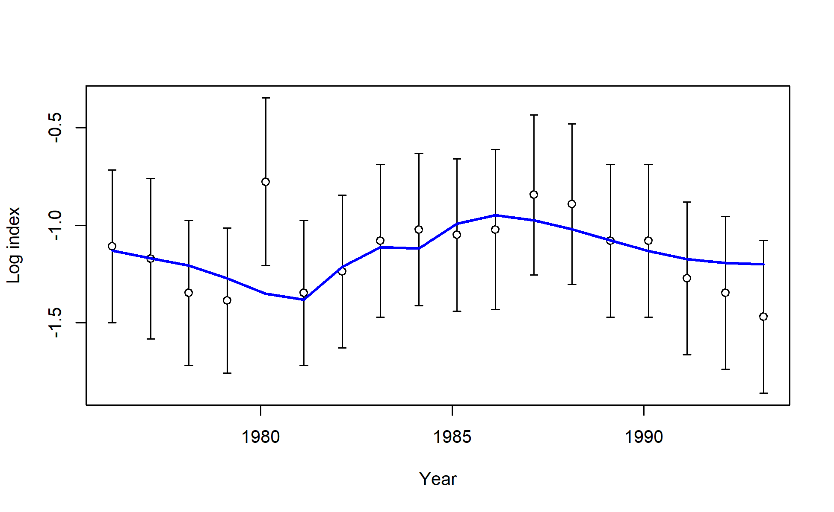
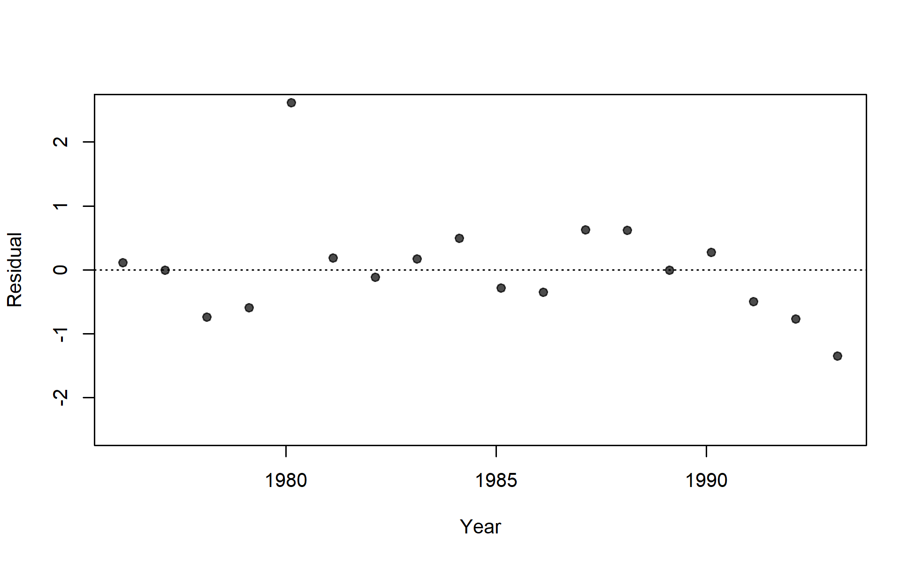
S03_JPN_WCNPO_LL_early_area2

Slide 9
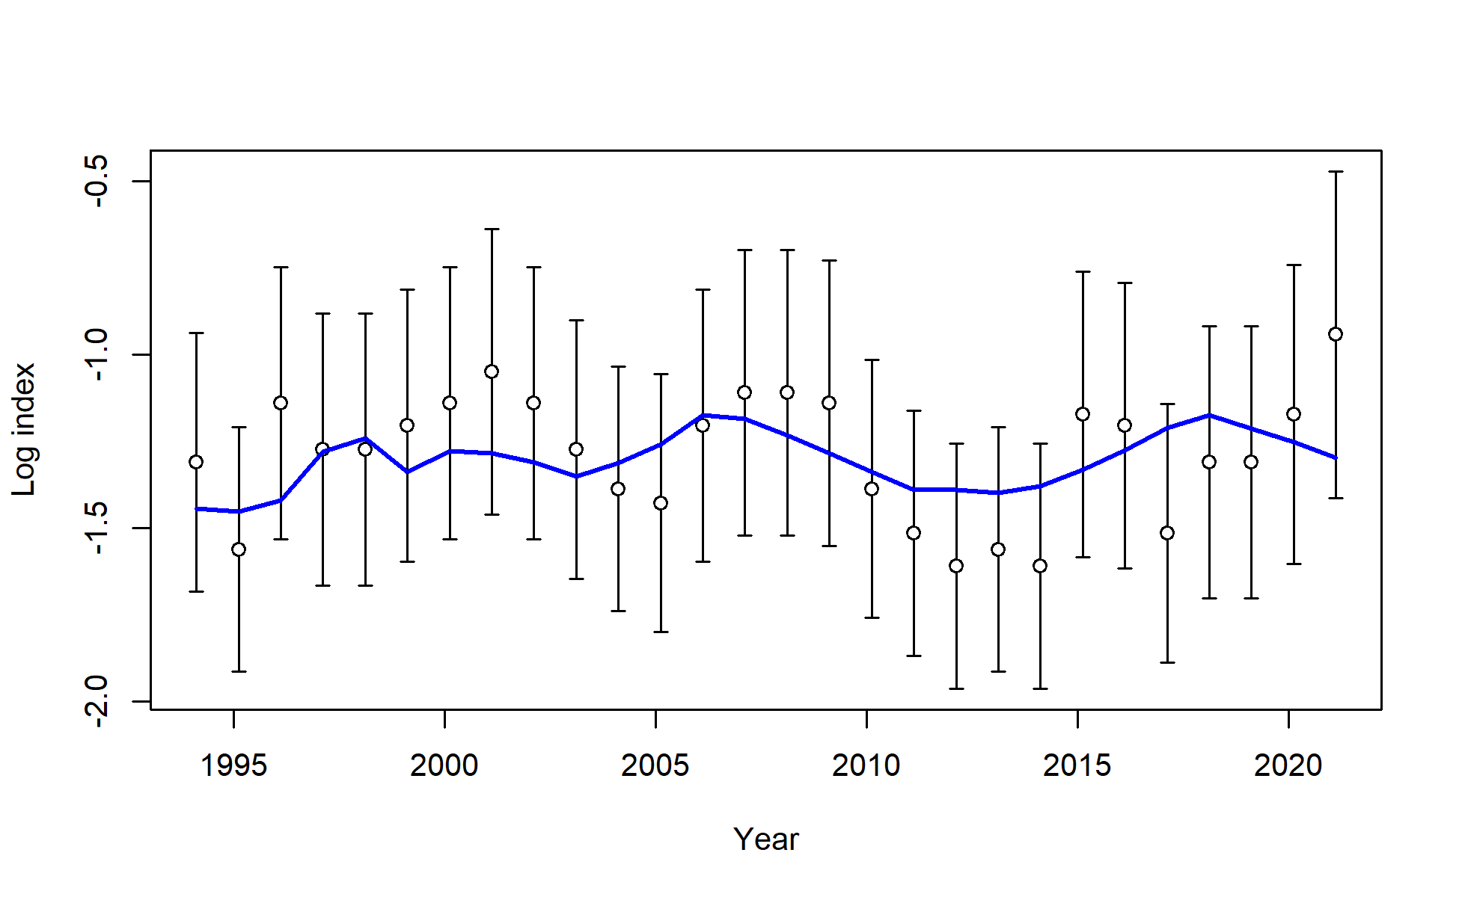
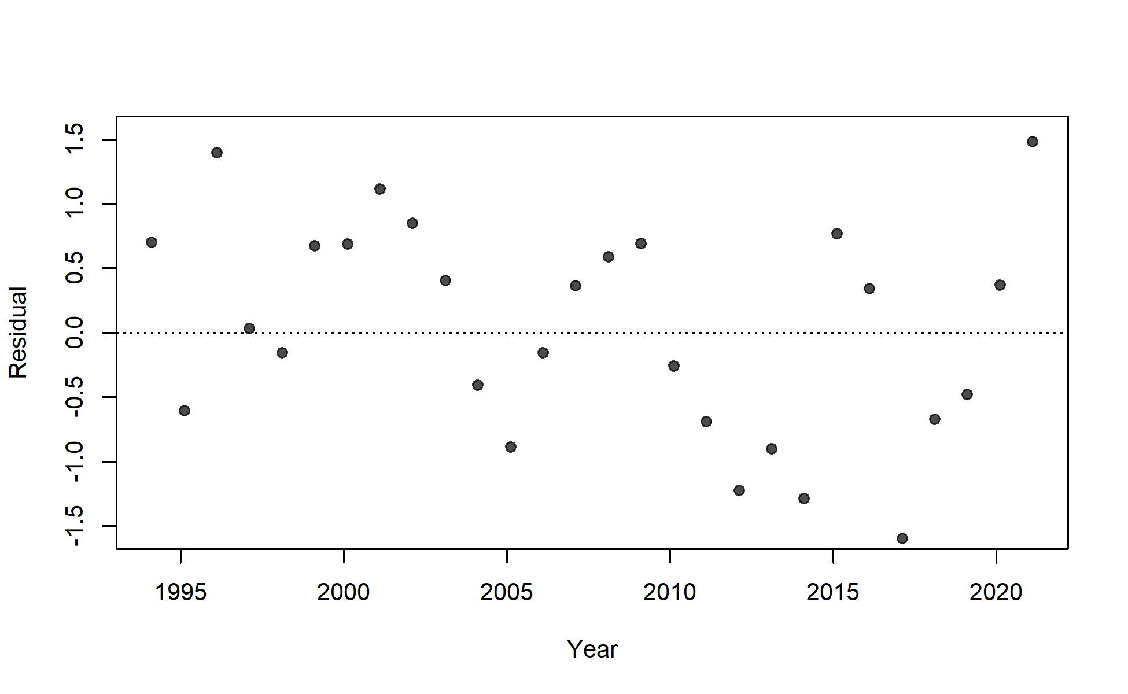
S04_JPN_WCNPO_LL_late_area2

Slide 10
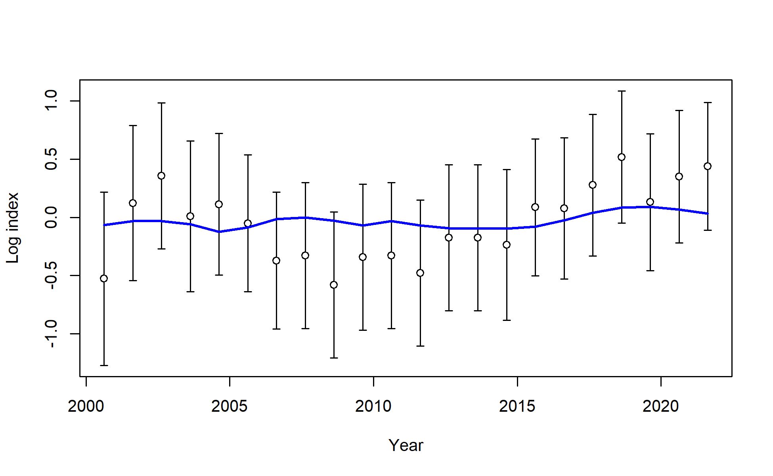
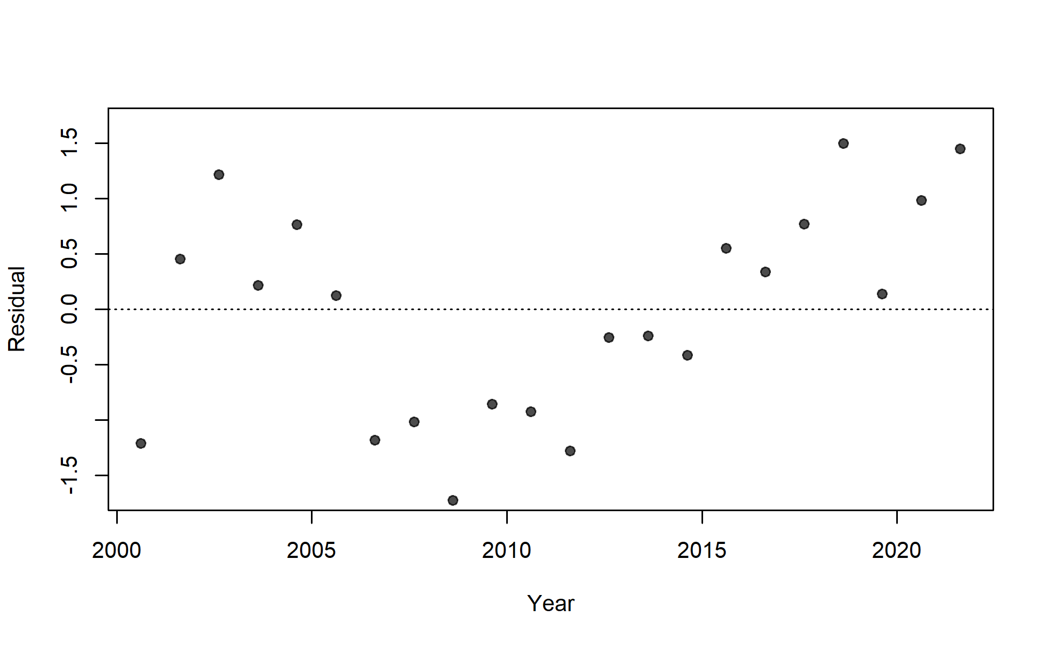
S05_TWN_WCNPO_DWLL

Slide 11
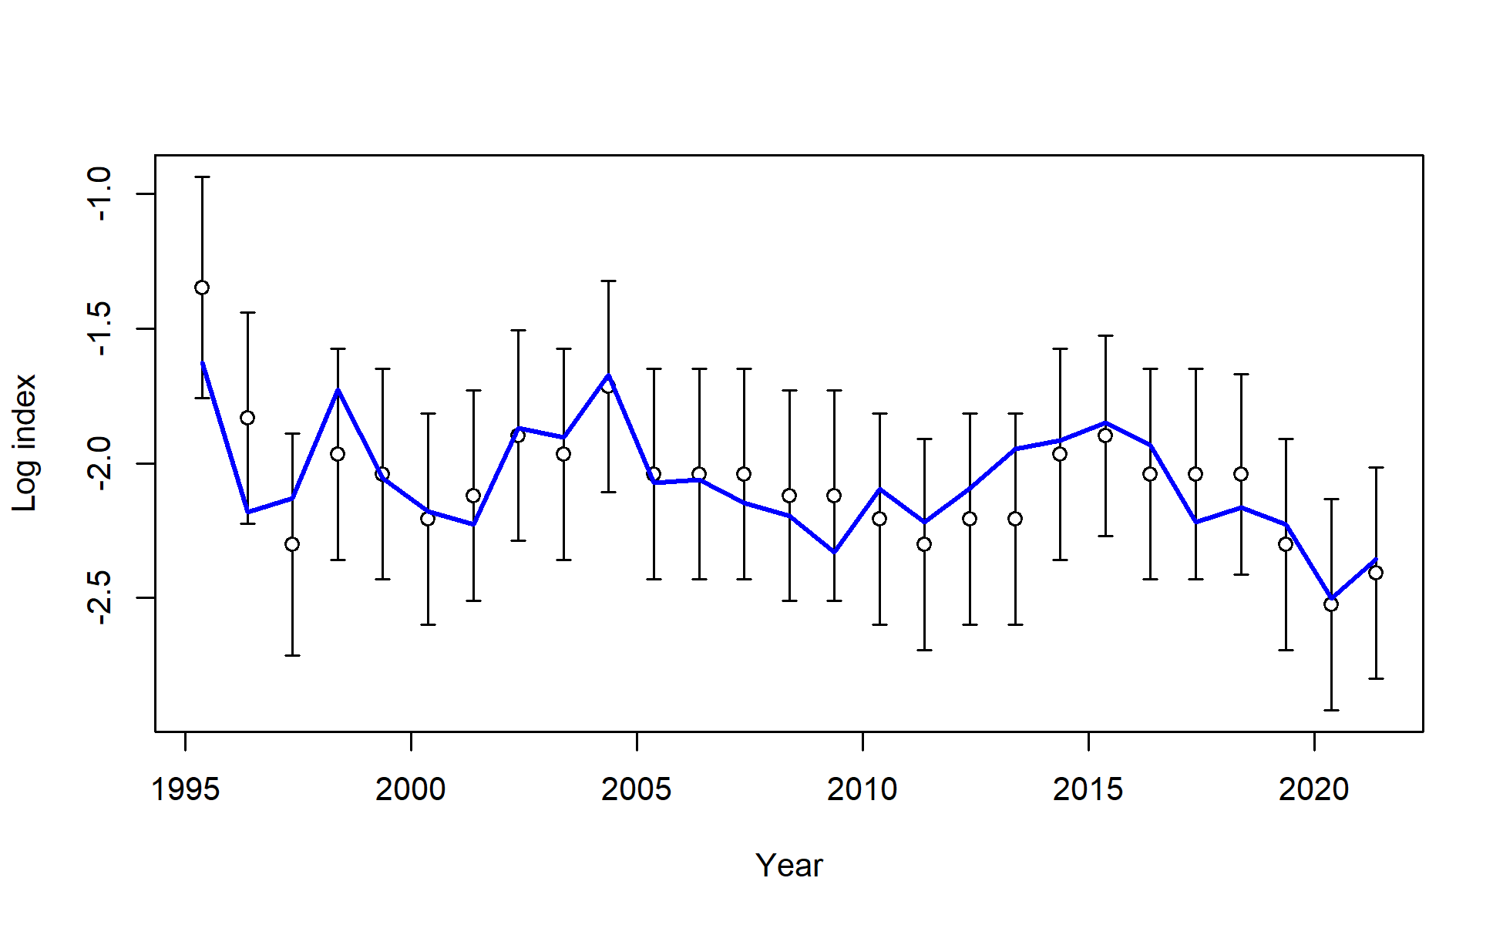
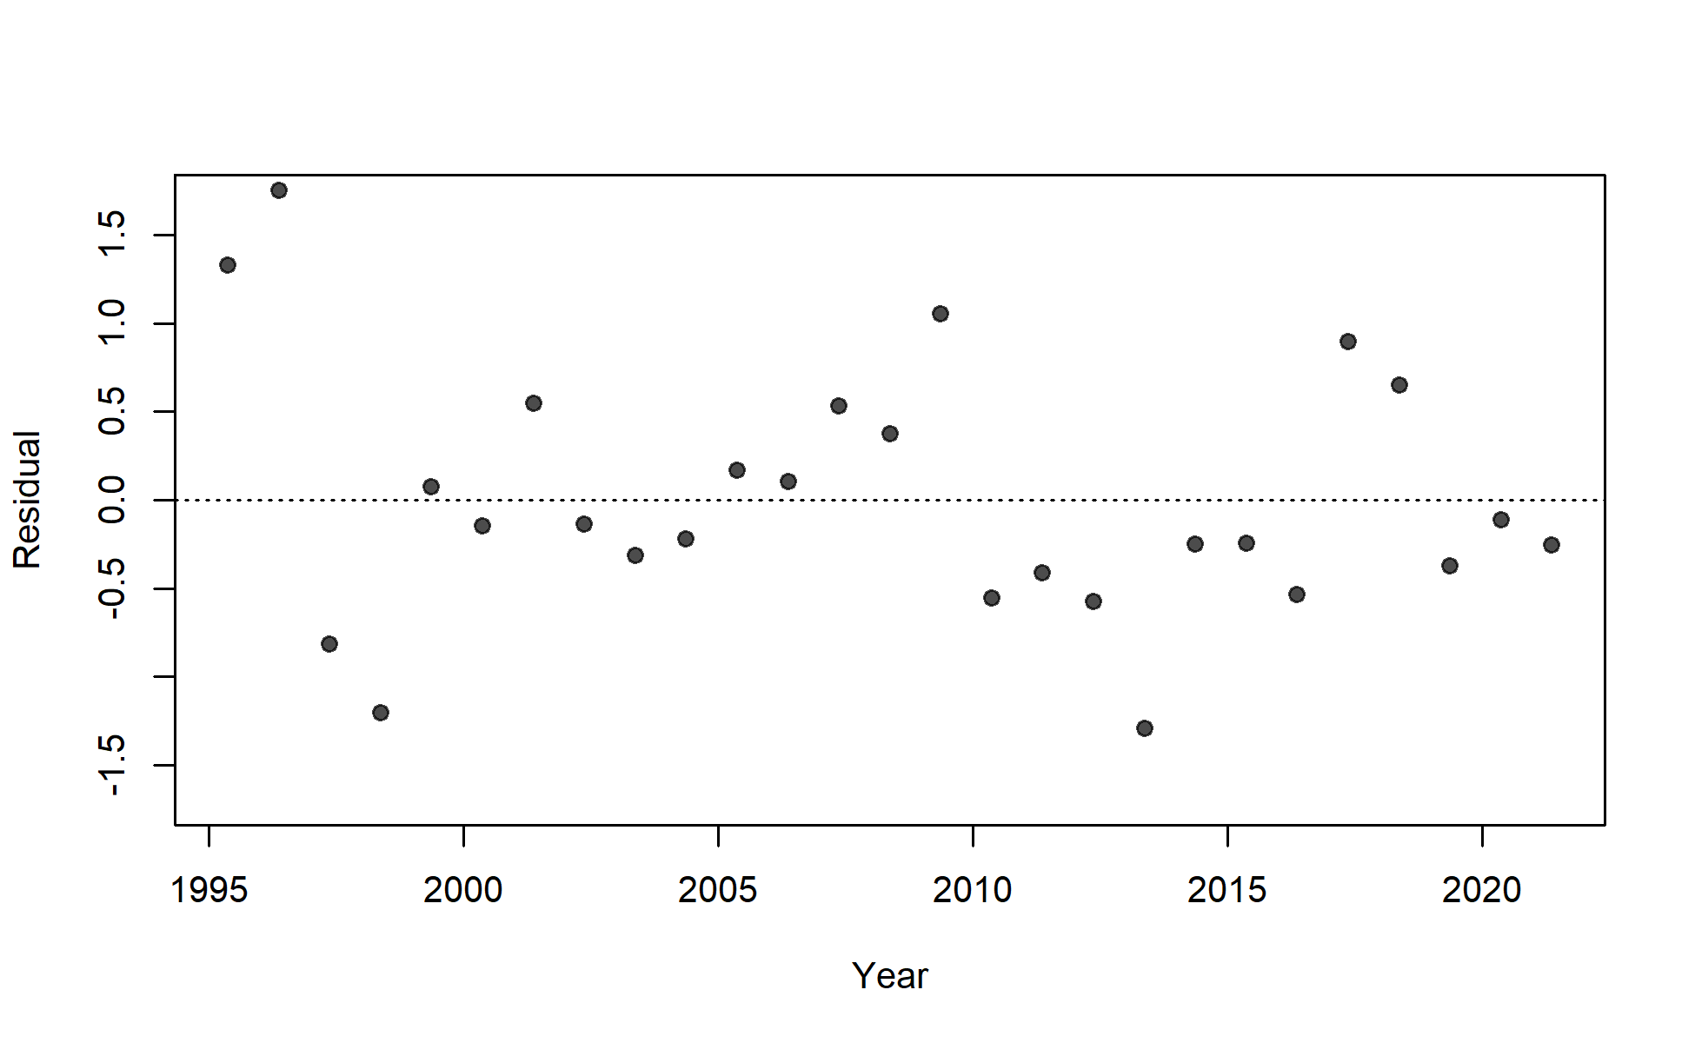
S06_US_WCNPO_LL_deep

Slide 12
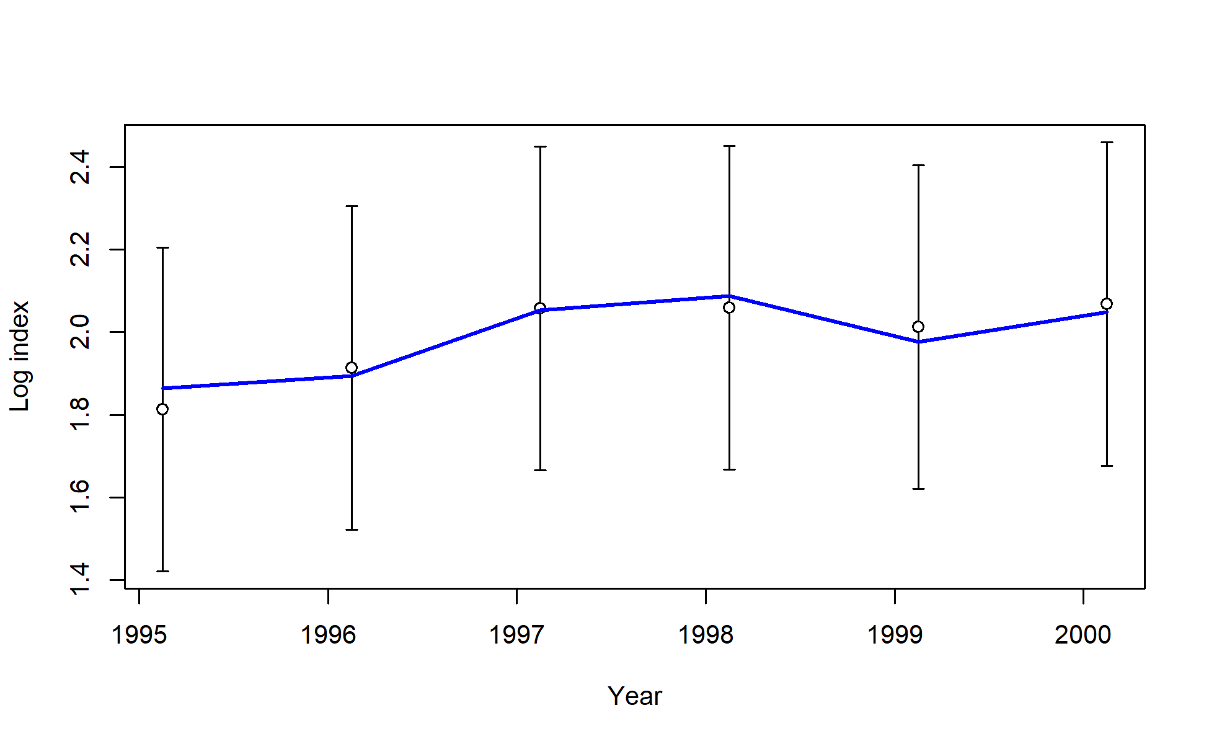
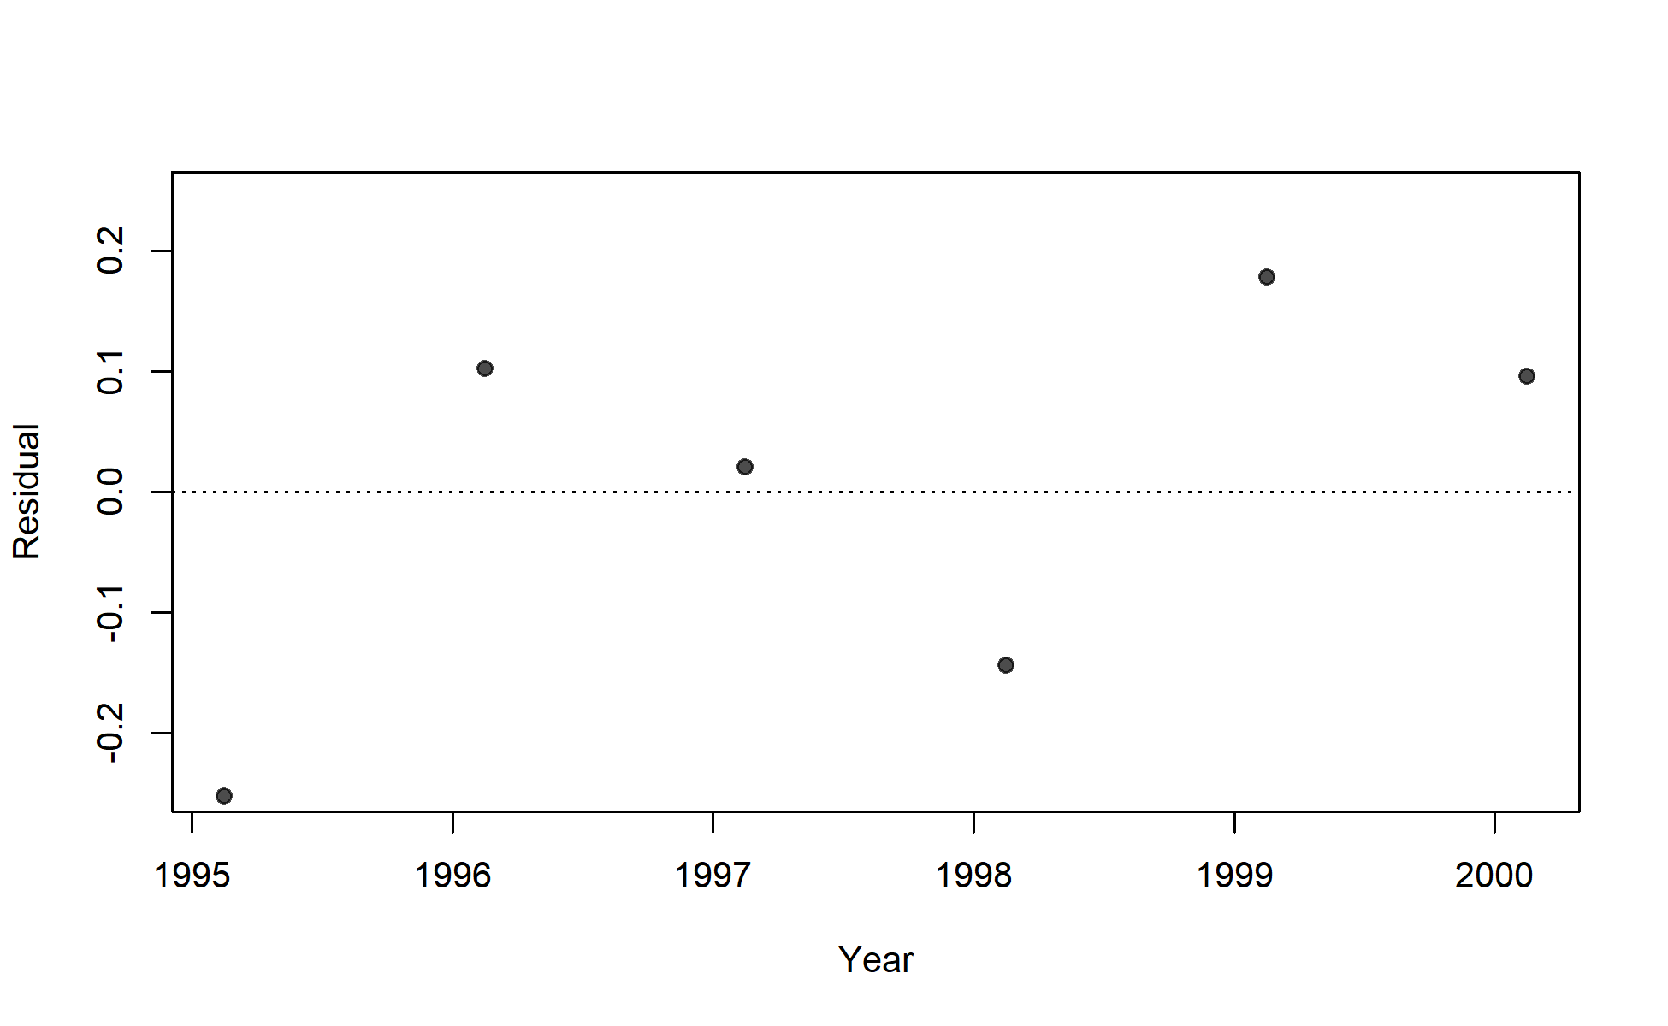
S07_US_WCNPO_LL_shallow_early

Slide 13
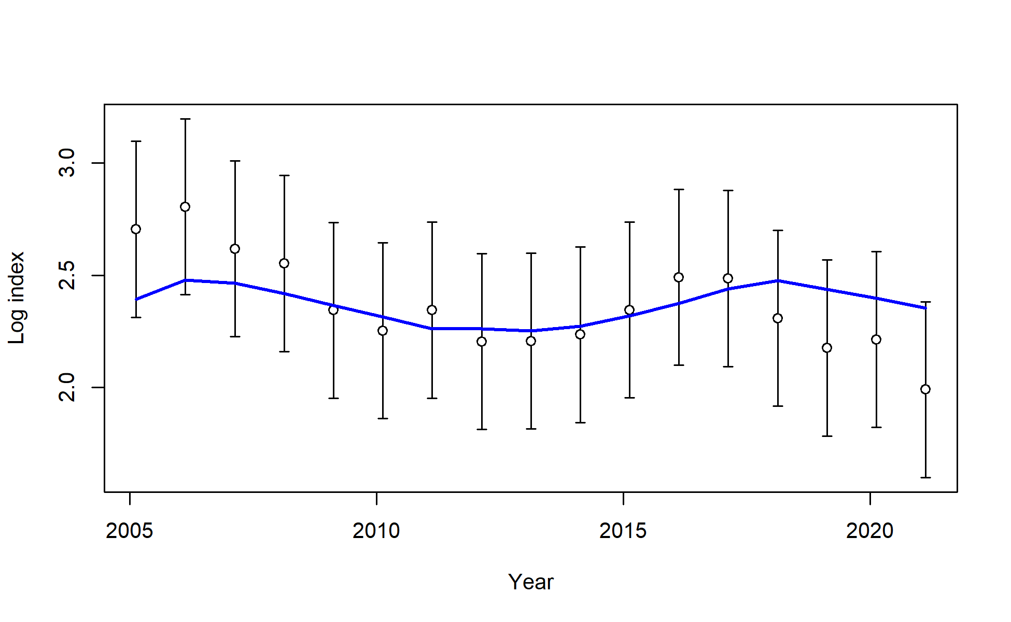
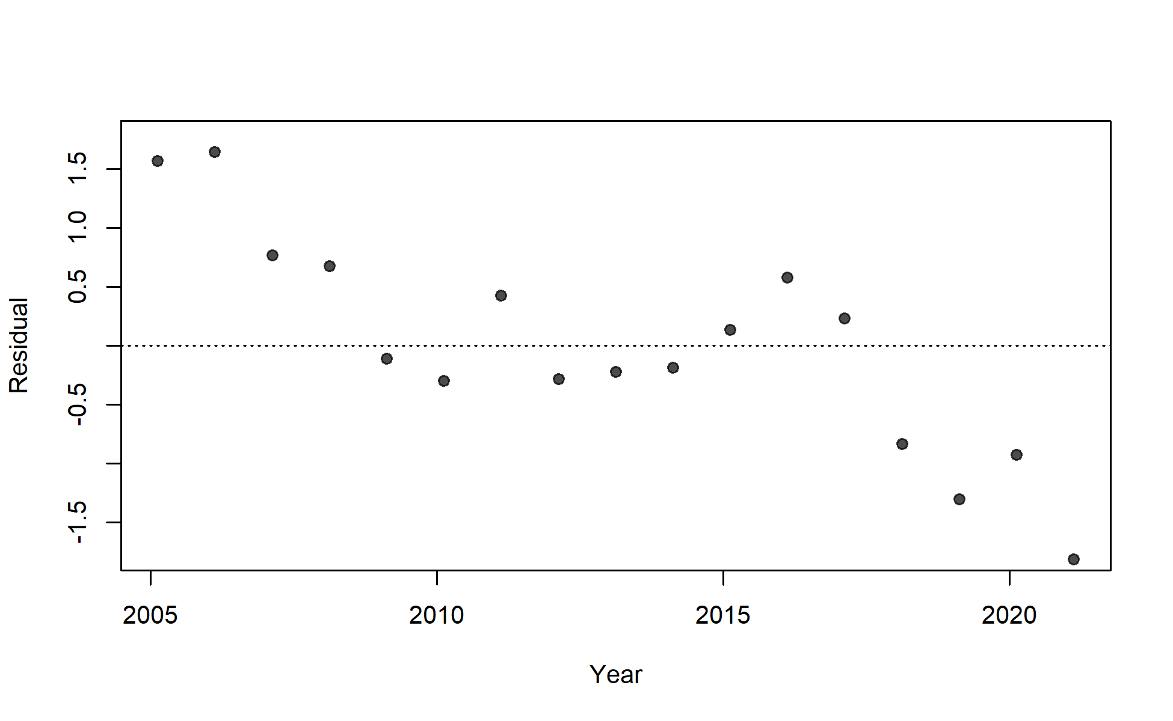
S08_US_WCNPO_LL_shallow_late

Slide 14
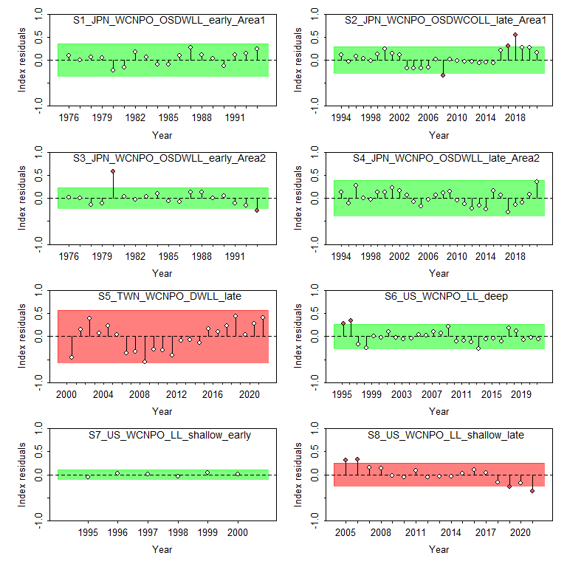
Figure 13: Results from a runs test for each CPUE index. Red indicates the index failed the test (residuals are not random), green indicates the index passed the test.

Slide 15
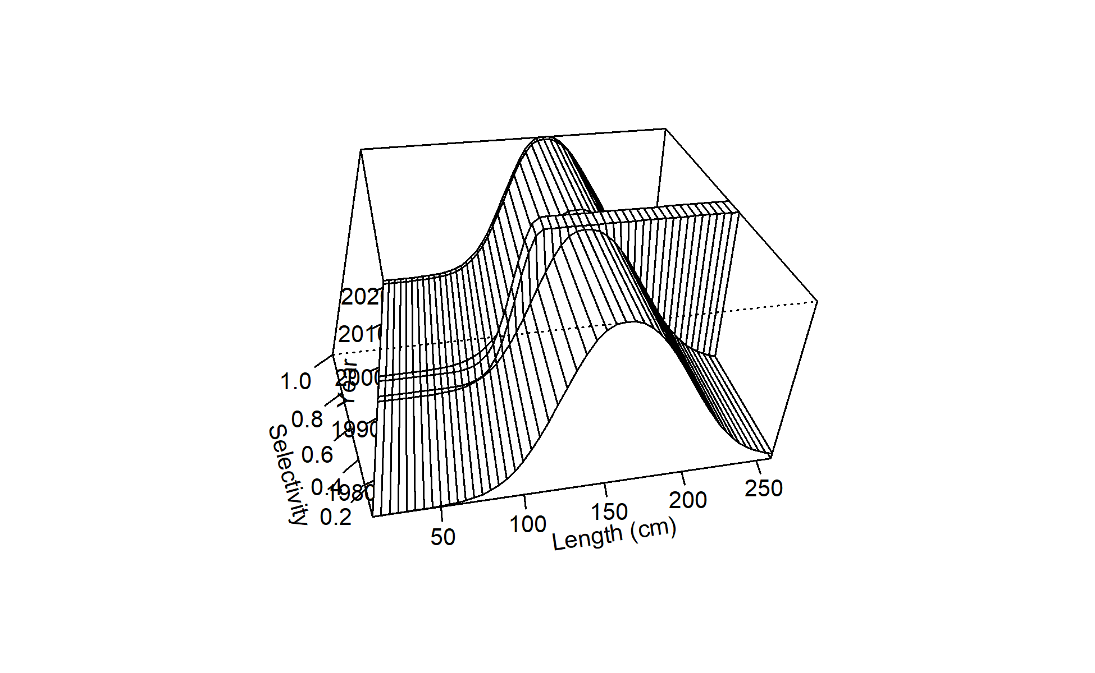
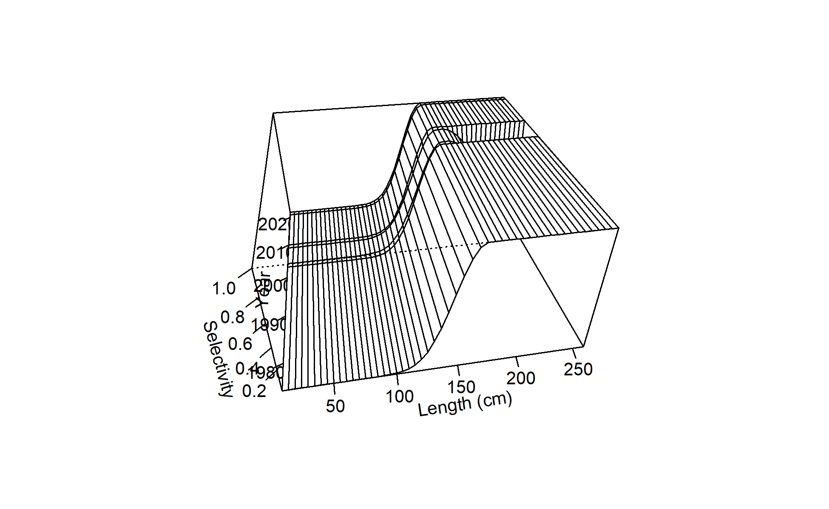
Figure 15: Time-varying selectivity estimated for F02 Chinese Taipei LL late.
Figure 14: Time-varying selectivity estimated for F01 Japan LL area 1 late.

Slide 16
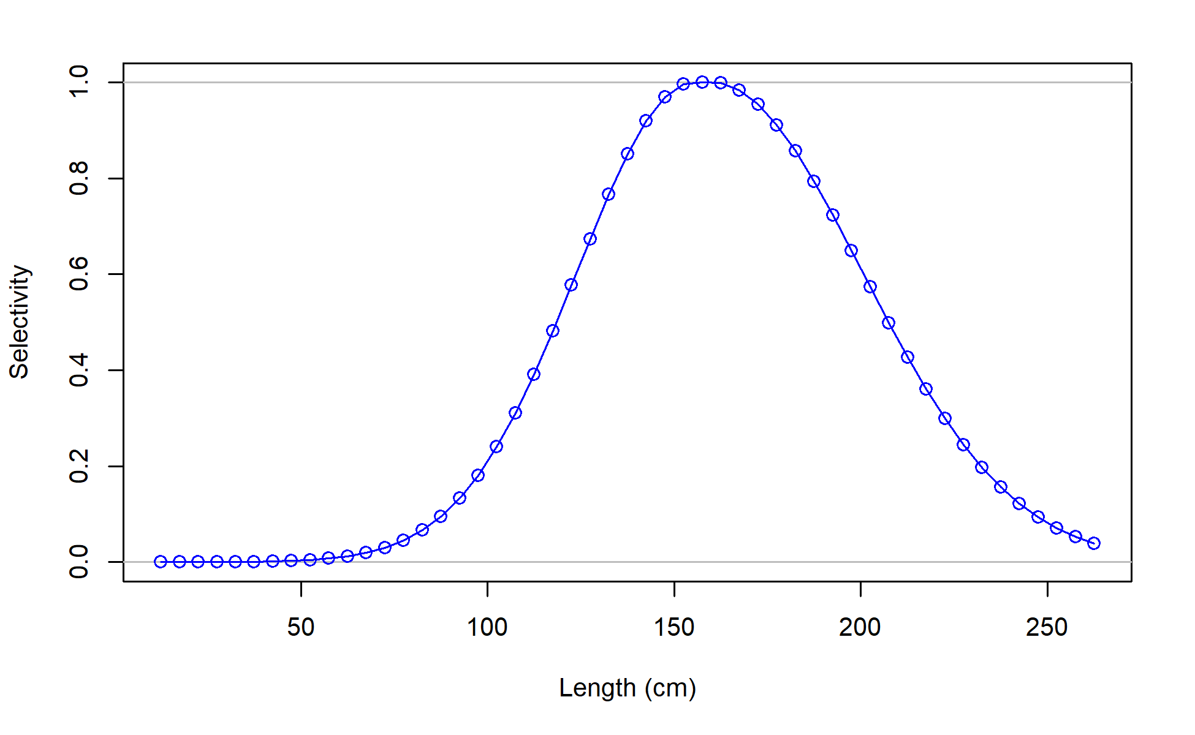
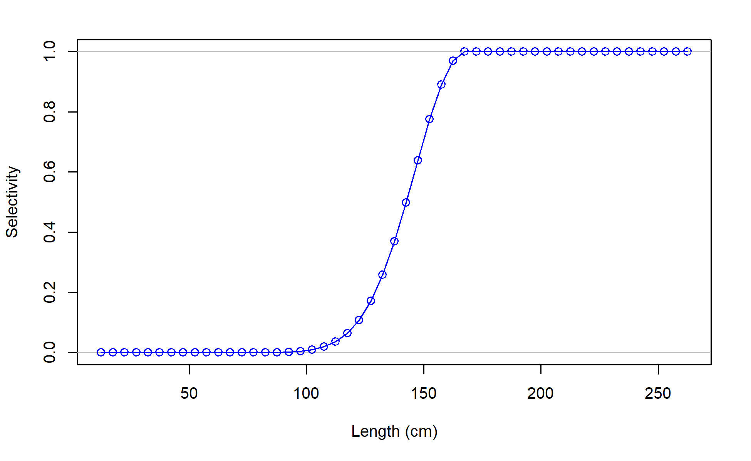
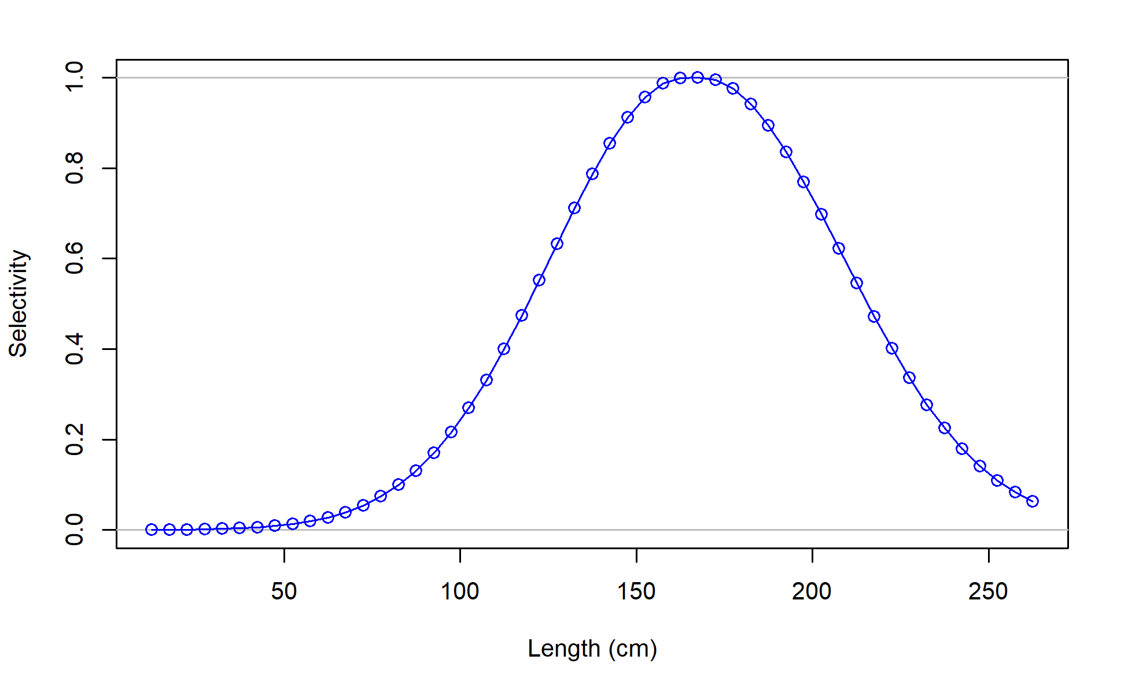
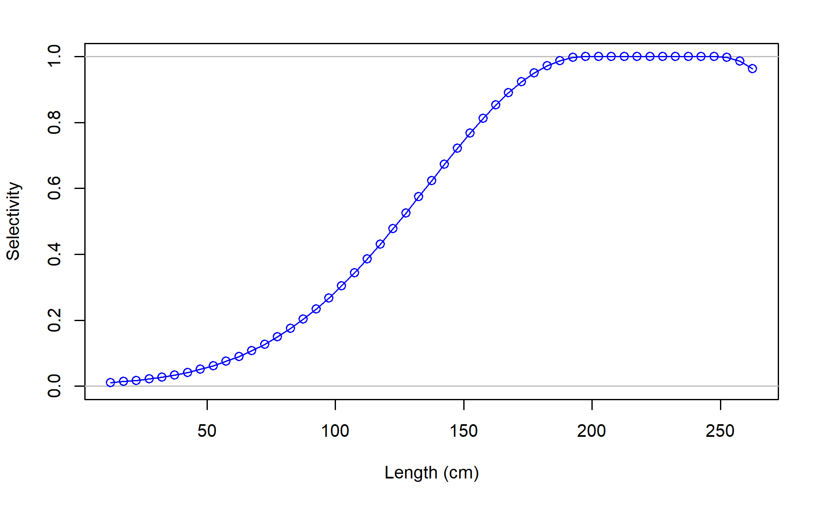
F01_JPN_WCNPO_OSDWLL_late_area1
F02_TWN_WCNPO_DWLL
F03_US_WCNPO_LL_shallow_late
F04_IATTC

Slide 17
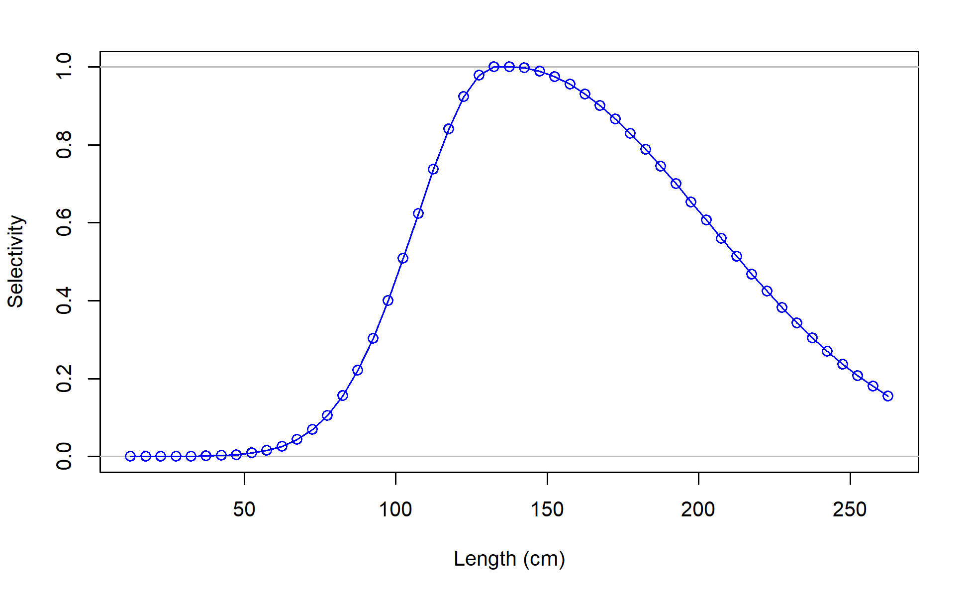
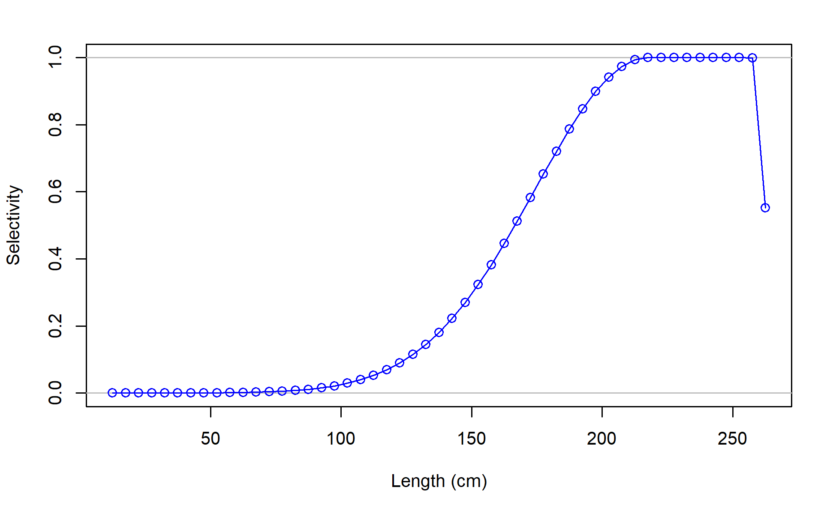
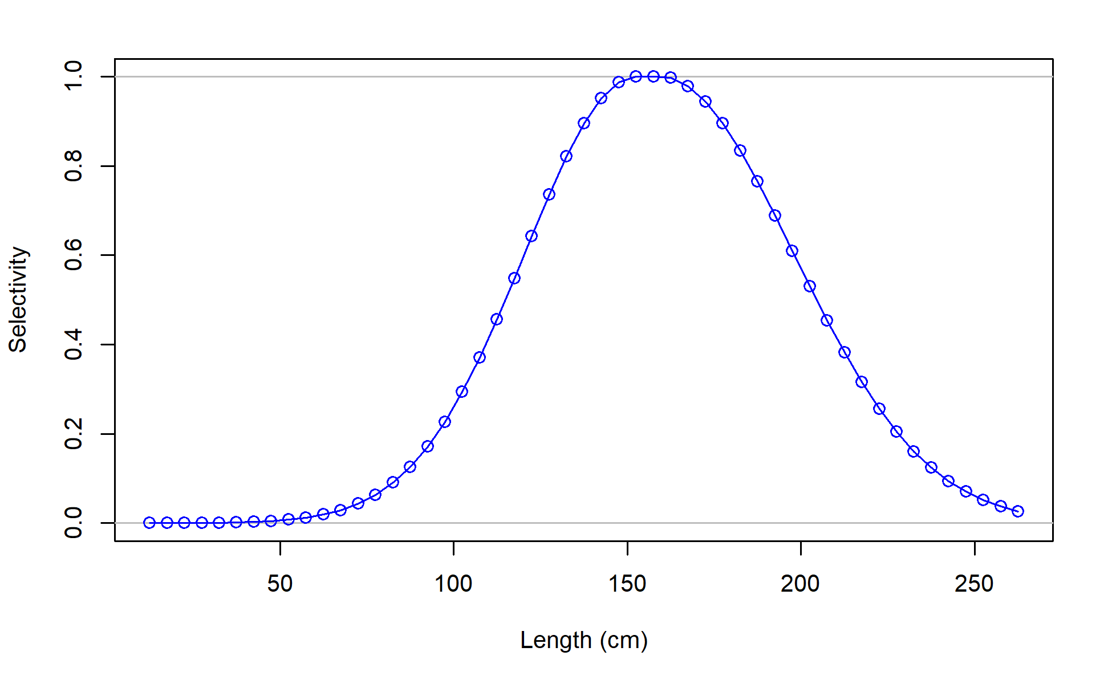
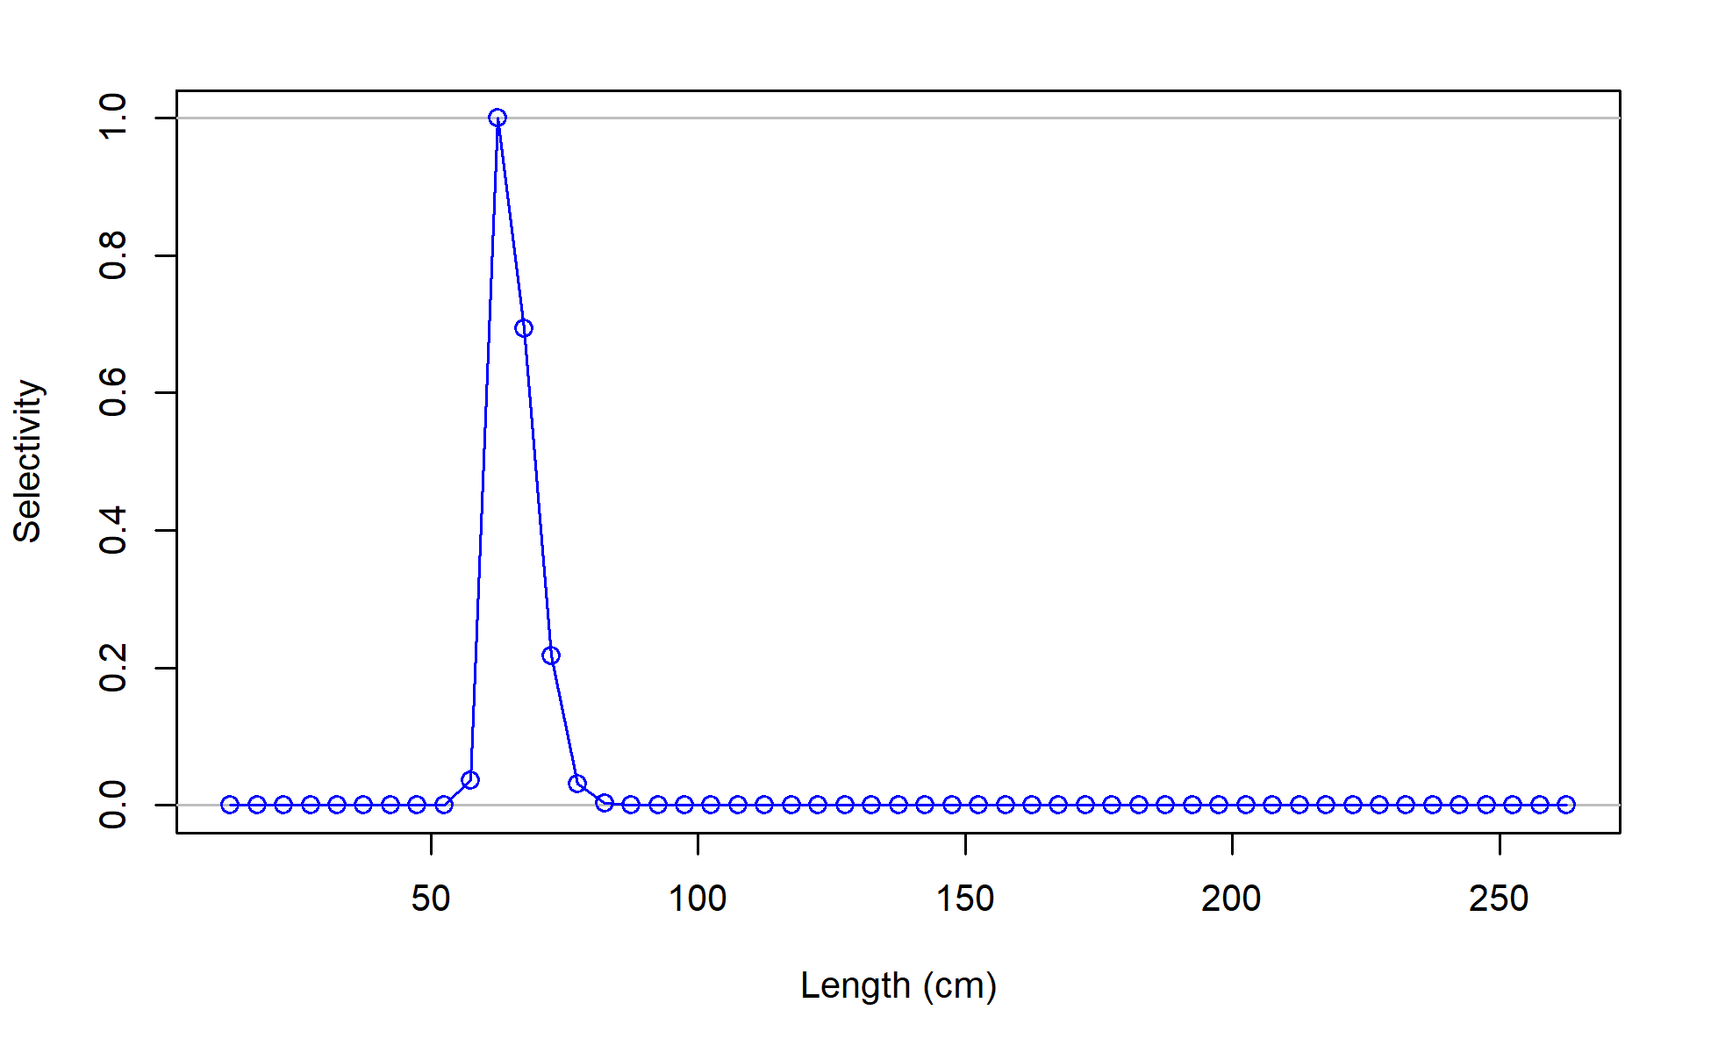
F06_JPN_WCNPO_OSDWLL_early_area2
F07_JPN_WCNPO_CODF
F08_US_WCNPO_LL_shallow_early
F09_US_WCNPO_LL_deep

Slide 18
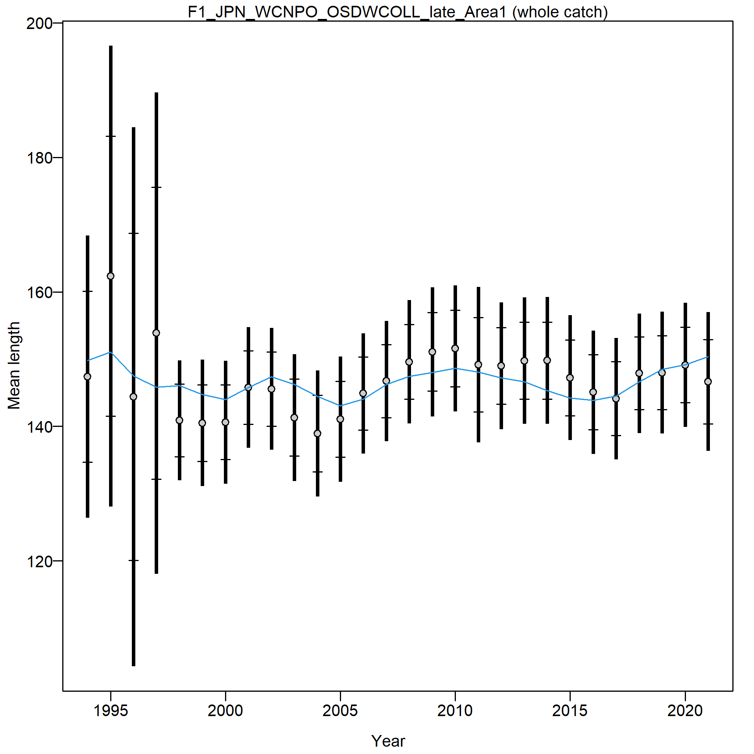
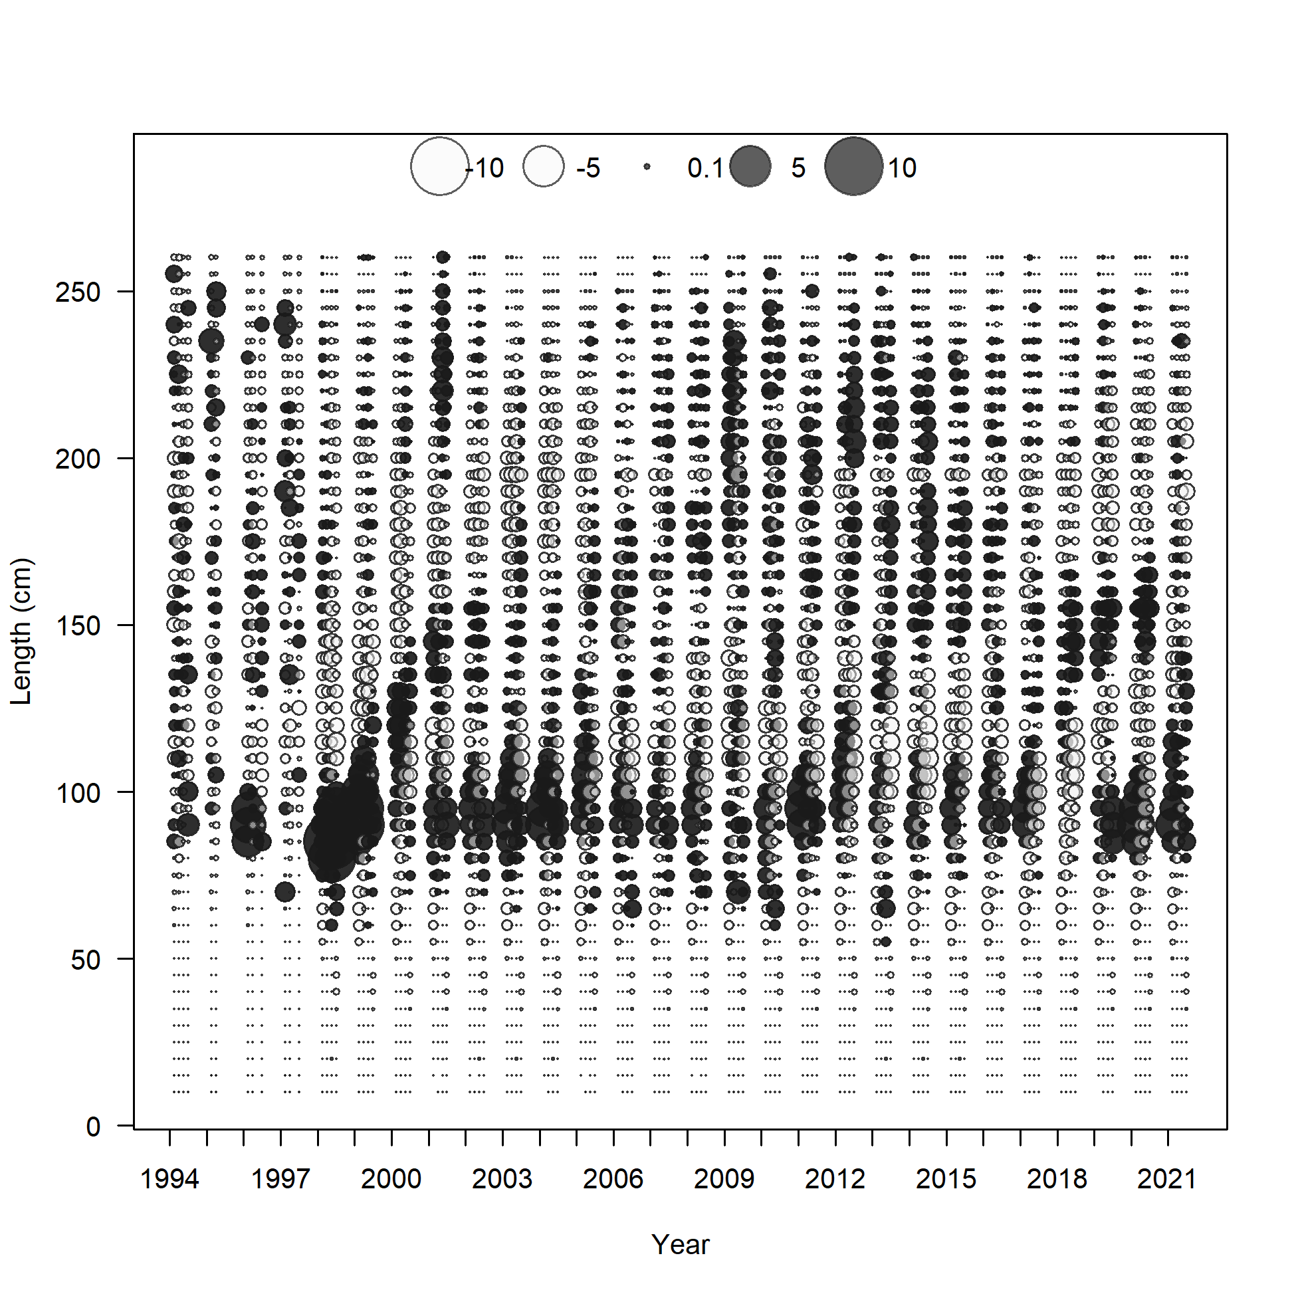

Slide 19
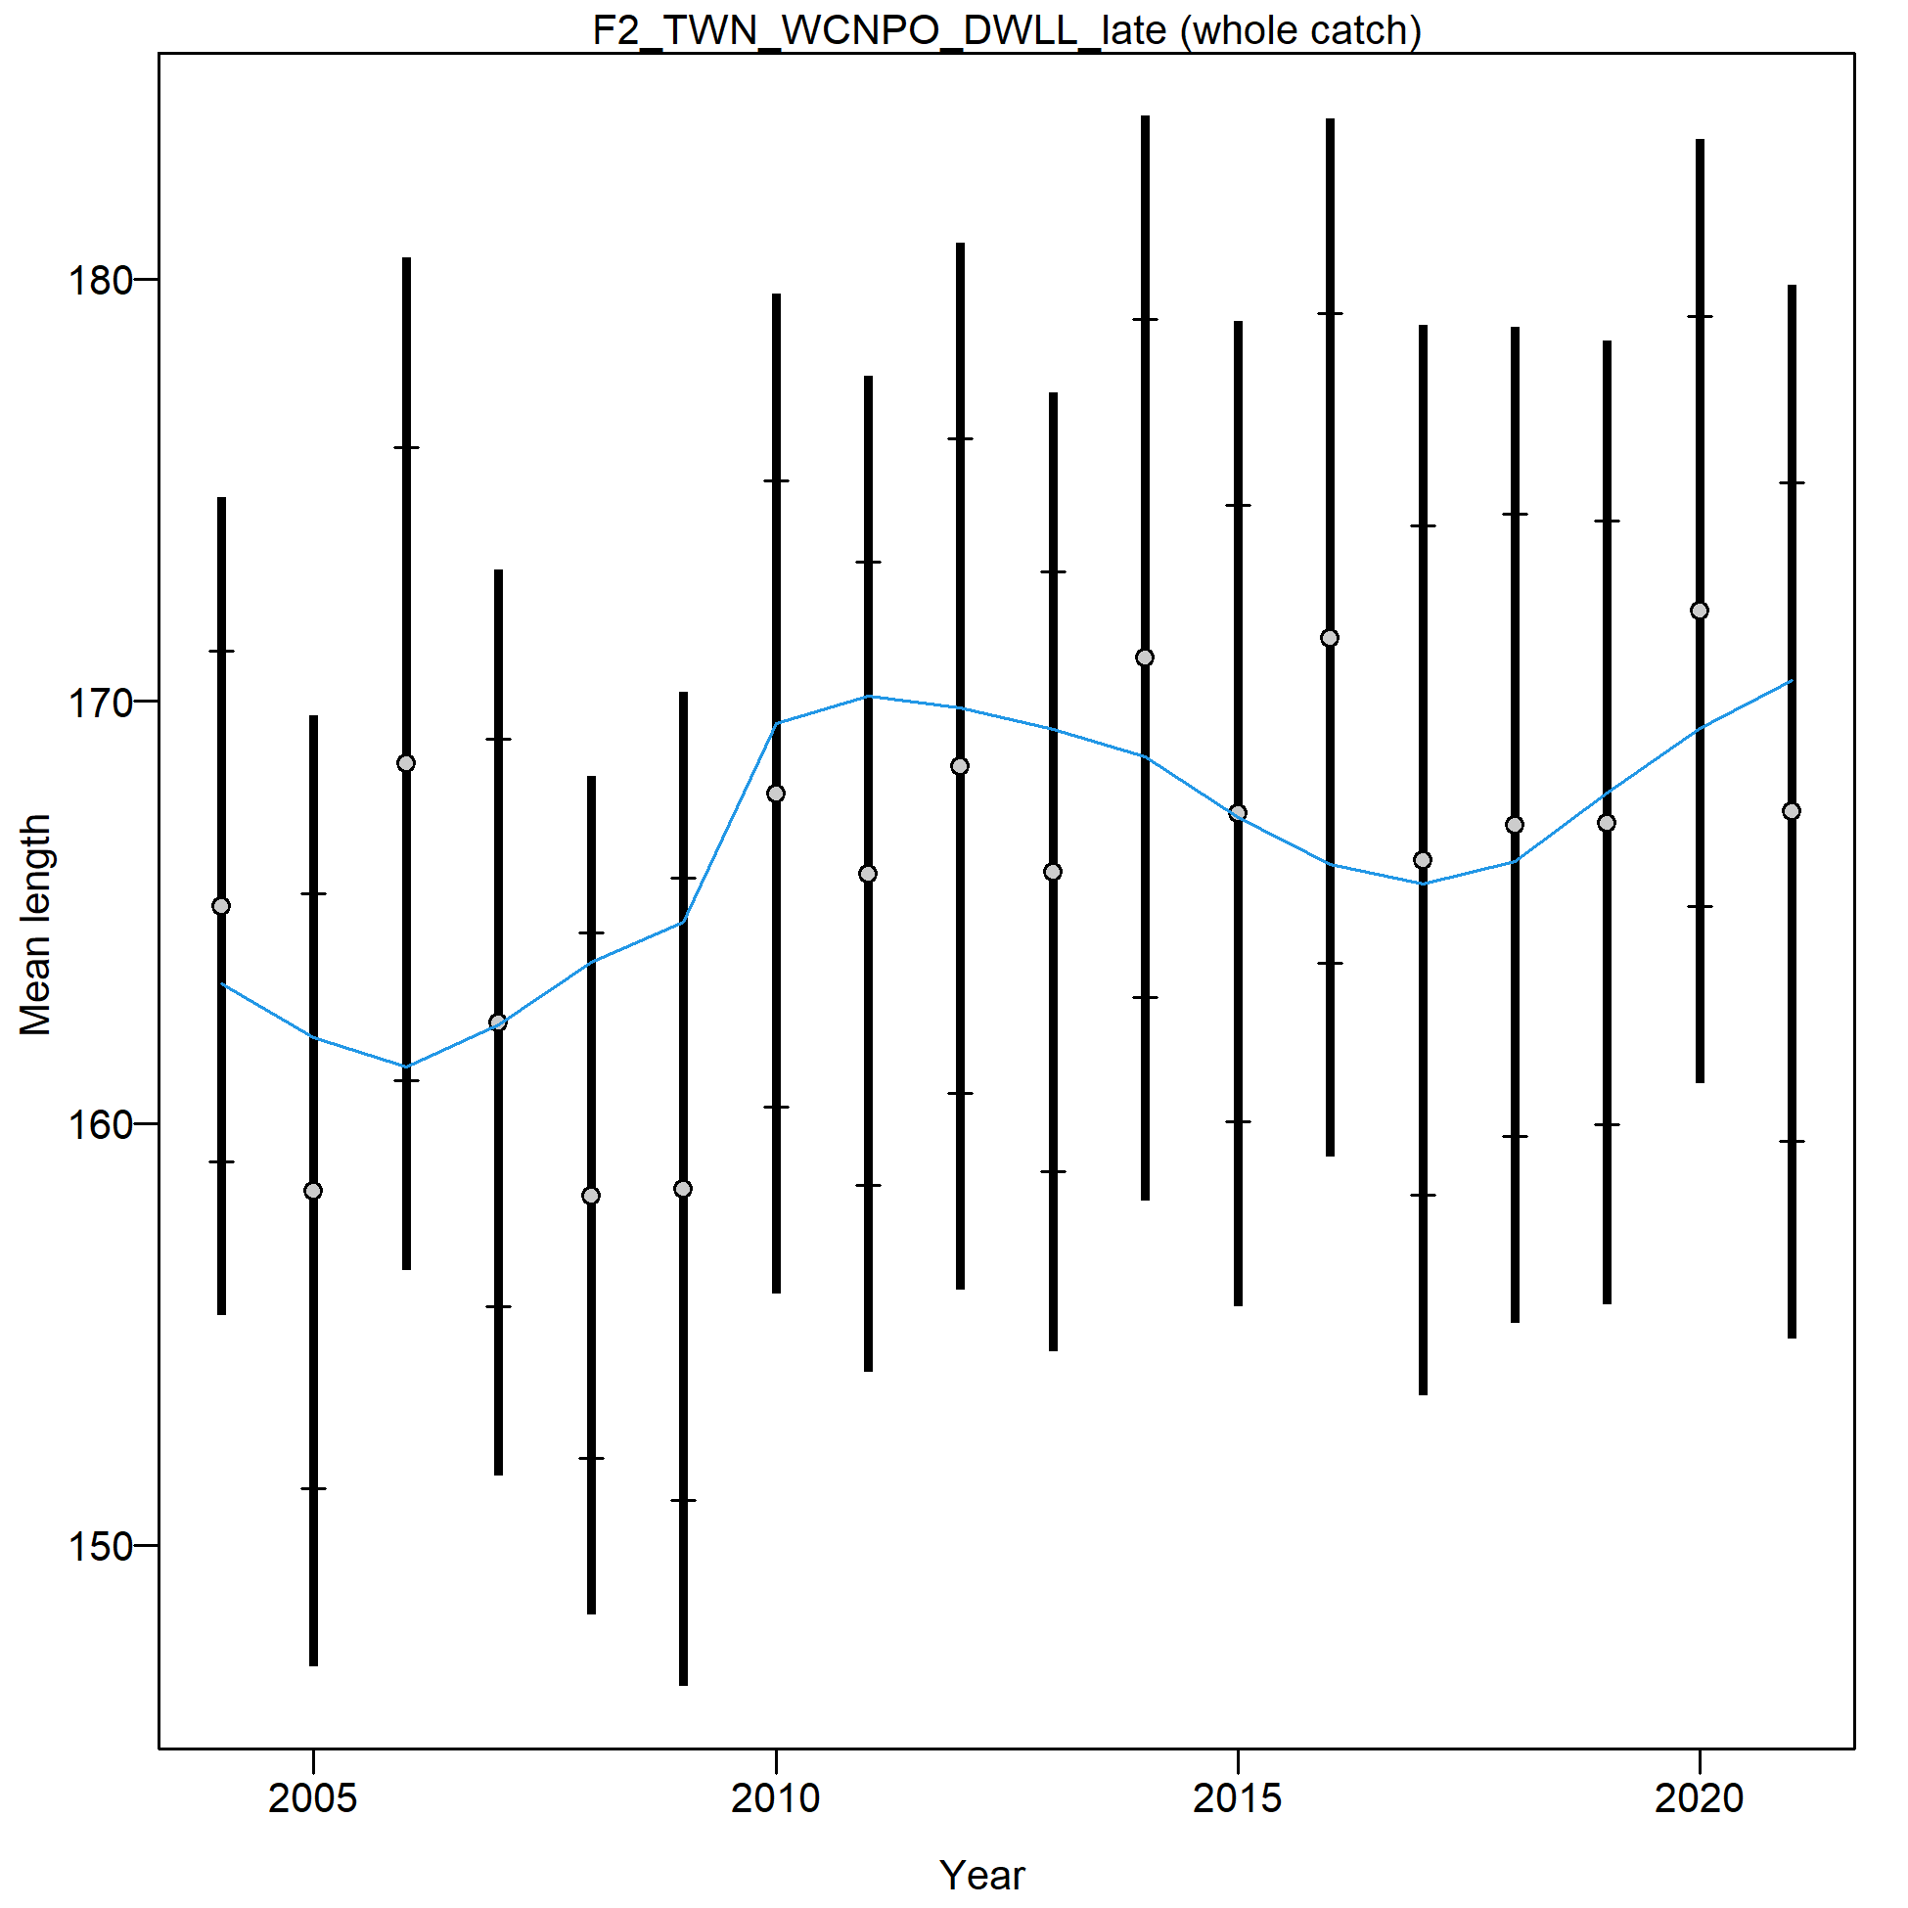
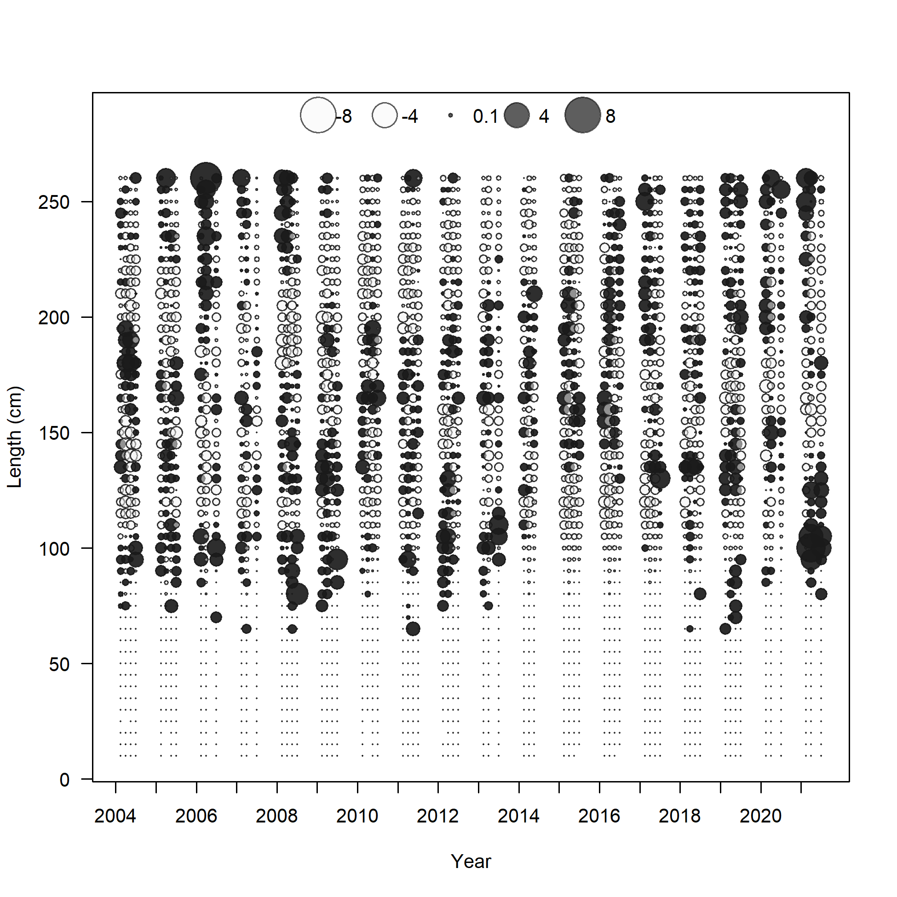

Slide 20
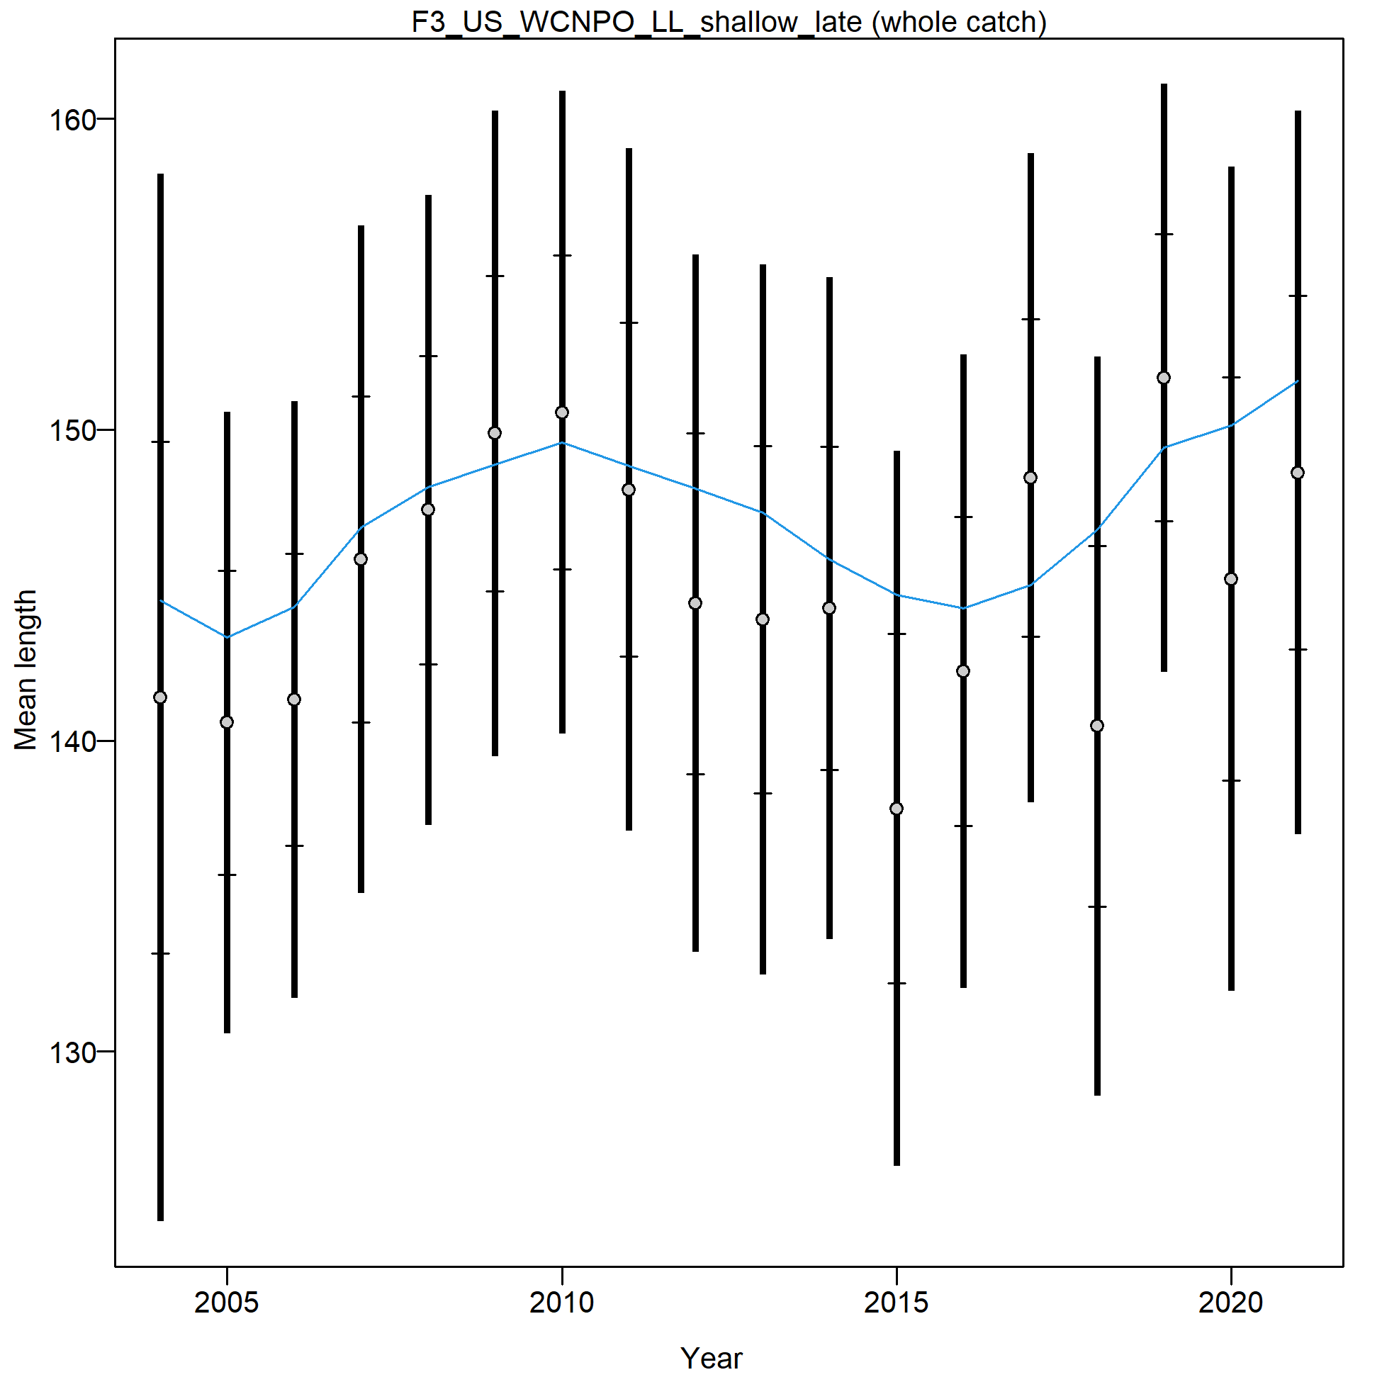
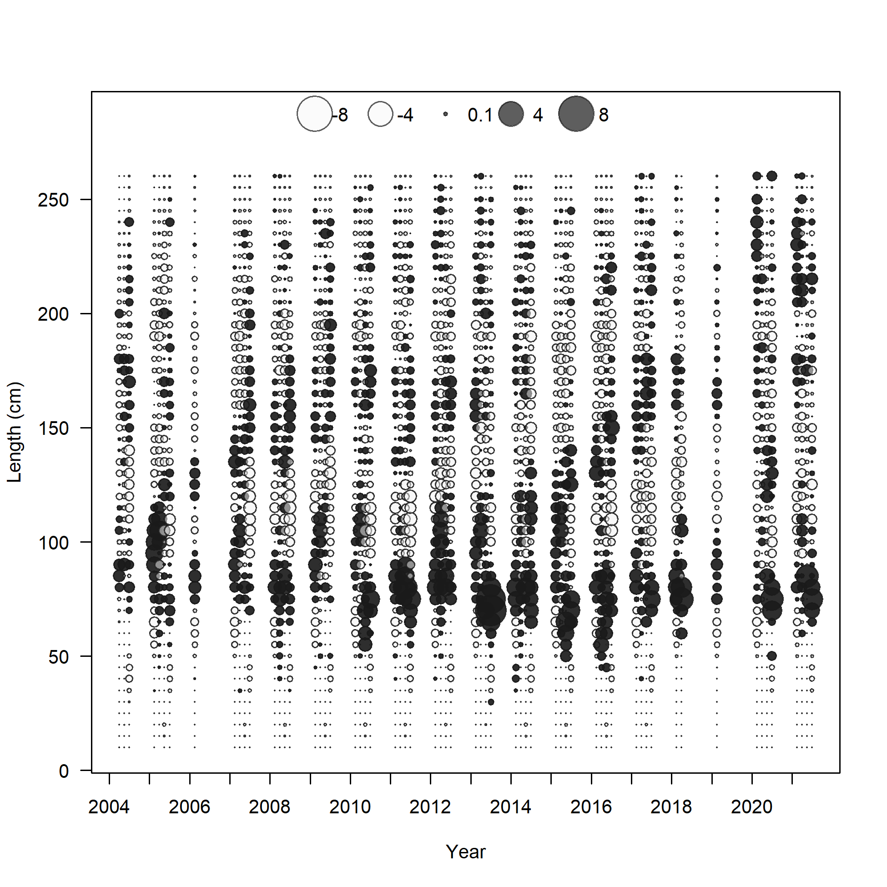

Slide 21
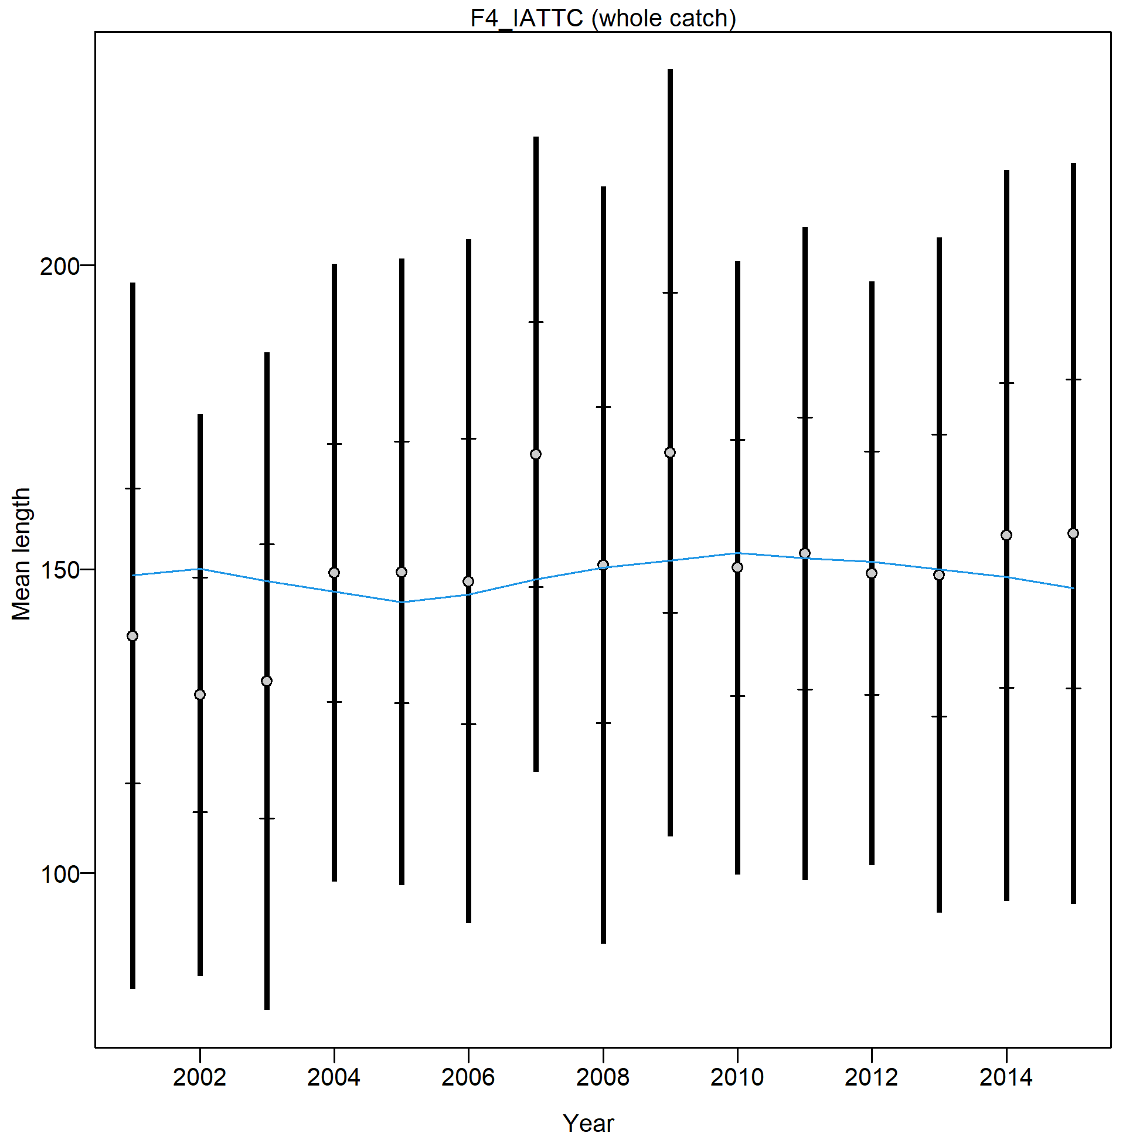
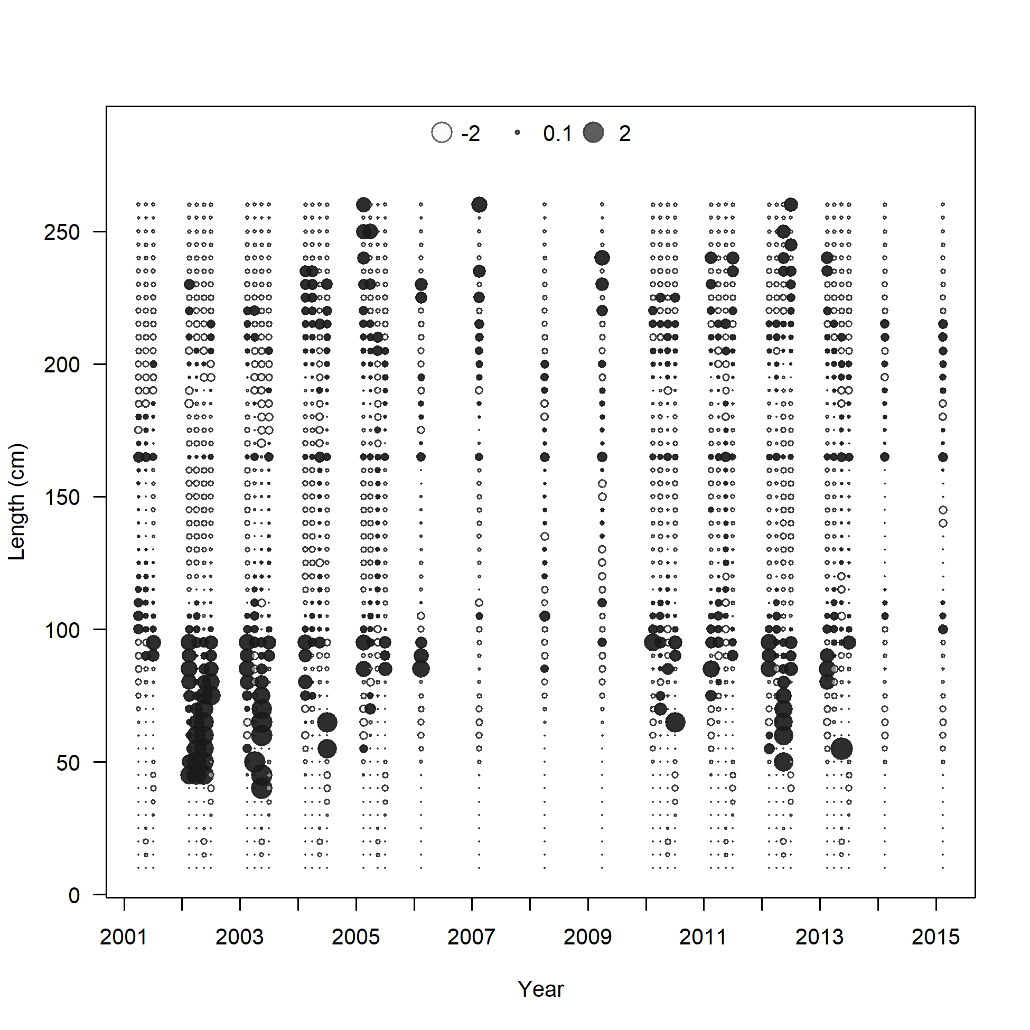

Slide 22
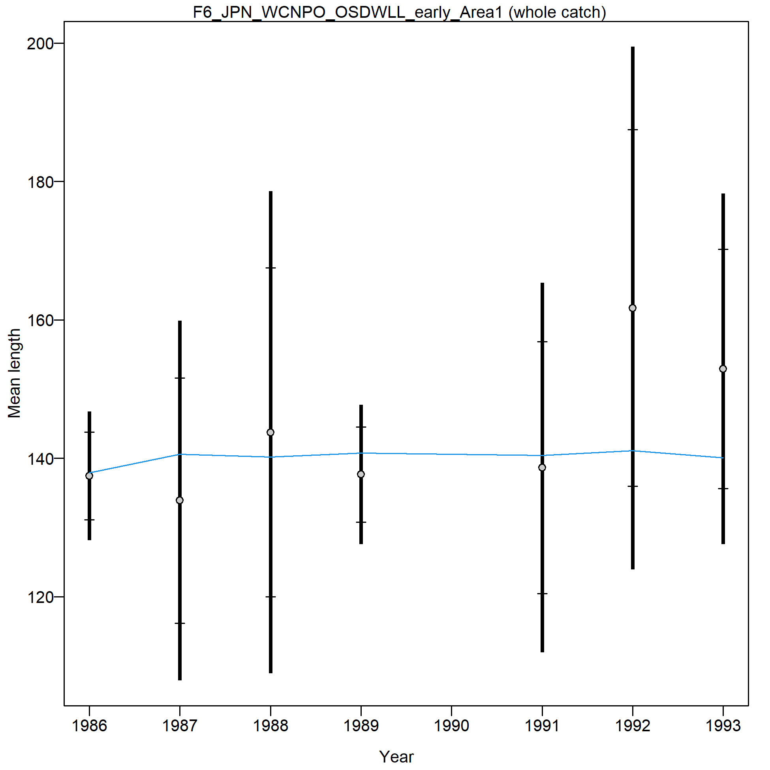
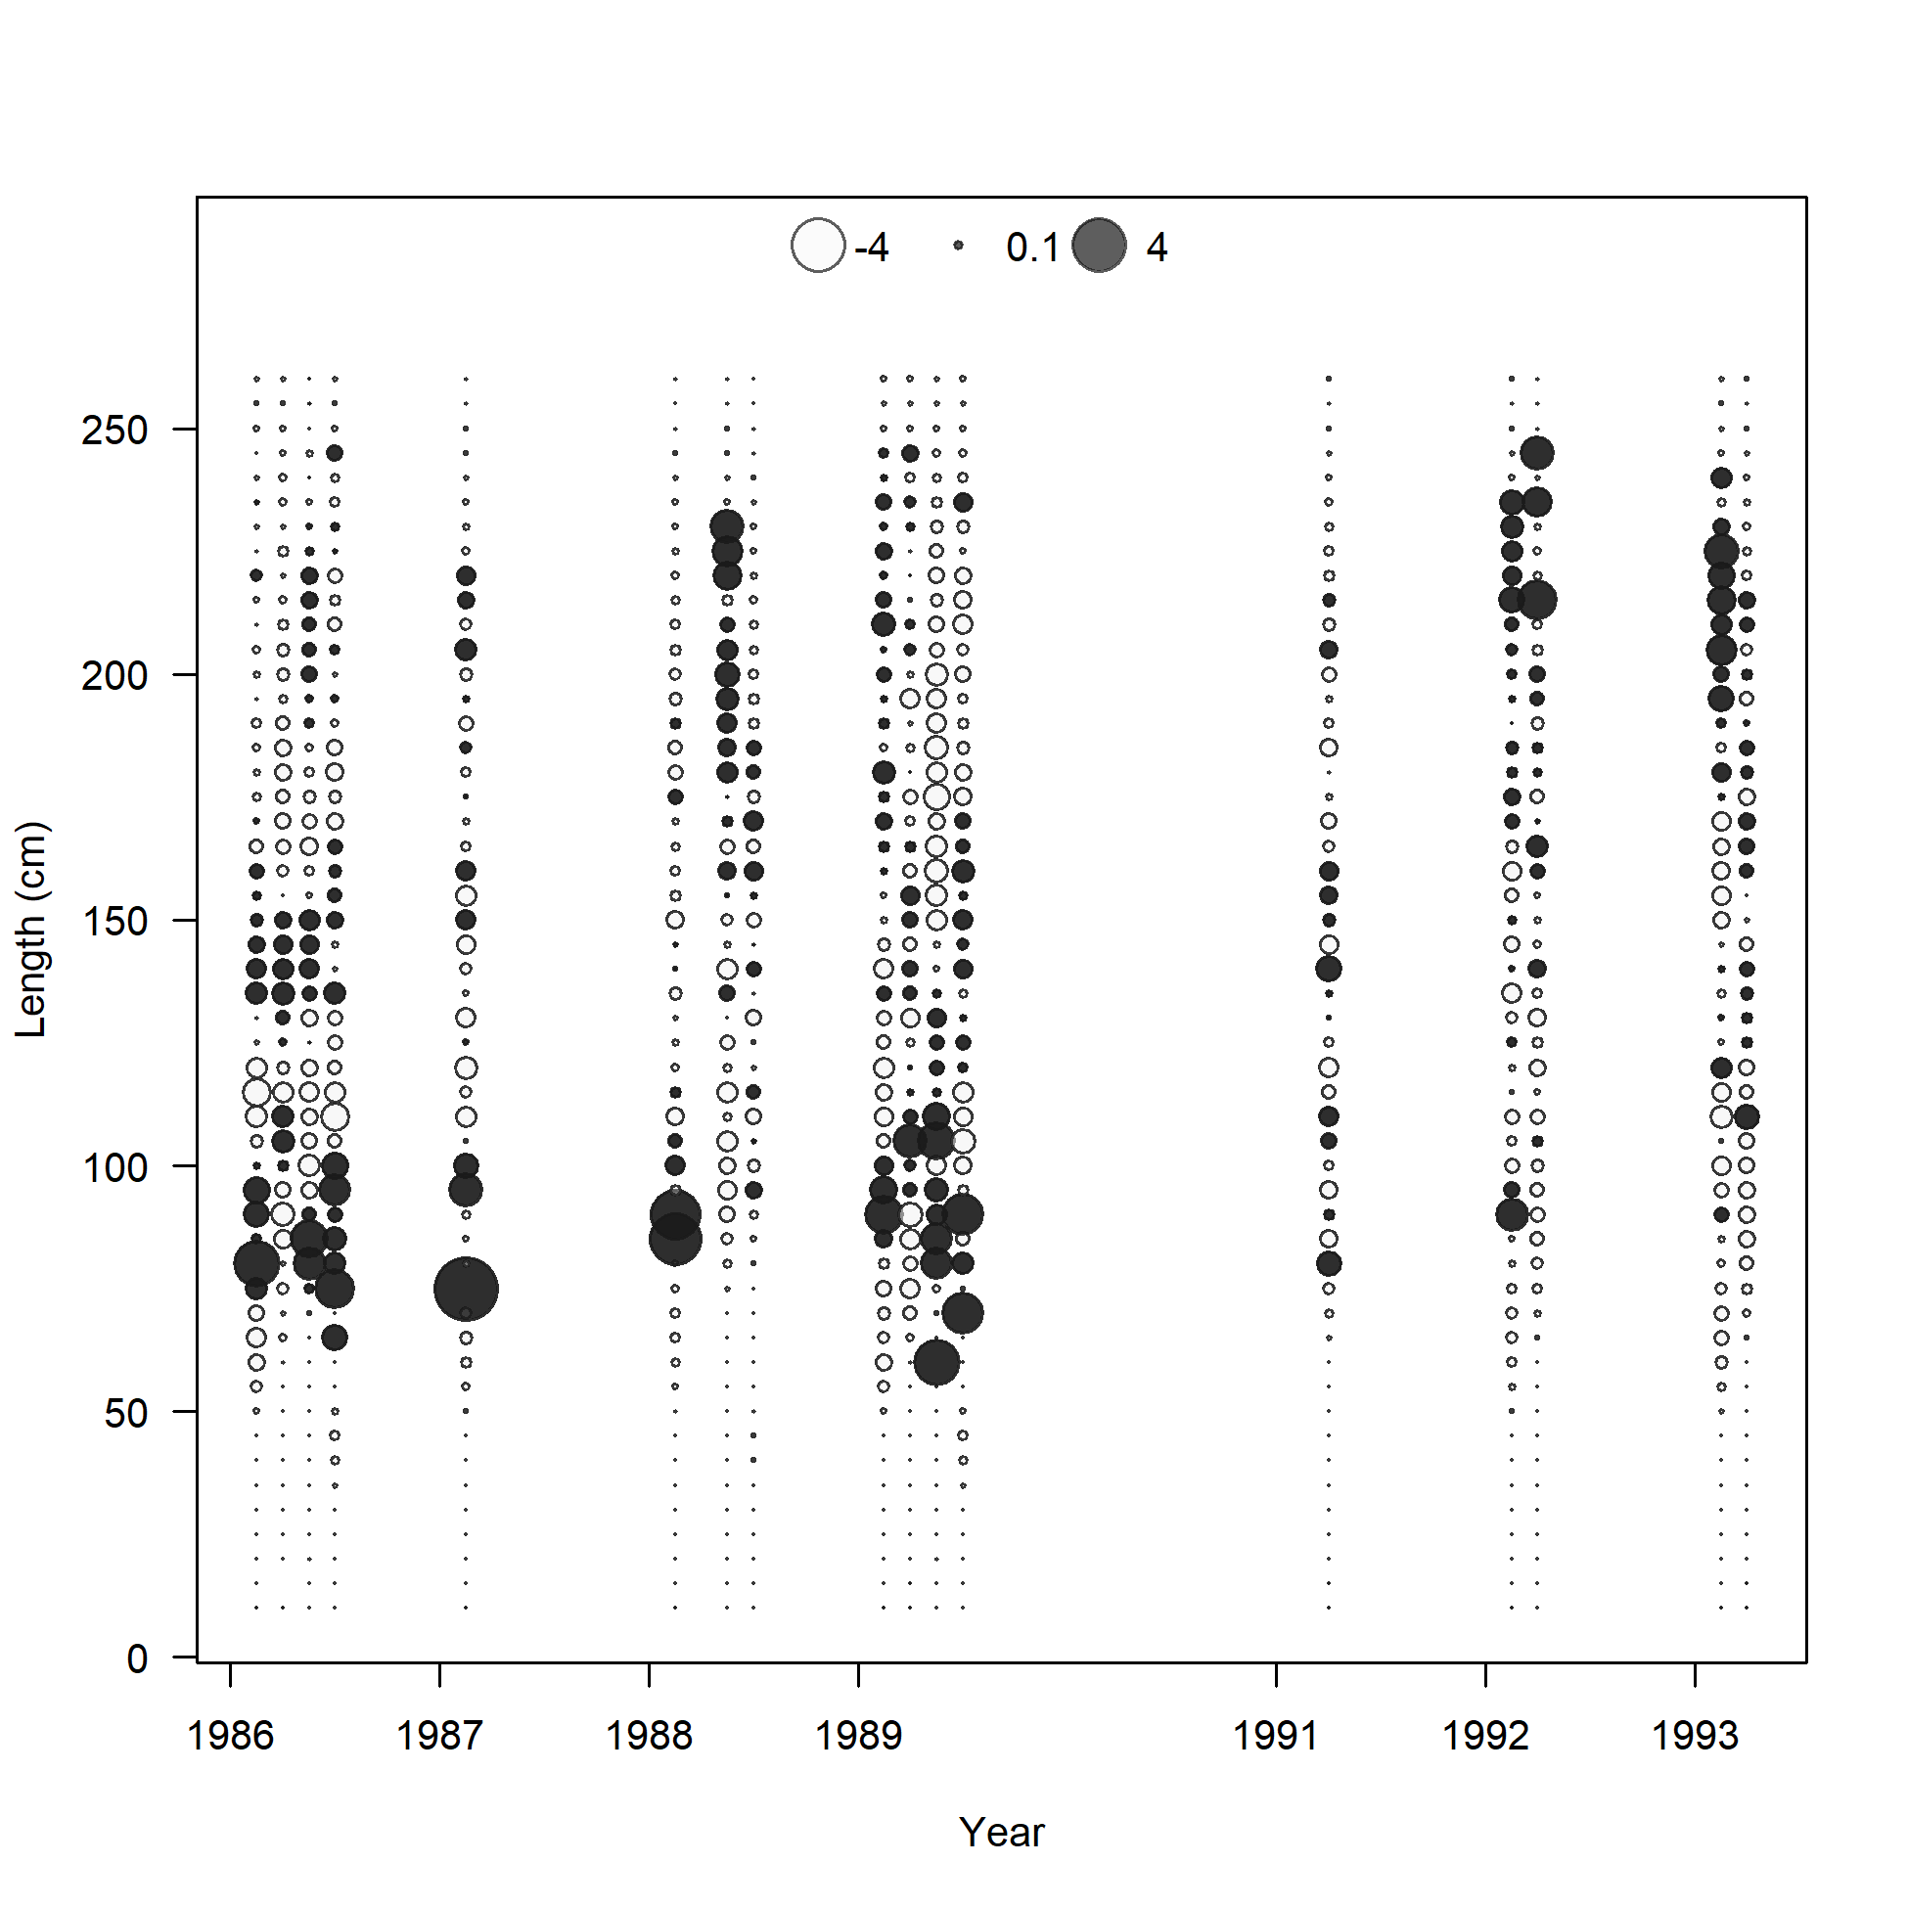

Slide 23
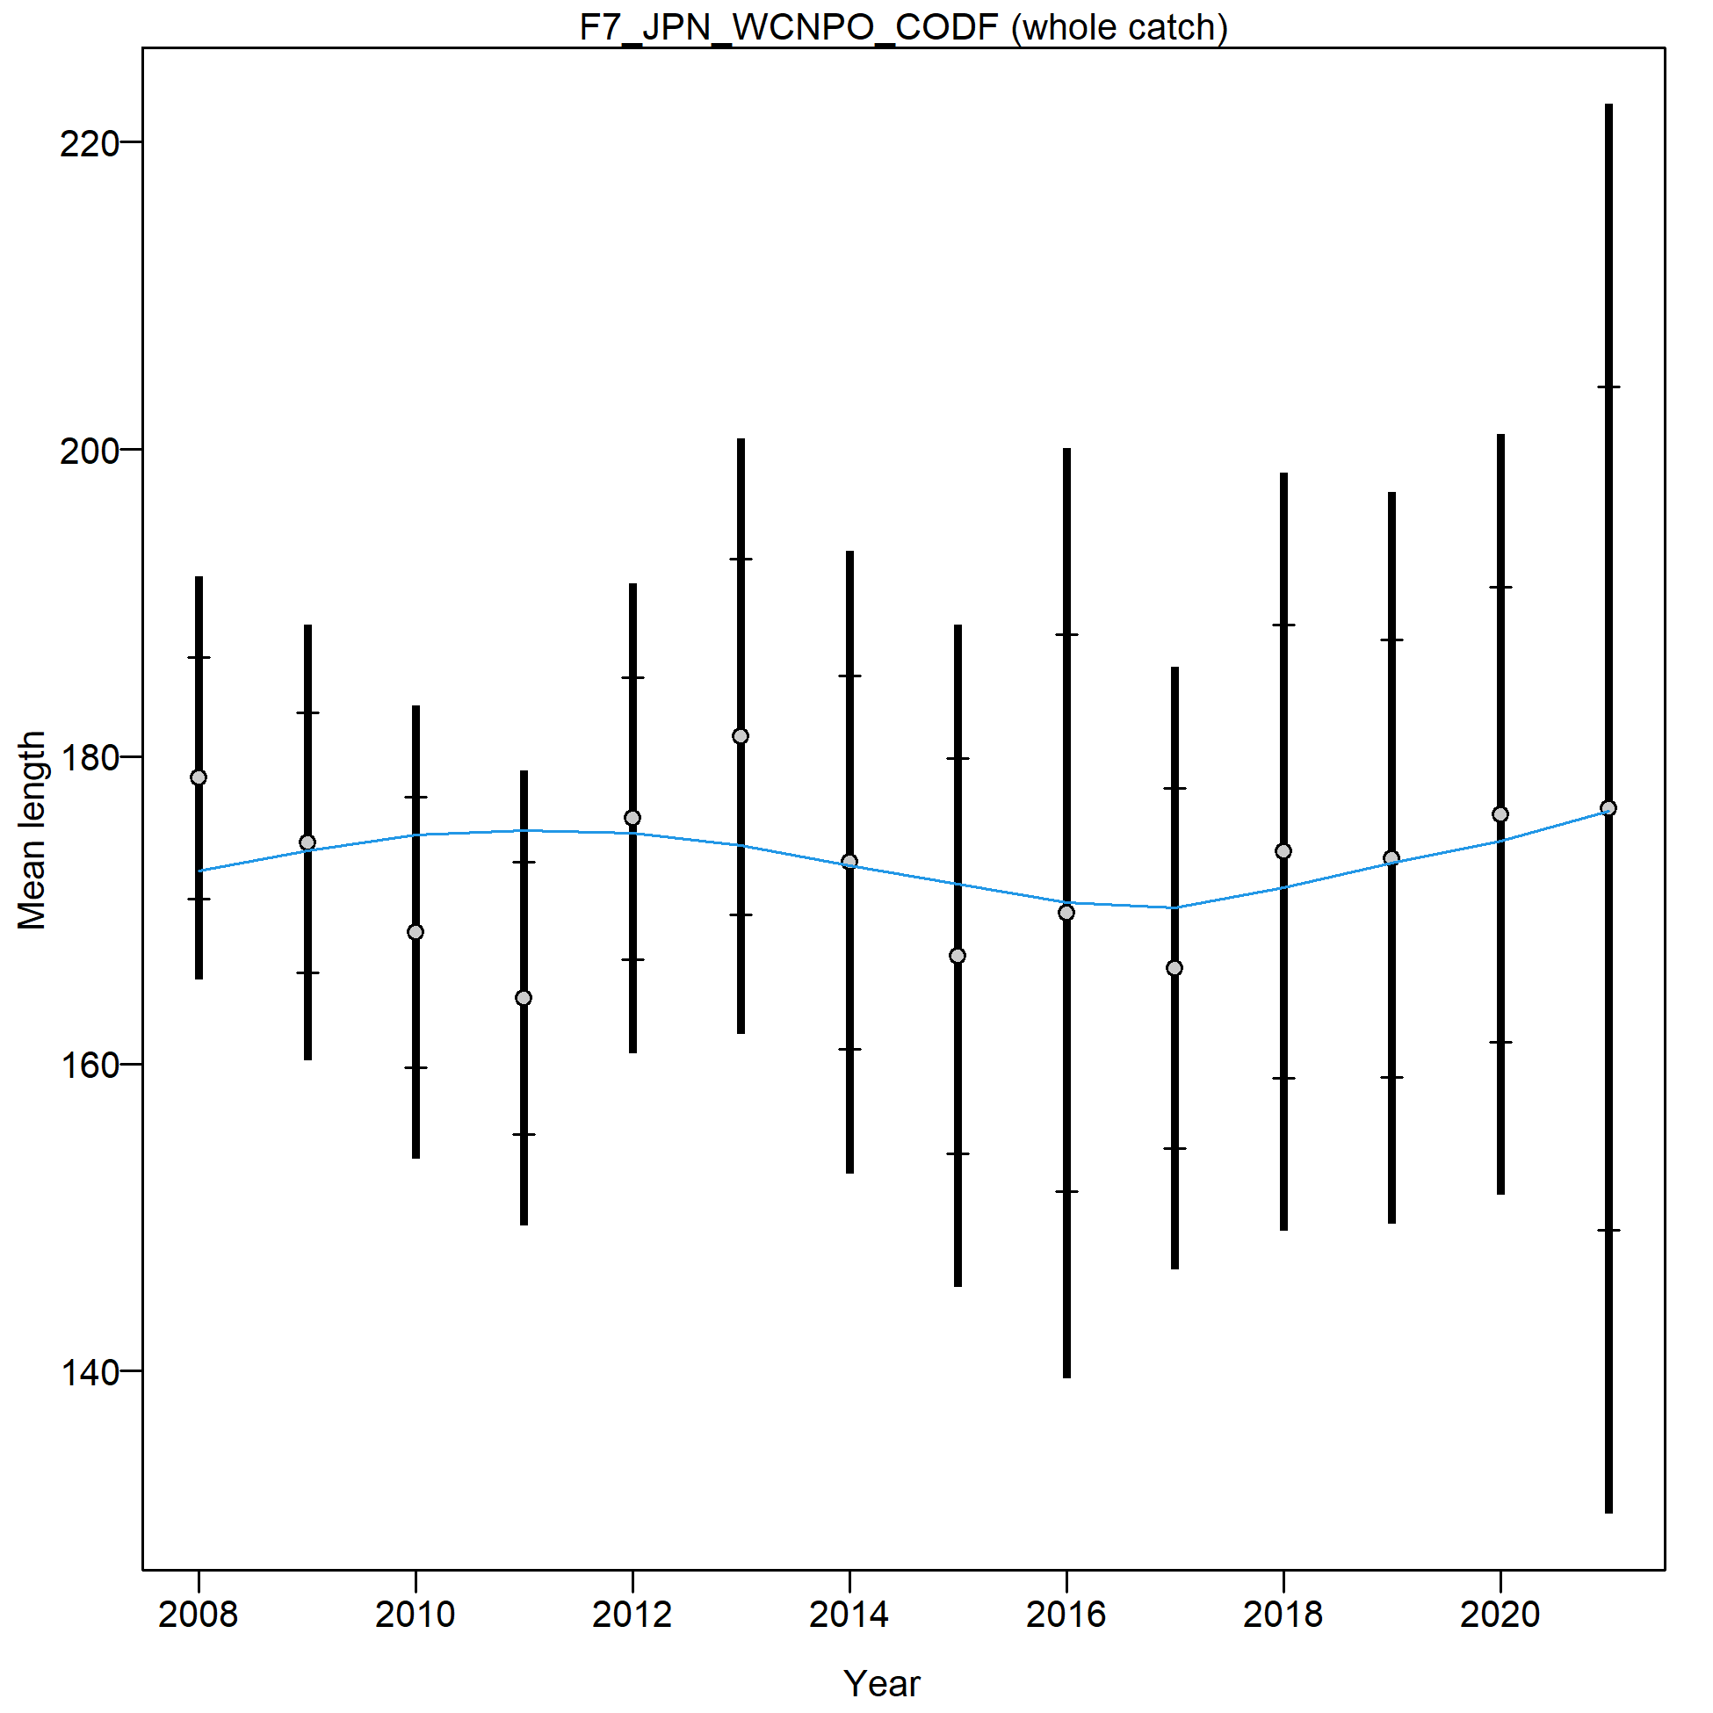
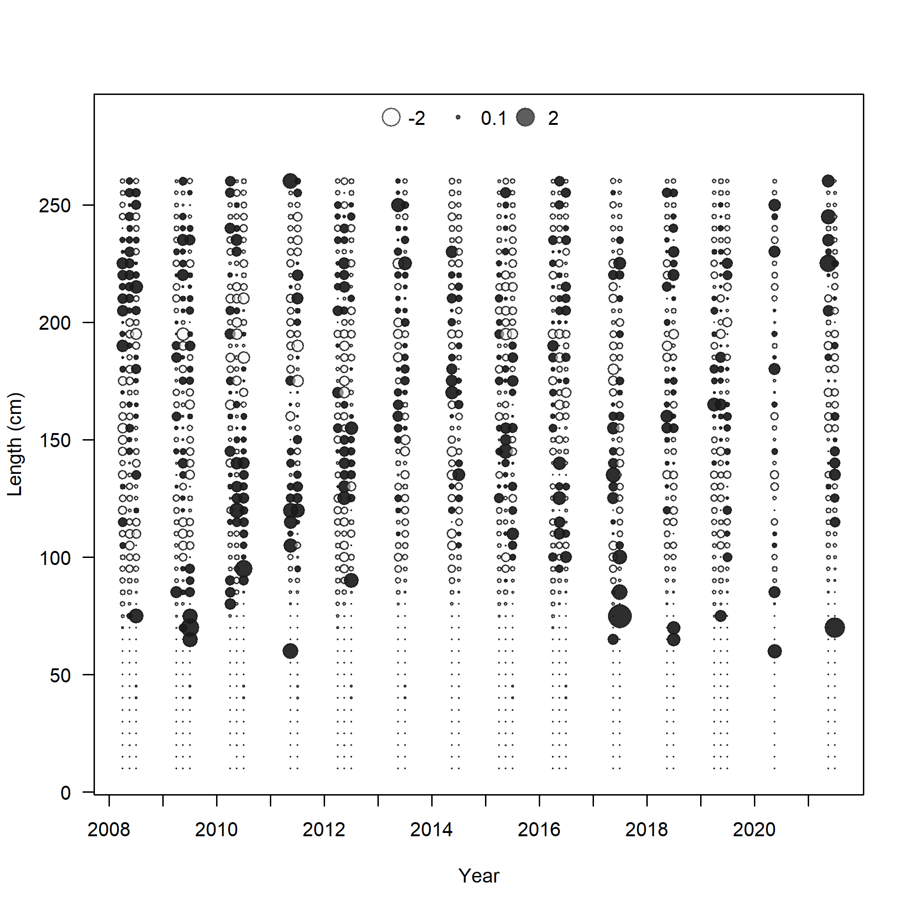

Slide 24
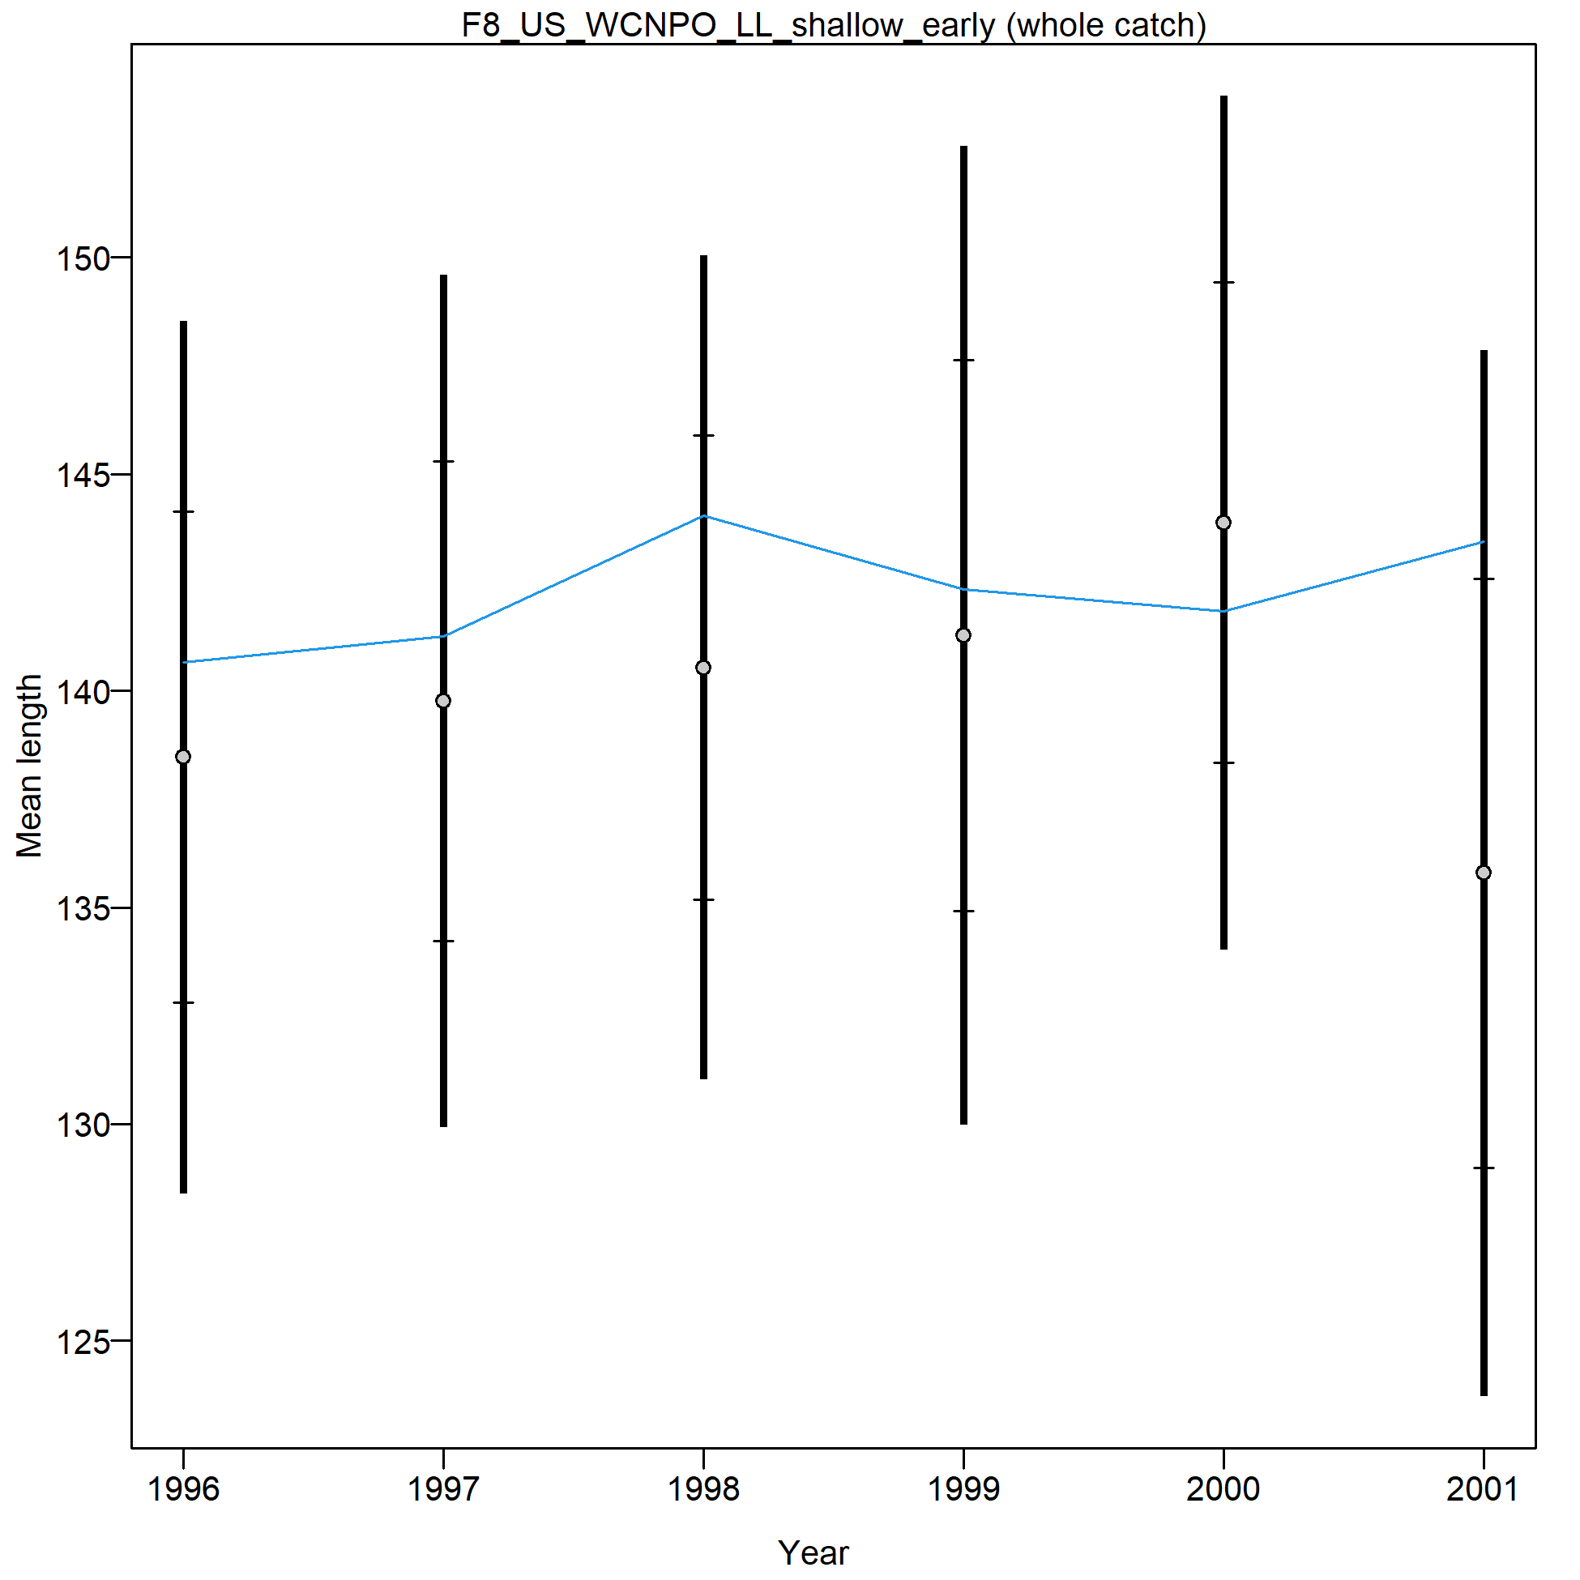
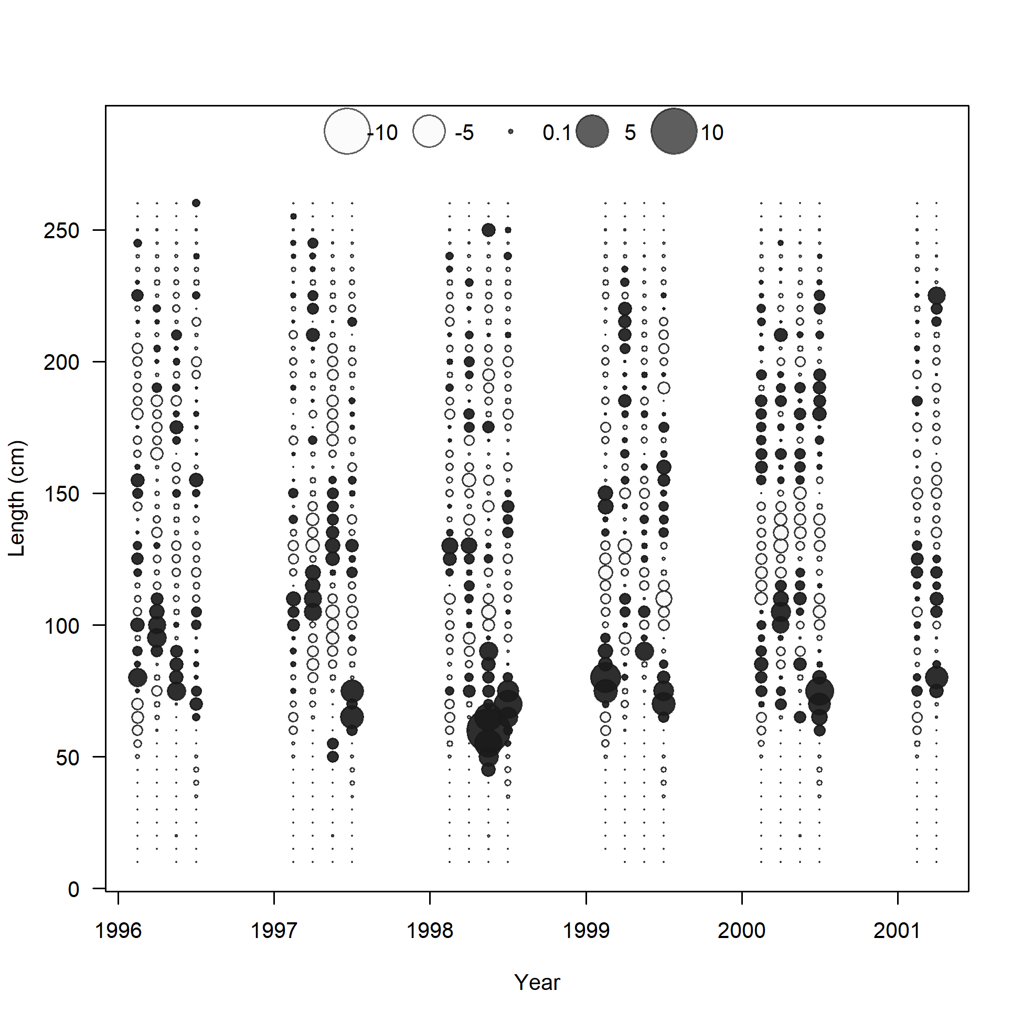

Slide 25
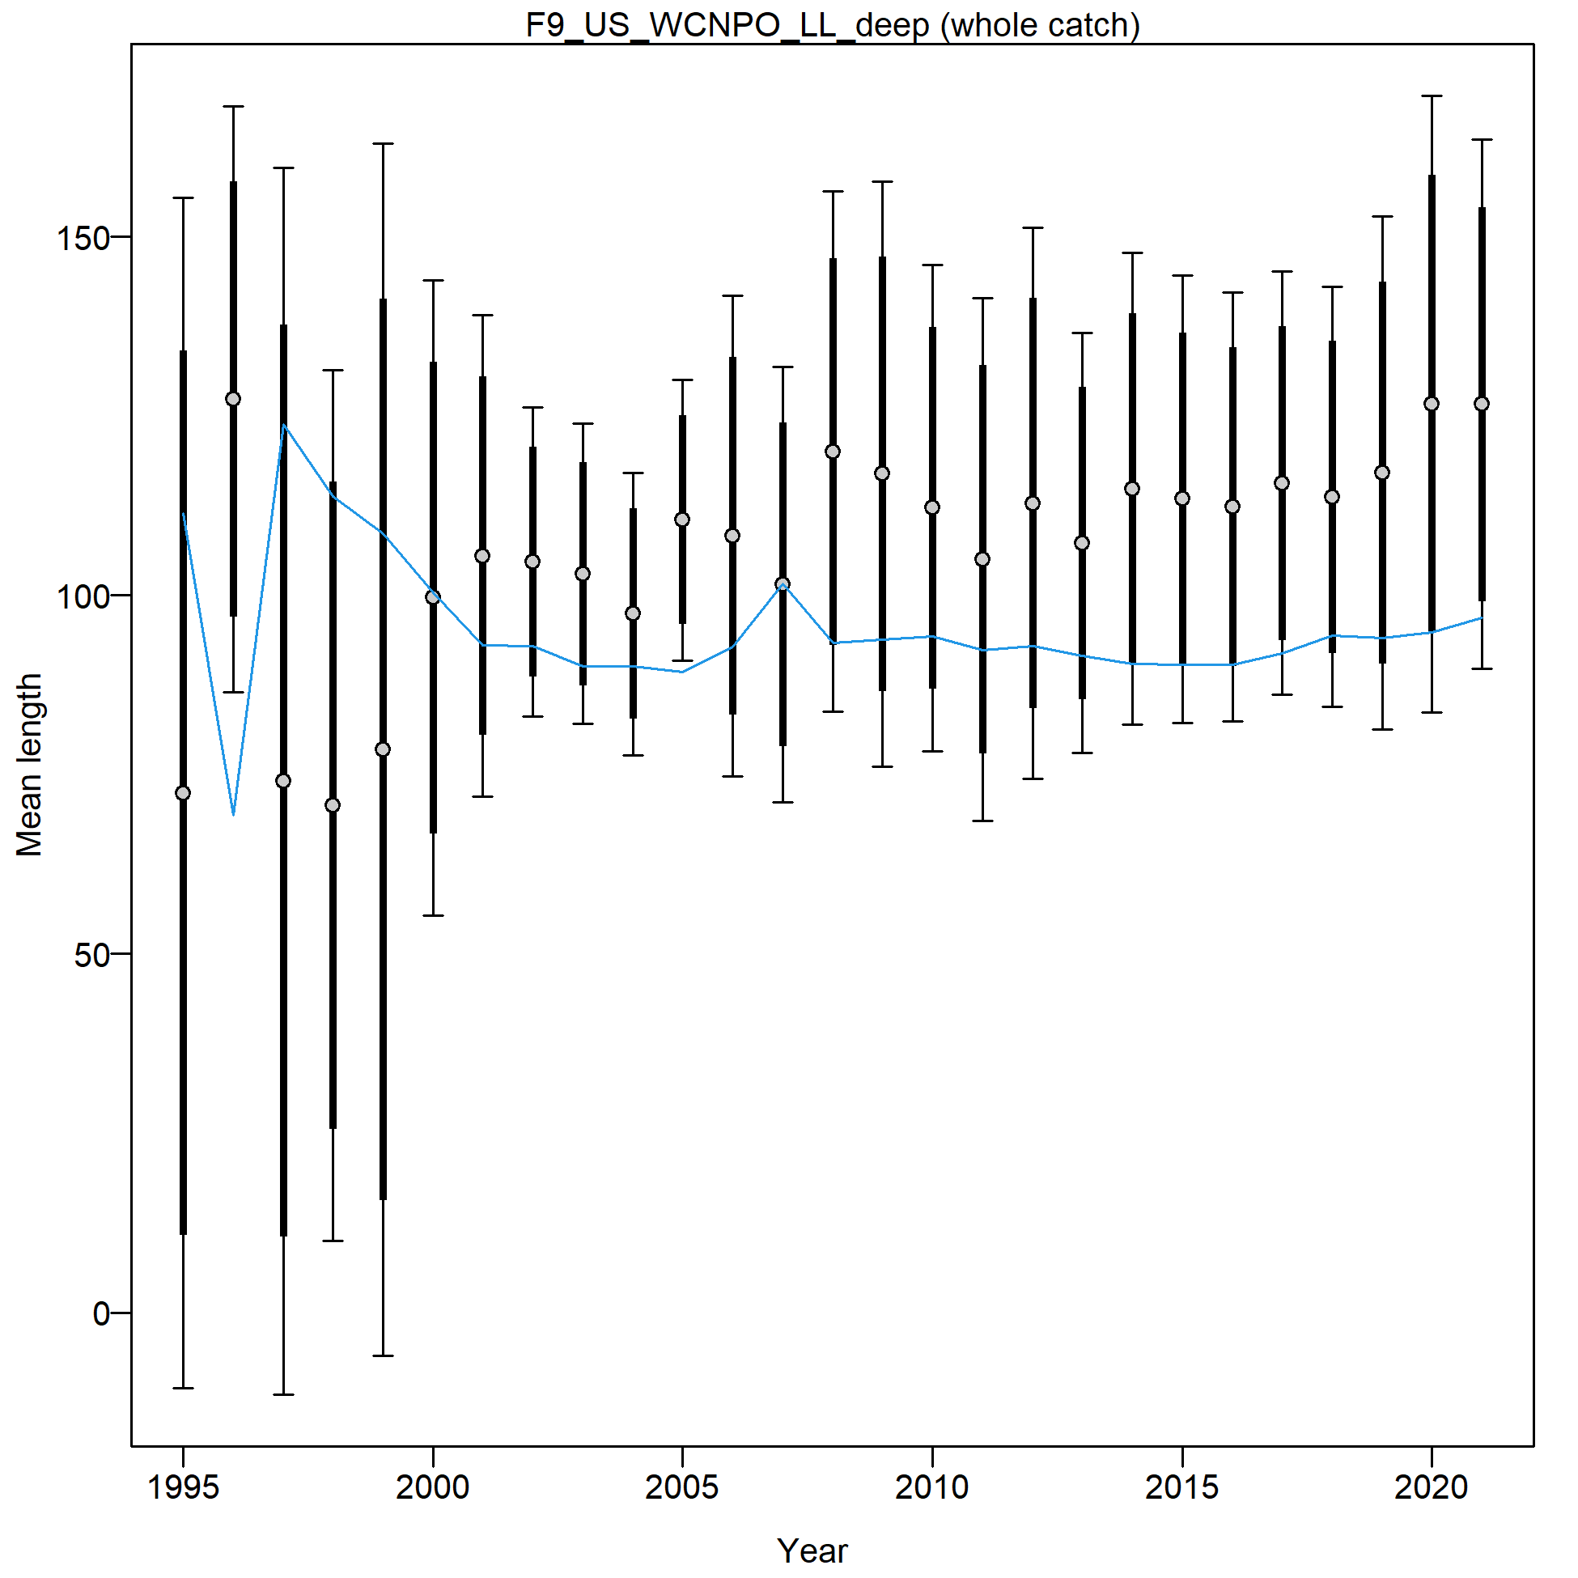
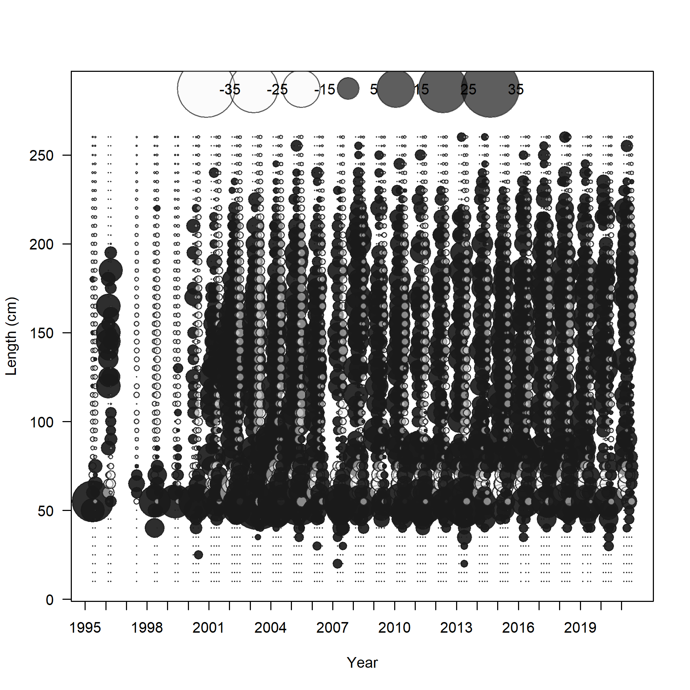
@ the last Modeling Team meeting, we decided to focus on improving the fit to this fleet. A model dividing this fleet into 4 is in progress, but while fits to the data improve, the model does not converge.

Slide 26
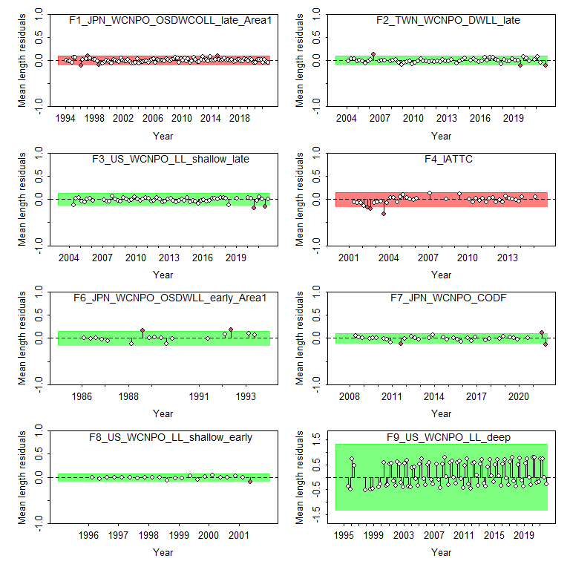

Slide 27
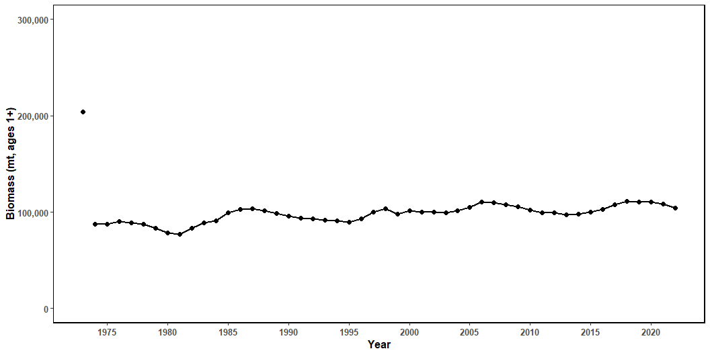
Figure 22: Estimated biomass (mt) of NP swordfish 1+ from the base-case model.

Slide 28

Figure 23: Estimated NP swordfish Spawning Stock Biomass (SSB) from the with 95% confidence intervals. SSB_{MSY} is indicated by the dashed green line.

Slide 29

Figure 24: Estimated annual fishing mortality (average ages 1-10) the with 95% confidence intervals. F_{MSY} is indicated by the dashed green line.

Slide 30

Figure 25: Estimated annual recruitment (thouseands of age-0 fish) with 95% confidence intervals.

Slide 31


Slide 32

Figure 27: Likelihood profile over R0 by CPUE index for the base-case model.

Slide 33

Figure 28: Likelihood profile over R0 for each length composition time series for the base-case model.

Slide 34

Figure 29: Spawning stock biomass trend for the ASPM model run (dashed line, triangles) and the base-case model (solid line, circles). Grey shading indicates 95% confidence intervals for each model.

Slide 35

Figure 30: Hind casting cross-validation (HCxval) results showing observed (large points with dashed line), fitted (solid lines), and one-year-ahead forecast values (small terminal points)

Slide 36

Figure 31: Hind casting cross-validation (HCxval) results for size composition mean lengths, showing observed (large points with dashed line), fitted (solid lines), and one-year-ahead forecast values (small terminal points.

