Slide 1
A Preliminary Base-case model in SS3.30 for the 2023 North Pacific Swordfish Assessment
Michelle L Sculley, Yi-Jay Chang, Hirotaka Ijima

Slide 2
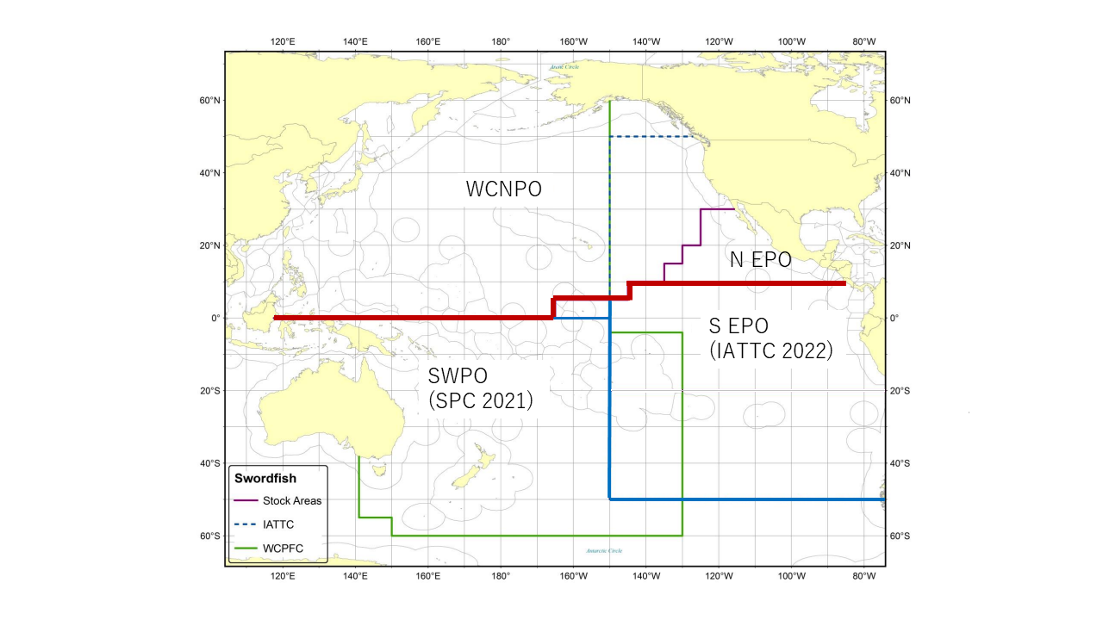
Figure 1: Western and Central North Pacific Ocean and North Eastern Pacific Ocean swordfish stock boundaries for the 2023 North Pacific swordfish assessment. Spatial structure is treated implicitly using fleets as areas.

Slide 3
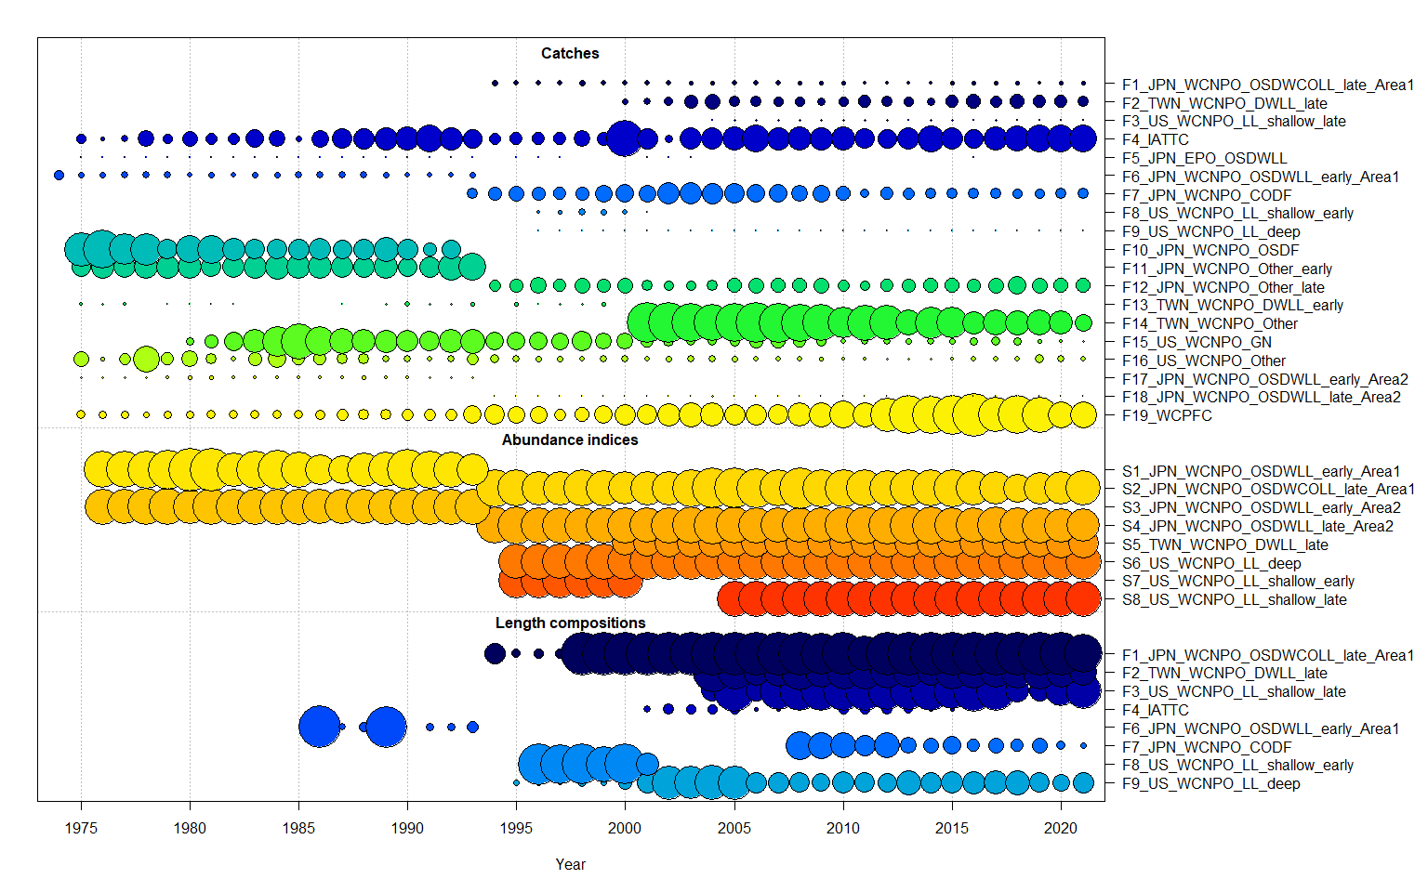
Figure 2: Catch, CPUE index, and size composition data included in the 2023 NP swordfish stock assessment. The size of the bubble indicates the relative number of observations available.

Slide 4
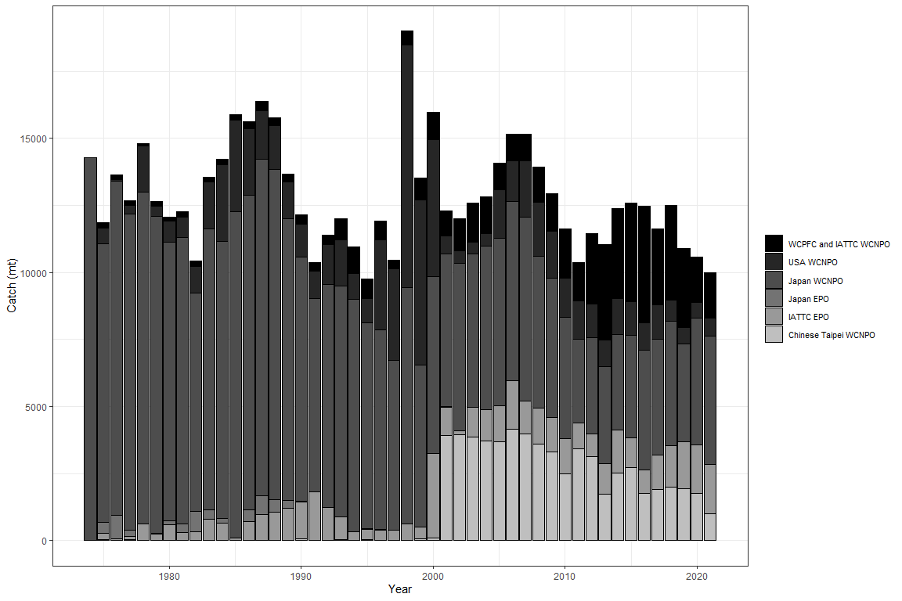
Figure 3: Annual catch of NP swordfish by country or commission and area.

Slide 5
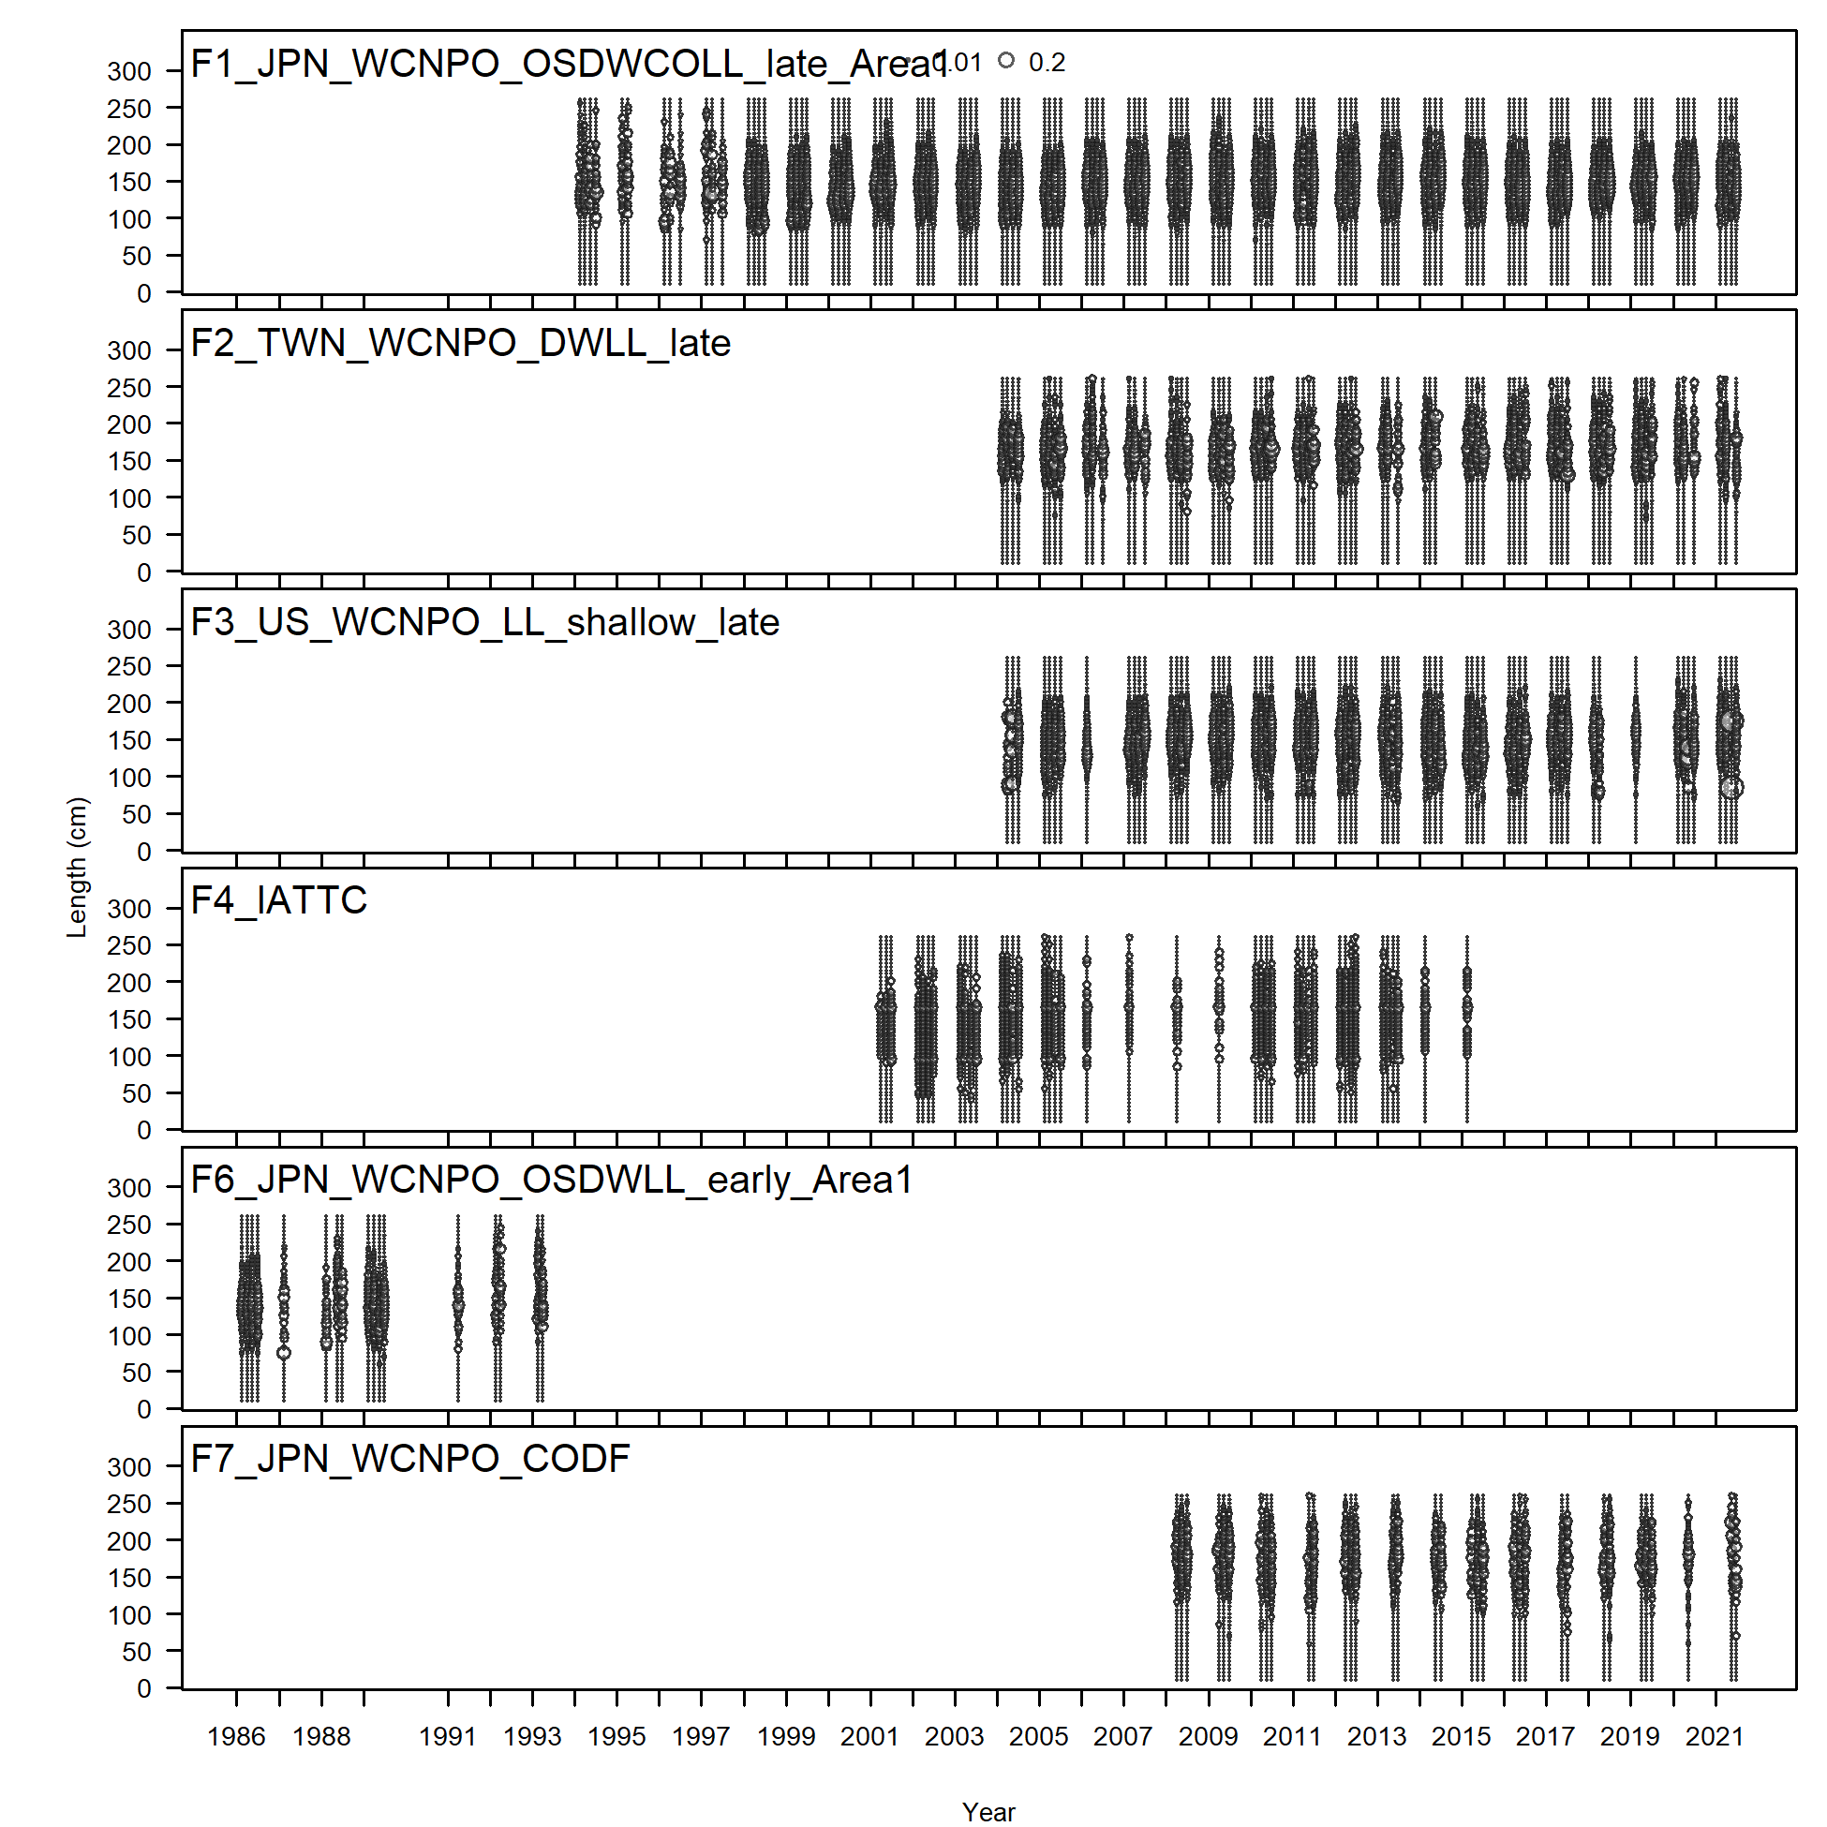
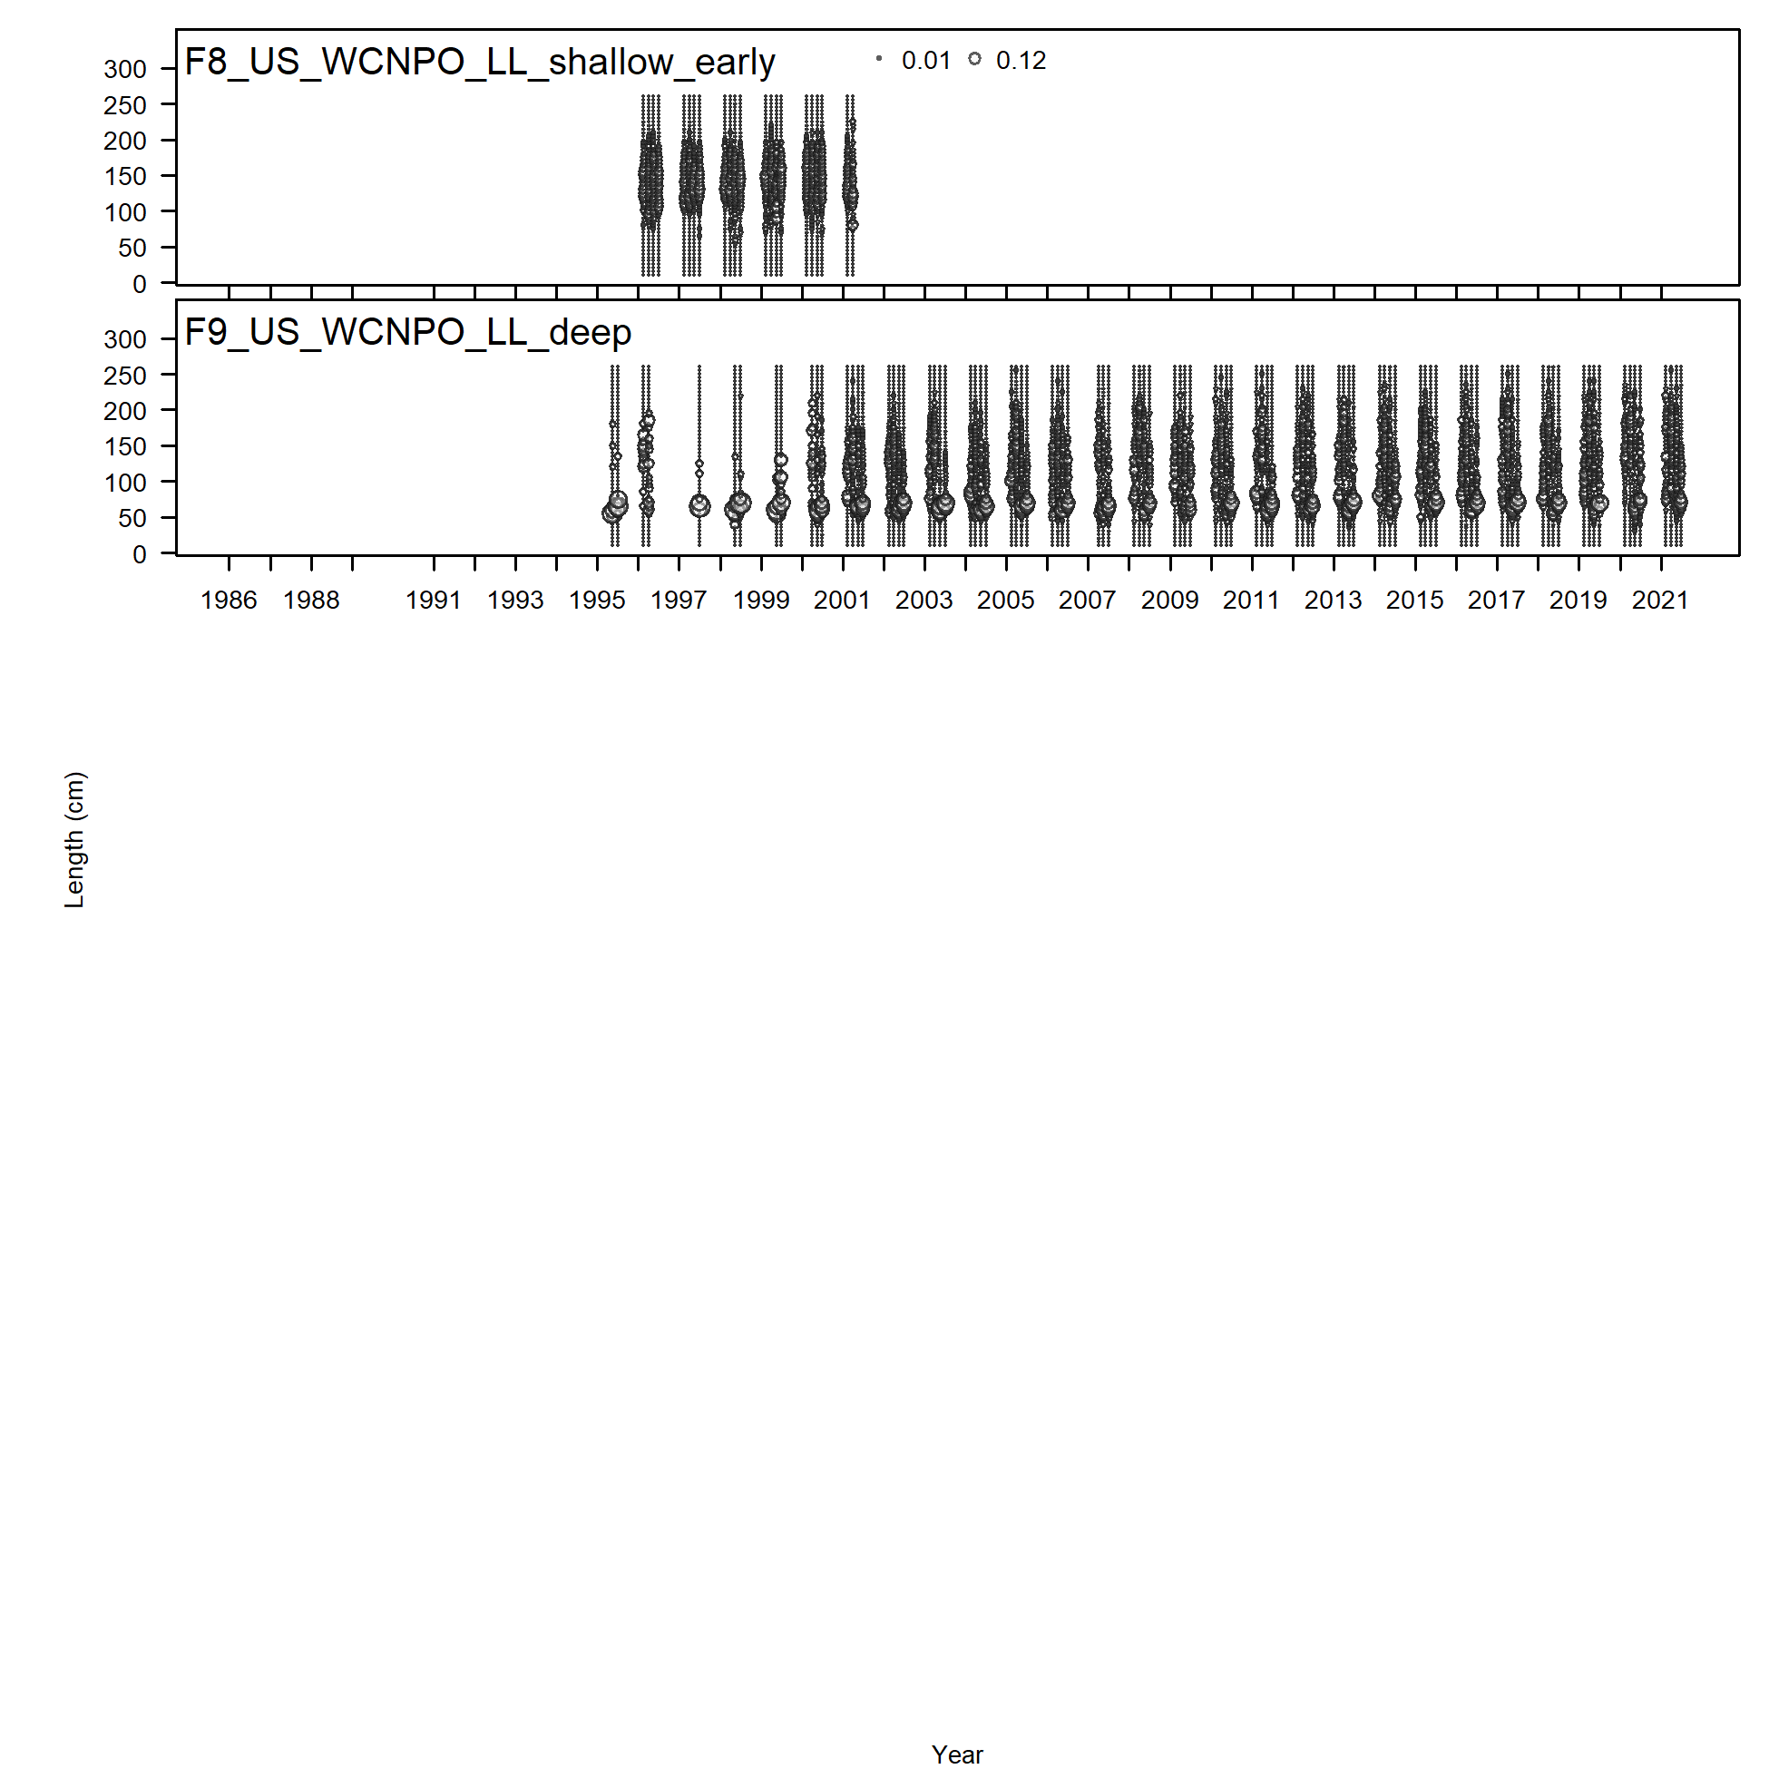

Slide 6
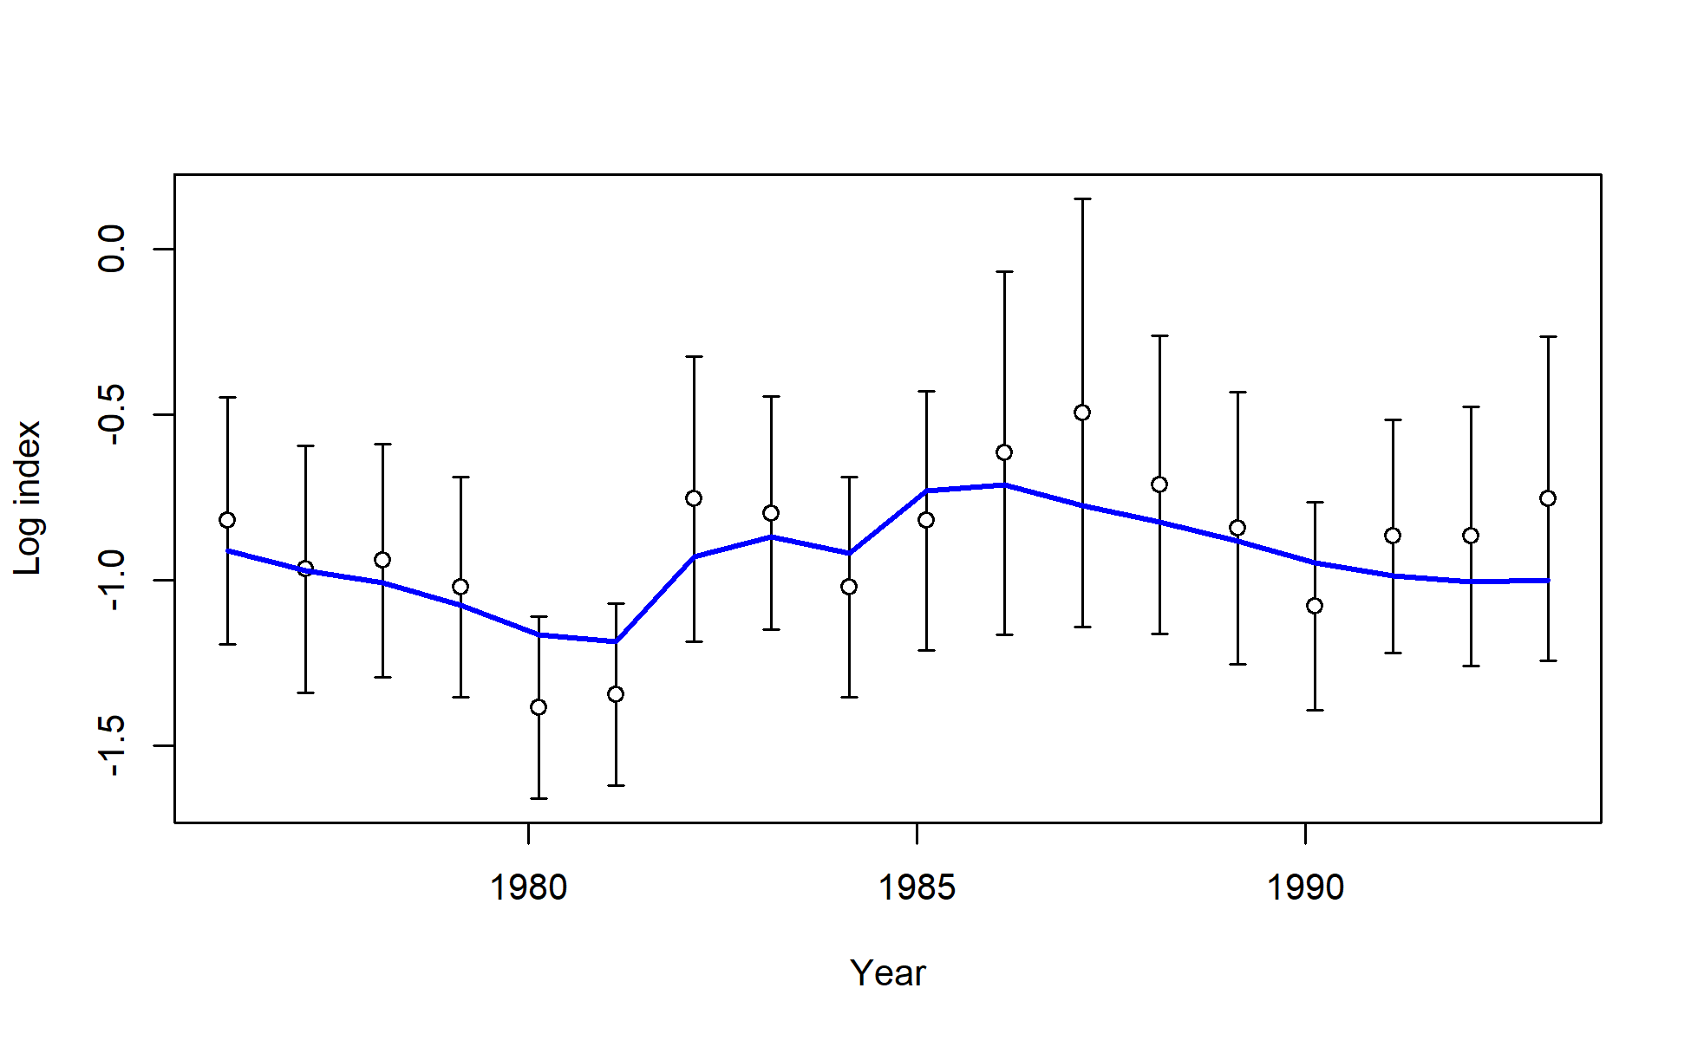
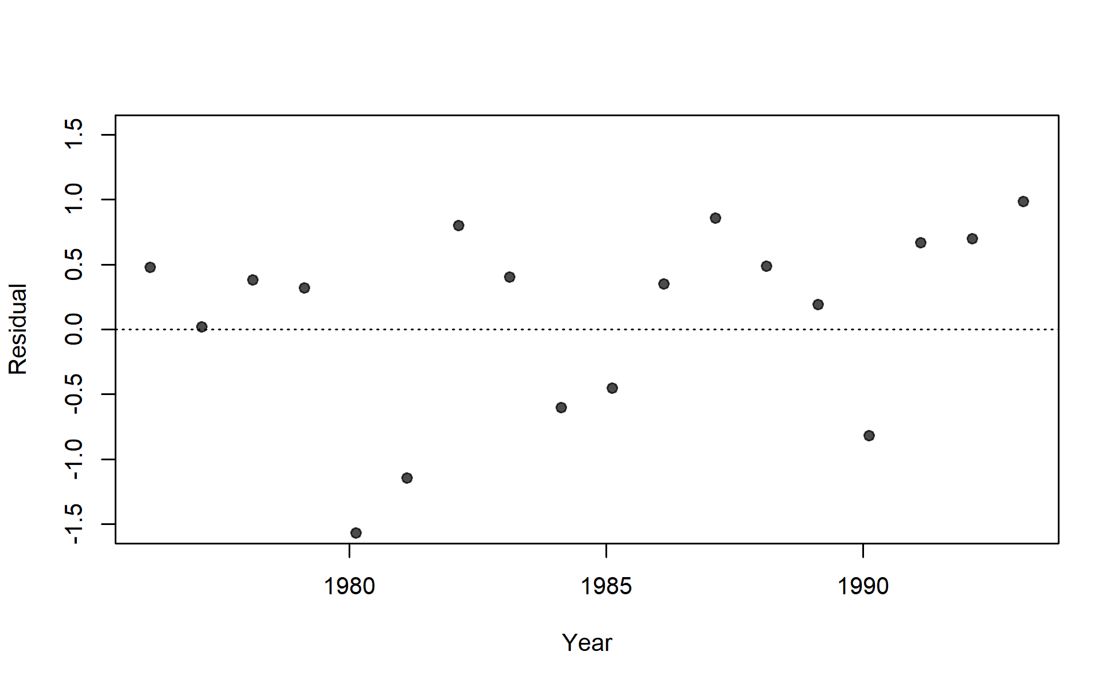
S01_JPN_WCNPO_LL_early_area1

Slide 7
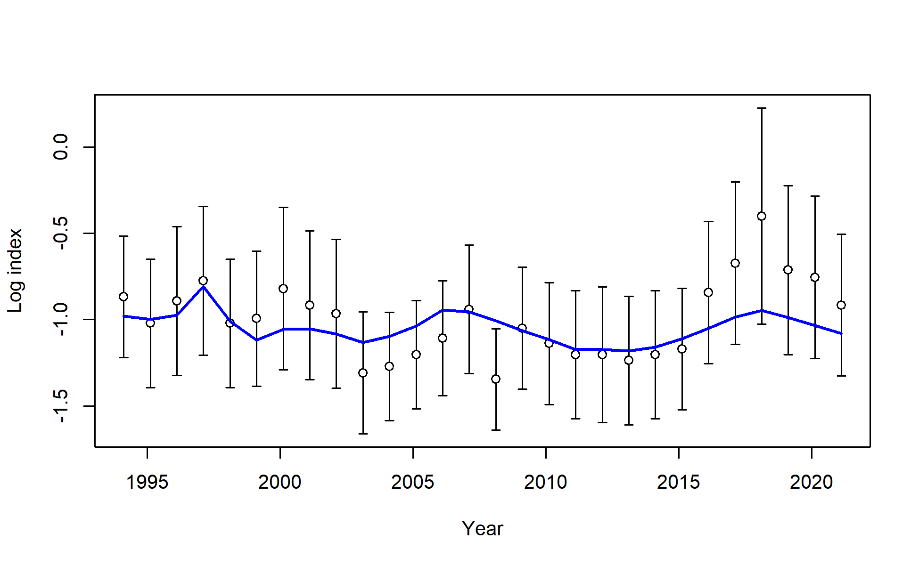
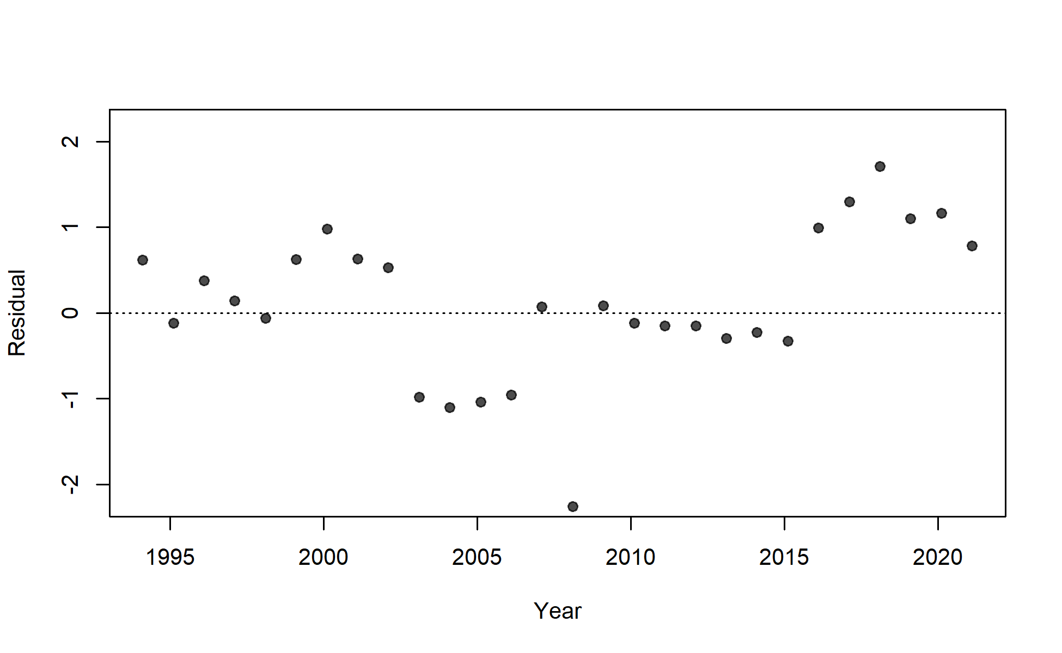
S02_JPN_WCNPO_LL_late_area1

Slide 8
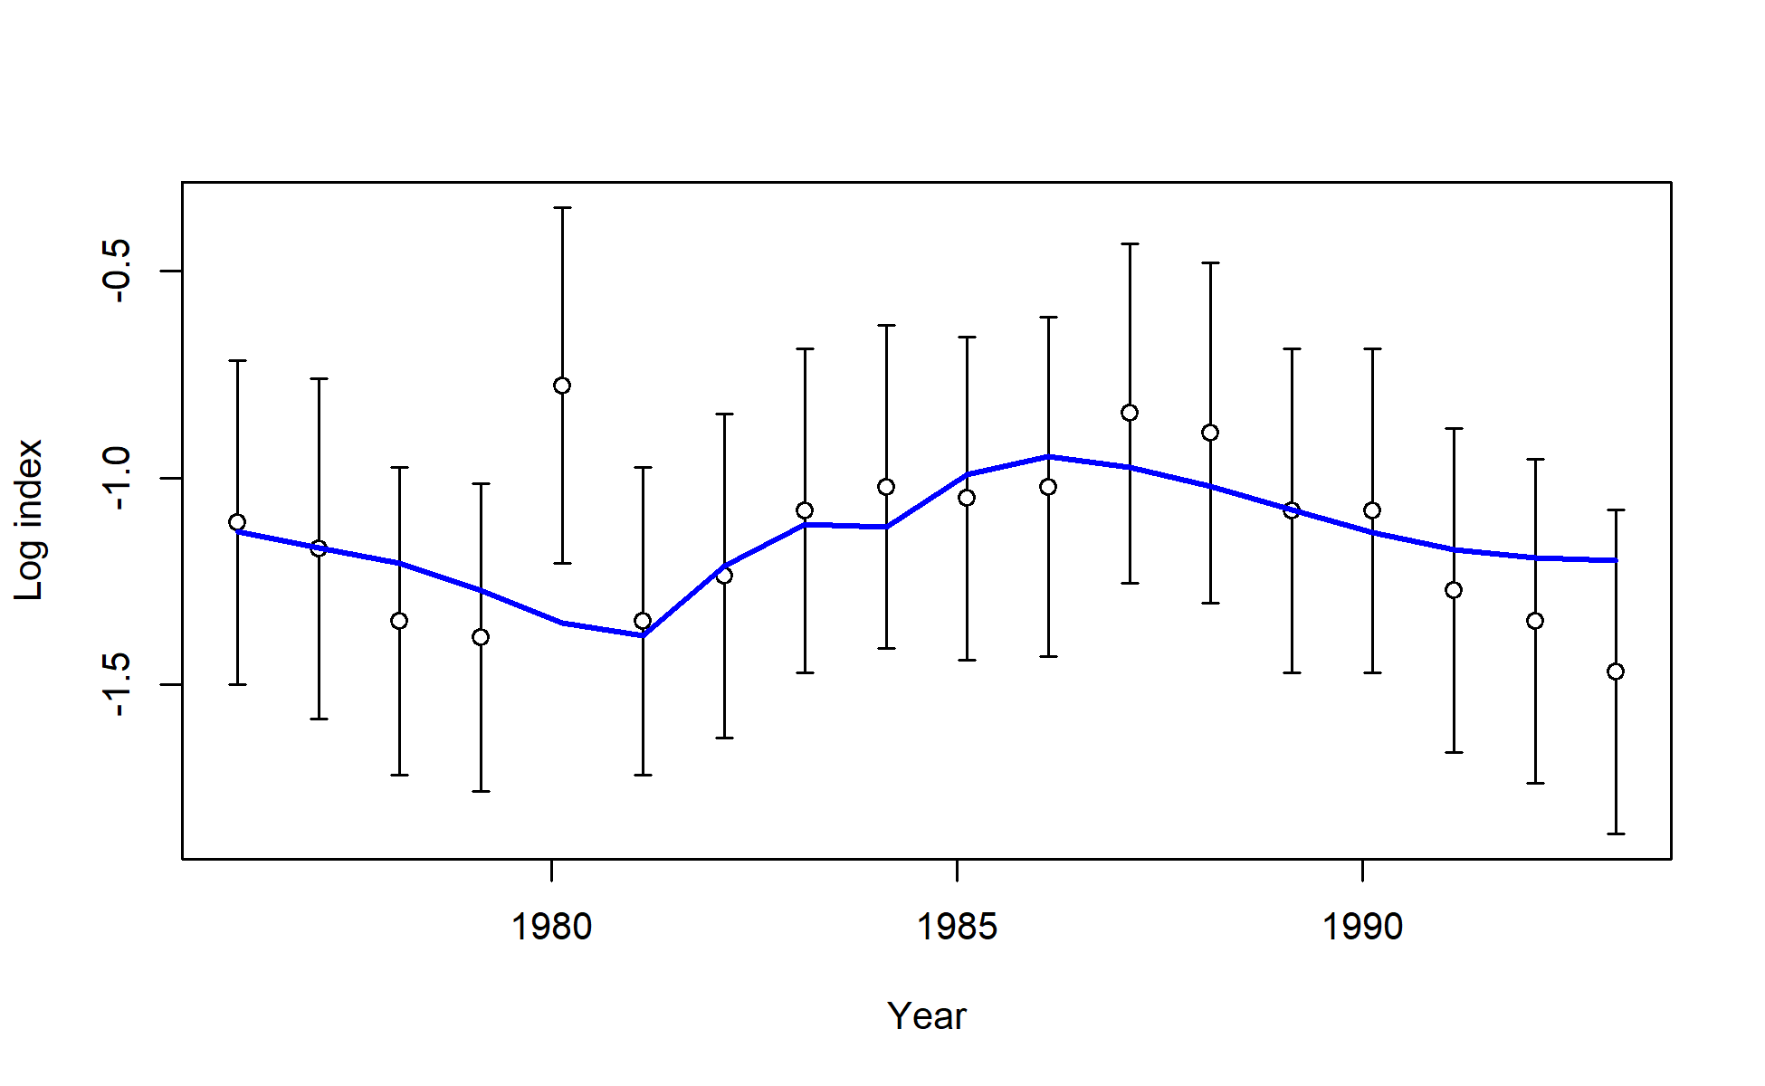
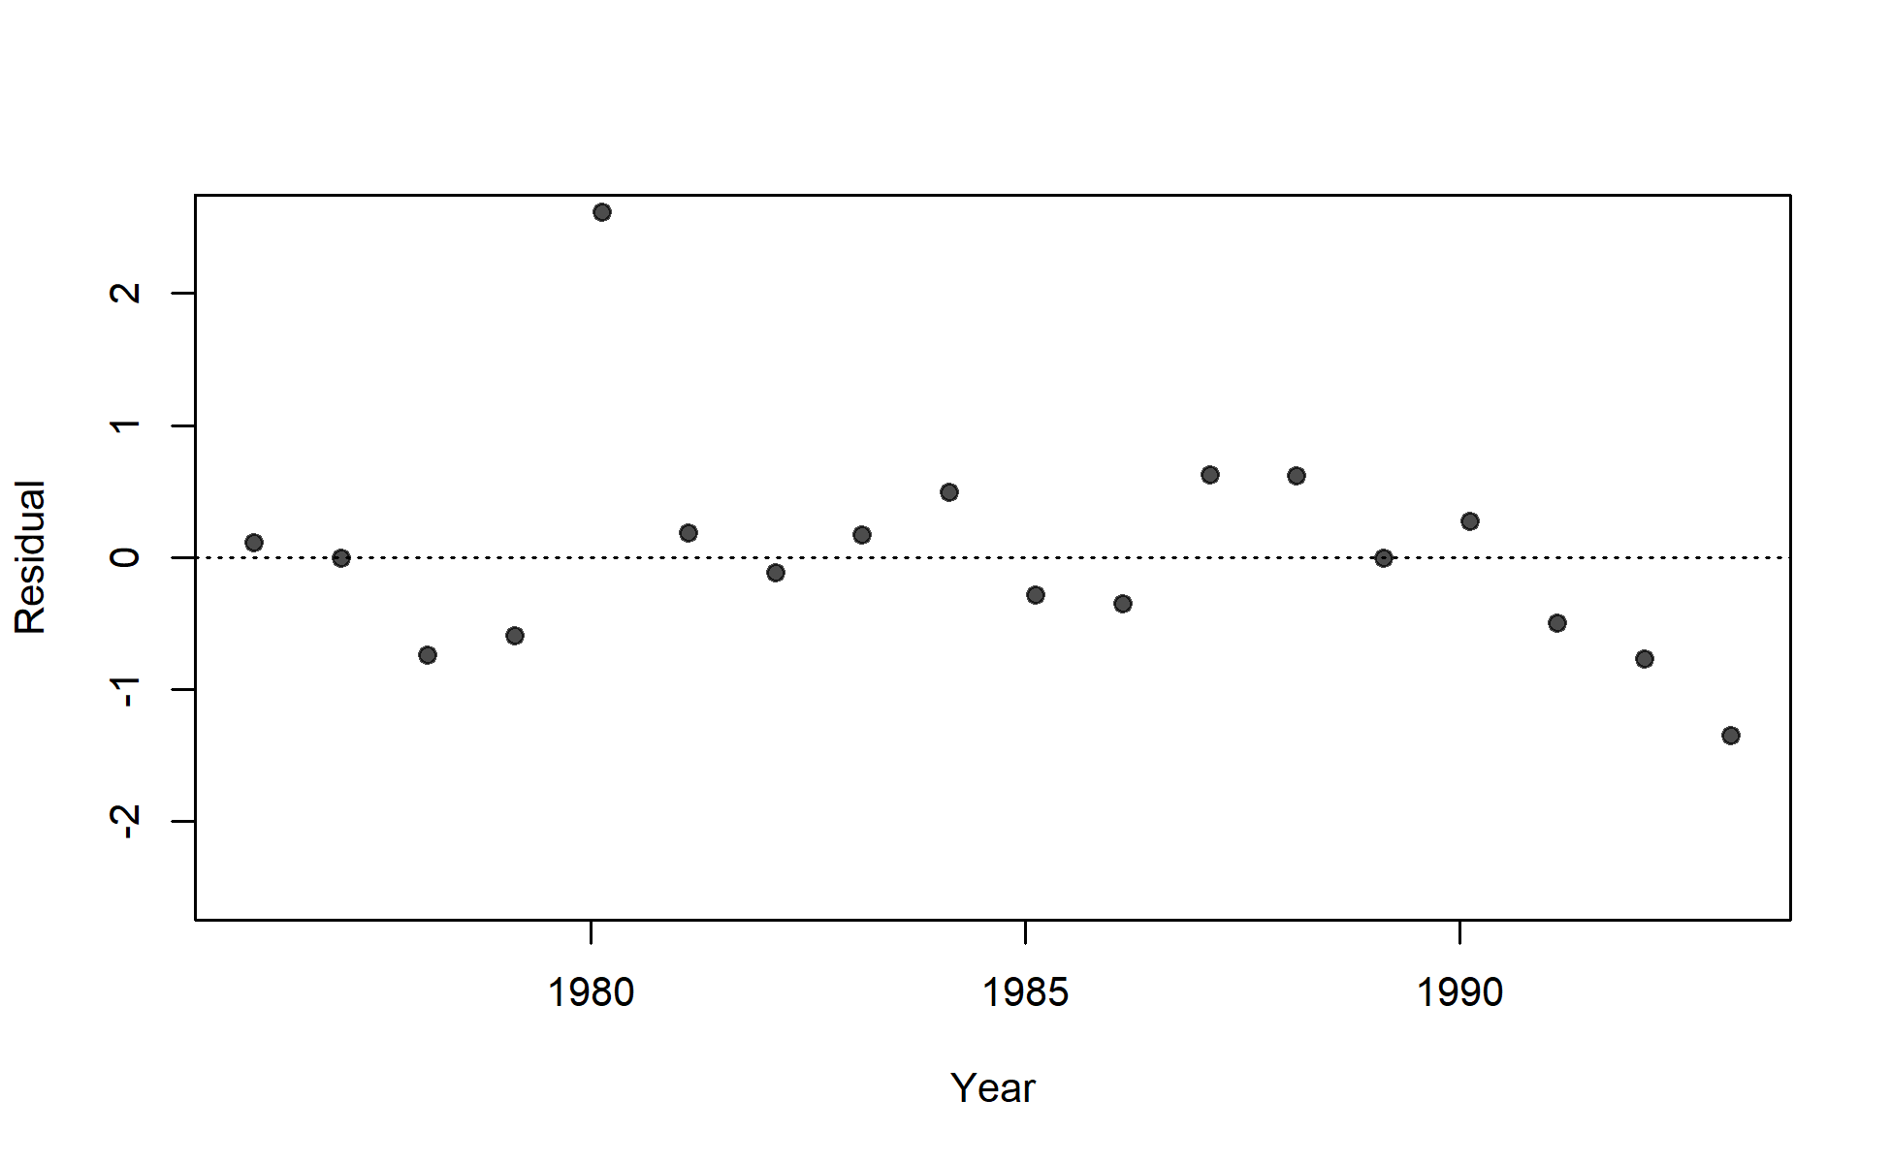
S03_JPN_WCNPO_LL_early_area2

Slide 9
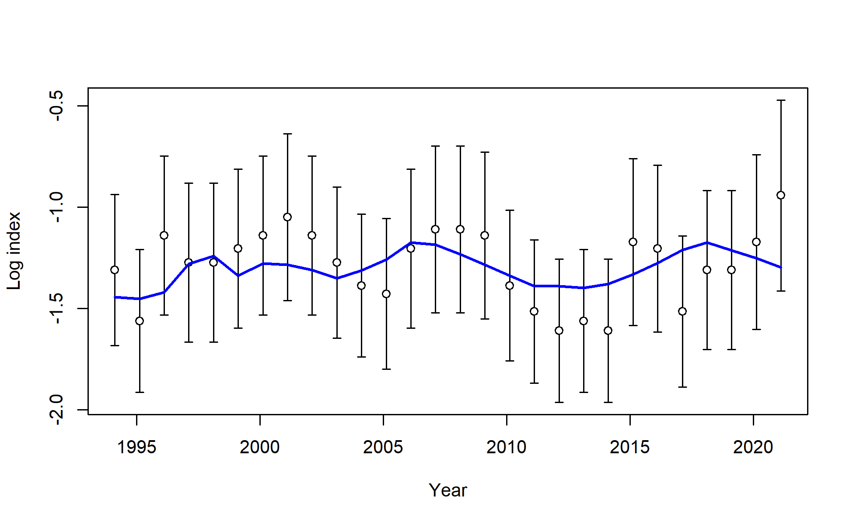
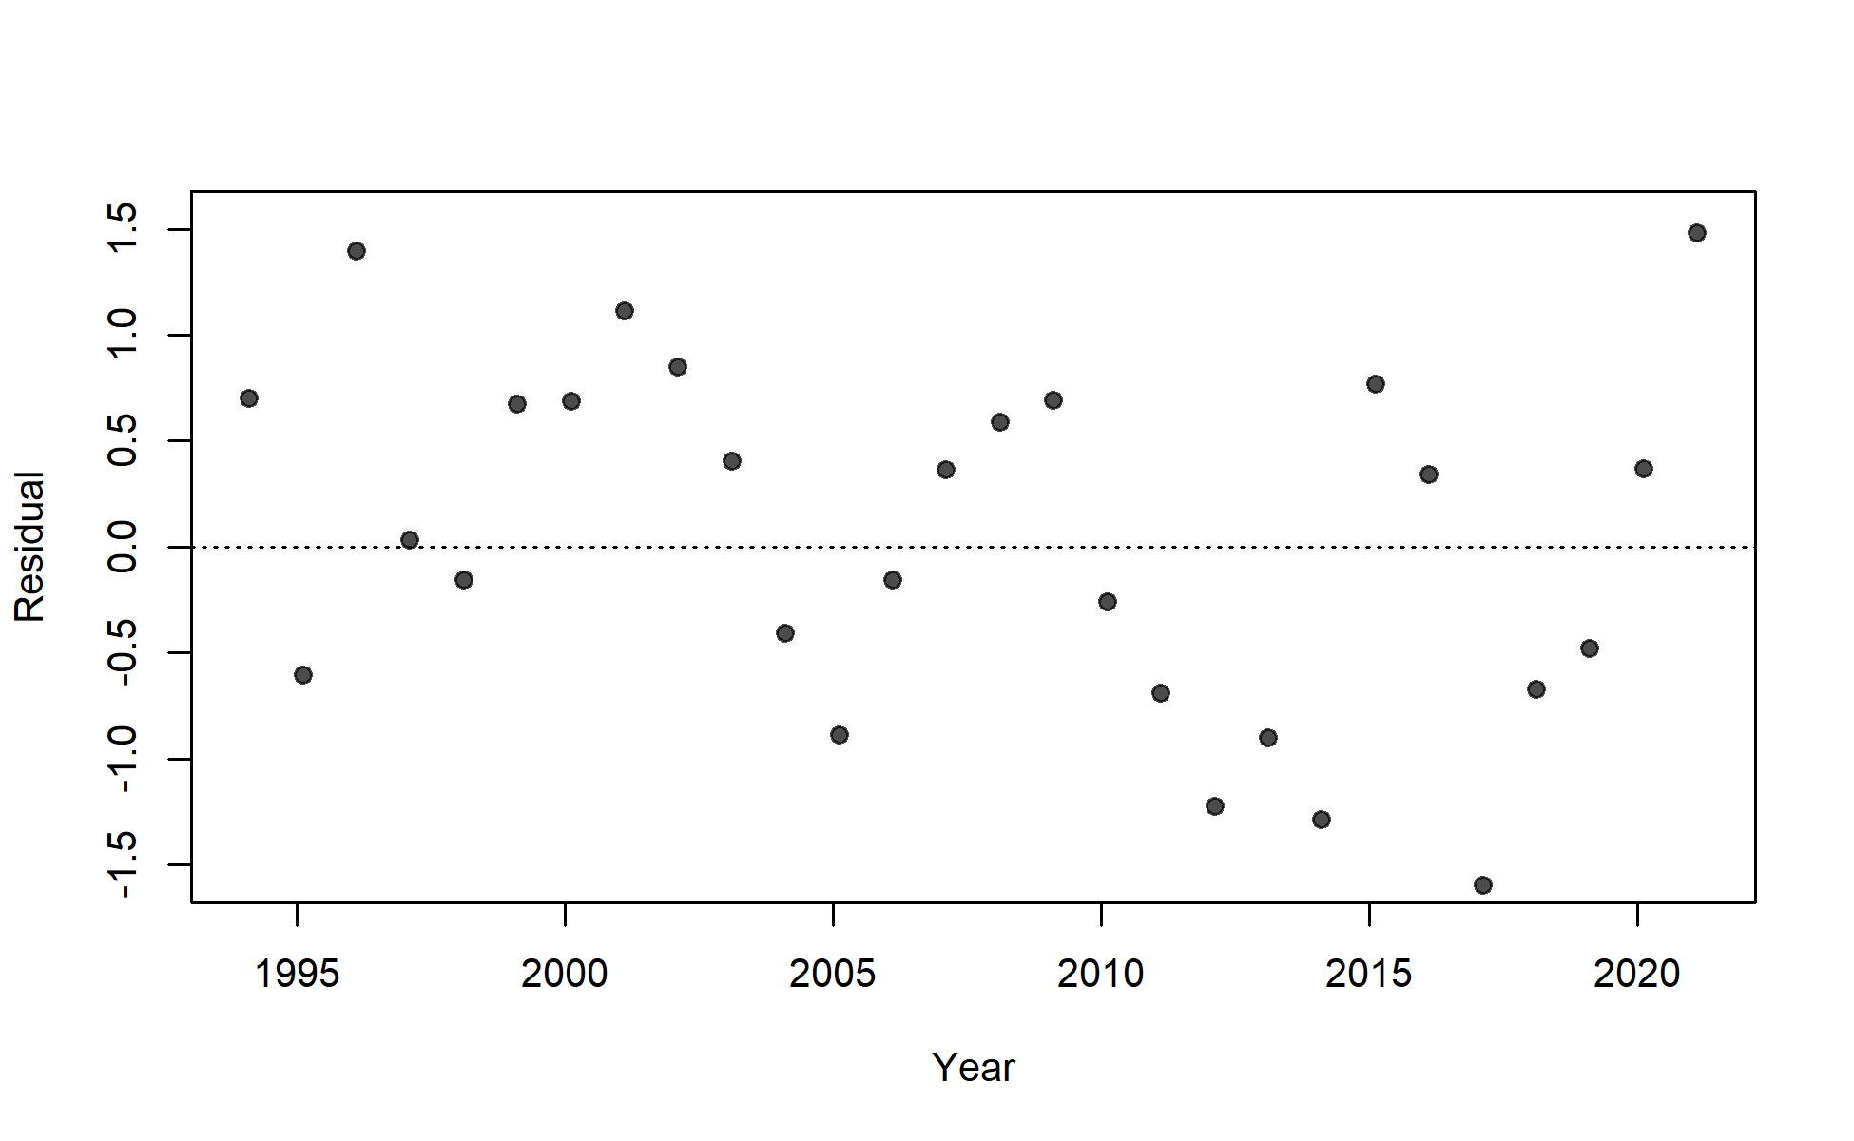
S04_JPN_WCNPO_LL_late_area2

Slide 10
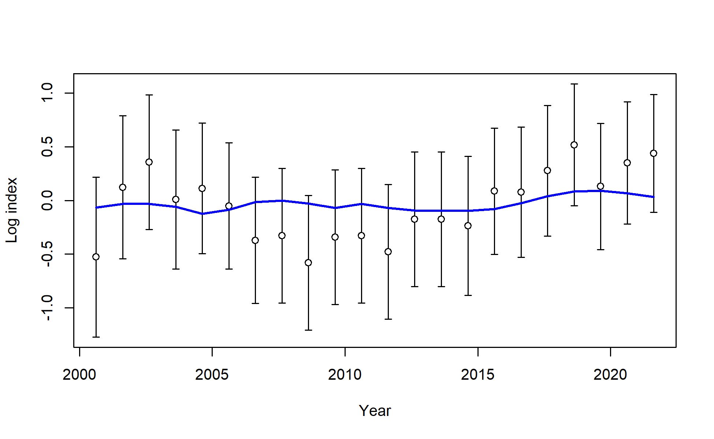
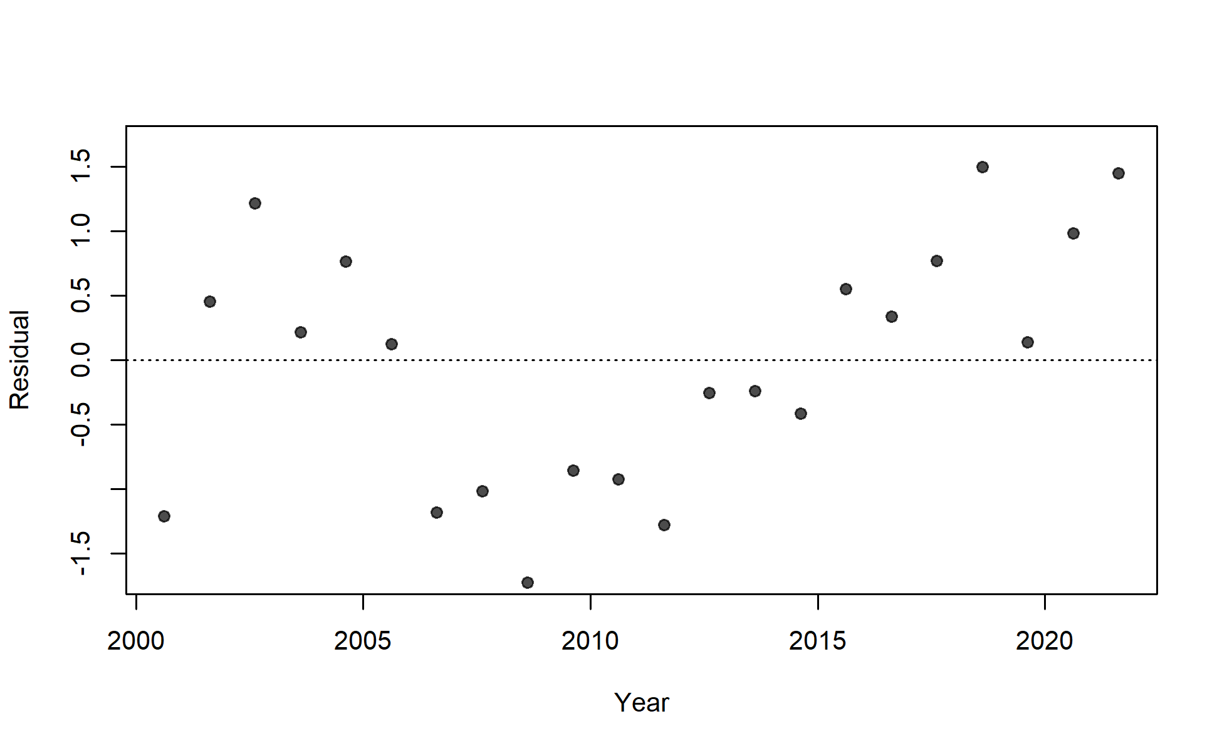
S05_TWN_WCNPO_DWLL

Slide 11
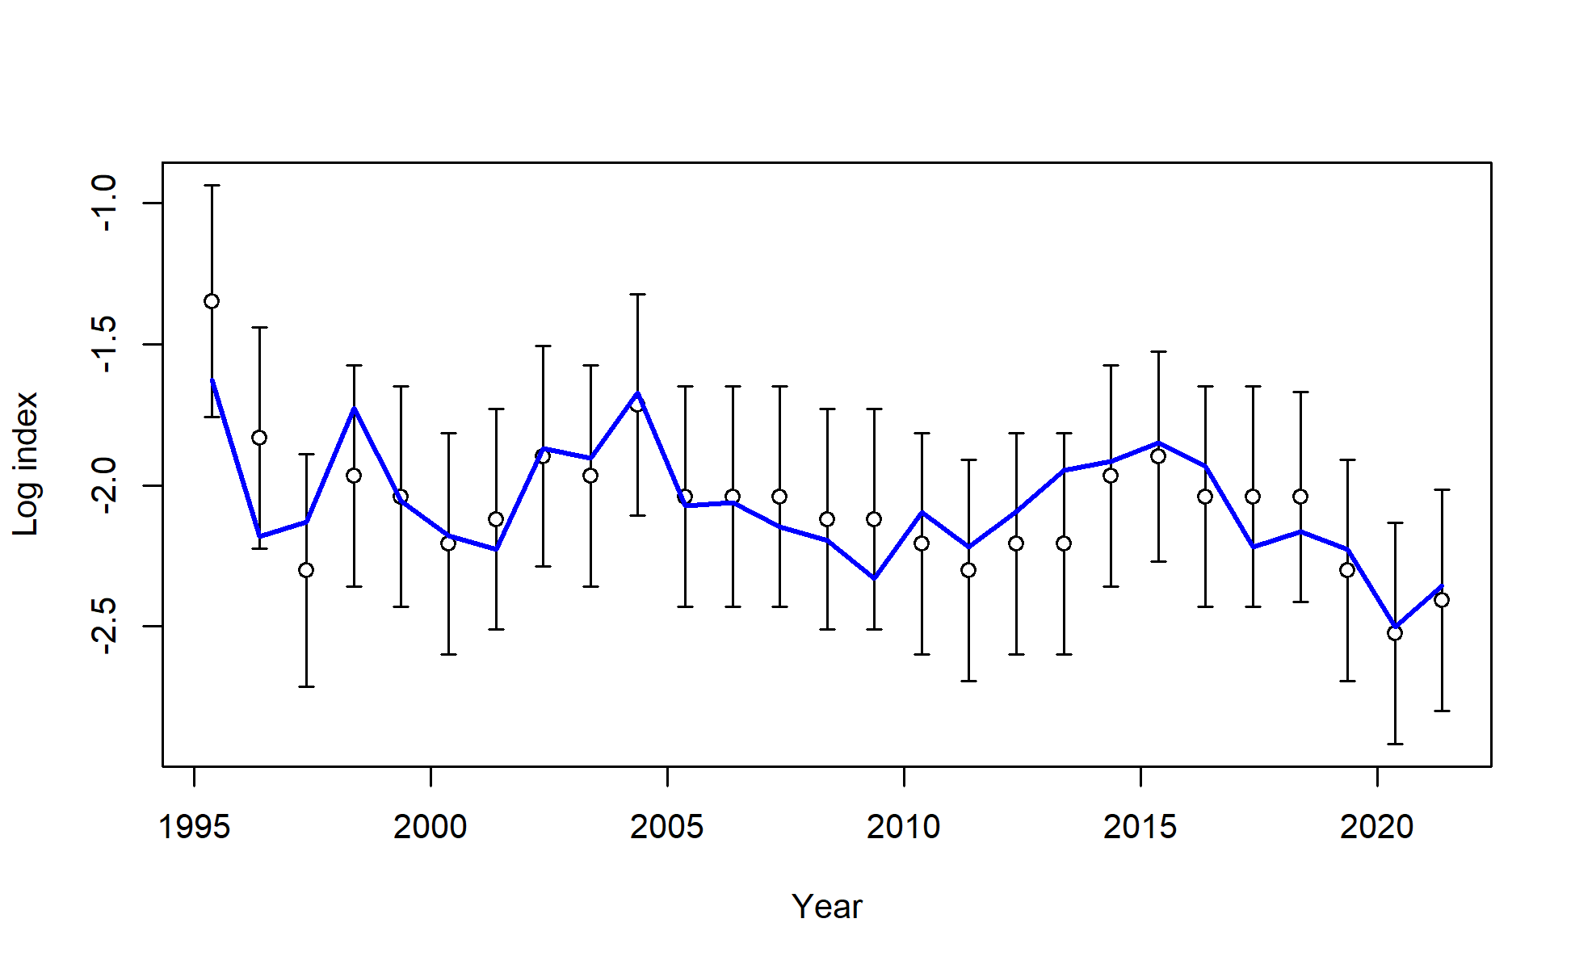
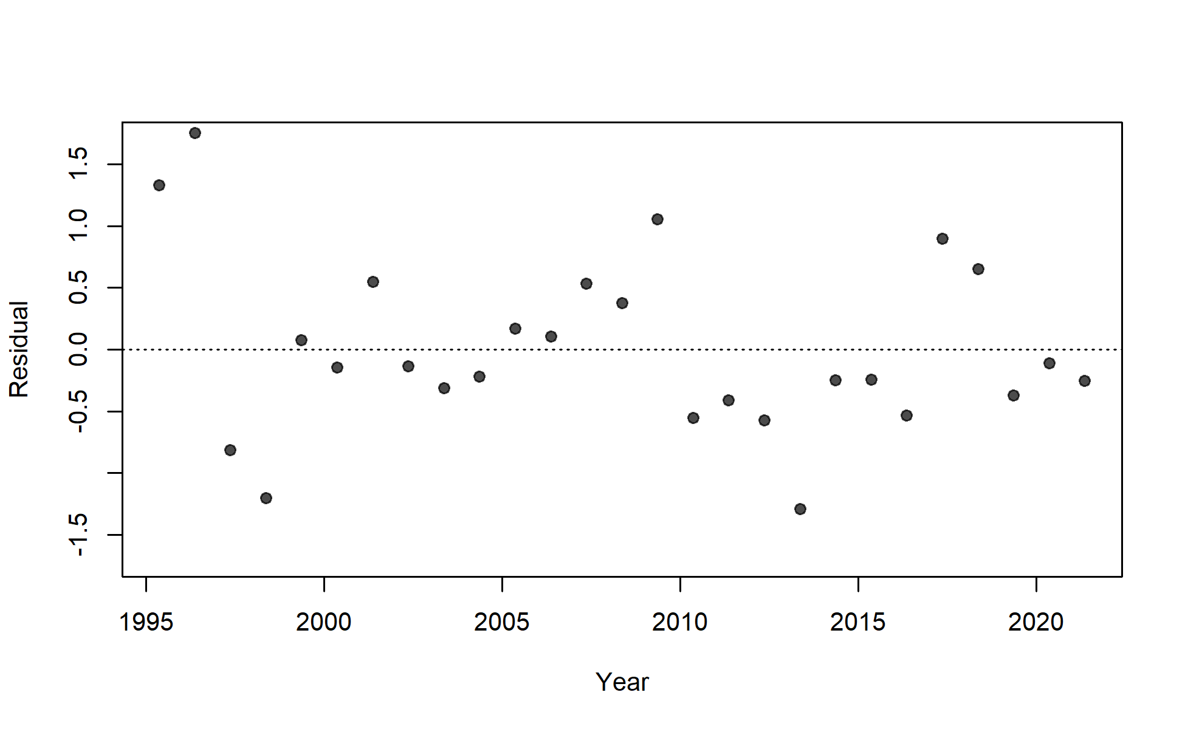
S06_US_WCNPO_LL_deep

Slide 12
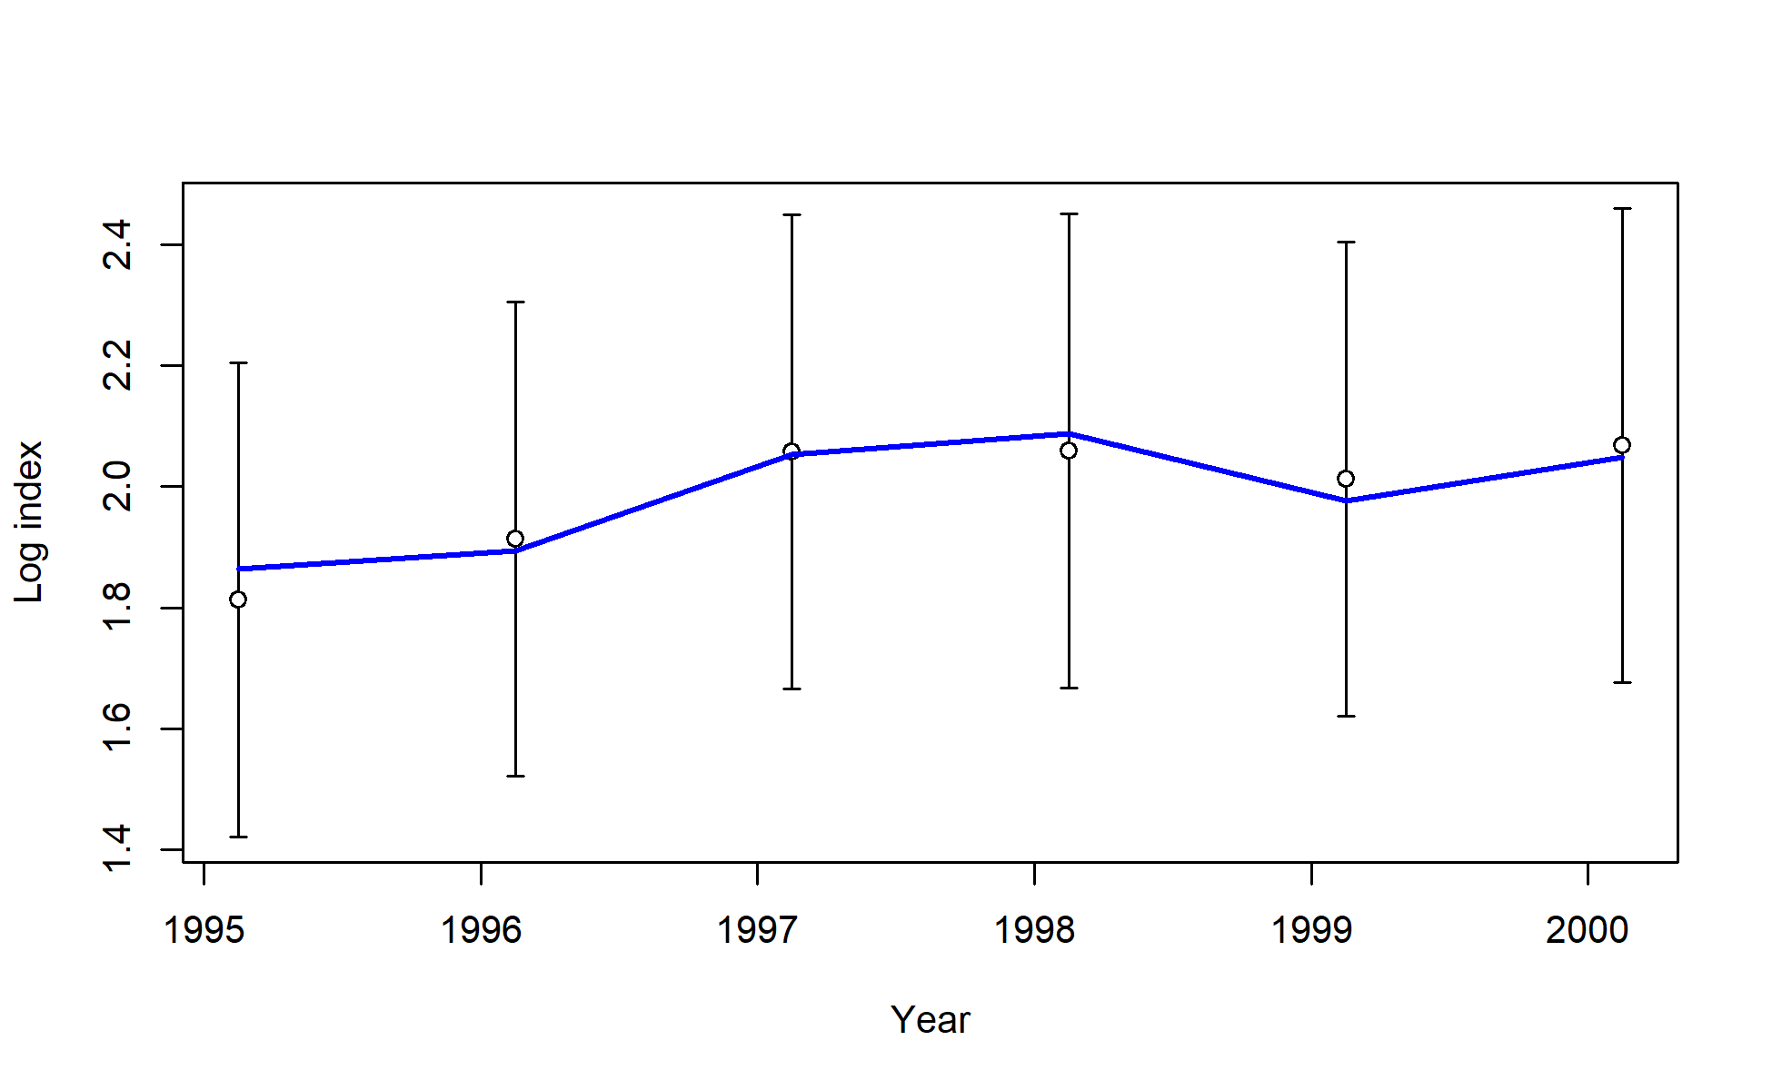
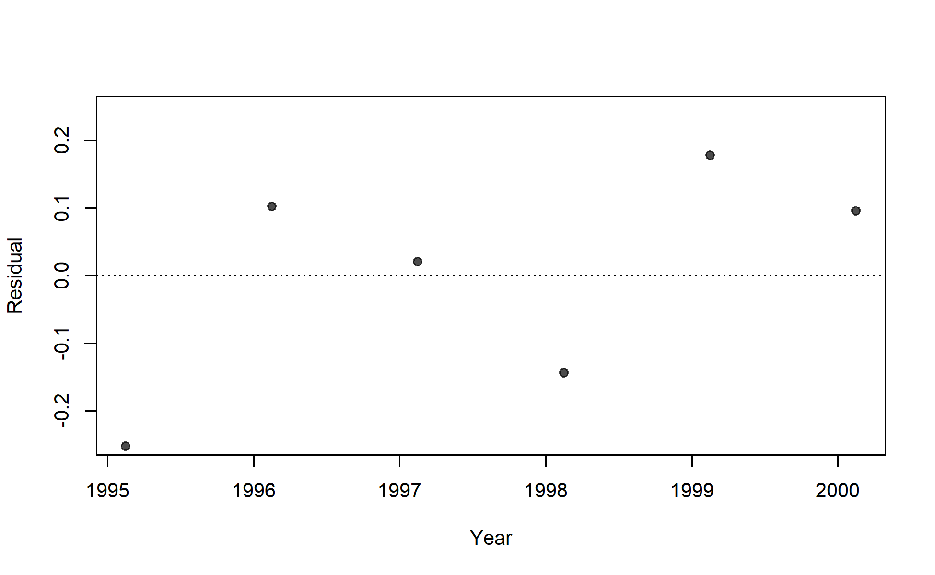
S07_US_WCNPO_LL_shallow_early

Slide 13
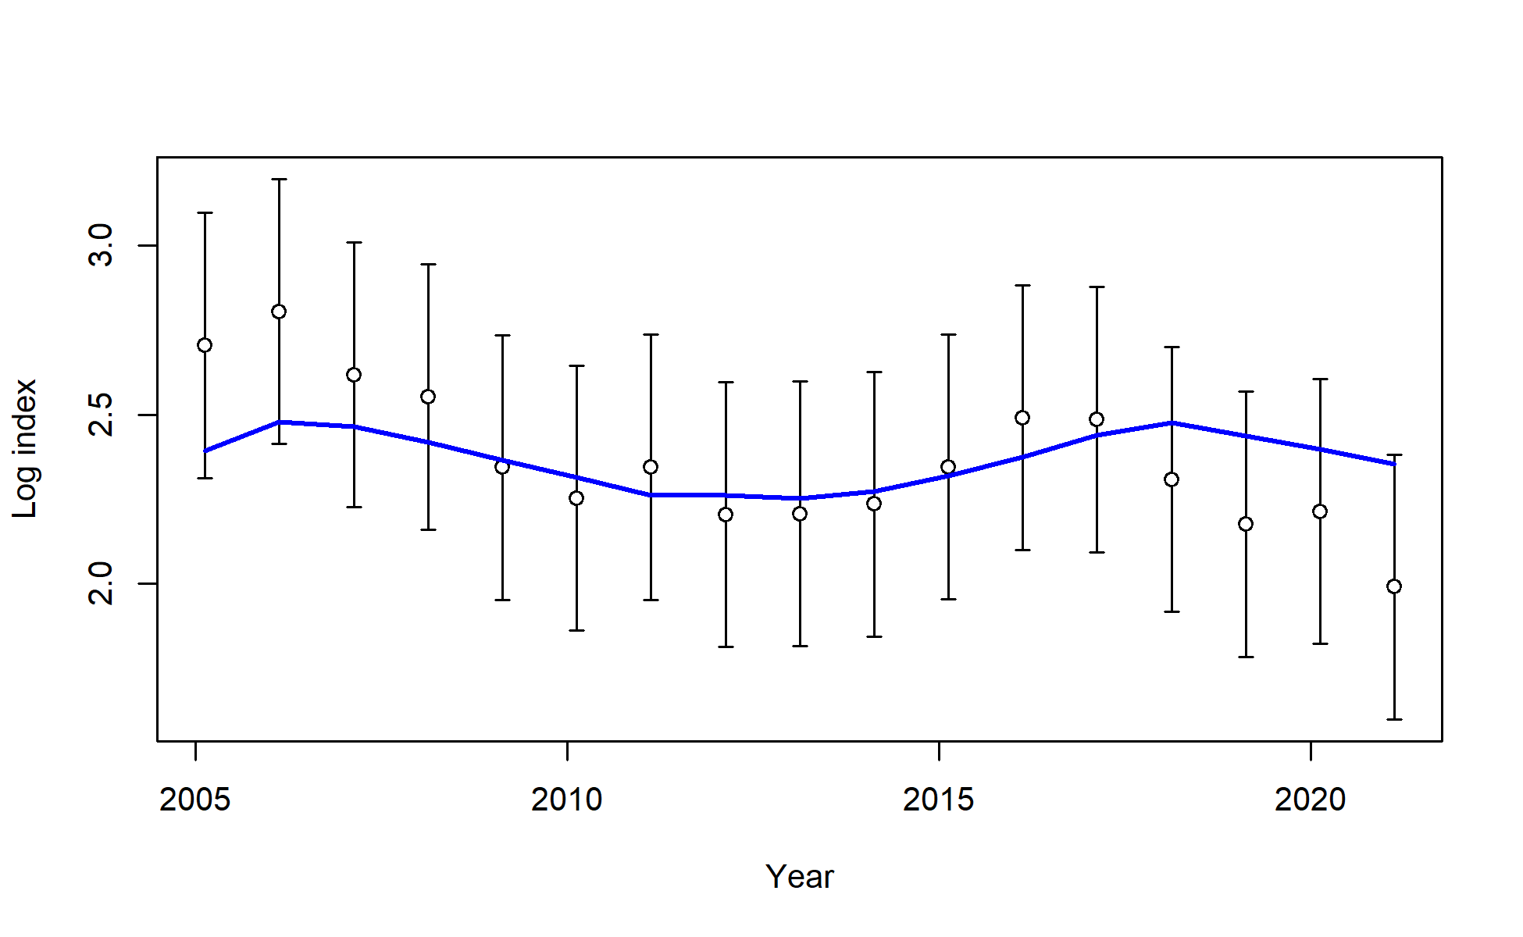
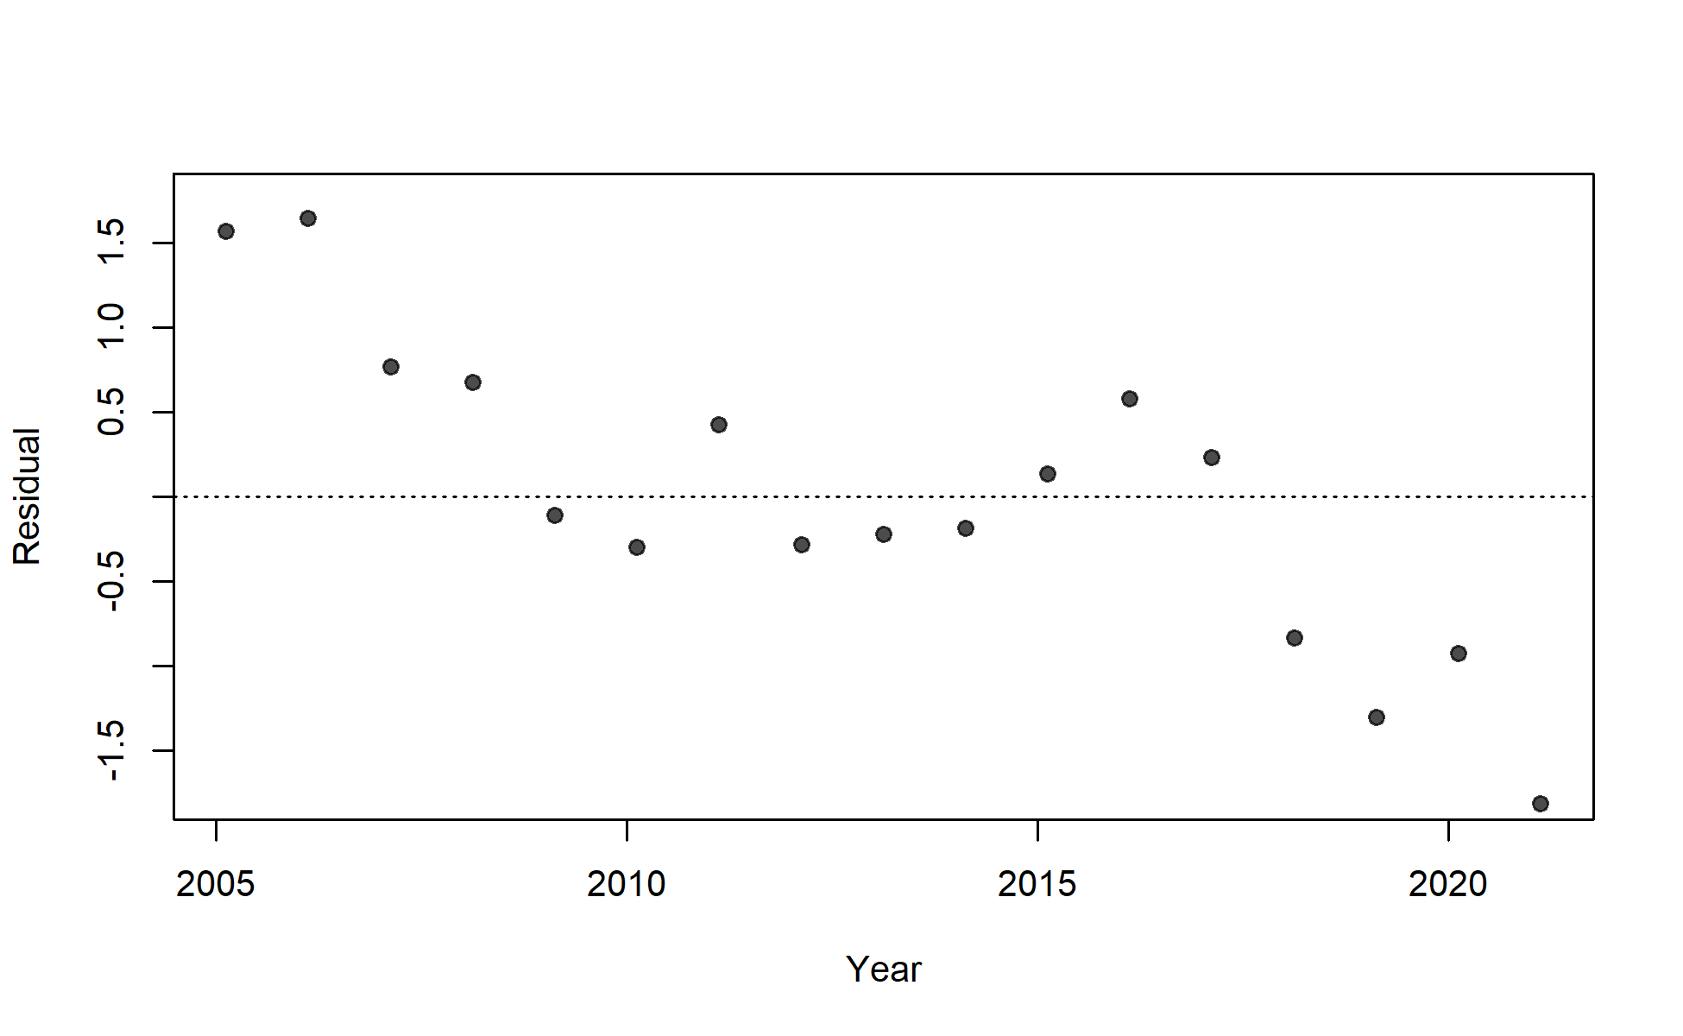
S08_US_WCNPO_LL_shallow_late

Slide 14
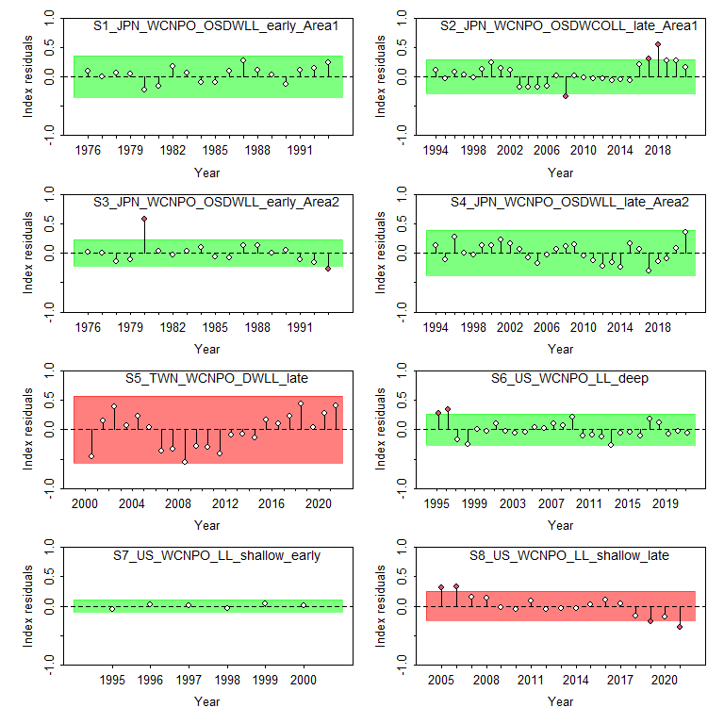
Figure 13: Results from a runs test for each CPUE index. Red indicates the index failed the test (residuals are not random), green indicates the index passed the test.

Slide 15
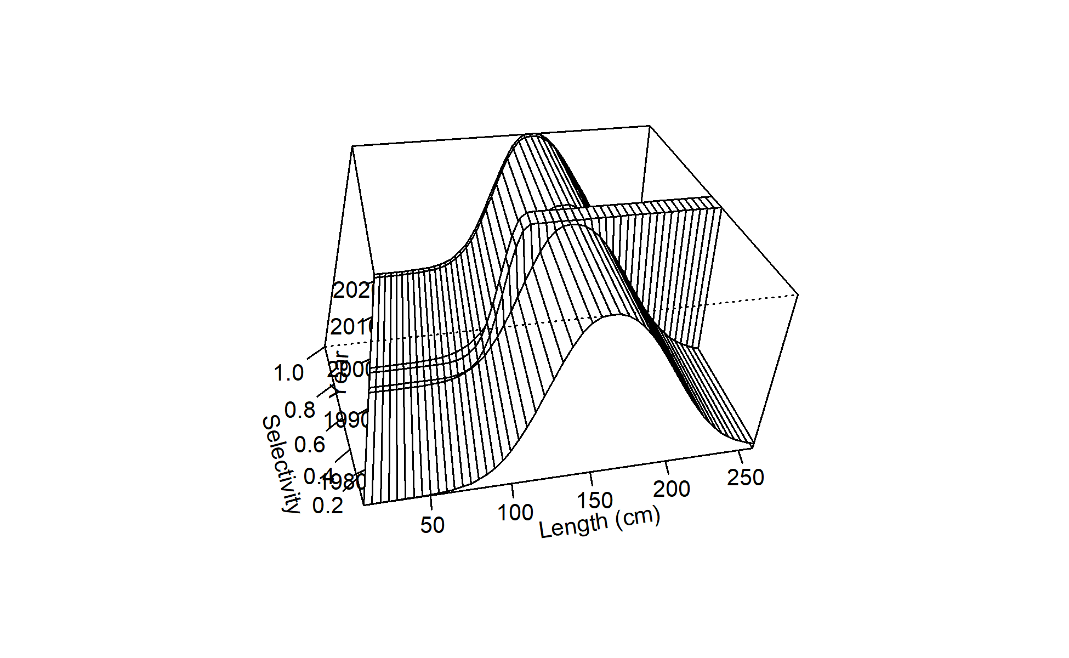
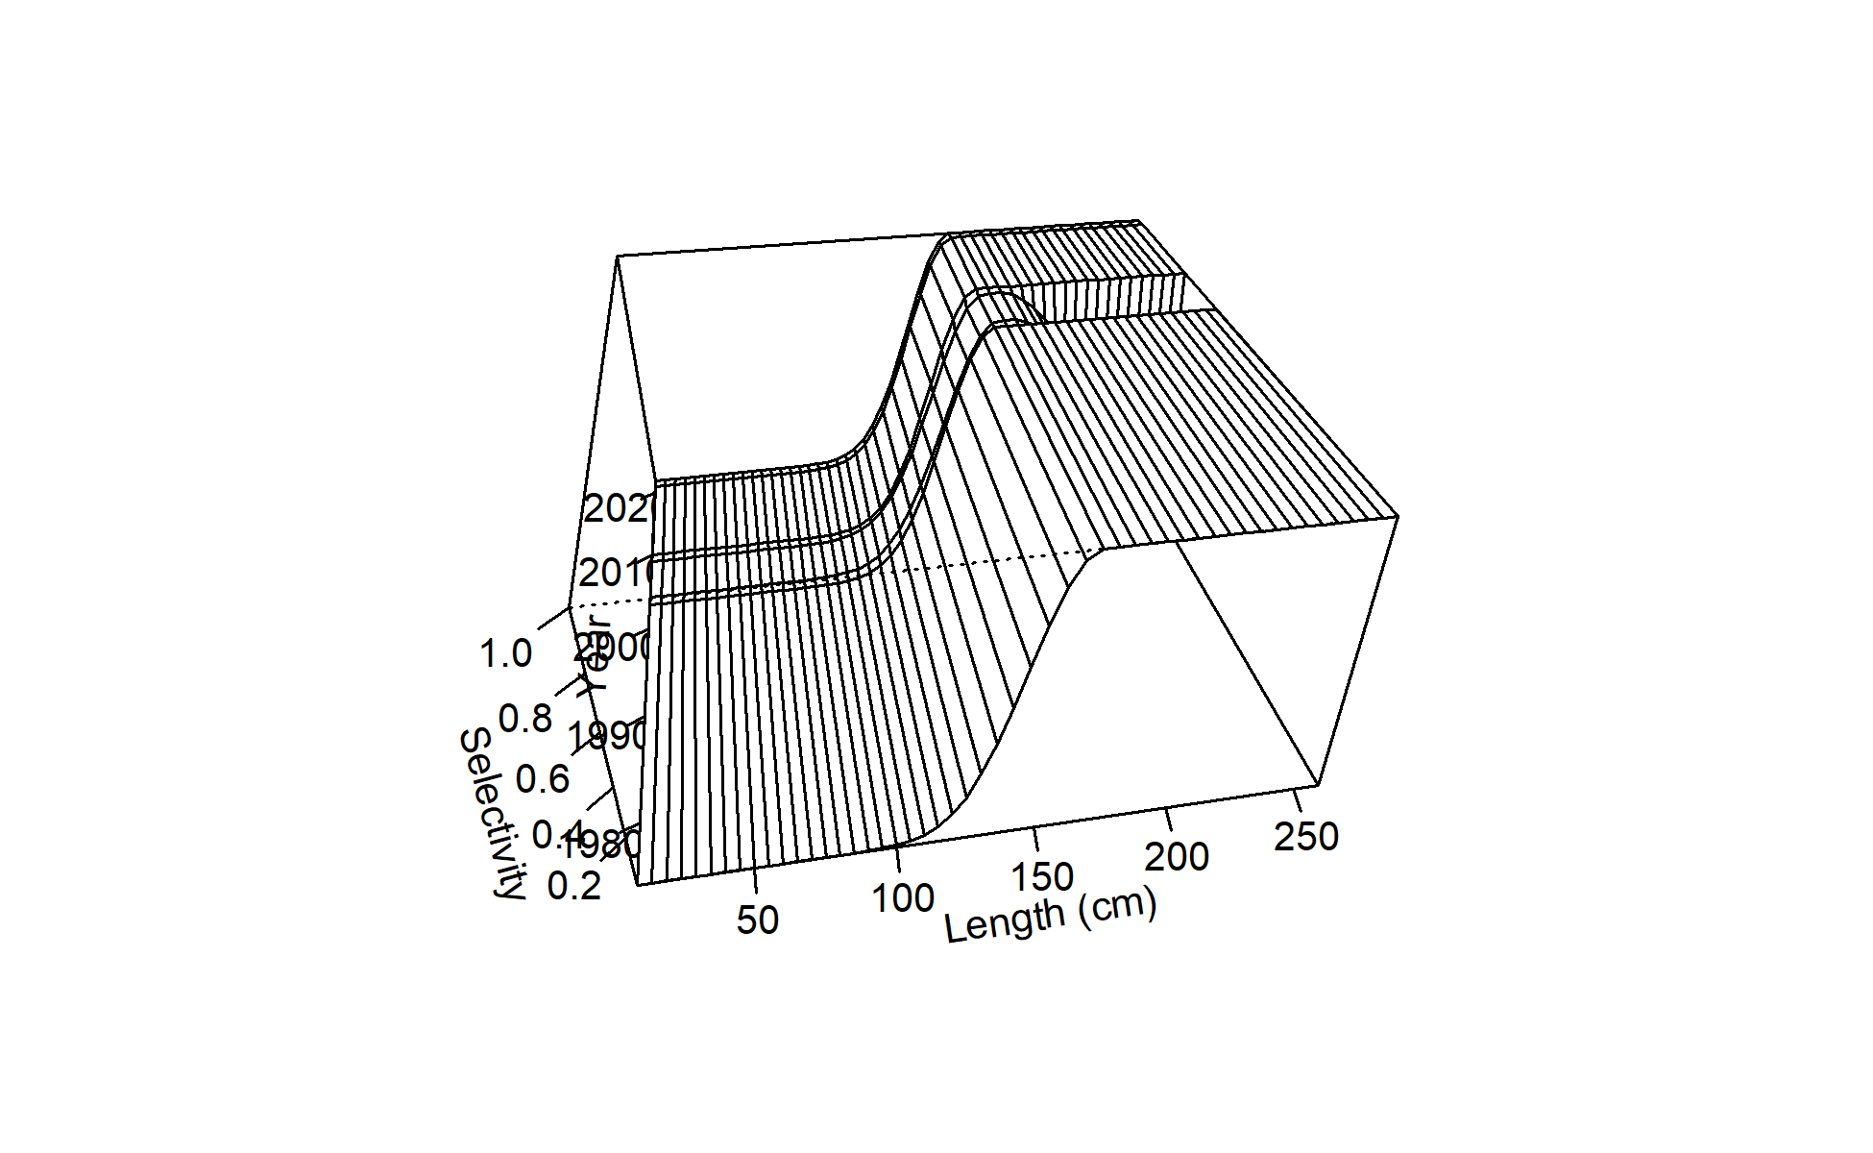
Figure 15: Time-varying selectivity estimated for F02 Chinese Taipei LL late.
Figure 14: Time-varying selectivity estimated for F01 Japan LL area 1 late.

Slide 16
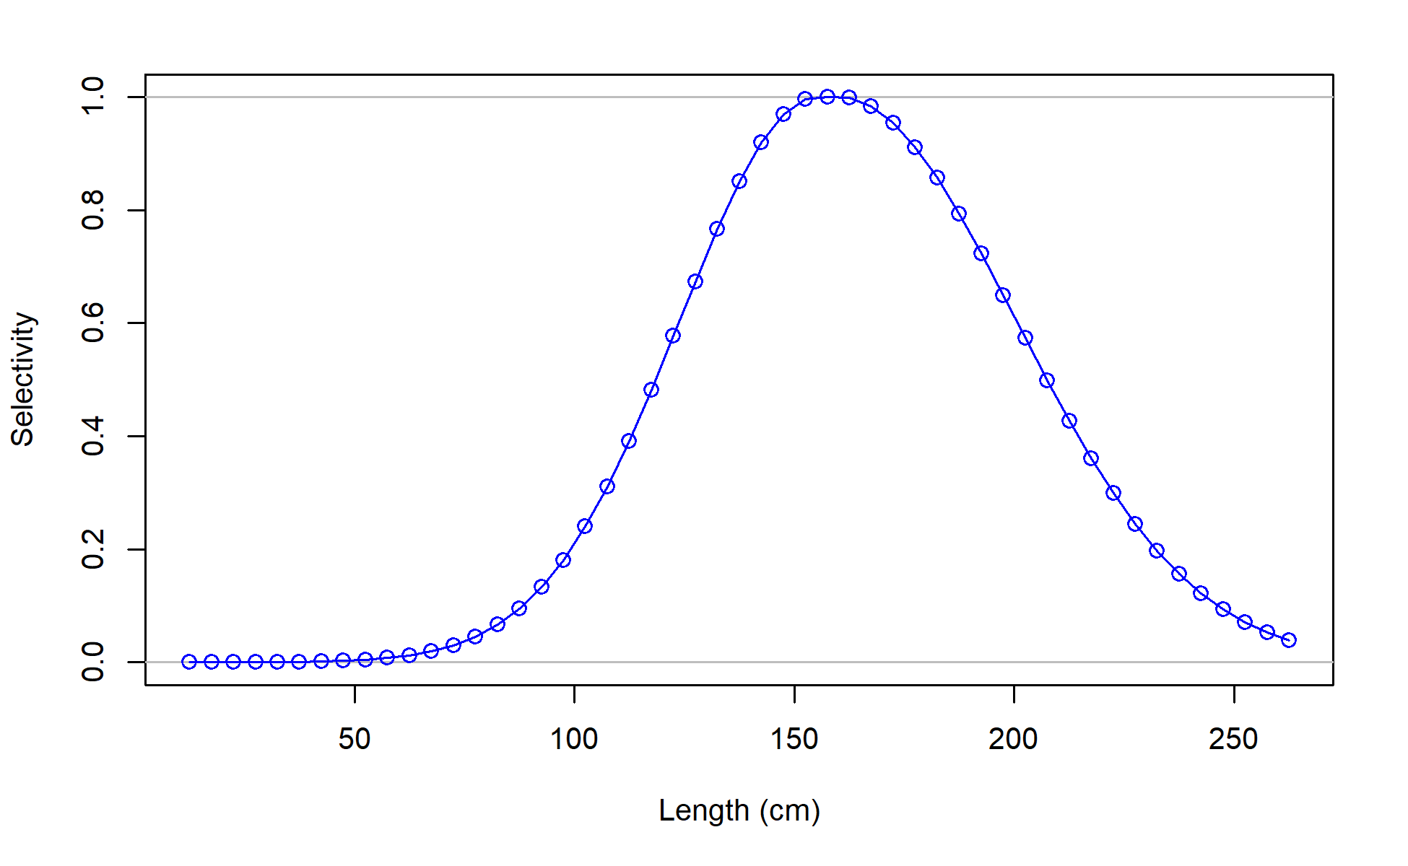
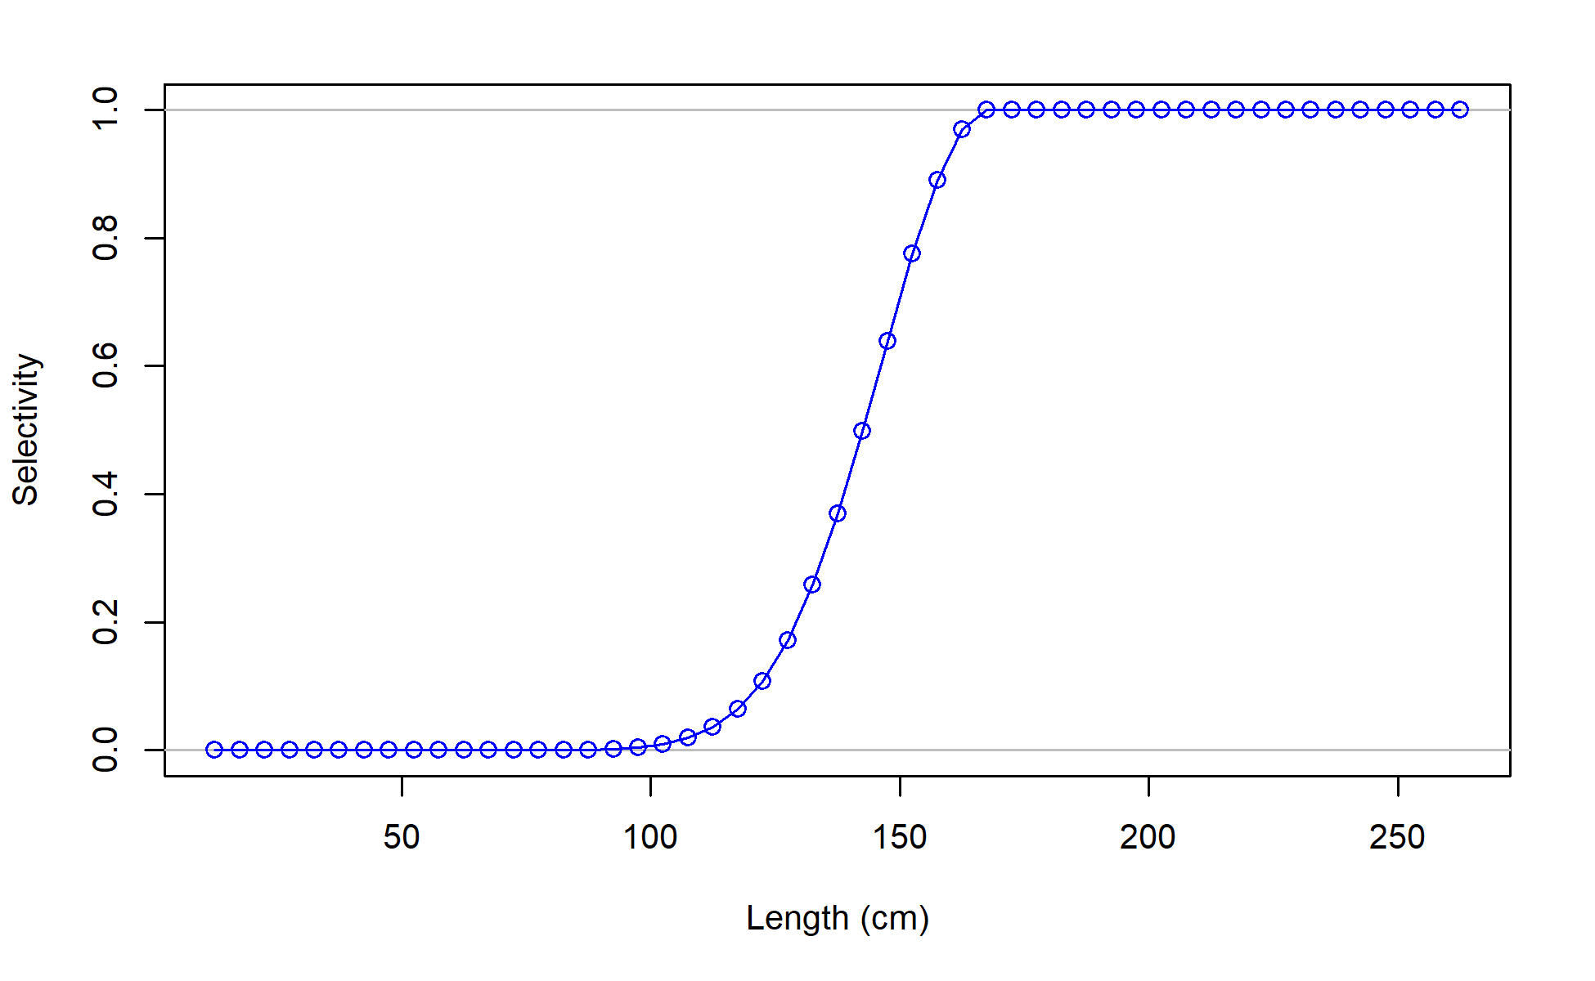
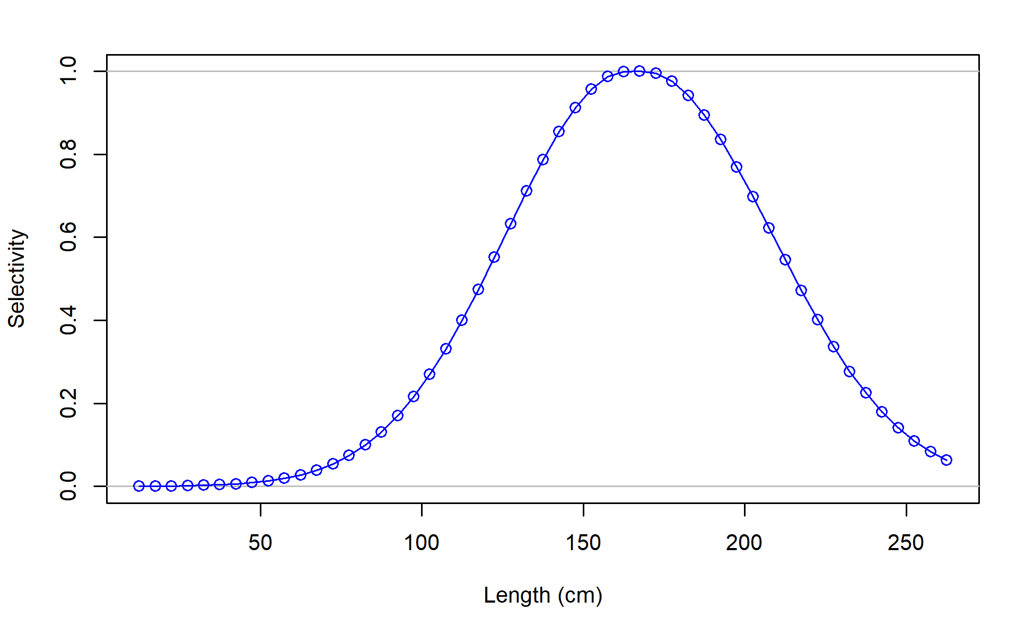
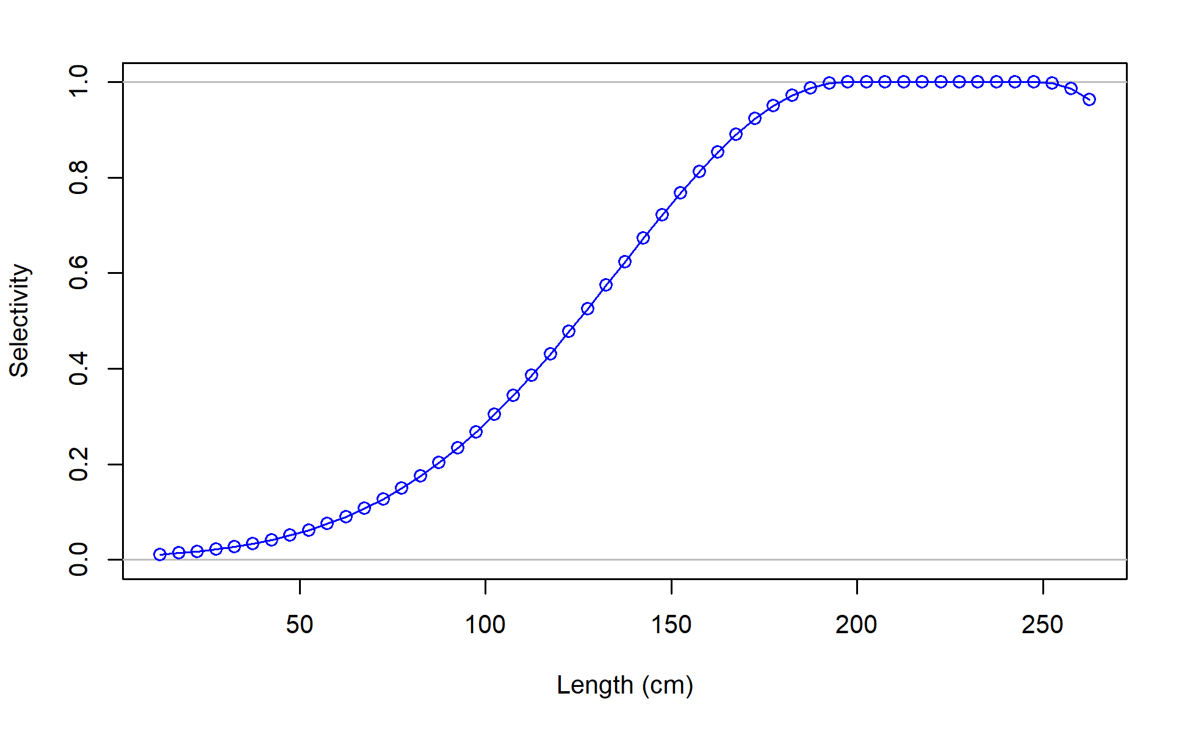
F01_JPN_WCNPO_OSDWLL_late_area1
F02_TWN_WCNPO_DWLL
F03_US_WCNPO_LL_shallow_late
F04_IATTC

Slide 17
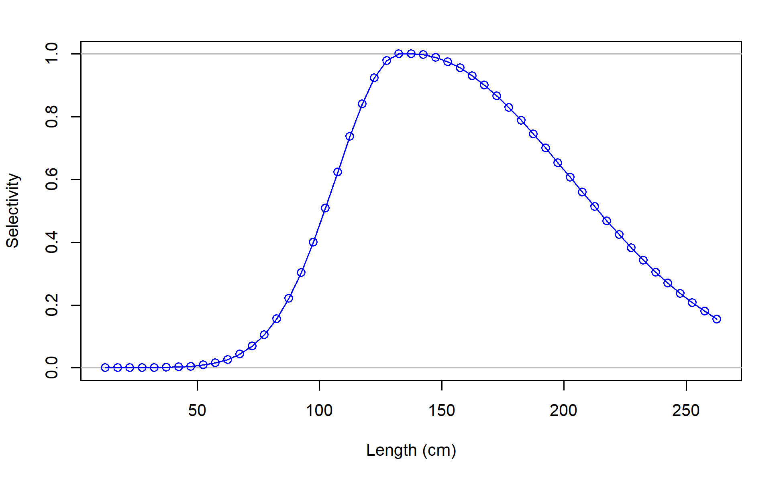
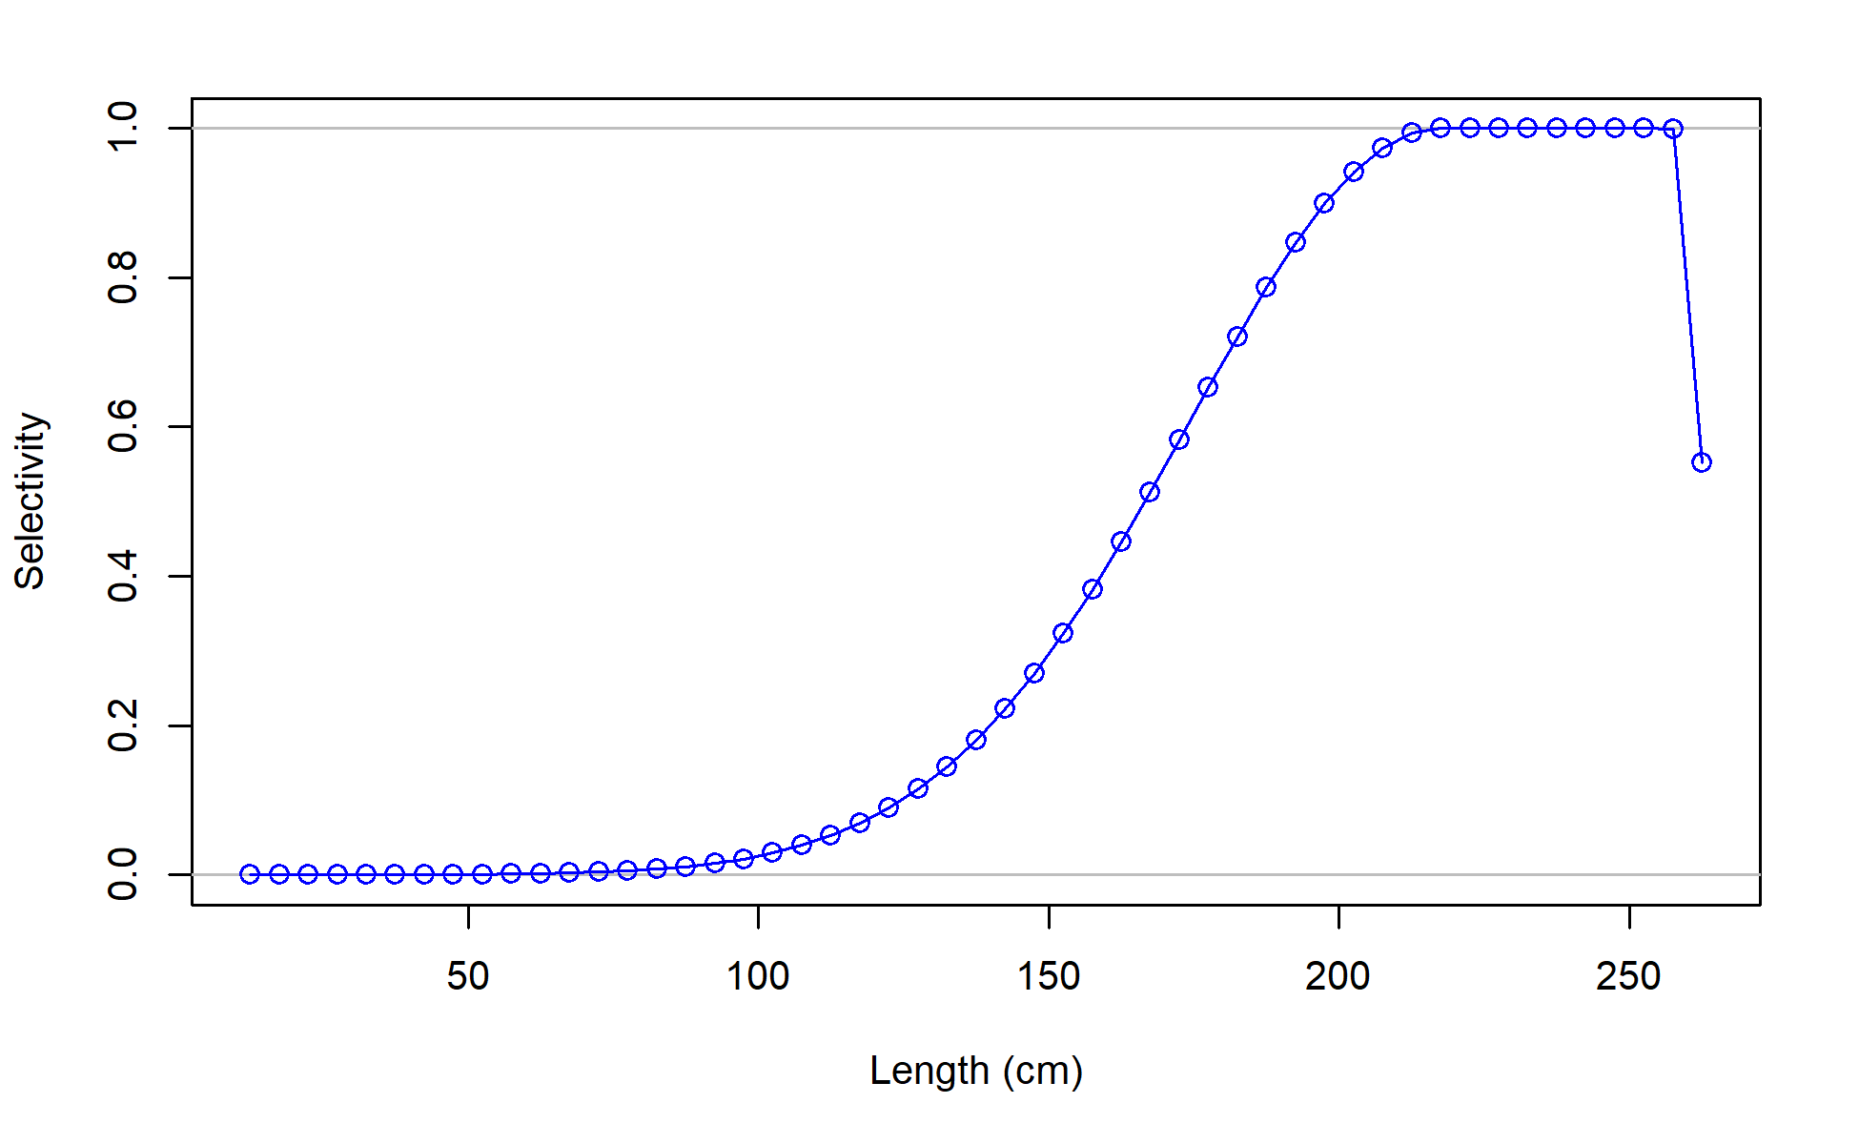
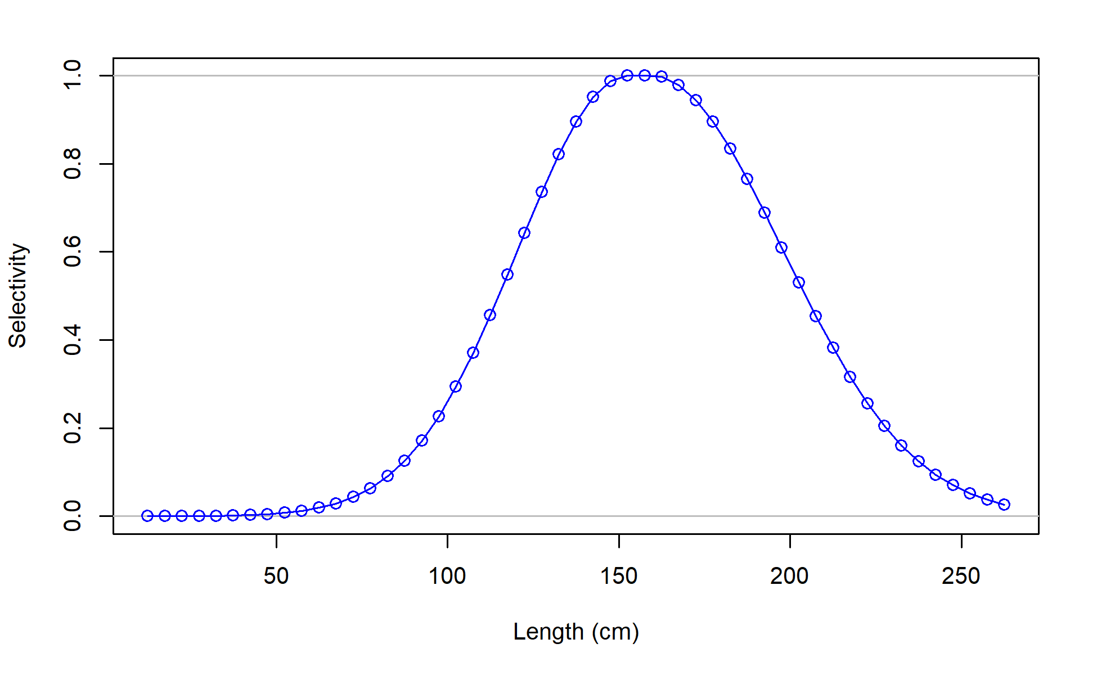
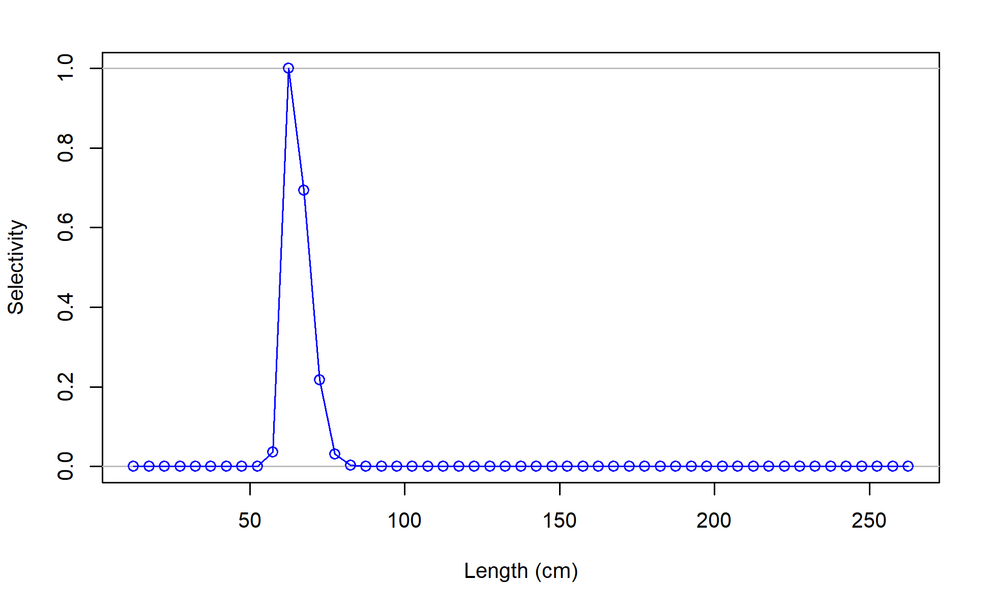
F06_JPN_WCNPO_OSDWLL_early_area2
F07_JPN_WCNPO_CODF
F08_US_WCNPO_LL_shallow_early
F09_US_WCNPO_LL_deep

Slide 18
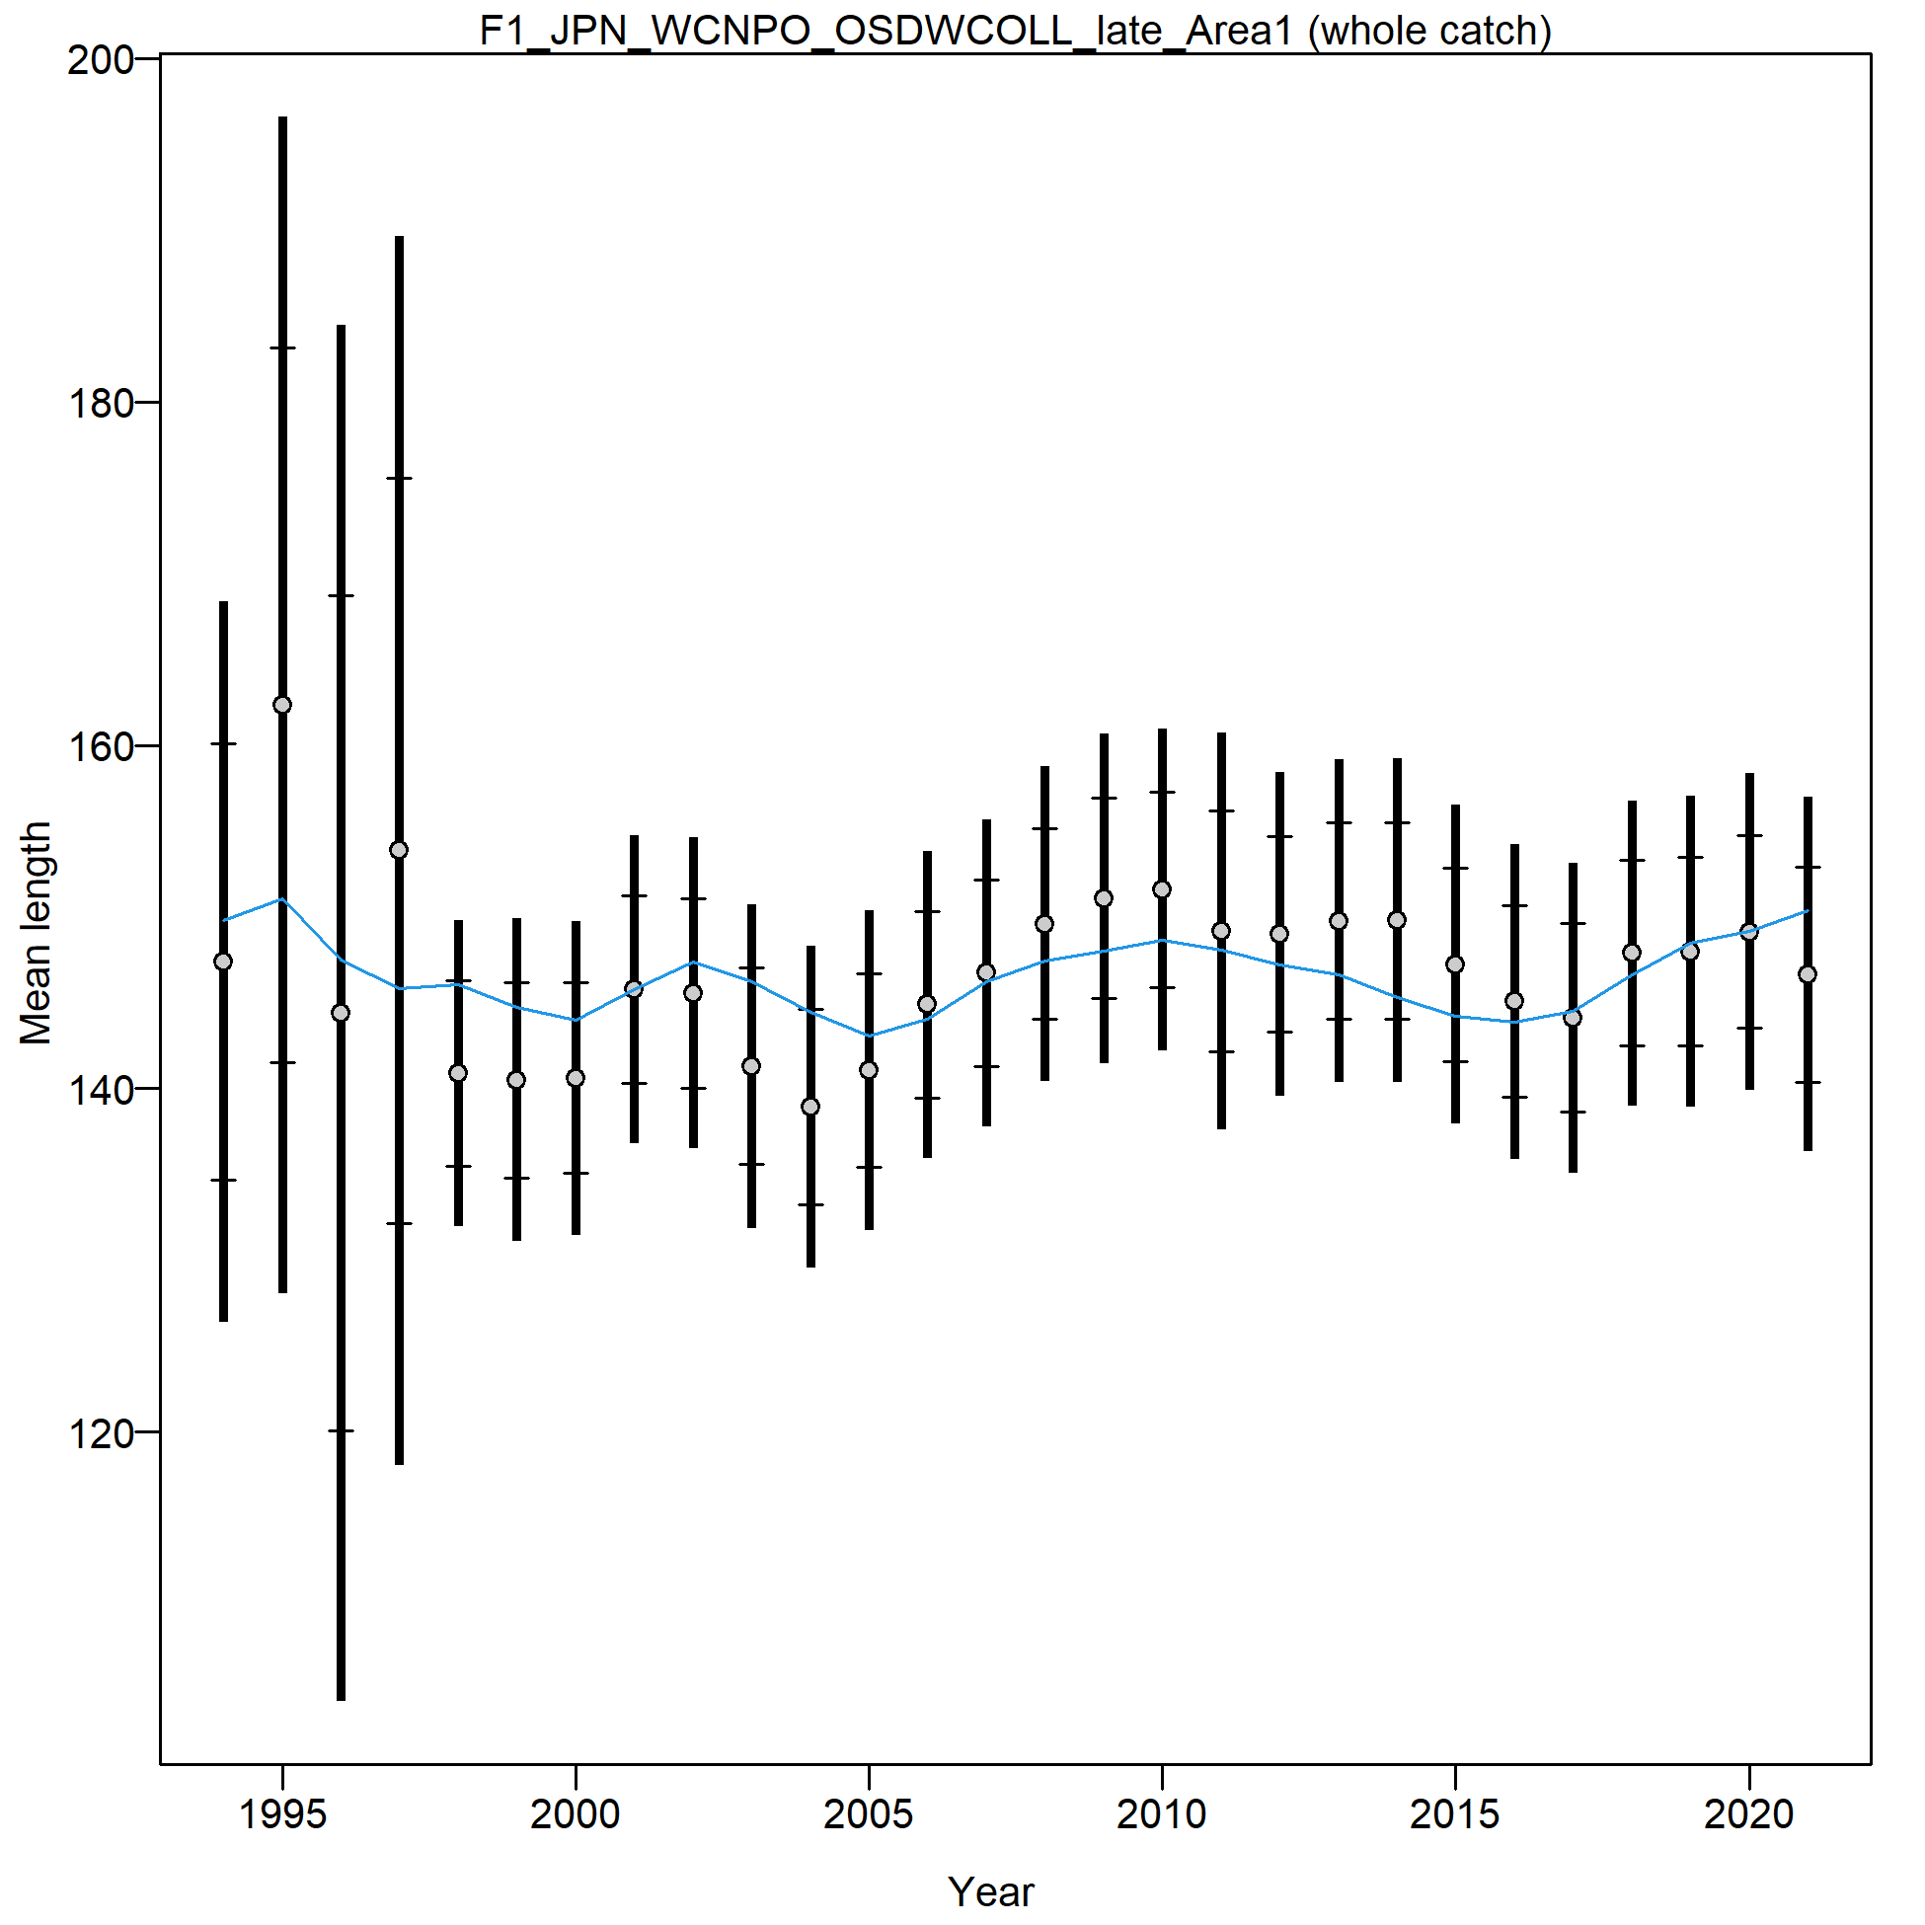
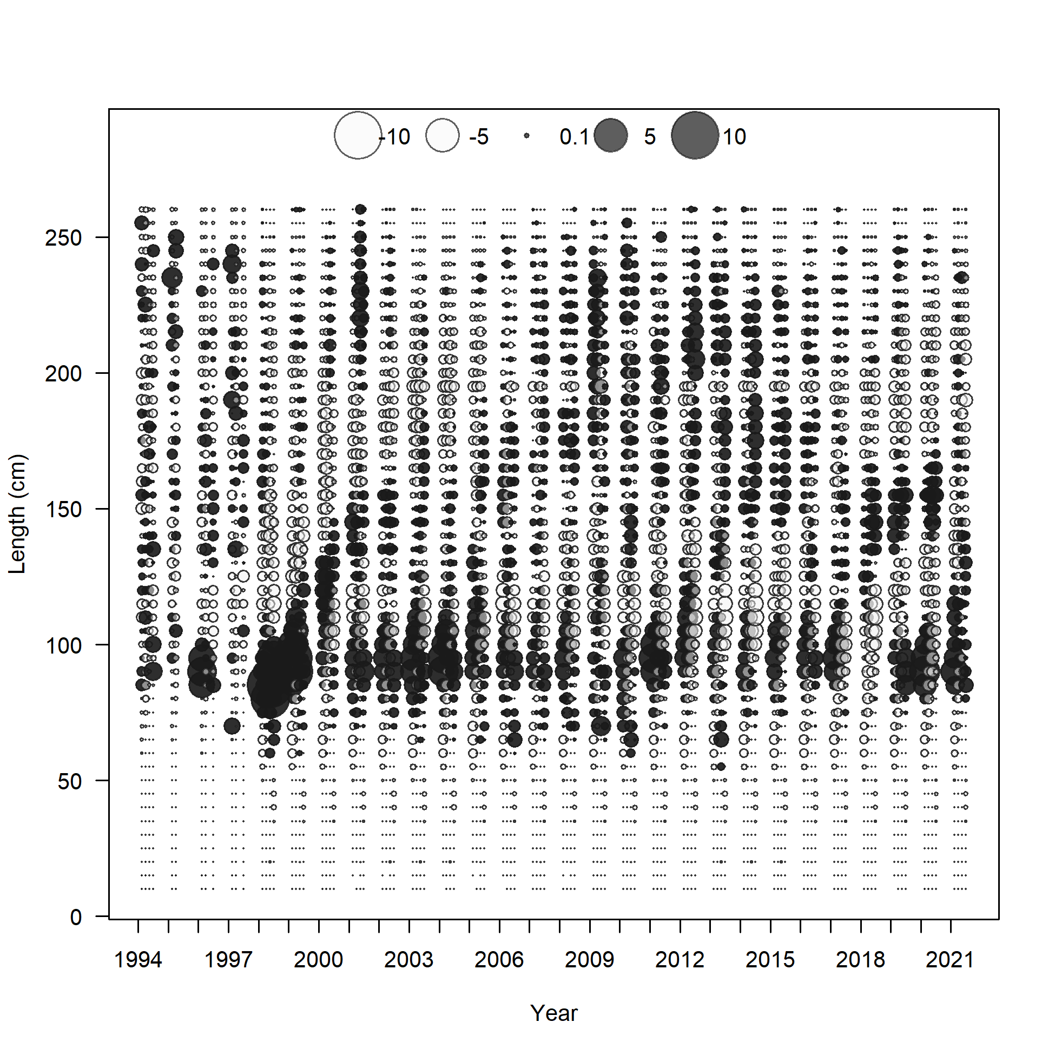

Slide 19
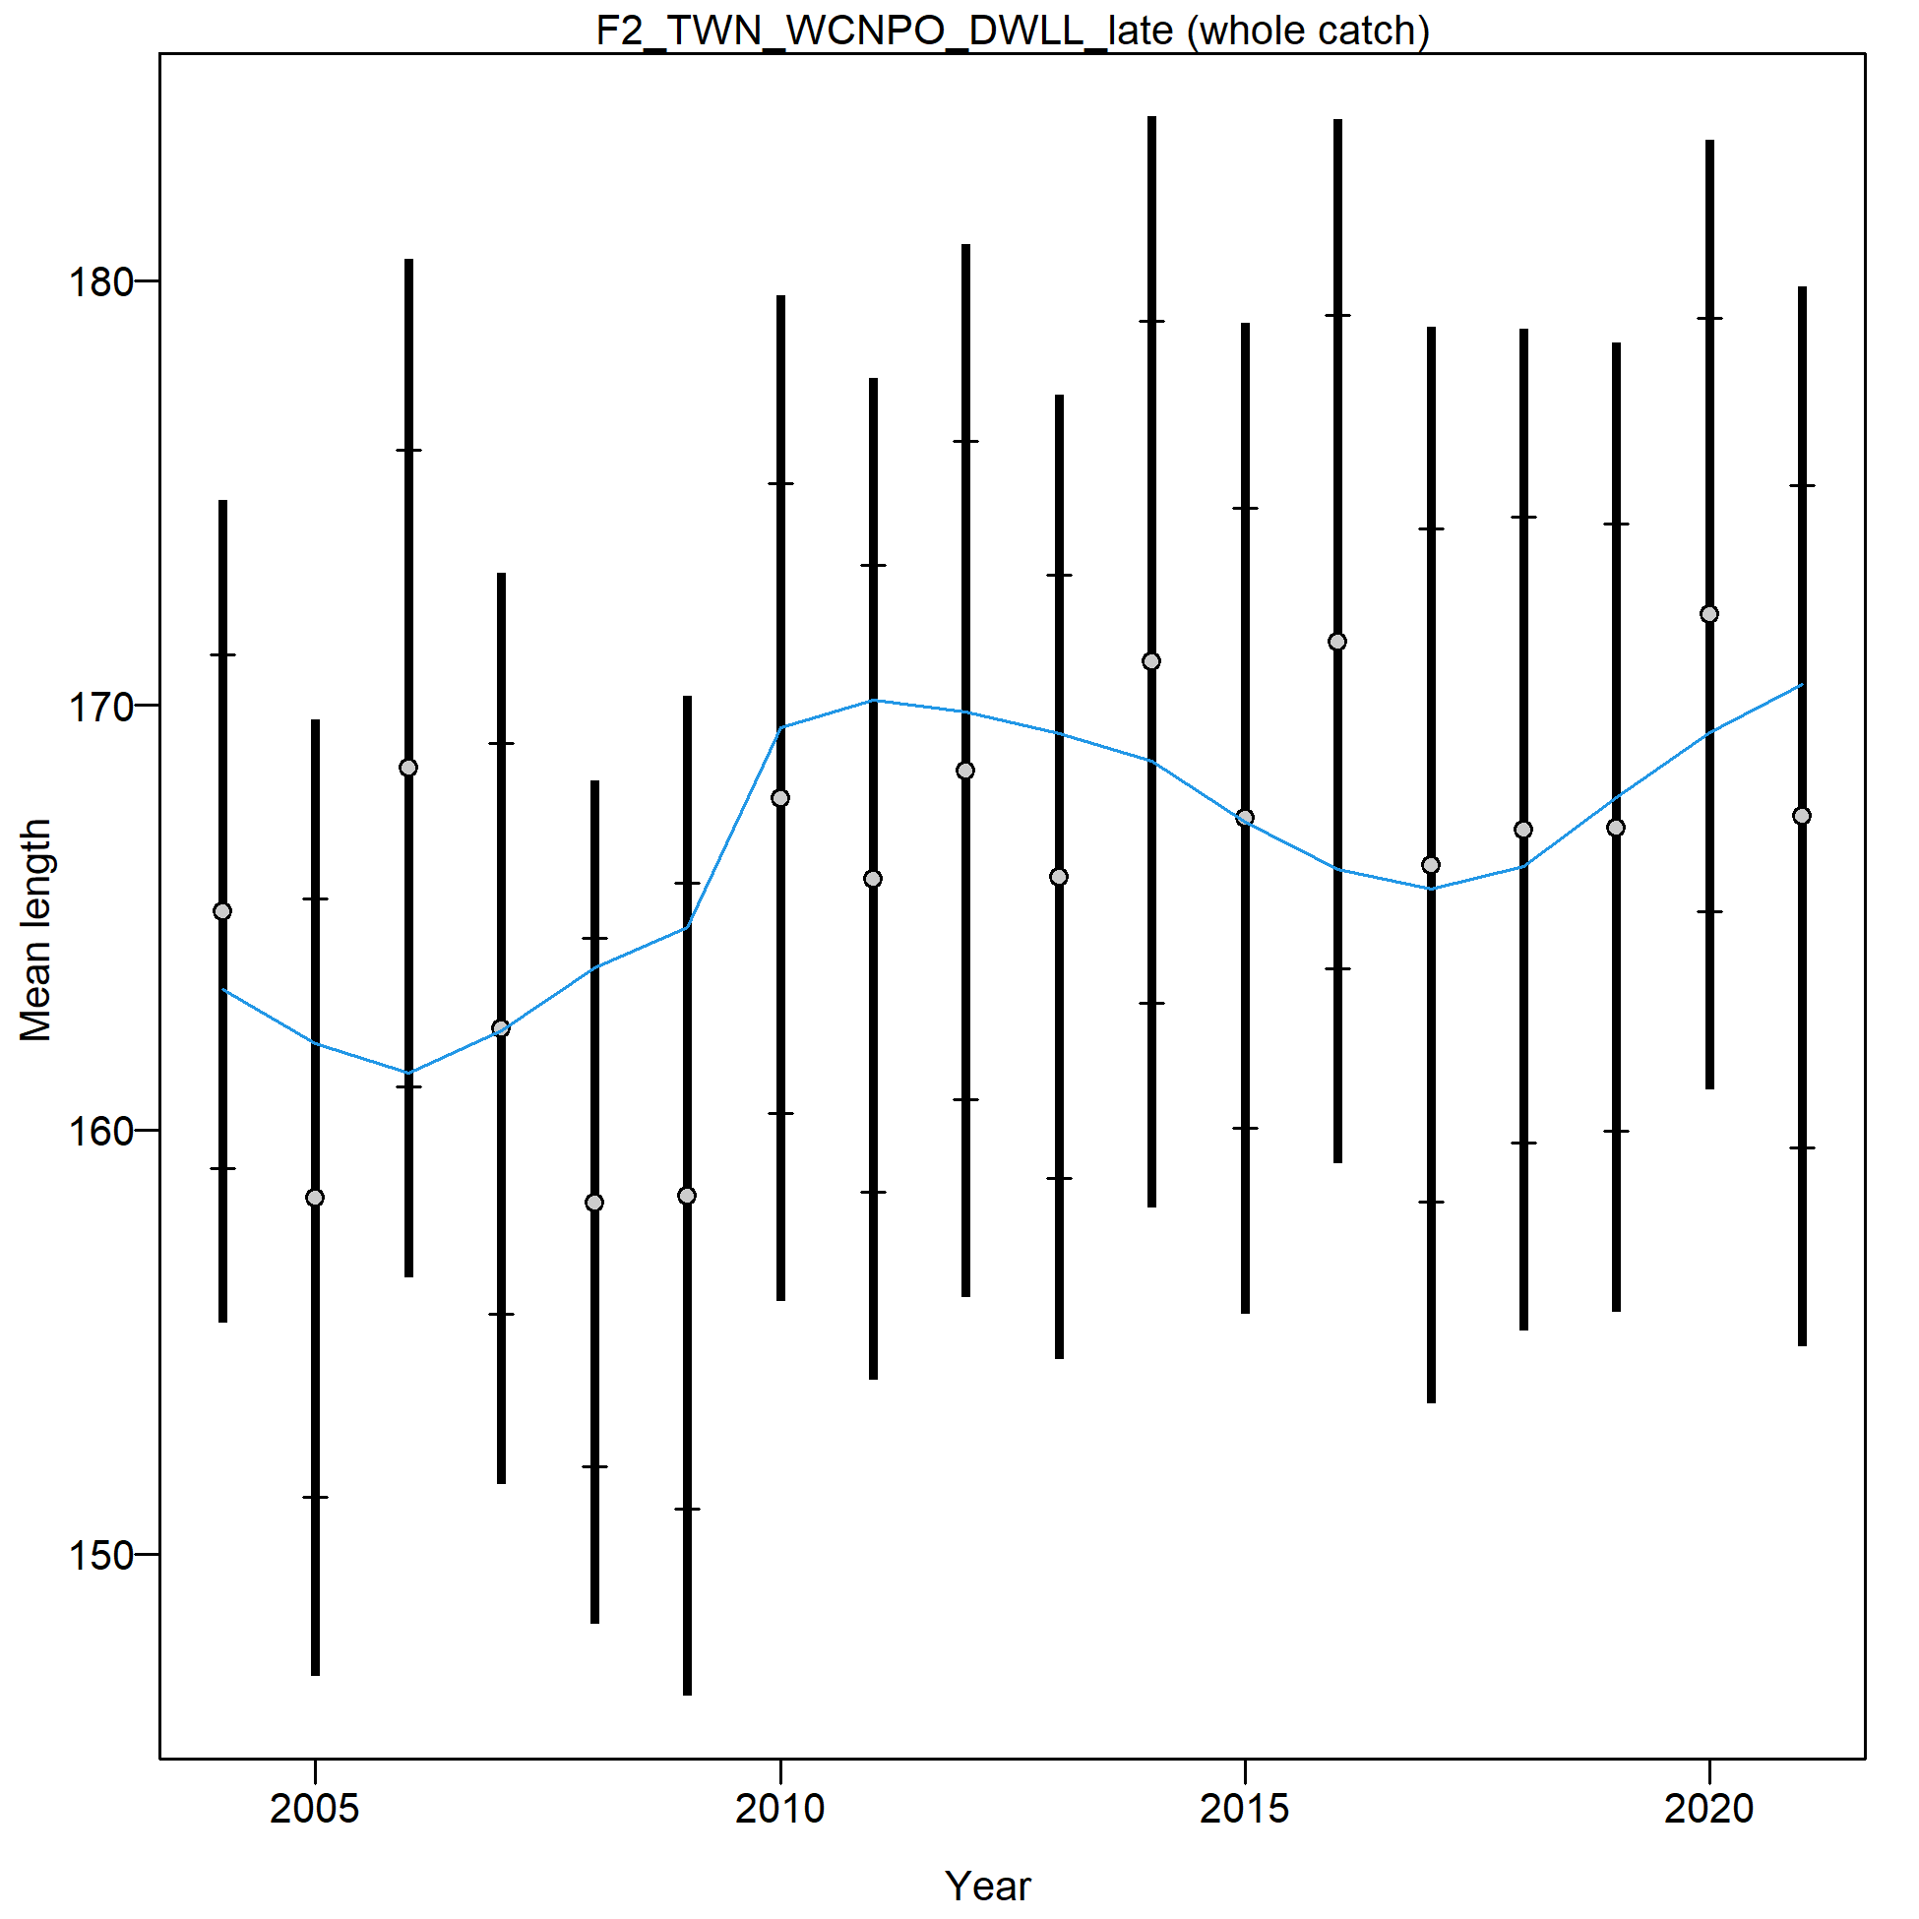
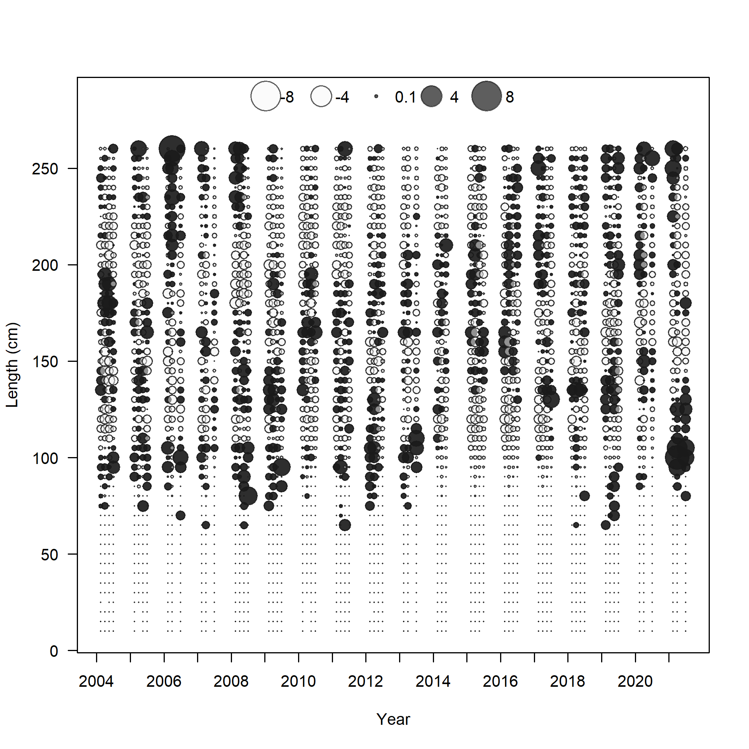

Slide 20
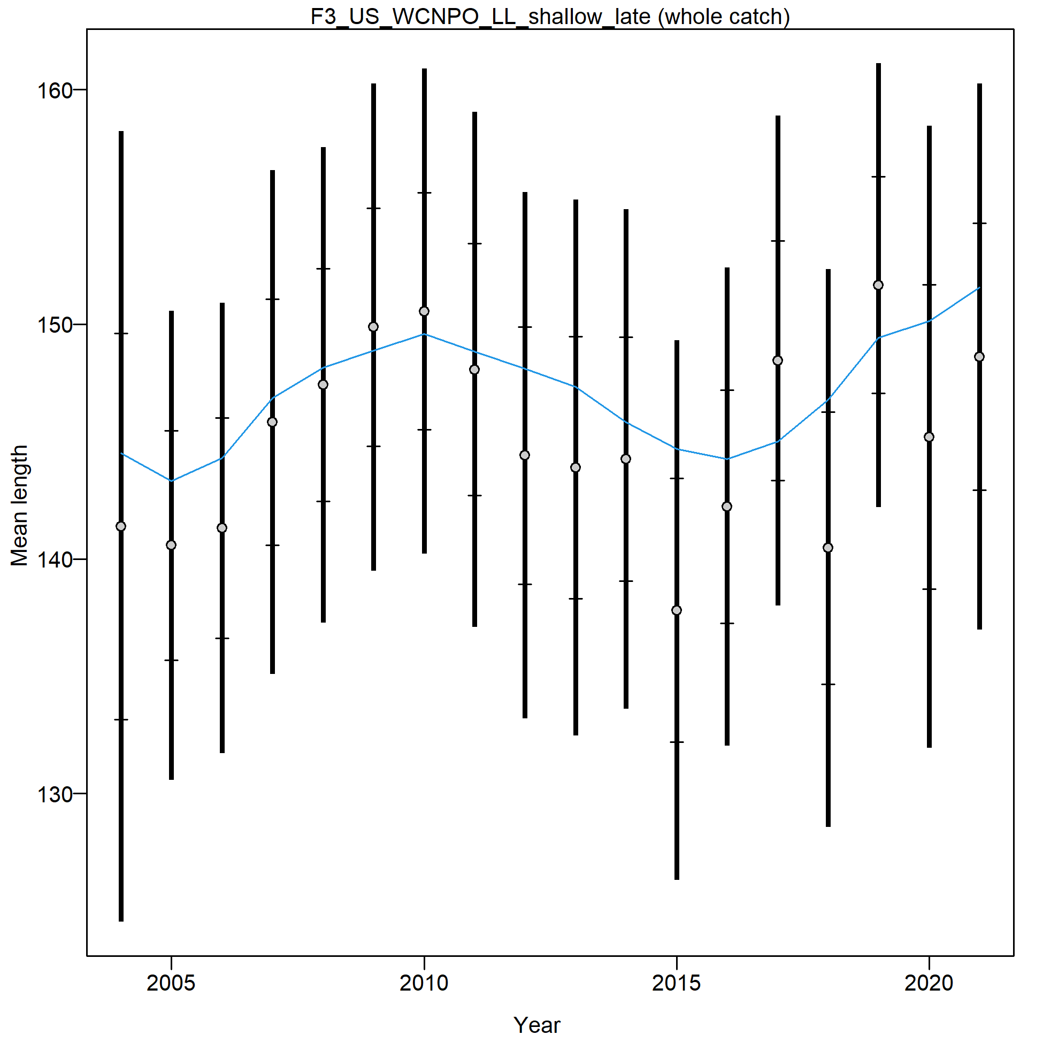
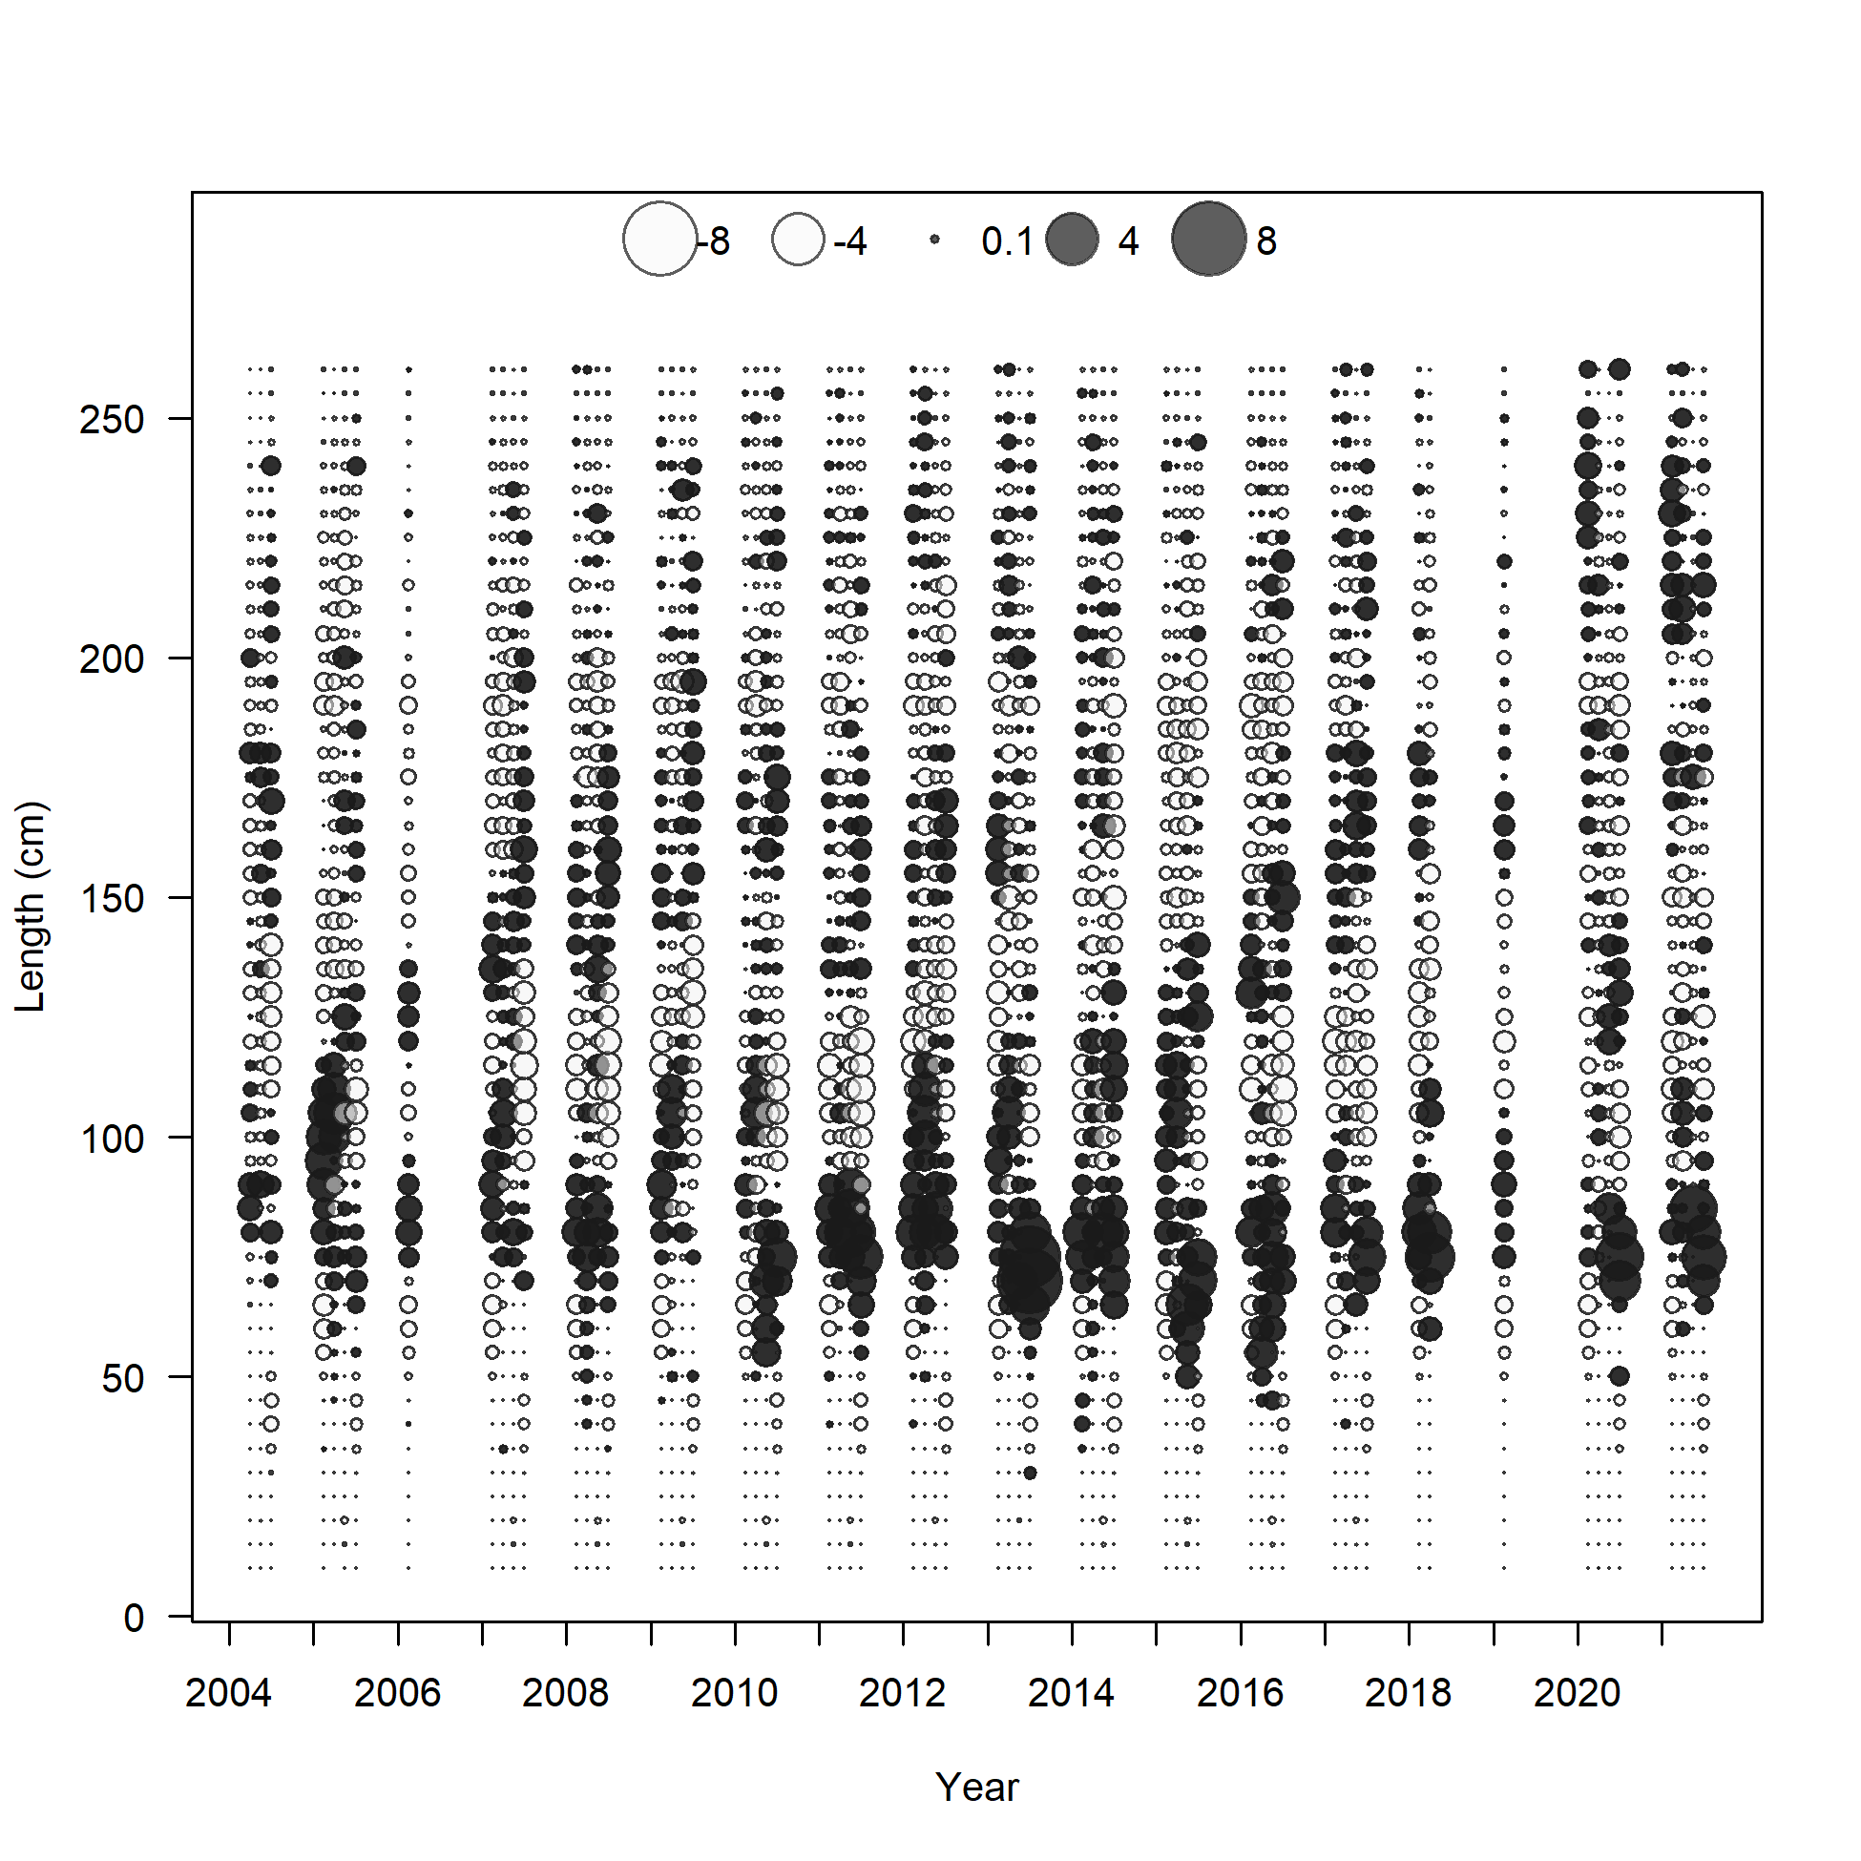

Slide 21
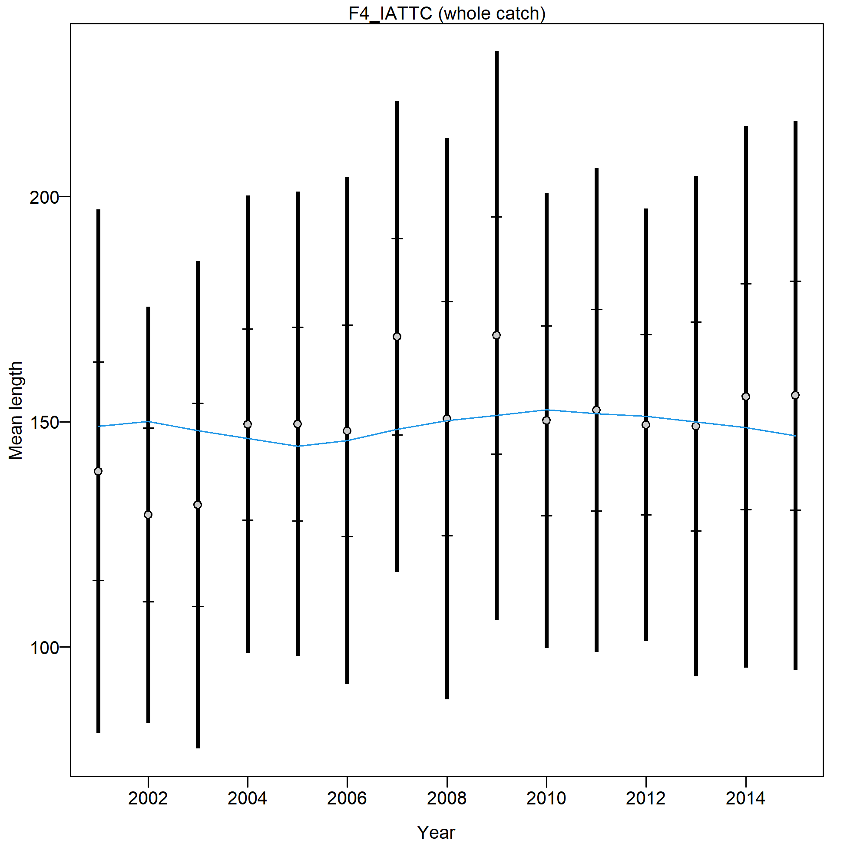
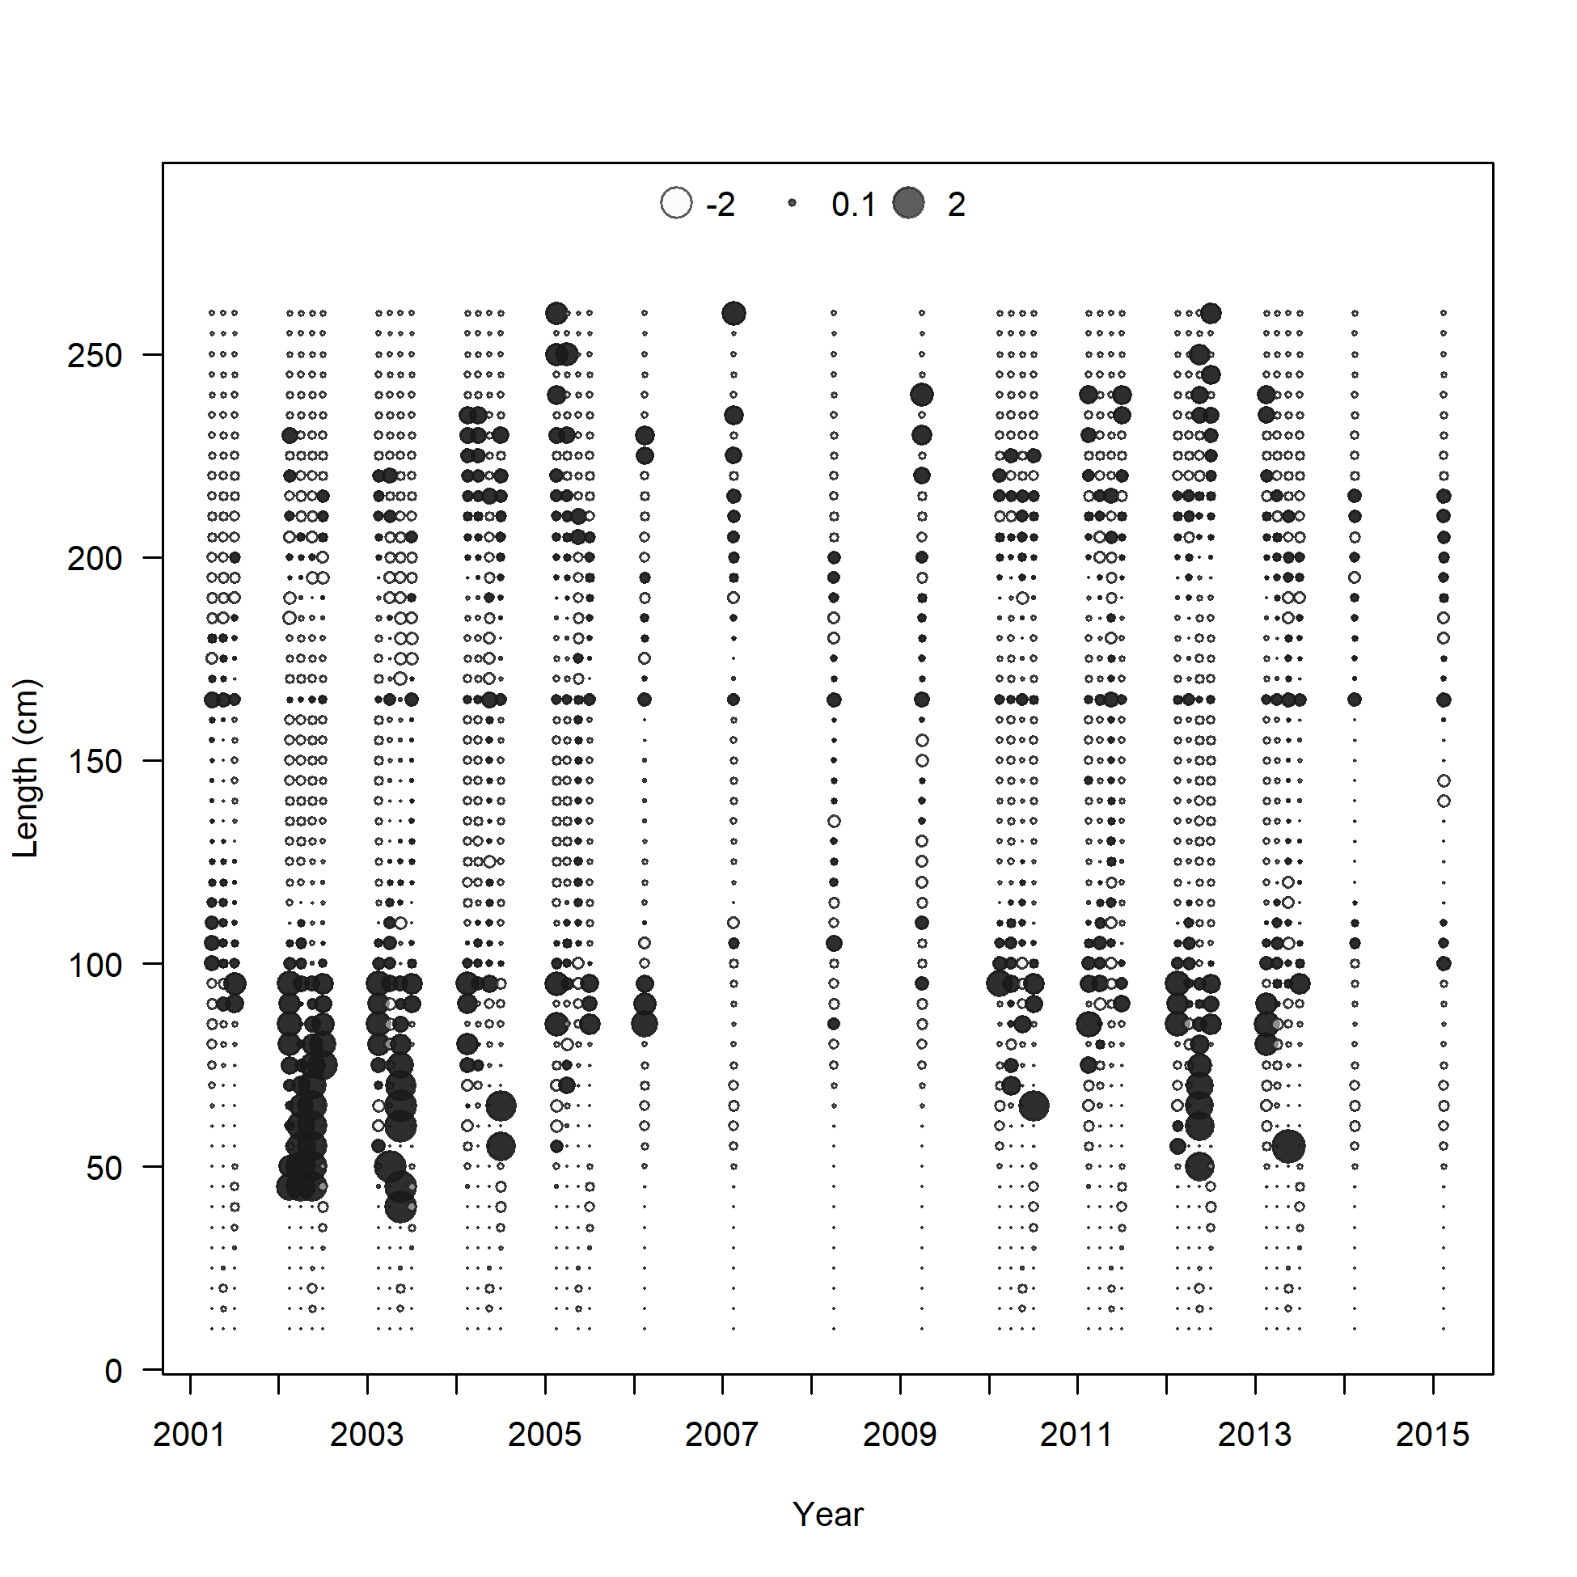

Slide 22
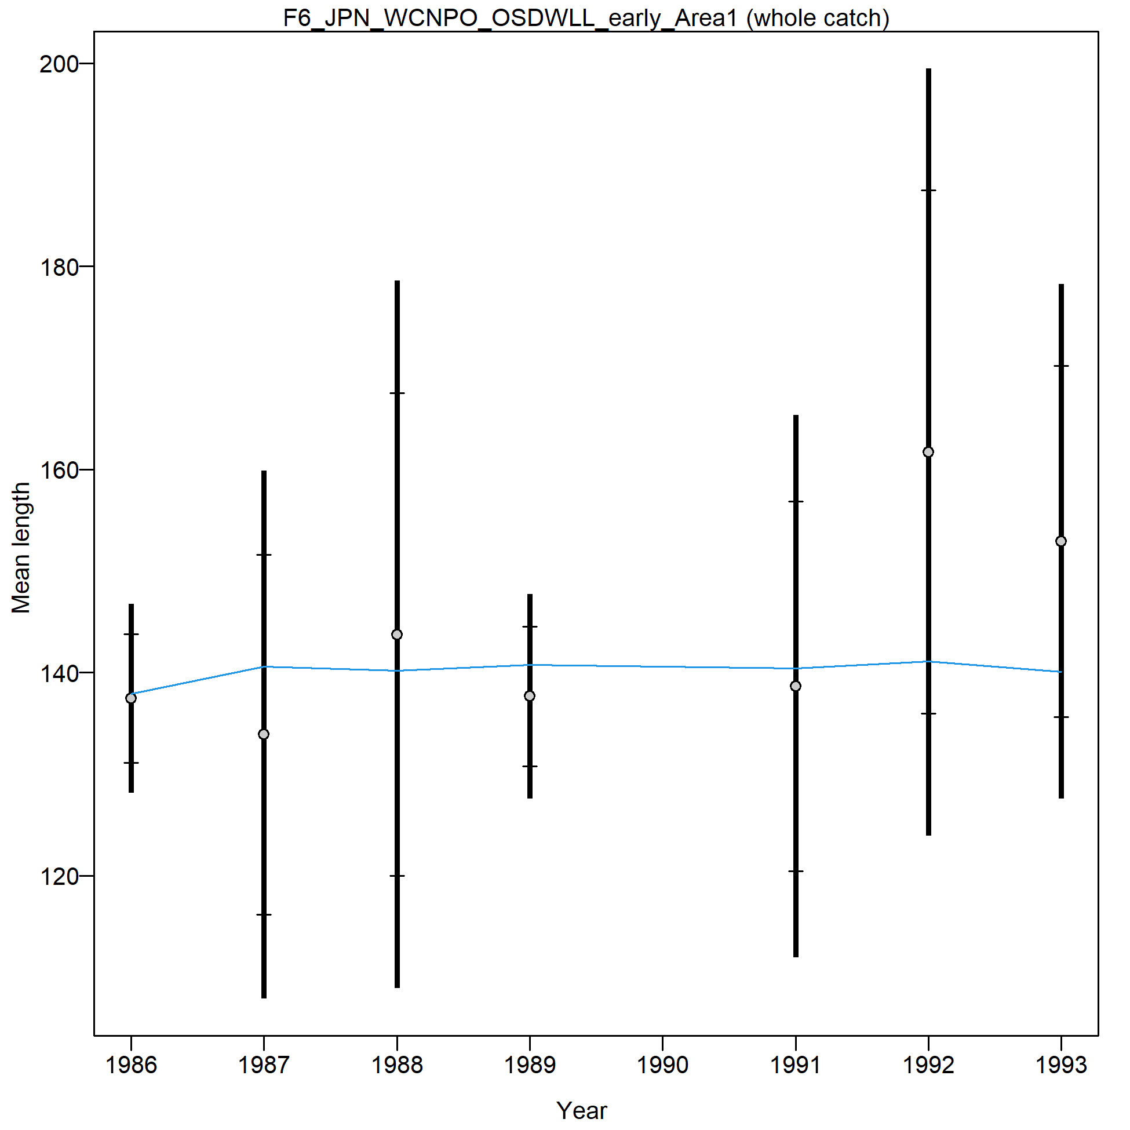
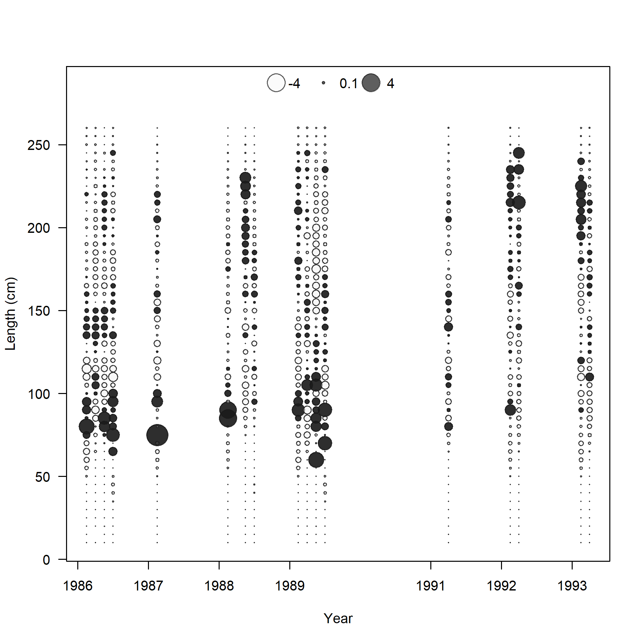

Slide 23
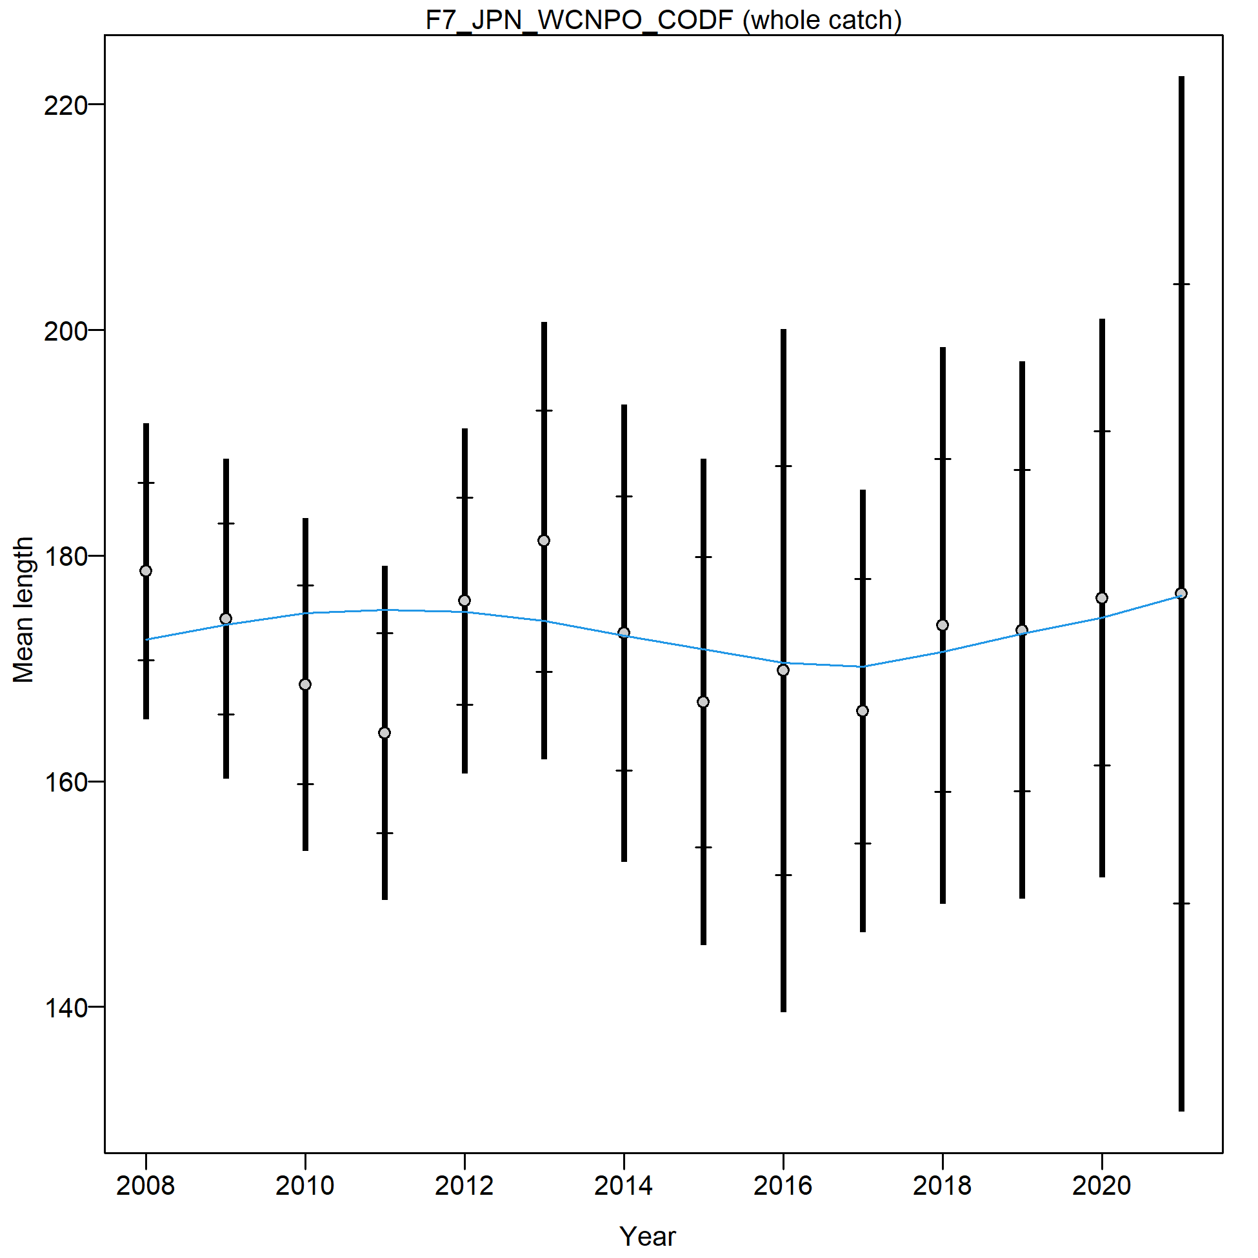
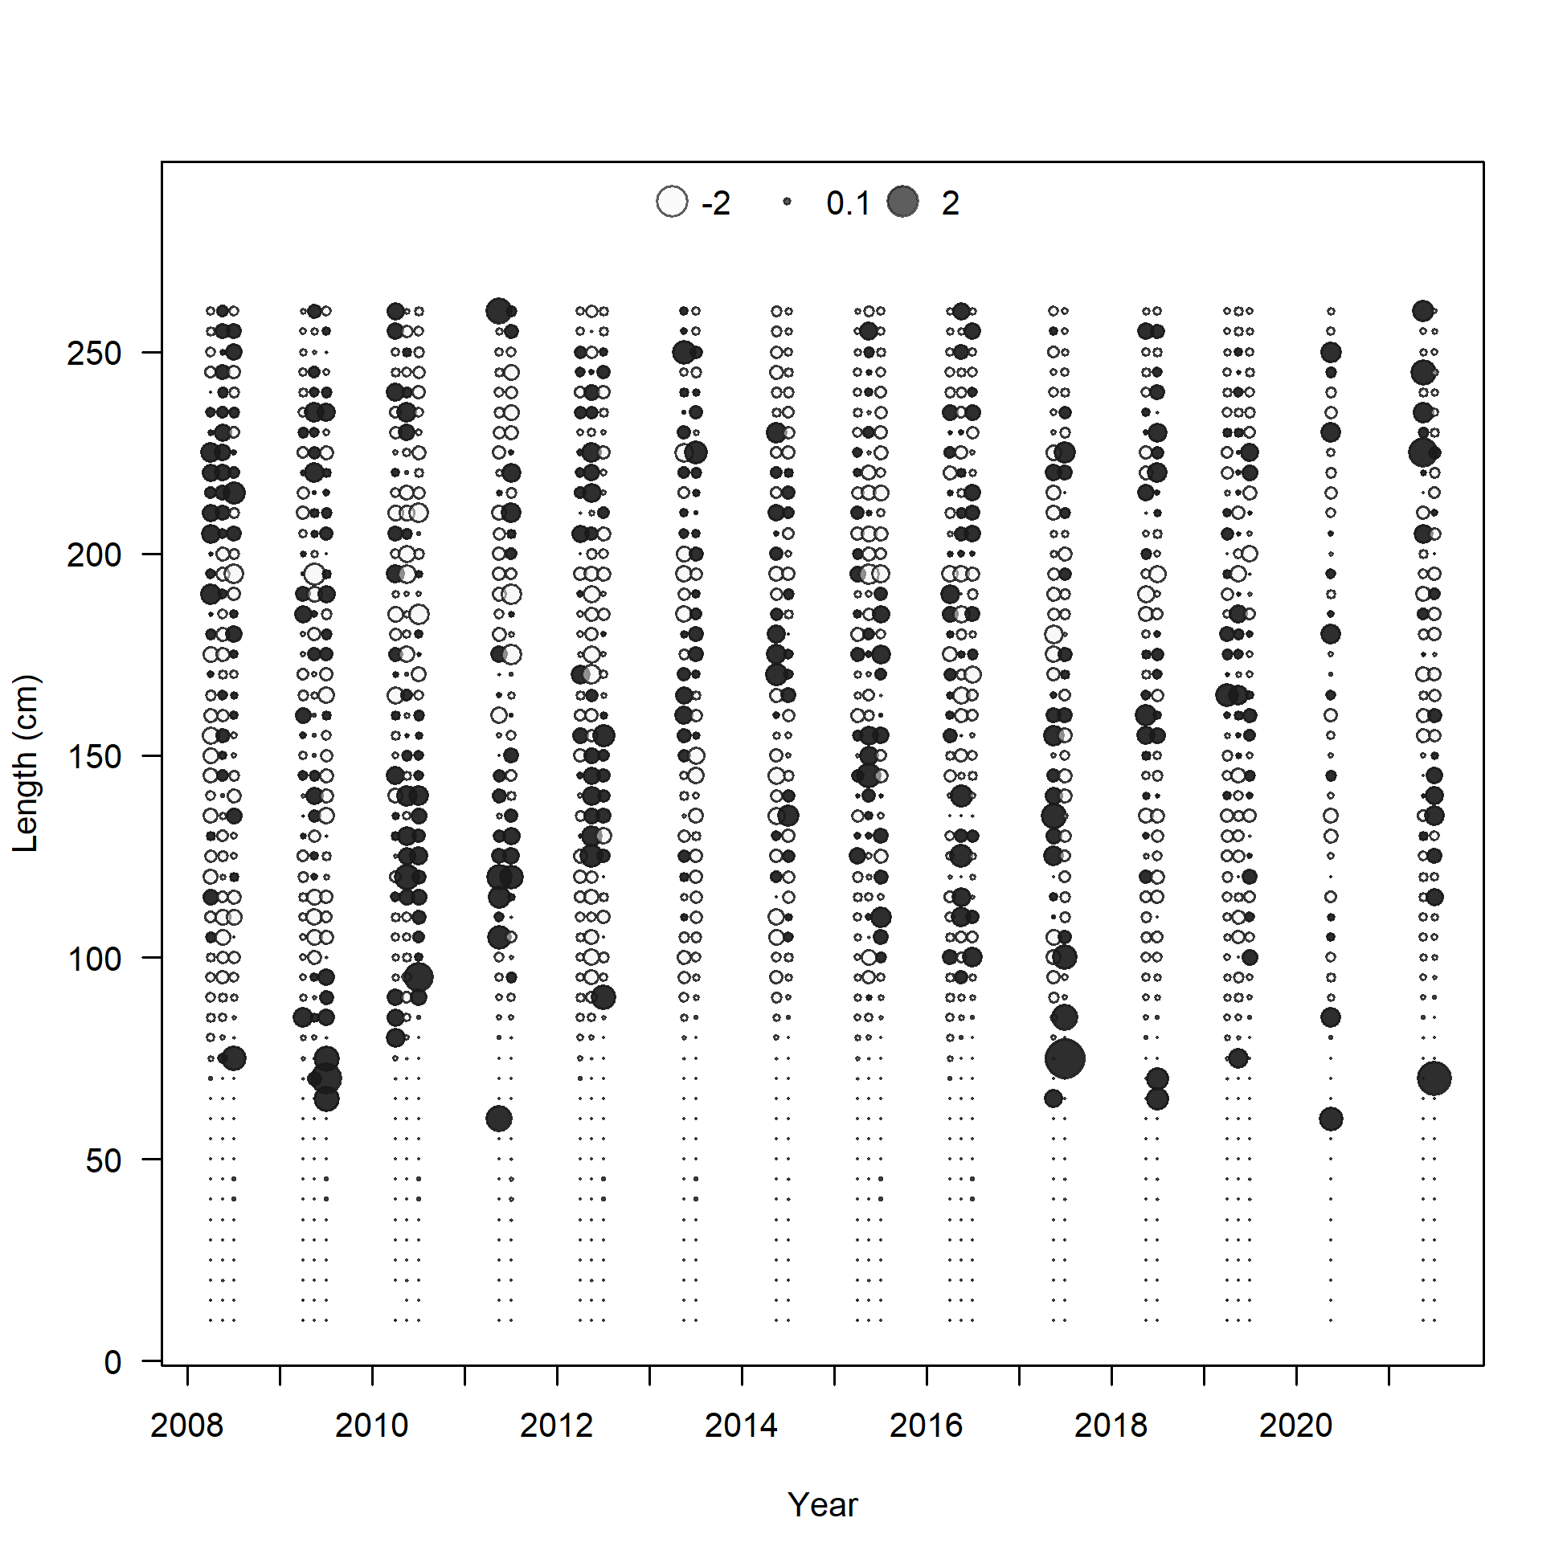

Slide 24
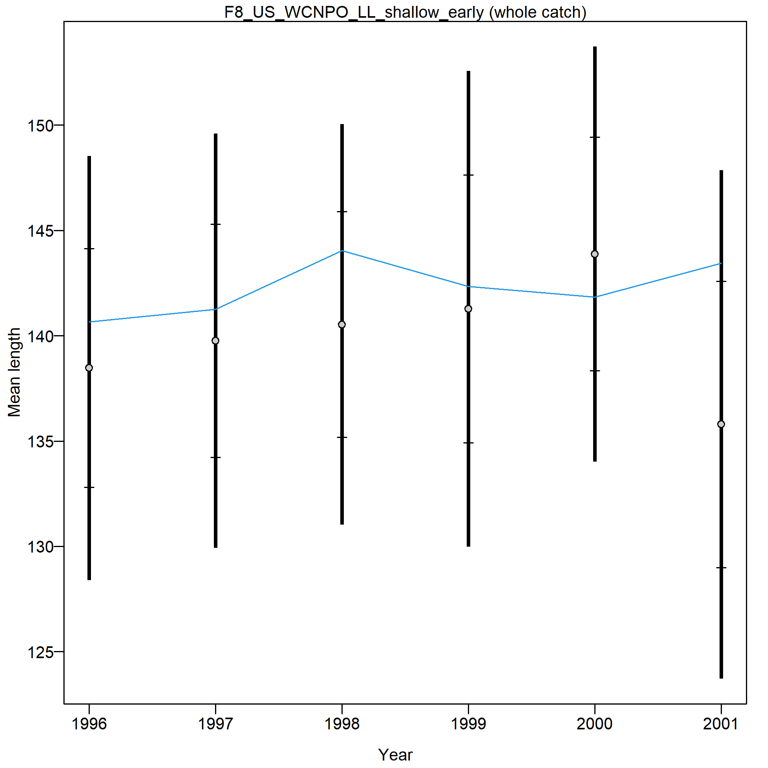
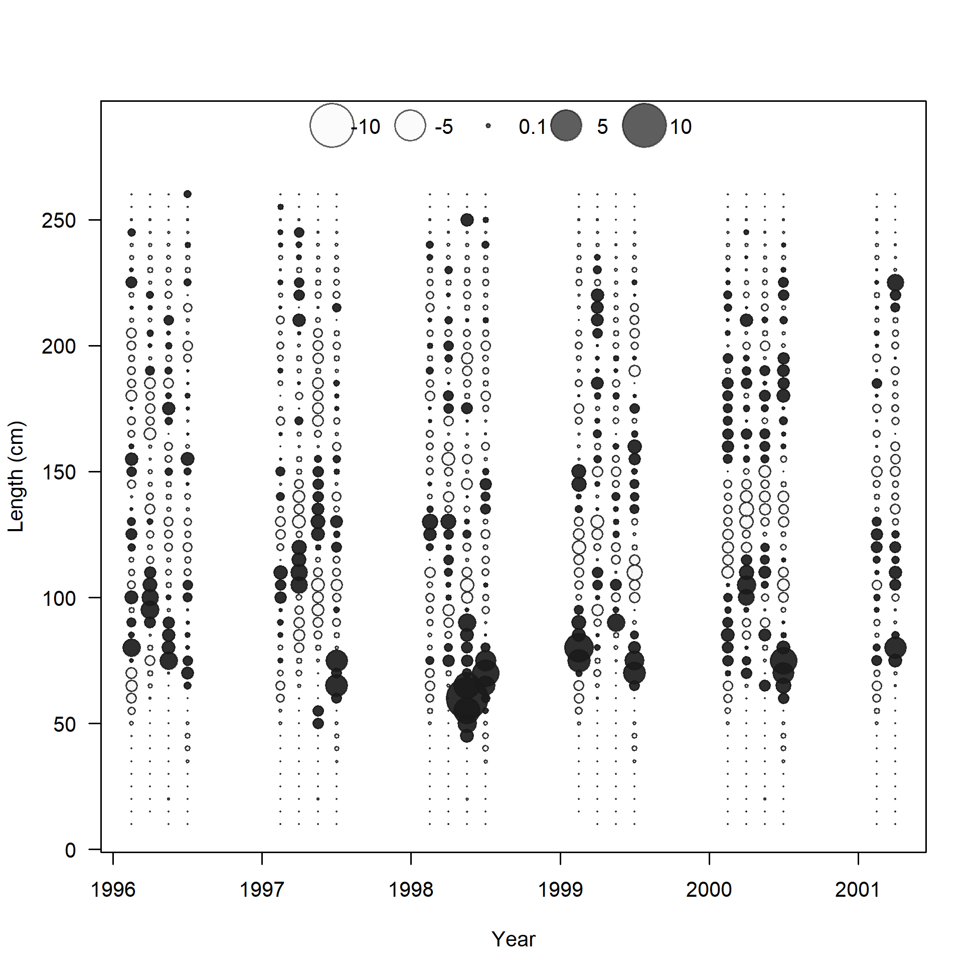

Slide 25
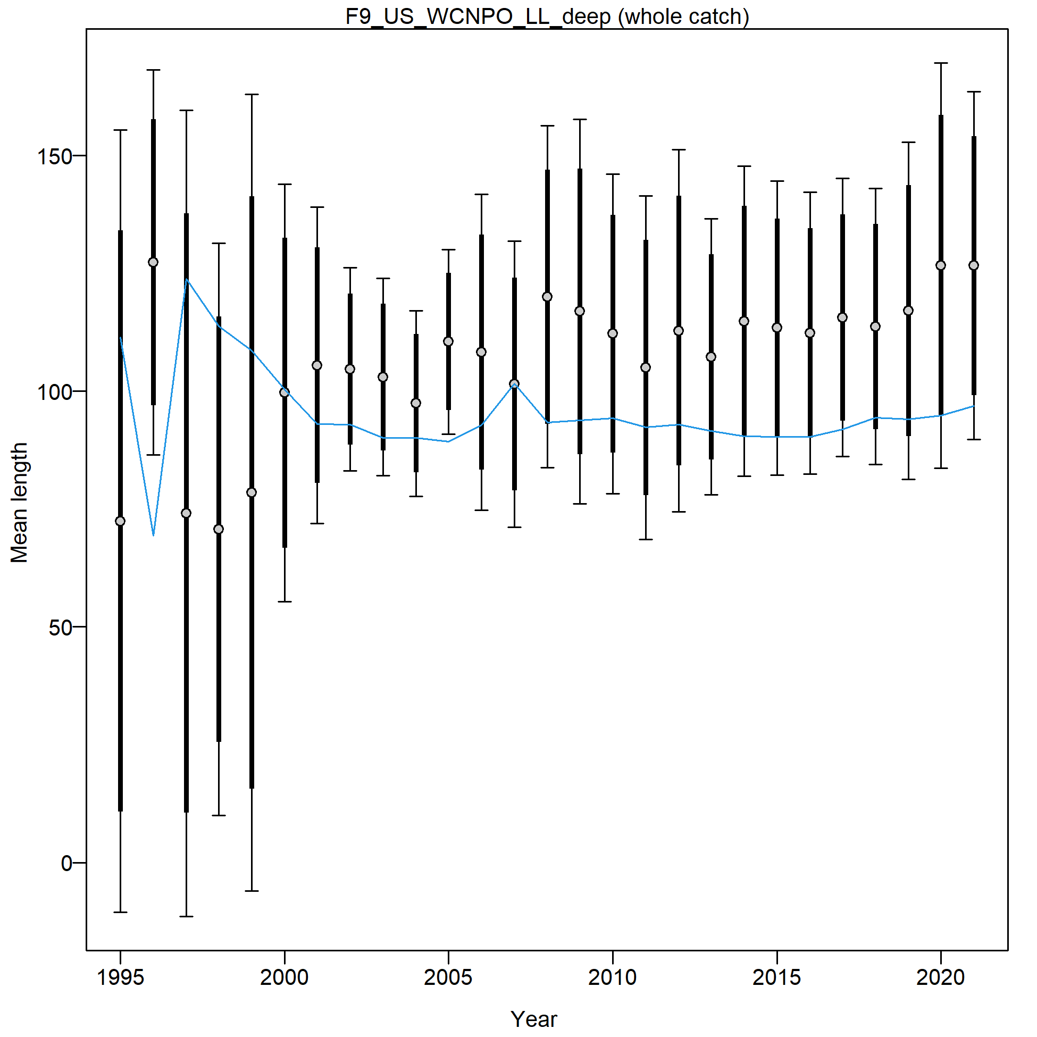
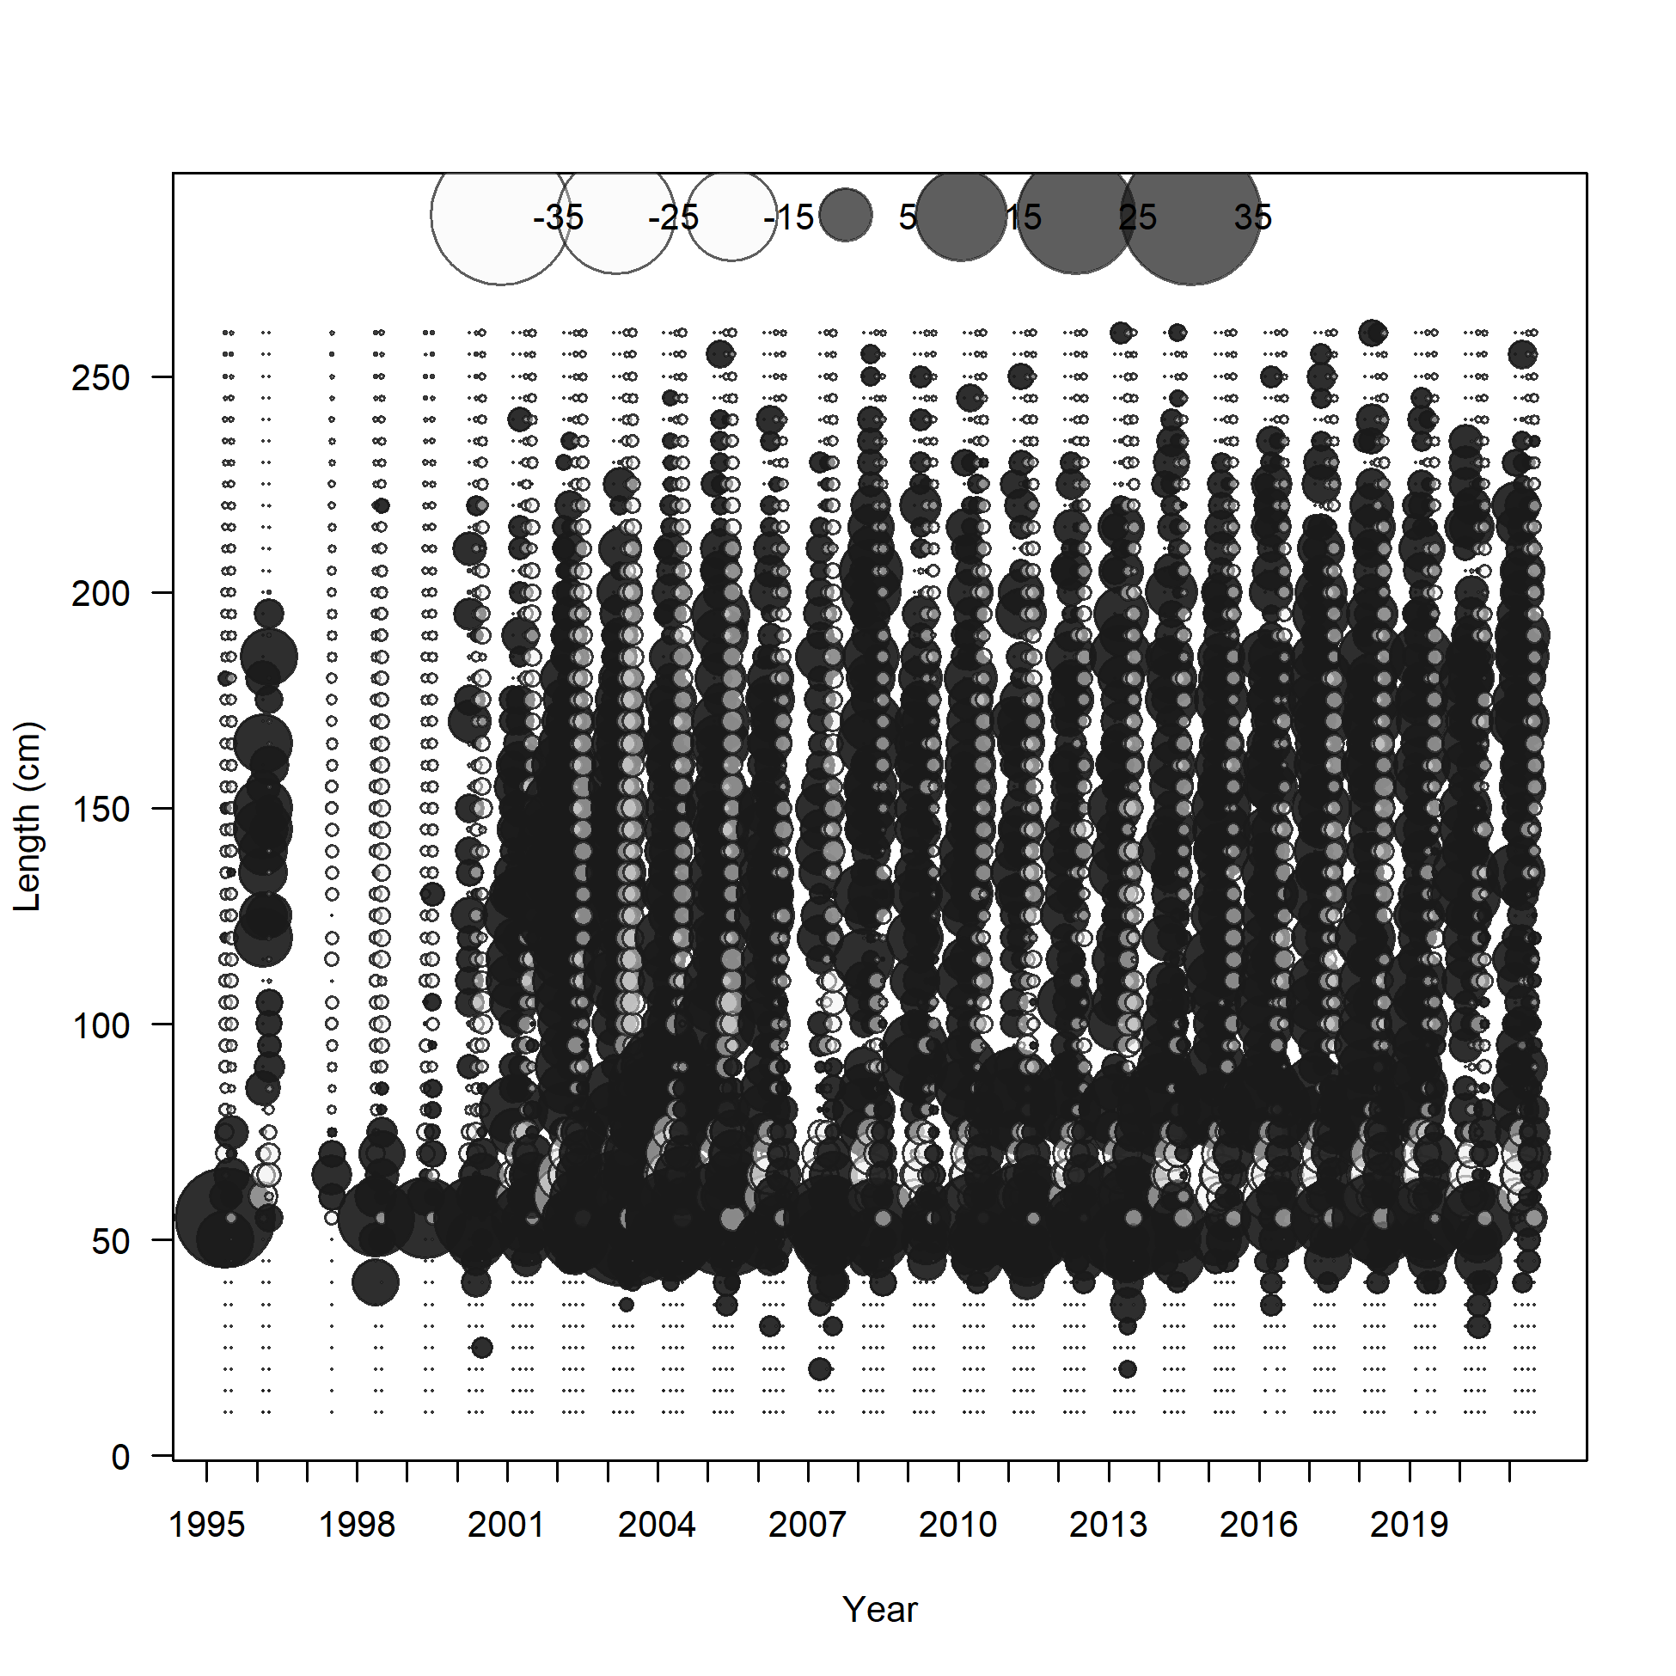
@ the last Modeling Team meeting, we decided to focus on improving the fit to this fleet. A model dividing this fleet into 4 is in progress, but while fits to the data improve, the model does not converge.

Slide 26
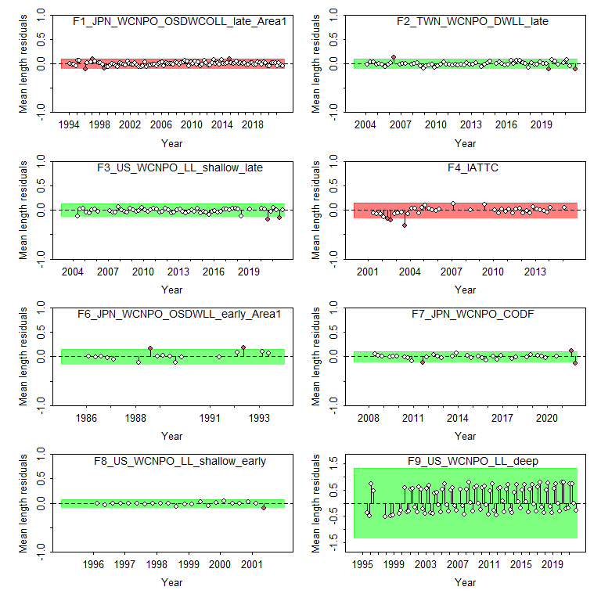

Slide 27
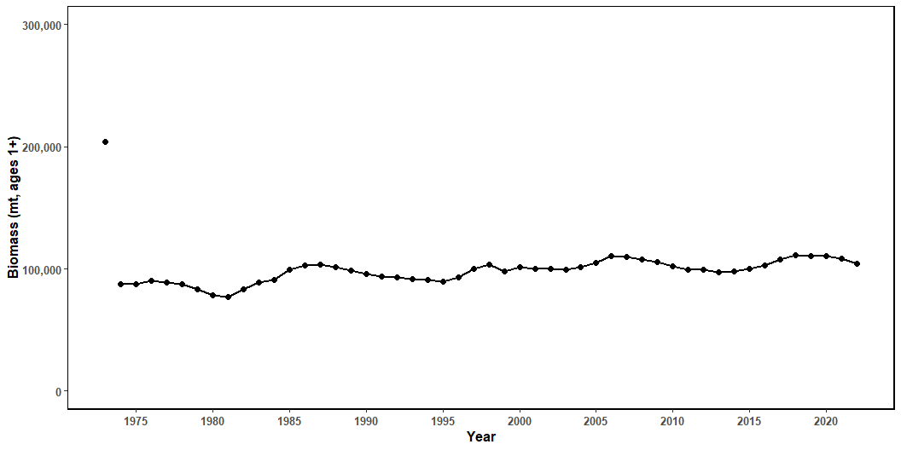
Figure 22: Estimated biomass (mt) of NP swordfish 1+ from the base-case model.

Slide 28

Figure 23: Estimated NP swordfish Spawning Stock Biomass (SSB) from the with 95% confidence intervals. SSB_{MSY} is indicated by the dashed green line.

Slide 29

Figure 24: Estimated annual fishing mortality (average ages 1-10) the with 95% confidence intervals. F_{MSY} is indicated by the dashed green line.

Slide 30

Figure 25: Estimated annual recruitment (thouseands of age-0 fish) with 95% confidence intervals.

Slide 31


Slide 32

Figure 27: Likelihood profile over R0 by CPUE index for the base-case model.

Slide 33

Figure 28: Likelihood profile over R0 for each length composition time series for the base-case model.

Slide 34

Figure 29: Spawning stock biomass trend for the ASPM model run (dashed line, triangles) and the base-case model (solid line, circles). Grey shading indicates 95% confidence intervals for each model.

Slide 35

Figure 30: Hind casting cross-validation (HCxval) results showing observed (large points with dashed line), fitted (solid lines), and one-year-ahead forecast values (small terminal points)

Slide 36

Figure 31: Hind casting cross-validation (HCxval) results for size composition mean lengths, showing observed (large points with dashed line), fitted (solid lines), and one-year-ahead forecast values (small terminal points.

Slide 37
April 13, 2023 Model 3_combine 1 and 2
Dropped S4 and S8 (lambda = 0)
Included corresponding time block to TWN CPUE as used in TWN size comp
Separated US deep size data into 2 fleets:
Fleet 9 is only quarters 1 and 2
Fleet 20 is only quarters 3 and 4
All fish 85 cm and larger are in quarter 4
All fish 80 cm and smaller are in quarter 3
All quarter 4 inputs are given negative years – the model won’t include their fits in the likelihood but will still fit the data
Normal Prior on R0 – mean of 7, standard deviation of 0.2

Slide 38
Results
R0 estimate is 11

Slide 39
What’s happening
The likelihood profile for the model with a single US deep size comp fleet has a very flat likelihood above the MLE estimate of R0
Of the information available to inform the upper bound of R0 – most of it comes from the US deep size data, it is the largest contributor to the likelihood.

Slide 40
Why does this matter?
In attempting to improve the fit to this size comp because the strong seasonality in selectivity produces very large residuals, we are reducing the contribution of this fleet to the likelihood, therefore removing the information informing the upper bound of R0
Because of this, and because the stock is in good condition, catch is declines, CPUE is increasing (mostly), the model is able to fit the input data well at almost any value above the minimum (~7.2), and therefore unless constrained, will always hit the upper bound
We have two (three?) basic choices to address this issue

Slide 41
How do we fix this?
Accept the poor fit to the US deep size data in the original model with the combined fleet
We can explain why this poor fit exists
We can attempt to downweight this fleet slightly, but acknowledge that it is a bycatch fleet and contributes a small amount of catch and it contains important information on recruitment
OR we could move forward with the split US deep size comps, and put a reasonably strong prior on R0
One option is to use the R0 from the combined size data model
But this makes a very strong assumption about R0 and should not be undertaken lightly.
The current model has a prior on R0, but still has very high result – decreasing the CV to 0.01 gives results fairly consistent with the combined model, but is a very strong prior
Or we could drop this size data all together and see what happens (we did this in the 2018 assessment).

